Slide 1
Analysis and simulations of a heavy rainfall event over northern Taiwan during 11-12 June 2012
Professor : Ming-Jen Yang
Student : Jyong-En Miao
Date : 2018/11/13
Chen, Y.-L., Y.-J. Chu, C.-S. Chen, C.-C. Tu, J.-H. Teng, and P.-L. Lin, 2018
Mon. Wea. Rev., 146, 2697–2715.

Slide 2
Introduction
Heavy rainfall events during the early summer rainy season over Taiwan are related to the arrival of subtropical cold fronts (Trier et al. 1990; Chen et al. 1989), mesoscale cyclones (Wang and Orlanski 1987), abundant moisture (Chen and Yu 1988), orographic effects and local winds (Li et al. 1997), and cold pools (Xu et al. 2012).
During periods of heavy precipitation over Taiwan, the subsynoptic low-level jet(LLJ) is frequently observed in the warm sector of the mei-yu front (Chen and Yu 1988).
The flow deceleration and flow splitting occur off the southwestern coast with a windward ridge/leeside trough pressure pattern due to orographic blocking (Chen et al. 1989). The deflected airflow accelerates northward, which results in strong orographically induced winds along the northwestern coast (e.g., barrier jet) (Chen and Li 1995a)
11–12 June 2012 case is the only widespread heavy precipitation event with maximum daily rainfall accumulation >400mm over both the northwestern coast of Taiwan (435 mm) and within the Taipei basin (477 mm) (Chu 2013).
For this study, we will focus on the orographic effects during and after the landfall of a mei-yu front.

Slide 3
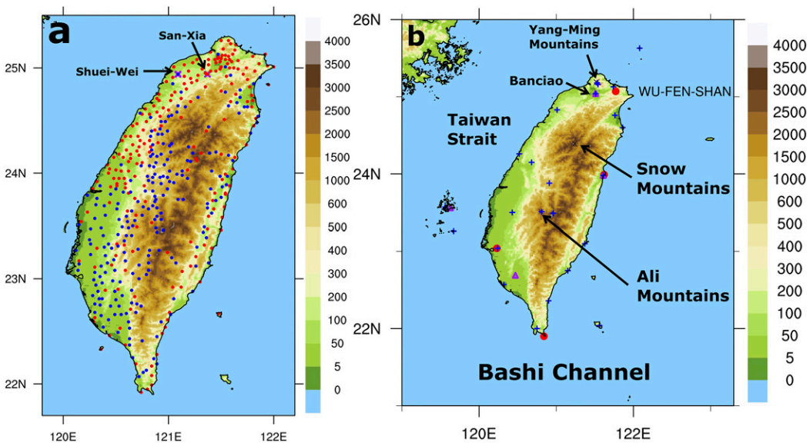
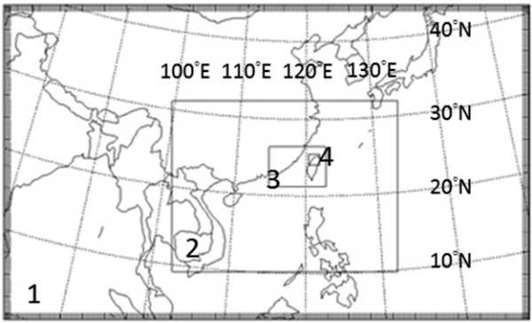
Data and model description
Horizontal grid sizes of 27, 9, 3, and 1 km
38 vertical levels with 13 levels below 2 km.
Grell’s convective parameterization (Grell and Dévényi 2002) d1&d2
Goddard’s microphysics (Tao and Simpson 1993)
RRTM longwave (Mlawer et al. 1997); Dudhia’s shortwave (Dudhia 1989)
Noah land surface model (Chen and Dudhia 2001)
YSU PBL scheme (Hong et al. 2006)
lower-boundary conditions: 1-km land-use data compiled by CWB are used.
36-h simulation initialized from the ERA-Interim analysis at 00Z 11 June 2012.

Slide 4
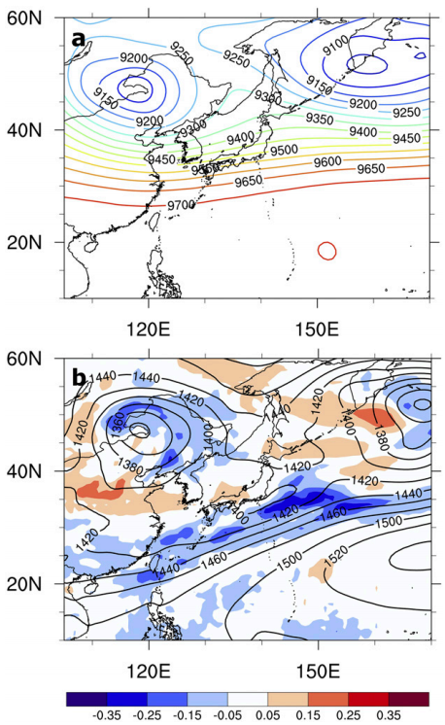

Slide 5
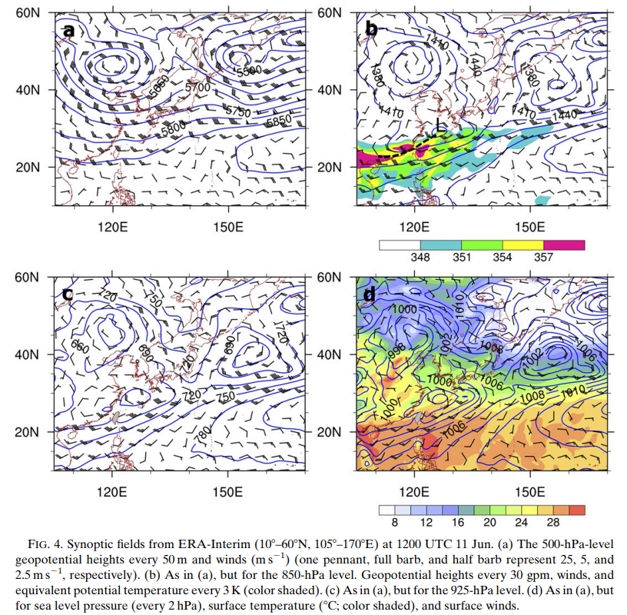

Slide 6
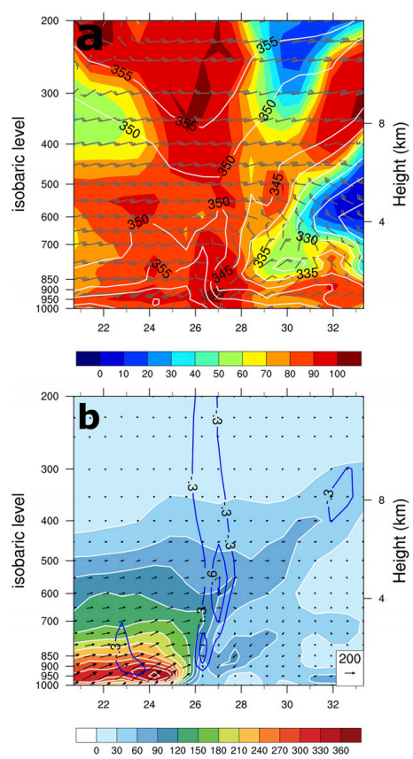

Slide 7
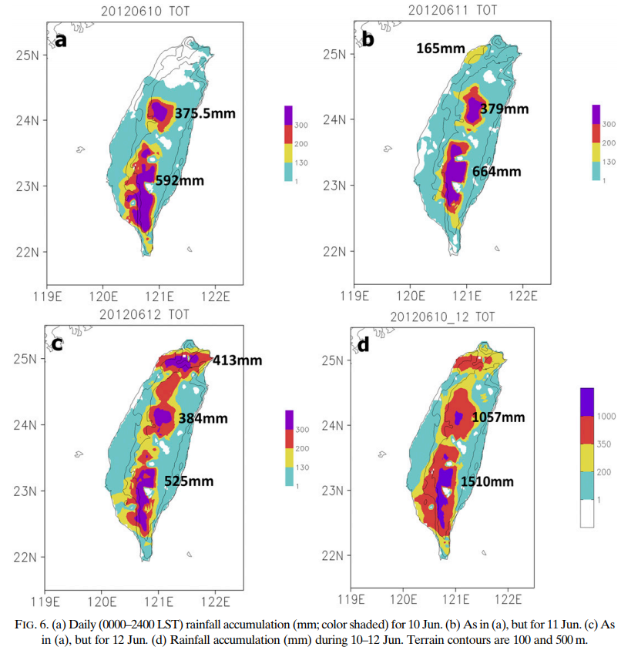

Slide 8
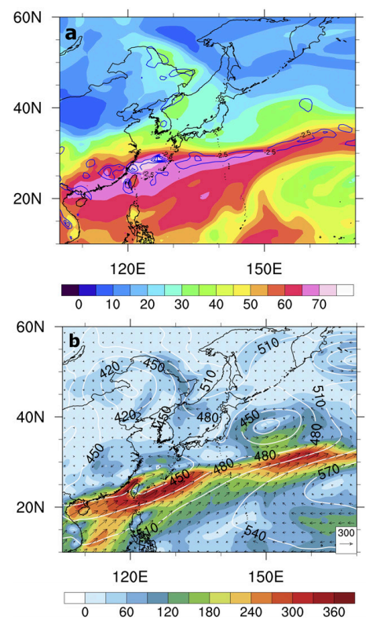
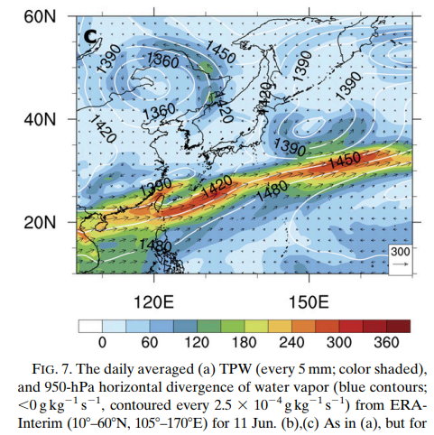

Slide 9
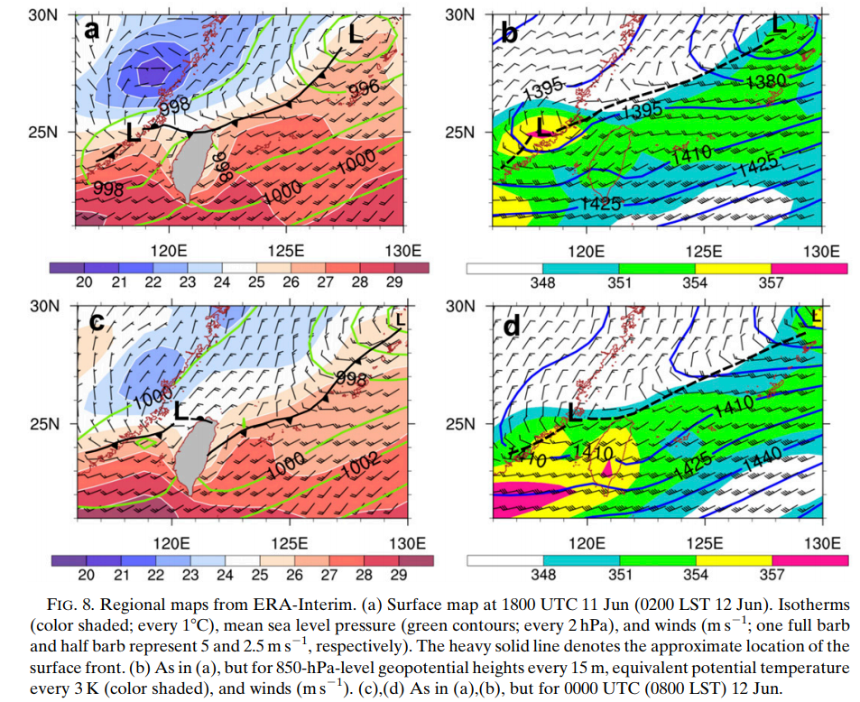

Slide 10
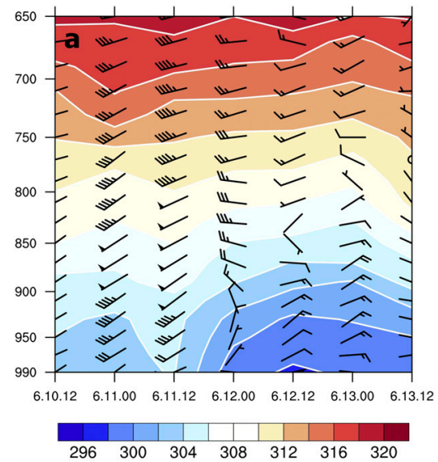
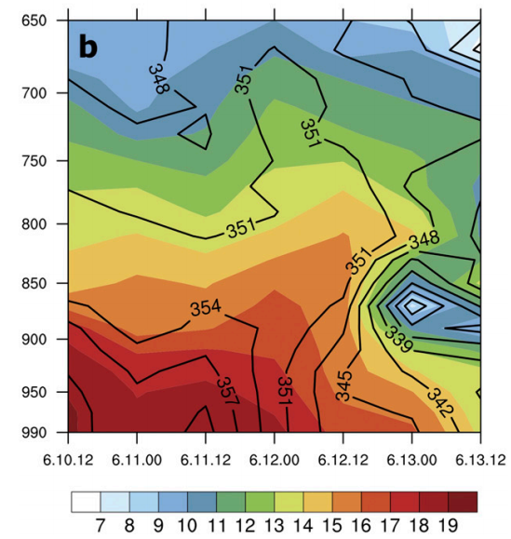

Slide 11
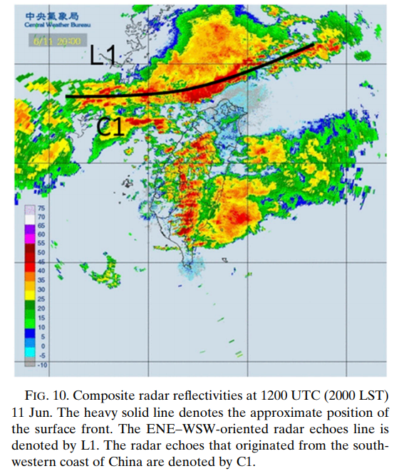

Slide 12
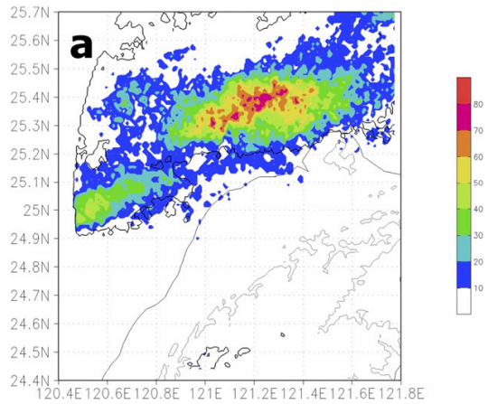
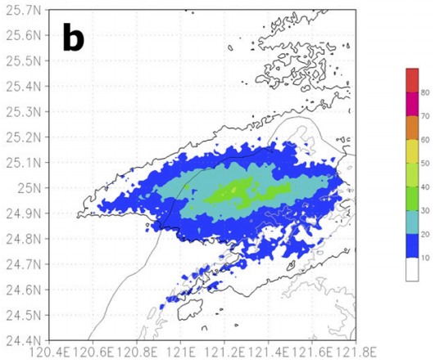

Slide 13
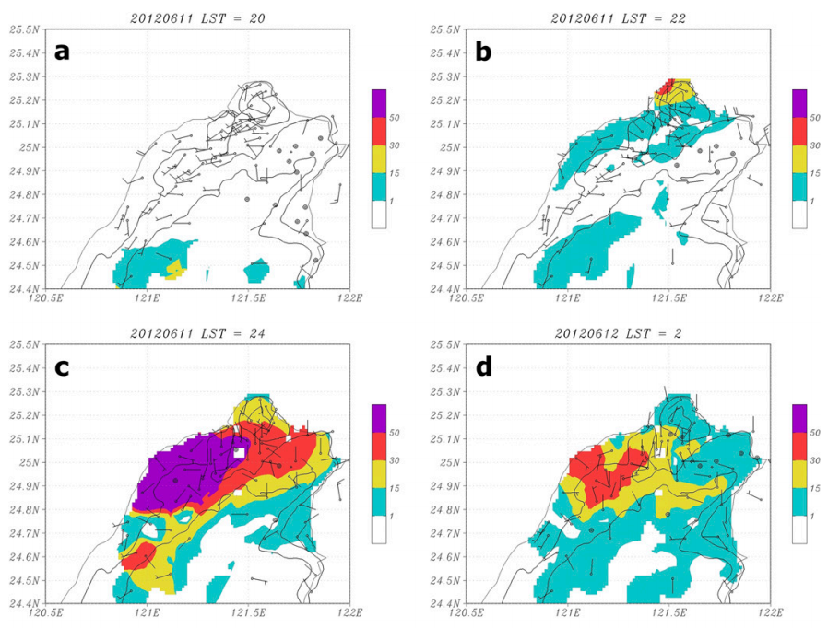

Slide 14
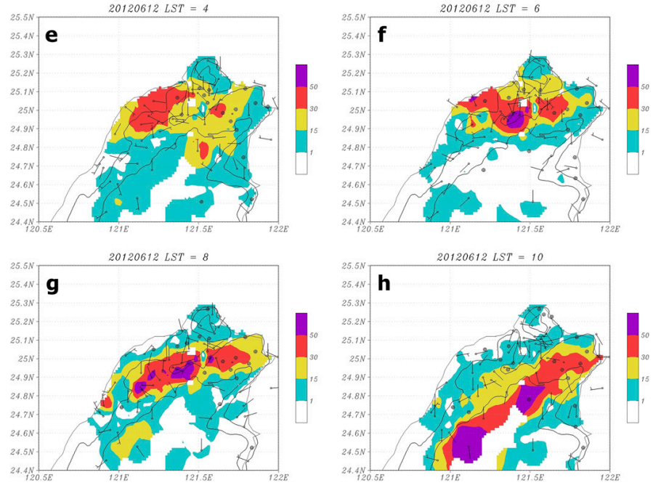

Slide 15
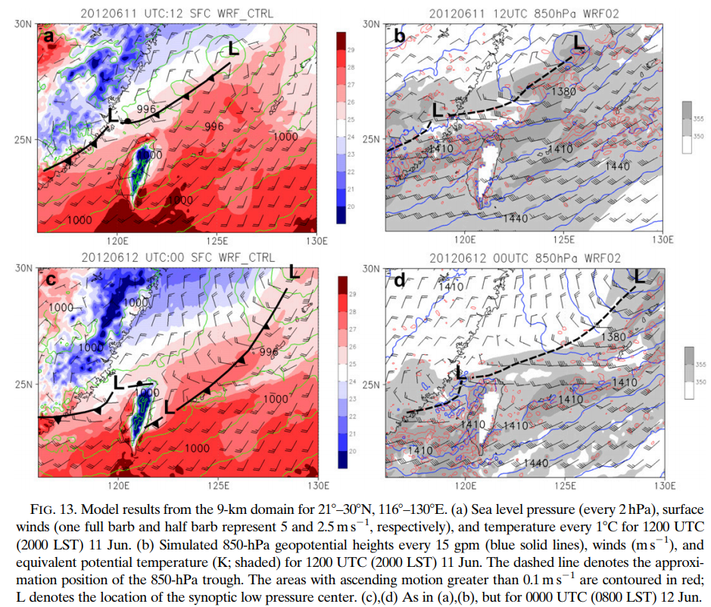

Slide 16
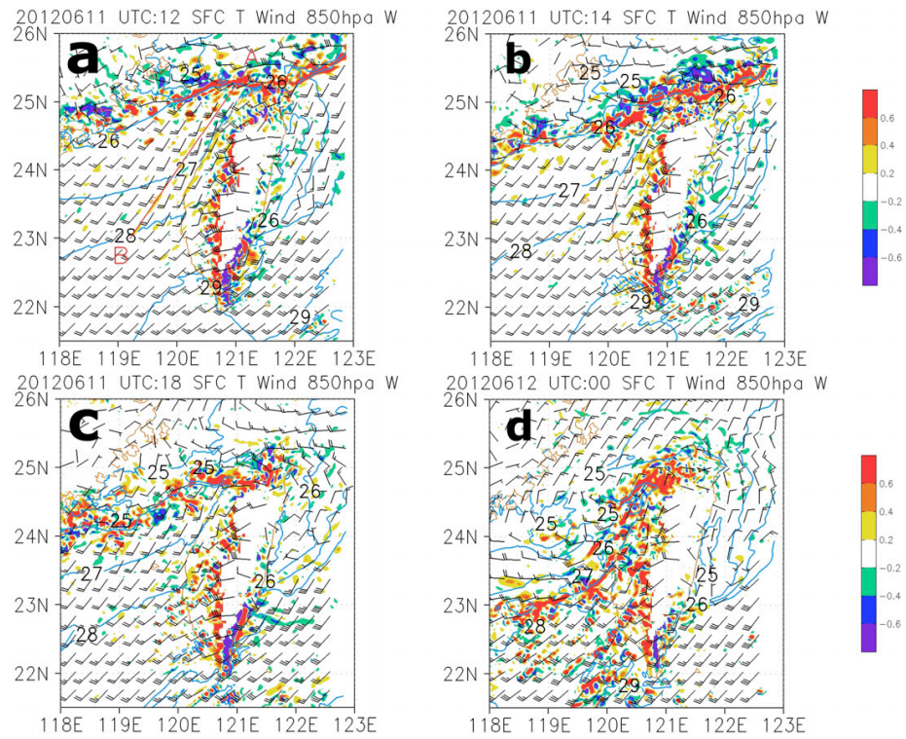

Slide 17
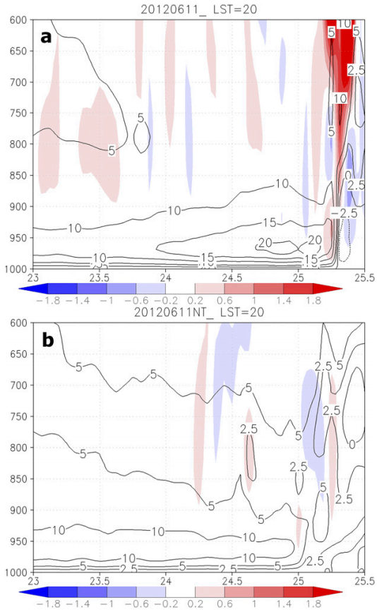

Slide 18
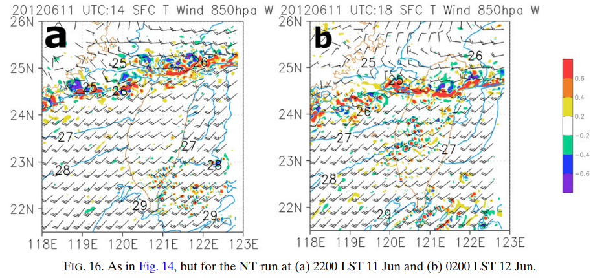

Slide 19
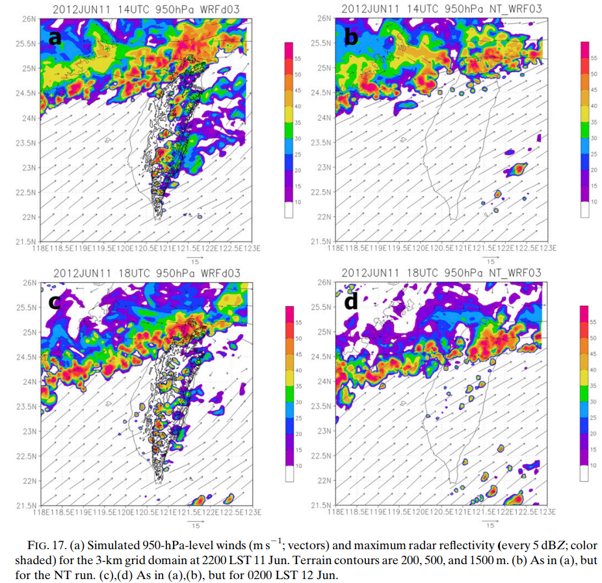

Slide 20
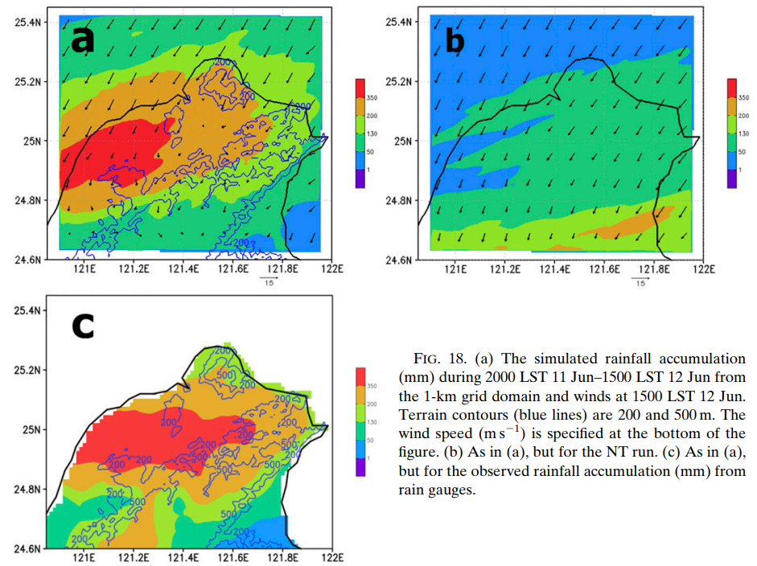

Slide 21
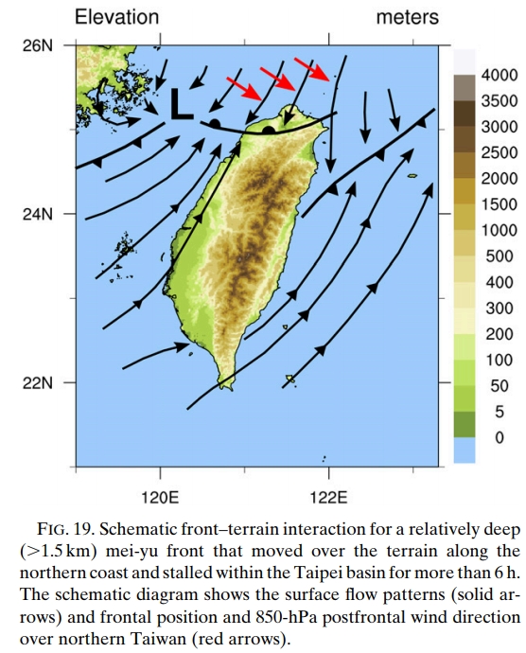

Slide 22
Conclusions
During this extreme precipitation event, the large-scale airflow is characterized by a midlatitude omega blocking pattern with a blocking ridge over the Okhotsk Sea for more than 4–5 days (9–13 June 2012). At 850-hPa, an ENE–WSW-oriented monsoon trough is located over southern China between the midlatitude blocking pattern and WPSH.
At surface, the mei-yu front is just off the northern Taiwan coast. It is characterized by a marked vertical tilt with an upper-level jet (>40 m/s) at the 250-hPa level. In the lower troposphere, the prefrontal potentially unstable WSW flow (>15 m/s) converges with the postfrontal cold northeasterly flow with rising motions in the frontal zone.
Under favorable large-scale settings, a strong persistent LLJ (>15 m/s) with elevated TPW(>70 kg m⁻²) impinges on the steep terrain at a relatively large angle. As a result, heavy orographic precipitation occurs on the windward side of both the Snow (>1000 mm) and Ali Mountains (>1500 mm) during 10–12 June

Slide 23
Conclusions
During 11–12 June, heavy precipitation occurs over the northwestern Taiwan coast (435 mm) and within the Taipei basin (477 mm) as the mei-yu front arrives. The convections in the frontal zone are enhanced by the localized convergence between the prefrontal barrier jet and the postfrontal cold air along the northwestern coast. After the frontal passage, localized convergence is present between the barrier jet and the offshore flow, which is due to nocturnal cooling and evaporative cooling.
Postfrontal cold air (1.5-km deep) is able to move into the Taipei basin and is held against the northwestern end of the Snow Mountains. The mei-yu front stalls over the Taipei basin during 0200–0800 LST 12 June with persistent heavy showers as the postfrontal northwesterly flow impinges on the northwestern slopes of the Snow Mountains.
With the model terrain removed, the simulated mei-yu front continues to move southward after landfall without reproducing the barrier jet and the observed rainfall maxima along the northwestern coast and within the Taipei basin.

