Slide 1
Diurnal Cycle of Rainfall and Winds near the South Coast of China
Du, Y. and R. Rotunno, 2018: Diurnal Cycle of Rainfall and Winds near the South Coast of China. J. Atmos. Sci., 75, 2065–2082.

Slide 2
Outline
Introduction
Diurnal cycle of rainfall from the CMORPH data
Diurnal cycle from the Du model data
Linear land-sea breeze theory with a background wind
Idealized simulations
Summary

Slide 3
Introduction
Du and Rotunno (2015), using a long-term daily simulation dataset (Du et al. 2014, 2015a,b, called the ‘‘Du model data’’), found that a simple 2D linear land–sea breeze model with friction can capture the wind-propagation signals off the east coast of China.
Qian et al. (2009) include a uniform background wind for $f=0$ (the equator) in the solution that introduces Doppler shifting and wave dispersion effects.
Li and Carbone (2015), based on their linear model, further proposed that the diurnal propagation of rainfall offshore of India over the Bay of Bengal and a diurnal, but nonpropagating, signal on the eastern side of the bay near the west coast of Burma might be related to the steering wind.

Slide 4
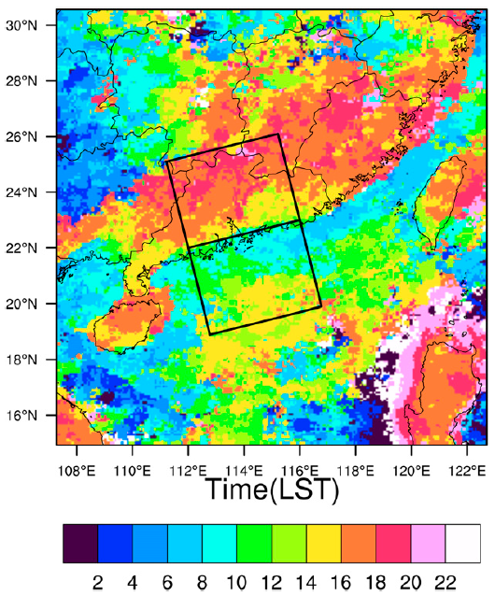
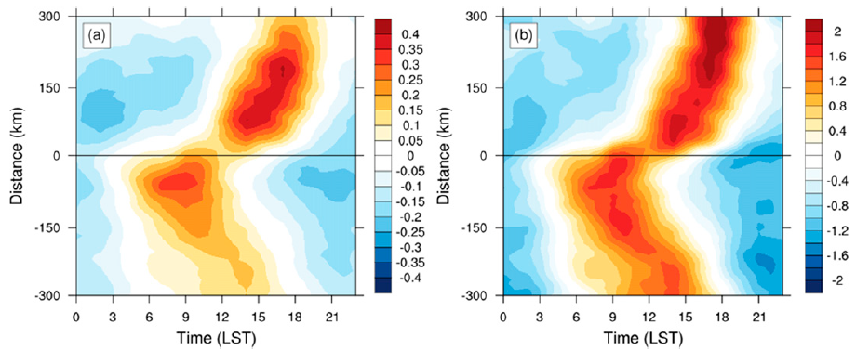
Diurnal cycle of rainfall from the CMORPH data
CMORPH
rainfall data / dx = 8 km / dt = 30 min / June 1998-2015
CMORPH data tend to underestimate the morning rainfall at coastal sites and overestimate the afternoon rainfall at inland sites. (Chen et al., 2018)
$$\frac{r_{t}−\overline{r}}{σ}$$
$$r_{t}−\overline{r}$$
precipitation deviations (mm)
normalized precipitation deviations

Slide 5
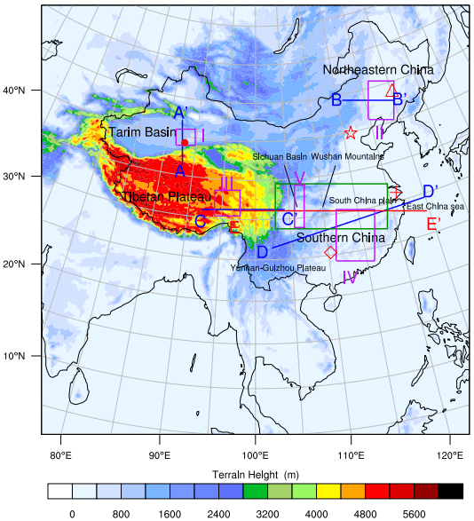
Diurnal cycle from the Du model data
WRF model (real case simulations)
June in 2006-2011
dx = 9 km / lev = 40 / dt = 1 hr
forecast time = from 12 hr to 36 hr
Parameterization scheme
KF / WSM6 / YSU / RRTM / Dudhia / Monin-Obukhov / Noah
Model verification (Du et al., 2014)
Credit: Fig.1, Du et al., 2014
Credit: Fig.2, Du et al., 2014

Slide 6
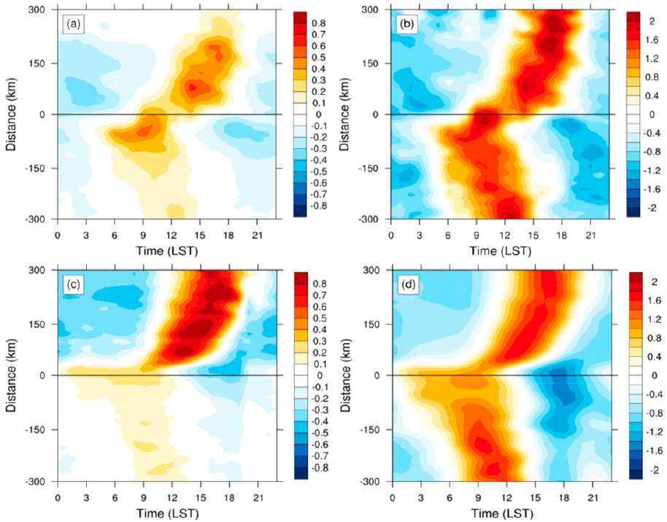
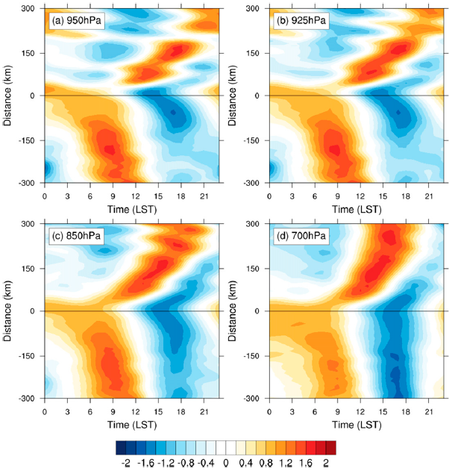
Diurnal cycle from the Du model data
normalized
precipitation deviations
$$\frac{w_{t}−\overline{w}}{σ}$$
precipitation deviations
normalized hourly w deviations
CMORPH
Du model

Slide 7
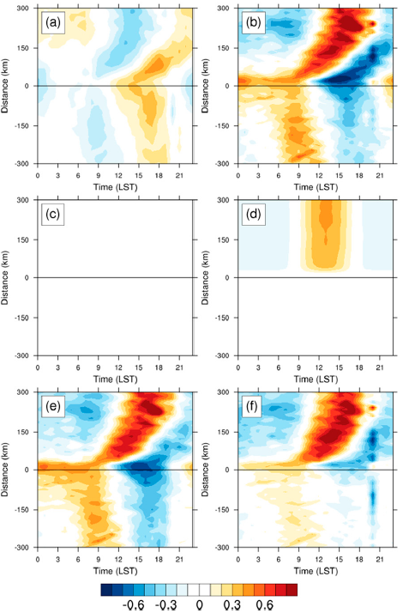
Diurnal cycle from the Du model data
Analysis of the rainfall budget
$$Q_{WVT}$$
$$Q_{WVF}$$
$$P=Q_{WVT}+Q_{WVF}+Q_{WVE}+Q_{CM}$$
$$Q_{WVT}=−\frac{∂[q_{v}]}{∂t}$$
$$Q_{WVF}=−\left[u\frac{∂q_{v}}{∂x}\right]−\left[v\frac{∂q_{v}}{∂y}\right]−\left[w\frac{∂q_{v}}{∂z}\right]$$
$$Q_{WVE}=E_{s}$$
$$Q_{CM}$$
$$Q_{WVE}$$
$$Q_{CM}=−\frac{∂\left[q_{l}\right]}{∂t}−\left[u\frac{∂q_{l}}{∂x}\right]−\left[v\frac{∂q_{l}}{∂y}\right]−\left[w\frac{∂q_{l}}{∂z}\right]$$
$$\left[F\right]=\int_{0}^{∞}{\overline{ρ}Fdz}$$
$$−\left[w\frac{∂q_{v}}{∂z}\right]$$
$$P$$

Slide 8
Linear land-sea breeze theory with a background wind
$$\left(\frac{∂}{∂t}+V\frac{∂}{∂y}\right)u−fv=0$$
$$N^{2}\frac{∂^{2}ψ}{{∂y}^{2}}+\left[f^{2}+{\left(\frac{∂}{∂t}+V\frac{∂}{∂y}\right)}^{2}\right]\frac{∂^{2}ψ}{{∂z}^{2}}=−\frac{∂Q}{∂y}$$
$$\left(\frac{∂}{∂t}+V\frac{∂}{∂y}\right)v+fu=−\frac{∂φ}{∂y}$$
$$N^{2}\frac{∂^{2}ψ}{{∂y}^{2}}+\left[f^{2}+{\left(\frac{∂}{∂t}+V\frac{∂}{∂y}\right)}^{2}\right]\frac{∂^{2}ψ}{{∂z}^{2}}=−Q_{0}\left(\frac{y_{0}}{y_{0}^{2}+y^{2}}\right)e^{\frac{−z}{z_{0}}}e^{−iωt}$$
$$−b=−\frac{∂φ}{∂z}$$
$$ψ=Re[Ψ(y,z)e^{−iωt}]$$
$$\left(\frac{∂}{∂t}+V\frac{∂}{∂y}\right)b+N^{2}w=Q_{0}\left[\frac{π}{2}+\tan^{−1}\left(\frac{y}{y_{0}}\right)\right]e^{\frac{−z}{z_{0}}}e^{−iωt}$$
$$N^{2}\frac{∂^{2}Ψ}{{∂y}^{2}}+\left[f^{2}+{\left(−iω+V\frac{∂}{∂y}\right)}^{2}\right]\frac{∂^{2}Ψ}{{∂z}^{2}}=−Q_{0}\left(\frac{y_{0}}{y_{0}^{2}+y^{2}}\right)e^{\frac{−z}{z_{0}}}$$
$$\frac{∂v}{∂x}+\frac{∂w}{∂y}=0$$
$$−N^{2}K^{2}\hat{ψ}+\left(f^{2}+σ^{2}\right)\frac{∂^{2}\hat{ψ}}{{∂z}^{2}}=−Q_{0}\sqrt{\frac{π}{2}}e^{−y_{0}\left|K\right|}e^{\frac{−z}{z_{0}}}$$
$$\hat{ψ}=\int_{−∞}^{∞}{ψe^{−iKy}dy}$$
$$σ=ω−KV$$

Slide 9
Linear land-sea breeze theory with a background wind
$$−N^{2}K^{2}\hat{ψ}+\left(f^{2}+σ^{2}\right)\frac{∂^{2}\hat{ψ}}{{∂z}^{2}}=−Q_{0}\sqrt{\frac{π}{2}}e^{−y_{0}\left|K\right|}e^{\frac{−z}{z_{0}}}$$
$$\hat{ψ}=\int_{−∞}^{∞}{ψe^{−iKy}dy}$$
$$σ=ω−KV$$
$$\hat{ψ}=\left\{\begin{aligned}−\sqrt{\frac{π}{2}}\frac{Q_{0}}{\left[\frac{f^{2}−σ^{2}}{z_{0}^{2}}\right]−N^{2}K^{2}}e^{−y_{0}\left|K\right|}\left\{e^{\frac{−z}{z_{0}}}−e^{−i\sqrt{\left[\frac{N^{2}K^{2}}{σ^{2}−f^{2}}\right]z}}\right\} \\ −\sqrt{\frac{π}{2}}\frac{Q_{0}}{\left[\frac{f^{2}−σ^{2}}{z_{0}^{2}}\right]−N^{2}K^{2}}e^{−y_{0}\left|K\right|}\left\{e^{\frac{−z}{z_{0}}}−e^{\sqrt{\left[\frac{N^{2}K^{2}}{σ^{2}−f^{2}}\right]z}}\right\} \\ −\sqrt{\frac{π}{2}}\frac{Q_{0}}{\left[\frac{f^{2}−σ^{2}}{z_{0}^{2}}\right]−N^{2}K^{2}}e^{−y_{0}\left|K\right|}\left\{e^{\frac{−z}{z_{0}}}−e^{i\sqrt{\left[\frac{N^{2}K^{2}}{σ^{2}−f^{2}}\right]z}}\right\}\end{aligned}\right.$$
$$K<\frac{ω−f}{V}$$
$$\frac{ω−f}{V}<K<\frac{ω+f}{V}$$
$$K>\frac{ω+f}{V}$$

Slide 10
Linear land-sea breeze theory with a background wind
$$ψ=Re\left[\frac{1}{2π}\int_{−∞}^{∞}{\hat{ψ}e^{i\left(Ky−ωt\right)}dK}\right]$$
$$w=−\frac{∂ψ}{∂y}=I_{1}+I_{2}+I_{3}$$
$$\left\{\begin{aligned}I_{1}=Re\left(\frac{1}{2π}\int_{−∞}^{\frac{ω−f}{V}}{\left(iK\right)−\sqrt{\frac{π}{2}}\frac{Q_{0}}{\left[\frac{f^{2}−σ^{2}}{z_{0}^{2}}\right]−N^{2}K^{2}}e^{−y_{0}\left|K\right|}\left\{e^{\frac{−z}{z_{0}}}−e^{−i\sqrt{\left[\frac{N^{2}K^{2}}{σ^{2}−f^{2}}\right]z}}\right\}dK}\right) \\ I_{2}=Re\left(\frac{1}{2π}\int_{\frac{ω−f}{V}}^{\frac{ω+f}{V}}{\left(iK\right)−\sqrt{\frac{π}{2}}\frac{Q_{0}}{\left[\frac{f^{2}−σ^{2}}{z_{0}^{2}}\right]−N^{2}K^{2}}e^{−y_{0}\left|K\right|}\left\{e^{\frac{−z}{z_{0}}}−e^{−\sqrt{\left[\frac{N^{2}K^{2}}{σ^{2}−f^{2}}\right]z}}\right\}dK}\right) \\ I_{3}=Re\left(\frac{1}{2π}\int_{\frac{ω−f}{V}}^{∞}{\left(iK\right)−\sqrt{\frac{π}{2}}\frac{Q_{0}}{\left[\frac{f^{2}−σ^{2}}{z_{0}^{2}}\right]−N^{2}K^{2}}e^{−y_{0}\left|K\right|}\left\{e^{\frac{−z}{z_{0}}}−e^{i\sqrt{\left[\frac{N^{2}K^{2}}{σ^{2}−f^{2}}\right]z}}\right\}dK}\right)\end{aligned}\right.$$
$$f=4.79×{10}^{−5} s^{−1}$$
$$Q_{0}=1.2×{10}^{−5} ms^{−1}$$
$$N=0.01 s^{−1}$$
$$z_{0}=1 km$$
$$y_{0}=50 km$$

Slide 11
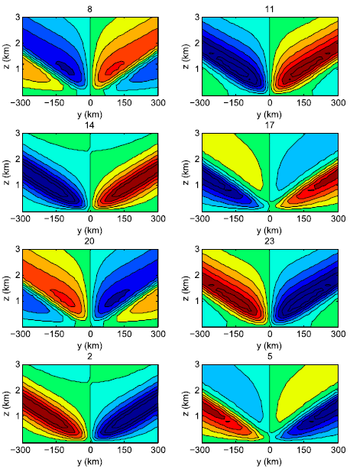
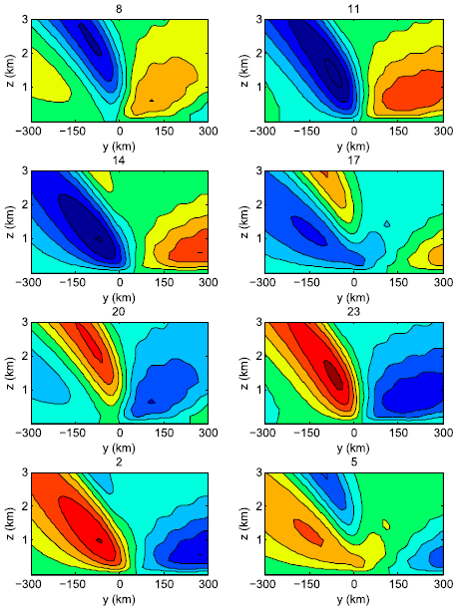
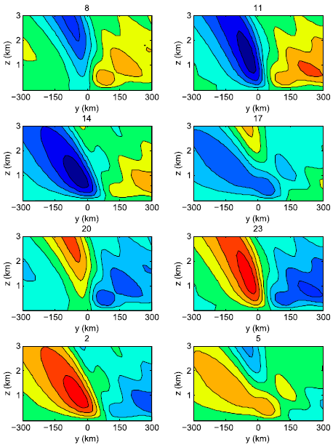
Linear land-sea breeze theory with a background wind
$$V=0 m/s$$
$$V=3 m/s$$
$$V=5 m/s$$

Slide 12
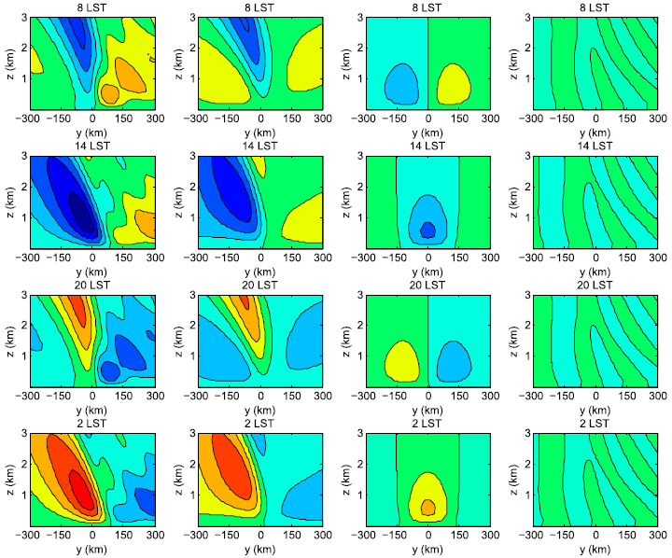
Linear land-sea breeze theory with a background wind
$$w$$
$$I_{1}$$
$$I_{2}$$
$$I_{3}$$
$$V=5 m/s$$
$$w=−\frac{∂ψ}{∂y}=I_{1}+I_{2}+I_{3}$$

Slide 13
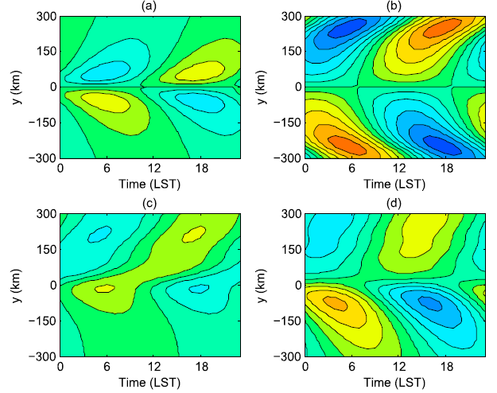
Linear land-sea breeze theory with a background wind
950 hPa
850 hPa
$$V=0 m/s$$
2D linear analytic solution v.s. Du model
$$V=3 m/s$$

Slide 14
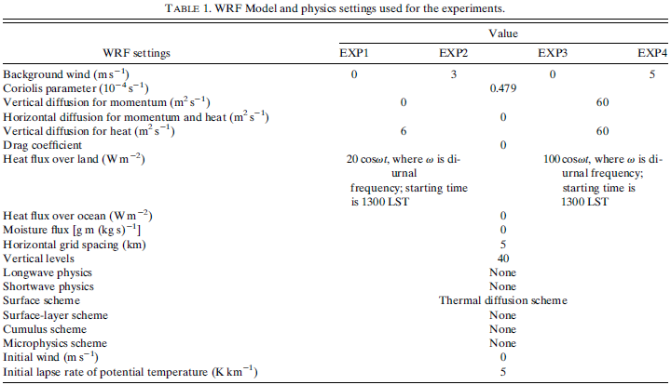
Idealized simulations
more realistic

Slide 15
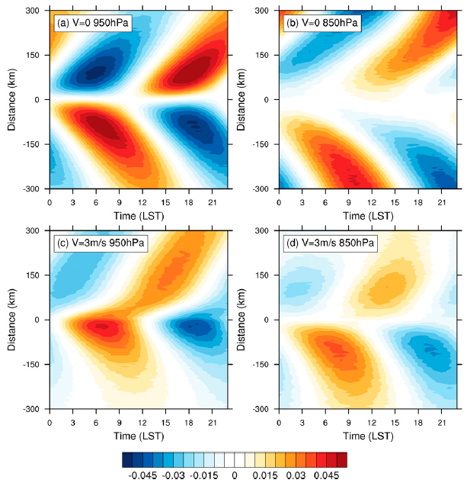
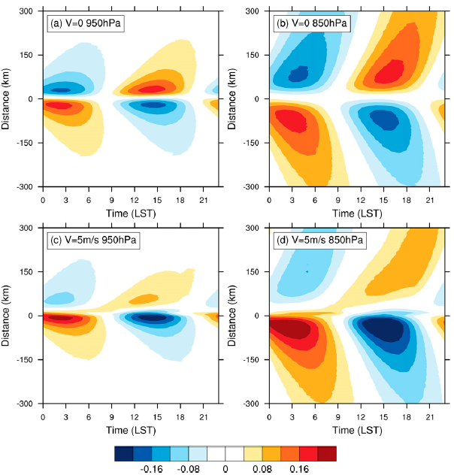
Idealized simulations
EXP 1
EXP 3
EXP 2
EXP 4

Slide 16
Summary
The diurnal propagation of vertical velocity is broadly similar to that of rainfall though there are different propagation speeds at different levels over land.
Through diagnosing the rainfall rate from the rainfall budget, we found that the diurnal cycle of vertically integrated vertical vapor advection is the main contributor to the diurnal cycle of rainfall, and therefore the diurnal cycle of vertical velocity at midlevels is a good indicator for the diurnal cycle of rainfall.

Slide 17
Summary
The background wind is a key factor for the offshore and onshore propagation pattern near the coast. Without the background wind, the two-way propagation exists and is symmetric with opposite phases, which is the classical inertia–gravity wave response to land–sea thermal forcing.
The background wind changes the tilt of the ray paths via contribution $I_{1}$ in the analytical solution, which is associated with Doppler shifting.
The background wind may also introduce an overland (north side) wave response with negative tilts over the land via the term $I_{3}$, which is similar to flow past a stationary heat source or a topographic obstacle.
The term $I_{2}$ indicates that the background wind has the effect of advection of trapped disturbances.

