Slide 1
The Behavior of Squall Lines in Horizontally Heterogeneous Coastal Environments KELLY LOMBARDO AND TRISTAN KADING
Speaker:潘鈺太
Professor:楊明仁

Slide 2
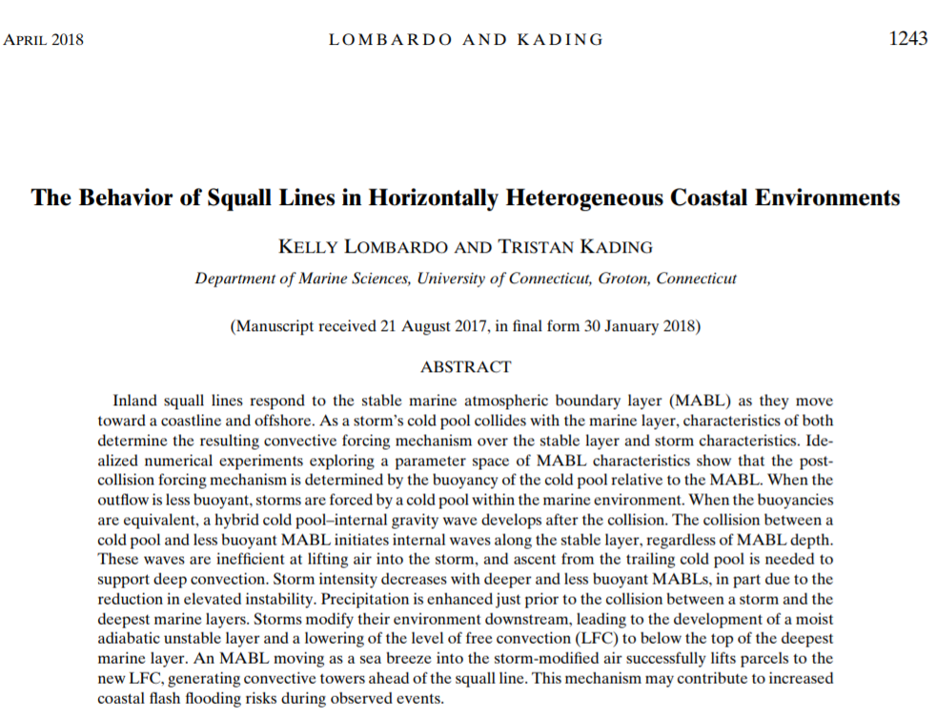

Slide 3
Outline
1.Introduction
2.Data and Method
3.Results
4.Internal gravity wave characteristics
5.Precipitation enhancement with MAUL
6.Summary

Slide 4
Introduction
Squall lines often respond to the stable marine atmospheric boundary layer(MABL) as they move toward the coast and offshore. Not confined to coastal regions, however, as the stable layer can progress tens to hundreds of kilometers inland as a sea breeze during certain synoptic regimes (e.g., Tijm et al. 1999; Lombardo et al. 2016).
Collide with MABL, some decay, while others remain intense(Lombardo and Colle 2012, 2013)
Simulations of northeastern U.S. squall lines showed that a successful coastline crossing can be supported by the Bore-like feature resulting from the collision of the storm cold pool and MABL(Lombardo and Colle 2013)

Slide 5
Introduction
During the Convection and Precipitation/Electrification (CaPE) Experiment over east-central Florida (Gray 1991), analysis of a collision between a less dense gust front and a denser sea breeze showed the generation of a bore that propagated ahead of the storm outflow, opposing the sea breeze motion (Wakimoto and Kingsmill 1995).
A few small convective cells developed in association with the bore, though it was unable to support deep convection over the coastal waters.
The goal of this study:
1.Understand the conditions that support the development of waves
following the interaction between a squall line and marine layer.
2.The impact of the offshore convective forcing mechanism on storm
structure and dynamics.

Slide 6
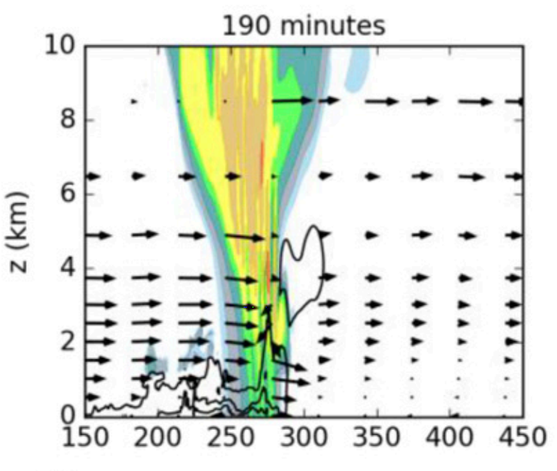
Data and method: a. Numerical model
1. Nonhydrostatic Cloud Model 1, CM1, version 18.
2. 600 km (horizontal-x) X 20 km (vertical-z)
The horizontal grid is 200m.
The vertical grid is stretched from 50-m spacing below 3 km to 250-m
spacing above 10 km, resulting 148 vertical levels.
3. Left 300KM(wooded-wetland surface )
Right 300KM(Water Surface) -->MABL
4. Microphysics: Morrison double-moment scheme.
5. No radiation and surface heat and moisture fluxes are included to prevent the convolution of a storm’s response to the MABL and time-varying environmental parameters.(But the horizontal boundaries are open radiative to minimize reflection off the lateral edges)

Slide 7
Data and method b. Sounding CAPE : 1923 J /kg CIN : 44 J /kg LCL : 1021 m LFC : 1796 m Red line: limits the ability of the MABL to initiate deep convective storms. (above LCL, or it would change CAPE!)
All simulations are initialized with the Weisman and Klemp (1982) analytic sounding ,as it supports long-lived, robust squall lines capable of traversing the full horizontal domain.
Vertical
Wind
Shear.
0~10m/s
From surface to 2500m.

Slide 8
Data and method : Warm bubble setting
Initiate at t =0 .
Elliptical +2K warm bubble.
Centered at 150 km from the left boundary and 1.5 km above the surface.
Horizontal and vertical radii of 10 and 1.5 km, respectively.

Slide 9
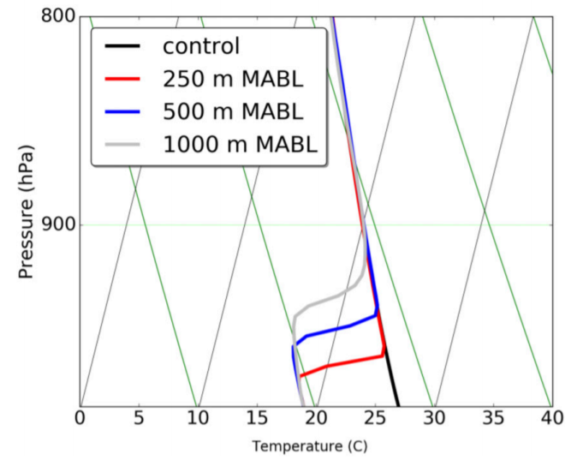
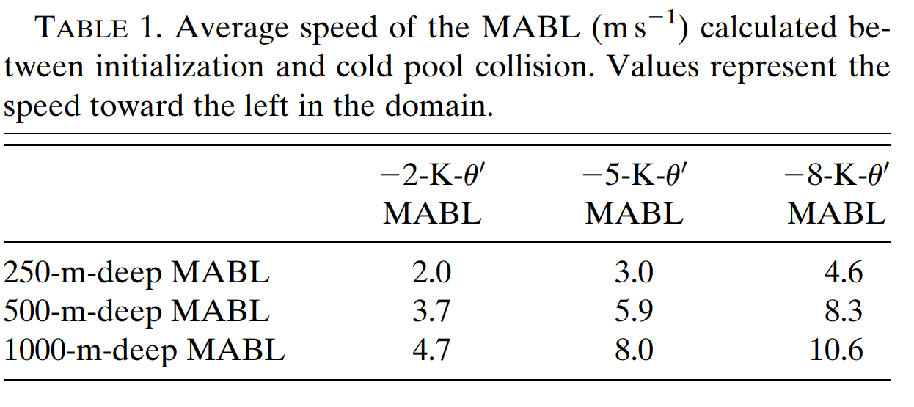
Data and method: Sensitivity Experiment setting
The MABL move westward as a density current,
which is characteristic of observed sea breezes
in the mid-Atlantic during JJA
(e.g., Simpson et al. 1977; Simpson 1997;
Galvin 1997; Lombardo et al. 2016, 2018).
The collision is inland because of
the movement of MABL.
(海洋邊界穩定層)

Slide 10
Data and method: Vertical momentum equation
1.Dynamic Vertical Perturbation Pressure Gradient Force
(DVPPGF)
2.Buoyant contribution to the vertical momentum
3. Nonhydrostatic Vertical Pressure Gradient Force
(NHVPGF) (1+2)
P’=Pd’+Pb’ (due to dynamic and density)

Slide 11
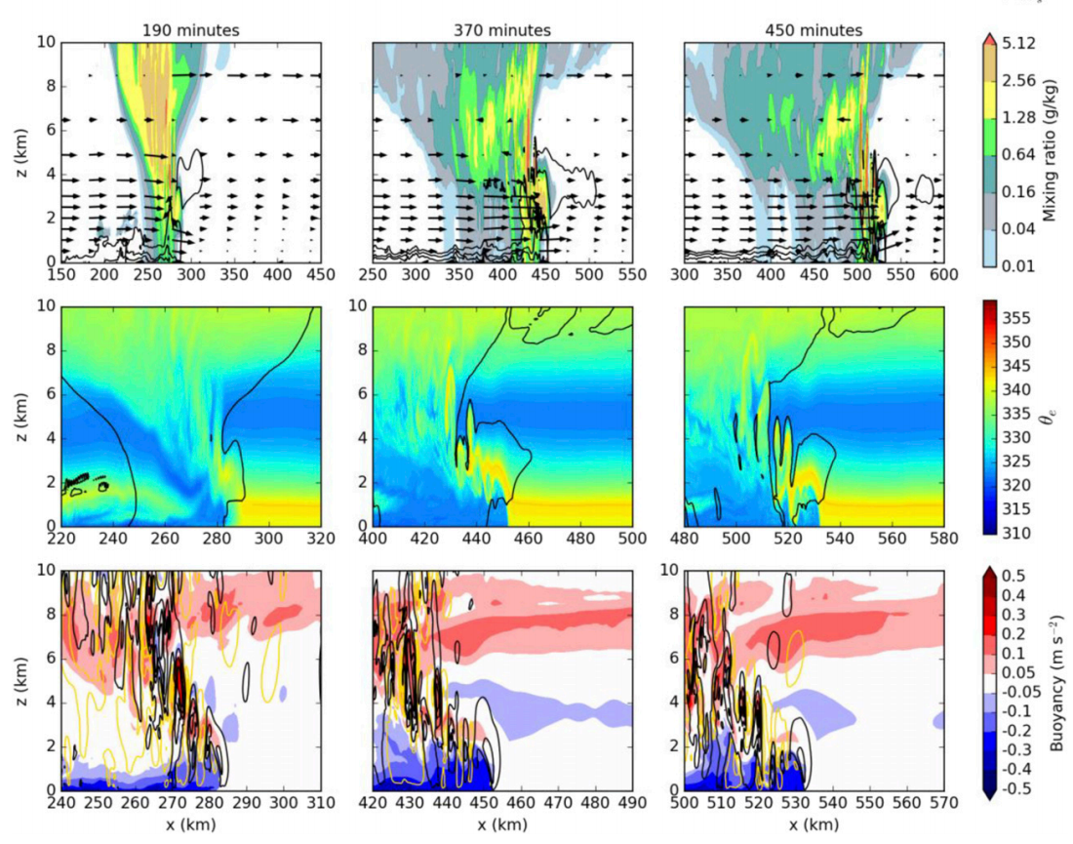
Result: Control simulation
混合比
1.Note that , there is no
MABL in the control run
2.Convection remains robust.
3.Potential instability values
Near -12 C/km btw 1-5km
Squall line的行進方向利於
發展對流。
相對位溫
浮力

Slide 12
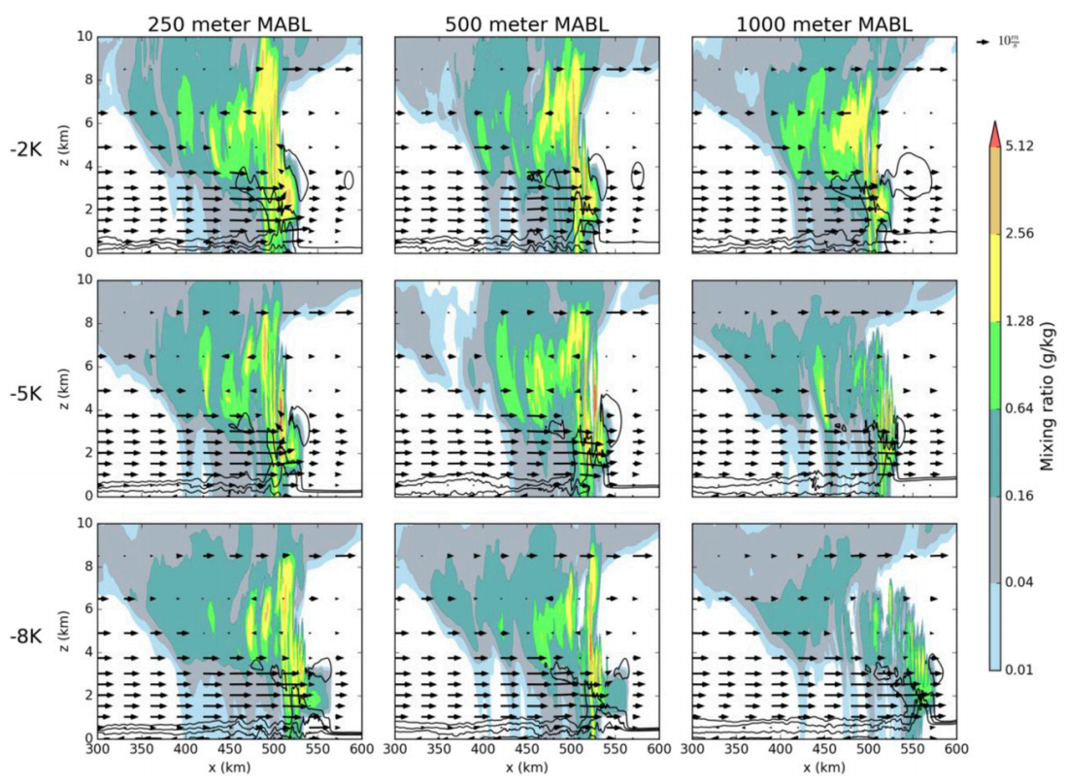
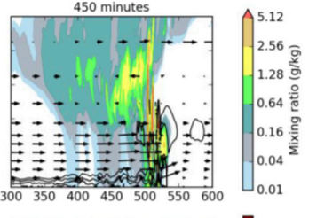
Result: Sensitivity experiment:
混合比
(bulk)
Time: 450min(進入海上已4hr.)
Shading: mixing ratio
Contour: T perturbation
Storms are weaker for
Deep and cold MABL.
重力波導致移速增快

Slide 13
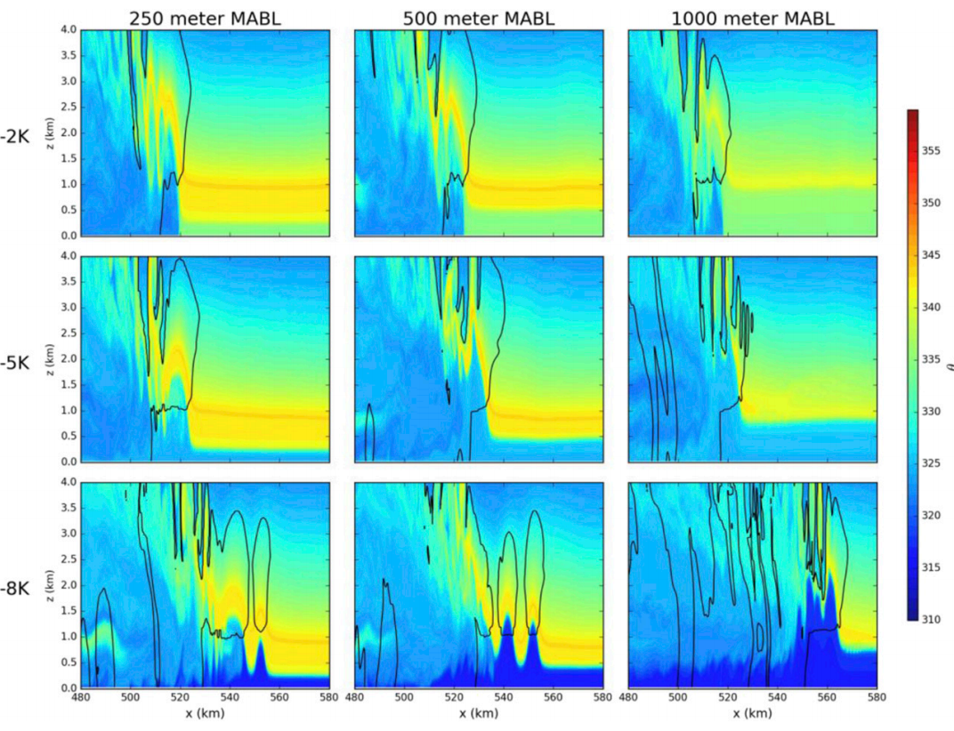
Result: Sensitivity experiment
相對位溫
Time:450min
Shading: Equivalent potential T
Instability over water surface
btw 1-5km,it helps storms moving
forward.
即使最冷最厚的MABL，
也不改變其強度。
But below 1km,不適合對流.
同時減少CAPE大小。
波動訊號

Slide 14
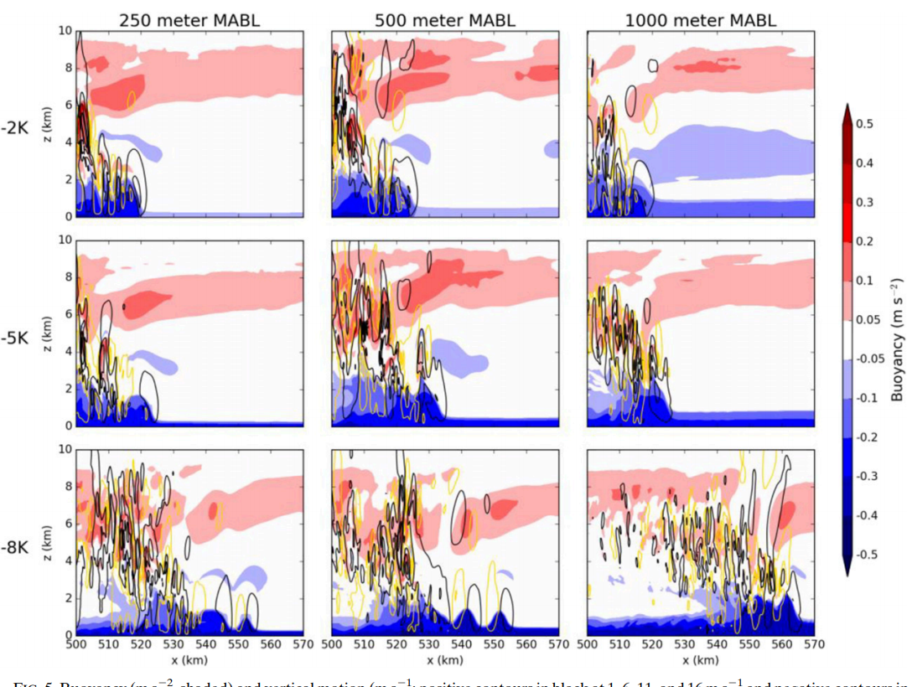
Result: Sensitivity experiment
浮力
1.冷池較冷
2.兩者相當
Time: 450min
Shading: Buoyancy
Contour: Vertical motion
3.MABL較冷
浮力的相對大小是產生波動與否的關鍵。

Slide 15
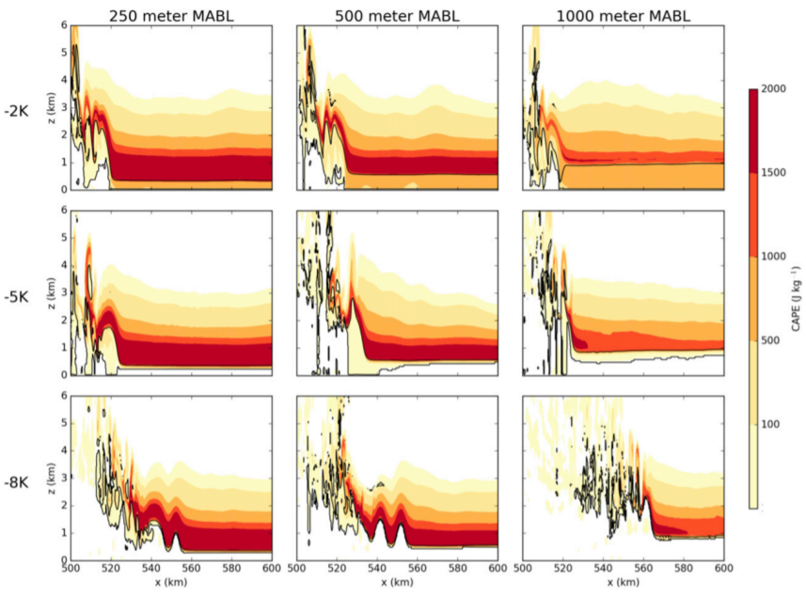
Result: Sensitivity experiment
CAPE/CIN
Time:450min
Shading: CAPE
Contour: CIN
Greatest CAPE above MABL to
1.5km,so shallower MABL favors
Intense storms.

Slide 16
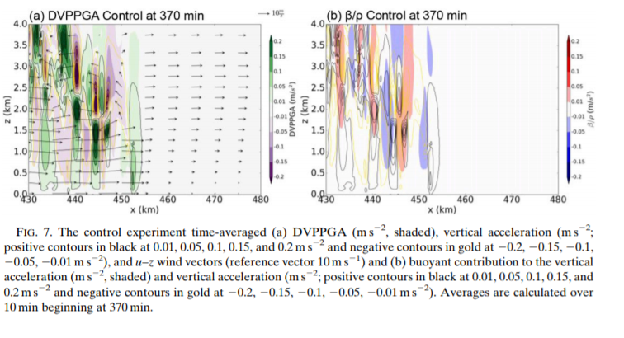
DVPPGA and Buoyant contribution for Control simulation
動力項
浮力項
Squall line
1.Calculated at 370min,squall line over MABL prior to decay.
(10min ave.)
2.The vertical motion is mostly contributed from DVPPGA.
3.Confluence is important.
Cold pool激發

Slide 17
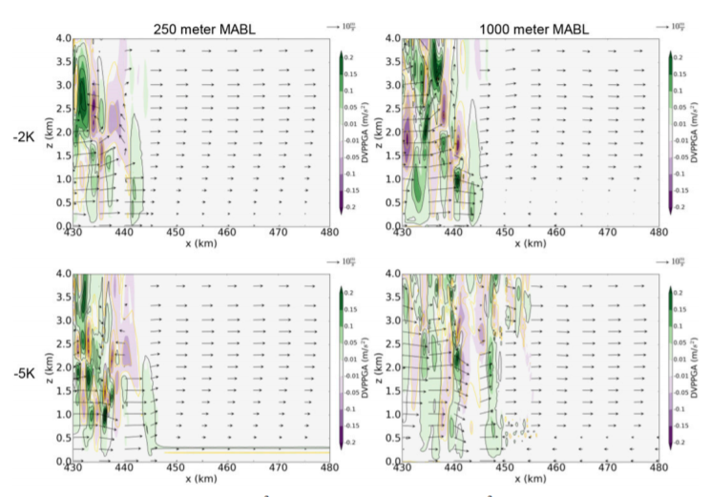
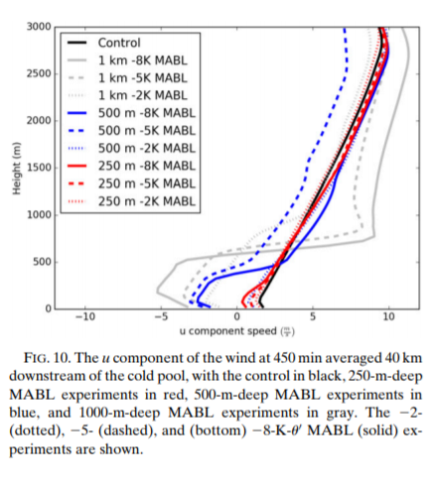
DVPPGA for sensitivity exp.
1.Why only choose 250m and 1000m?
2.Weaker convergence at leading edge.
3.For 1000m deep, vertical motions are more vigorous.
Highlight the vertical motion
Weaker convergence
Same buoyancy
Weaker PGF, due to similar density.
Two maxima
對流機制改變

Slide 18
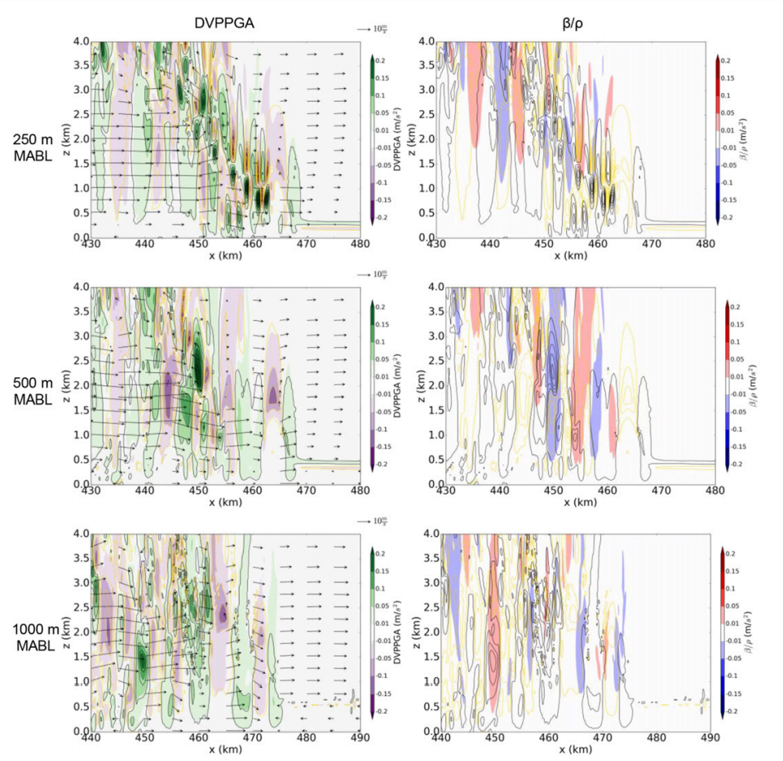
For -8K MABL
*Internal gravity waves occurs.
*It is very obvious the up and down motion.
(Black and Yellow contour)
-8K波動的產生

Slide 19
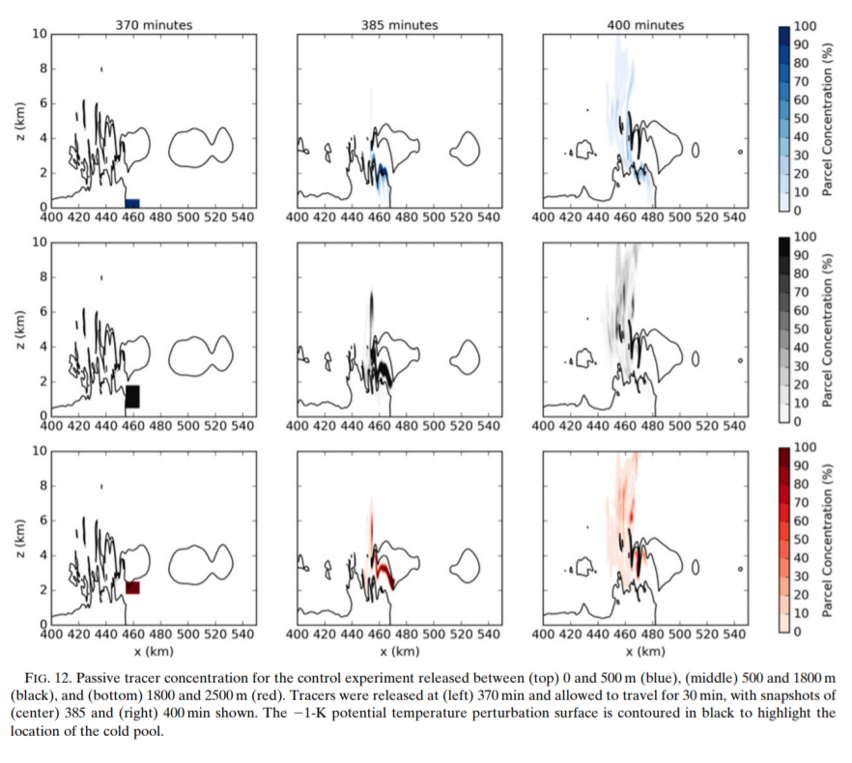
Passive tracer motion
a.
Release btw
a. 0~500m <-MABL (低層)
b. 500~1800m MABL~LFC (中層)
c. 1800~2500m LFC-> (高層)
All the parcel ascend into upper air.
b.
LFC=1.5km
c.
Contour:-1K位溫擾動(方便找出冷池位置)

Slide 20
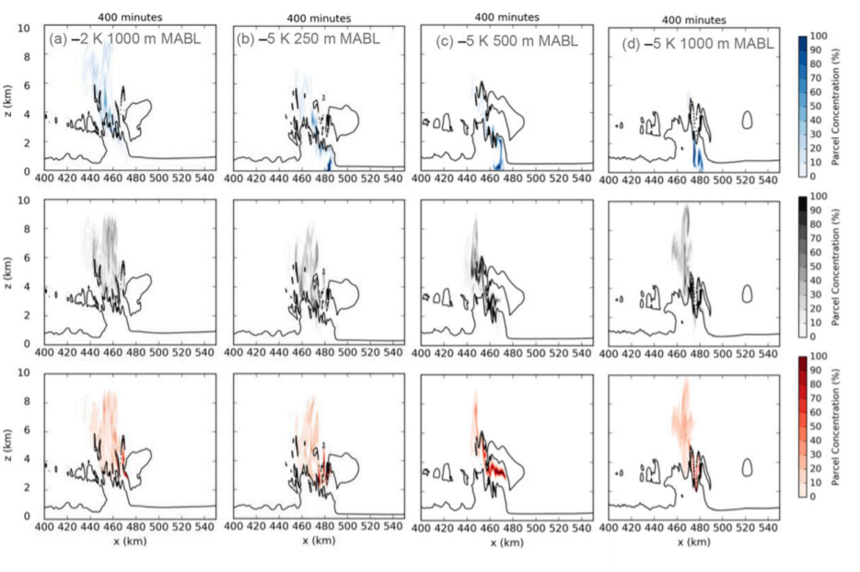
Passive tracer for sensitivity experiment
原因:CAPE值在低層越來越低
38%
4.5%
<3%

Slide 21
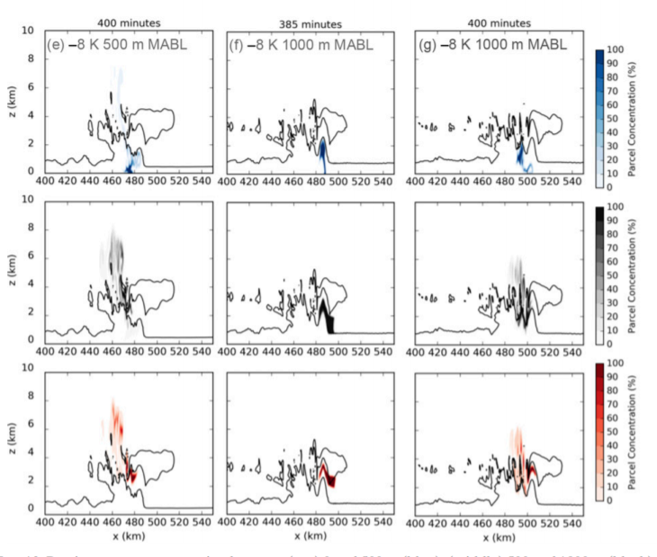
Passive tracer motion
*Waves are inefficient for lifting
air into storm, because of its upward and
dowmward motion.
*The ingestion of MABL air into the
storm would diminish the deep convective
latent heating, resulting in a reduction
in storm intensity and potentially decay
(Alfaro 2017).
*Subsequently, air successfully ascends
into the storm and lift from the trailing cold
pool is necessary.
385min to 400min
<2%
0%
0%
隨後冷池舉升

Slide 22
Internal gravity wave characteristics
1. A bore is a gravity wave disturbance that can form as a density current (冷池)encounters a stably stratified boundary layer(-8K MABL) and propagates along the low level inversion ahead of the density current.
(Haase and Smith 1984; Rottman and Simpson 1989; Koch et al. 1991). Unlike density currents, classical bores transport no mass.
2. A bore can evolve into a family of solitary waves, known as Soliton, energy can become trapped when there exists a relatively deep, weakly stratified layer above the stable boundary layer as well as a favorable curvature vertical profile in the low-level winds.
(Doviak and Ge 1984;Wood and Simpson 1984; Rottman and Simpson 1989; Klemp et al. 1997; Parker 2008)
3. Cold pool (+) -8K MABL ->Atmospheric bores->Into a family of solitary waves(a soliton)

Slide 23
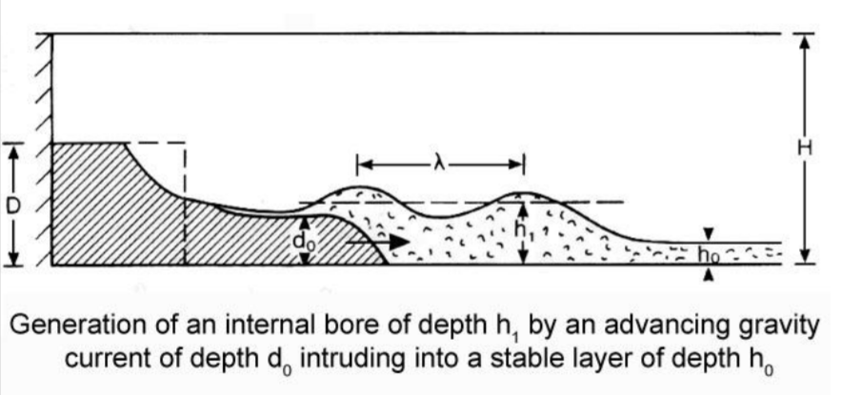
Bore (Courtesy Koch 2004.)
在本實驗:
do=冷池密度流厚度
ho=MABL厚度

Slide 24
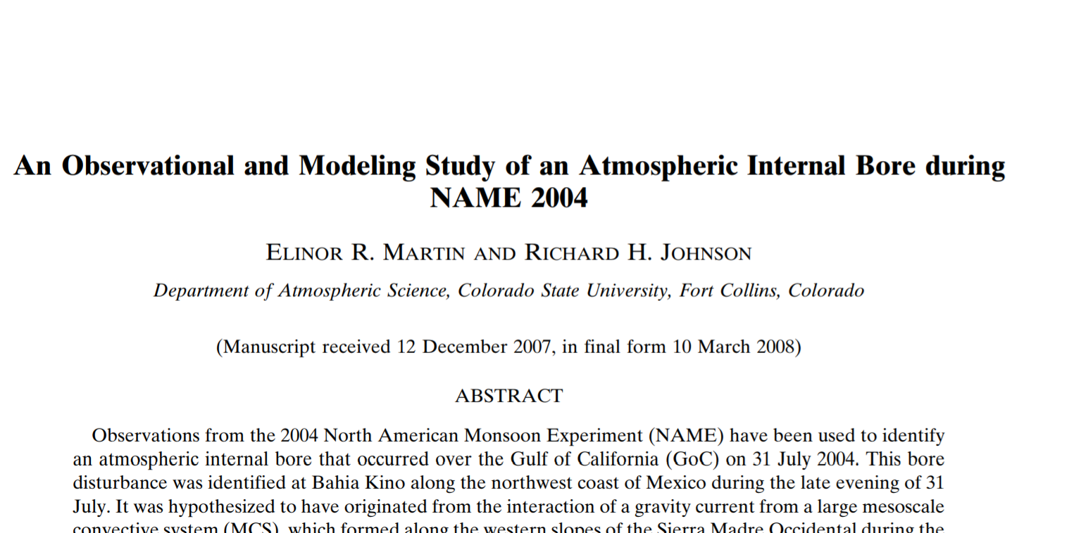
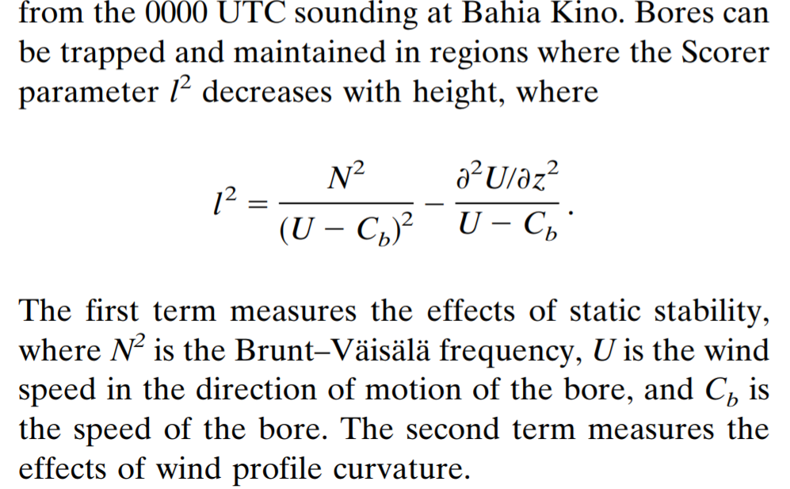
How it traps vertical energy -Scorer parameter 要隨高度遞減

Slide 25
Internal gravity wave characteristics
The curvatures and magnitudes of the vertical wind profile are similar to those seen in Doviak and Ge (1984), Crook (1988), and Fulton et al. (1990).
本實驗有足夠的垂直風切產生soliton.
→Explain why there are internal gravity waves in -8K MABL.
If a mechanism is not present to trap the vertical propagation of wave energy, the bore will quickly diminish (Crook 1988; Koch et al. 1991; Koch and Clark 1999).
*但此篇沒有特別去算scorer parameter.

Slide 26
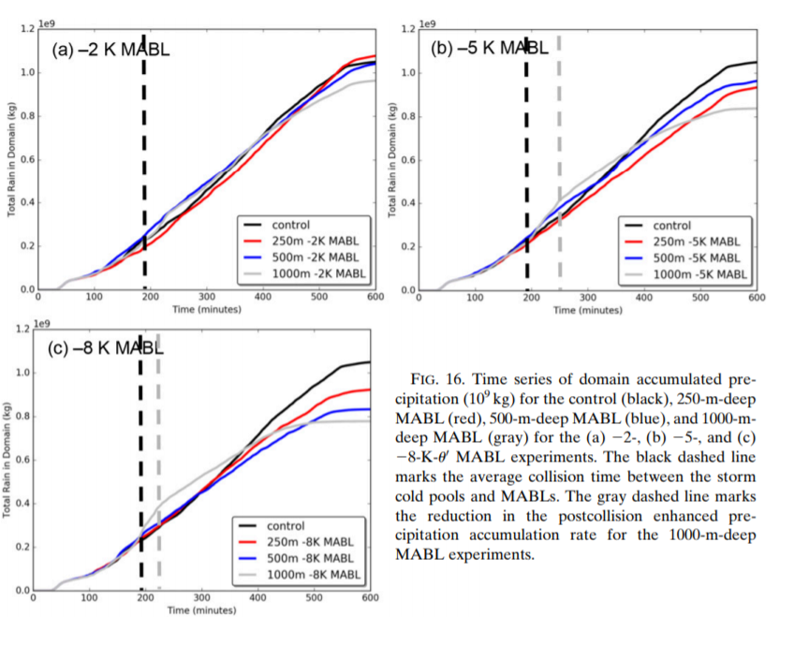
Precipitation enhancement (時間約20~40min)
黑虛線:增強開始
灰虛線:增強結束
1. Directly related to MABL depth and temperature.
2. Increase first, but decrease finally.
3. -2K(figure.a) is not obvious.
4. Focus on -8K(figure.c) gray line.

Slide 27
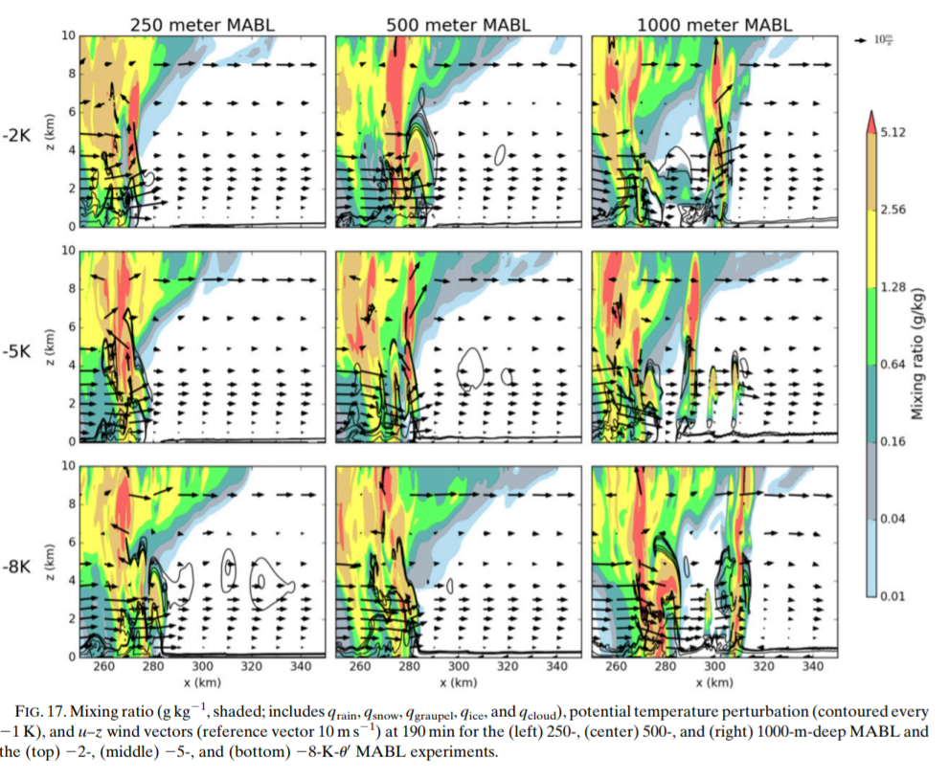
*Explain why there is precipitation enhancement
右圖時間為碰撞前(190min)
*Only occur in 1000m deep MABL.
*Due to the modification of the environment downstream of the squall line by the storms.
(冷池使前方的環境條件改變)
*Downstream of squall line,
the moist absolutely unstable layer(MAUL) develop.
*MAUL will make LFC lower than
the depth of 1000m MABL.

Slide 28
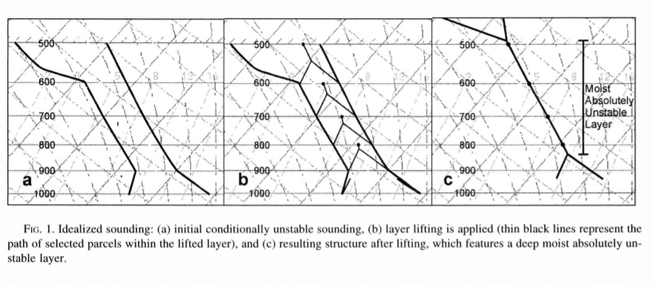
條件不穩定大氣 → 整層經過外力舉升 → 產生MAUL不穩定層

Slide 29
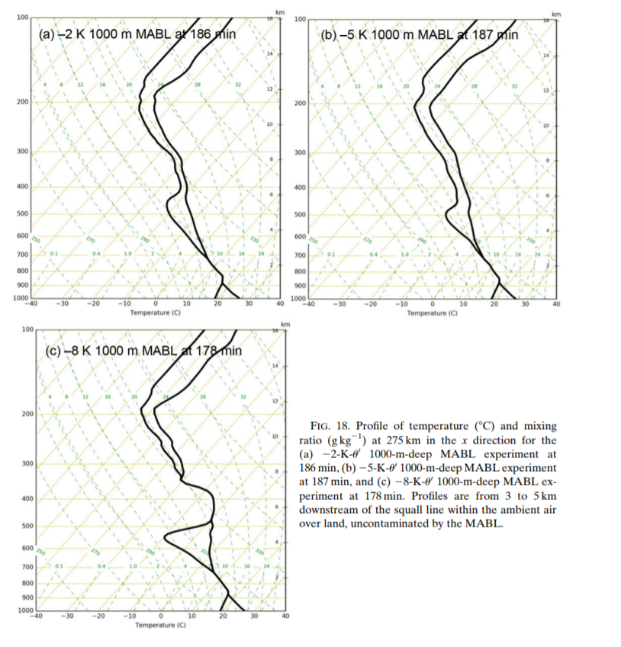
What is MAUL:
MAUL:
1.Saturated layer of air exhibits a lapse rate greater
than moist adiabatic.
(飽和環境降溫率>濕絕熱).
2.Tens of km downstream of squall line.
(此實驗約距離20~30km)
3.Maintain more than 30 mins.
In our experiment, the MAUL causes the
decrease of LFC to 840-890m, so it can be
lifted to such a height by 1000m-MABL.

Slide 30
Precipitation enhancement
Explain why there is a decrease in total rainfall.
1.First, MABL isn’t a good environment for convection.
2.Since the internal waves oscillate vertically, it brings low theta-e into air for a long period time.
(reduce buoyancy)
3. Therefore, while internal gravity waves are a mechanism to advance storms offshore, they contribute to less intense precipitation because of their inefficiency at lifting air into the storms.

Slide 31
Summary
When the cold pool was less buoyant than the MABL (-2K MABL), the storm remained forced by a cold pool over the stable layer, as it was over land. The convection was less intense compared to a control experiment with no MABL, in part due to the decrease in the vertical profile of instability in the presence of the stable marine layer.
When the buoyancy values were equivalent (-5K MABL), the collision between the marine layer and storm cold pool resulted in the development of a cold pool–wave hybrid.
The collision of the cold pool and marine layer initiated internal gravity waves on top of the stable marine layer, specifically atmospheric bores that evolved into a soliton, when the storm outflow was more buoyant than the MABL (-8K MABL).

Slide 32
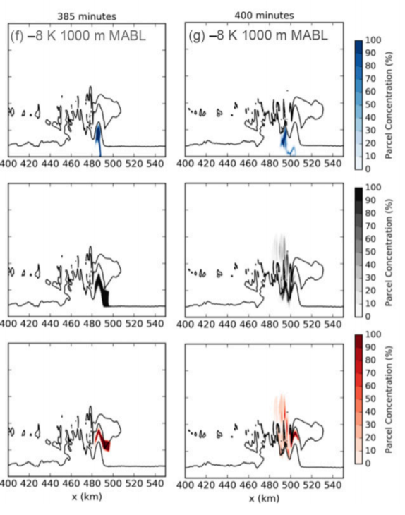
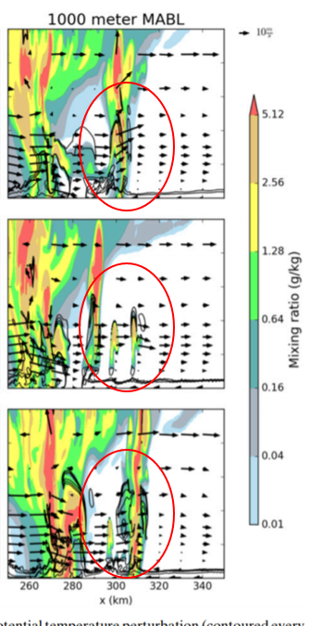
Summary
Waves are inefficient at lifting the unstable air into the storm. Wave motions forced air parcels downward on the backside of the waves, and lift from the trailing storm cold pool was needed for parcels to ascend into the storms updrafts.
Precipitation enhancement occurred just prior to the collision of the storm cold pool and only the deepest marine layers (i.e., 1000 m).
Dynamic lift and gravity wave processes associated with the storm led to the development of a moist adiabatic unstable layer (MAUL) ahead of a system and a lowering of the level of free convection (LFC) below the top of the deep MABL, leading to an increase in accumulated precipitation.
*This mechanism may indicate a greater coastal flash-flooding risk during certain observed squall-line events.

