Slide 1
Simulated Kelvin-Helmholtz waves over terrain and their microphysical implications
Professor : Ming-Jen Yang
Student : Jyong-En Miao
Date : 2018/10/09
Conrick, R., C. F. Mass, and Q. Zhong, 2018
J. Atmos. Sci., 75, 2787–2800.

Slide 2
Introduction
Kelvin–Helmholtz (KH) waves have been observed in a variety of atmospheric settings, including cumulonimbus anvils (Petre and Verlinde 2004), sea breeze circulations (Sha et al. 1991), and within midlatitude baroclinic systems and fronts (e.g., Wakimoto et al. 1992; Houze and Medina 2005; Medina and Houze 2015, 2016; Barnes et al. 2018).
KH waves have also been reported in regions of complex terrain, where terrain-enhanced vertical wind shear can initiate KH instability (e.g., Geerts and Miao 2010; Medina and Houze 2016).
(Houze and Medina 2005) upward motion in KH waves leads to enhanced depositional growth, which can increase orographic precipitation.
(Houser and Bluestein 2011) the upward motion of KH waves has a significant impact on microphysical processes, with riming enhanced because of either an increase in turbulent motions or from the introduction of supercooled water into a region of frozen particles.
Barnes et al. (2018) described the influence of KH waves on radar-observed fields and precipitation during the OLYMPEX field campaign. They showed KH-related modulation of rain rate when the waves were below the melting level, along with impacts on mass-weighted mean drop diameter, reflectivity, and fall speed.

Slide 3
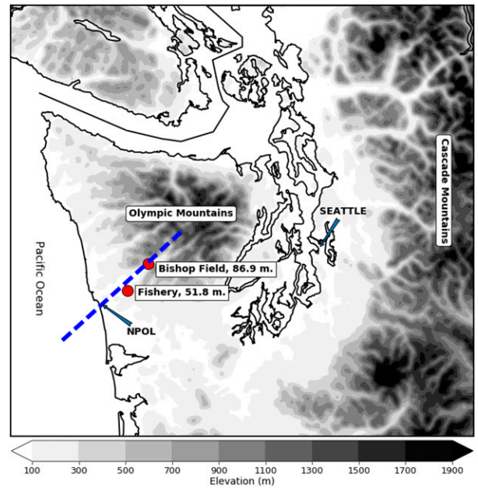
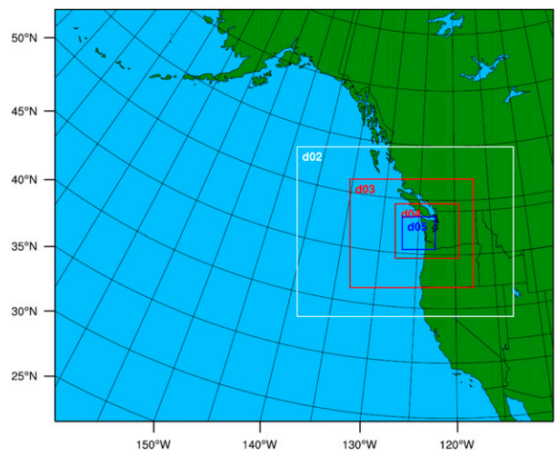
Model configuration
WRFV3.8.1
36–12–4–1.33–0.444 km domain configuration with 51 vertical levels
Initial and 3-h boundary conditions are from GFS 0.25° gridded analysis. Since new GFS data are available every 6 h, only forecast hours 0000 and 0300 are used for boundary conditions and nudging. (Grid nudging on the 36-km domain)
Grell–Freitas CP on the 36-, 12-, and 4-km domains (Grell and Freitas 2014)
Thompson microphysics (Thompson et al. 2008)
YSU PBL scheme (Hong et al. 2006)
Noah-MP (Niu et al. 2011)
RRTMG scheme (Iacono et al. 2008)

Slide 4
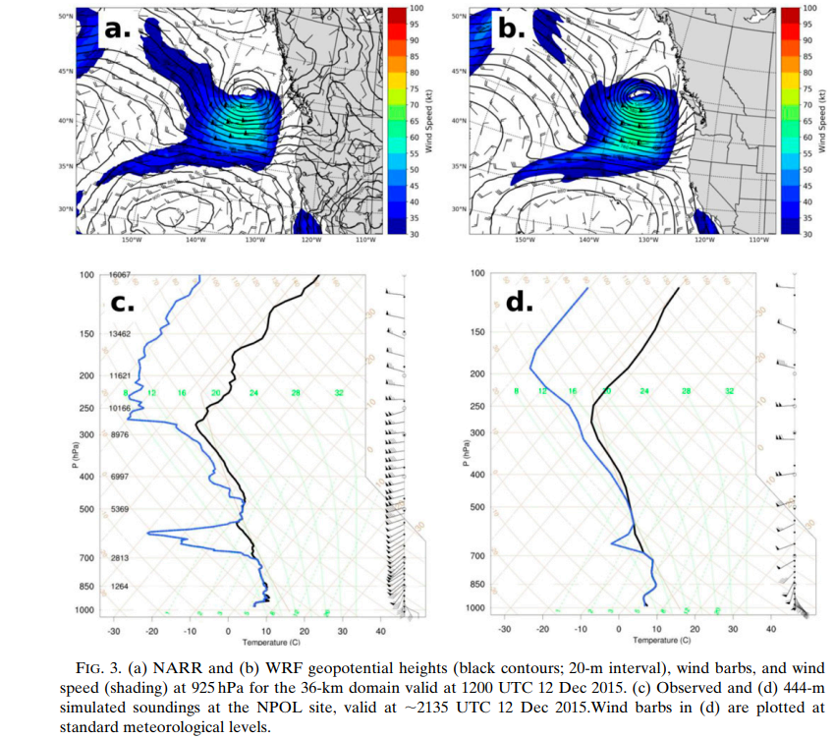

Slide 5
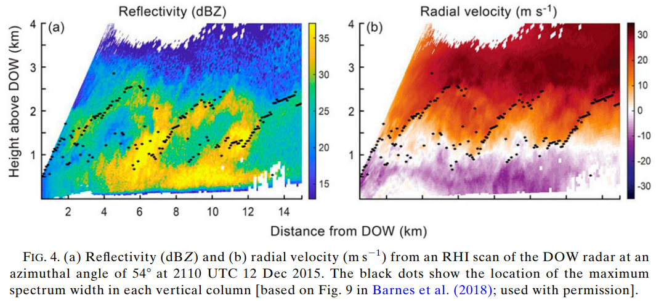

Slide 6
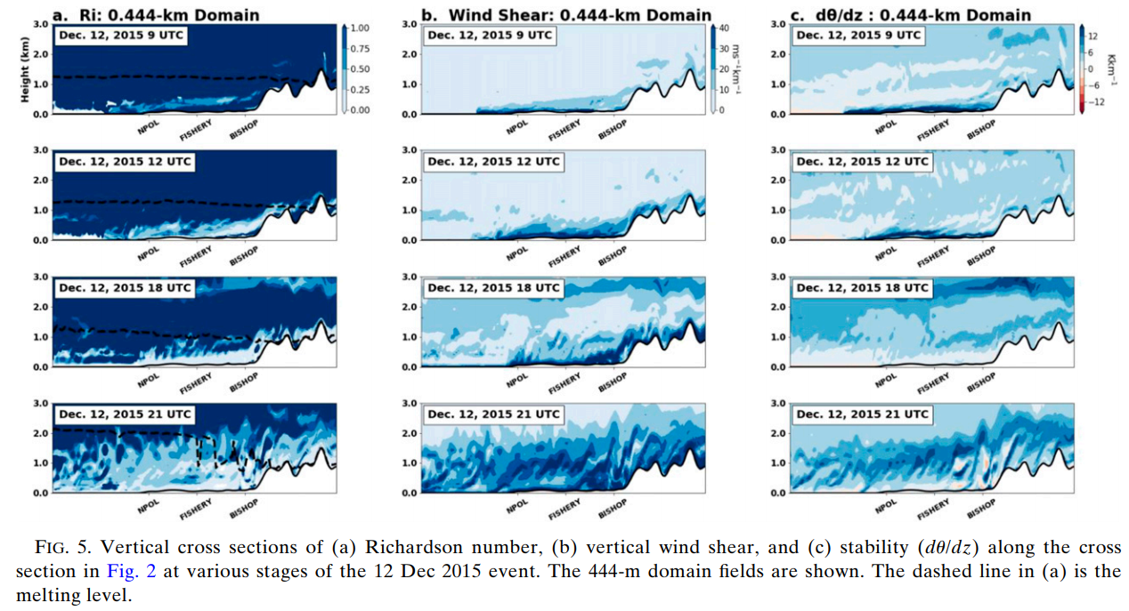

Slide 7
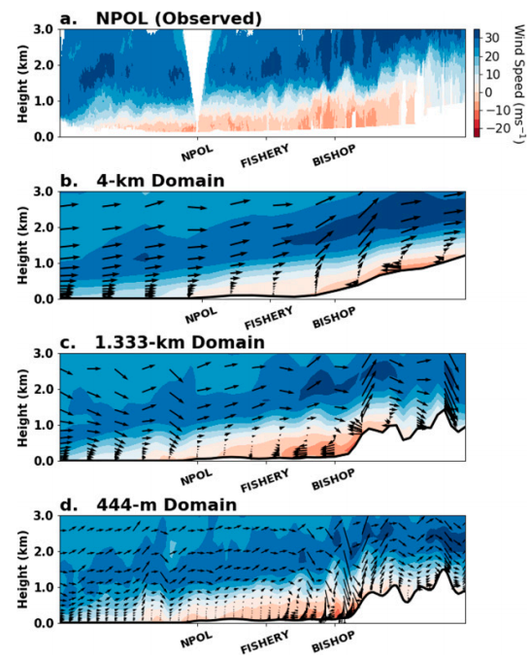

Slide 8
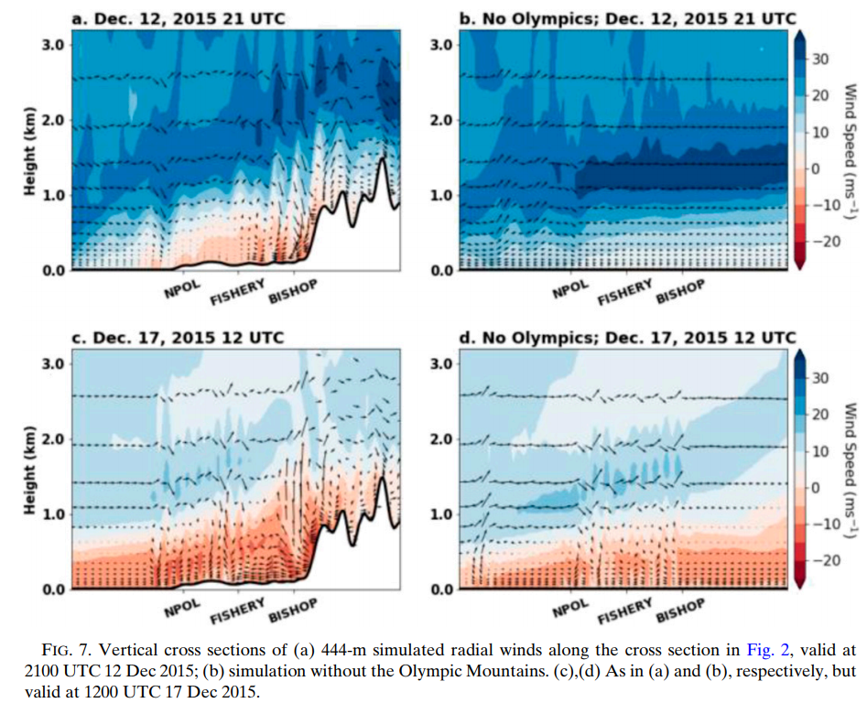

Slide 9
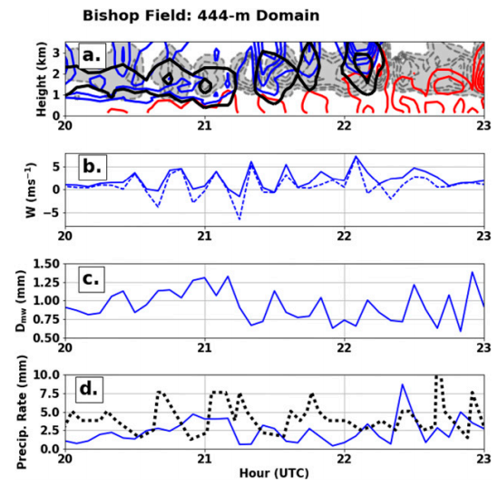

Slide 10
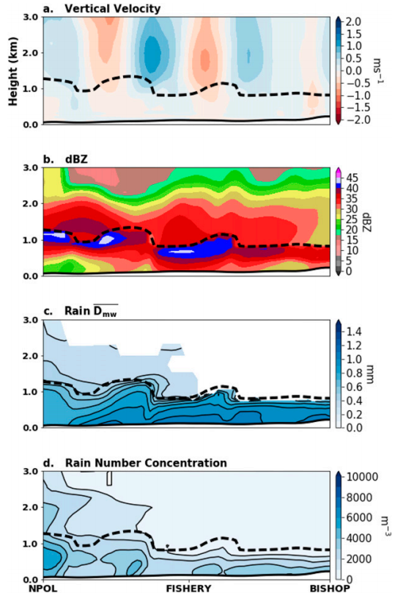

Slide 11
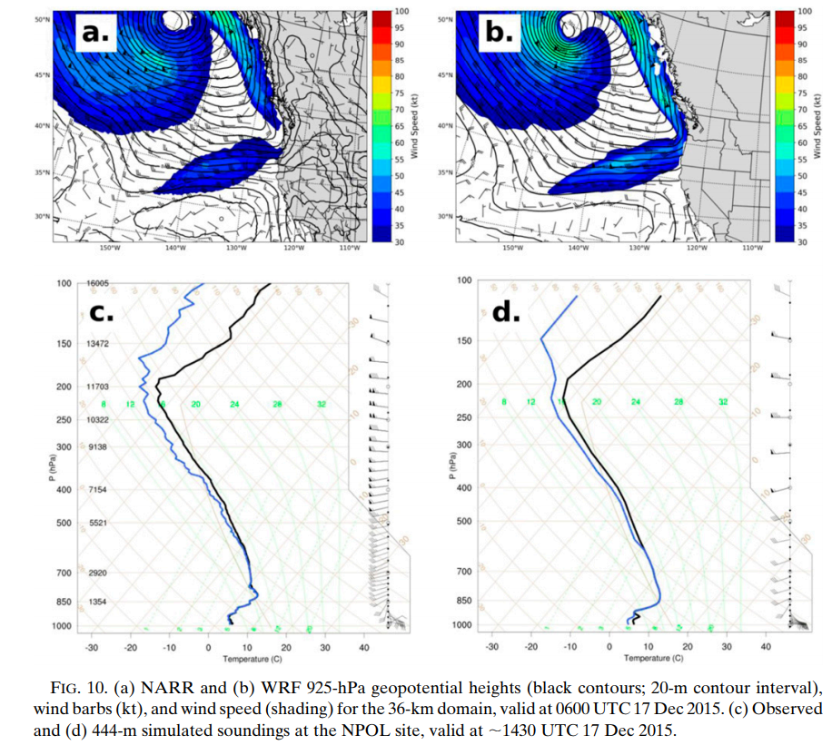

Slide 12
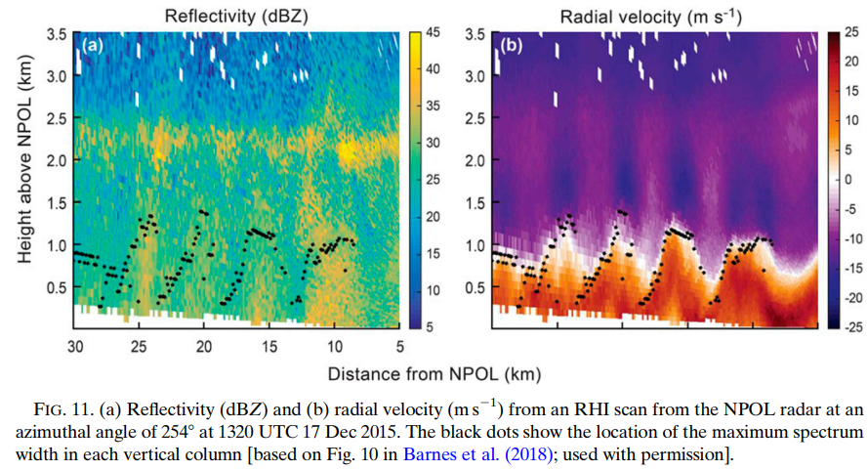

Slide 13
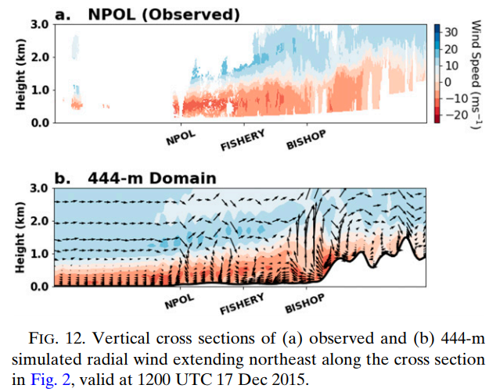

Slide 14
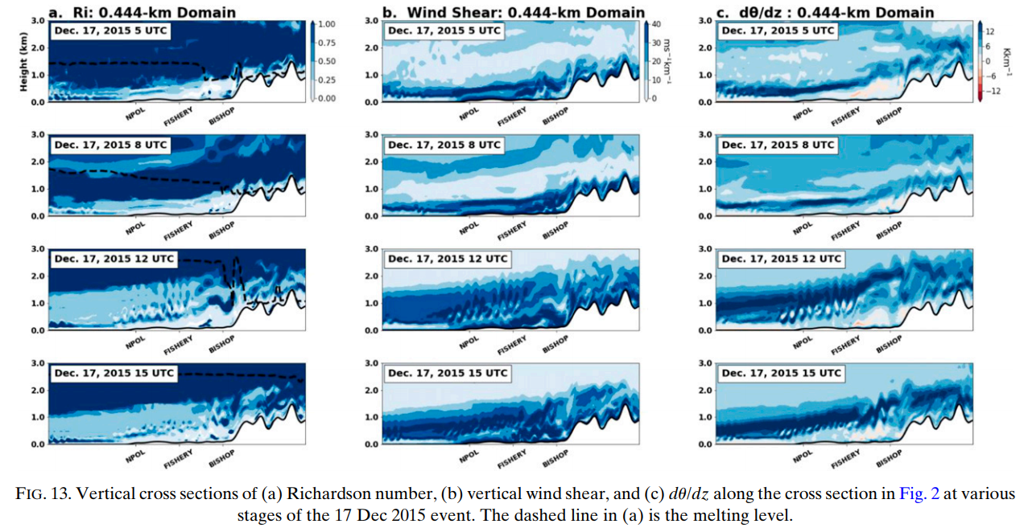

Slide 15
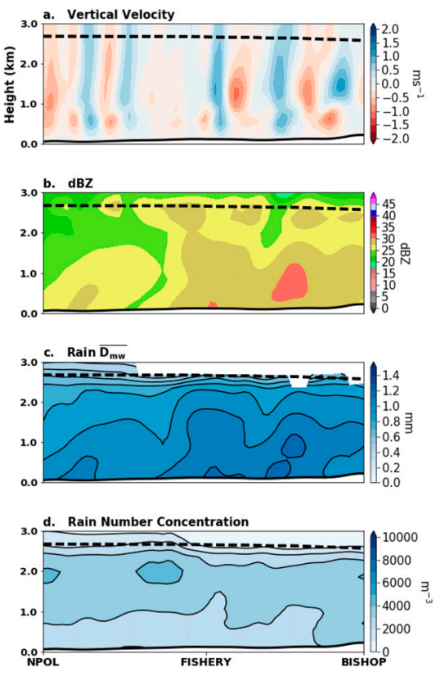

Slide 16
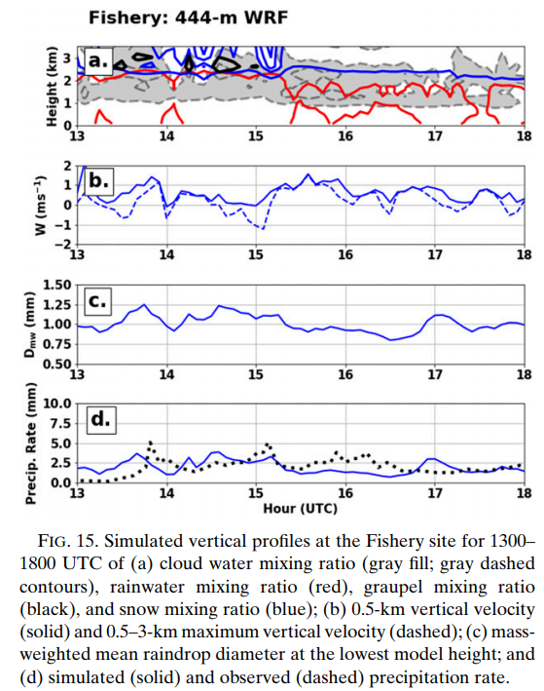

Slide 17
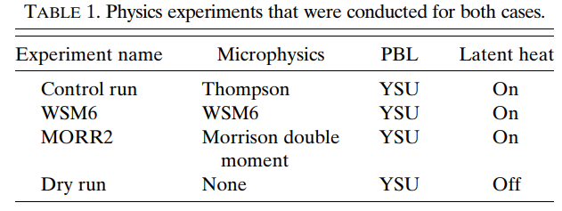

Slide 18
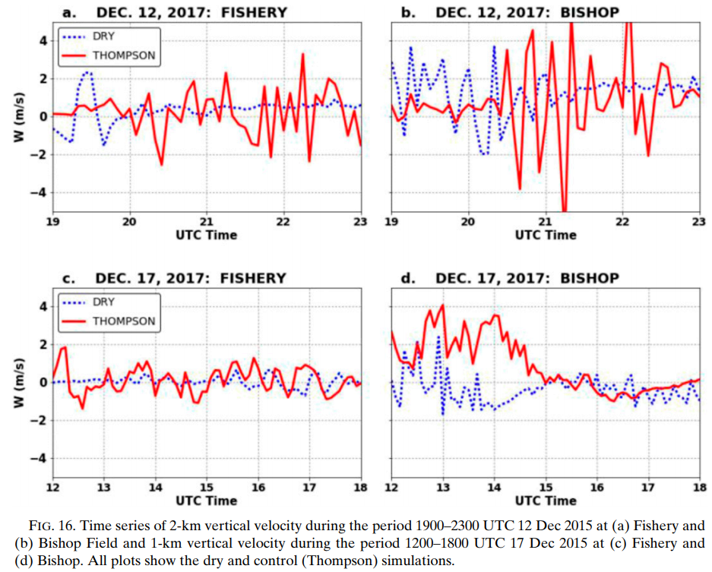

Slide 19
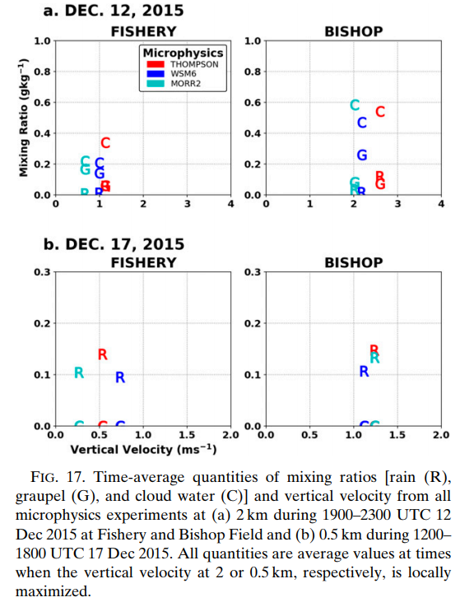

Slide 20
Conclusions
Kelvin–Helmholtz (KH) waves observed during two events of the OLYMPEX field campaign were simulated and examined. The WRF Model accurately simulated the observed synoptic and mesoscale environments of these events and development of KH waves over the western side of the Olympic Mountains.
During the 12 December case, KH waves were observed within the melting level in the Quinault valley. Simulated cross sections indicated KH waves in the same region, with modeled wave structures agreeing qualitatively with radar observations from Barnes et al. (2018). Because of the observed 3–5-km wavelengths, the ability to simulate the waves was resolution dependent: only at 444-m grid spacing were the waves adequately resolved.
Simulated KH waves developed as the Richardson number on the southwest side of the Olympics dropped to approximately 0.25. The decline in Richardson number had two origins: the strengthening of easterly flow near the surface, causing wind shear to increase, and a concomitant reduction of low-level stability.

Slide 21
Conclusions
The 17 December event had observed and simulated KH waves below the melting level in the Quinault valley.
The Olympic Mountains played a critical role during the 12 December event by blocking the incoming flow and producing low-level easterly winds. Removing the Olympics prevented development of easterly near-surface flow, thereby eliminating the shear zone and resulting in the absence of wave development.
In contrast, during the 17 December event, low-level easterly flow was synoptically forced and began hours prior to wave onset. Removing the Olympics reduced, but did not eliminate, the low-level easterly winds, and KH waves still developed within a shear layer.
12 December event: the simulation showed collocated enhancement of vertical velocity, snow and graupel mixing ratios, and mass-weighted mean drop diameter by the wave circulations. Enhancements in cloud water mixing ratios were collocated with upward motion in the waves and was largest in the vicinity of and immediately above the melting level, which is consistent with generation of supercooled water necessary for riming.

