Slide 1
Interactions between Water Vapor and Potential Vorticity in Synoptic-Scale
Monsoonal Disturbances: Moisture Vortex Instability
Adames, A. F., and Y. Ming, 2018: Interactions between water vapor and potential vorticity in synoptic-scale monsoonal disturbances: Moisture vortex instability. J. Atmos. Sci., 75, 2083–2106.

Slide 2
introduction
synoptic-scale monsoonal disturbances (SMDs) are cyclonic features that occur during the active months of the Indian monsoon.
horizontal scale ~ 2000km
circulation anomalies that are strongest in the lower troposphere
SMDs predominantly develop over the Bay of Bengal, propagate northwestward toward the Indian subcontinent with a phase speed of ~5m/s
A linear framework that may explain the propagation and growth of SMDs.

Slide 3
A linear model for SMDs with prognostic moisture
a basic set of equations linearized with respect to a background state with the following properties:
Zonally uniform mean state that is characterized by a weak zonal flow
A climatological-mean precipitation of ~10 mm/day
The mean humidity and temperature increase with latitude
Notes:
This mean state is chosen so that it qualitatively resembles the South Asian monsoon but is sufficiently simple to allow for solutions with a single-layer model.

Slide 4
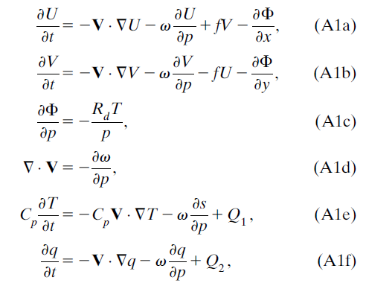
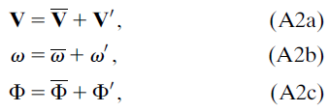
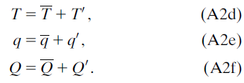

Horizontal momentum
Hydrostatic vertical momentum
Mass conservation
thermodynamic
Moisture conservation
Assume that diabatic heating is due to phase changes in water vapor, so $Q_{1}=− Q_{2}=Q$
$$\left\langle Q\right\rangle =precipitation$$
Assume that the equations satisfy hydrostatic balance and that the flow is incompressible
Linearization:

Slide 5

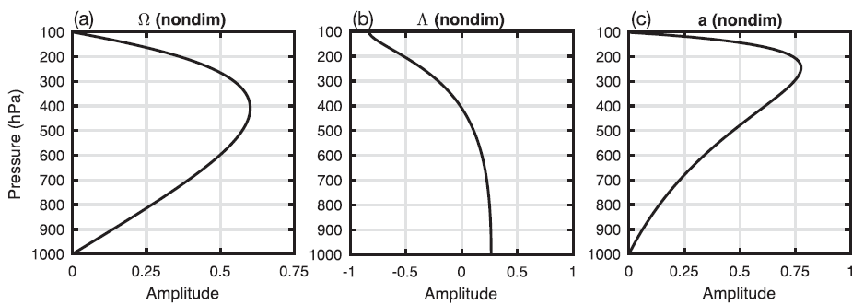
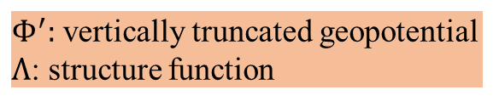

The field variables are separated into time-mean and perturbation components:
$Φ:$ geopotential
Perturbation fields are truncated vertically using basis functions:
$Φ^{′}:$ vertically truncated geopotential
$Λ$: structure function
All the structure functions are consistent with a first baroclinic mode in vertical motion.
Vertical velocity
Horizontal wind and
geopotential height
temperature
Notes:
the geopotential phi , and the temperature T are separated into a horizontal component and a vertical structure function.
All the structure functions used in this study are chosen so that they are consistent with a first baroclinic mode in vertical motion, a profile of ascent that is
of the same polarity throughout the troposphere with a peak amplitude in the midtroposphere (~400 hPa).

Slide 6
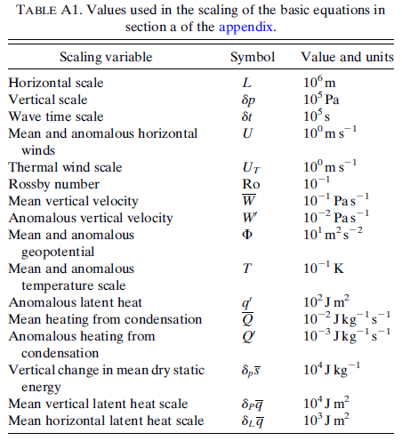
To keep the analysis simple, the mean and anomalous flow are assumed to be on the order of ${10}^{0}ms^{−1}$.

Slide 7
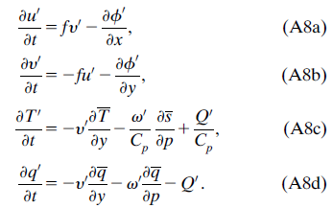
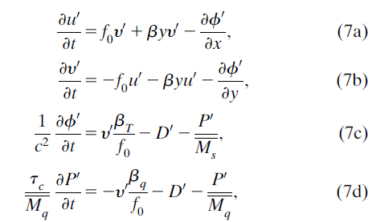
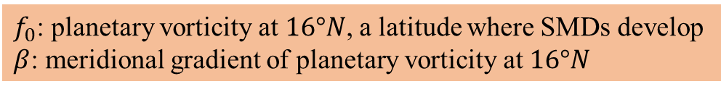
Coriolis acceleration
Pressure gradient force
$f_{0}$: planetary vorticity at $16°N$, a latitude where SMDs develop
$β$: meridional gradient of planetary vorticity at $16°N$

Slide 8




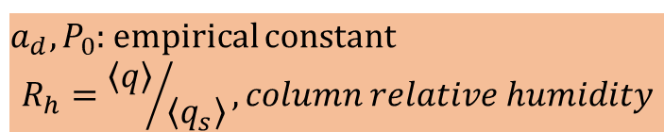


Adames and Ming (2018) found that column moisture and precipitation are highly correlated in space in SMDs:
convective adjustment time scale:
The variables are vertically integrated
$$\frac{∂p}{∂R_{h}}=a∙[P_{0}\exp\left(aR_{h}\right)]=a∙P(R_{h})$$
$$R_{h}^{′}=\frac{\left\langle q^{′}\right\rangle }{\left\langle \overline{q_{s}}\right\rangle }$$
$a_{d}, P_{0}$: empirical constant
$$R_{h}={\left\langle q\right\rangle }/{\left\langle q_{s}\right\rangle }, column relative humidity$$

Slide 9
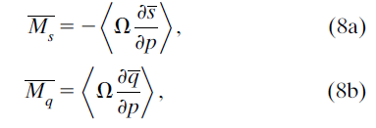
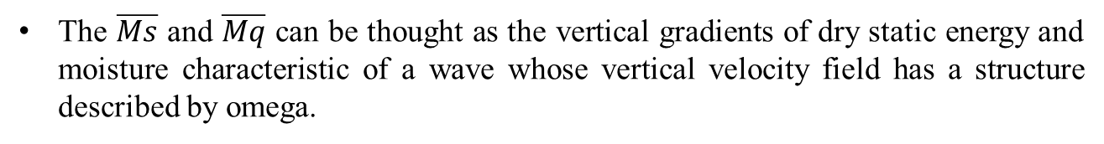
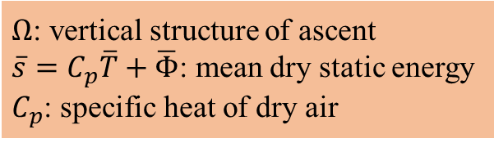
Climatological-mean gross dry stability:
Climatological-mean gross moisture stratification:
$Ω$: vertical structure of ascent
$\overline{s}=C_{p}\overline{T}+\overline{Φ}$: mean dry static energy
$C_{p}$: specific heat of dry air
The $\overline{Ms}$ and $\overline{Mq}$ can be thought as the vertical gradients of dry static energy and moisture characteristic of a wave whose vertical velocity field has a structure described by omega.
Notes:
The Ms and Mq are the climatological-mean gross dry stability and the gross moisture stratification.
The Ms and Mq can be thought as the vertical gradients of dry static energy and moisture characteristic of a wave whose vertical velocity field has a structure described by omega.

Slide 10
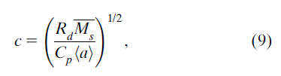
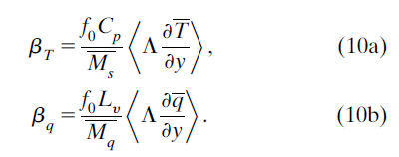
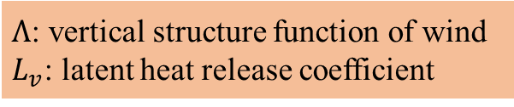
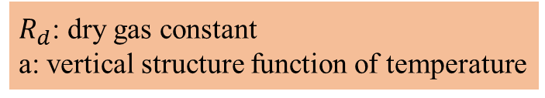
The phase speed of first baroclinic free gravity waves:
$R_{d}$: dry gas constant
a: vertical structure function of temperature
climatological-mean meridional temperature gradient,
climatological-mean meridional moisture gradient,
$Λ$: vertical structure function of wind
$L_{v}$: latent heat release coefficient
Notes:
Rd is the dry gas constant and a is the vertical structure function of temperature
The bT and bq are the climatological-mean meridional temperature and moisture gradients, respectively, scaled so that they are in the same units as

Slide 11


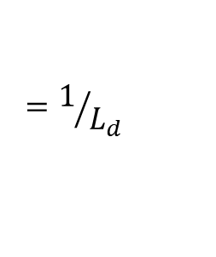
$β_{T}$ is related to the mean vertical wind shear through the thermal wind equation:
Thermal wind equation
k_{d} is the inverse of the Rossby radius of deformation L_{d}:
$$=1/{L_{d}}$$
Notes:
The betaT is defined here as a small quantity (betaT<<beta) that contributes little to the thermodynamic balance and to the momentum equations. However, it will play an important role in the dynamics of idealized SMDs.

Slide 12
Meridional advection of mean temperature
Latent heat release
Vertical DSE advection
Horizontal advection of mean moisture
Loss of moisture through precipitation
Vertical moisture advection
Notes:
The f0 is the planetary vorticity at 16N, a latitude where SMDs commonly develop.
beta is the meridional gradient of planetary vorticity at 16N.
advection of the terms in Eqs. (7a)–(7d) by the mean flow are neglected.
This is because of the weak flow required to maintain simplicity in the analysis sought here.

Slide 13




$${∂ (7a)}/{∂y}+{∂ (7b)}/{∂x}$$
Generation of vorticity by anomalous divergence
Advection of planetary vorticity
assume that the anomalous horizontal winds are approximately nondivergent:
Geostrophic balance
Notes:
The term betayD’ has been dropped since, for small variations in y, its contribution to the vorticity budget is small.
To further simplify the equations, we will assume that the anomalous horizontal winds are approximately nondivergent

Slide 15
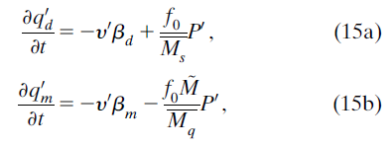



Advection of mean dry PV
PV generation from vortex stretching in deep convection
vertical moisture import exceeds the loss of moisture through precipitation
Normalized gross moist stability (NGMS):
Quasi-geostrophic potential vorticity (dry PV):
Moist potential vorticity:
Notes:
Substituting z0 and y0 in Eqs. (13) and (7d) with Eqs. (14a) and (14b) reduces our set of variables to three.
Finally, we can remove D0 from the equations by merging Eqs. (7c) and (13) and similarly Eqs. (7c) and (7d) to create two equations with two variables.
In the moist PV (moisture) budget, however, only a negative NGMS results in generation of moist PV.
When the NGMS is negative, vertical moisture import exceeds the loss of moisture through precipitation, thus allowing the moist PV anomalies to increase.

Slide 16

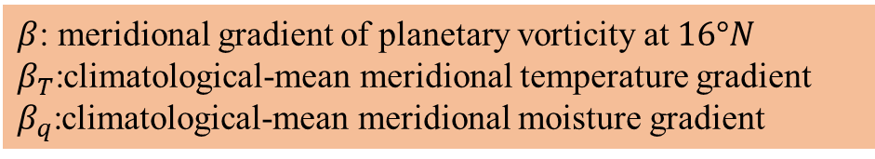
dry PV gradients:
moist PV gradients:
$β$: meridional gradient of planetary vorticity at $16°N$
$β_{T}$:climatological-mean meridional temperature gradient
$β_{q}$:climatological-mean meridional moisture gradient

Slide 17

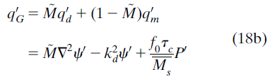

‘‘gross’’ PV:
mean gross PV gradient:
Notes:
We can merge Eqs. (15a) and (15b) to remove P’ from the rhs and obtain one equation that fully describes the idealized SMDs analyzed here.
The prefix ‘‘gross’’ implies a generalized PV field that includes vorticity generation from moist processes while also suggesting its relationship to NGMS. We use uppercase G as the subscript since lowercase g is commonly used to denote fields that are in geostrophic balance.

Slide 18
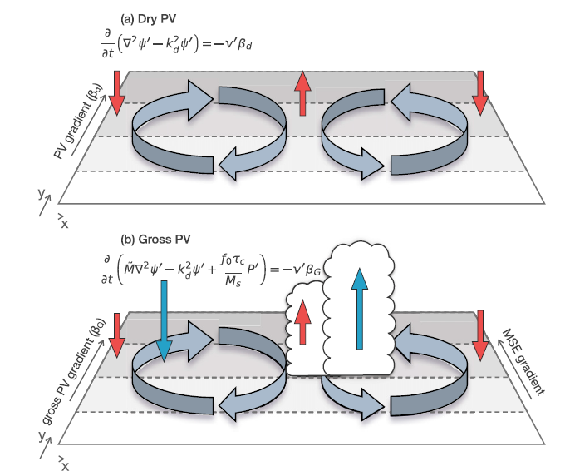
isentropic ascent/descent
Notes:
In the dry PV framework, meridional advection of mean PV by the anomalous flow induces westward propagation of the Rossby wave.
Isentropic (QG) ascent, denoted by a red arrow, occurs in phase with the northerly anomalies while descent occurs with southerly wind anomalies.
The gross PV framework in (b) is a generization of (a) that includes meridional moisture gradient and the impact of moist processes in the PV budget.
In it, horizontal moisture advection and QG ascent moisten the atmosphere.
This moistening causes deep convection to increase (blue arrow), which results in a vorticity tendency from vortex stretching.
The propagation of the wave is then from a combination of dry PV advection and vortex stretching from moist processes.

Slide 19
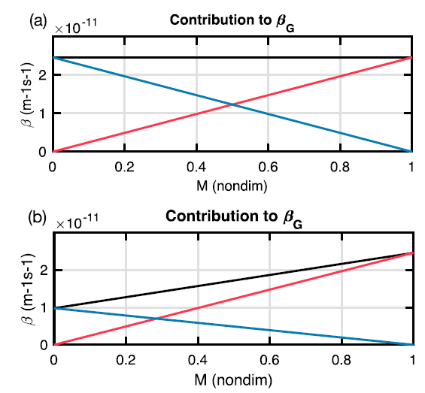





$$β_{m}=β_{d}=2.4×{10}^{−11}$$
$$β_{m}=1.0×{10}^{−11}$$
Black line: $β_{G}$
Red line: $β_{d}$
Blue line: $β_{m}$
Notes:
When the atmosphere is dry, the NGMS is approximately unity, and precipitation processes become negligible ( M ~1, P’~0, and betaG ~betad), so that
Eq. (18a) becomes the equation for dry PV.
When the atmosphere is moist ( M~0), betaG ~betam, indicating that the propagation of the anomalous circulation is governed by moist processes (bm). For values of ~M between 0 and 1, both dry and moist processes contribute to the propagation of the wave, and their relative contributions depend on the values of these two terms

Slide 20

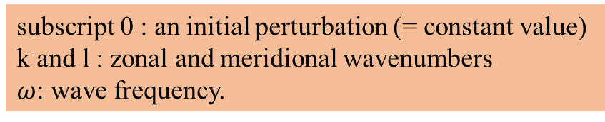

a. Dispersion relation
subscript 0 : an initial perturbation (= constant value)
k and l : zonal and meridional wavenumbers
$ω$: wave frequency.
Dispersion relation:
$K^{2}=k^{2}+l^{2}$: horizontal wavenumber
Notes:
Meridional variations in Ms and Mq can be shown to be small (see section a of the appendix) over our analysis domain, such that the value at the reference latitude (16N) can be used.
the NGMS will be treated as a constant.
The convective moisture adjustment timescale tc will be a constant corresponding to the time scale at the reference latitude. (=12 h, average value of tc in the Asian monsoon.)

Slide 21
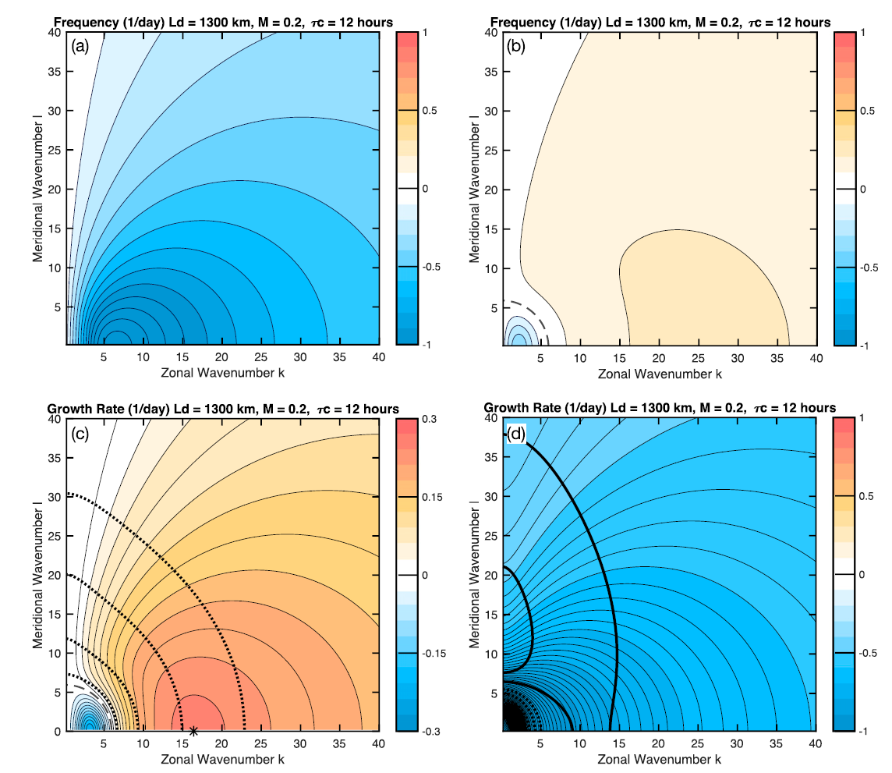

$K^{2}=k^{2}+l^{2}$: horizontal wavenumber
First mode
second mode
Growth rate for first mode
Growth rate for second mode
Dotted lines: phase speeds = -15, -10, -5, -2.5 m/s
Notes:
For l = 0, the frequency increases until zonal wavenumber 6 and steadily decreases for larger wavenumbers, reminiscinent of baroclinic Rossby waves.
These modes exhibit meridionally elongated structures with little horizontal tilt.
Damping is observed for zonal and meridional wavenumbers less than 5.
in Figs. 3b and 3d, It is a slowly propagating wave that is strongly damped for all zonal and meridional wavenumbers.
The rate of damping when averaged across all k and l in Fig. 3d is 0.6 day-1.

Slide 22



b. Approximate solution
considering the case when the imaginary component is small
Doing Taylor expansion, truncating on second term
Rearranging and expanding
Phase speed
Group velocity
Notes:
This phase speed describes a Rossby wave whose propagation is determined by betaG rather than just beta.
we can describe this phase speed as the sum of a dry component and a moist component

Slide 23
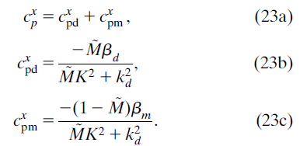
divide into a dry component and a moist component
meridional dry PV advection
meridional moisture and temperature advection inducing increased precipitation to the west of the vortex.
Notes:
we can describe this phase speed as the sum of a dry component and a moist component
The dry phase speed is the component that is due to meridional dry PV advection.
The moist phase speed is due to meridional moisture and temperature advection inducing increased precipitation to the west of the vortex.
This component does not describe PV advection but PV generation due to vortex stretching that comes as a result of increased convection.
The convection increases because of moistening from horizontal moisture advection (bq) and vertical moisture advection that results from isentropic ascent (bT).

Slide 24
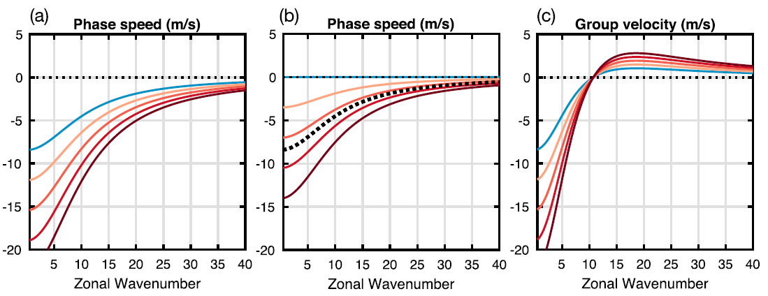
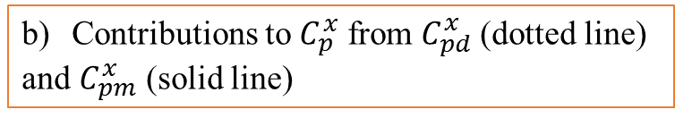
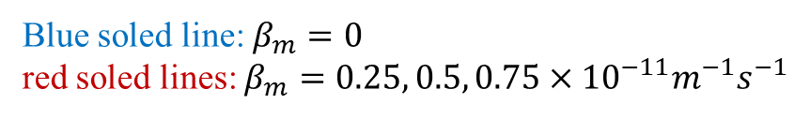
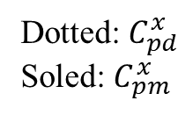
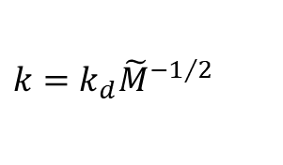
Contributions to $C_{p}^{x}$ from $C_{pd}^{x}$ (dotted line)
and $C_{pm}^{x}$ (solid line)
$$k=k_{d}{\tilde{M}}^{−1/2}$$
$l=0, L_{d}=1300km, \tilde{M}=0.2, and β_{d}=2.4×{10}^{−11}m^{−1}s^{−1}$
Blue soled line: $β_{m}=0$
red soled lines: $β_{m}=0.25, 0.5, 0.75×{10}^{−11}m^{−1}s^{−1}$
Dotted: $C_{pd}^{x}$
Soled: $C_{pm}^{x}$
Notes:
values of betam ranging from 0 to 1 X 10 -11 m-1 s-1.
This corresponds to a temperature gradient that monotonically increases from 0 to 0.5K(1000 km)-1 and a moisture gradient that increases from 0 to 8mm(1000 km)-1.
The wave exhibits westward phase propagation and a group velocity that is westward at the largest scales and eastward for smaller scales, and
it is ~0 near zonal wavenumber 10, which is when k=kd ~M -1/2.
As betam increases, the phase speed increases, and the group velocity becomes more pronounced.

Slide 25

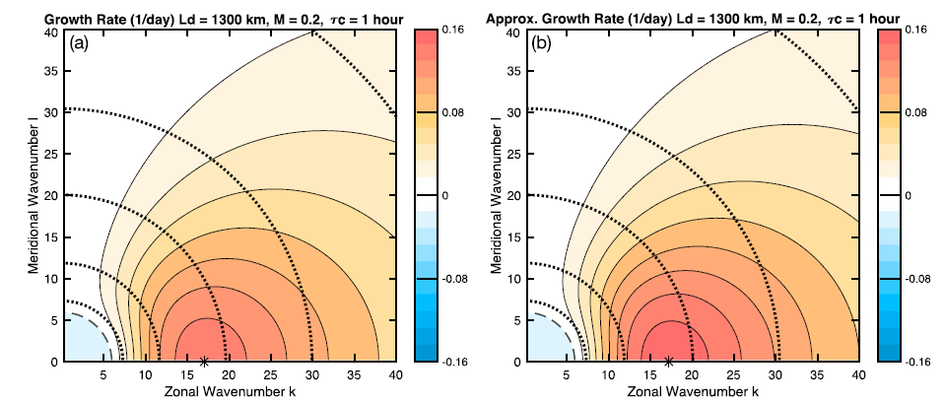
Dotted lines: phase speeds = -15, -10, -5, -2.5 m/s
Notes:
Nearly identical patterns are seen for tc =1 h.
While the solution is less accurate for larger values of tc (not shown), growth is still a maximum near zonal wavenumber ;16.

Slide 26
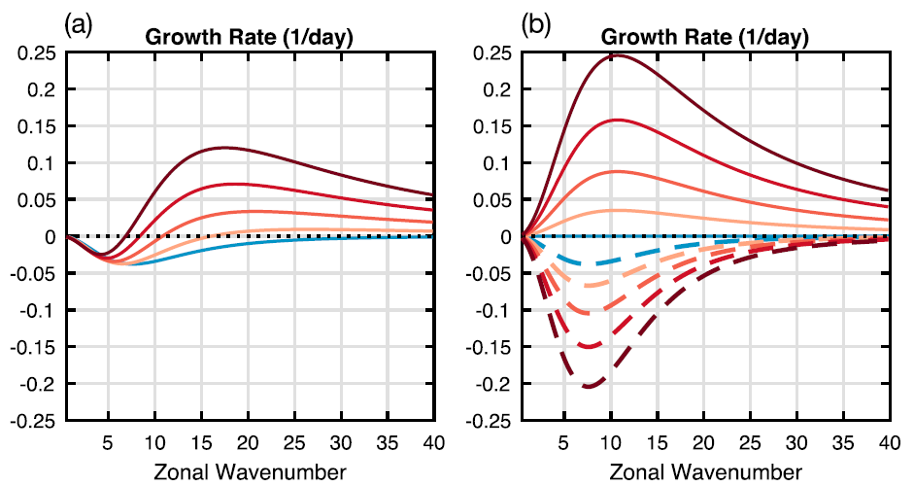
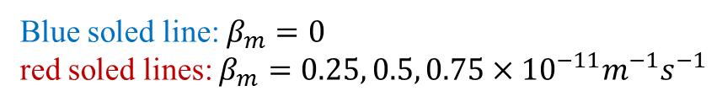
approximate growth rate
Blue soled line: $β_{m}=0$
red soled lines: $β_{m}=0.25, 0.5, 0.75×{10}^{−11}m^{−1}s^{−1}$
Notes:
When betam = 0, the wave is weakly damped from zonal wavenumbers 0–30 and approximately neutral thereafter.
For a small value of betam of 2 X 10-12m-1 s-1, the wave is unstable for zonal wavenumbers 15 and larger, and no clear scale selection is seen.
For larger values of betam, growth is largest at the synoptic scales, between zonal wavenumbers 10 and 25.

Slide 27
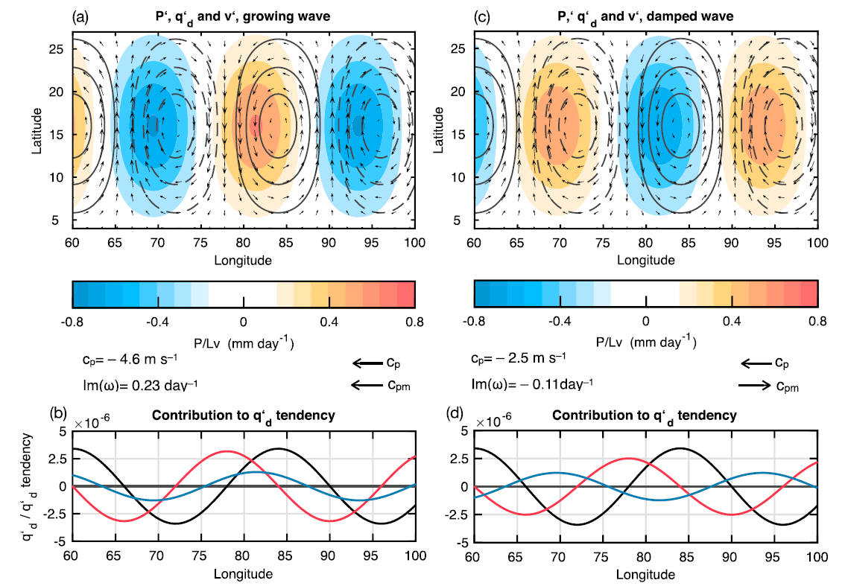
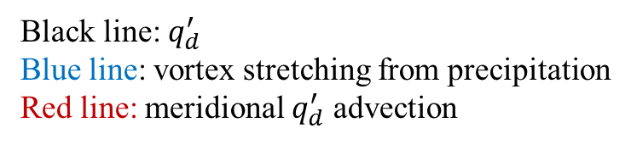


the relationship between $q_{d}^{′}$and $P^{′}$ (growing wave)
Shaded: $P^{′}$
Contours:$q_{d}^{′}$
Black line: $q_{d}^{′}$
Blue line: vortex stretching from precipitation
Red line: meridional $q_{d}^{′}$ advection
Notes:
In the growing wave, cxp and cxpm are both westward, implying that both betaG and betam increase with latitude.
in Fig. 7b, both vortex stretching from convection and meridional dry PV advection are a maximum to the west of the q’d maximum, which results
in westward propagation.
A salient feature of the growing wave solution is the phasing between P’ and q’d.

Slide 28
the relationship between $q_{d}^{′}$and $P^{′}$ (damped wave)
Shaded: $P^{′}$
Contours:$q_{d}^{′}$
Black line: $q_{d}^{′}$
Blue line: vortex stretching from precipitation
Red line: meridional $q_{d}^{′}$ advection
Notes:
Anomalous southerly flow now induces moistening, and precipitation is a maximum to the east of the moistening
This results in a P’ that is slightly in phase with the anticyclonic anomalies.
Because precipitation generates a cyclonic tendency, it follows that it will damp the anticyclonic anomalies

Slide 29







phase angle between $P^{′}$ and $ψ^{′}$
the polarization relation between $P^{′}$ and $ψ^{′}$
the phase angle between $P^{′}$ and $ψ^{′}$
When $ω_{r}≫ω_{i}$,
Notes:
A simpler relationship is obtained when we consider the case when the real component of the dispersion relationship is much larger than its imaginary part ($ω_{r}≫ω_{i}$)

Slide 30
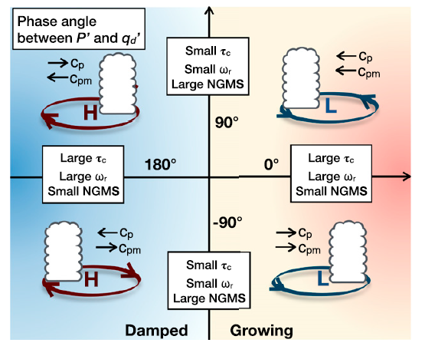

$$P^{′}=\frac{\left\langle q^{′}\right\rangle }{τ_{c}}$$
Notes:
As the vortex propagates westward, the phasing between P’ and psi’ depends on the duration of P‘ and the speed in which the circulation anomalies propagate.
The P’ is highly sensitive to <q’> when tc is small (~1 h) and responds quickly to moistening.
Thus, small values of tc yield a P’ response that is closely in phase with moistening, namely, horizontal advection of moist PV.
When tc is long, the sensitivity is lower, and precipitation increases slowly, resulting in a shift toward the vortex center.
The magnitude of the shifting also depends on the wave frequency since faster propagation will result in the wave propagating toward the
region of precipitation more quickly.
When the NGMS is larger, moisture is removed quickly in a precipitating column, limiting the duration of precipitation.
When the NGMS is small, moisture is removed slowly, allowing for longer duration of precipitation.
Longer-lasting precipitation results in a larger shift toward the center of low pressure.
V = L x f

Slide 31
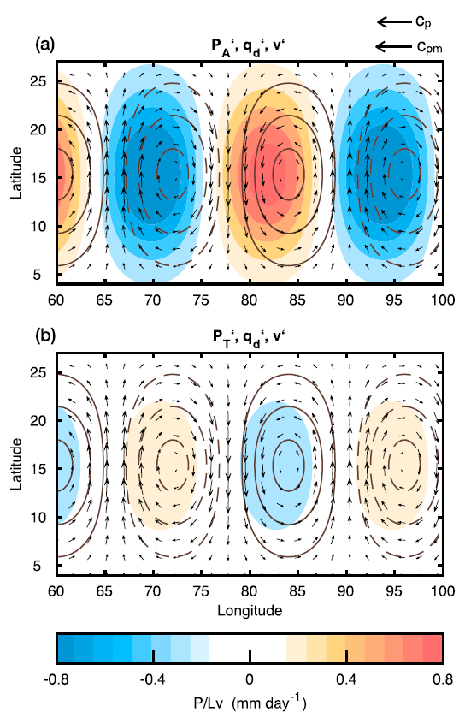

$$P^{′}=P_{A}^{′}+P_{T}^{′}$$
Advection of moist PV by the anomalous winds $P_{A}^{′}$
Temperature tendency (thermal contribution) $P_{T}^{′}: k_{d}ψ^{′}$
Notes:
Figure 9 shows the P anomalies from Fig. 7 decomposed into P’A and P’T.
It is clear that P’A is the leading order term.
It is associated with moistening to the west of the q’d maximum.
The PT’ is smaller and of the opposite sign to P’A.
This can be interpreted as adiabatic compression to the west of the q’d maximum reducing tropospheric moistening.

Slide 32
Contribution to the growth rate from $P_{A}^{′}$ (solid line) and $P_{T}^{′}$ (dashed line)
Notes:
This separation of P’ into P’A and P’T allows us to further interpret the approximate growth rate in Eq. (24).
When cxp and cxpm are in the same direction, P’A favors growth at all zonal wavenumbers and is a peak near zonal wavenumber 10.
The P’T, on the other hand, induces damping at all zonal wavenumbers and is a maximum near zonal wavenumber 7.
When both terms are considered, the largest scales are damped and the maximum growth occurs at the synoptic scale.

Slide 33
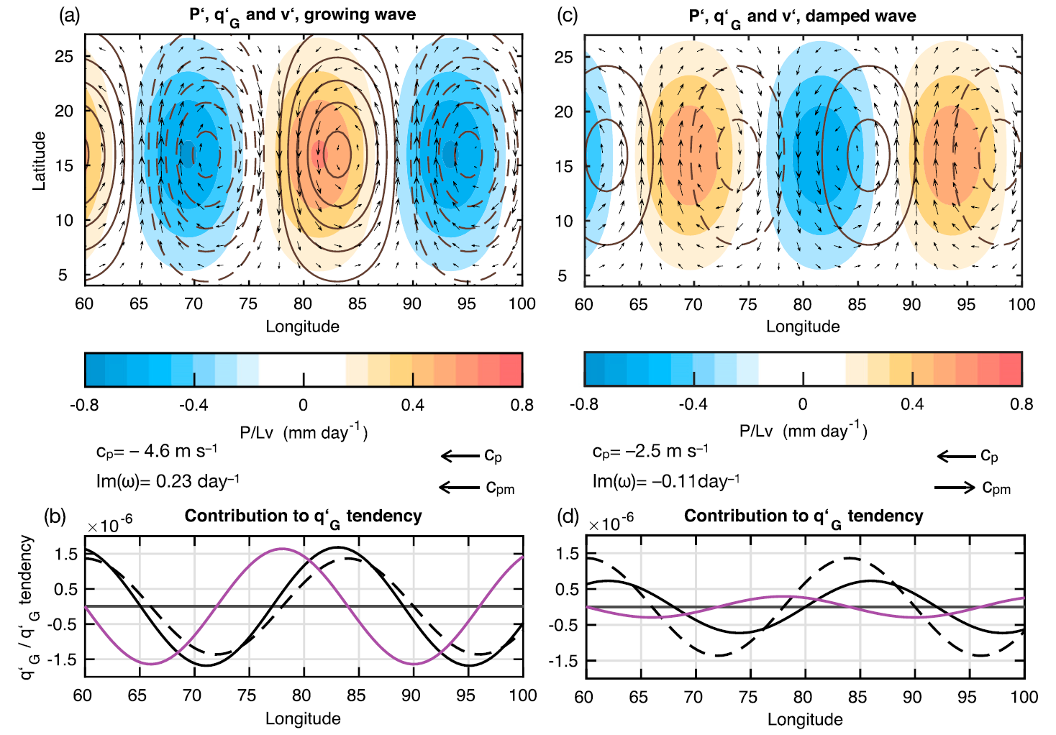

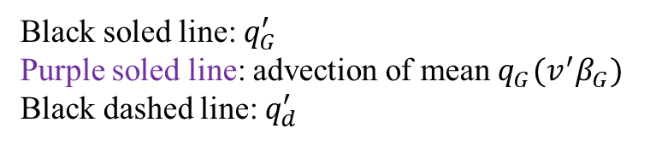
Shaded: precipitation
Contours:$q_{G}^{′}$
Black soled line: $q_{G}^{′}$
Purple soled line: advection of mean $q_{G}(v^{′}β_{G})$
Black dashed line: $q_{d}^{′}$
Notes:
In the growing mode, q’G is ~40% as large as q’d and is shifted slightly to the east.
This eastward shift implies that a small component of q’G is in phase with the advection of betaG, implying that the wave is growing.
In the damped mode (Fig. 10c), q’G exhibits a smaller amplitude than the growing mode and is shifted to the east of q’d.
Advection of q’G (betaG) is a maximum to the west of the q’G maximum, indicating westward propagation.
An out-of-phase component is also clearly evident, suggesting that q’G is damped.
Thus, using q’G offers a simple summary of the propagation and growth of these waves.

Slide 34

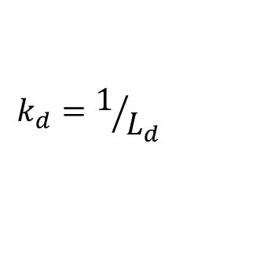

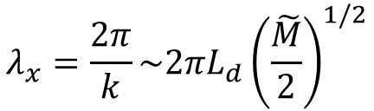
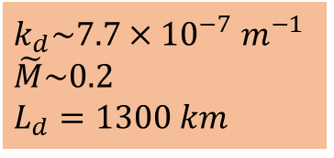

Considering the case that the propagation of the SMD is largely governed by moist processes
the zonal wavenumber $k_{max}$ satisfies ${∂Im(ω)}/{∂k}$
the scale of the wave:
which is similar to the observed wavelength of SMDs.
$k_{d}\sim 7.7×{10}^{−7} m^{−1}$
$\tilde{M}\sim 0.2$
$L_{d}=1300 km$
$$k_{d}=1/{L_{d}}$$
$$λ_{x}=\frac{2π}{k}\sim 2πL_{d}{\left(\frac{\tilde{M}}{2}\right)}^{1/2}$$
$$\sim 2600 km$$
Notes:
the propagation of the SMD is largely governed by moist processes

Slide 35
Summary
The instability occurs only if the wave’s dry and moist phase speeds are in the same direction.
The dry phase speed includes dry processes such as advection of planetary vorticity by the anomalous winds and vortex stretching from dry isentropic ascent.
The moist phase speed only includes propagation that is induced by vortex stretching from deep convection.
This subsequent convection occurs in phase with the cyclonic anomalies, intensifying them through vortex stretching.

Slide 36
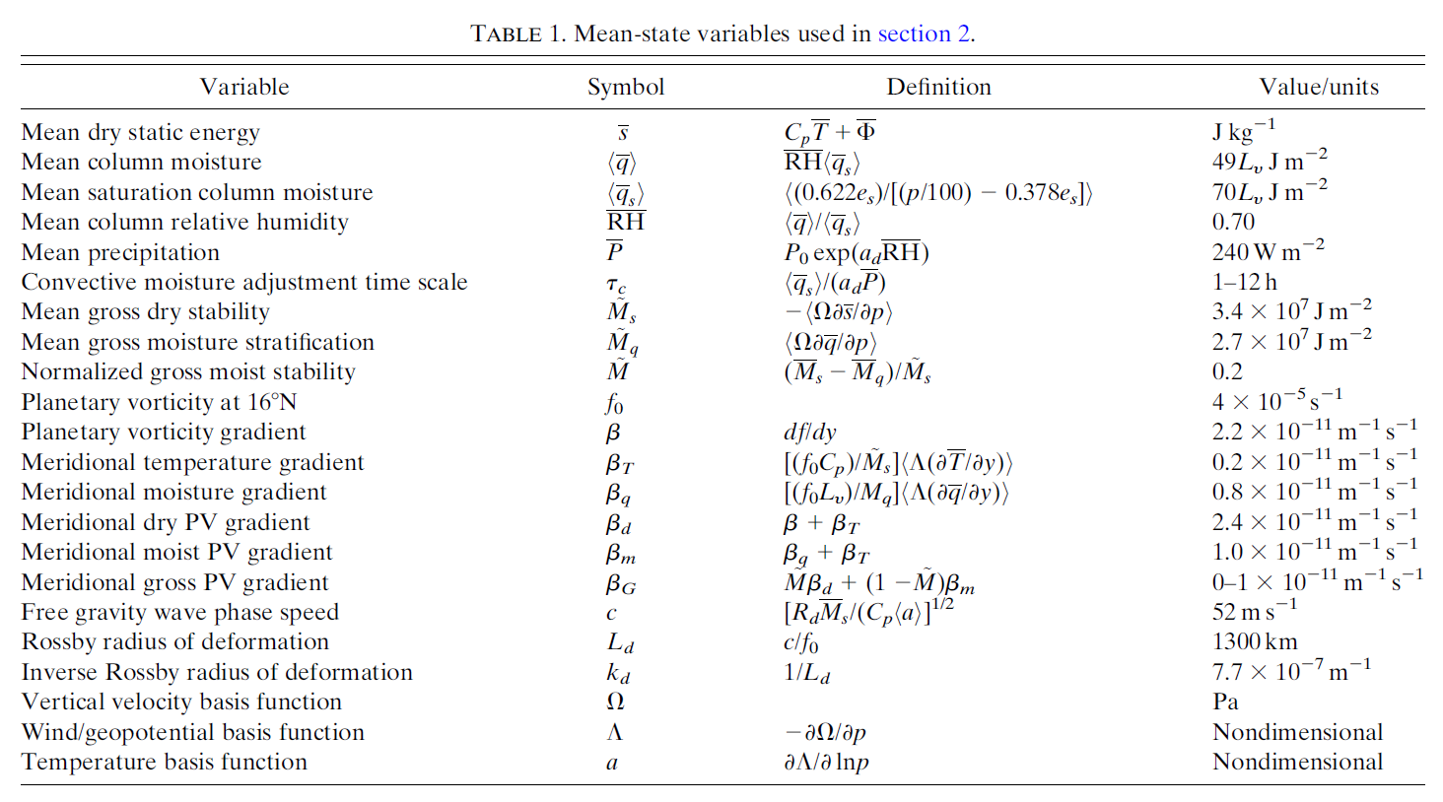

Slide 37
abstract
South Asian monsoon low pressure systems, referred to as synoptic-scale monsoonal disturbances (SMDs), are convectively coupled cyclonic disturbances that are responsible for up to half of the total monsoon rainfall.
Interactions between moisture and potential vorticity (PV) in the presence of a moist static energy gradient can be understood in terms of a ‘‘gross’’ PV (qG) equation.
Linear solutions to the coupled PV and moisture equations reveal Rossby-like modes that grow because of a moisture vortex instability.
Meridional temperature and moisture advection to the west of the PV maximum moisten and destabilize the column, which results in enhanced convection and SMD intensification through vortex stretching.
This instability occurs only if the moistening is in the direction of propagation of the SMD and is strongest at the synoptic scale.

Slide 38
By incorporating prognostic equation for column moisture, a wave instability arises that may describe the growth of SMDs.
This instability involves a coupling between lower-tropospheric vorticity and column moisture.
Warm-air and moisture advection by the anomalous winds moisten the free troposphere ahead of the cyclone, creating an environment favorable for deep convection.
The subsequent convection intensifies the SMD through vortex stretching. g a prognostic equation for

