Slide 1
The study of inland eyewall reconstruction of Typhoon Fanapi (2010) using numerical experiments and vorticity budget analyses.
2018.09.18
Yang, M.-J., Y.-C. Wu, and Y.-C. Liou, 2018: The study of inland eyewall reconstruction of Typhoon Fanapi (2010) using numerical experiments and vorticity budget analyses. J. Geophys. Res. Atmos., 123, doi: 10.1029/2018JD028281.

Slide 2
Introduction
Numerical studies indicate that VHTs play an important role in an upscale transport process in which convective-scale vorticity anomalies can act collectively to convert a tropical disturbance into a TC. (Hendricks et al., 2004; Montgomery et al., 2006)
Using the airborne Doppler radar data, Houze Jr. et al.(2009) documented that for the tropical depression leading to the genesis of Hurricane Ophelia (2005), the VHTs were typically 10-km wide and 17-km deep with updrafts of 10–20 m/s throughout the middle to upper troposphere.
Liou et al. (2016) documented observational changes in the eyewall of Typhoon Fanapi (2010) after the landfall on Taiwan. The signatures of VHTs within the reintensified eyewall were also shown in their radar data analysis.
How Typhoon Fanapi (2010) reformed its eyewall structure after crossing the Taiwan terrain?

Slide 3
Model description
WRF v3.3.1
0000UTC 18 Sep 2010 – 0000UTC 20 Sep 2010 (48hr)
dx (9, 3, 1 km), 55 levels
IC/BC: ECMWF/TOGA (6hrs/1.125º)
CTL
NTR
NLH (turned off at 0000UTC 19 Sep 2010)

Slide 4
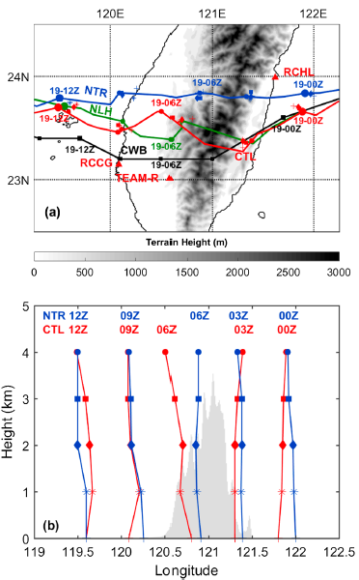
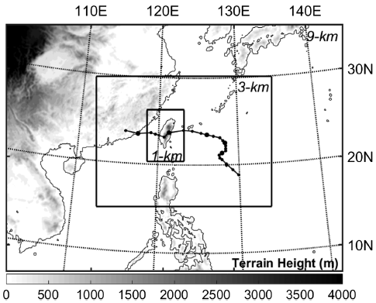

Slide 5
Model verification

Slide 6
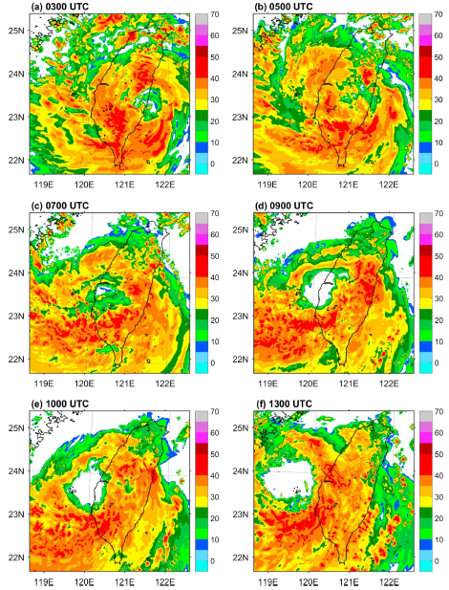
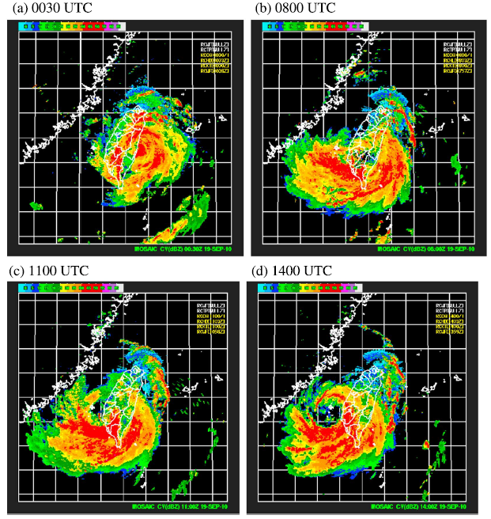

Slide 7
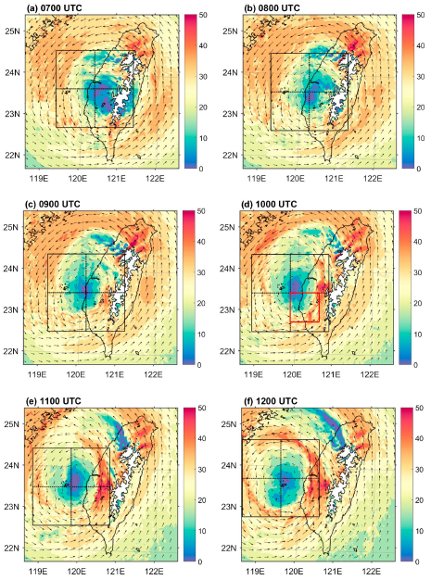
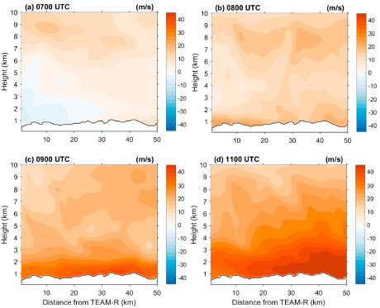
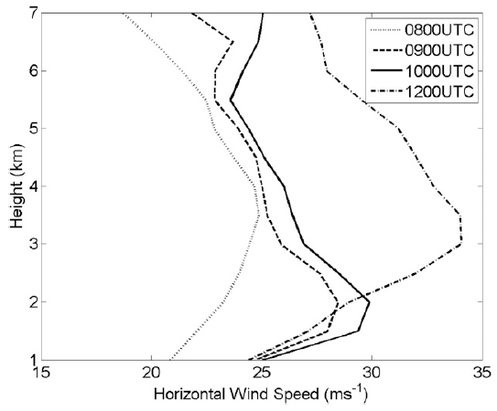
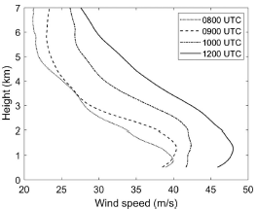
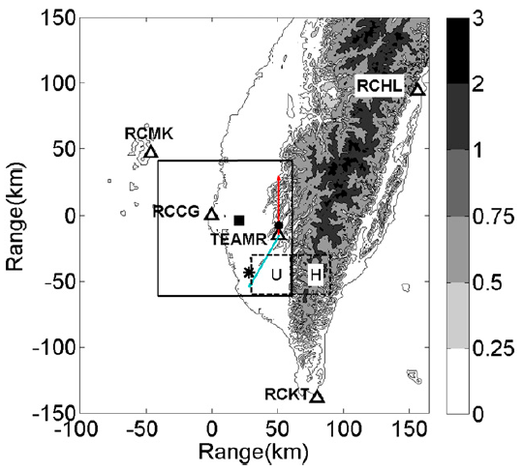
Liou et al. 2016

Slide 8
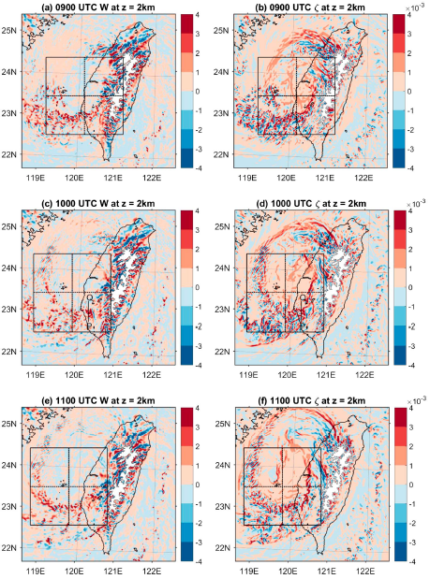
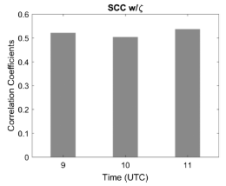
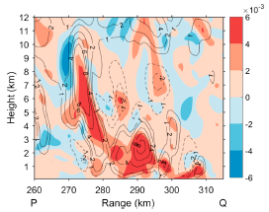
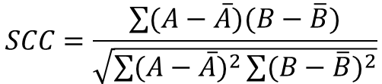
$$SCC=\frac{\sum{(A−\overline{A})(B−\overline{B})}}{\sqrt{\sum{{(A−\overline{A})}^{2}}\sum{{(B−\overline{B})}^{2}}}}$$

Slide 9
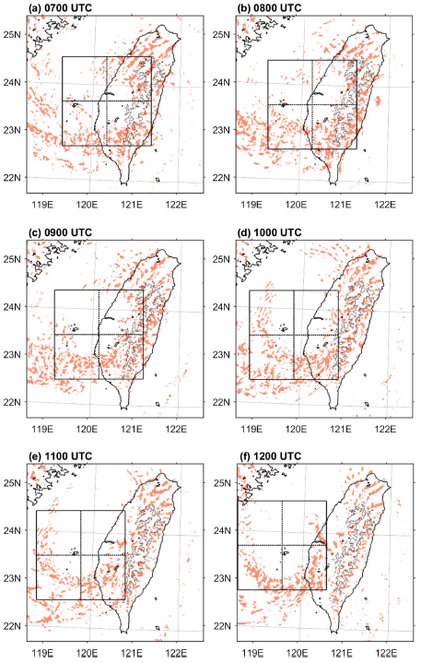
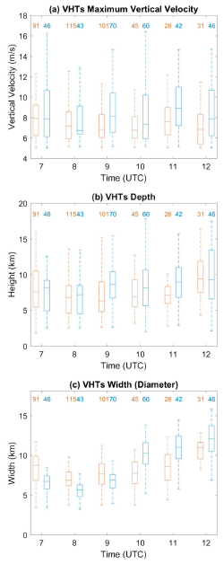

Slide 10
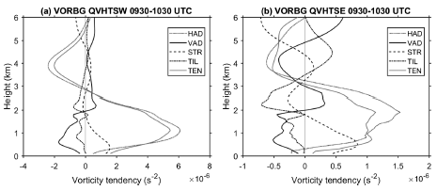
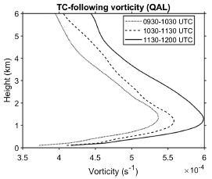
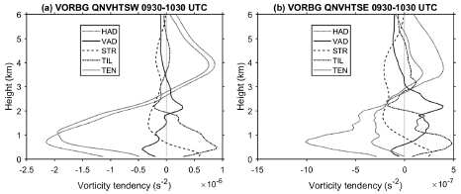
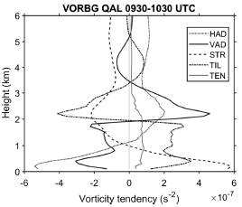
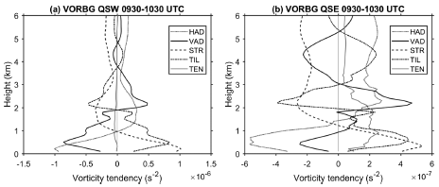
Vorticity budget analysis

Slide 11
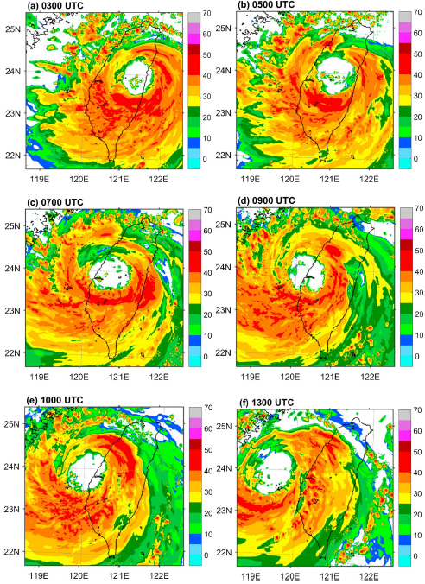
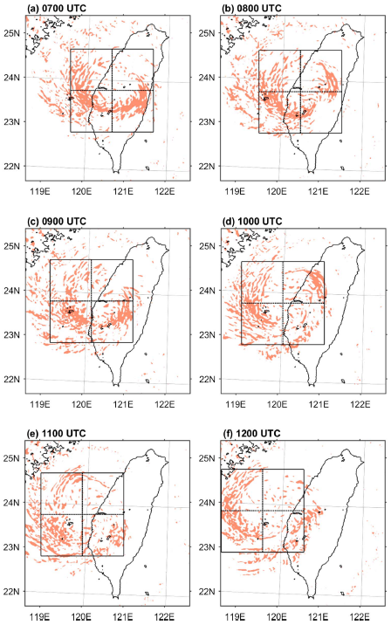
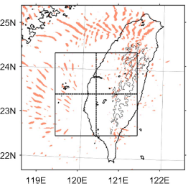
NLH 0700 UTC

Slide 12
Conclusions
A statistical comparison of the median value indicates that the VHTs over land have weaker maximum updrafts (7.0–8.0 m/s), narrower diameter (7.5–11.5 km), and shallower depth (6.5–9.0 km), compared with the stronger maximum updrafts (7.5–9.0 m/s), wider (10.0–12.0 km), and deeper (7.5–9.0 km) VHTs over the Taiwan Strait.
At low levels (z < 3 km), the HAD process transports positive (cyclonic) vorticity into the VHTs in association with deep convective cores, resulting in negative (anticyclonic) vorticity TEN in the remaining regions with moderate and weak convection.
These organized VHTs in the southeast quadrant of TC Fanapi help transport cyclonic vorticity into middle levels and then cooperate with the rich vorticity within the rainband by HAD to rebuild the Fanapi eyewall. Without the latent heat release, the VHTs quickly decay and radiate outward from the eyewall as gravity-wave perturbations.
The net positive vorticity TEN for the TC circulation at low-to-middle levels at 1000 UTC is consistent with the increase of cyclonic vorticity from lower to middle levels, supporting the bottom-up reformation of TC vortex circulation and eyewall structure after 1000 UTC.

