Slide 1
Comparison of observed and simulated spatial patterns of ice microphysical processes in tropical oceanic mesoscale convective systems
Barnes, H. C., and R. A. Houze Jr. (2016), Comparison of observed and simulated spatial patterns of ice microphysical processes in tropical oceanic mesoscale convective systems, J. Geophys. Res. Atmos., 121, 8269–8296, doi: 10.1002/2016JD025074.
Wei-Jen Tseng
2018-06-19

Slide 2
Outlines
Methodology
Microphysical Interpretation of PID Algorithm
Classification of Microphysical Processes in WRF
Data Assimilation Simulations
Model Spatial Compositing Technique
Radar Observations of MCS
Kinematic Structure of Simulated MCS
Microphysical Comparison
Deposition / aggregation / riming / melting
Impact of Microphysical Differences

Slide 3
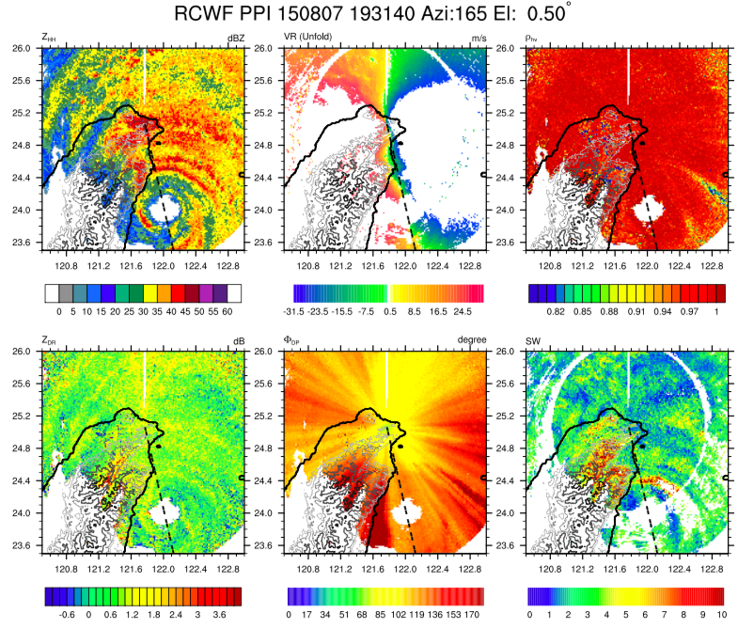
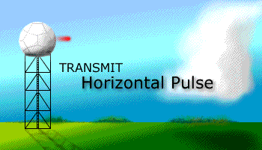
Radar: Dual Polarization
https://www.weather.gov/bmx/radar_dualpol

Slide 4
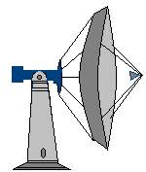
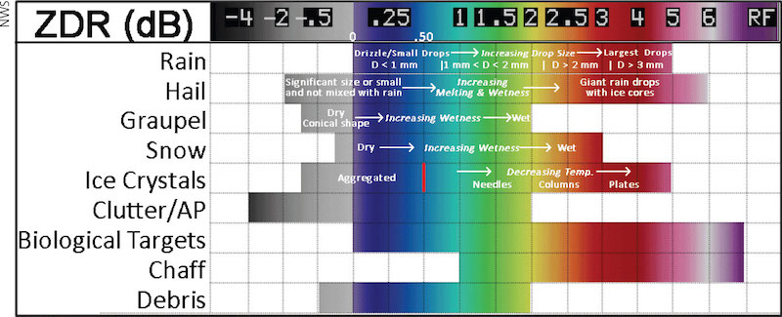
Radar: differential reflectivity (Z_{DR})
V
$$Z_{DR}=10\log_{10}{\frac{Z_{HH}}{Z_{VV}} } [dB]$$
H
Courtesy of 呂崇華
https://www.lakeeriewx.com/Reference/Radar/Radar.html

Slide 5
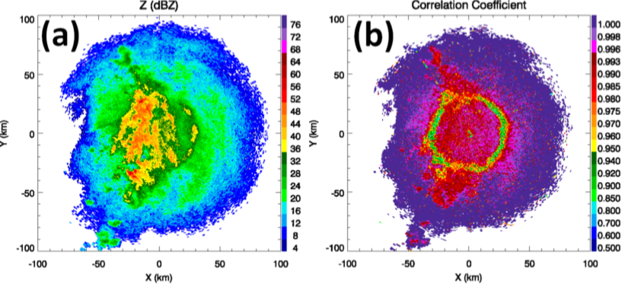
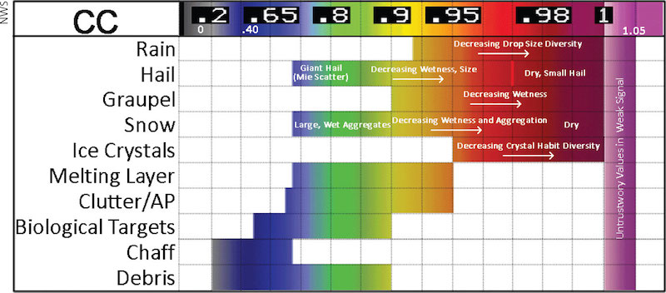
Radar: cross correlation (ρ_{hv})
correlation between the reflected horizontal and vertical power returns. It is a good indicator of regions where there is a mixture of precipitation types, such as rain and snow or rain and hail, and non-meteorological targets.
Kumjian (2013)
https://www.lakeeriewx.com/Reference/Radar/Radar.html

Slide 6
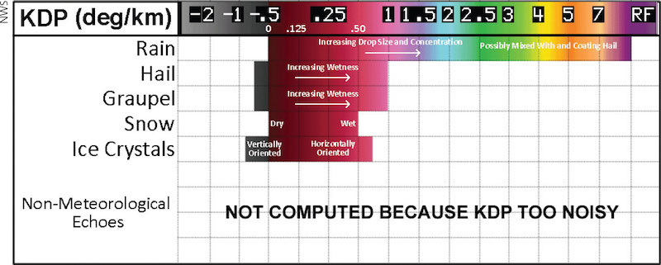
Radar: Specific differential phase shift
Φ_{DP}:A comparison of the returned phase difference between the horizontal and vertical pulses. This phase difference is caused by the difference in the number of wave cycles (or wavelengths) along the propagation path for horizontal and vertically polarized waves. It is a good indicator of precipitation type and intensity.
https://www.lakeeriewx.com/Reference/Radar/Radar.html

Slide 7
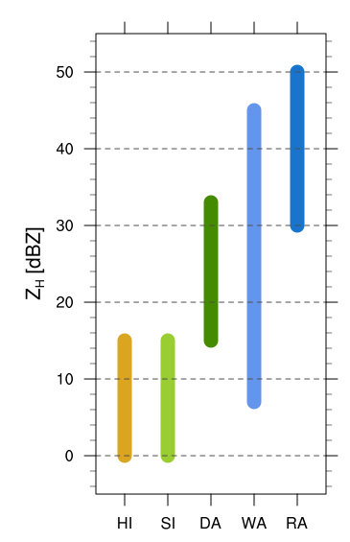
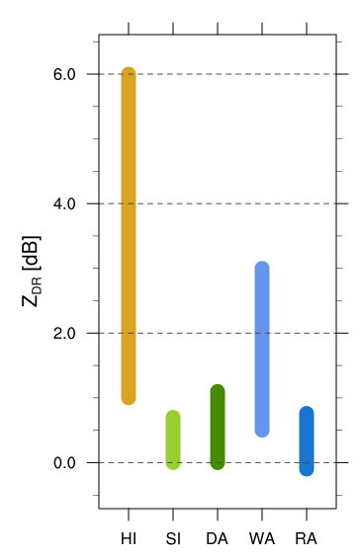
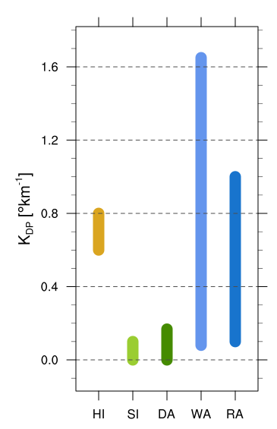
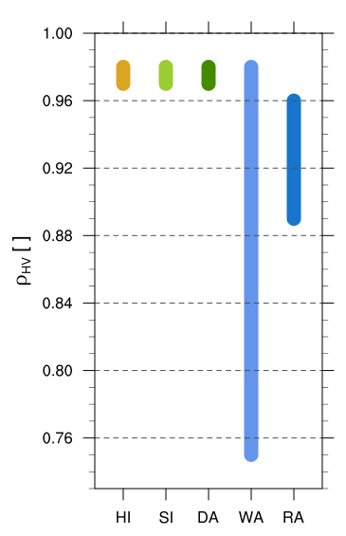
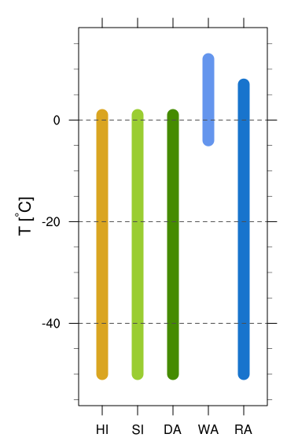
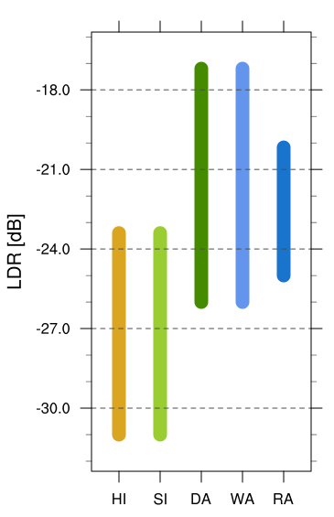
Polarimetric values used in PID
Table 1: approx. values used in NCAR S-PolKa PID during DYNAMO/AMIE
HI: deposition Horizontally oriented ice crystal
SI: deposition Small ice crystals
DA: aggregation + deposition Dry aggregates
WA: aggregation + melting Wet aggregates
RA: riming + deposition Graupel / rimed aggregates

Slide 8
Definition of microphysical processes
Deposition:
Frozen hydrometeor + water vapor
Aggregation:
Frozen hydrometeor + frozen hydrometeor
Riming:
Frozen hydrometeor + liquid hydrometeor
Melting:
Frozen hydrometeor → liquid hydrometeor

Slide 9
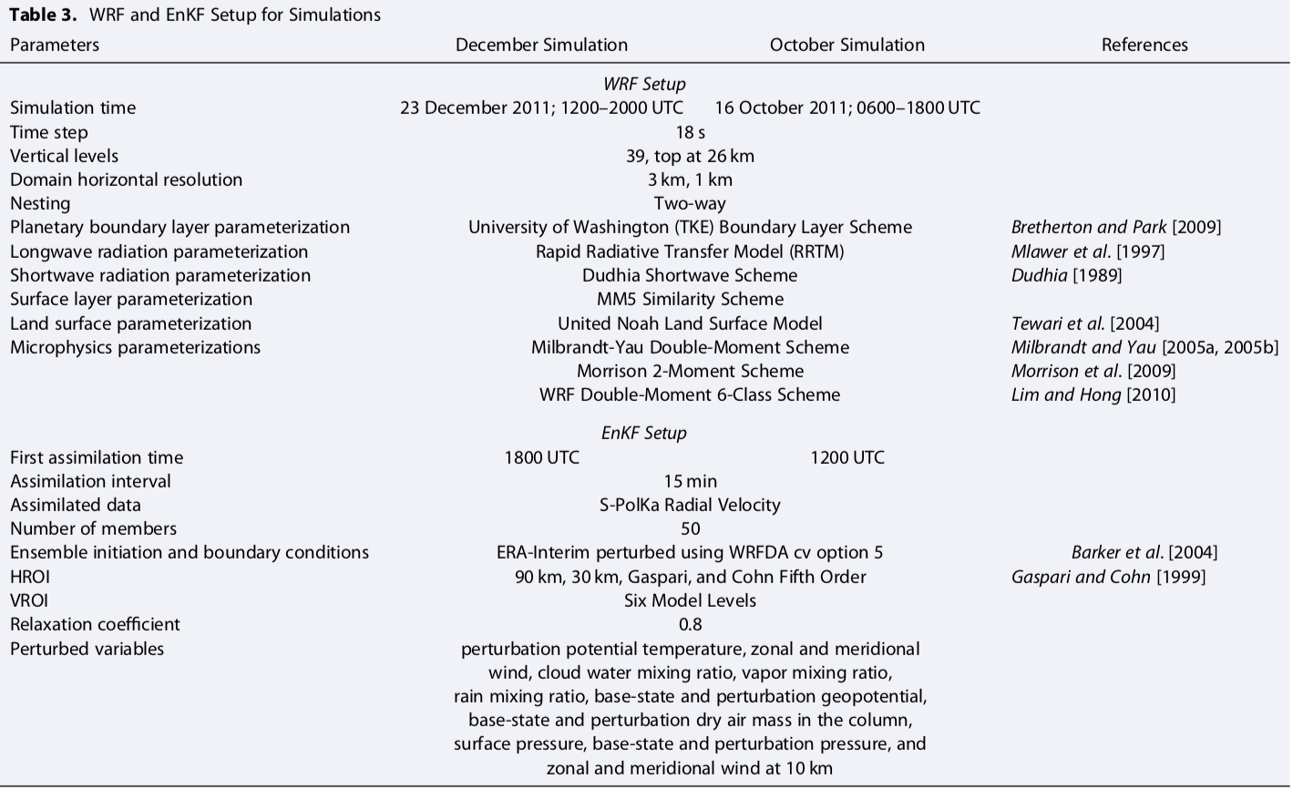
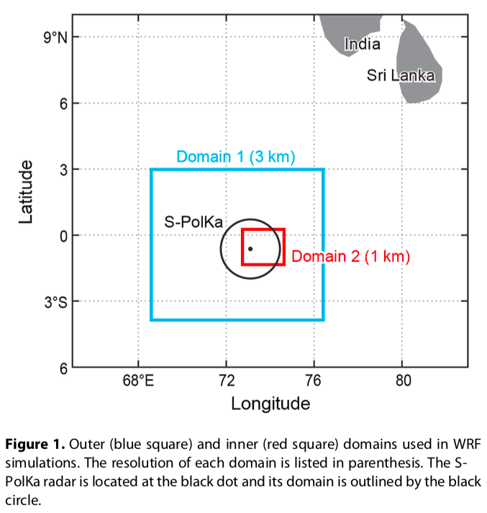
WRF and EnKF Setup
QC ( low SNR / clutter / high SW / NCAR EOL package)
Data thinned: 150m → 1 km

Slide 10
Microphysics scheme
Scheme Name | Mass Variables | Number Variables
Milbrandt | Qc Qr Qi Qs Qg Qh | Nn Nc Nr Ni Ns Ng Nh
Morrison | Qc Qr Qi Qs Qg Qh | Nn Nc Nr Ni Ns Ng Nh
WDM6 | Qc Qr Qi Qs Qg Qh | Nn Nc Nr Ni Ns Ng Nh

Slide 11
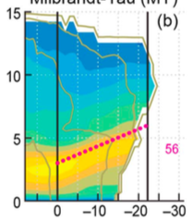
How to find inflows and its core? (1/3)
剖面資料垂直內插
非等間距eta→等間距高度
凸顯對流
忽略「回波過弱」的column (<5dBZ above 5km AGL)
移除對流核心
忽略「回波過強」的column，門檻視個案不同。
Z >30dBZ above 8km AGL & w>2m/s at any level [23Dec]
Z >30dBZ above 6km AGL & w>2m/s at any level [16Oct]
辨識「potential midlevel inflow (PMI)」
找水平風速較強的地區(PMI)，門檻視個案不同。
>18 m/s [23Dec], >9 m/s [16Oct]

Slide 12
How to find inflows and its core? (2/3)
找「最強風速(s)」位置
於模式各層資料中，在「PMI」中找最強風速點
確保PMI為「線性」
利用各層最強風速位置，擬合出「線性」PMI。
移除相關係數低於0.9的剖面資料(最強風速點vs線性入流)。
確保中層入流「不會過於陡峭」
確保用於分析的個案，其中層入流都是由左至右降至低處。
只保留斜率介於 -15 與 0之間的剖面資料。
找「base of the core of midlevel inflow」
定義：maximum points with the lowest altitude
可以稱為「convective end of the midlevel inflow core」
移除該點右方的「所有資料」

Slide 13
How to find inflows and its core? (3/3)
確保 core of the midlevel inflow的一致性
任一最強風速的網格點，其相鄰並在經度上相距0.1度以上時，只保留這一系列最右方之最強風速之網格點。
備註：0.1度為人為定義，此長度只影響使用到的剖面個案數目、並不影響分析結果。
找「top of the core of midlevel inflow」
剖面資料中，找最強風速網格點[最高層&水平方向最左側]。
可以稱為「anvil end of midlevel inflow core」。
確保「中層入流」在空間上足夠顯著
排除「anvil/convective end of midlevel inflow core」在經度上小於0.2度*的剖面資料。[*人為定義且不影響結果]
Only 1 coherent storm within inflow core
排除以下剖面：任一高度上水平方向連續五個網格點模擬回波<5 dBZ、垂直方向出現回波空洞(<5dBZ)

Slide 14
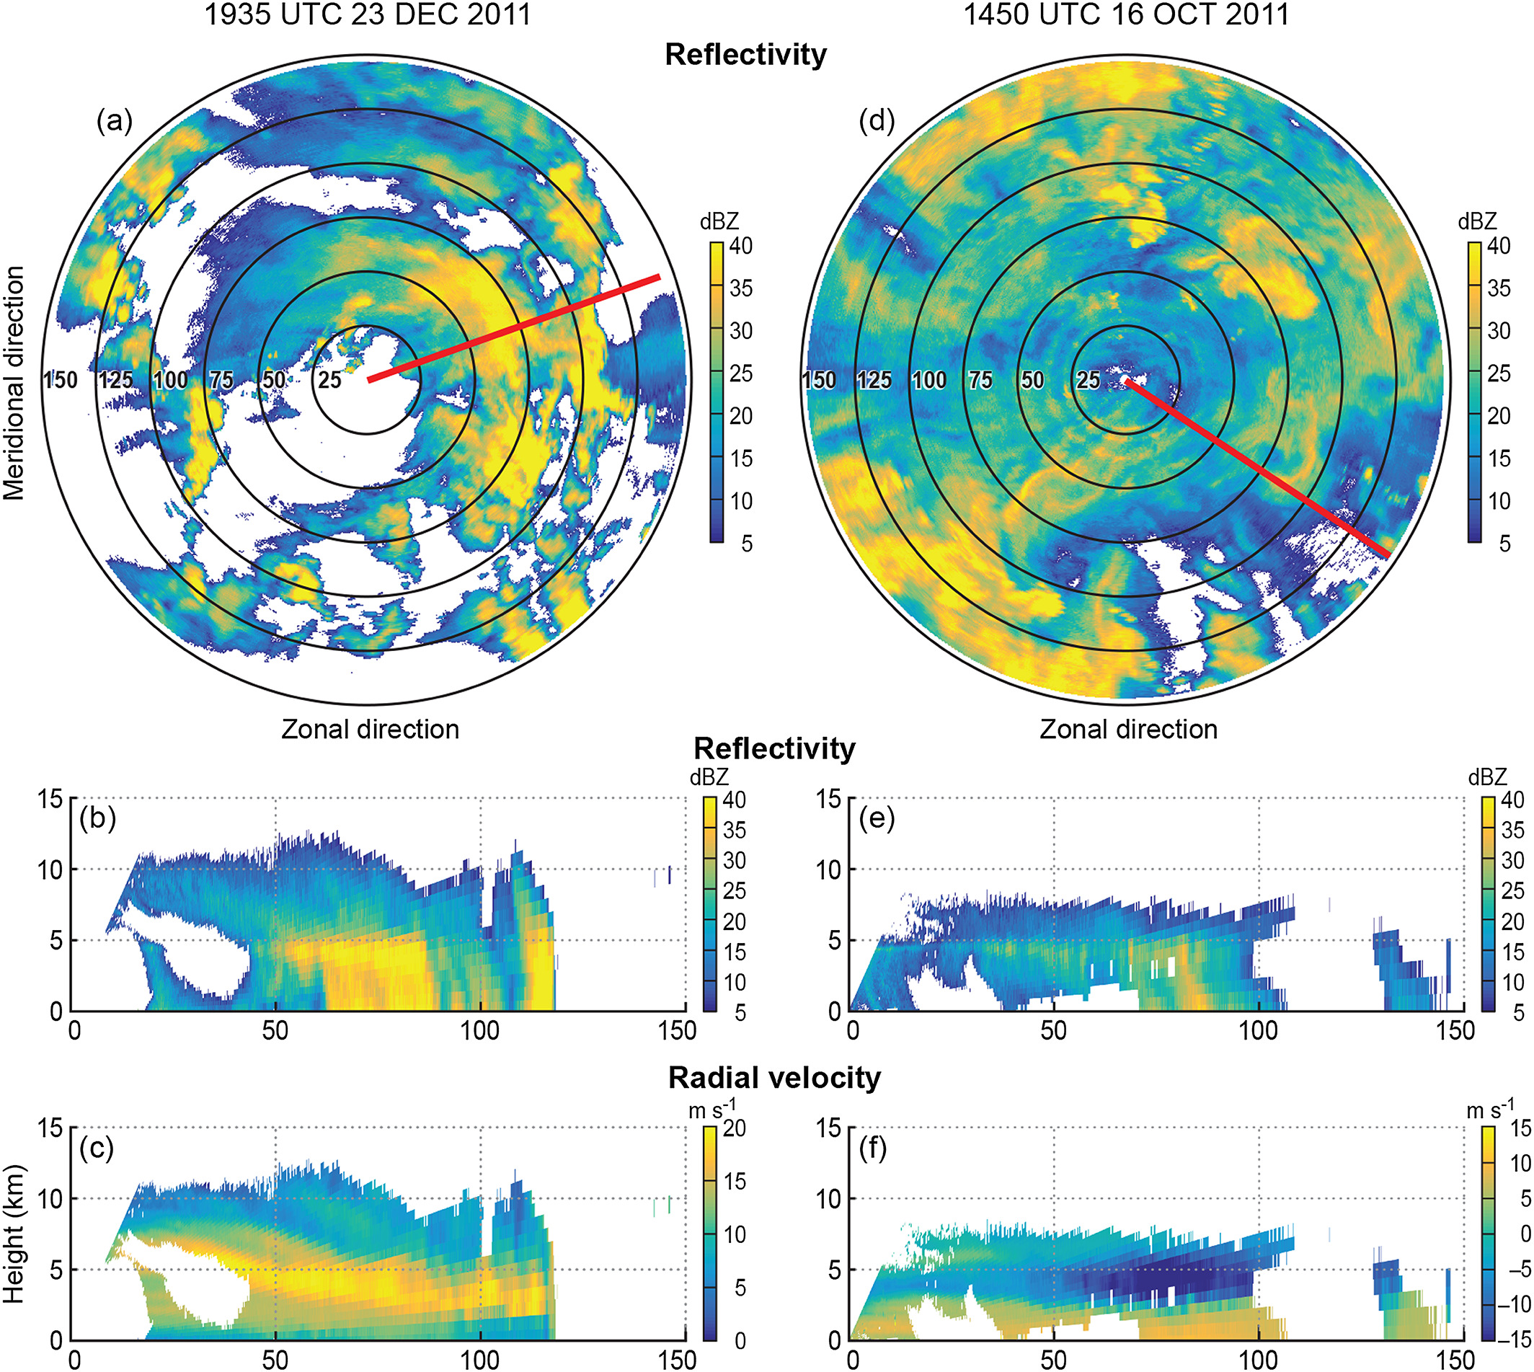
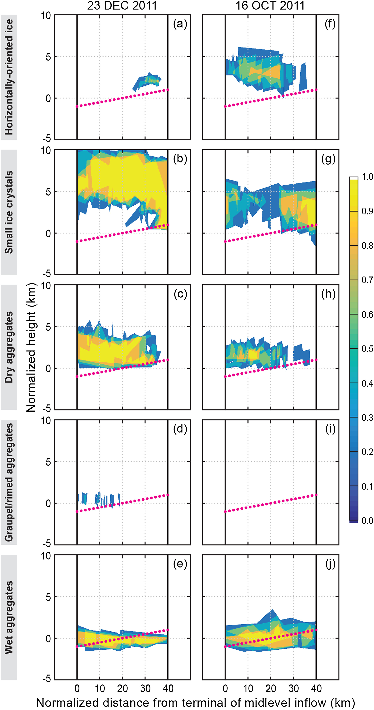
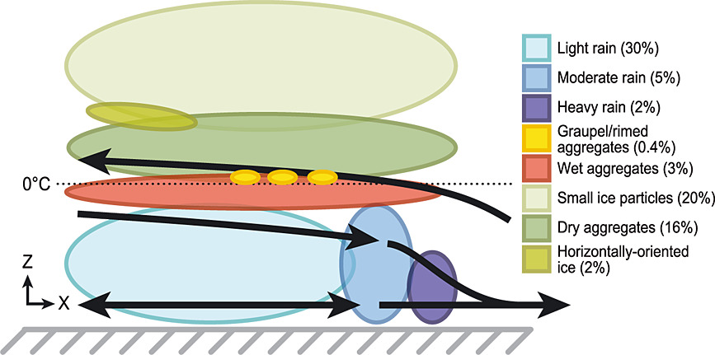
Radar observation & PID
Barnes and Houze (2014)

Slide 15
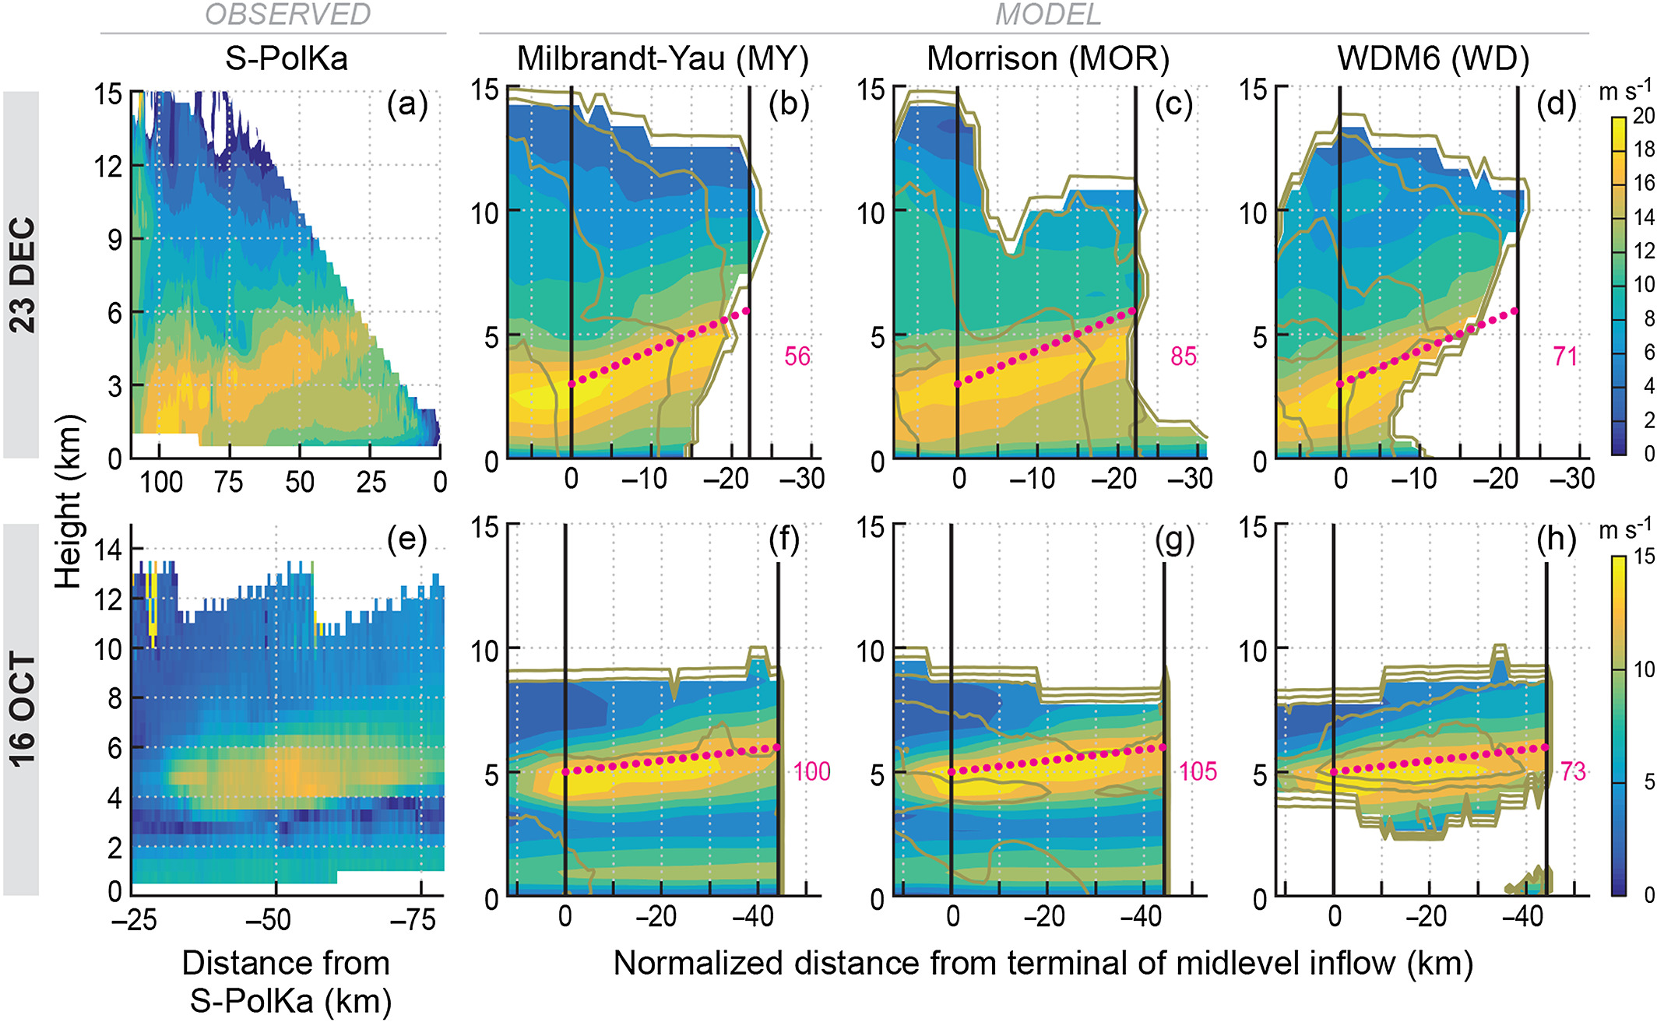
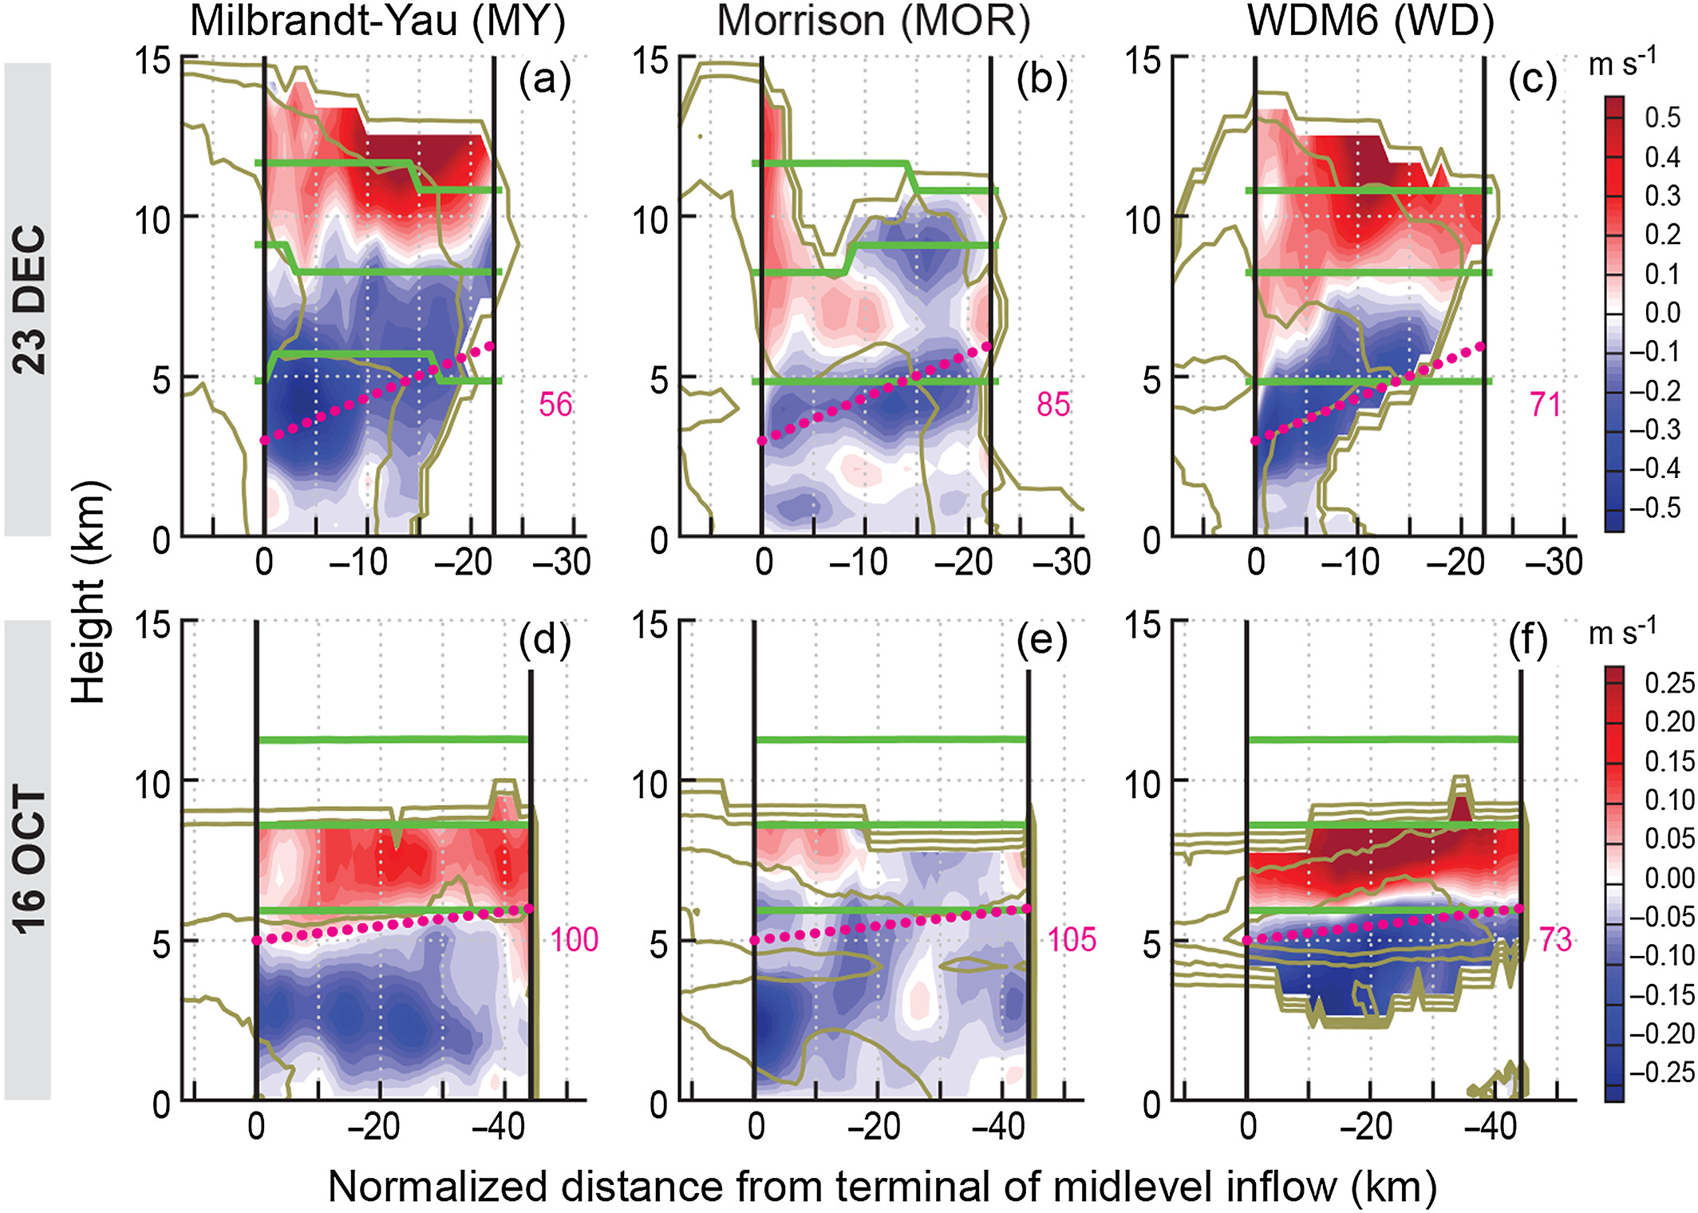
Kinematic structure of
simulated MCS
↖
radial velocity (shading)
←
Vertical velocity (shading)
Temperature (green line)
0 / -20 / -40

Slide 16
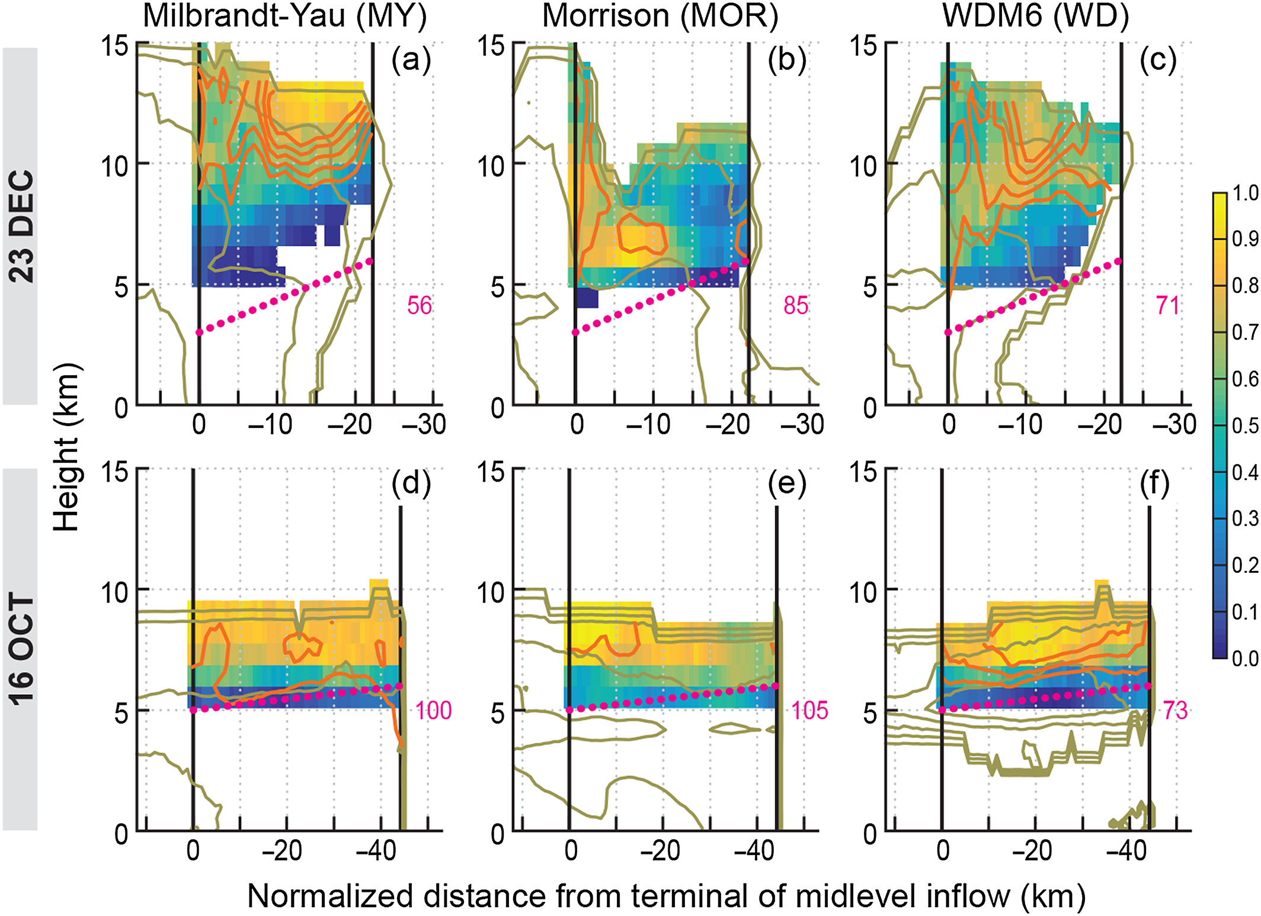
Comparison: deposition
Frozen hydrometeor + water vapor
↖
Shading=
Deposition freq.
Orange line =
Upward motion
← ←
Shading=
Vertical velocity
Green line=
Temperature 0 / -20 / -40
←
Shading=
Frequency

Slide 17
Comparison: deposition
Frozen hydrometeor + water vapor
↖
Shading=
Deposition freq.
Orange line =
Upward motion
← ←
Shading=
Vertical velocity
Green line=
Temperature 0 / -20 / -40
←
Shading=
Frequency

Slide 18
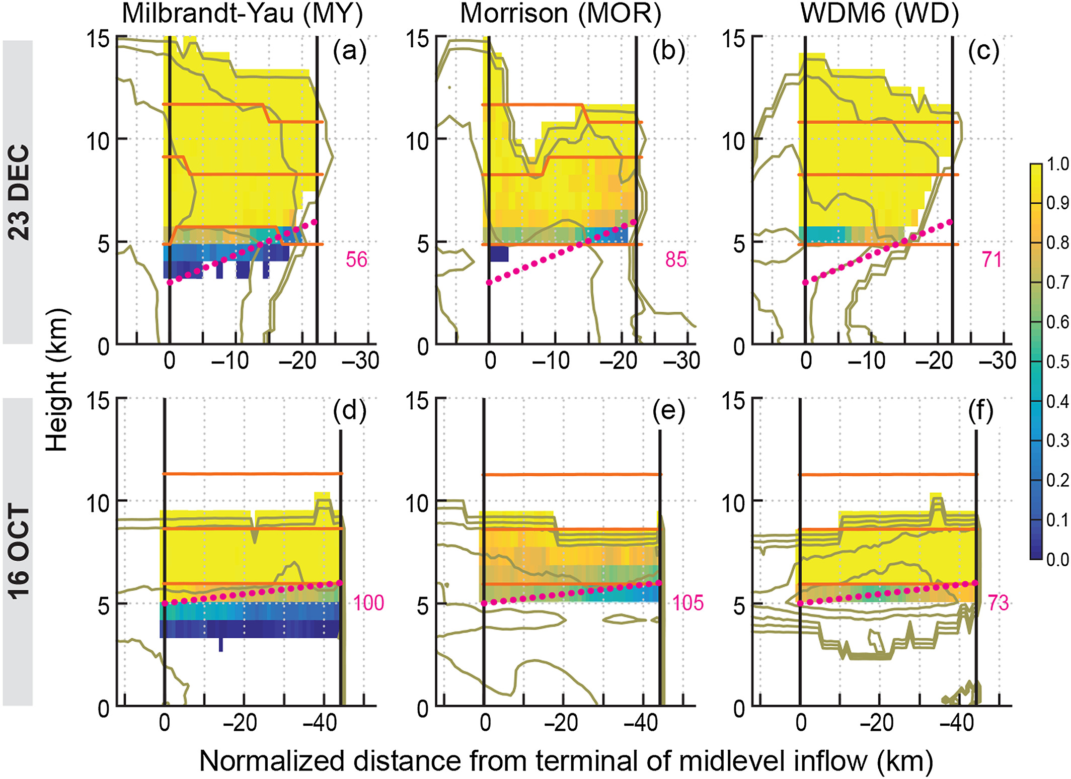
Comparison: Aggregation
Frozen hydrometeor + frozen hydrometeor
←
Shading=
Frequency
↑
Shading=
Aggregation freq.
orange line=
Upward motion (0.1 … 0.5 m/s)

Slide 19
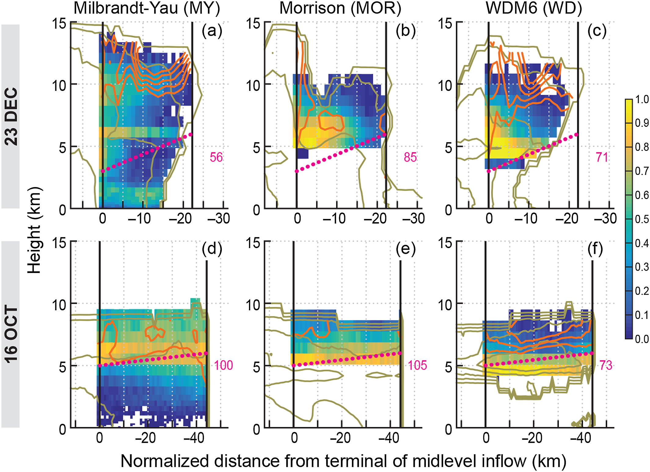
Comparison: riming
Frozen hydrometeor + liquid hydrometeor
←
Shading=
Frequency
↑
Shading=
riming freq.
orange line=
Temperature 0 / -20 / -40

Slide 20
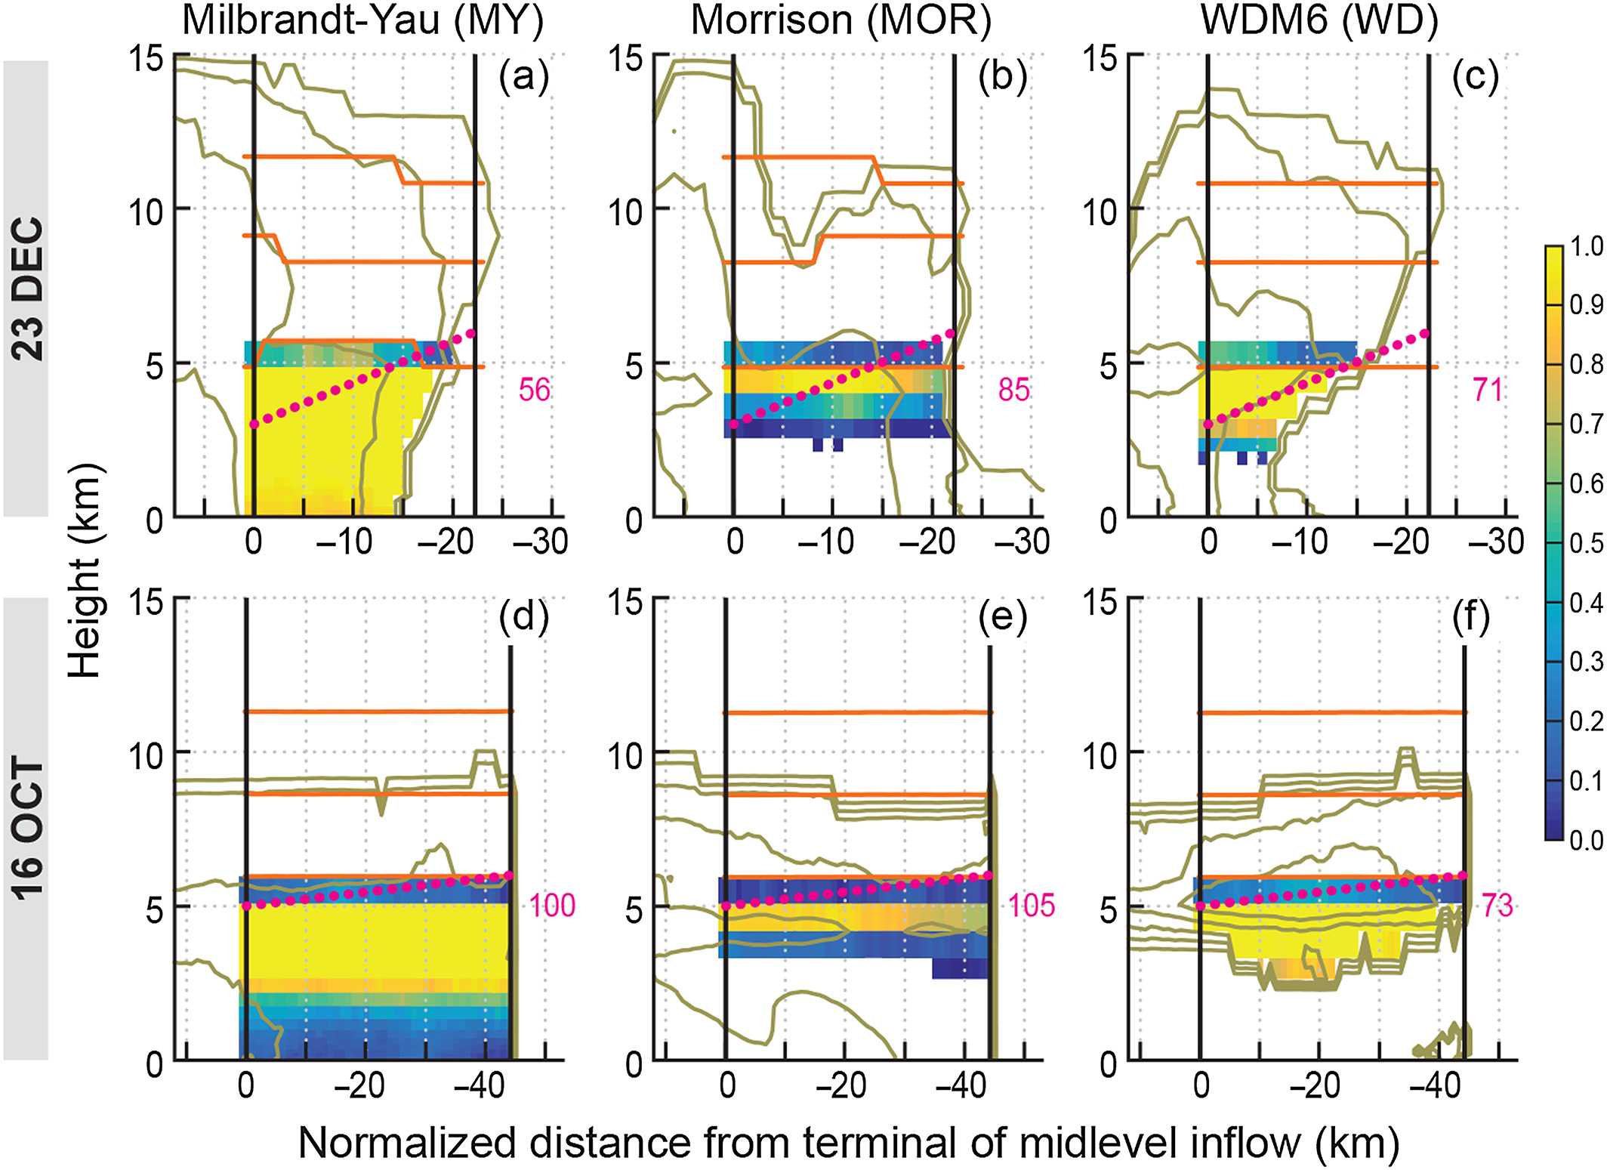
Comparison: melting
Frozen hydrometeor → liquid hydrometeor
←
Shading=
Frequency
↑
Shading=
melting freq.
orange line=
Temperature 0 / -20 / -40

Slide 21
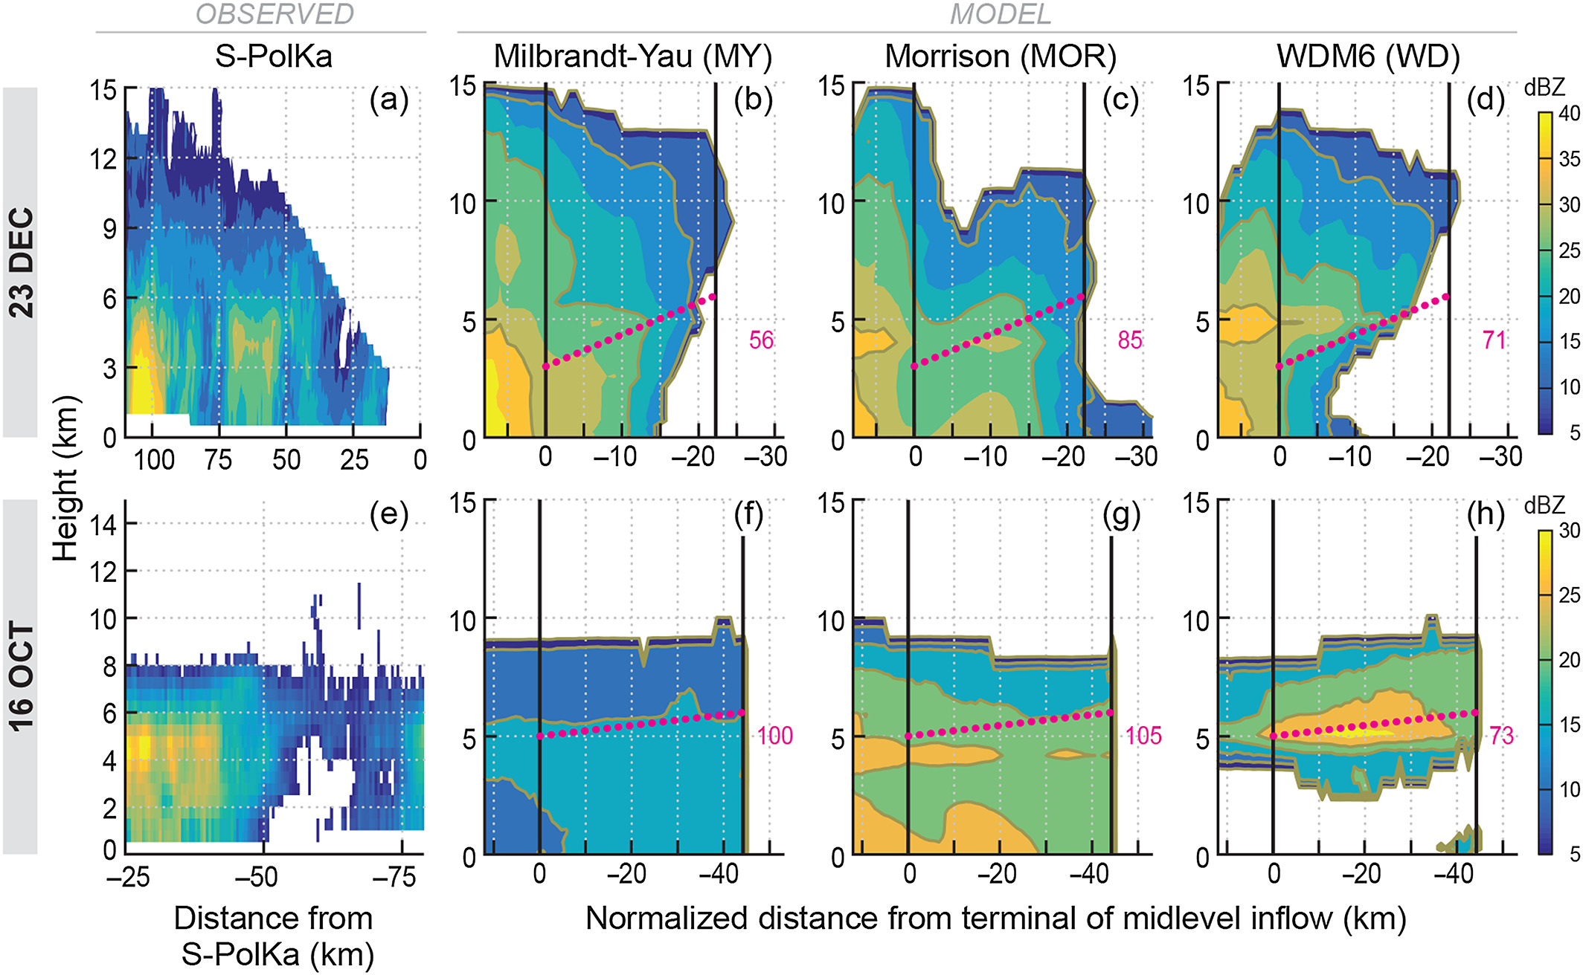
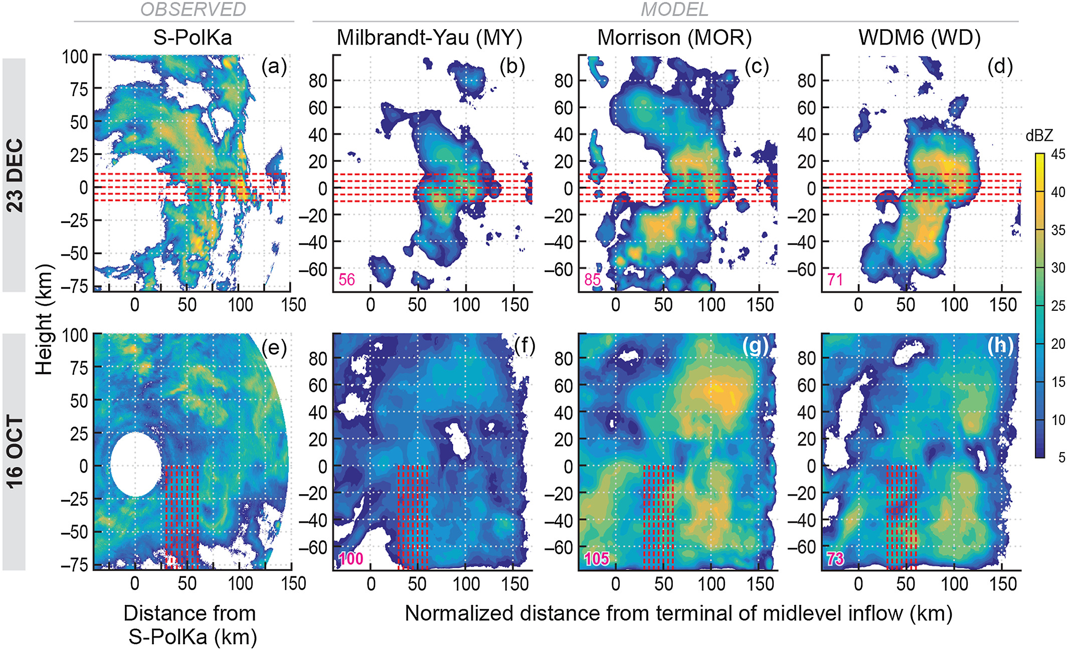
Impact of microphysical differences
Shading= Reflectivity

Slide 22
Conclusions
Simulated ice processes in the midlevel inflow are consistent with radar observations and theory
Of the processes considered, simulated riming and aggregation differ the most from observations
Disparate simulated ice microphysical patterns factor into reflectivity differences

