Slide 1
Precipitation Efficiency and Water Budget of Typhoon Fitow (2013):A Particle Trajectory Study
Xu, H., G. Zhai, and X. Li, 2017: Precipitation Efficiency and Water Budget of Typhoon Fitow (2013): A Particle Trajectory Study. J. Hydrometeor., 18, 2331–2354.

Slide 2
Vapor: Tend=HFC+VFC+Div-Cond+Evap+PBL+Diff+Resd
Hydrometeors: Tend=HFC+VFC+Div+Cond−Evap+P+PBL+Diff+Resd
What are the main physical processes responsible for the torrential rainfall on land?
What is the evolution of those physical processes when the rain particles go from ocean to land?
How does the precipitation efficiency vary?

Slide 3
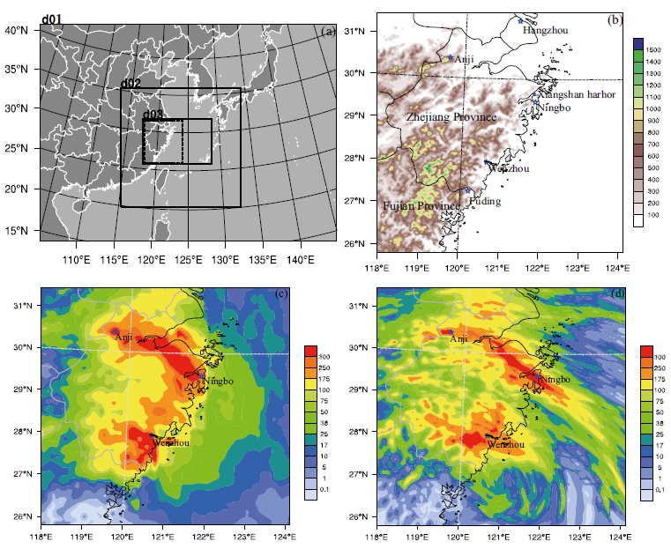
WRFV3.5.1
dx 27/9/3 km & 35 eta lev
Two-way feedback
Lin scheme for mp
No cumulus scheme
IC/BC: NCEP FNL 1ºx1º
2013-10-06 00Z ~ 2013-10-7 12Z
FLEXPART-WRF
CMORPH

Slide 4
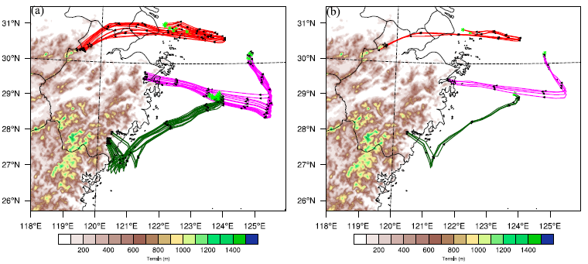
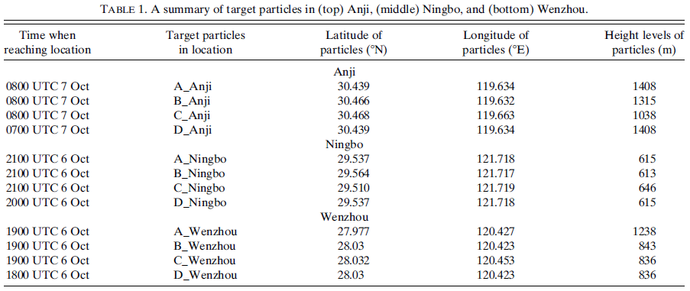

Slide 5
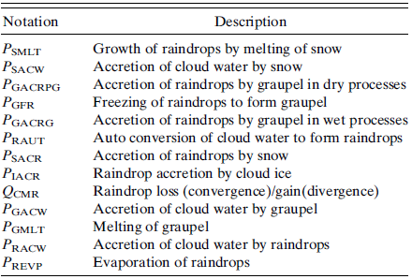
$$P_{s}=S_{qr}+Q_{CMR}$$
$$P_{s}=−\int_{1}^{0}{\frac{1}{g}\left[−\frac{∂V_{Q_{r}}^{f}Q_{r}}{∂σ}\right]dσ}$$
$$Q_{CMR}=−\int_{1}^{0}{\frac{1}{g}\left[−\frac{∂Q_{r}}{∂t}−∇(\overset{⃑}{V}Q_{r})\right]dσ−\int_{1}^{0}{\frac{1}{g}\left[F_{Q_{r},pbl}+F_{Q_{r},diff}\right]dσ}}$$
$$S_{qr}=P_{SMLT}+P_{SACW}+P_{GACRPG}+P_{GFR}+P_{GACRG}+P_{RAUT}+P_{SACR}+P_{IACR}+P_{GACW}+P_{GMLT}+P_{RACW}+P_{REVP}$$

Slide 6
$$LSPE=\frac{P_{s}}{\sum_{i=1}^{5}{H(Q_{i})Q_{i}}}$$
$$CMPE=\frac{P_{s}}{Q_{WVOUT}+H(Q_{CM})Q_{CM}}$$
$$Q_{WVOUT}=H\left(P_{LADJ}\right)P_{LADJ}+H(P_{IADJ})P_{LADJ}+H(P_{SDEP})P_{SDEP}+H(P_{GDEP})P_{GDEP}$$
$$Q_{CM}=Q_{CMC}+Q_{CMR}+Q_{CMI}+Q_{CMS}+Q_{CMG}$$
$$Q_{CMQ_{m}}=Q_{Q_{m}LOC}+Q_{Q_{m}FC}$$
$$∇∙(\overset{⃑}{V}φ)=φ\left(∇∙\overset{⃑}{V}\right)+\overset{⃑}{V}∙∇φ$$
$$Q_{Q_{m}LOC}=\left[−\frac{∂q_{m}}{∂t}\right]$$
$$Q_{Q_{m}FC}=Q_{m}Div+Q_{m}ZAdv+Q_{m}MAdv+Q_{m}VAdv$$
$$Q_{Q_{m}FC}=[−∇∙\overset{⃑}{V}q_{m}]$$

Slide 7
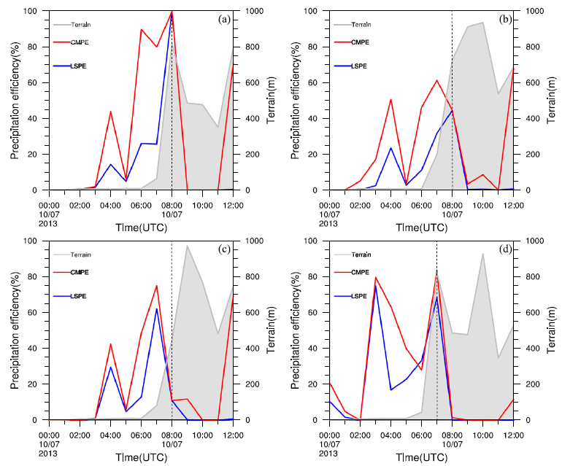
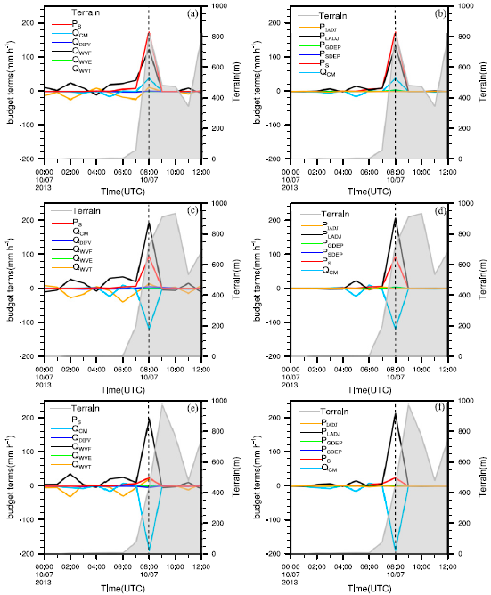
A_Anji
B_Anji
A_Anji_SRBG
A_Anji_CMBG
C_Anji
D_Anji
B_Anji_SRBG
B_Anji_CMBG
C_Anji_SRBG
C_Anji_CMBG

Slide 8
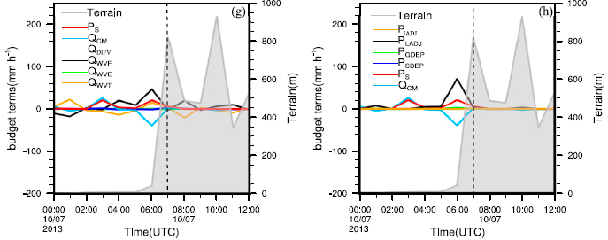
A_Anji
B_Anji
C_Anji
D_Anji
D_Anji_SRBG
D_Anji_CMBG
Q_{WVF} weaker than A_Anji~C_Anji
Q_{WVF} ~ -Q_{CM}
P_{LADJ}~-Q_{CM}

Slide 9
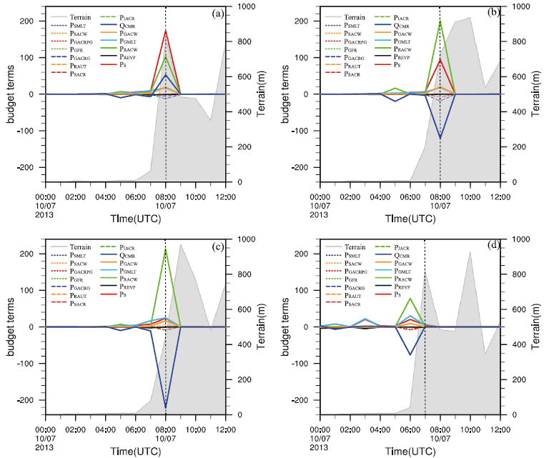
A_Anji
B_Anji
P_{RACW}
P_{RACW}
C_Anji
D_Anji
P_{RACW}
P_{RACW} ~ -Q_{CMR}

Slide 11
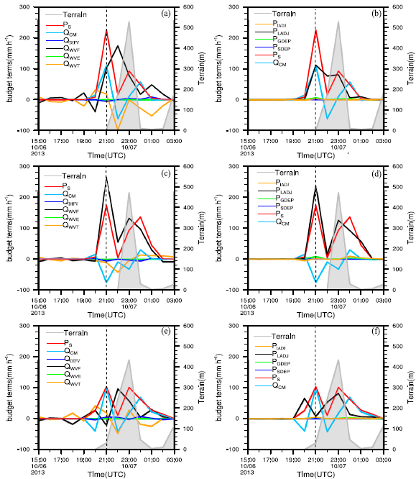
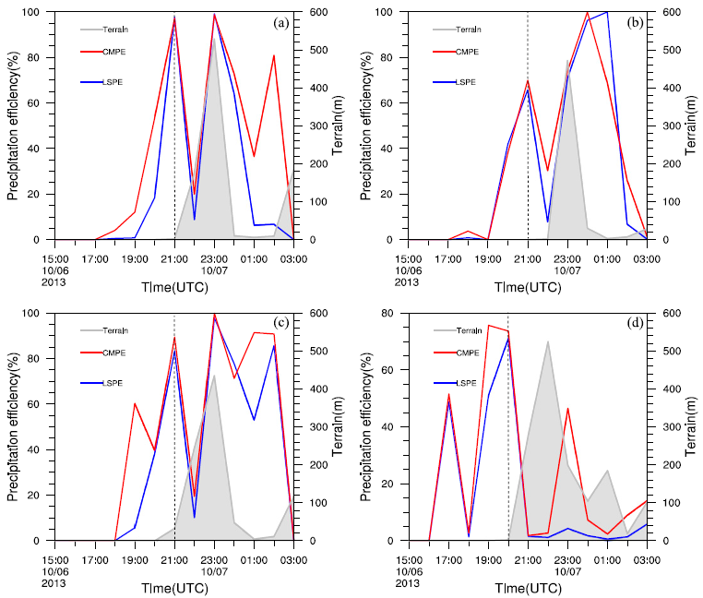
A_Ningbo
B_Ningbo
A_Ningbo_SRBG
A_Ningbo_CMBG
C_Ningbo
D_Ningbo
B_Ningbo_SRBG
B_Ningbo_CMBG
C_Ningbo_SRBG
C_Ningbo_CMBG

Slide 12
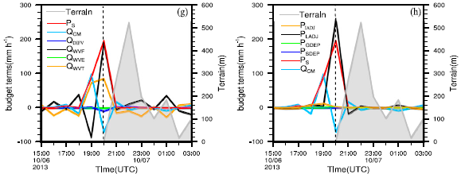
A_Ningbo
B_Ningbo
C_Ningbo
D_Ningbo
D_Ningbo_SRBG
D_Ningbo_CMBG

Slide 13
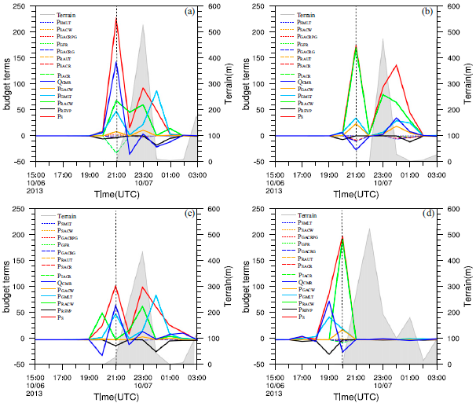
A_Ningbo
B_Ningbo
P_{RACW}
Q_{CMR}
C_Ningbo
D_Ningbo
P_{RACW}
Q_{CMR}
P_{GMLT}

Slide 15
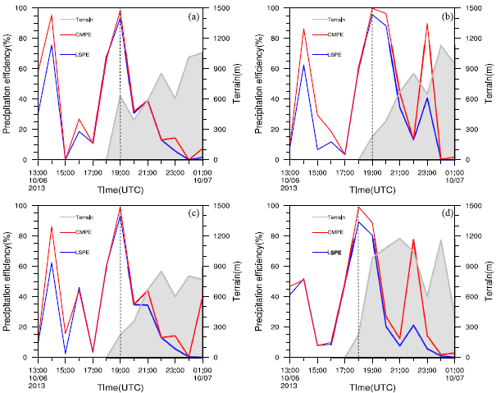
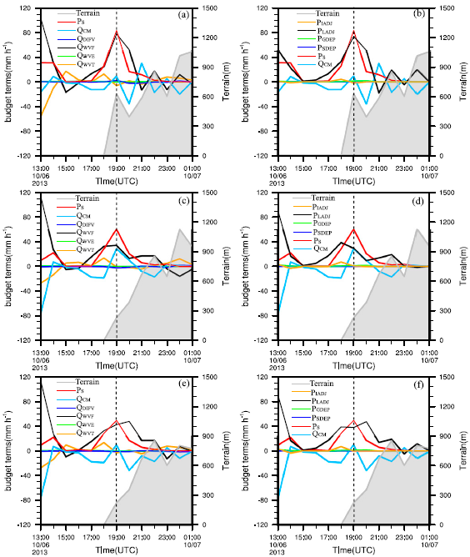
A_Wenzhou
B_Wenzhou
A_Wenzhou_SRBG
A_Wenzhou_CMBG
C_Wenzhou
D_Wenzhou
B_Wenzhou_SRBG
B_Wenzhou_CMBG
C_Wenzhou_SRBG
C_Wenzhou_CMBG

Slide 16
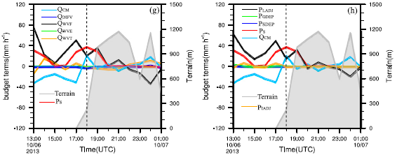
A_Wenzhou
B_Wenzhou
C_Wenzhou
D_Wenzhou
D_Wenzhou_SRBG
D_Wenzhou_CMBG
Q_{WVF} ↓

Slide 17
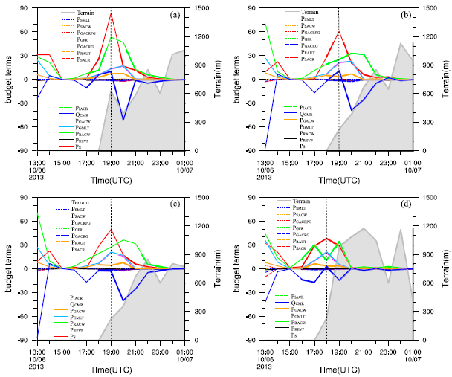
A_Wenzhou
B_Wenzhou
P_{RACW}
P_{RACW}
P_{GMLT}
C_Wenzhou
D_Wenzhou
P_{RACW}
P_{GMLT}
P_{RACW}
P_{GMLT}

Slide 18
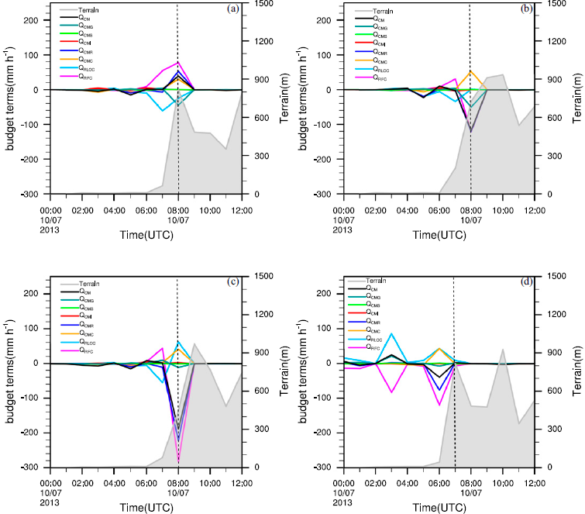
A_Anji_SRBG
A_Anji_CMBG
A_Anji
B_Anji
Q_{CM}=Q_{CMC}+Q_{CMR}+Q_{CMI}+Q_{CMS}+Q_{CMG}
Q_{CMR}=Q_{RLOC}+Q_{RFC}
B_Anji_SRBG
B_Anji_CMBG
C_Anji
D_Anji
C_Anji_SRBG
C_Anji_CMBG

Slide 19
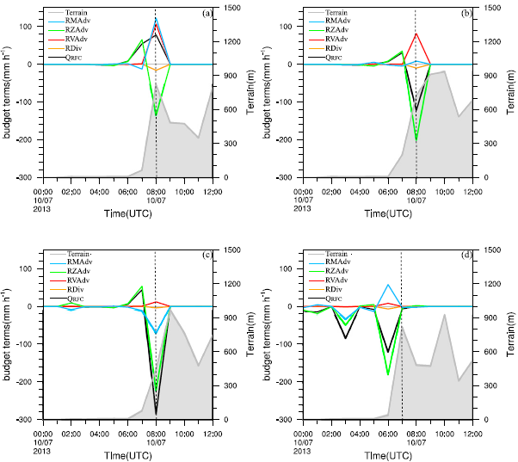
A_Anji
B_Anji
Q_{RFC}=RZAdv+RMAdv+RVAdv+RDiv
C_Anji
D_Anji

Slide 20
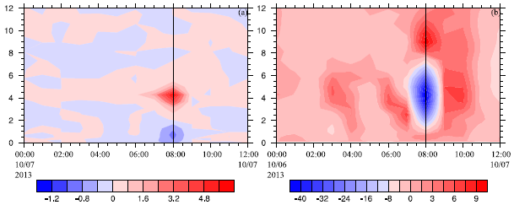
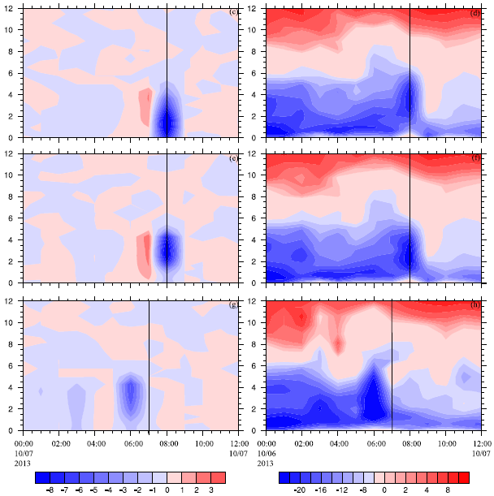
$$\frac{∂q_{r}}{∂σ}$$
$$\frac{∂q_{r}}{∂x}$$
$$μ_{d}ω$$
$$μ_{d}u$$
small qr
large qr
large qr small qr
QCM consumes rainfall due to RZAdv in B/C/D_Anji

Slide 21
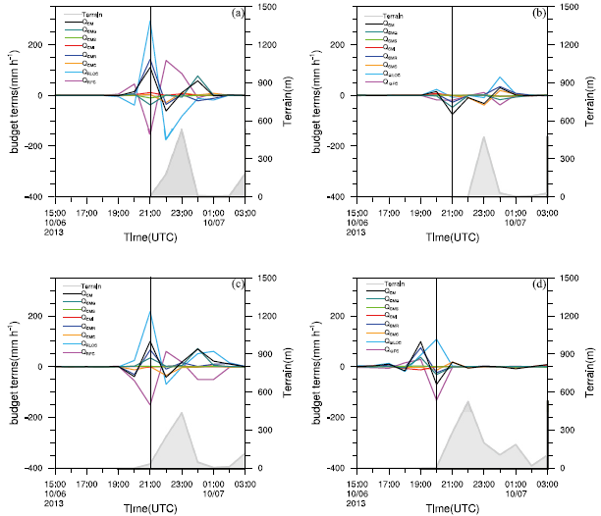
Q_{CMR} → Q_{RFC}
Q_{CMG} → Q_{GFC}
A_Ningbo
B_Ningbo
C_Ningbo
D_Ningbo

Slide 22
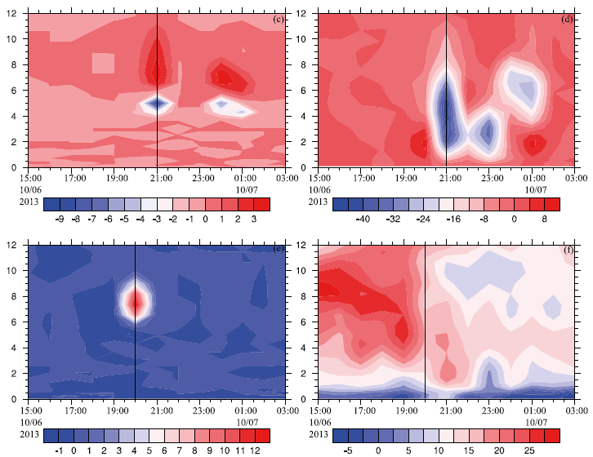
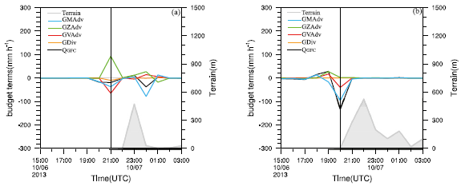
$$\frac{∂q_{g}}{∂σ}$$
$$μ_{d}ω$$
Q_{GFC}=GZAdv+GMAdv+GVAdv+GDiv
GVAdv
GMAdv
B_Ningbo
B_Ningbo
$$\frac{∂q_{g}}{∂y}$$
$$μ_{d}v$$
B_Ningbo
D_Ningbo
D_Ningbo
D_Ningbo
small qg
large qg

Slide 23
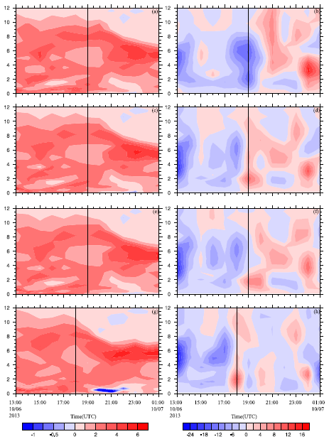
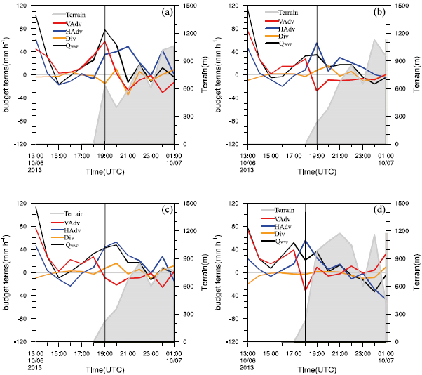
A_Wenzhou
B_Wenzhou
$$\frac{∂q_{r}}{∂σ}$$
$$μ_{d}ω$$
VAdv
A_Wenzhou
B_Wenzhou
C_Wenzhou
D_Wenzhou
C_Wenzhou
small qv
large qv
small qv
large qv
D_Wenzhou

Slide 24
Conclusions
Trajectory analysis indicates that particles near the strong rainfall centers come from the East China Sea.
The rainfall centers are often associated with high precipitation efficiency of nearly 100% when water vapor convergence, condensation, and hydrometeor loss/convergence are the major rainfall sources in producing rainfall.
Hydrometeor gain/divergence occurs adjacent to the rainfall centers, which primarily reduces the rain rate and supports the transport of hydrometeors to the rainfall centers.

Slide 25
Conclusions
While water vapor convergence and condensation are major rainfall sources, respectively, in the surface rainfall budget and cloud microphysical budget, hydrometeor change/convergence controls precipitation efficiency.
Water vapor convergence decreases with increasing terrain height in Anji, whereas it increases with increasing terrain height in Wenzhou. The water vapor convergence is stronger in the plains (Ningbo) than in the mountains (Anji and Wenzhou). This suggests that water vapor convergence may not be positively correlated to orographic lifting.

Slide 26
Conclusions
The rain budget shows that the transport of hydrometeors to rainfall centers is the transport of raindrops, which is primarily supported by the accretion of cloud water by raindrops and melting of graupel.
The upward motions and upward decrease of hydrometeors account for the increase in the vertical advection of hydrometeors, leading to the increase in hydrometeor flux convergence, and thus hydrometeor loss/convergence occurs.

