Slide 1
Torrential rainfall processes associated with a landfall of Typhoon Fitow (2013): A three-dimensional WRF modeling study
Professor : Ming-Jen Yang
Student : Jyong-En Miao
Date : 2018/05/22
Xu, H., and X. Li, 2017
J. Geophys. Res. Atmos., 122, 6004–6024

Slide 2
Introduction
Braun [2006] analyzed water budget of Hurricane Bonnie (1998) using MM5 and found that the majority of condensation occurred in the convective hot towers in the eyewall, and most of the mass seeded the stratiform rainfall in the outer regions in the form of ice particles.
Yang et al. [2011] analyzed water budget of Typhoon Nari (2001) with WRF and revealed that Taiwan's terrain enhanced precipitation efficiency and surface rain rate by significantly strengthening secondary circulations and producing stronger vapor import at low levels.
Huang et al. [2014] analyzed water budget of Typhoon Morakot (2009) and showed that condensation and ice deposition caused the high precipitation efficiency over the Central Mountain Ranges, producing tremendous rainfall in southwestern Taiwan.
Fritz and Wang [2014] investigated the evolution of water budgets from tropical wave to tropical cyclone using a high‐resolution model. They found that the organized convection and concentrated diabatic heating near the cyclone's center may contribute to the intensification of secondary circulations, leading to the strengthened low‐level convergence and increased inward moisture flux.
This study examines the dominant processes that are responsible for the torrential rainfall during the landfall of Typhoon Fitow (2013) through analyzing surface rainfall budget, cloud microphysical budget, and raindrop microphysical budget.

Slide 3
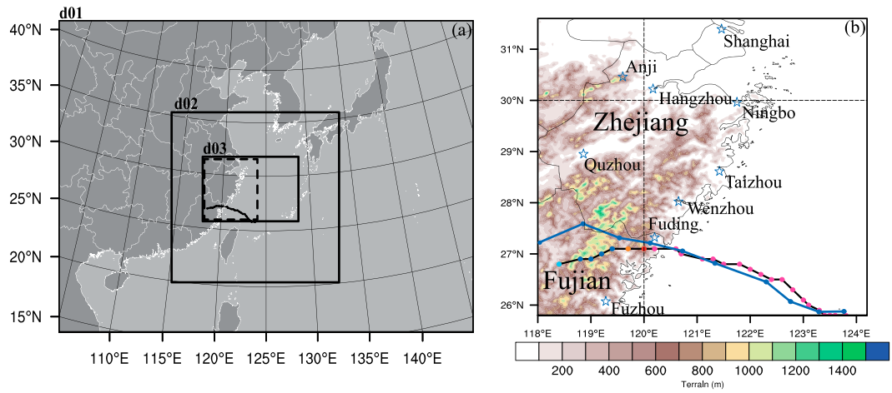
Model and Experiment Design
WRFV3.5.1
Two‐way nesting: 27, 9, and 3 km. 3km: 361 × 223 × 35 grid points
from 0000 UTC 6 October to 1200 UTC 7 October 2013.
shortwave [Dudhia, 1989] and longwave [Mlawer et al., 1997]
five‐layer thermal diffusion land surface scheme [Dudhia, 1996]
YSU PBL [Hong and Pan, 1996; Hong et al., 2006]
Purdue‐Lin cloud microphysical parameterization [Lin et al., 1983]
No Cumulus scheme is used in all three model domains
NCEP FNL Analysis data (1° × 1°)

Slide 4
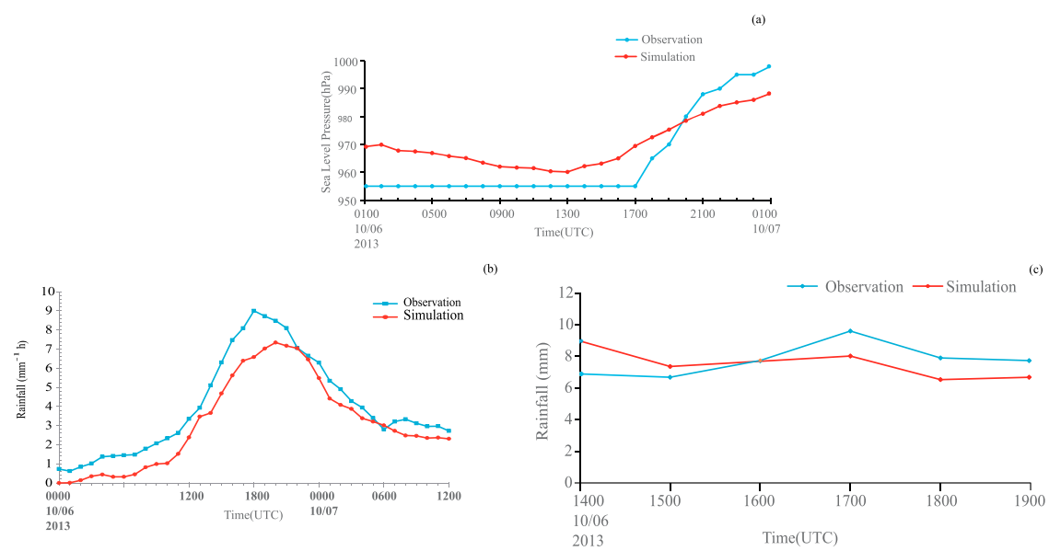

Slide 5
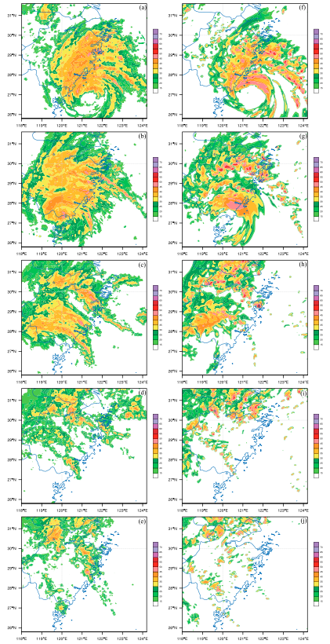
1300 UTC
10/6
Radar reflectivity at 3km
Left: OBS
Right: MODEL
1800 UTC
10/6
0000 UTC
10/7
0600 UTC
10/7
1200 UTC
10/7

Slide 6
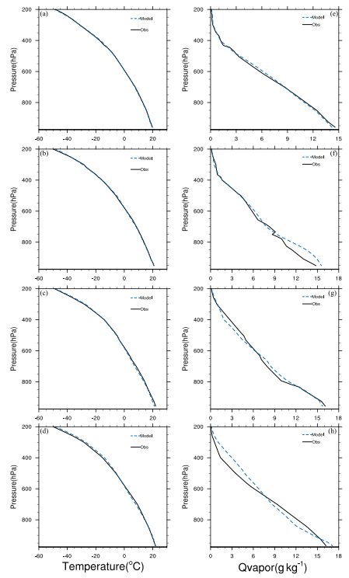
0000 UTC
10/6
Thermodynamic structure
OBS為4個站的合成探空
1200 UTC
10/6
0000 UTC
10/7
1200 UTC
10/7

Slide 7
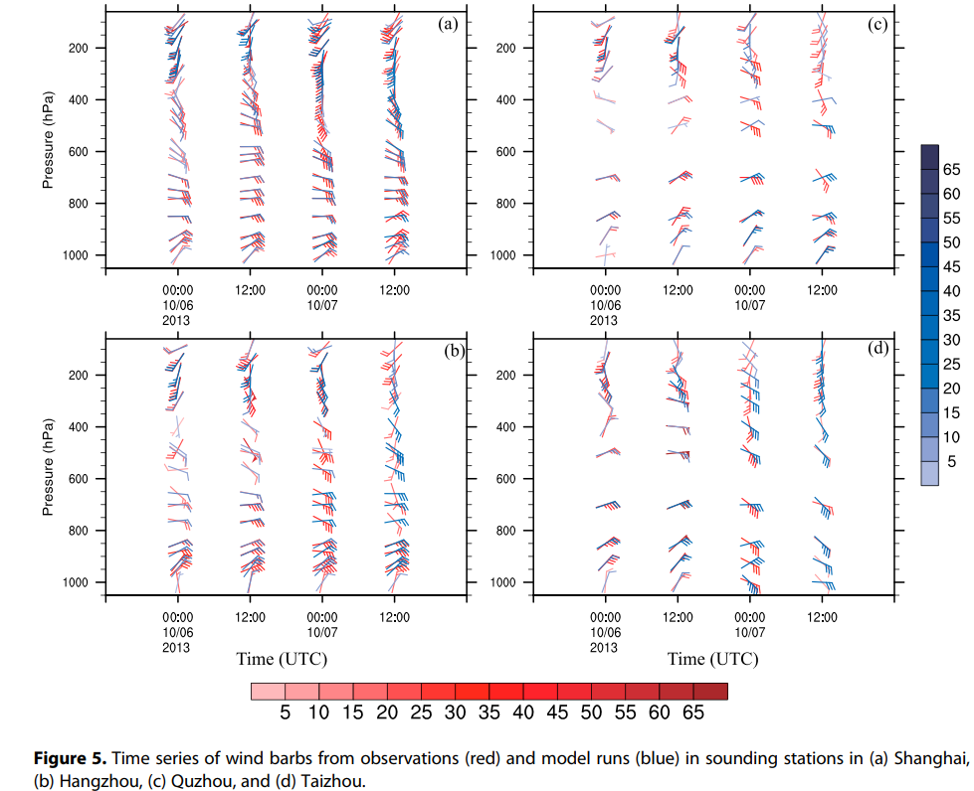

Slide 8
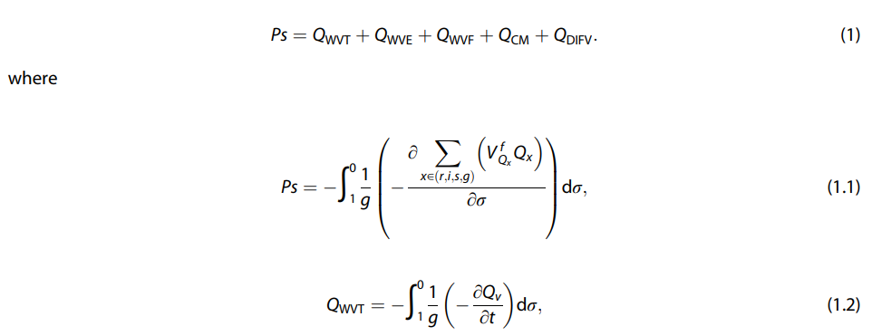
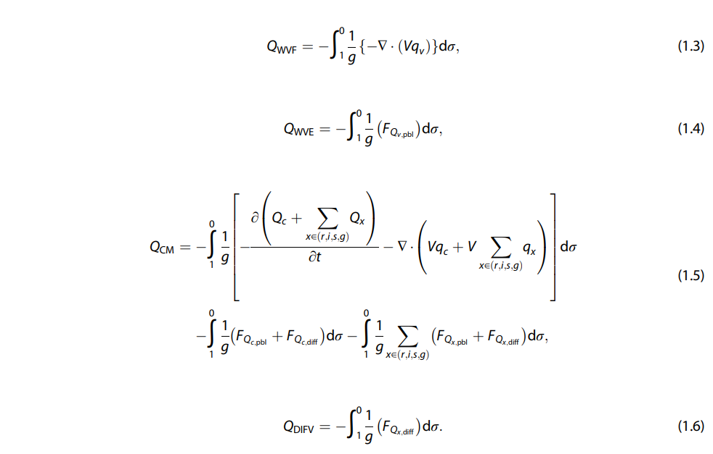

Slide 9
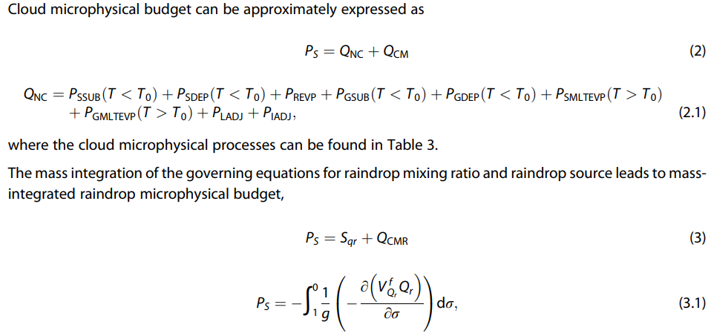

Slide 10
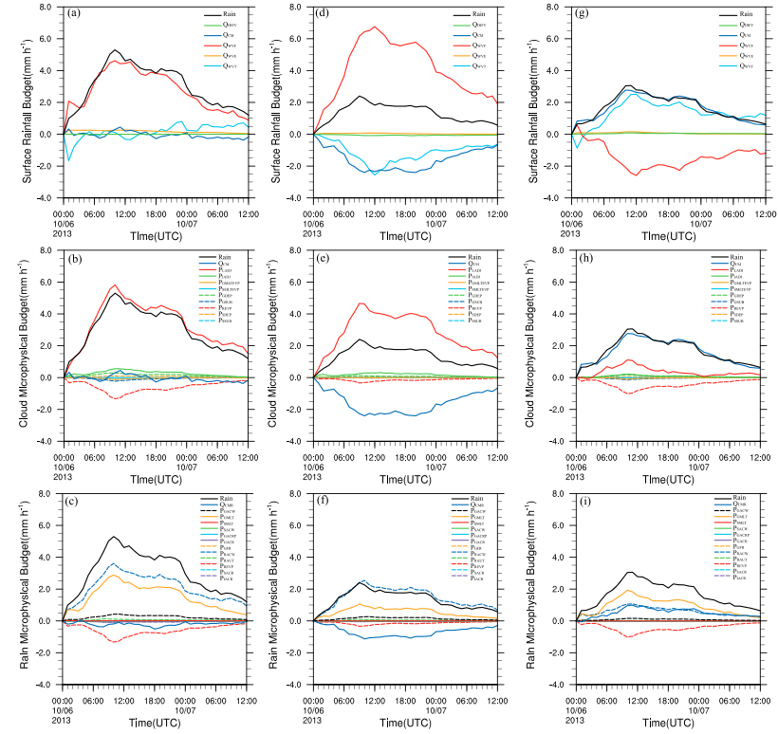

Slide 11
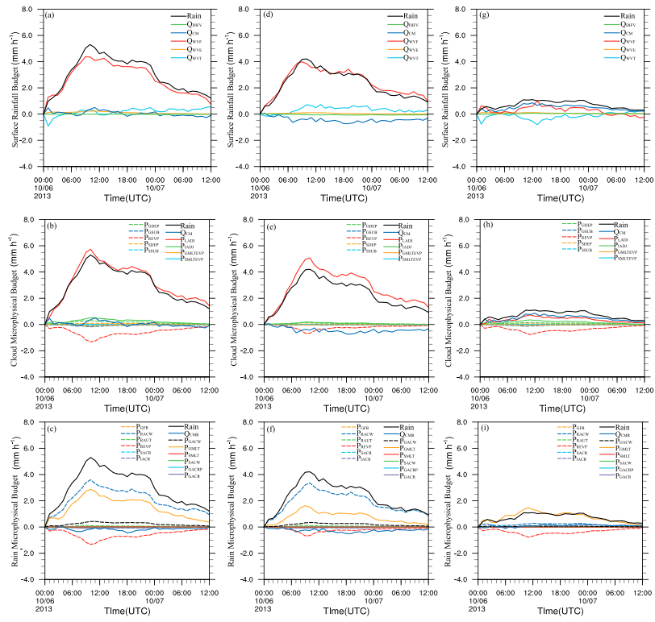

Slide 12
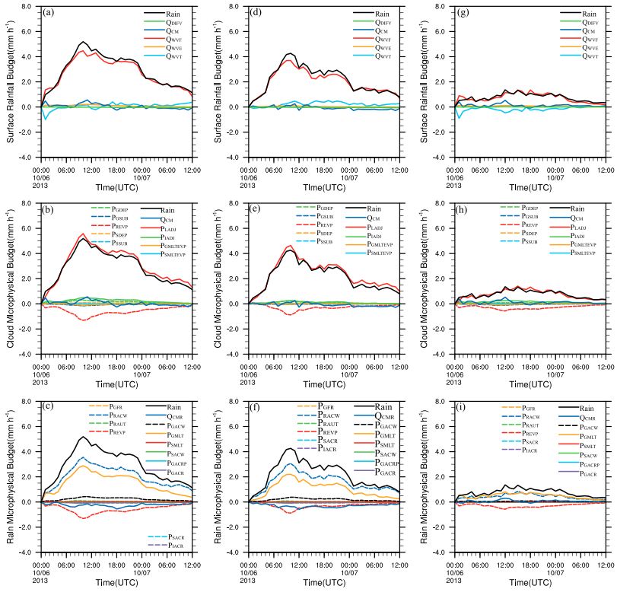

Slide 13
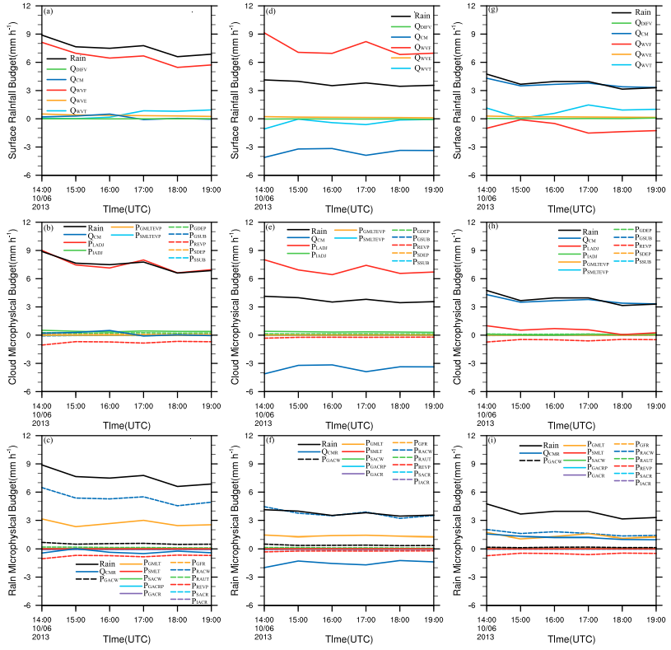

Slide 14
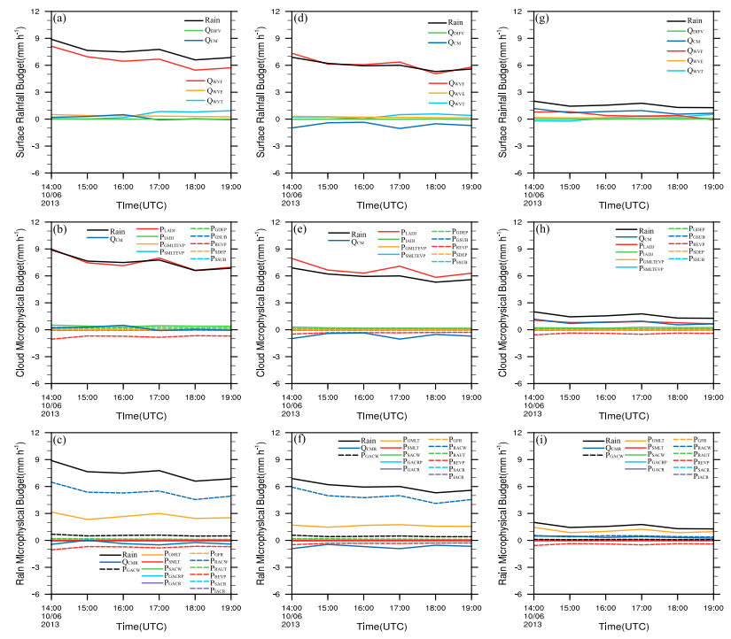

Slide 15
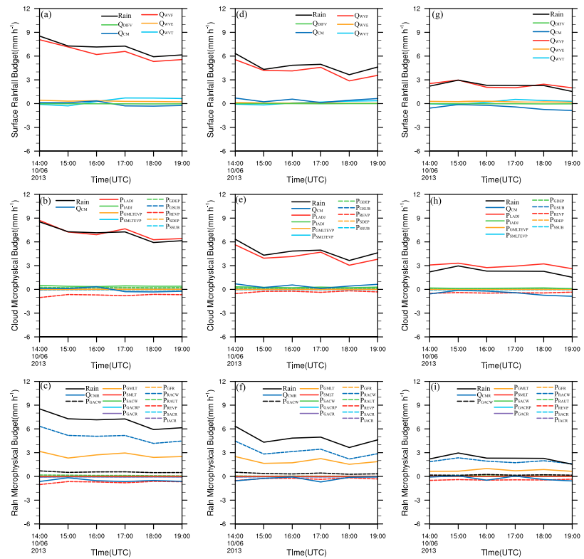

Slide 16
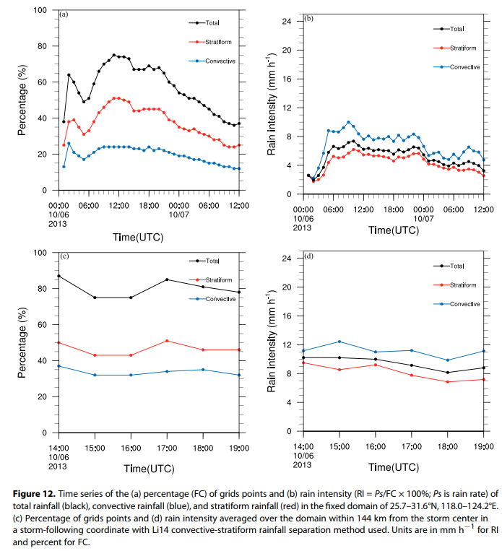

Slide 17
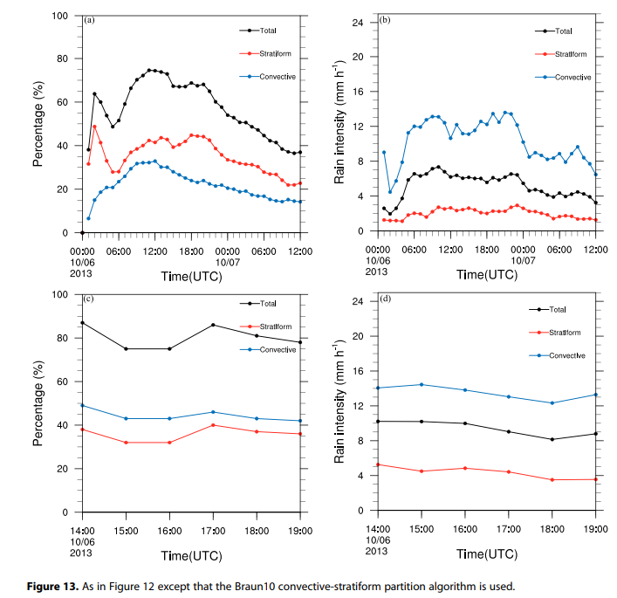

Slide 18
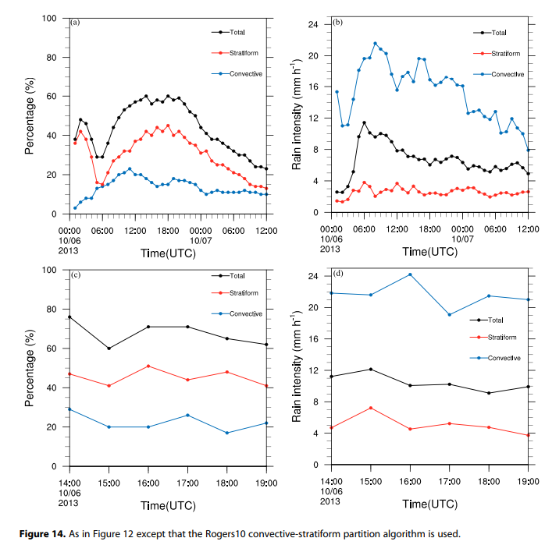

Slide 19
Conclusions
The model reproduces well Fitow’s track, minimum central pressure, and maximum wind speed during the landfall. The simulated soundings show the warm and moist lower troposphere and cold and dry upper troposphere.
Area mean rainfall is mainly associated with water vapor convergence in surface rainfall budget, condensation in cloud budget and accretion of cloud water by rain, and melting of graupel in rain budget.
Water vapor convergence, condensation, and accretion of cloud water by rain over convective regions mainly support convective rainfall and transport of hydrometeor from convective regions to stratiform regions.
Stratiform rainfall is mainly related to the transport of hydrometeor from convective regions, while water vapor divergence decreases local atmospheric moisture in surface rainfall budget, and condensation and evaporation of rain are nearly balanced in cloud microphysical budget.
Stratiform rainfall mainly corresponds to melting of graupel and transport of raindrops from convective regions in rain microphysical budget.
Rain intensity of convective rainfall is much intense than that of stratiform rainfall, whereas stratiform rainfall contributes more to the total rainfall during the integration times, since the areal coverage of stratiform rainfall is larger than that of convective rainfall.

Slide 20
Conclusions
The results drawn by using Li et al. [2014] algorithm are generally similar to those using Braun et al. [2010] and Rogers [2010] convective-stratiform rainfall partitioning methods in the fixed domain.
The results from the analyses of Li et al. [2014] and Braun et al. [2010] in a storm-following coordinate are generally similar to those applied in the fixed domain.
Whereas the results using Rogers [2010] in a storm-following coordinate and those in the fixed domain show differences: hydrometeor transports from stratiform rainfall regions to convective rainfall regions, and accretion of cloud water by raindrop is more important than melting of graupel in stratiform rainfall regions in a storm-following coordinate.
No matter which convective-stratiform rainfall partitioning method is used, rain intensity of convective rainfall is much intense than that of stratiform rainfall, whereas stratiform rainfall contributes more to the total rainfall during the integration times in the fixed domain. Within 144 km from the storm center in a storm-following coordinate, similar conclusion could be drawn, except that the areal coverage of convective rainfall is larger than that of stratiform rainfall using Braun et al. [2010].

