Slide 1
The impact of Low-level moisture error on model forecasts of an MCS observed during PECAN
Peters et al. (MWR 2017)

Slide 2
Effective Inflow layer (Thompson et al. 2007)
CAPE>100 J/kg ; CIN>-250 J/kg
EIL properties highly sensitive to low-level moisture and temperature! (eg. EIL depth; Schumacher 2015b)
Vertical structure of low-tropospheric CAPE, CIN highly relevant to behavior and location of nocturnal storms due to weaker lifting
Rapid, localized CAPE/CIN change (10-100km; 1-60 min) in the Great Plains is often difficult to predict and unresolvable with operational data
High temporal resolution sounding data is acquired during PECAN (~15min for this particular case)
Daytime convection
Cold pool
Nighttime convection
Cold pool
Negatively buoyant

Slide 3
I. Observational summary
24 July 2015 Iowa MCS (IOP15)

Slide 4
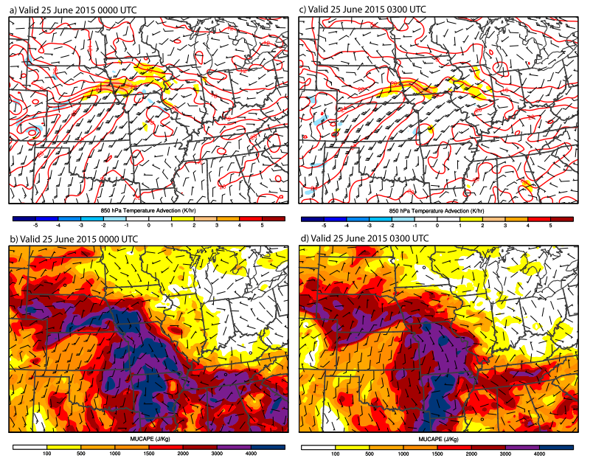
Observations of Iowa MCS (IOP15)
IA
LLJ
Notes:
The region that storms developed is slightly north of a west-east frontal zone impinged by a strong 850hPa LLJ. Strong temperature advection can be found in the terminus of this LLJ. Convective system developed in the cold side of frontal region is commonly observed in the Great Plains.
There exists a broad reservoir of most unstable CAPE (MUCAPE)>3000J/kg south of the frontal boundary mainly due to the moisture transport by LLJ.

Slide 5
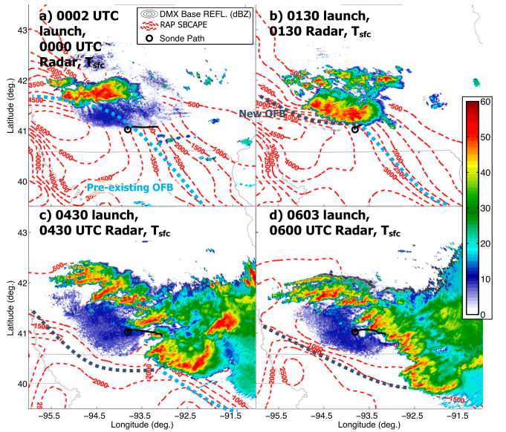
Des Moines, IA NEXRAD
Radar (KDMX)
Rearward off-boundary
development (Keene and Schumacher 2013)
Notes:
This MCS event started with discrete supercells initiated along a pre-existing surface boundary. RAP analysis further shows that significant SBCAPE gradient along the southwestern flank of these storms.

Slide 6
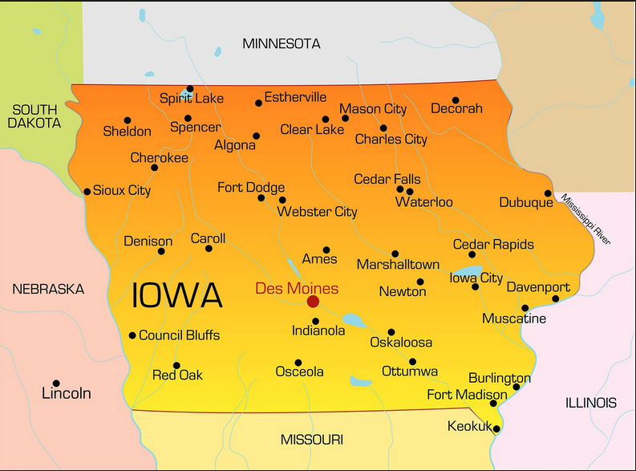
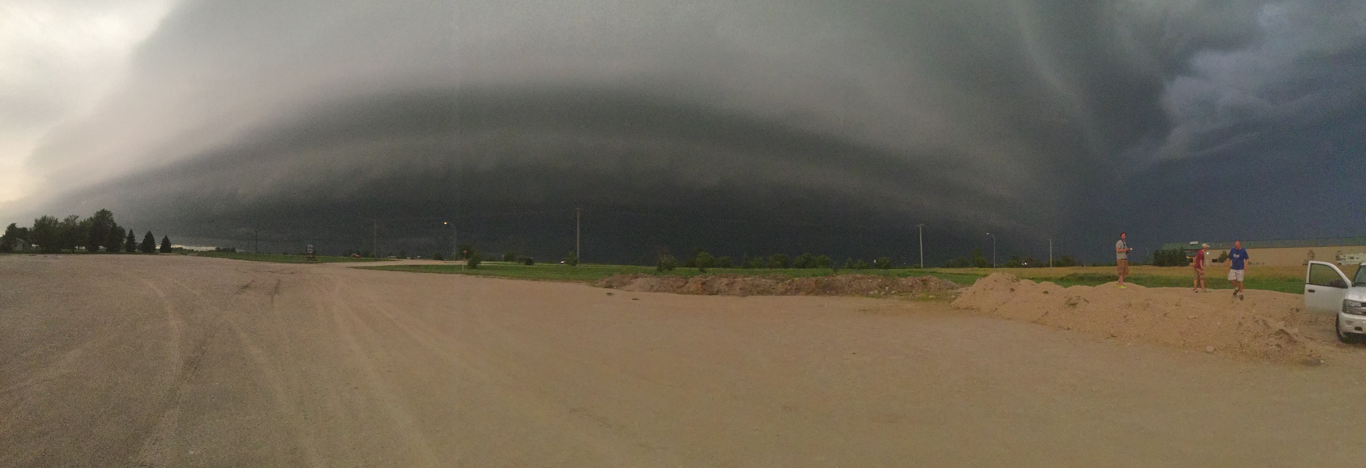

Slide 7
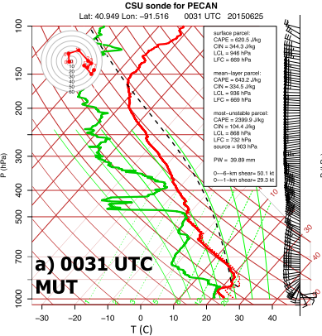
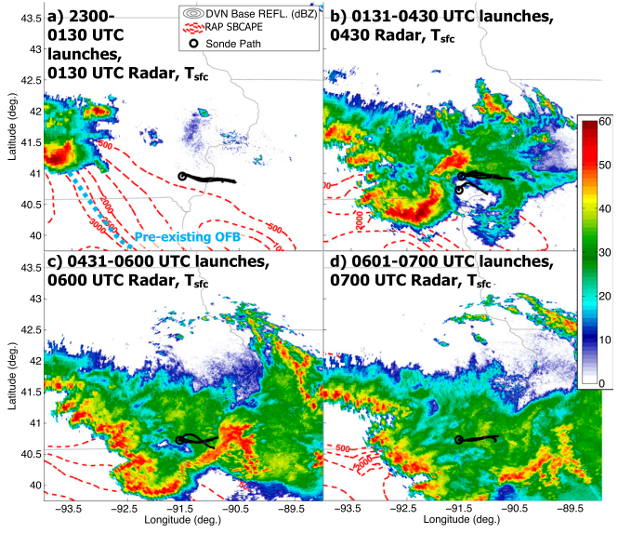
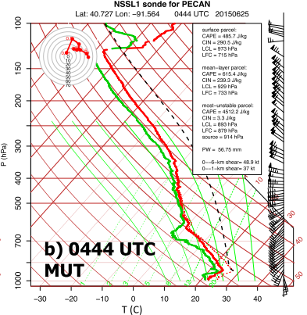
16 soundings launched by
MUTs near Burlington, IA
from 2300UTC to 0700UTC

Slide 8
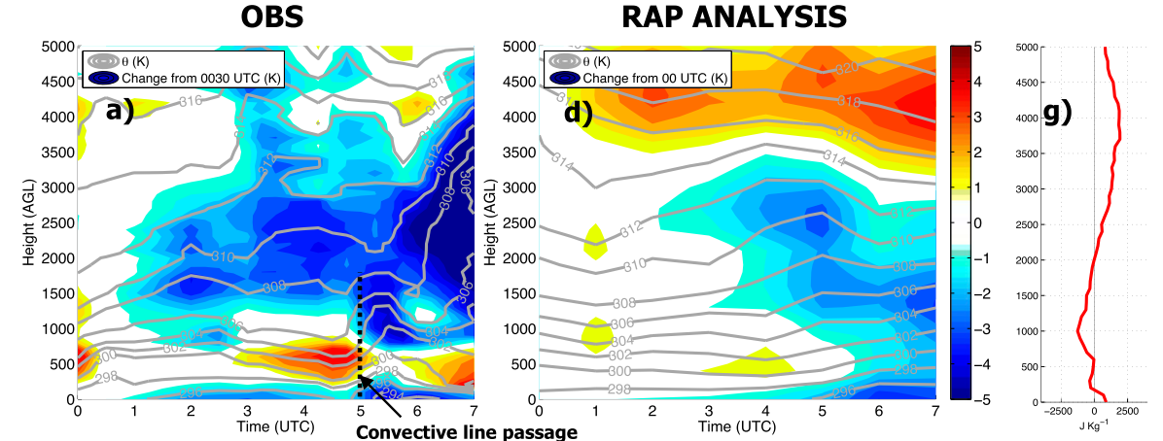
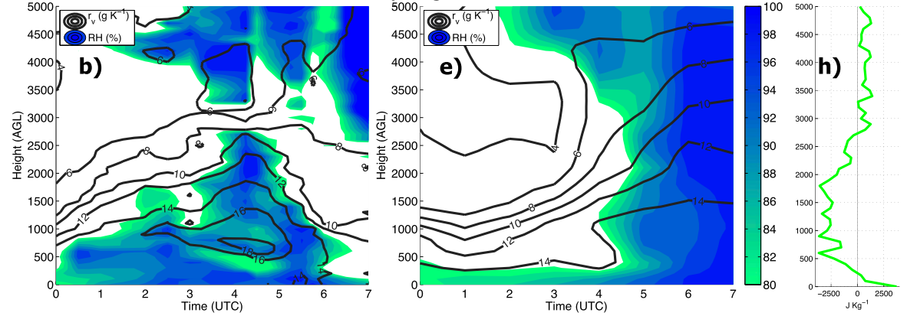
Perturbation
potential
temperature
(shading)
RH (shading, %)
qv (contour)
Notes:
Through radiosonde interpolation, we notice rapid change of prestorm environment in SE IA. In terms of temperature, we notice a warming anomaly that was consistent with the formation of an inversion layer, after ~05UTC radiosonde observed a shallow surface-based cold pool associated with the propagating system. Furthermore, above the inversion layer there was deep cooling that it

Slide 9
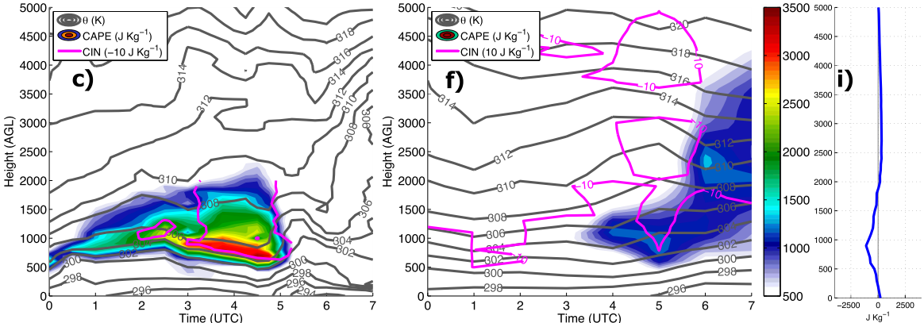
CAPE underestimation
~500-1000 J/kg
(0.5-1.5km AGL)

Slide 10
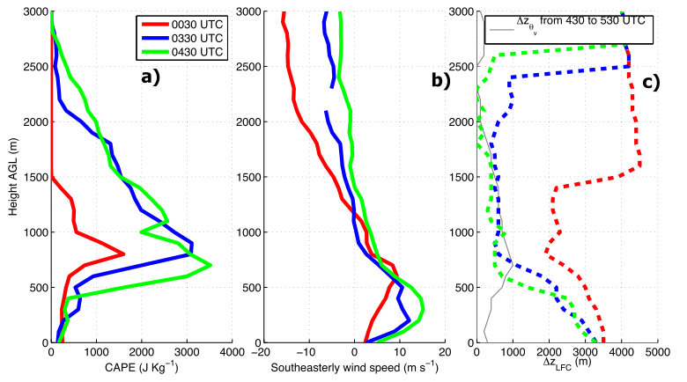
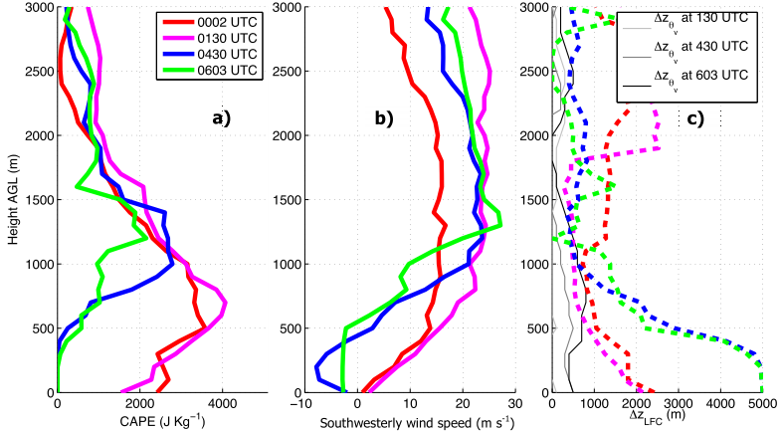
MUT (near SE-propagating
squall line)
Low-level shear direction (SE)
Stronger lifting along
downshear-propagating
outflow
EIL
Inversion
MP4 (near initial supercells and
Quasi-stationary convective line)
We launched 0130UTC
sounding several minutes before
supercell arrival
Relocated to the south to avoid
hail damage
Went back to original location
to sample convective cold pool.
OFB
Height
Notes:
Contrasting shear regime: Near SE-propagating squall line, SE wind speed decrease with height. Wind shear is directed out of the system, downshear lifting would often have lifting that exceeds cold pool depth due to favorable buoyancy and pressure gradient force.
Shear direction along OFB tends to be directed towards the boundary, vertical lifting would have similar depth to outflow depth due to downward PGF. (Unfavorable for vigorous CI)

Slide 11
II. Comparison to model guidance during PECAN
How do varying pre-convective grids influence forecast MCS?

Slide 12
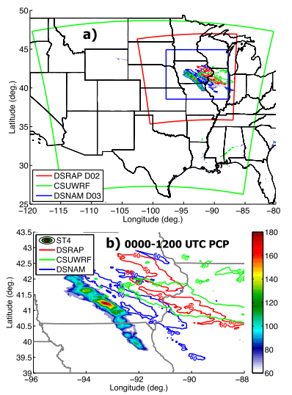
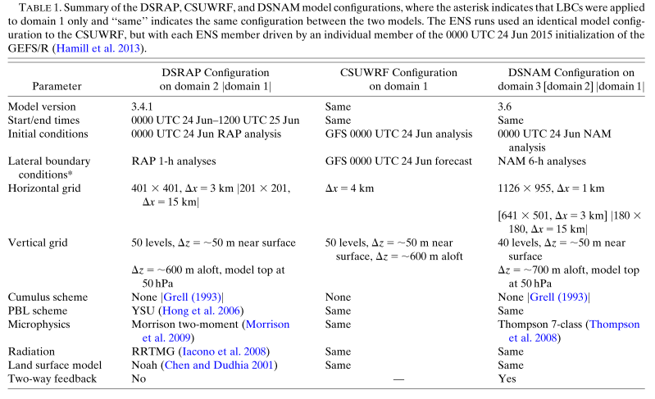

Slide 13
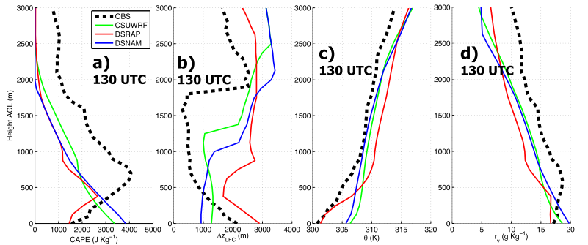
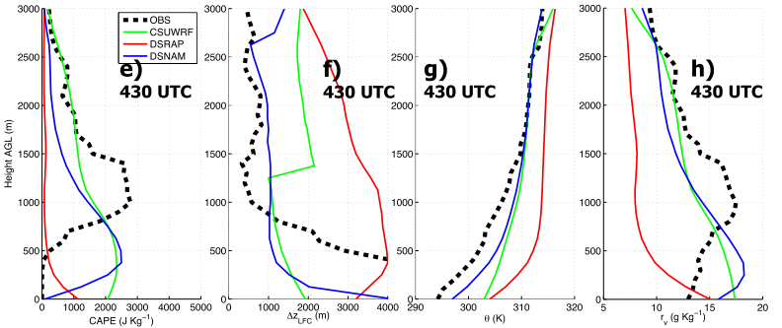
CAPE underestimation above
0.5km; overestimation below
0.5km (CSUWRF, DSNAM)
Difference between models
and obs. Del_Zlfc
similar to CAPE
Over/Underestimation highly
correlated with moisture
mixing ratio (d)
MP4
Pre-convective region moisture
representation is again
important at 0430UTC
Hypothesis: Difference in del_Zlfc
contributed to model
MCS placement error

Slide 14
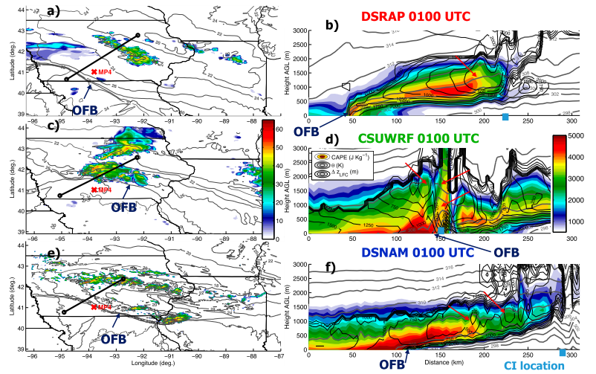
1000-1500m isentrope displacement
500-1000m isentrope displacement
Notes:
Placement of surface boundary is displaced to NE in CSUWRF due to lack of surface data assimilation, DSRAP/DSNAM are closer to observation. While DSRAP has stronger lifting, DSNAM has slightly smaller delta_Zlfc values, therefore the resultant CI location is actually similar between DSRAP/DSNAM. (More lifting+harding to lift/Weaker lifting+easier to lift)
Different from DSRAP/DSNAM, CSUWRF almost immediately initiates convection at OFB. Isentropic lifting is much stronger than DSRAP/DSNAM. We also find a broader region of delZlfc<250m (notably ~2000m south of OFB and above OFB). Stronger lifting + low delZlfc = lack of CI displacement from OFB.

Slide 15
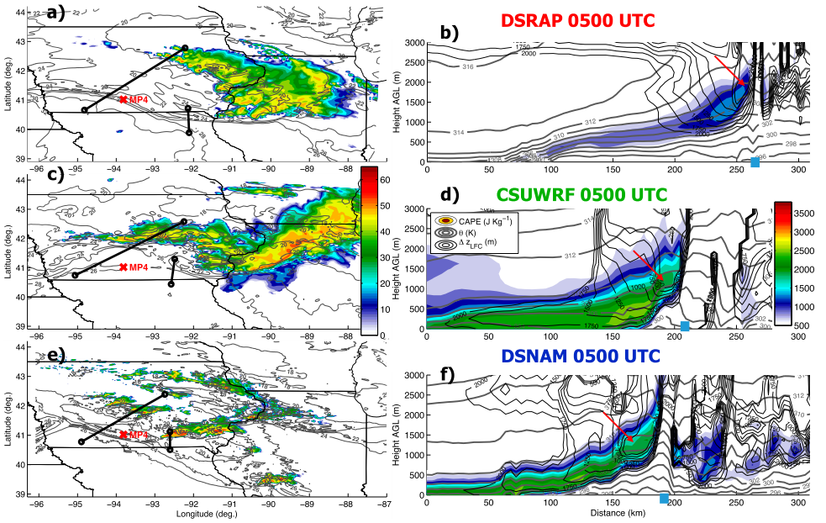
Notes:
Now we examine the simulated mature MCS. Initiated cells in DSNAM run grew upscale to moved southeastward, simulated and observed MCS’s location are similar. Storms in CSUWRF run also strengthened but the squall line moved east-southeastward instead of southeastward like in observation (and DSNAM), the system was therefore displaced to NE.
Storms in DSRAP is weaker and less organized along eastern flank than CSUWRF/DSNAM, with also a more severe NE displacement.

Slide 16
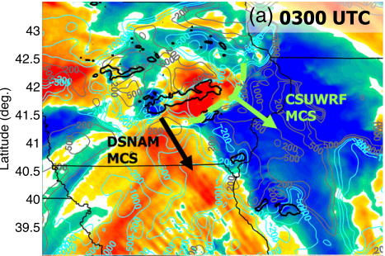
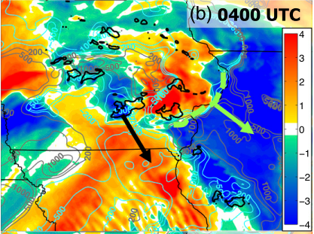
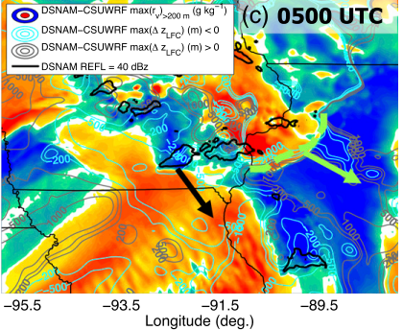
Notes:
Is this propagation direction difference related to low-level moisture? Authors find substantially more moisture in E IA/NW IL in CSUWRF run due to stronger advection, with smaller dZlfc over this region than DSNAM. OTOH, DSNAM tends to be more moist in S IA/N MO and correspondingly, lower dZlfc than CSUWRF. So the difference in propagation direction is simply a reflection of the fact that convection tends to develop where dZlfc is lowest.
However, from horizontal map we find outflow boundaries in S IA/N MO in all 3 simulations, but why only DSNAM develops convection in this region?

Slide 17
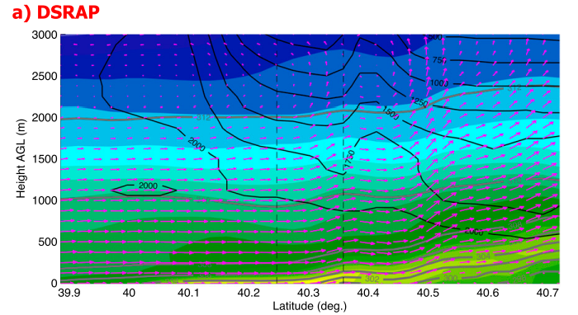
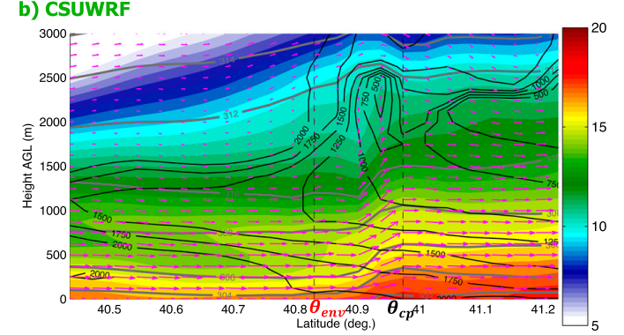
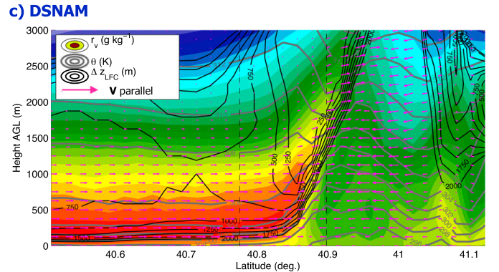
Notes:
Cross section over outflow boundaries in all 3 simulations are compared. General wind distribution are similar among the models, with all 3 simulations show a prominent LLJ. However, cold pool is very shallow in DSRAP and isentrope displacement was limited to the lowest 500m. The inflow air has weak CAPE, very large dZlfc and is substantially drier than CSUWRF/DSNAM. This indicates that the pre-outflow boundary air is highly stable and the weak lifting is not able to initiate deep convection. In CSUWRF, the environment has substantially more moister, and accrondingly, lower dZlfc and higher CAPE. However, the isentropic lifting is only at aroung 400-500m (still not enough to neutralize the dZlfc. OTOH, DSNAM southerly flow in prestorm environment has the highest qv and lowest dZlfc, this further supports their hypothesis that moisture is the crucial determining term that controls the MCS location and propagation direction difference, with the stronger moisture promotes more southward propagation in DSNAM run.

Slide 18
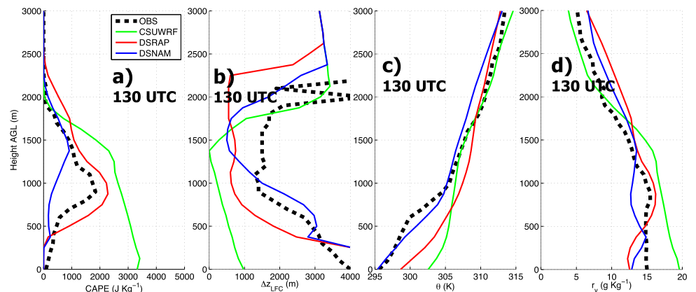
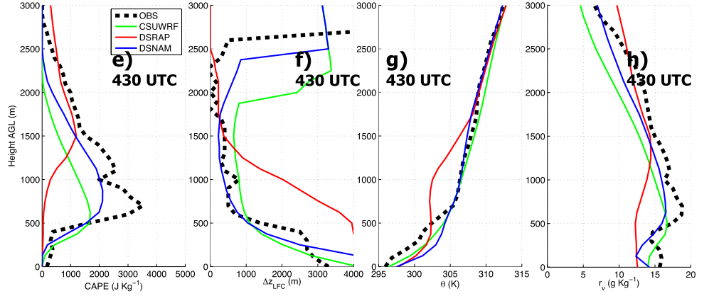
Notes:
Now we compare the modeled and observation atmospheric soundings at MUT location are provided above. First we note that, at CI time, DSNAM is closer to observations in terms of temperature but DSRAP is closer in terms of moisture. CSUWRF overpredicts CAPE and underpredicts dZlfc due to a severe moist bias in the lowest 2km.
During the mature system phase, the predicted atmospheric properties have evolved mightily. Size relationship at this period becomes more consistent with the eventual MCS location bias discussed earlier. Again, the role of correct moisture representation in the lowest 1km is emphasize here. At the period, DSNAM is the least erroneous model, and this is reflected in the small NE location bias compared to StageIV observation.
Difference can be further revealed through cross section analysis, as shown by the stronger lifting (~1500m) in DSNAM than CSUWRF/DSRAP (750-1000m) and the relative small location difference between the observed and simulataed rearward-developed QS training line.

Slide 19
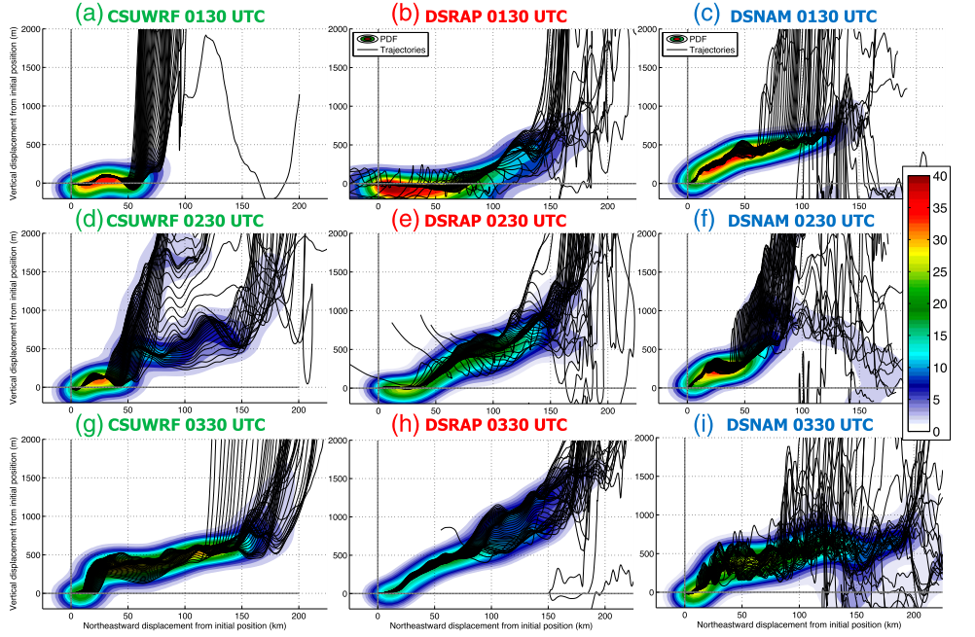
Parcel height PDF
(shading), individual
trajectory (black line)
Launch location: MP4 site (200-1500m)
Notes:
Trajectory analysis is utilized to confirm the assumption that the location bias shown above (especially for the training line location) is intrinsically related to low tropospheric pre-convective moisture concentration by controlling the distance where instability is released while parcels are being lifted gently along the sloping isentropes.
Analysis results are in broad agreement with the vertical cross section analysis. Specifically, this result is encouraging as this confirms the validity of the parcel lifting deduction method by comparing the height changes of isentropes.

Slide 20
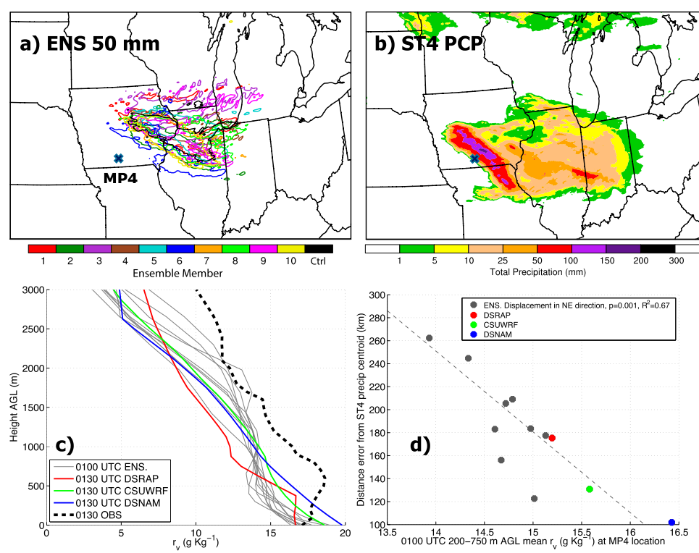
Quick-and-dirty statistical validation
DSRAP, CSUWRF, DSNAM and 10 ensemble members
Statistical relationship significant to 95% confidence level (eg. P<0.05 based on student’s T test
Notes:
With the preceding analysis, it is possible that for this case, the moisture mixing ratio upstream (at MP4 site) can directly impact the simulated MCS location bias. To ensure that the result has enough physical variability, results from 10 extra ensemble members are added to the simulation agglomeration. All simulated MCS in the ensemble members displaced to the northeast compared to StageIV analysis, relationship between NE displacement and moisture can be established by comparing the moisture profiles (ensemble members uniformly drier than observations, even drier than DSRAP in the lowest 1km).
Comparison between lowest level moisture and displacement from observation shows a strong negative correlation. The simulation with the driest lowest 1km corresponds to the largest NE displacement in the simulation set while the simulation with most moisture in low troposphere leads to the smallest displacement.

Slide 21
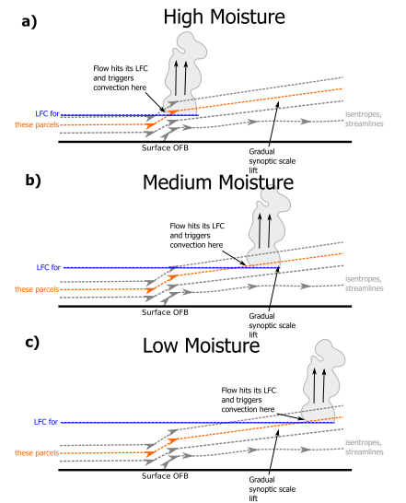
Conclusion
Moisture influences nocturnal MCS through regulating environmental CIN and LFC height
Relatively small moisture error -> huge impact on the location, structure, propagating direction and strength of forecast MCS
Lack of representation of low-level moisture evolution in reanalysis dataset is highly troubling for operational purposes (Garbage in, garbage out!)

