Slide 1
Nowcast guidance of afternoon convection initiation for Taiwan
Professor : Ming-Jen Yang
Student : Jyong-En Miao
Date : 2018/04/24
Chang, H.-L., B. G. Brown, P.-S. Chu, Y.-C. Liou, and W.-H. Wang, 2017
Wea. Forecasting, 32, 1801–1817.

Slide 2
Introduction
(Mueller and Wilson 1989; Wilson and Mueller 1993) forecasters can often anticipate thunderstorm initiation by monitoring radar-detected convergence lines.
(Stensrud and Maddox 1988) not all convergence lines initiate storms, even when they collide in conditionally unstable environments.
Wilson et al. (1998) showed that the initiation of convective storms is often controlled by boundary layer convergence, vertical wind shear, and buoyancy.
Lin et al. (2012) found that the best predictors of afternoon thunderstorms were vapor pressure, humidity, wind direction, and wind speed of the boundary layer in the morning, as well as CAPE, dewpoint depression, wind direction, and wind speed in 1000–500 hPa from sounding at 0800 LST.
Focusing on ACIs in Taiwan under weak synoptic forcing, we applied the Taiwan Auto-NowCaster (TANC) to produce 1-h likelihood nowcasts of CI based on a fuzzy logic approach. Eight predictors were used in the study, and two of them were based on the radar climatology constructed by Lin et al. (2012).

Slide 3
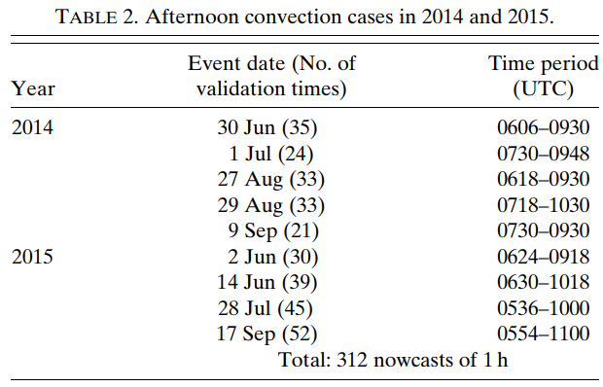
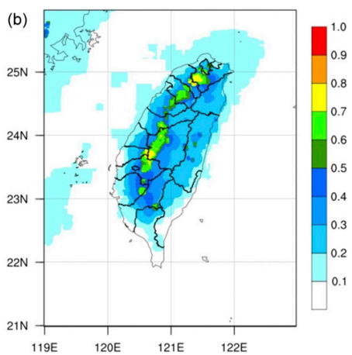
TANC and study data
The TANC with a 0.01° horizontal resolution; the system estimates the 1-h likelihood of CI every 6 min operationally.
This study focuses on well-organized afternoon convective storms under weak synoptic forcing in May–October. Well-organized convection cases: 1) radar reflectivity ≧ 35 dBZ over areas ≧ 300 km² , 2) lasted ≧90 min and 3) between 0400 and 1200 UTC

Slide 4
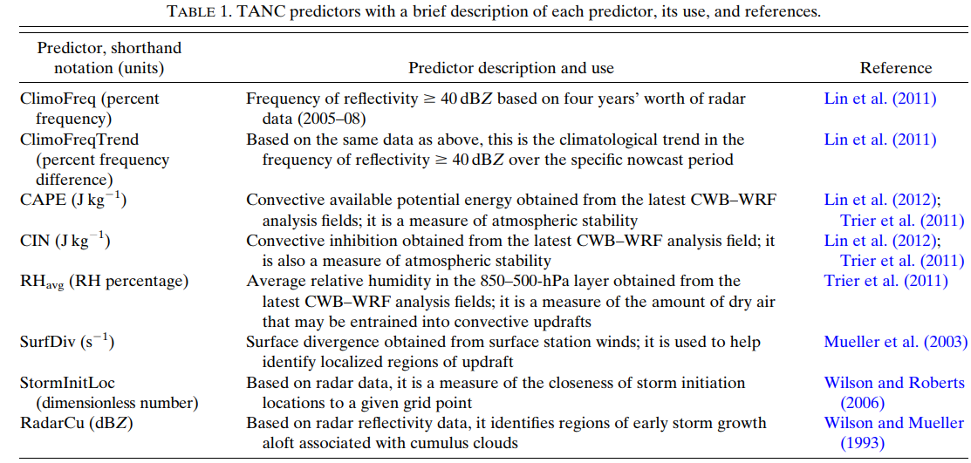

Slide 5
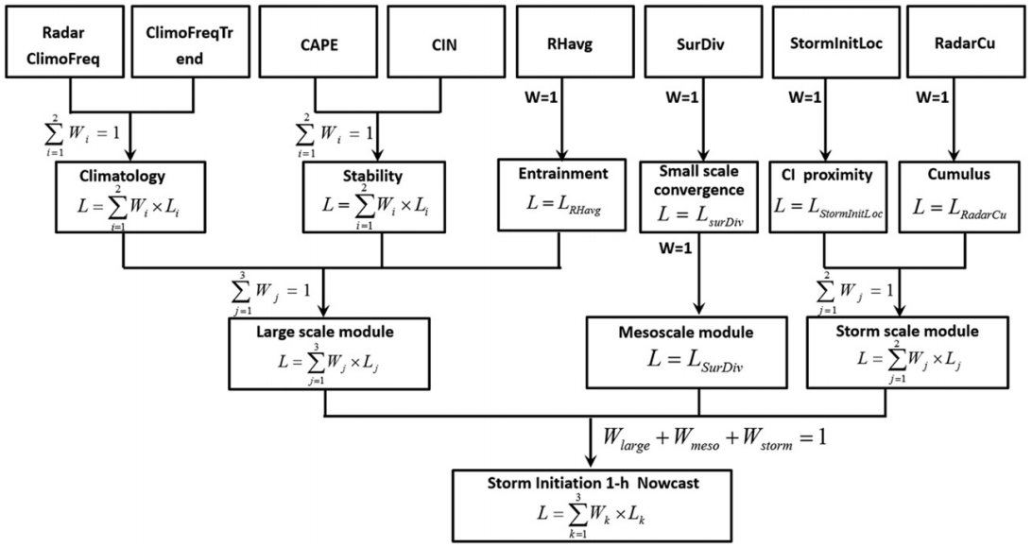
the predictor values are converted into likelihood values through fuzzy membership functions.
likelihood values range from -1 to 1. Higher positive values indicate an increased likelihood of CI in a region, lower negative values indicate a decreased likelihood, and 0 indicates a neutral likelihood (Mueller et al. 2003).

Slide 6
Verification methodology
To provide guidance on the most likely region for CI, we attempt to determine an optimal likelihood threshold (Lt) that best corresponds to the observed CI. Therefore, the likelihood forecasts are converted into yes/no forecasts.

Slide 7
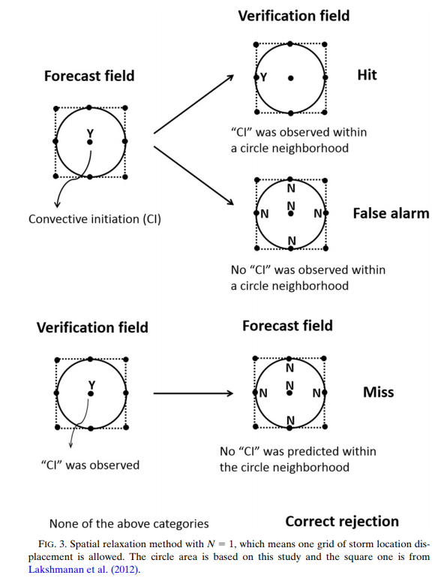
Spatial relaxation

Slide 8
Temporal relaxation
If the initial time of the 1-h CI nowcast was 0630 UTC, the predicted new convection would likely occur between 0718 and 0742 UTC (0730 UTC ± 12 min) under the T = 12 min relaxation.
In other words, the new convection predicted by the TANC nowcasts between 0618 and 0642 UTC (0630 UTC ± 12 min) would probably occur at 0730 UTC.

Slide 9
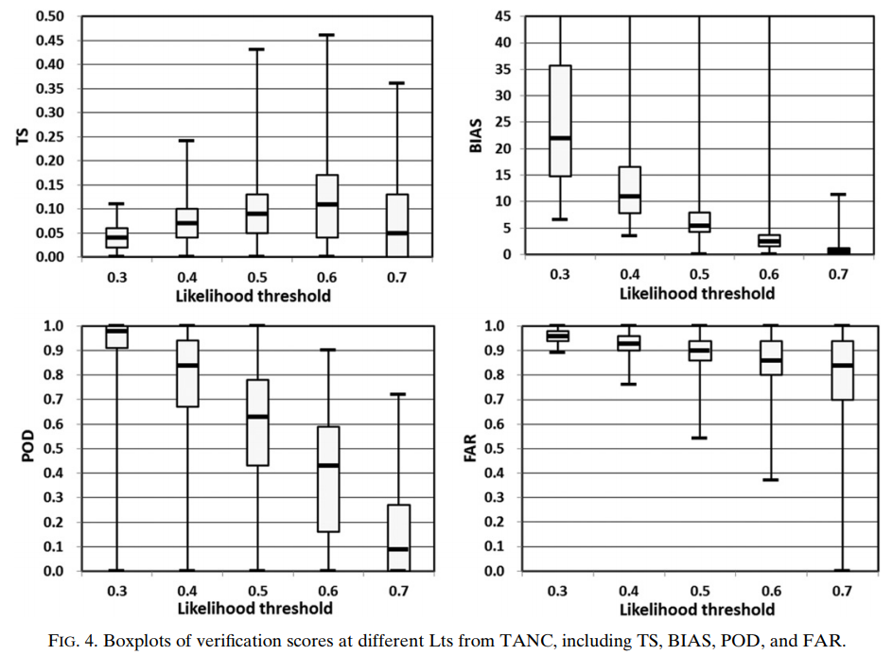

Slide 10
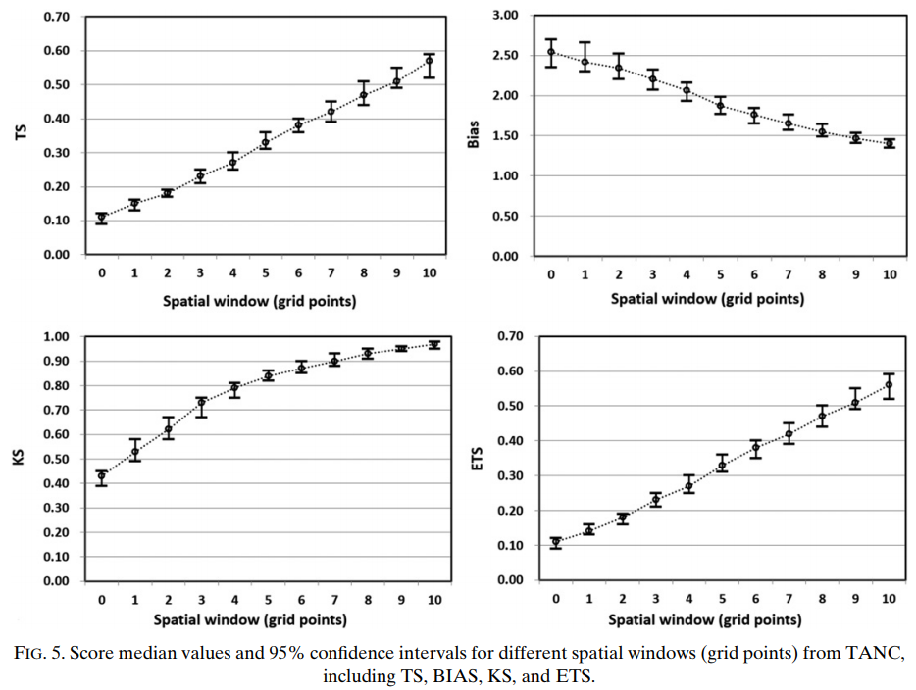

Slide 11
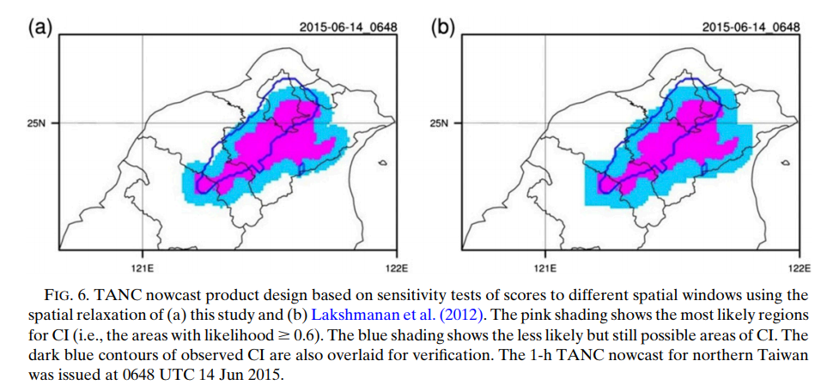

Slide 12
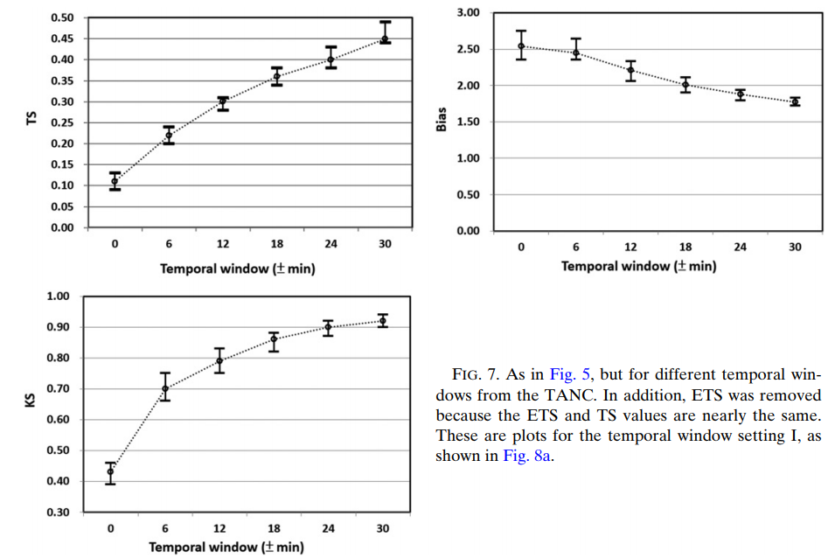

Slide 13
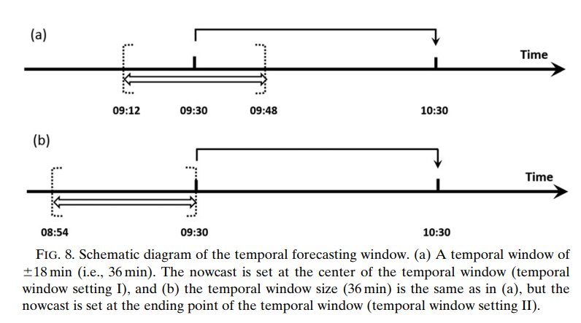

Slide 14
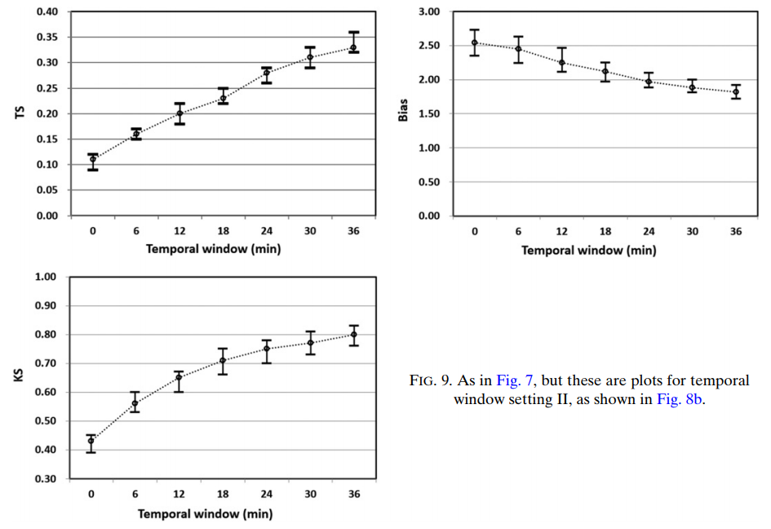

Slide 15
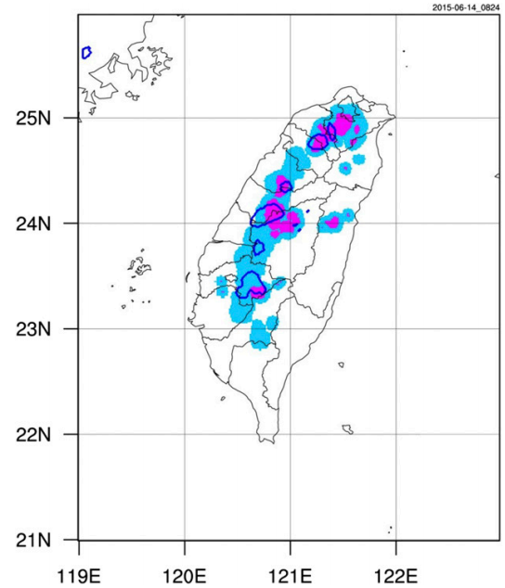

Slide 16
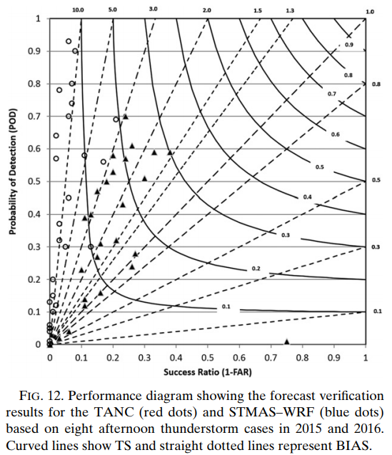
TANC:
STMAS-WRF:

Slide 17
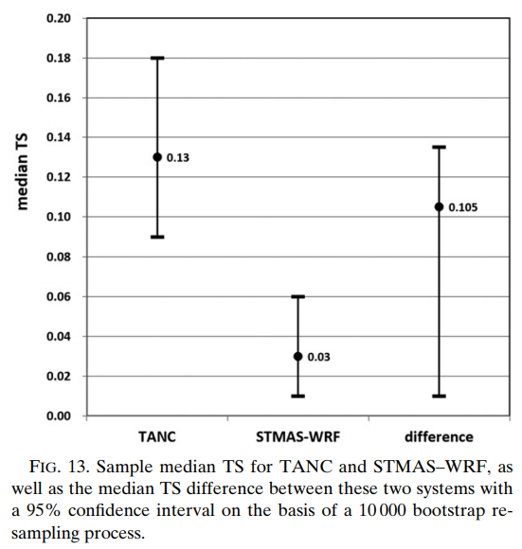

Slide 18
Conclusions
Focusing on nine days’ worth of afternoon thunderstorms under weak synoptic forcing in 2014 and 2015, we apply the TANC to generate 1-h likelihood nowcasts of ACIs based on a fuzzy logic approach. The primary purpose is to provide more useful nowcast guidance of ACIs for forecasters.
The optimal value of Lt for ACI is suggested to be 0.6. A combination of a spatial window of 5 km and a temporal window of 18 min is preferred as the acceptable uncertainty range of forecast errors when operational needs are taken into account.
Verification results and a Mann–Whitney test suggest that the TANC significantly surpasses the competing STMAS–WRF model with a very low p value.
To produce more accurate ACI nowcasts, some predictors of the TANC should be changed. Analysis fields of the STMAS–WRF model should be considered as replacements for their equivalents in the CWB–WRF model to provide higher temporal and spatial resolution information

Slide 19
Conclusions
Other predictors:
satellite cumulus cloud IR temperature change
onset time of the sea breeze
the time of sea-breeze passage at key surface stations
Information on the previous day’s convective storms

Slide 20
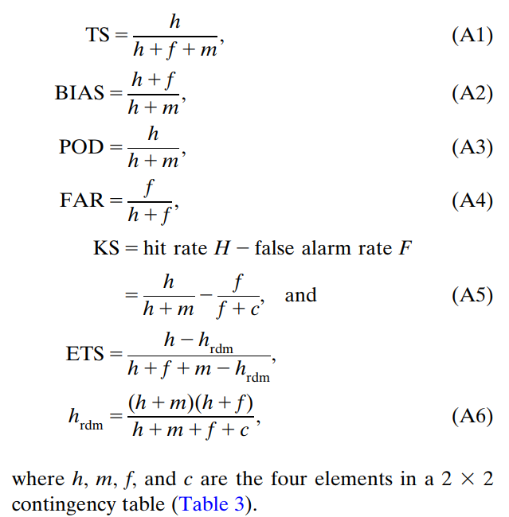

Slide 21
