Slide 1
High-Resolution Model-Based Investigation of Moisture Transport into the Pacific Northwest during a Strong Atmospheric River Event
Mueller M. J., K. M. Mahoney, and M. Hughes, 2017: High-Resolution Model-Based Investigation of Moisture Transport into the Pacific Northwest during a Strong Atmospheric River Event. Mon. Wea. Rev., 145, 3861-3879.

Slide 2
Scientific Questions
1) Where were the primary corridors for inland moisture penetration?
2) How much moisture traveled through the corridors in comparison to over adjacent terrain?
3) What proportion of upstream moisture flux was lost during transit through the corridors?

Slide 3
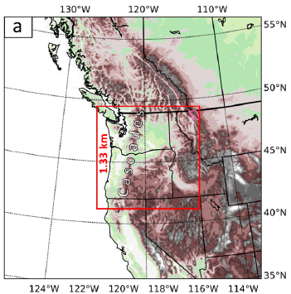
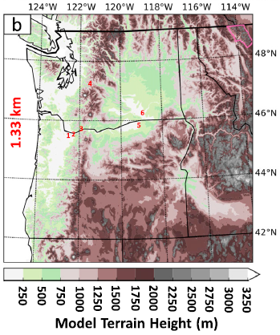
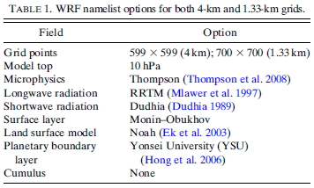
PDX
TTD
CZK
SMP
HRI
PSC
Columbia River
WA
MT
ID
OR
NV
UT
CA
WRF-ARW V3.8.1
0000 UTC 3 Nov – 0000 UTC 9 Nov 2006
IC/BC: CFSR T382(~38km) / 64 levs / Downscaling to 4 km
One Way
54 levs

Slide 4
$$DR=1−\frac{{IWT}_{downstream}}{{IWT}_{upstream}}$$
$$IWV=\frac{1}{g}\int_{sfc}^{200mb}{q_{vap}dp}$$
$${QT}_{vap}=∆x\int_{t_{0}}^{t_{f}}{\left|IVT\right|dt}$$
$${QT}_{mois}=∆x\int_{t_{0}}^{t_{f}}{\left|IWT\right|dt}$$
$$IVT=\frac{1}{g}\int_{sfc}^{200mb}{q_{vap}\overset{⃑}{U}dp}$$
$$IWT=\frac{1}{g}\int_{sfc}^{200mb}{q_{mois}\overset{⃑}{U}dp}$$
${{QTV}_{vap}\text{/}{QTV}_{mois}/uQTV}_{vap}$/${vQTV}_{vap}$/${uQTV}_{mois}$/${vQTV}_{mois}$

Slide 5
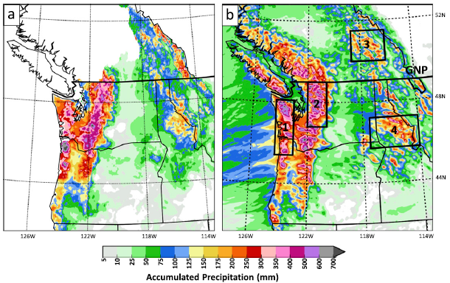
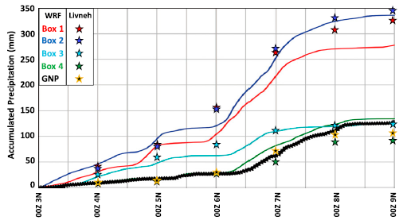
Livneh precipitation data (6 days)
dx ~ 5 km
dy ~ 7 km
Model Verification
Precipitation
125-175mm
<50mm
300-600mm
12-15hr delay

Slide 6
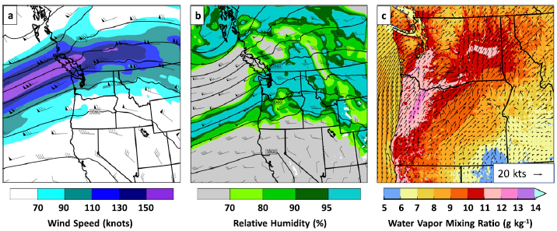
Model Verification
Synoptics
0000 UTC 7 Nov 2006
300mb
700mb
Qv2 + U10/V10
1) Terrain effect
2) AR core location
low-level moisture convergence near higher terrain was a key factor in precipitation enhancement during the event

Slide 7
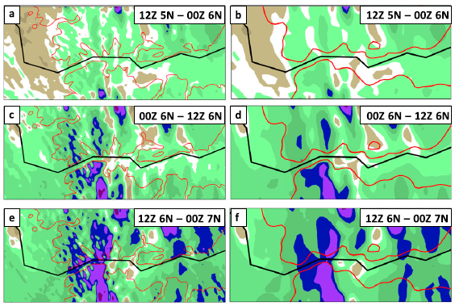
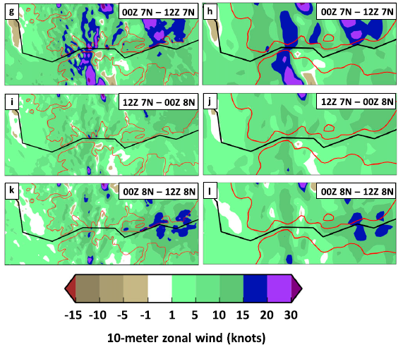
1.33 km
4 km
Model Verification
Surface Winds I
1.33 km
4 km

Slide 8
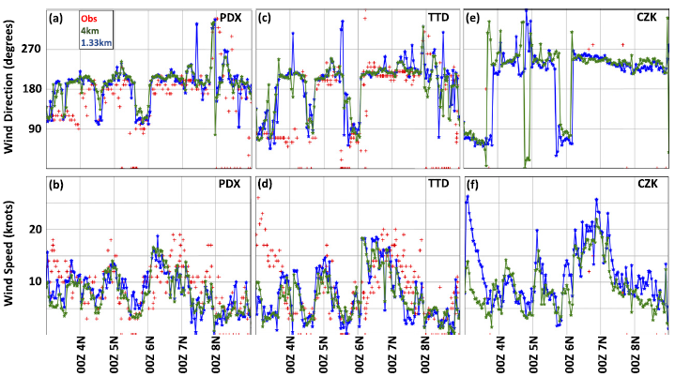
Model Verification
Surface Winds II

Slide 9
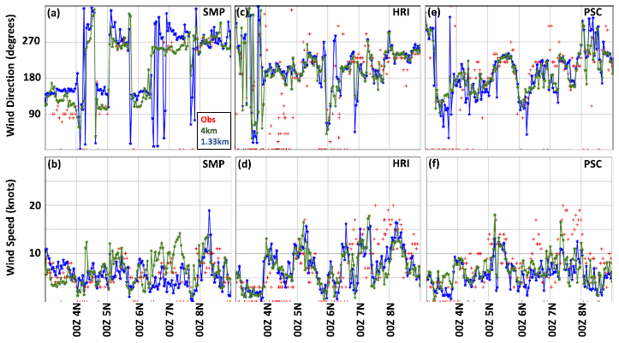
Model Verification
Surface Winds III

Slide 10
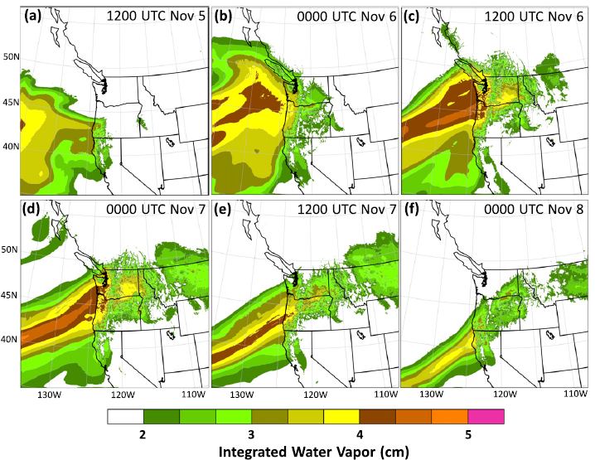
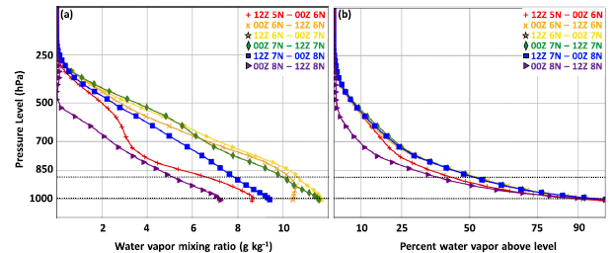
approach
landfall
inland penetration
decay
ridge height
moisture removal via precipitation
Routing of low-level moisture

Slide 11
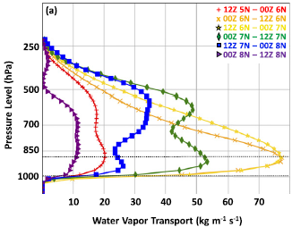
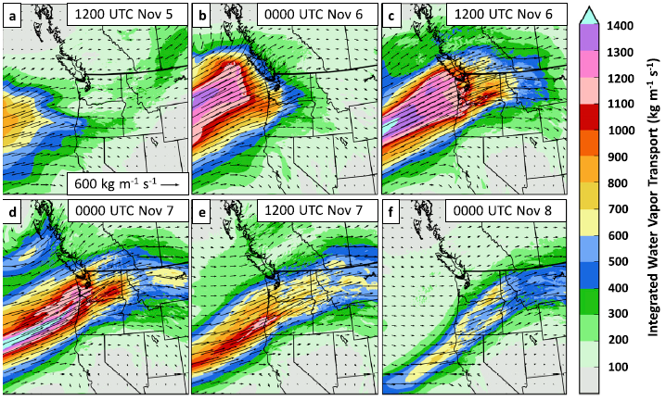
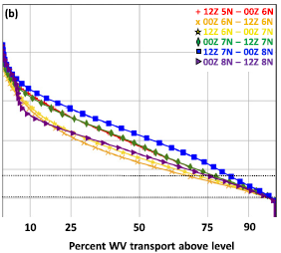
Moisture Transport (IVT)

Slide 12
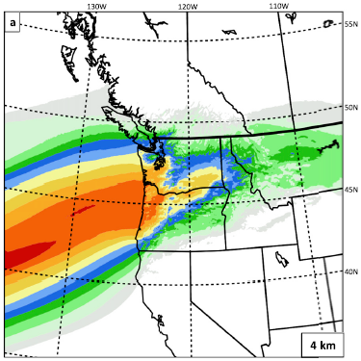
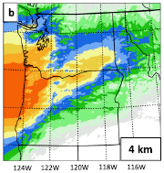
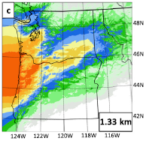
1200 UTC 5 Nov - 1200 UTC 8 Nov 2006
Moisture Transport (QT)
1) The CR Gap was a ‘‘path of least resistance’’ through which water vapor transport was largest
2) A large proportion of water vapor impinging on the Cascades survived transit over the ridge into eastern Washington and Oregon

Slide 13
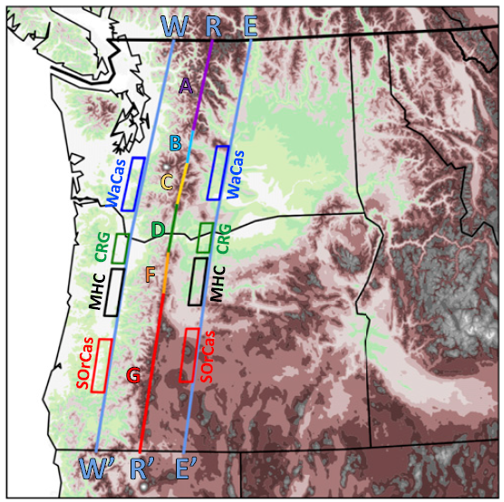
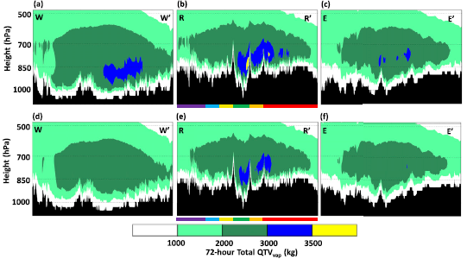
1200 UTC 5 Nov - 1200 UTC 8 Nov 2006
$${QTV}_{vap}$$
$${uQTV}_{vap}$$

Slide 14
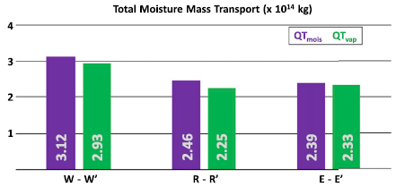
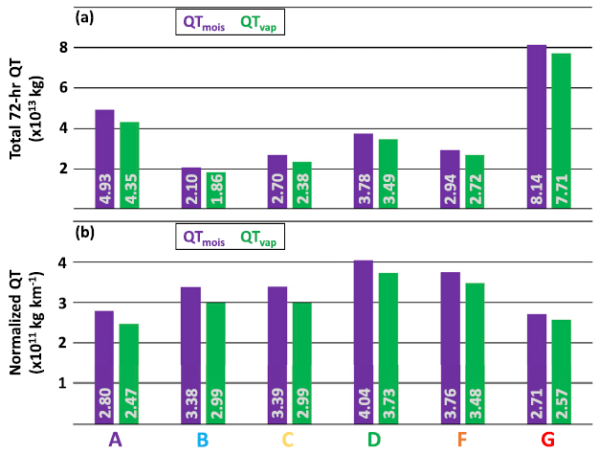
1) The majority (91.5%–97.5%) of transported moisture was in the form of water vapor.
2) The majority (90.4%) of moisture transport depletion occurred along the western slopes of the Cascades.
90.6%
9.6%
15.4%
Most concentrate

Slide 15
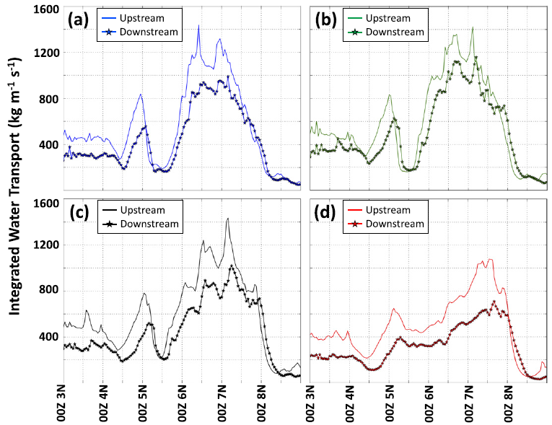
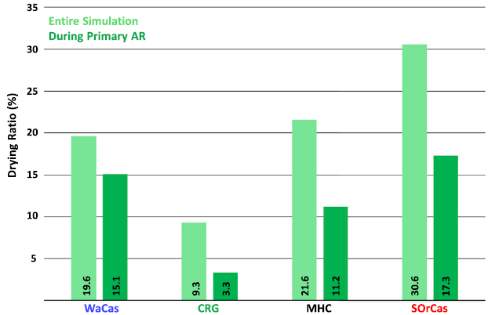
IVT
<18%
1) Moisture transport across the Cascades was most efficient through the CR Gap and least efficient over the SOrCas corridor.
2) A strong connection between the vertical depth of water vapor transport and water vapor penetration efficiency.
3.3%

Slide 16
Conclusions
1) Identify corridors through the Cascades that facilitate inland moisture penetration
While IWV, IVT, and ${QT}_{vap}$ plan views and ${QTV}_{vap}$ cross sections suggested the CR Gap and the Mt. Hood corridor just south of Mt. Hood comprised a ‘‘path of least resistance’’ through the Cascades, it was also apparent that a large proportion of inland-penetrating moisture was moving over the Cascades ridge.
2) Quantify moisture transport through the corridors
Only ~16% of total cross-Cascades transport moved through the CR Gap; the remainder moved over the Cascades ridge(~84%). The moisture transport through the CR Gap and Mt. Hood Corridor was more intense than anywhere else.

Slide 17
Conclusions
3) Quantify moisture depletion through the corridors
Drying ratios clearly indicated the most efficient (i.e., minimal moisture loss) pathway across the Cascades was through the CR Gap (DR = 9.3%/3.3%).
These results indicate the vertical distribution of moisture transport—both moisture and wind components—is an important factor when assessing the likelihood of water vapor and moisture penetration over terrain.

