Slide 1
Paper review
Precipitation hydrometeor type
relative to the mesoscale airflow in mature oceanic deep convection of
the Madden‐Julian Oscillation
Wei-Jen Tseng
Barnes, H. C., and R. A. Houze Jr. (2014), Precipitation hydrometeor type relative to the mesoscale airflow in mature oceanic deep convection of the Madden‐Julian Oscillation, J. Geophys. Res. Atmos., 119, 13990–14014

Slide 2
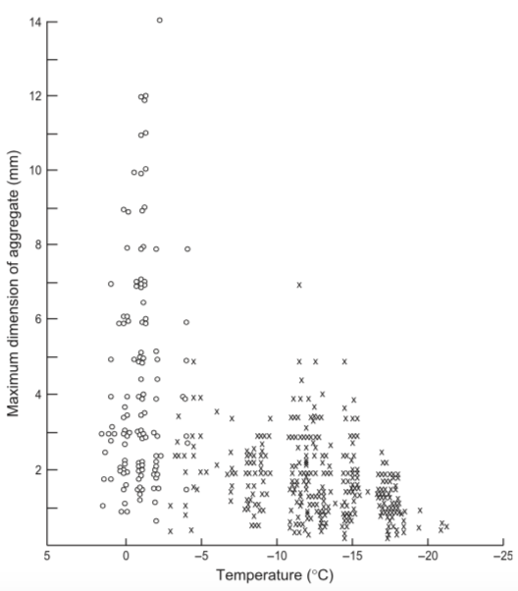
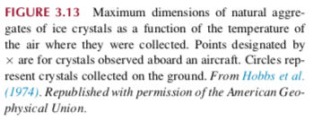
Keywords: Aggregation
ice particles collect other ice particles
Factors
depends strongly on temperature (㊝ above -5℃, ㊡ below -20 ℃)
crystal type (arms of dendrites grows between -10 ℃ and -16 ℃)
supersaturation (wetness and hence sticking efficiency)

Slide 3
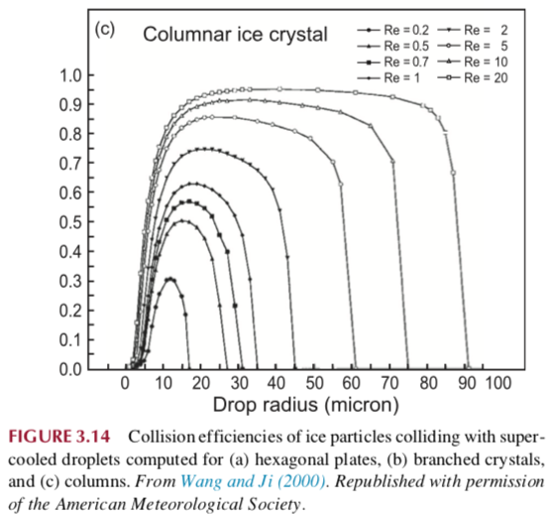
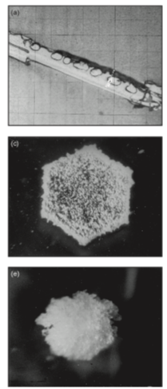
Keywords: Riming
ice particles collect liquid drops (contact freezing)
Factors
the size of the supercooled drops (radius threshold:10μm, but decreases for the largest cloud droplets [100μm] )
Reynolds number (R_{e}=2VD/ν)
V: terminal velocity (ice)
D: drop diameter
ν :viscosity of the air
type of ice particle
Keep riming … graupel and hail
(a) A lightly rimed needle,, (c) densely rimed plate, (e) lump graupel From Wallace and Hobbs (1977). Copyright Elsevier.

Slide 4
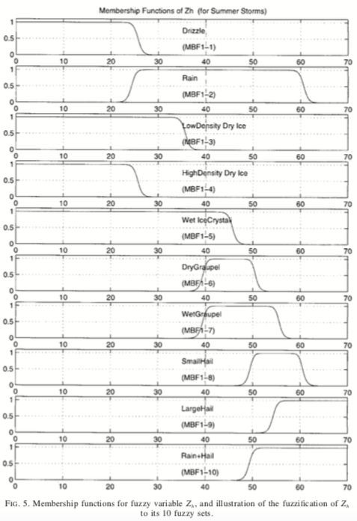
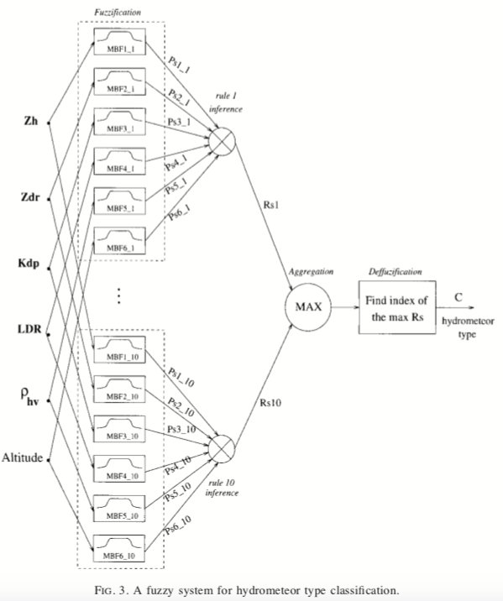
Keywords: PID
HONGPING LIU AND V. CHANDRASEKAR (2000)

Slide 5
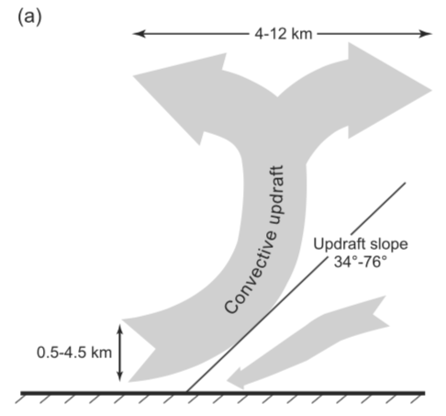
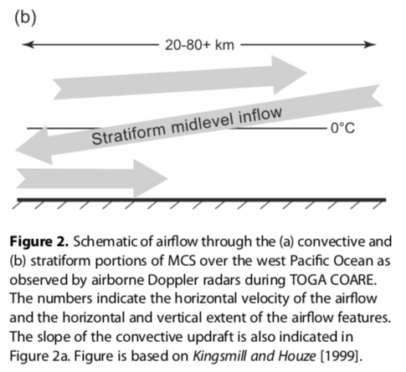

Slide 6
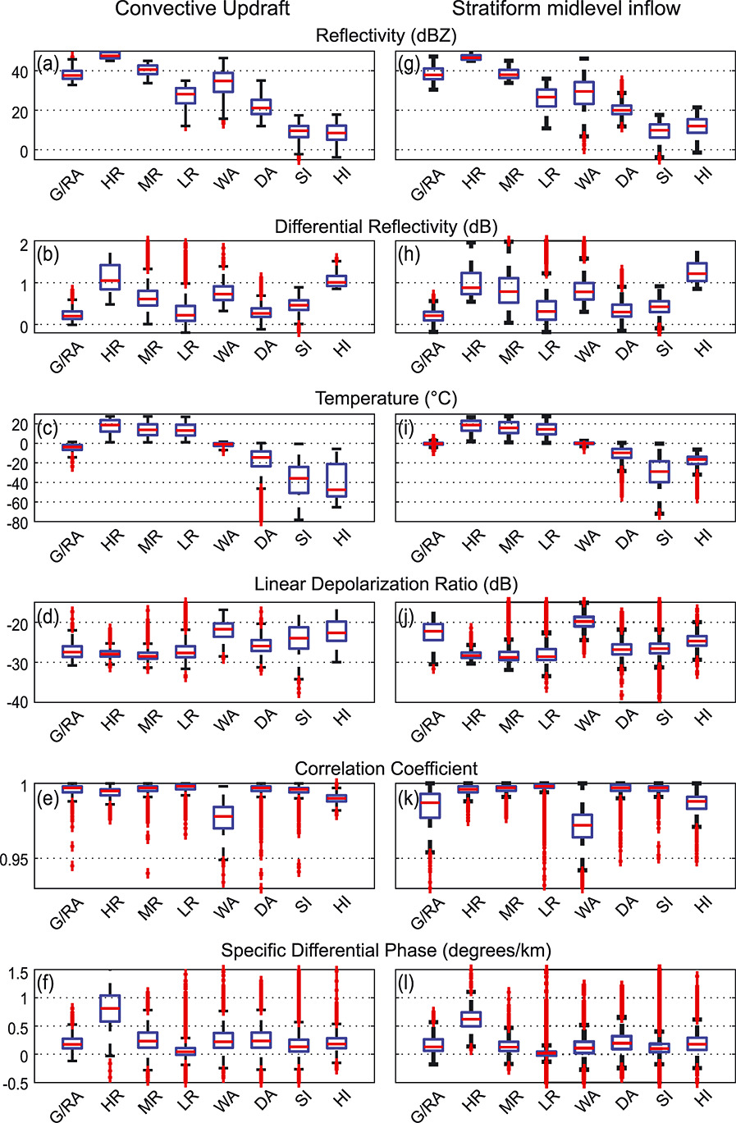
G/RA: graupel/rimed aggregates
HR/MR/LR: heavy/moderate/light rain
WA/DA: wet/dry aggregates
SI: small ice particles HI: horizontally oriented ice crystals.

Slide 7
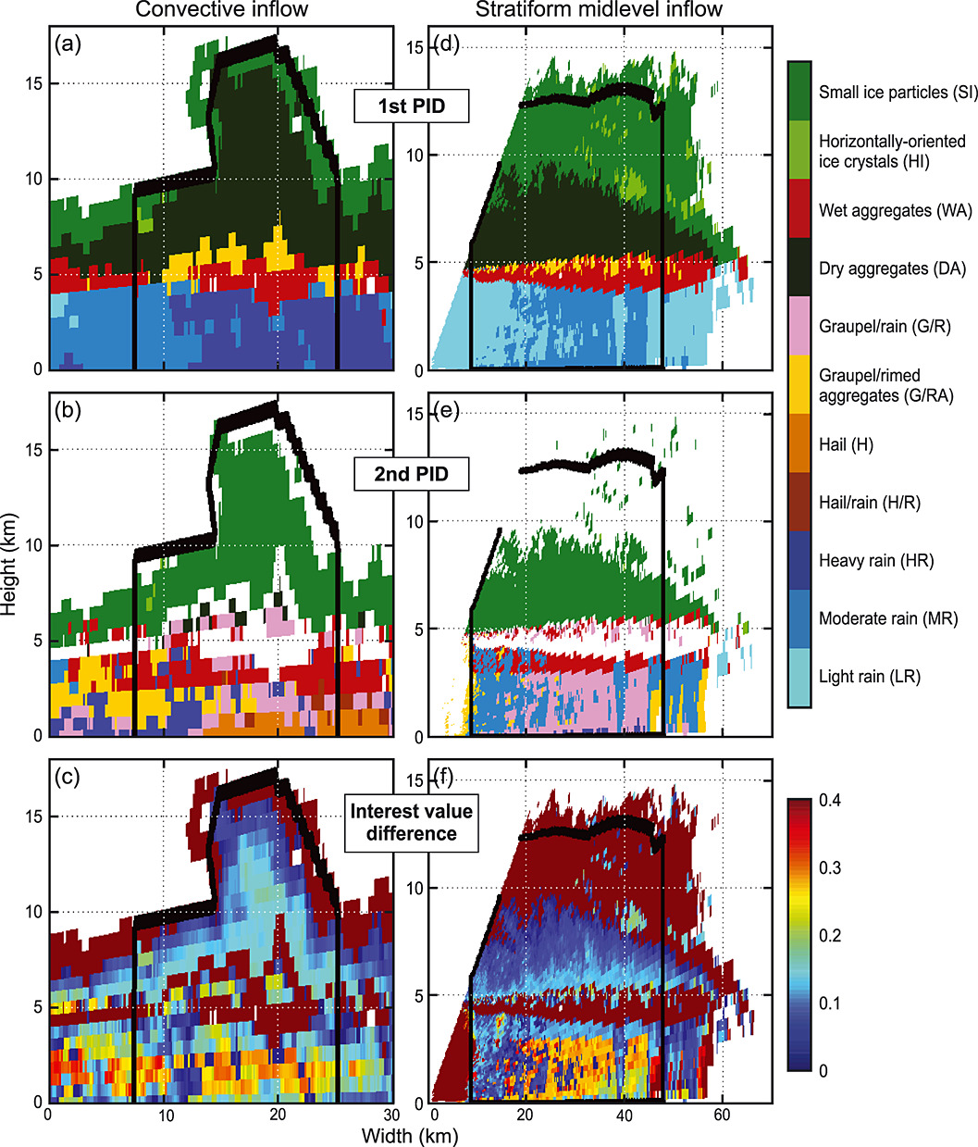
Certainty of PID

Slide 8
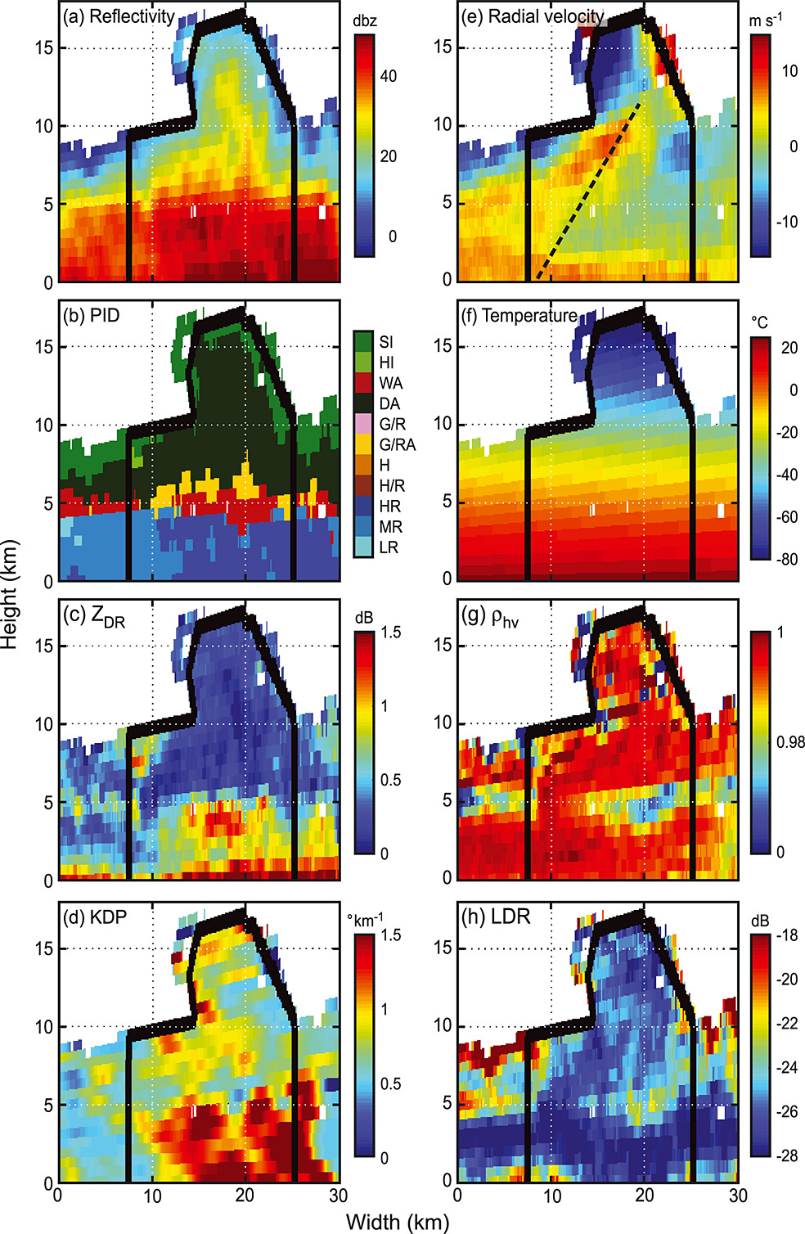
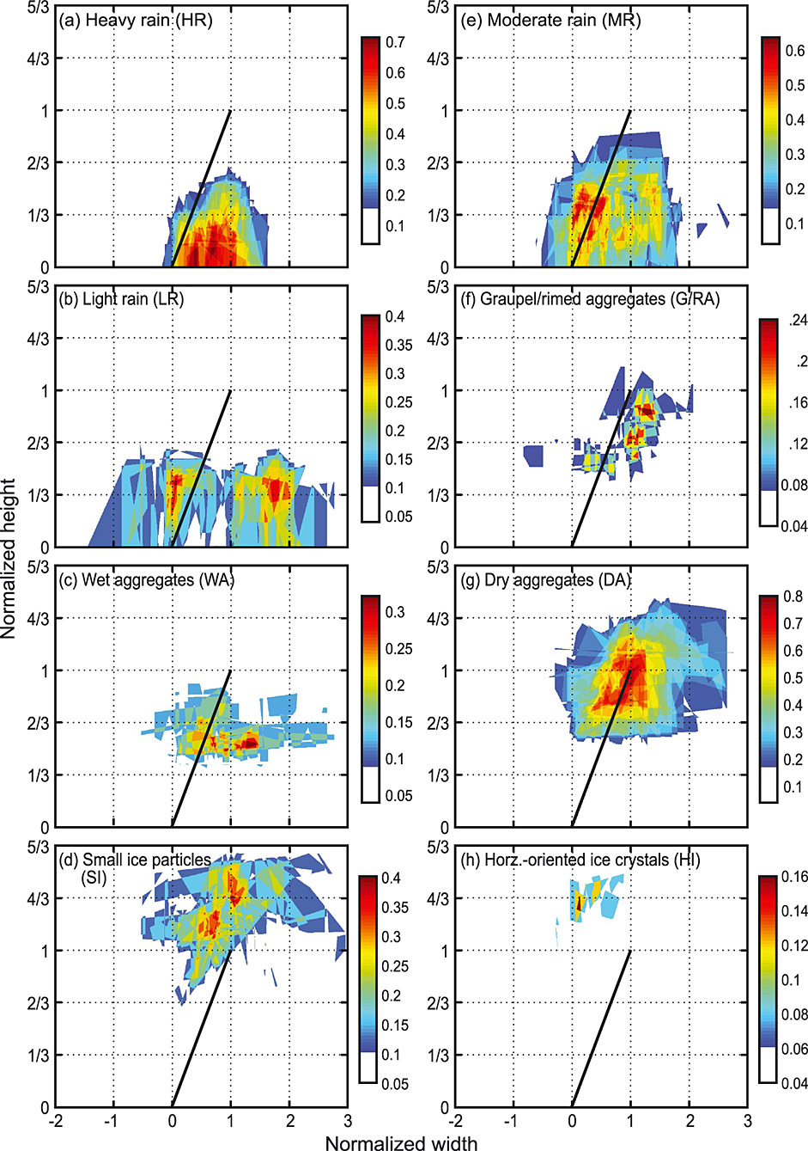
Convective region

Slide 9
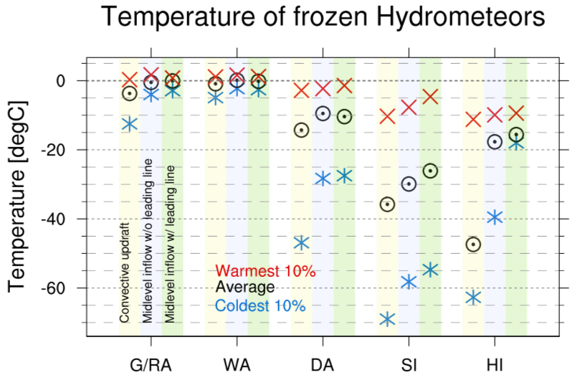
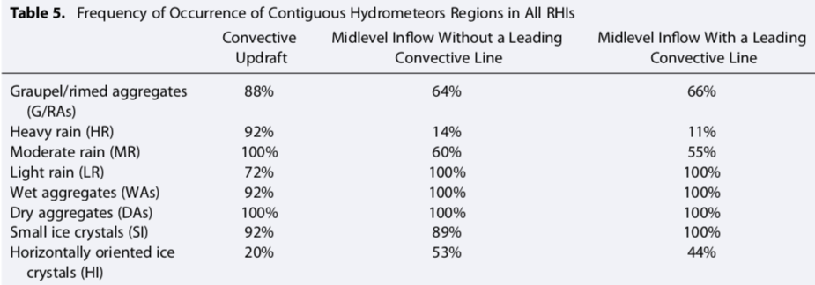

Slide 10
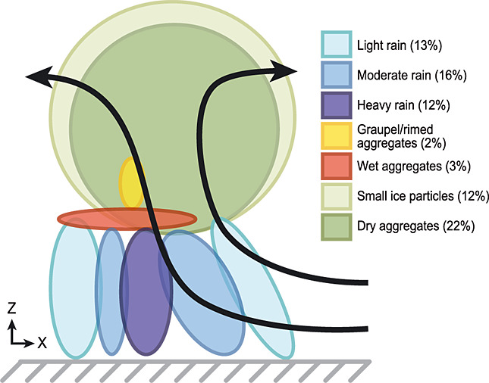
Convective region

Slide 11
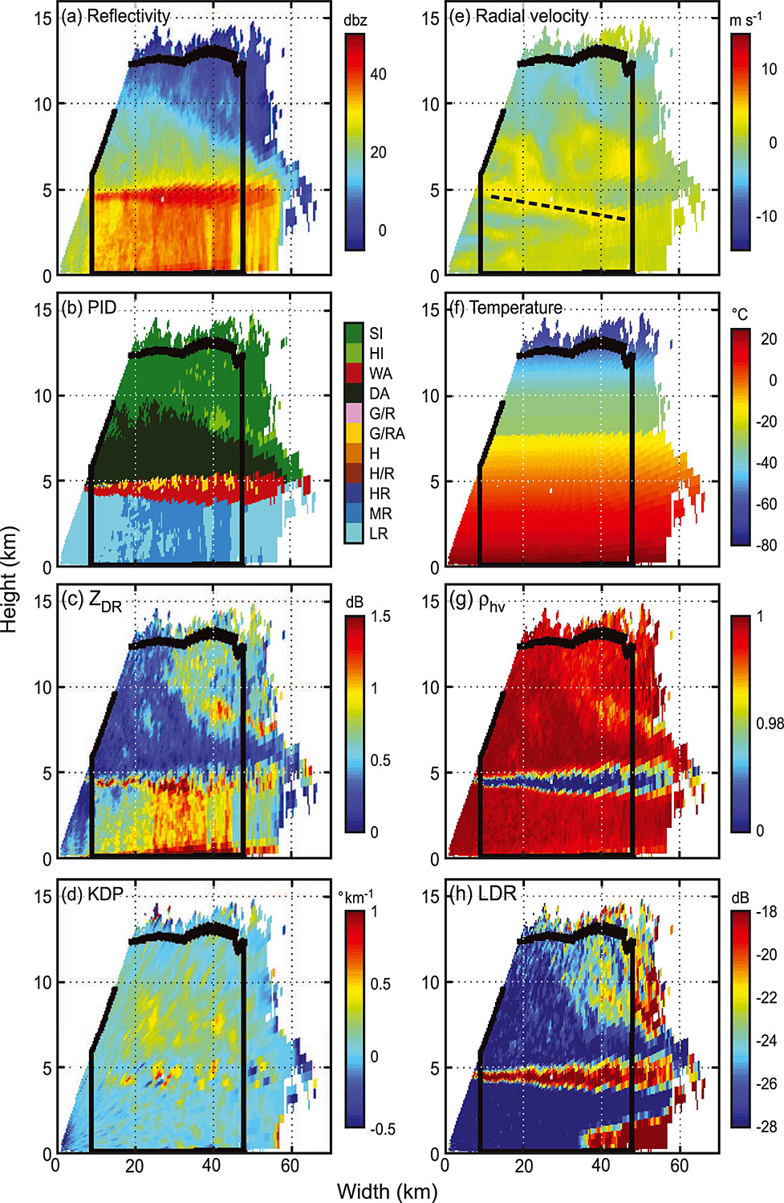
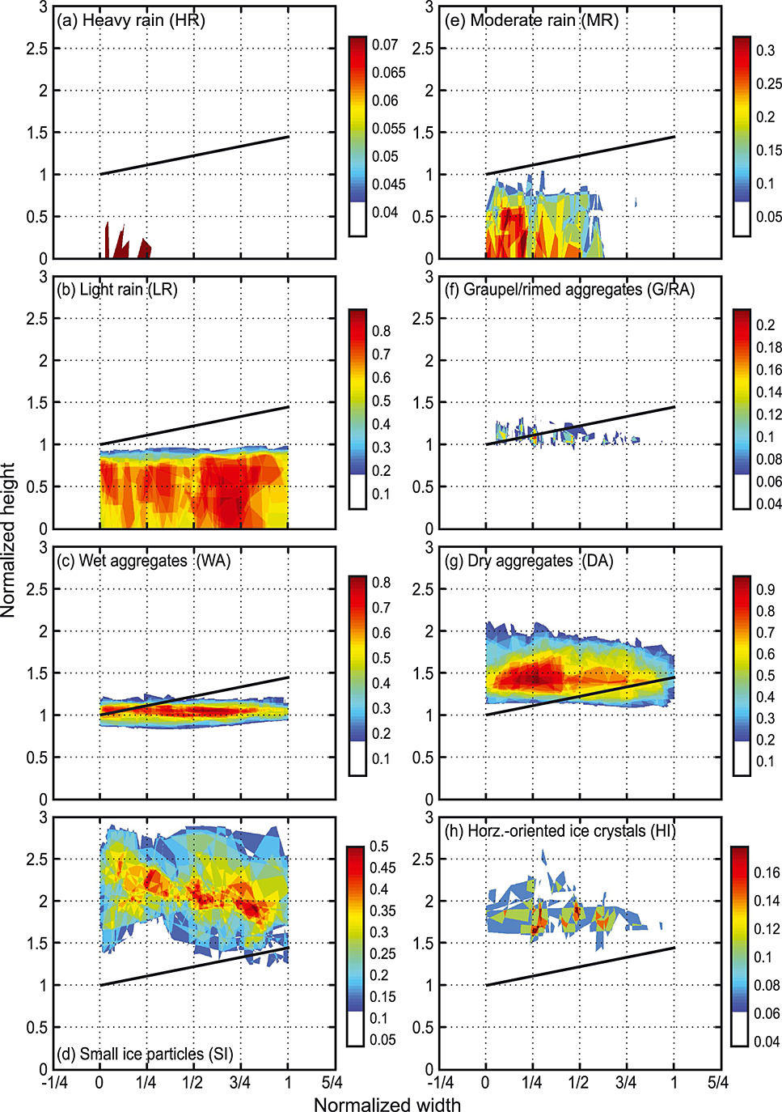
Stratiform region

Slide 13
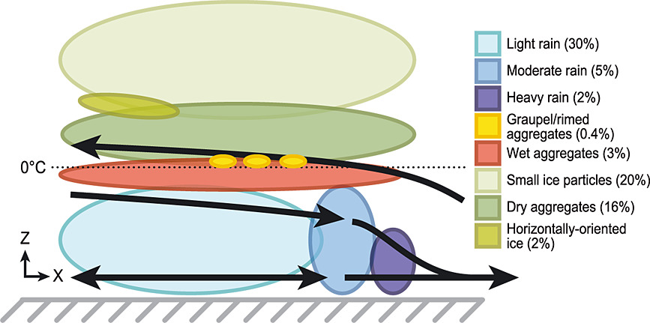
Stratiform region

Slide 14
Summary
Convective core
Low level: Moderate rain.
Above ML: Dry aggregates (environment).
Behind and below: Heavy rain and Graupel/rimed aggregates. They are related to convective scale downdrafts. G/RAs exist in a narrow zone (just a few kilometers above ML).
No hail (updrafts over tropical oceans are not large enough and survive below ML)
Melting level (ML) of the convective region is sometimes marked by band of WA.
Edge of the convective region .. Decreased rain intensity and SI

Slide 15
Summary
Stratiform region
2 types, 1 conceptual model.
Rain intensity decreases toward anvil. LR > MR > HR (midlevel inflow @ sfc.) Too heavy to move.
Layered ice hydrometeors: WA(@ML), DA, then SI (at the highest level). Weak vertical motions allow gravity settle.
G/RAs above WA: collapsing deep convective cores or localized convection (Kelvin-Helmholtz instability)
Horizontally-oriented ice (HI): associated with enhanced dendritic growth by vapor deposition

