Slide 1
The Inner-Core Temperature Structure of Hurricane Edouard (2014): Observations and Ensemble Variability
Erin B. Munsell, Fuqing Zhang, Scott A. Braun, Jason A. Sippel and Anthony C. Didlake
Wei-Ting Fang
2017.04.17

Slide 2
Introduction (I)
Maximum inner-core perturbation temperature typically occurred between 250 and 300 hPa, although a secondary maximum near 600–650 hPa was observed in Inez (Jordan 1958)
Hurricane Erin (2001): A maximum perturbation temperature (using an environmental dropsonde as a reference profile) of 11 K near 500 hPa (Halverson et al. 2006)
Nine different storms: The height of the maximum perturbation temperature existed anywhere between 750 and 250 hPa (Durden 2013)
Hurricane Earl (2010): Two distinct perturbation temperature maxima of similar magnitude were constantly observed: one in the midtroposphere (4–6 km) and the other in the upper troposphere (9–12 km); no relationship was found between the height of Earl’s maximum perturbation temperature and either the current intensity or subsequent intensity changes (Stern and Zhang 2016)
Six differenct TCs: Neither the height nor the magnitude of the warm core correlated with intensity change. (Komaromi and Doyle 2017)

Slide 3
Introduction (II)
TCs with maximum inner-core temperature perturbations in the midlevels (4–8 km) (Stern and Nolan 2012; Stern and Zhang 2013a,b)
two distinct maxima in perturbation temperature in their simulation of Super Typhoon Megi (2010): one in the midlevels (5–6 km) and the other in the upper levels (15–16 km) (Wang and Wang 2014)
The inner-core maximum perturbation temperature was found to be at ~9 km throughout much of the intensification phase, and a secondary upper-level temperature perturbation only developed once the TC reached near-major hurricane strength (Ohno and Satoh 2015)
Hurricane Earl (2010): Maximum perturbation temperature occurred at a height of 8 km at peak intensity (Chen and Gopalakrishnan 2015)
Hurricane Wilma (2005): A single maximum perturbation temperature was found at 14 km (Chen et al. 2011; Chen and Zhang 2013)

Slide 4
Hurricane Edouard (2014)
significant intensification ~12.9 m s⁻¹
tropical depression
tropical storm
peak intensity 54.0 m s⁻¹
Hurricane
9/11 12 UTC
9/12 00 UTC
9/14 12 UTC
9/16 12 UTC
modeling
9/11 12 UTC
9/18 12 UTC
dropsonde
9/16 12 UTC

Slide 5
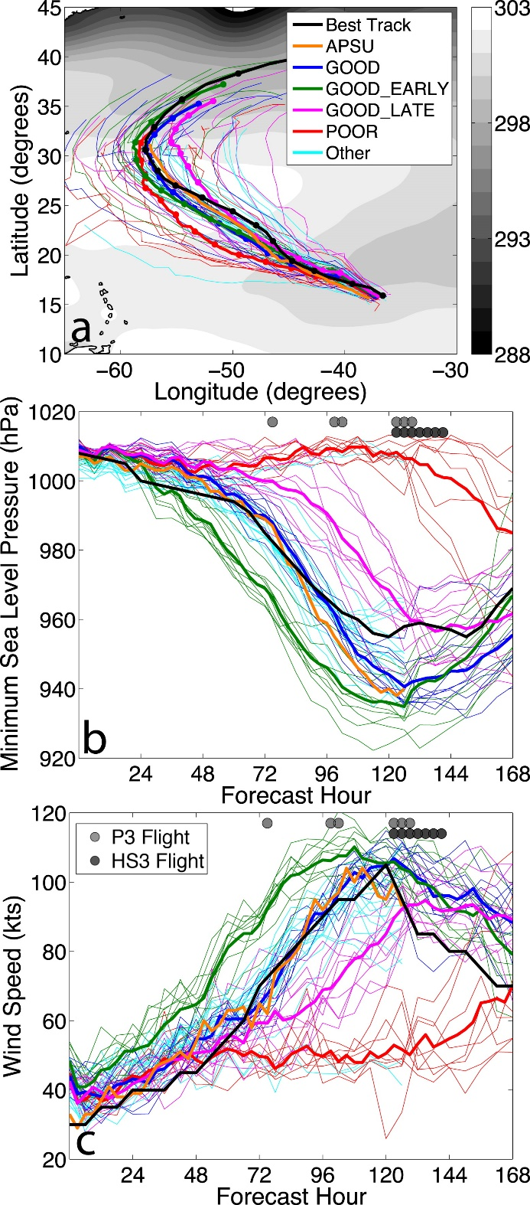
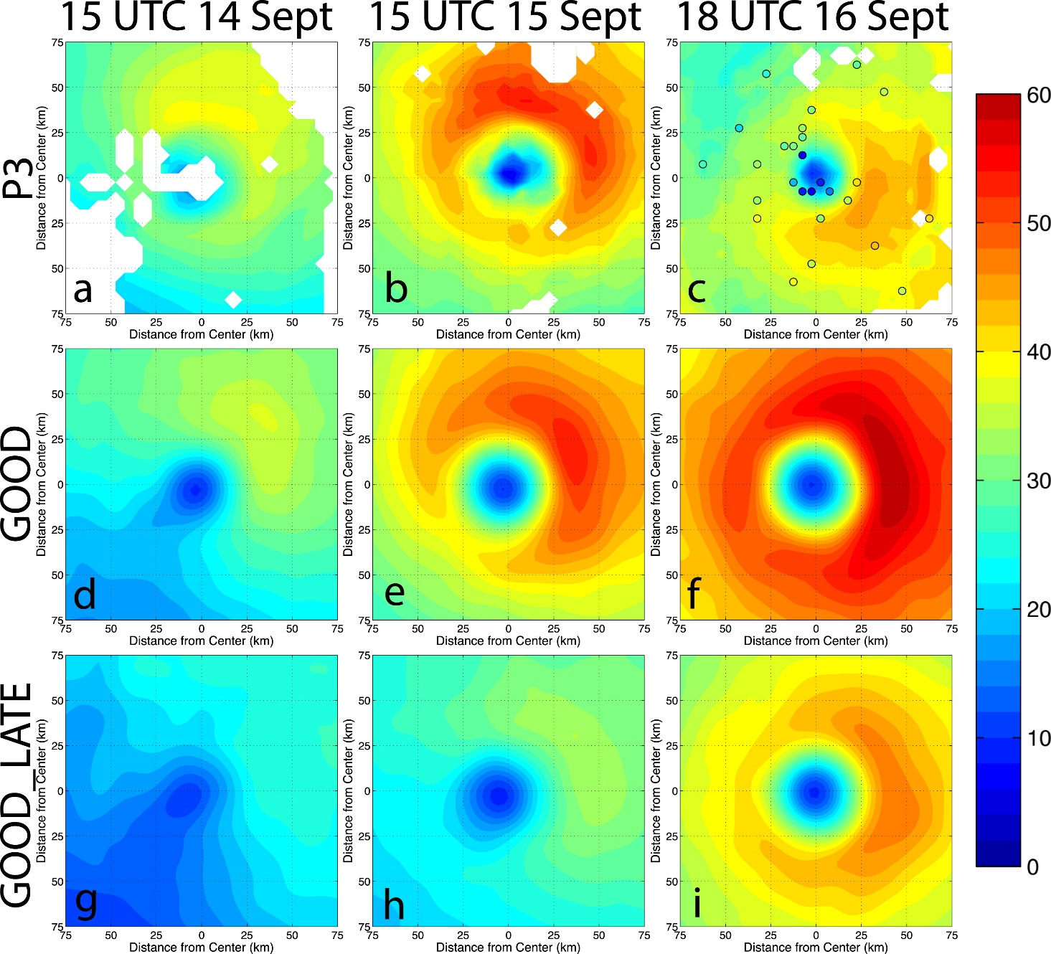
The disagreement results from the failure of some GOOD members to capture an ERC and also a tendency of GOOD to decay at a slower rate than observed. 14/20 members show evidence of an ERC.

Slide 6
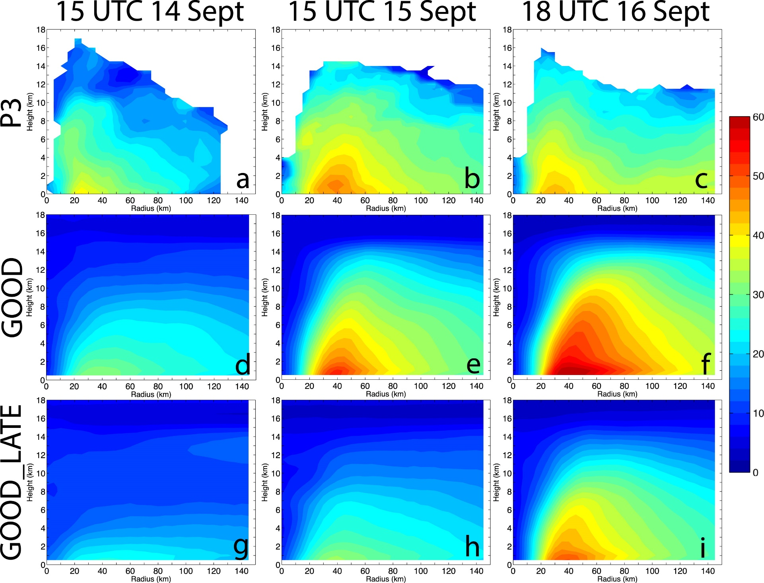

Slide 7
Results and discussion
Analysis of the observed warm core
Analysis of the simulated warm core: Comparison to observations
GOOD_LATE
Analysis of the simulated warm core: Relationship to RI
All groups
Analysis of the simulated warm core: Ensemble composite group variability
GOOD
Analysis of the simulated warm core: Correlation analyses
GOOD

Slide 8
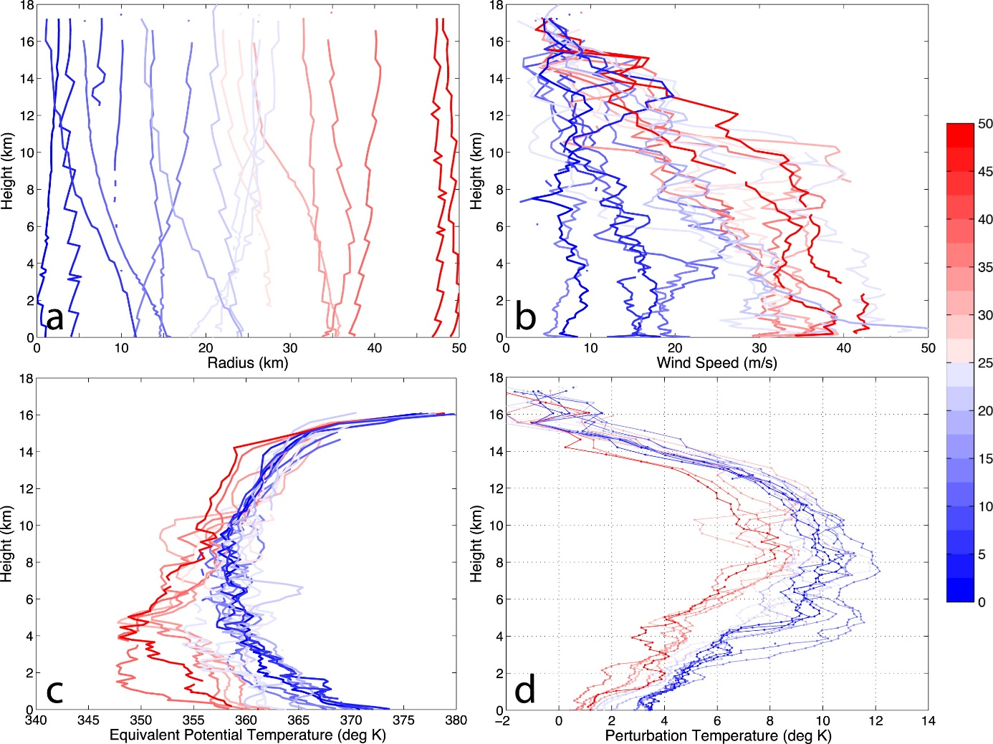
c. Analysis of the observed warm core
16–17 September
21/87 dropsondes were passing within 50km of the surface center
Perturbation temperature structures were at higher altitudes and had larger magnitudes in perturbation temperature when a climatological sounding, such as Dunion (2011), was used

Slide 9
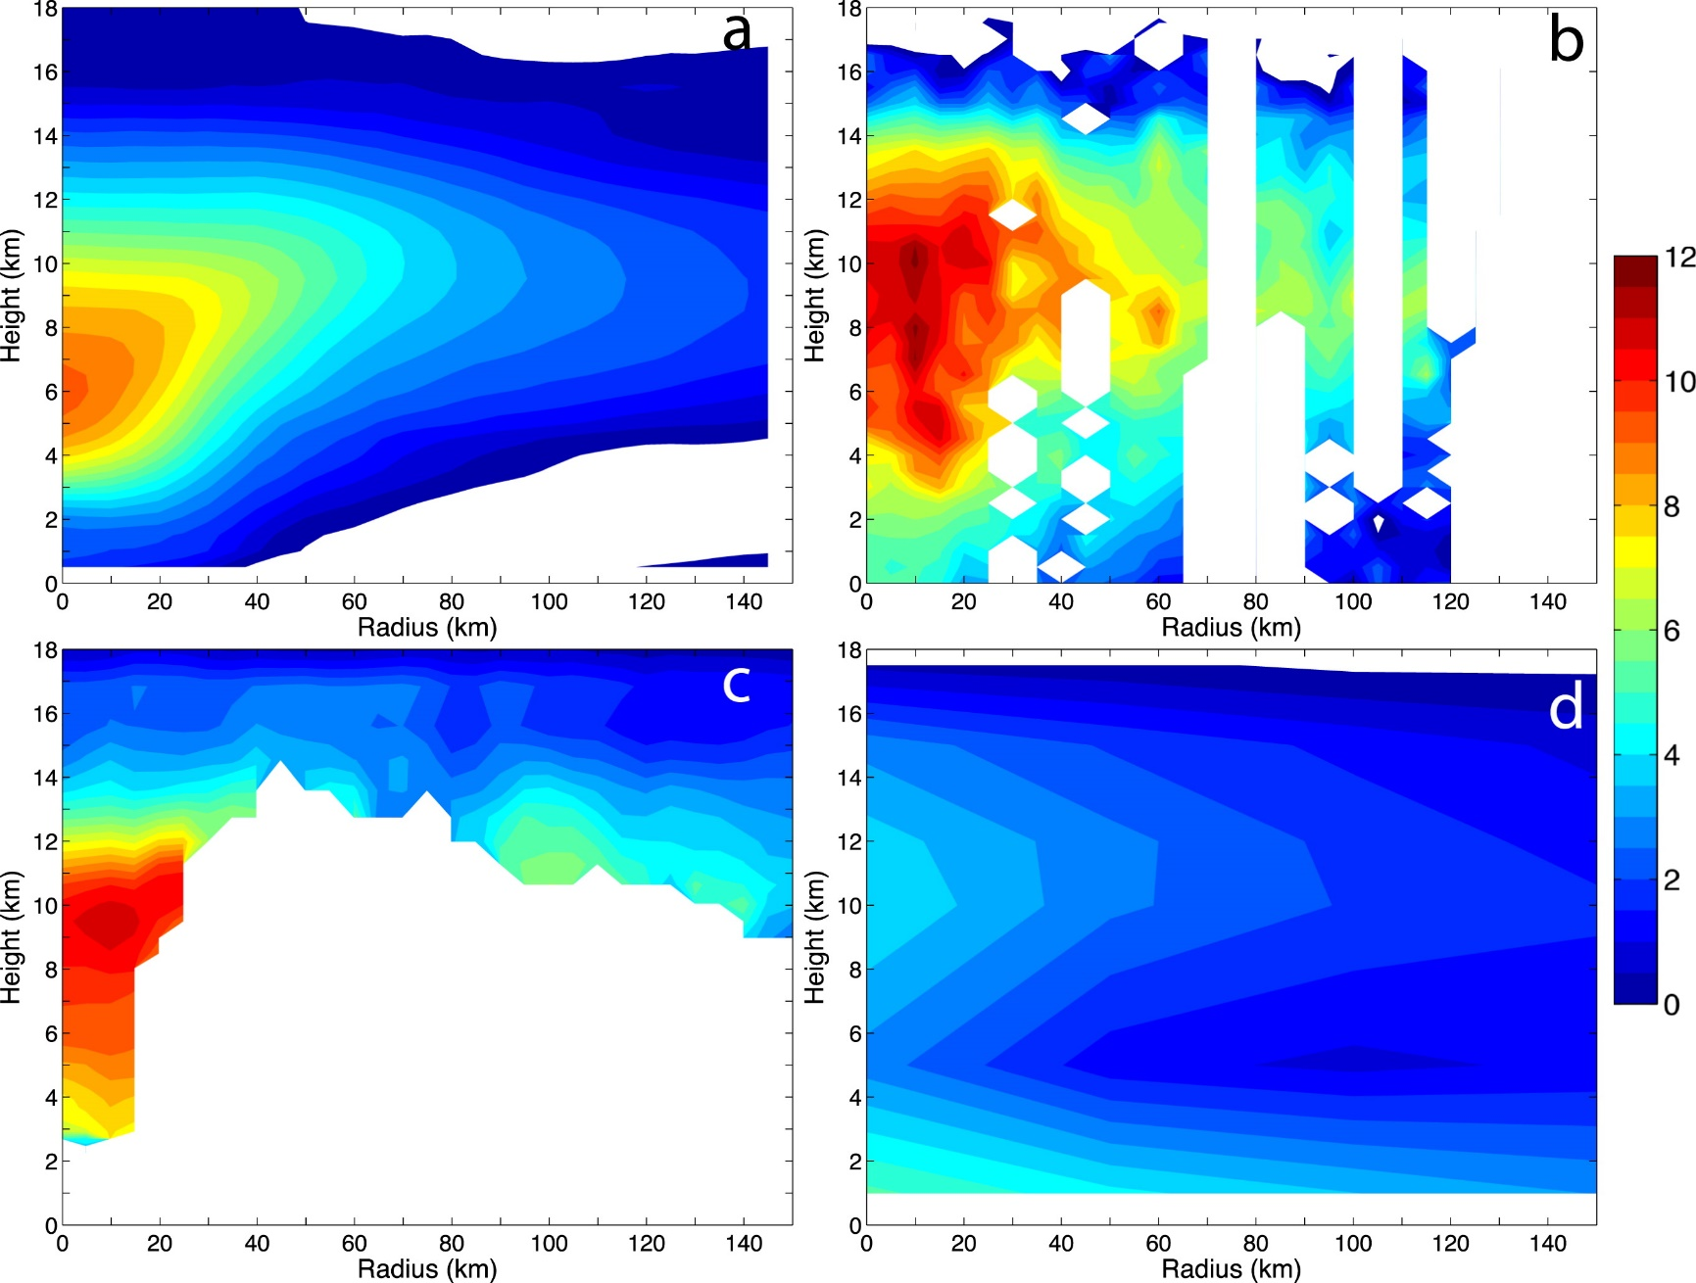
16–17 September
GOOD_LATE
dropsondes
S-HIS*
AMSU-A
reference profile is calculated from either observations or numerical data between 300 and 700kmfrom Edouard’s surface center
*Scanning High-Resolution Interferometer Sounder

Slide 10
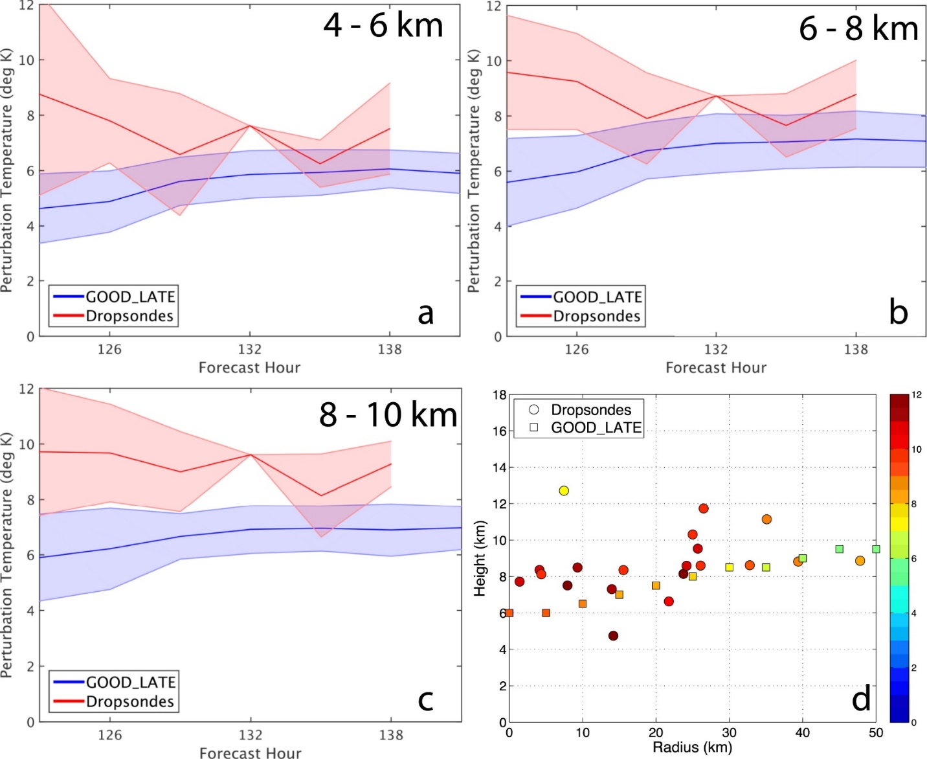
Comparison to observations
perturbation temperatures averaged within a 50-km radius
~123

Slide 11
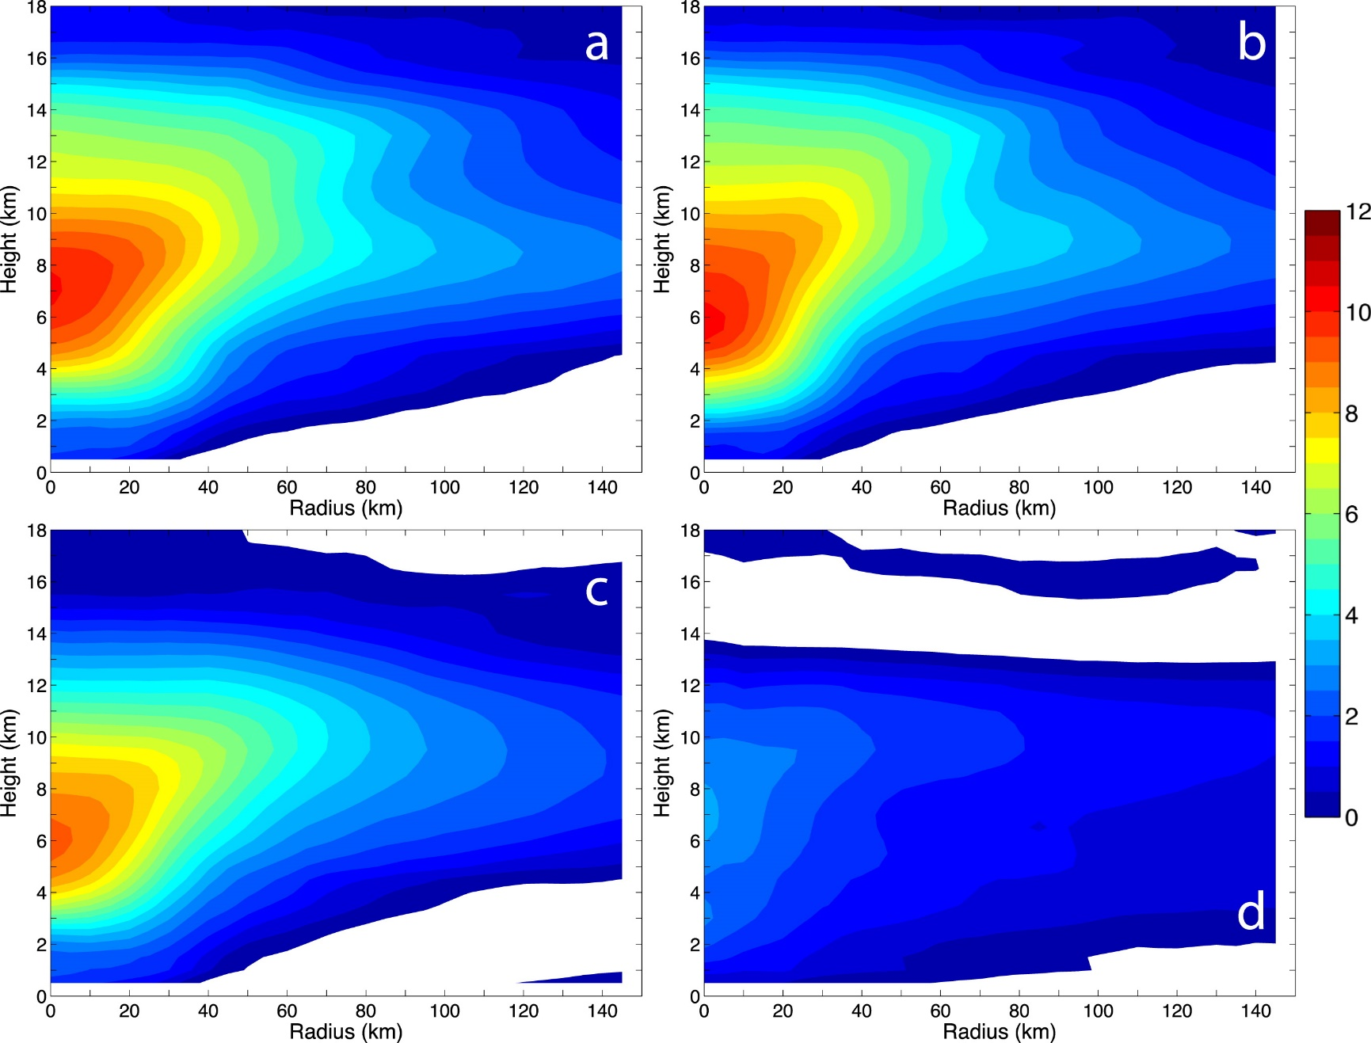
Relationship to RI
GOOD_EARLY
GOOD
GOOD_LATE
POOR

Slide 12
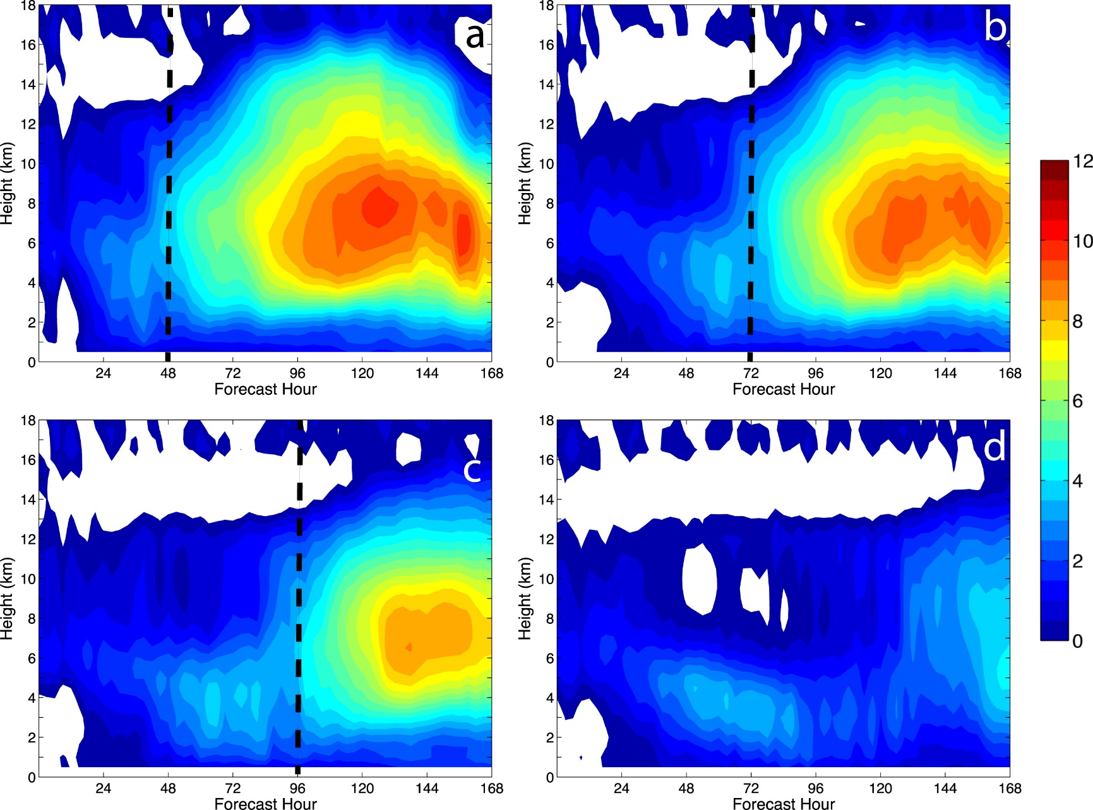
some warming (~3 K) is evident ~24 h prior to RI onset (@~4–6 km)
extends upward through 8–10 km (~3–6 h prior to RI)
GOOD_EARLY
GOOD
GOOD_LATE
POOR
up to 48 h prior to RI onset

Slide 13
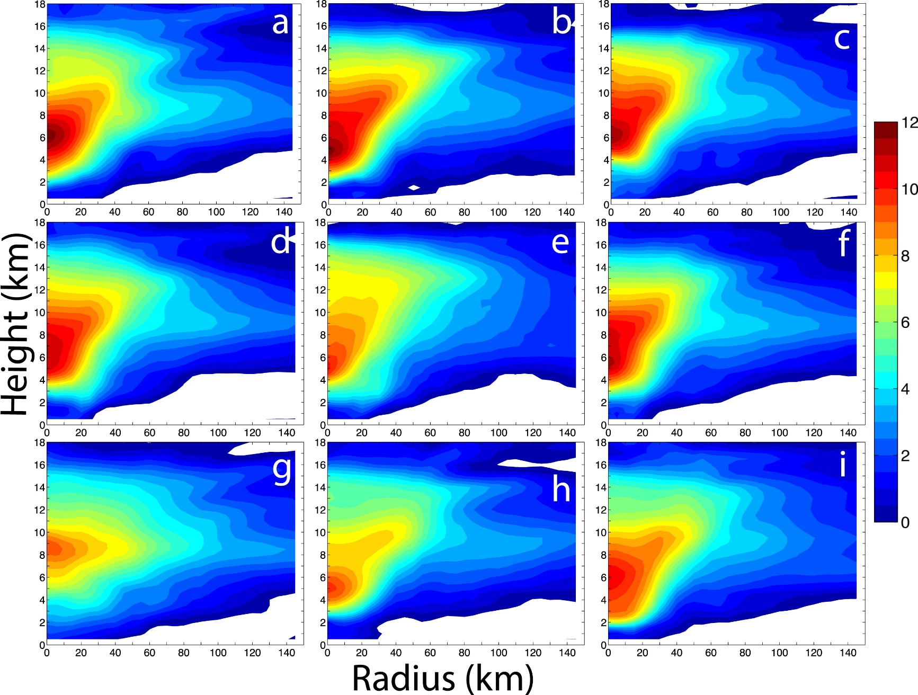
Ensemble composite group variability

Slide 14
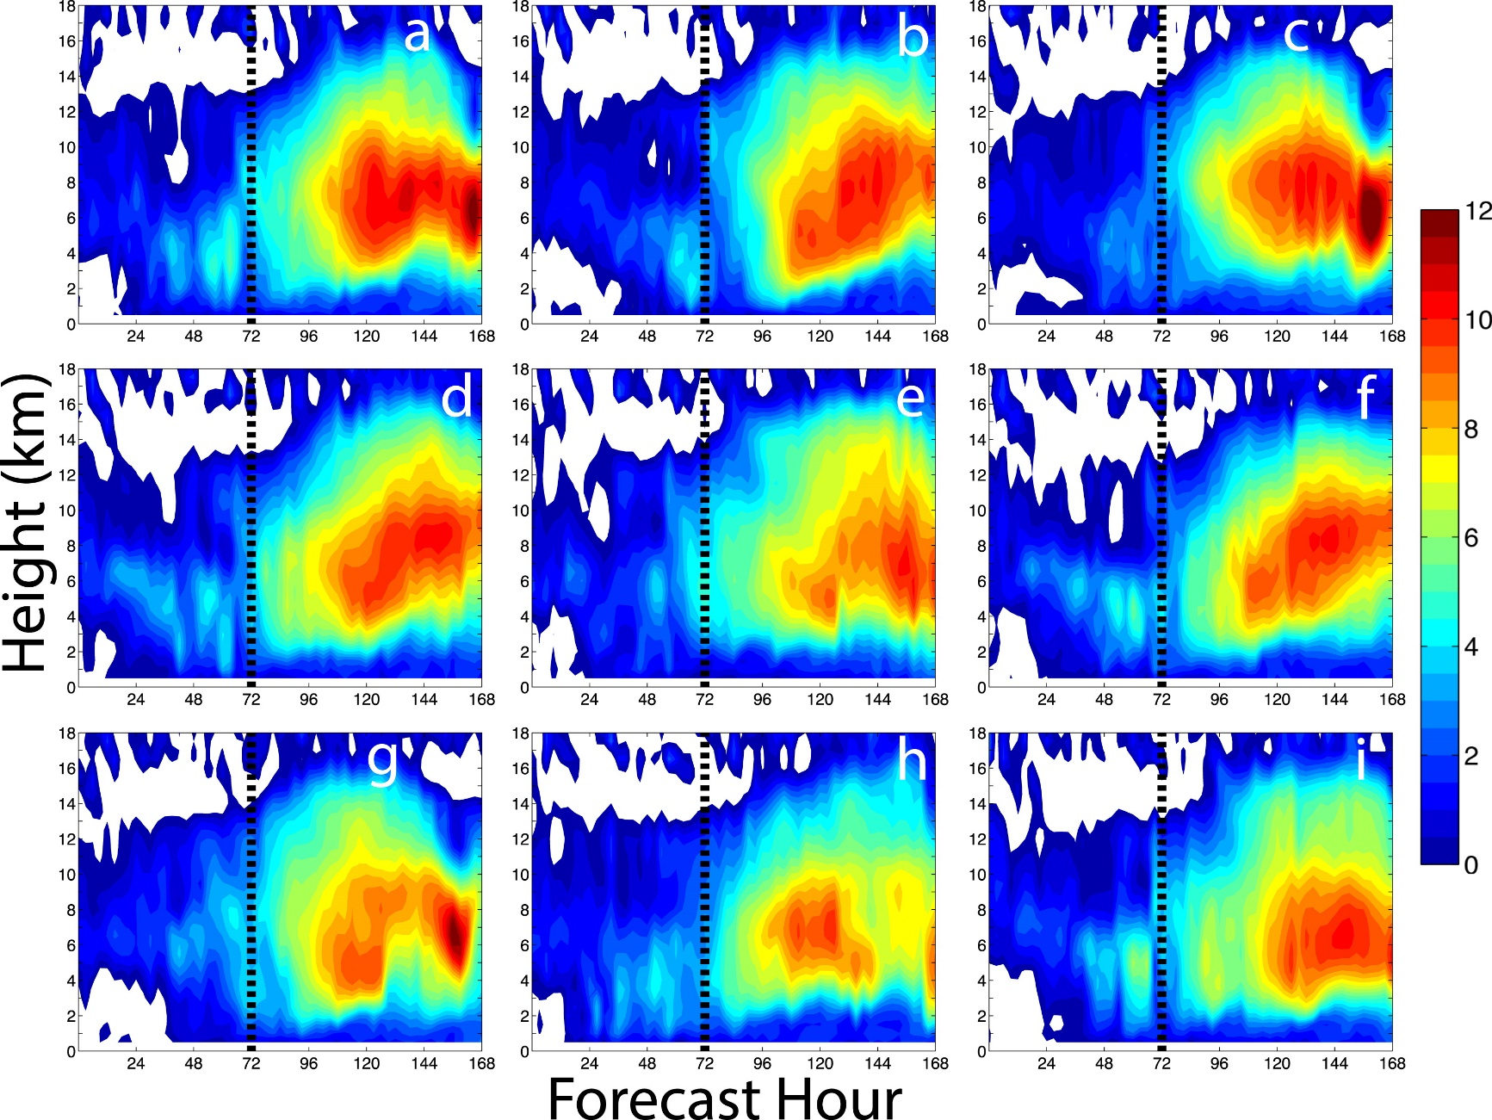

Slide 15
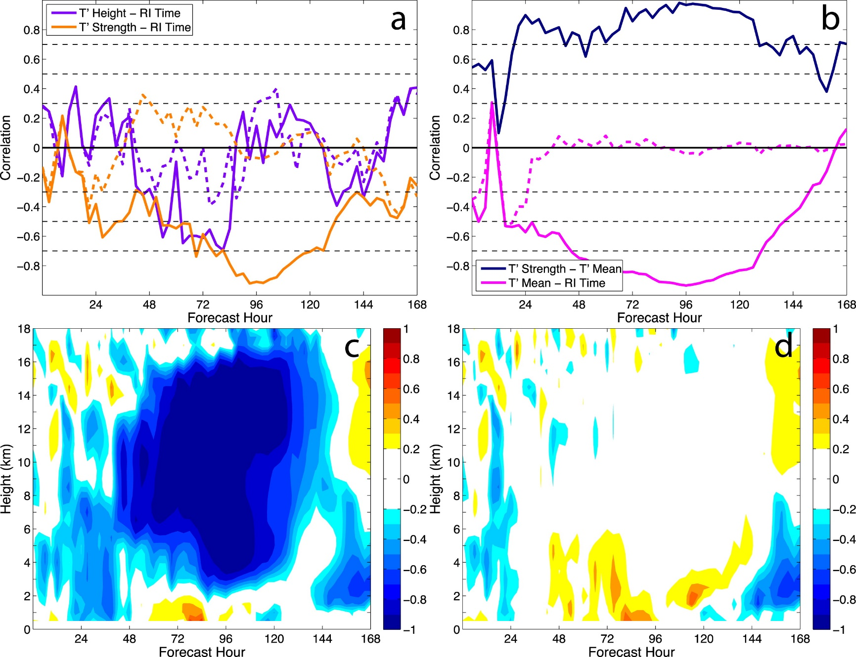
Correlation analyses

Slide 16
Summary(I)
The profiles of the innermost dropsondes primarily yielded multiple perturbation temperature maxima of ~10–12 K, centered at 4–6 and 7–9 km; some dropsondes have an additional maximum at ~10 km. The dropsondes farther away from the surface center observed a single perturbation temperature maximum of ~6–8 K at heights of ~7–9 km.
All developing composites indicate some moderate warming (~4 K) in the low to midlevels (~2–6 km) ~24–48 h prior to RI, but the most significant warming (>7 K) is present higher in the inner core (~8 km) and does not occur until at least 24 h after RI begins.
The height at which this maximum occurs can be as low as 5 km or as high as 9 km. The warm core steadily builds upward in height in some members, while other members have perturbation temperature maxima at relatively constant heights.

Slide 17
Summary(II)
There is some evidence that variations in the strength of the inner-core updrafts, the magnitude of midlevel static stability, and the strength and depth of the intensifying vortex (as measured by inertial stability) can impact the height and strength at which the maximum warming occurs, although these variables are only weakly correlated.
There is little to no relationship between the strength or height of the maximum perturbation temperature and subsequent TC intensity changes, consistent with Stern and Zhang (2016) and Komaromi and Doyle (2017).
Thermodynamic changes in the inner core of Edouard likely occur either in tandem with or after intensification has already commenced and are therefore not a useful predictor of RI onset in this ensemble.

