Slide 1
Updates in the NCEP GFS Cumulus Convection Schemes with Scale and Aerosol Awareness
Han, J., W. Wang, Y. C. Kwon, S.-Y. Hong, V. Tallapragada, and F. Yang, 2017: Updated in the NCEP GFS cumulus convection schemes with scale and aerosol awareness. Wea. Forecasting, 32, 2005–2017.

Slide 2
introduction
The current version of the NCEP GFS deep convection scheme is based on Pan and Wu (1995), which uses Arakawa and Schubert’s (1974) quasi-equilibrium assumption as a closure
The cumulus convection schemes in NCEP GFS have been developed under the assumption that the fractional areas of convective updrafts over the grid box are negligibly small.

Slide 3
a scale-aware parameterization is necessary for cumulus convection at the grid sizes (e.g., sizes of 500 m–10 km) where the convective updrafts are not negligibly small and are partially resolved (Hong and Dudhia 2012).
rain conversion and cloud condensate detrainment in the convective updraft are given by a function of the cloud condensation nuclei (CCN) number concentration. [Lim (2011) and Han et al. (2016)]

Slide 4
Scale-aware parameterization
cloud mass flux decreases with increasing grid resolution.
Vertical convective eddy transport decreases with increasing fractional updraft area. [Arakawa and Wu (2013)]
W : vertical velocity
$φ$ : variable ( T, q )
$σ_{u}$: fractional updraft area
Overbar: grid average
Prime: perturbation from the grid average
E : when $σ_{u}≪1$
Eq. (3) tends to produce unrealistically small $σ_{u}$ (<0.1) even for 2-km resolution.
Notes:
one should also have a good estimation of wu, cu, and grid-scale c, as well as more realistic grid-scale w from the model forecast

Slide 5
Following GF (Grell and Freitas, 2014), $σ_{u}$ is given as:
$A_{grid}$: grid-box area
$R_{c}$: radius of the convective updraft
$ε_{0}$: turbulent lateral entrainment rate of the updraft
$Z_{B}$: cloud base height
$C_{0}$: constant (0.1 for deep, 0.3 for shallow)

Slide 6
$σ_{u}$ distributions of the convective updrafts, 6-h HWRF Model runs
2-km
6-km

Slide 7
6-h accumulated precipitation, 2-km resolution, 6-h HWRF Model runs
convective
Total
(convective + grid scale)
with scale awareness
without scale awareness
Notes:
the convective precipitation for the grid size of 2 km is much smaller with the scale-aware parameterization than without it (Figs. 2a,b) while there is not much difference in the total precipitation.
reduces convective precipitation, leads to increased grid-scale precipitation resolved by cloud microphysics, as may be expected to happen at high grid resolution.

Slide 8
6-h accumulated precipitation, 6-km resolution, 6-h HWRF Model runs
convective
Total
(convective + grid scale)
with scale awareness
without scale awareness

Slide 9
Aerosol-aware parameterization
rain conversion rate of the parcel in updrafts:
Following Han et al. (2016),
Because N_{ccn} varying with time and space is not currently available…
$a_{1}=−0.7$
$a_{2}=24$
$$N_{ccn}=100 for see$$
$N_{ccn}=7000 for$land
Notes:
The conversion rate d₀ not only decreases exponentially above the freezing level but also increases with decreasing aerosol number concentration
b is set to the much smaller value of 0.01 to avoid too much of an increase in cloud condensate in the upper troposphere.

Slide 10
Quasi-equilibrium closure
${\frac{A−α\left(w\right)A_{0}}{τ(w)}}_{LS}+$ $M_{BE}{\frac{A^{′}−A}{M_{BE}^{′}∂t}}_{cu}=0$
following Arakawa and Schubert (1974)
cloud base mass flux
A: cloud work function
$A_{0}$: reference cloud work function (= 0.)
$α(w)$: function of vertical velocity w, modifying A₀
$τ(w)$: convective adjustment time scale → convective turnover time
Notes:
The value of A0 is set to zero, implying that the instability is completely eliminated after the convective adjustment time.

Slide 11
Large-scale adjustment time scale:
$$τ(w)=dt+(1800−dt)(\frac{ω_{base}+4∙{10}^{−2}}{−8∙{10}^{−3}+4∙{10}^{−2}})$$
dt: model time step
$ω_{base}$: vertical velocity at the cloud base
Convective turnover time:
$$τ=(1+dx/75000)∙(Z_{T}−Z_{B})/\left\langle w_{u}\right\rangle$$
$\left\langle w_{u}\right\rangle$: cumulus updraft velocity averaged over the whole cloud depth
$Z_{T}, Z_{B}$: the height at cloud top and base

Slide 12
For grid sizes < 8 km:
$\left\langle w_{u}\right\rangle$: cumulus updraft velocity averaged over the whole cloud depth
B : buoyancy
$$C_{1}, C_{2}=4.0, 0.8$$
(Simpson and Wiggert 1969)
When the convective turnover time (CTT) > advective time (ADT), the convective mixing is not fully conducted before the cumulus cloud is advected out of the grid cell
$$ADT=dx/\left\langle V\right\rangle$$
$\left\langle V\right\rangle$: wind speed averaged over the cloud depth
dx: grid size
P: pressure (Pa)
T: temperature (K)
$CTT=(1+dx/75000)∙(Z_{T}−Z_{B})/\left\langle w_{u}\right\rangle$
$$M_{BE}=\frac{ADT}{CTT}∙100 \frac{P}{r_{d}∙T}∙0.03\left\langle W_{u}\right\rangle$$
Notes:
as the grid size becomes smaller and smaller, the quasi-equilibrium closure assumption in AS may not be valid any more.

Slide 13
Convection trigger function
A parcel lifted from the convection starting level (CSL) without entrainment must reach the level of free convection within the range of 120–180 hPa.
convective inhibition (CIN):
$$−120 <CIN<−80 (m^{2}s^{2})$$
$Z_{s}$: CSL
$Z_{B}$: cloud base

Slide 14
Convection trigger function
unrealistically spotty rainfall over high terrain during summertime
convection triggering may be too easy over mountainous regions.
Notes:
This unrealistically spotty rainfall is found to be mainly from convective rain, indicating that convection triggering may be too easy over mountainous regions.

Slide 15
Convective cloudiness enhancement
convective cloudiness in the GFS is taken into account by detraining cloud water from upper cumulus layers into the grid-scale cloud condensate, which helps to increase high cirrus clouds.
Notes:
convective cloudiness in the GFS is taken into account by detraining cloud water from upper cumulus layers into the grid-scale cloud condensate, which helps to increase high cirrus clouds.

Slide 16
Entrainment enhancement in dry environments
more strongly suppress convection in a drier environment
entrainment rate:
$d_{1}=1.0×{10}^{−4}→1.0×{10}^{−3}$
q_{s}, q_{sb} : saturation specific humidity at the parcel level and the cloud base
$Z_{B}$: cloud base height
$C_{0}$: constant (0.1 for deep, 0.3 for shallow)

Slide 17
Medium-range forecast results
6-day forecasts for the period of 1 July–31 October 2015
64 vertical sigma-pressure hybrid layers
semi-Lagrangian T1534 (about 13 km) horizontal resolution.
no data assimilation

Slide 18
Mean differences in anomaly correlation of 500-hPa height
< 95% confidence level
Notes:
Although there is slight improvement in the Southern Hemisphere in later forecast hours, the improvement is not statistically significant.

Slide 19
60–84-h precipitation forecasts over the continental U.S.
Red: updated schemes
Blue: CTL
Notes:
The forecast scores for the 12–36- and 36–60-h precipitation forecasts (not shown) were similar to those for the 60–84-h precipitation forecasts.
updated schemes show a significant improvement in the continental U.S. precipitation forecasts.
The equitable threat score (Figs. 8a,c) is better with the updated schemes for all rain threshold ranges, although it is statistically not significant for the
heavy rain ranges larger than 25mmday21.
the updated schemes reduce both the wet bias for light rain (e.g., rain less than the threshold of 5mmday21) and the dry bias for moderate rain (e.g., rain within the threshold of 10–35mmday21).
Although they tend to produce more heavy rain (e.g., increased wet bias for rain over 35mmday21), it is statistically not significant.

Slide 20
(updated schemes - CTL)
Notes:
Although overall the differences are small, there are some areas with a significant precipitation difference over the tropics.

Slide 21
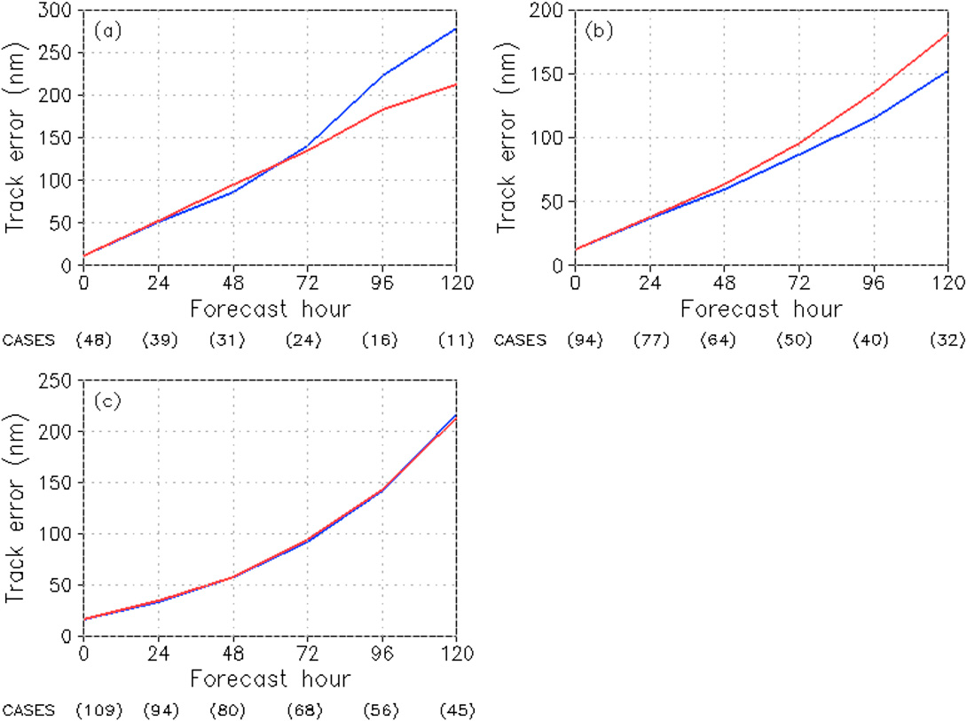
mean hurricane track errors
Atlantic
east Pacific
West Pacific Ocean
Red: updated schemes
Blue: CTL
Notes:
Compared to the control track forecasts, the updated schemes show smaller errors after 72 forecast hours for 2015 Atlantic hurricanes (Fig. 10a),
while they display larger errors after 48 forecast hours for 2015 east Pacific hurricanes (Fig. 10b).

Slide 22
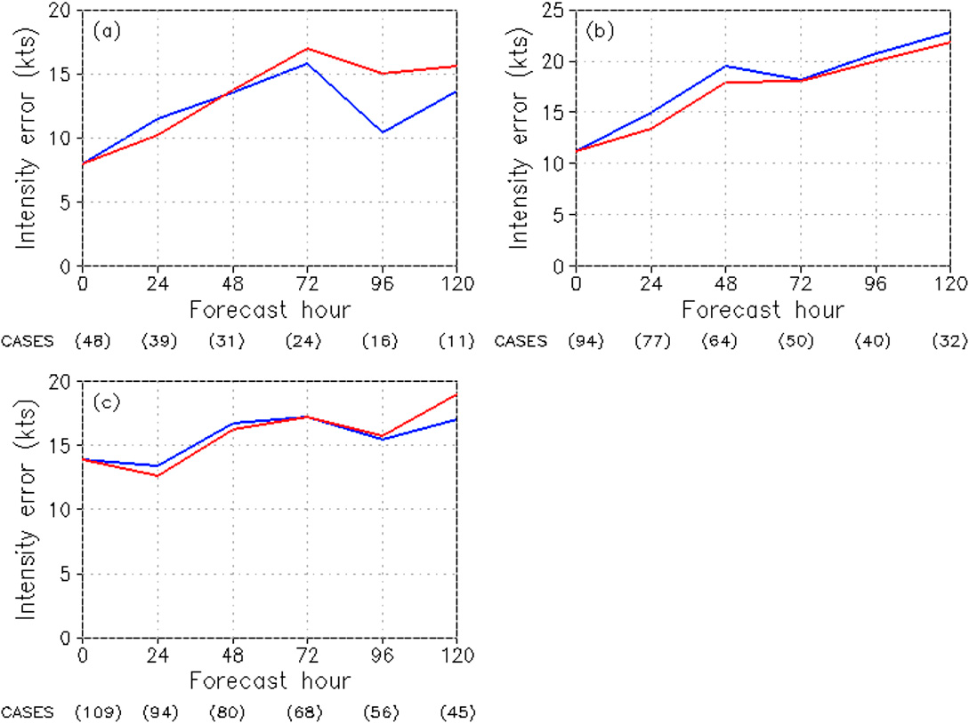
mean hurricane intensity errors
Atlantic
east Pacific
Red: updated schemes
Blue: CTL
West Pacific Ocean
Notes:
the updated schemes generally show larger errors than the control for 2015 Atlantic (Fig. 11a)
west Pacific (Fig. 11c) hurricanes except for during the early forecast hours,
while for 2015 east Pacific hurricanes (Fig. 11b), they display smaller errors than the control during most forecast hours.

Slide 23
Summary and discussion
scale-aware parameterization:
cloud mass flux decreases with increasing grid resolution
The ratio of advective time to convective turnover time
aerosol-aware parameterization:
rain conversion in the convective updraft is modified by aerosol number concentration

Slide 24
Other updates:
Quasi-equilibrium closure
convective trigger function
convective cloudiness
lateral entrainment rate
The updated NCEP GFS cumulus convection schemes display significant improvements especially in the summertime continental U.S. precipitation forecasts.

Slide 26
abstract
NCEP GFS cumulus convection schemes are updated with a scale-aware parameterization where the cloud mass flux decreases with increasing grid resolution.
The ratio of advective time to convective turnover time is also taken into account for the scale-aware parameterization.
A simple aerosol-aware parameterization where rain conversion in the convective updraft is modified by aerosol number concentration is also included in the update.
The cloud-base mass-flux computation in the deep convection scheme is modified to use convective turnover time as the convective adjustment time scale.
The rain conversion rate is modified to decrease with decreasing air temperature above the freezing level.
Convective inhibition in the subcloud layer is used as an additional trigger condition.
Convective cloudiness is enhanced by considering suspended cloud condensate in the updraft. The lateral entrainment in the deep convection scheme is also enhanced to more strongly suppress convection in a drier environment.
The updated NCEP GFS cumulus convection schemes display significant improvements especially in the summertime continental U.S. precipitation forecasts.

Slide 27
Following Arakawa and Wu (2013):
: average of w over the entire grid cell
c : updraft
~ : environment
$$δw=w_{c}−\tilde{w}+σ∆w$$
$$δwδφ={\left(1−σ\right)}^{2}∆w∆φ$$
$$=w_{c}−\tilde{w}+σ(w_{c}−\tilde{w})$$
$$=\left(1−σ\right)∙(w_{c}−\tilde{w})$$
$$=\left(1−σ\right)∆w$$

