Slide 1
The Development of a Terrain-Resolving Scheme for the Forward Model and Its Adjoint in the Four-Dimensional Variational Doppler Radar Analysis System (VDRAS)
2018.01.02
Tai, S.-L., Y.-C. Liou, J. Sun, S.-F. Chang, 2017: The Development of a Terrain-Resolving Scheme for the Forward Model and Its Adjoint in the Four-Dimensional Variational Doppler Radar Analysis System (VDRAS). Mon. Wea. Rev., 145, 289-306.
Tai, S.-L., Y.-C. Liou, J. Sun, S.-F. Chang, and M.-C. Kuo, 2011: Precipitation forecasting using Doppler radar data, a cloud model with adjoint, and the Weather Research and Forecasting model: Real case studies during SoWMEX in Taiwan. Wea. Forecasting, 26, 975–992

Slide 2
Outline
VDRAS and Terrain
Descriptions of VDRAS
GCIBM
Tests of the forward model with IBM_VDRAS
An OSSE radar DA experiment
Conclusion

Slide 3
VDRAS 4DVar Variational Doppler Radar Analysis System (Sun and Crook, 1997,1998)
Cloud-resolving model
Cartesian coordinates (flat surface)
4DVar (including radial velocity and reflectivity)
Update cycles ≤ 15 min
Applications:
Low-level wind and temperature retrieval (Sun and Crook, 2001)
Supercell initialization (Sun, 2005)
Radar radial velocity dealiasing (Lim and Sun, 2010)
Short-term QPF (Sun and Zhang, 2008; Tai et al., 2011; Chang et al., 2016)
Formation mechanisms of heavy rain events (Friedrich et al., 2016; Gochis et al., 2015)
Nowcasting

Slide 4
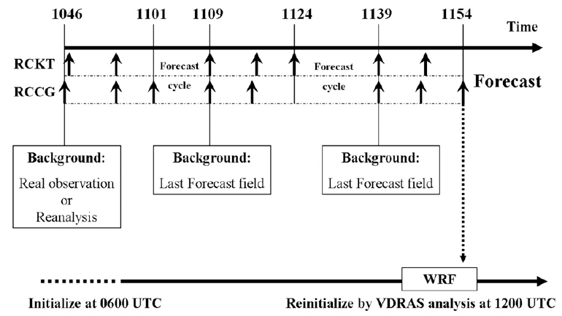
VDRAS and terrain
VDRAS-WRF (Tai et al., 2011)
IBM-VDRAS

Slide 5
Descriptions of VDRAS – cloud model
$$\frac{d\overline{ρ}u}{dt}=−\frac{∂p^{′}}{∂x}+ν∇^{2}\overline{ρ}u$$
$$\frac{d\overline{ρ}v}{dt}=−\frac{∂p^{′}}{∂y}+ν∇^{2}\overline{ρ}v$$
$$\frac{d\overline{ρ}w}{dt}=−\frac{∂p^{′}}{∂z}+g\overline{ρ}(\frac{T^{′}}{T}+0.61q_{v}^{′}−q_{c}−q_{r})+ν∇^{2}\overline{ρ}w$$
$$\frac{∂\overline{ρ}u}{∂x}+\frac{∂\overline{ρ}v}{∂y}+\frac{∂\overline{ρ}w}{∂z}=0$$
$$∇^{2}p^{′}=−∇∙(v∙∇\overline{ρ}v)+g\overline{ρ}\frac{∂}{∂z}(\frac{T^{′}}{T}+0.61q_{v}^{′}−q_{c}−q_{r})$$

Slide 6
Descriptions of VDRAS – cost function, adjoint and TLM
$$J=J_{b}+J_{o}+J_{p}$$
$$J=\frac{1}{2}{\left(𝕩_{0}−𝕩_{b}\right)}^{T}𝔹^{−1}\left(𝕩_{0}−𝕩_{b}\right)+\frac{1}{2}\sum_{σ,t}{[η_{v}{\left(V_{r}−V_{r}^{o}\right)}^{2}+η_{q}{(q_{r}−q_{r}^{o})}^{2}]}+J_{p}+J_{mb}$$
$$𝕩_{i}=M[𝕩\left(t_{0}\right)]$$
M
$$V_{r}=\frac{(x−x_{r})}{d}u+\frac{(y−y_{r})}{d}v+\frac{(z−z_{r})}{d}(w−V_{Tm})$$
L
$$δ𝕩_{i}=L(t_{0},t_{i})δ𝕩_{0}$$
$$Z=43.1+17.5\log_{10}(ρ_{a}q_{r})$$
$$J_{p}=\sum_{σ,t,i,j}{α_{1i}{\left(\frac{∂A_{j}}{∂x_{i}}\right)}^{2}+α_{2i}{\left(\frac{∂^{2}A_{j}}{∂x_{i}^{2}}\right)}^{2}+α_{3i}{\left(\frac{∂A_{j}}{∂t}\right)}^{2}+α_{4i}{\left(\frac{∂^{2}A_{j}}{∂t^{2}}\right)}^{2}}$$

Slide 7
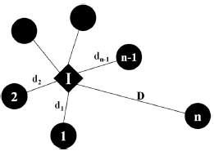
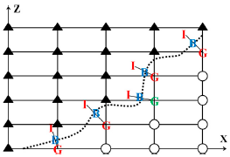
GCIBM

Slide 8
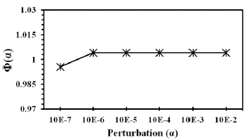
GCIBM

Slide 9
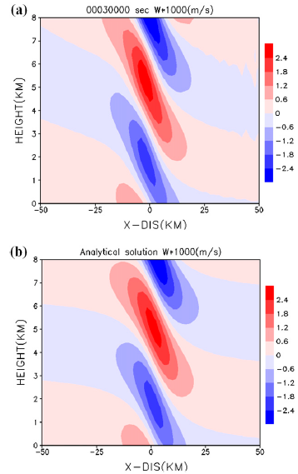
IBM_VDRAS – 2D linear mountain wave
$$H\left(x\right)=\frac{ha}{x^{2}+a^{2}}$$
$$δ\left(x,z\right)={\left(\frac{ρ_{0}}{\overline{ρ}}\right)}^{2}ha\frac{a∙cos⁡(lz)−x∙sin(lz)}{x^{2}+a^{2}}$$
$$l^{2}=\frac{g^{2}}{C_{p}\overline{T}{\overline{U}}^{2}}−\frac{g^{2}}{4R^{2}{\overline{T}}^{2}}$$
$$u^{′}=−\frac{\overline{U}}{\overline{ρ}}\frac{∂\overline{ρ}δ}{∂x}$$
$$\left\{\begin{aligned}\overline{T}=250 K \\ \overline{U}=20 m/s \\ a=10 km \\ h=1 m \\ 202 km×20 km \\ dx=2 km \\ dz=0.2 km\end{aligned}\right.$$
$$w^{′}=\overline{U}\frac{∂δ}{∂x}$$

Slide 10
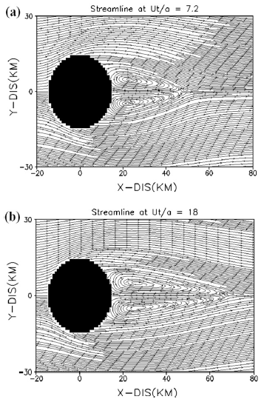
IBM_VDRAS – 3D lee-vortex simulation
$$\left\{\begin{aligned}N=0.01 s^{−1} \\ \overline{U}=6 m/s \\ H=2.5 km \\ a=10 km \\ 181 km ×121 km ×15 km \\ dx=1 km, dz=0.3 km \\ F_{r}=0.24\end{aligned}\right.$$

Slide 11
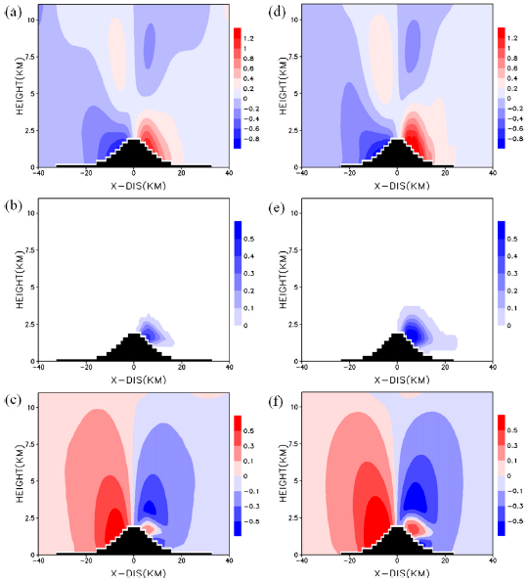
IBM_VDRAS – WRF

Slide 12
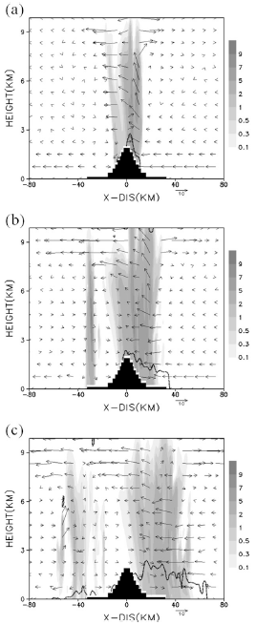
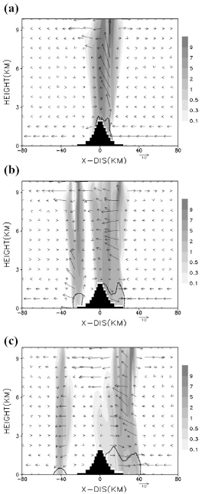
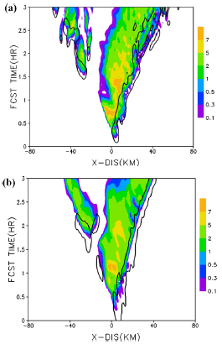
WRF
IBM_VDRAS
WRF
IBM_VDRAS

Slide 13
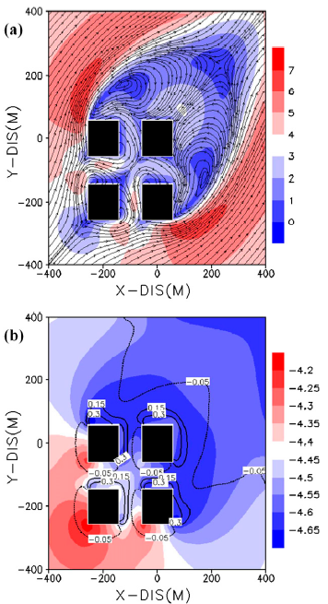
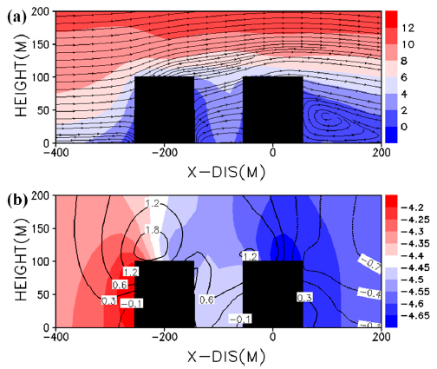
IBM_VDRAS – A building-scale simulation
Building: 100 m x 100 m x 100 m
dx = 10 m
dt = 0.05 s

Slide 14
An OSSE radar DA experiment

