Slide 1
Water Budget and Intensity Change of Tropical Cyclones over Western North Pacific
Gao, S., S. Zhai, B. Chen, and T. Li, 2017: Water budget and intensity change of tropical cyclones over the western North Pacific. Mon. Wea. Rev., 145, 3009–3023.

Slide 2
introduction
TC intensity prediction still lags track prediction (DeMaria et al. 2014).
Difficulties in rapid intensification prediction:
large-scale environmental controls:
vertical wind shear, relative humidity (RH), upper-level trough interactions, and synoptic flow patterns
air–sea interactions:
transfer of high air–sea heat fluxes
inner-core dynamics and thermodynamics
latent heat release, convective bursts, hot towers, and mid- to upper-level warm core

Slide 3
Atlantic TCs intensity change
dry Saharan air layer (SAL) air could be either favorable or unfavorable for intensification of Atlantic TCs, depending on its location relative to TC center. [Shu and Wu (2009)]
RI Atlantic TCs were associated with a sharp decrease of 400–300-hPa RH from 200 to 800km beyond the TC center at the right-front quadrant of TC motion. [Wu et al. (2012)]
RI storms have more symmetric patterns of rainfall and latent heat flux, higher latent heat flux, but less moisture transport than non-RI storms.

Slide 4
Water budget
Total moisture tendency:
Vertical advection
horizontal advection
Apparent moisture sink
Vertical moisture advection can be decomposed to
Horizontal and vertical moisture flux convergence (MFC)

Slide 5
Integrating (3) from P_{S} (the pressure at the sea surface) to P_{T} (the pressure at upper bound)
(Väisänen 1961; Palmén and Holopainen 1962)
C: column-integrated MFC
E: surface evaporation
P: precipitation
TPW: Total Precipitable Water
Bulk aerodynamic formula (Fairall et al. 2003):
$ρ_{a}$ : air density
C_{E} : turbulent exchange coefficient for moisture
U : 10-m wind speed
q_{sat}(SST) : saturation specific humidity at the SST
q_{a} :10-m specific humidity.

Slide 6
Data
Time period: 2001-09, 217 WNP TCs
 | Data sets | Special resolutions | Temporal resolutions
TC best track | JTWC |  | 6-hourly
Precipitation | TRMM 3B42V7 | 0.25 ° | 3-hourly
Total precipitation water (TWP) | TRMM Microwave Imager (TMI) | 0.25° | daily
Surface evaporation | IFREMER3 | 0.25 ° | daily
SST | NOAA | 0.25 ° | daily
Wind, specific humidity, surface pressure | NCEP FNL | 1.0° | 6-hourly

Slide 7
$$\left(\right):standard deviation$$
RMW is negatively correlated with intensity change except for the W category with the least RMW.
Notes:
TC tends to be stronger with smaller RMW at the peak intensity (Willoughby and Rahn 2004).

Slide 8
mean vertical wind shear (VWS)
annular region of 200–800km from the storm center
after applying a vortex removal technique.
Notes:
RI storms have apparently lower shear than non-RI storms and W storms have the strongest shear, as VWS is detrimental to TC intensification
(e.g., DeMaria 1996).
However, the direction of shear vector does not show significant difference among RI, SI, and N categories, which exhibit mean easterly shear while W storms exhibit mean westerly shear.

Slide 9
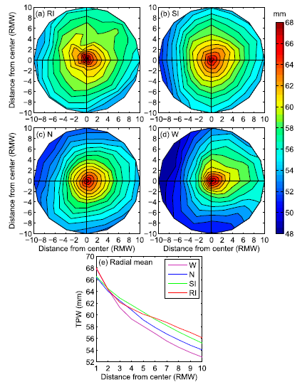
Total precipitable water
composite shear-relative distribution
N
Shear vector
normalized by RMW
Notes:
all the storms show the highest TPW of about 66–68mm in the core regions. RI storms have higher TPW than non-RI storms in the relatively outer environment (beyond six RMWs) while RI storms have comparable TPW to the non-RI storms in the inner environment (within five RMWs), suggesting that high TPW in the
outer environment is vital to storm rapid intensification.
All the non-RI storms have relatively low TPW in the outer environment left of shear, especially for W storms that are associated with the lowest TPW beyond three
RMWs among all four categories, indicating that dry air intrusion tends to inhibit storm rapid intensification.
W storms have as high TPW as RI storms within two RMWs.
The high TPW in W storms may result from their high initial intensity (Table 1) and strong MFC (see Fig. 4) because another moisture source term surface evaporation of W storms is the lowest (Fig. 2) among four categories.

Slide 10
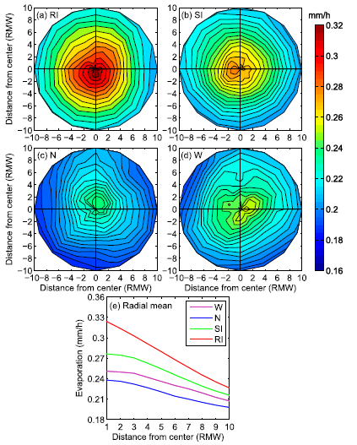
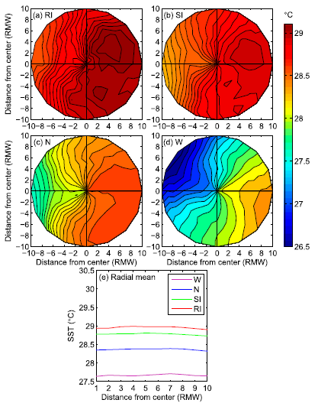
composite shear-relative distribution
Surface evaporation
SST
N
Shear vector
Notes:
RI storms have much higher surface evaporation and more symmetric pattern of surface evaporation than non-RI storms in all the quadrants
RI storms do not have the highest initial intensity (Table 1) but have the highest SST (Fig. 3), thus the difference in surface evaporation between RI and non-RI storms is dominated by SST.
The W storms show the lowest SST (Fig. 3) but higher surface evaporation than the N storms (Fig. 2) because of their high initial intensity (Table 1).
Surface evaporation decreases with increasing radius for all the categories, indicating that its radial profile is determined by 10-m winds.

Slide 11
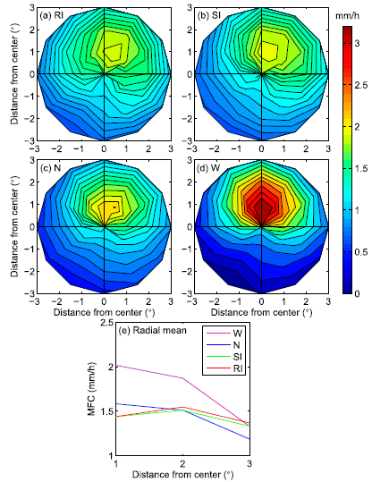
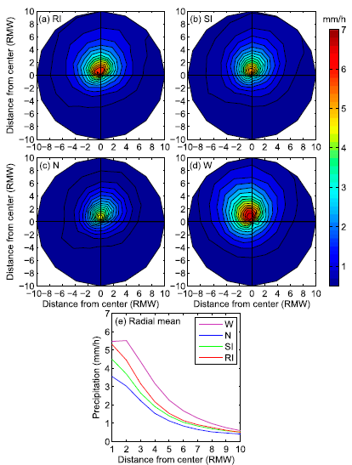
Moist flux convergence
precipitation
N
Shear vector
Notes:
Column-integrated MFC is always stronger on the downshear side for each category, with the maximum near the downshear direction, where W storms
show the strongest column-integrated MFC probably resulting from their highest initial intensity (Table 1) and RI storms show the weakest among categories.
The precipitation maximum is always located in the downshear left quadrant regardless of intensity change.
Compared to SI and N storms, additional precipitation of RI storms (Fig. 5) is supported by the moisture from surface evaporation (Fig. 2), since MFC of RI storms is
weaker or comparable (Fig. 4).
the onset of storm rapid intensification is not accompanied by deep convection producing heavy rainfall.
Deep convection and heavy rainfall often occur in a short period before the end of storm rapid intensification, resulting in the heaviest precipitation
at the beginning of the weakening stage (Fig. 5) supplied by the largest column-integrated MFC (Fig. 4).

Slide 12
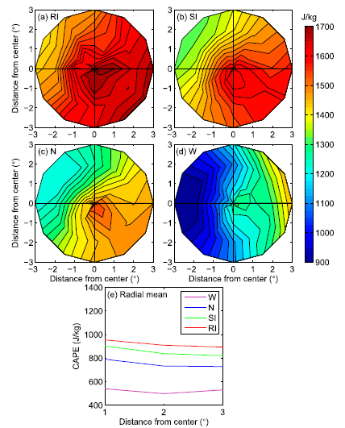
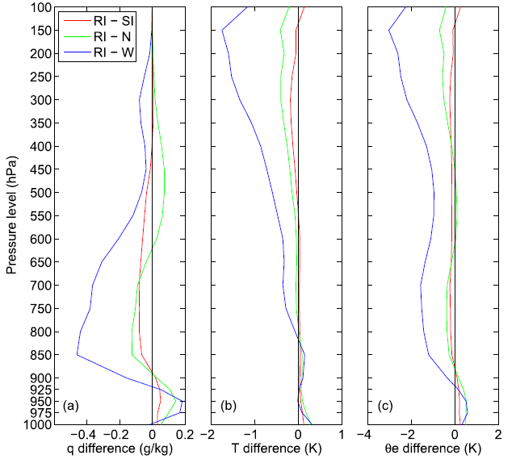
CAPE
Vertical profile
Averaged within 300 km of the storm center
Notes:
RI storms are associated with higher temperature and specific humidity in the boundary layer (Fig. 7, also higher outer region TPW in Fig. 1) due to more moisture and heat exchange with underlying ocean in the surface evaporation process (Fig. 2), resulting in higher boundary layer theta-e (Fig. 7) that contributes to larger CAPE (Fig. 6).
The warmest free troposphere of W storms is likely because of their strongest warm cores being associated with the highest storm intensity.
The wettest free troposphere of W storms and the driest lower and middle atmosphere of RI storms (Fig. 7a) are possibly related to the associated moisture transports (Fig. 4) and consumptions (i.e., precipitation; Fig. 5).
CAPE is positively correlated with storm intensification rate.

Slide 13
Summary
Surface evaporation (associated with the highest sea surface temperature) plays an important role in storm RI TCs.
Total precipitable water in the outer environment (mainly provided by surface evaporation) is also vital to storm RI (less dry air intruded into the storm circulation).
The roles of surface evaporation and TPW in storm RI are related to the enhanced CAPE by moistening and warming the boundary layer.
TC intensity change results from a competition between surface moisture and heat fluxes and low-entropy downdrafts into the boundary layer.
Notes:
Strong downdrafts and evaporative cooling associated with increased precipitation (Fig. 5) could reduce TC intensity by bringing low $θ_{e}$ air from the middle troposphere down to the inflow boundary layer and suppressing eyewall convection when these low values of $θ_{e}$ could not be restored by extracting heat and moisture from the ocean surface through oceanic evaporation process (Fig. 2).

