Slide 1
An Axisymmetric View of Concentric Eyewall Evolution in Hurricane Rita (2005)
2017.12.05
Bell, M. M., M. T. Montgomery, and W.-C. Lee, 2012: An Axisymmetric View of Concentric Eyewall Evolution in Hurricane Rita (2005). J. Atmos. Sci., 69, 2414-2432.
Didlake, A. C., Jr., and R. A. Houze Jr., 2013: Convective-Scale Variations in the Inner-Core Rainbands of a Tropical Cyclone. J. Atmos. Sci., 70, 504-523.

Slide 2
Outline
RAINEX
Convective characteristic
Kinematic evolution
Boundary layer structure
Summary

Slide 3
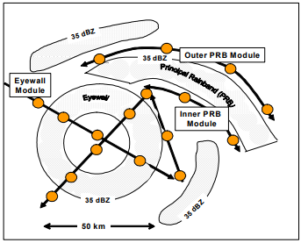
RAINEX
NOAA P-3 (X- and C-band)
NRL P-3 (X-band)
USAF C130
The Hurricane Rainband and Intensity Change Experiment (RAINEX) Operations Plan (Houze et al, 2005)

Slide 4
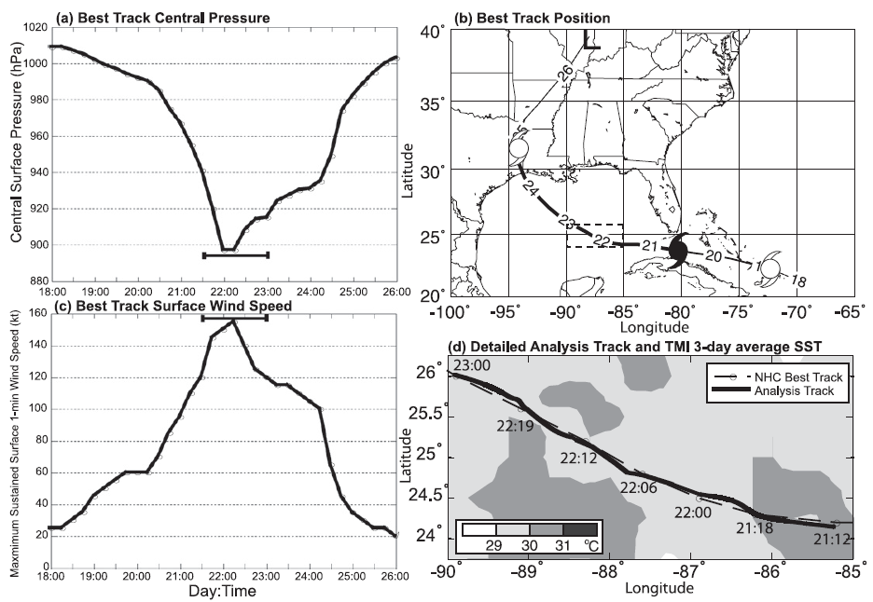

Slide 5
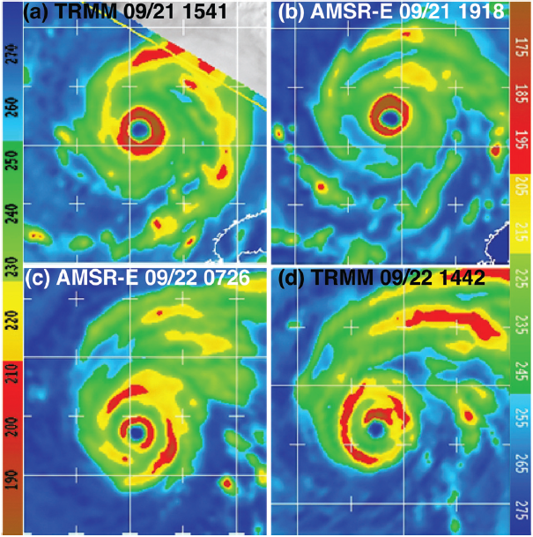
Convective characteristic

Slide 6
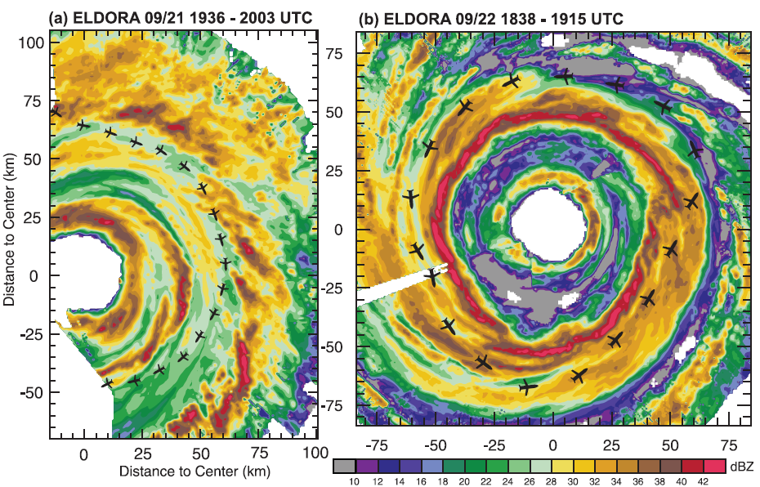
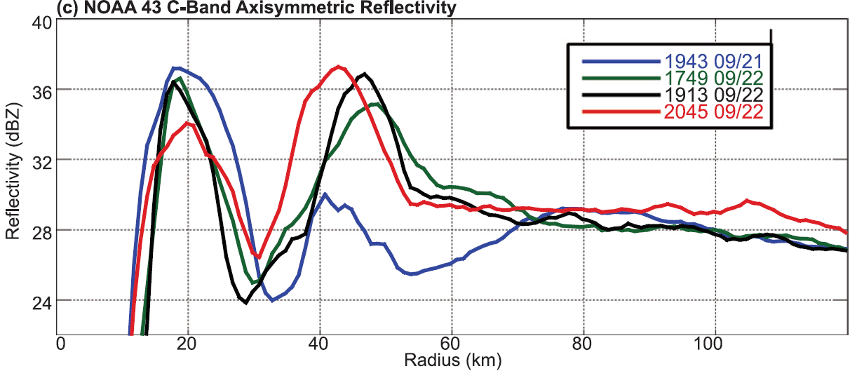

Slide 7
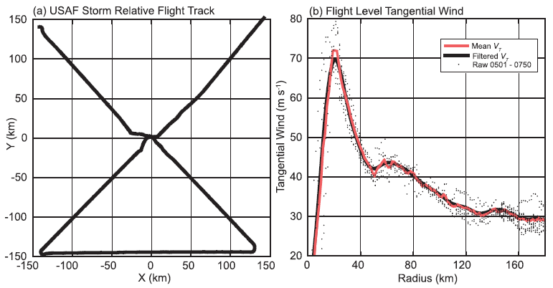
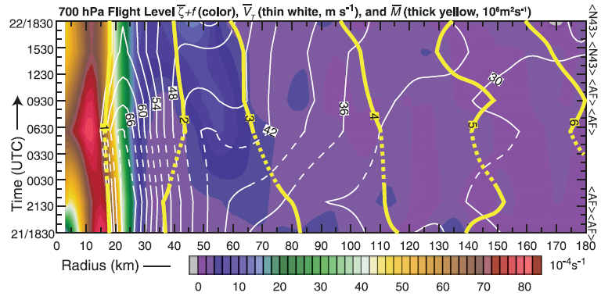
Kinematic evolution
C-130 & NOAA P-3
figure-four flight at 700 mb
$$η=\frac{1}{r}\frac{∂M}{∂r}$$
$$\overline{η}=\frac{\overline{v}}{r}+\frac{∂\overline{v}}{∂r}+f$$
+ + - +

Slide 8
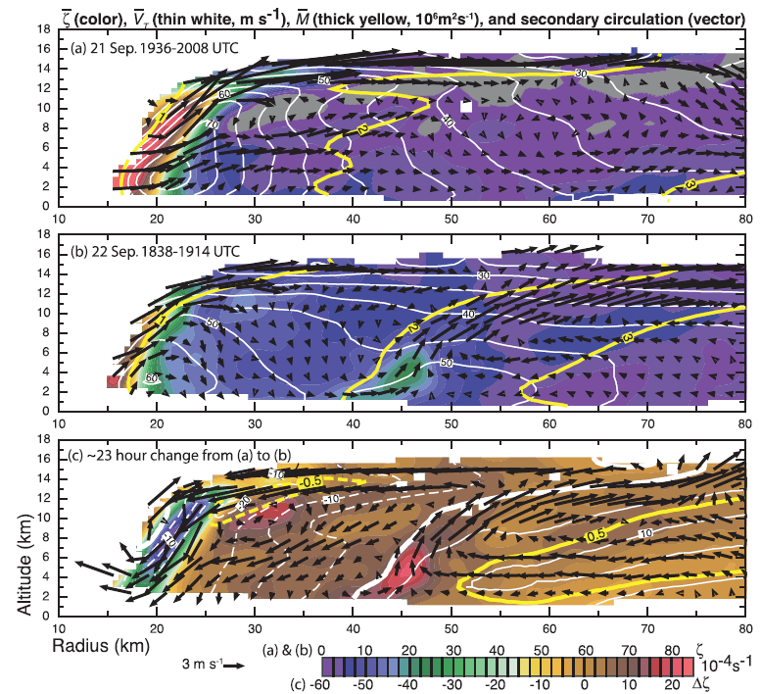
ELDORA analysis

Slide 9
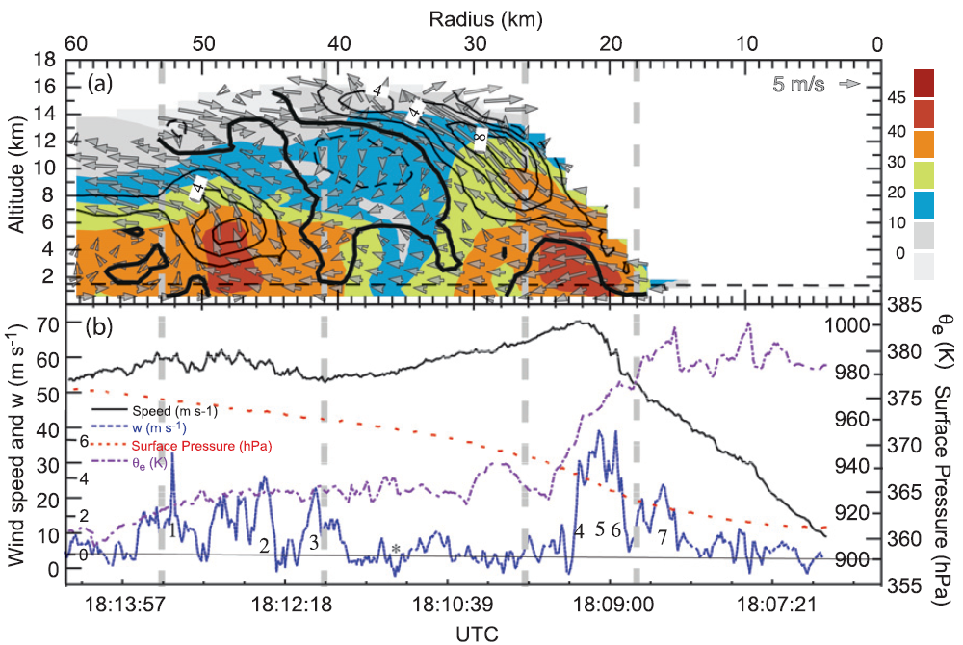
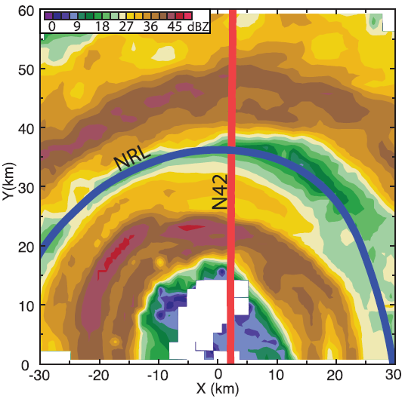
Quad-Doppler analysis
N42 P-3 at z=1.5km & NRL P-3 at z=3.6km
dx ~ 1.5km

Slide 10
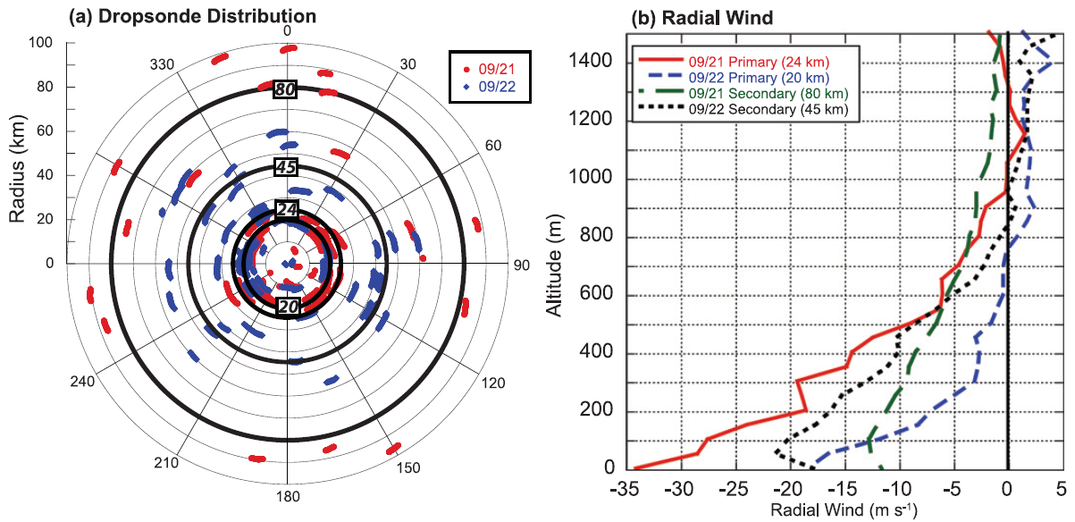
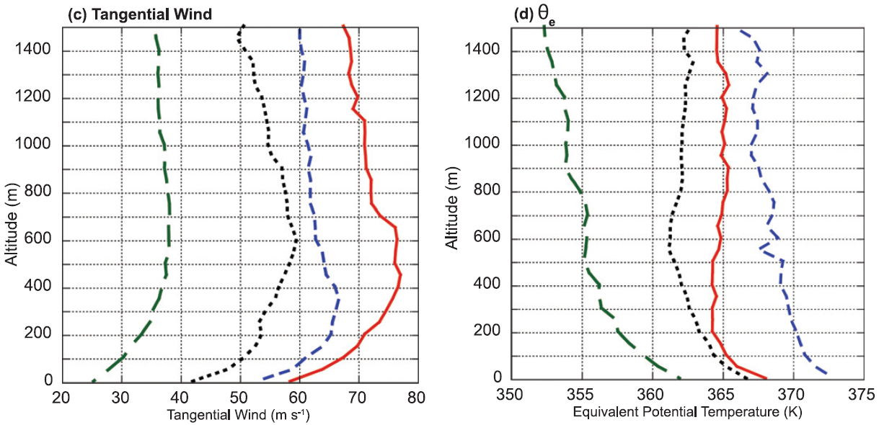
Boundary layer structure

Slide 11
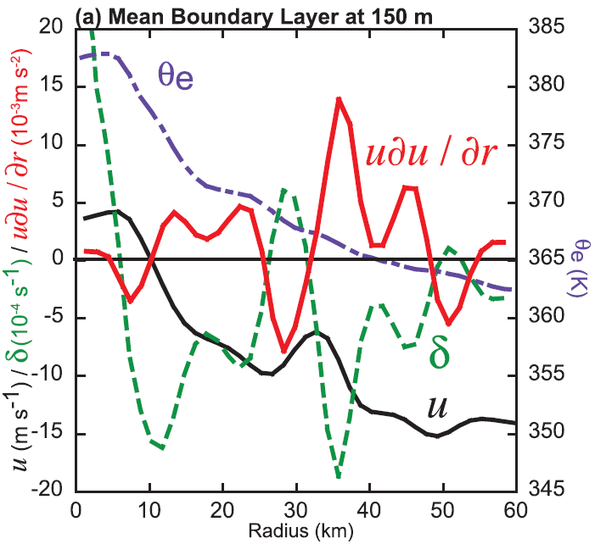
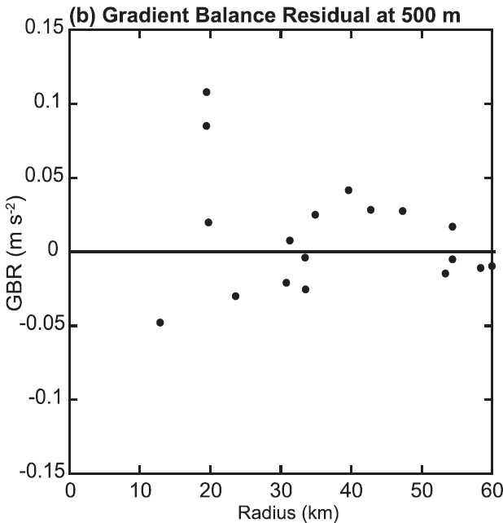
$$\frac{∂u}{∂t}=−u\frac{∂u}{∂r}−\frac{v}{r}\frac{∂u}{∂θ}−w\frac{∂u}{∂z}+\frac{v^{2}}{r}+fv−\frac{1}{ρ}\frac{∂p}{∂r}+F_{r}$$
(Kepert, 2001; Kepert and Wang, 2001; Didlake and Houze, 2012)
$$\frac{du}{dt}=GBR+F_{r}$$
$$\frac{du}{dt}=\frac{∂u}{∂t}+u\frac{∂u}{∂r}+\frac{v}{r}\frac{∂u}{∂θ}+w\frac{∂u}{∂z}$$

Slide 12
Summary
The axisymmetric spinup of the secondary eyewall is associated with radial convergence of absolute angular momentum above and within the boundary layer.
Above the boundary layer, M is approximately conserved materially as it is advected toward the developing eyewall in the low to midtroposphere by a deep layer of weak radial inflow that is argued to be a result of diabatic heating in the intensifying convective ring.
Although M is not materially conserved in the boundary layer due to the azimuthal torque associated with surface friction, spinup of the boundary layer tangential wind that may exceed interior values can occur if the radial inflow is sufficiently large to converge rings of air to small radii with minimal loss of M.
The generation of supergradient winds leads to a rapid deceleration of inflow in the boundary layer that, in conjunction with conditional instability, supports deep convection in the secondary eyewall and further intensification.

