Slide 1
On the Initiation of an Isolated Heavy-Rain-Producing Storm near the Central Urban Area of Beijing Metropolitan Region
Professor : Ming-Jen Yang
Student : Jyong-En Miao
Date : 2017/12/12
Li, H., X. Cui, and D.-L. Zhang, 2017
Mon. Wea. Rev., 145, 181–197.

Slide 2
Introduction
Previous studies have shown the CI of MCSs along the convergence zones in the PBL, frontal zones, and drylines.
location of CI is influenced by spatial variability of temperature and moisture in the PBL (e.g., Mueller et al. 1993; Weckwerth et al. 1996), variable terrain, or inhomogeneous surface characteristics (e.g., Clark and Arritt 1995; Weckwerth 2000; Baker et al. 2001; Lin et al. 2001) that are often on scales too small to be resolved.
Wilson et al. (2010) studied the development of convective storms over the BMR, and found that various boundary layer convergence lines of different origins such as gust fronts, sea breezes, and colliding boundaries play an important role in the initiation and evolution of the storms.
the purpose of this study is to investigate the CI of a local heavy rain event associated with an isolated convective storm near the central urban area of the BMR on 9 August 2011

Slide 3
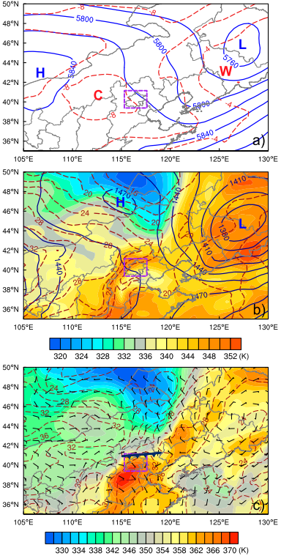
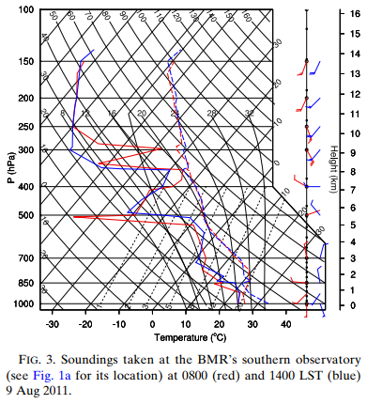

Slide 4
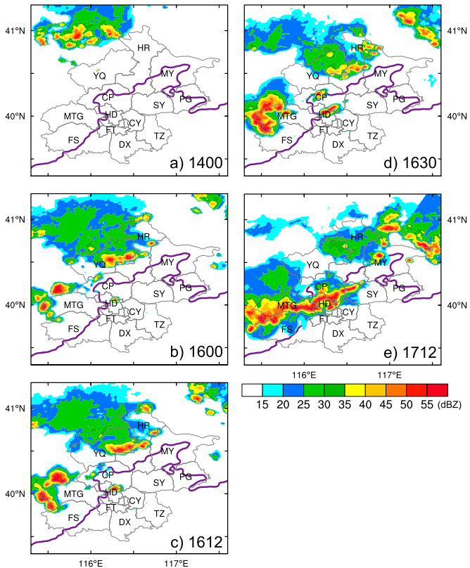

Slide 5
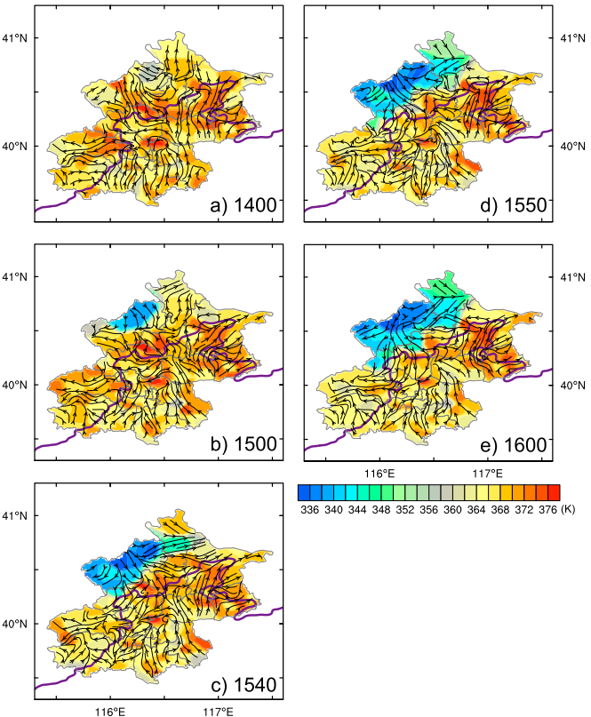

Slide 6
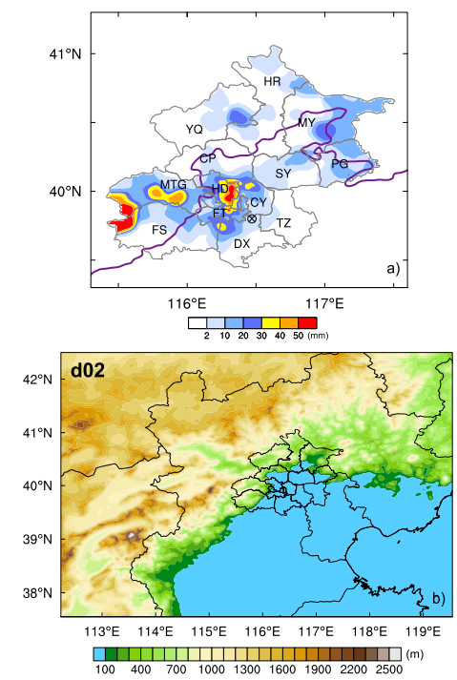
Model Setup
version 3.5.1 of the ARW
Horizontal grid spacing: 4km, 1.33km
A stretched vertical grid with 50 levels
YSU PBL
Morrison microphysics
Dudhia shortwave radiation
RRTM longwave radiation
FDDA (0800-1300LST)

Slide 7
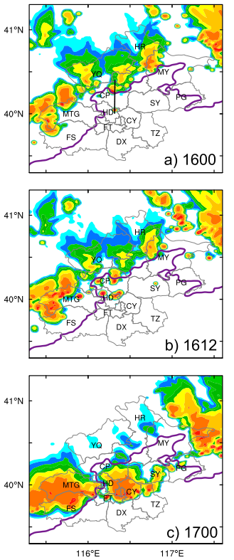
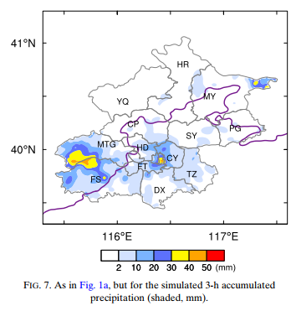

Slide 8
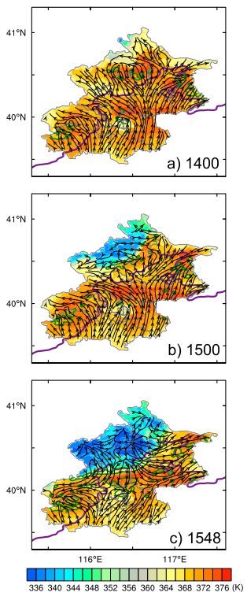

Slide 9
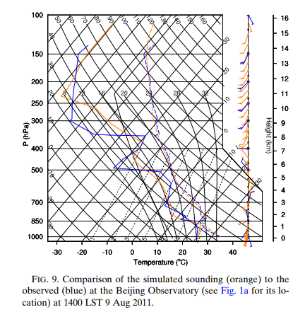

Slide 10
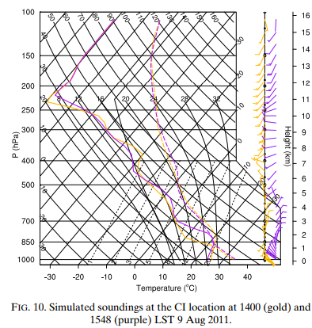

Slide 11
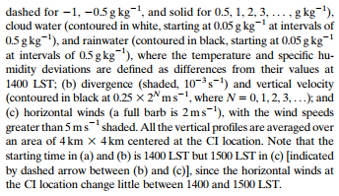

Slide 12
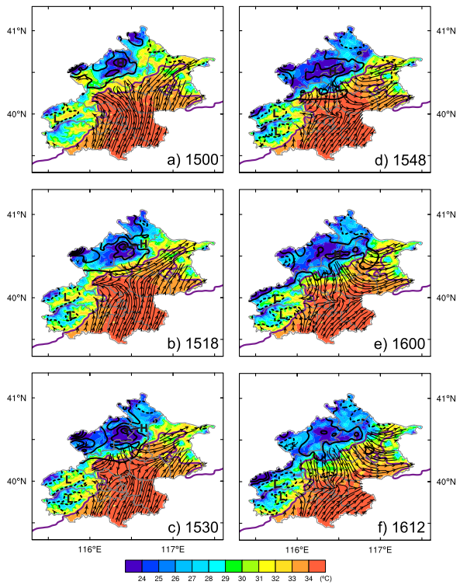

Slide 13
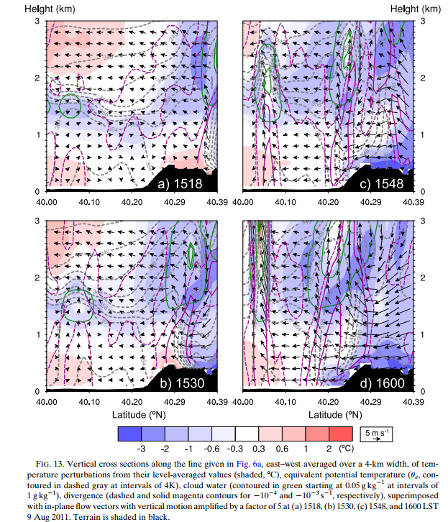

Slide 14
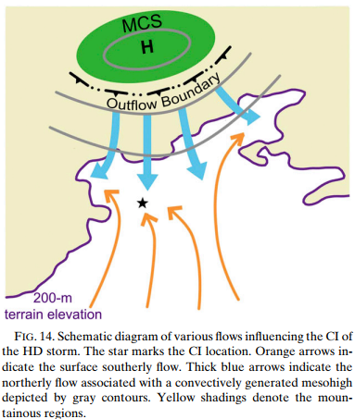

Slide 15
An observational analysis of the ECMWF reanalysis,upper-air soundings and AWSs data shows that the large-scale quasigeostrophic conditions for the present case were unfavorable for organized convective development, but the regional environment was favorable for CI, including the presence of conditional instability, a lowlevel southerly flow with weak warm advection and a high-thetae tongue.
Results show that the HD storm begins with a thin layer of cloud condensation at the top of the urban boundary layer, as a result of the afternoon development of the mixed layer, aided by the UHI effects over the BMR’s central business districts. The boundary layer top cloud condensation also occurs elsewhere, scattered over higher-ue areas and on the upslope sides of the BMR’s mountainous regions during the late afternoon hours.

Slide 16
Both the AWSs data and the model simulation indicate that up-valley flows into the northwestward-concaved valleys in the BMR’s western mountains shift the incoming southerly flow, forming a favorable convergence area near the HD– CP border. This wind shift would then allow more higher-thetae air nearby to be fed to the CI site, which may be otherwise influenced by the upstream lower-thetae air over the BMR’s central business districts.
It takes about 36 min for the condensation-driven updrafts to remove a 1-km layer of CIN above the mixed layer before the occurrence of convective outbreak with intense updrafts. However, this isolated convective outbreak would not be possible without the sustained low-level convergence of high-thetae air between south-to-southeasterly flows and a northerly flow. The latter occurs far ahead of a meso-beta-scale high associated with a convectively generated cold pool by the northern MCS.

