Slide 1
Evolution of mesoscale convective system organizational structure and convective line propagation
Professor : Ming-Jen Yang
Student : Jyong-En Miao
Date : 2017/11/07
Bodine, D. J., and K. L. Rasmussen, 2017
Mon. Wea. Rev., 145, 3419–3440.

Slide 2
Introduction
(Parker and Johnson 2000) the most common MCS archetype is the leading-line, trailing stratiform archetype that comprises approximately 60% of MCSs, while parallel and leading stratiform occur in the remaining 40%
(Corfidi et al. 1996) mesoscale convective complex motion was related to both the mean wind and propagation associated with new convection. The propagation component is similar in magnitude to the low-level jet vector, but in the opposite direction.
(Fovell et al. 2006) discrete propagation: new convection was initiated by gravity waves ahead of the leading line. If the new convection becomes sufficiently deep prior to the merger, it develops a cold pool and leads to a discrete ‘‘jump’’ in the position of the MCS cold pool and leading line.
Parker (2008) four stages of nocturnal MCSs: strengthening, quasisteady, stalling, and elevated. In the strengthening stage, the MCS becomes better organized, the surface cold pool becomes more intense, and MCS speed increases. In the quasi-steady stage, MCS motion is approximately constant and the MCS remains intense.

Slide 3
Introduction
the objective of this study is to assess possible causes of these propagation changes by examining internal and external factors toMCS evolution, and to explore thermodynamic, microphysical, and kinematic changes within the MCS.

Slide 4
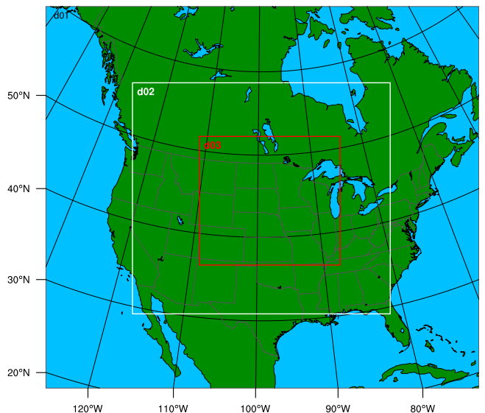
Model Setup
version 3.6.1 of the ARW
Horizontal grid spacing: 27km, 9km, 3km
A stretched vertical grid with 44 levels
YSU PBL
Morrison microphysics
Dudhia shortwave radiation
RRTM longwave radiation
Kain–Fritsch cumulus in the outer domains

Slide 5
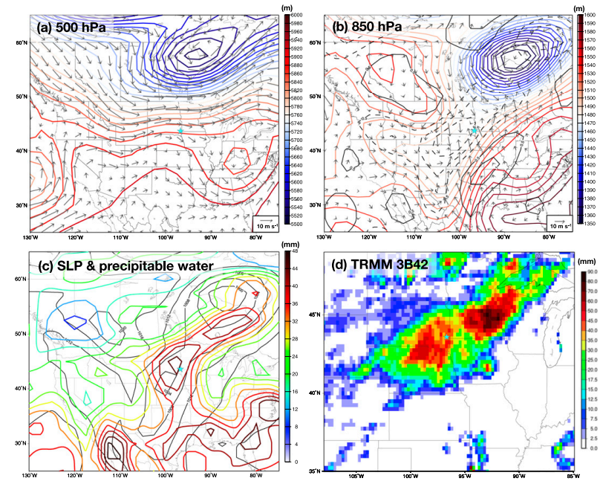

Slide 6
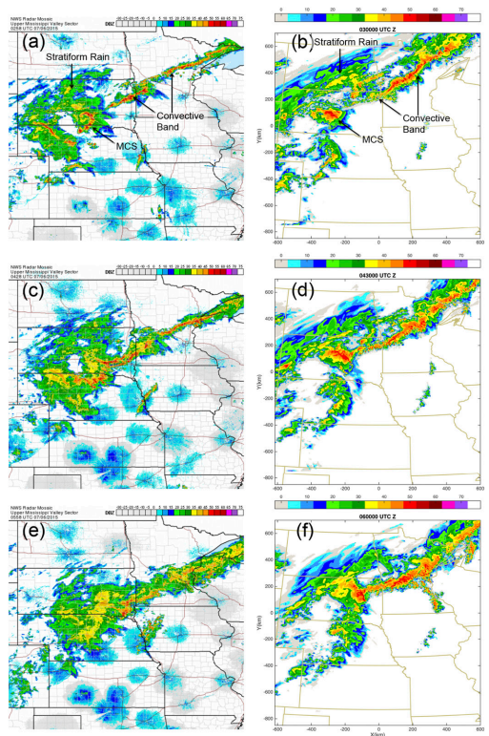

Slide 7
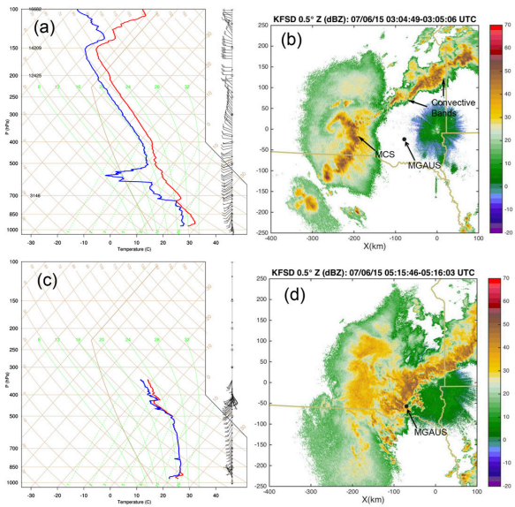

Slide 8
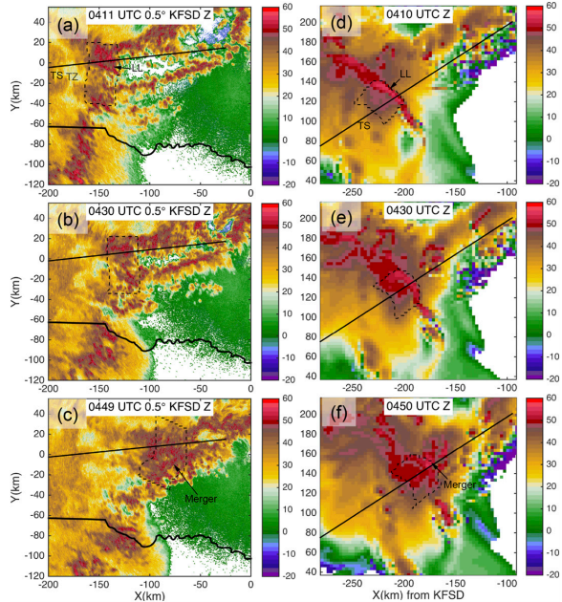

Slide 9
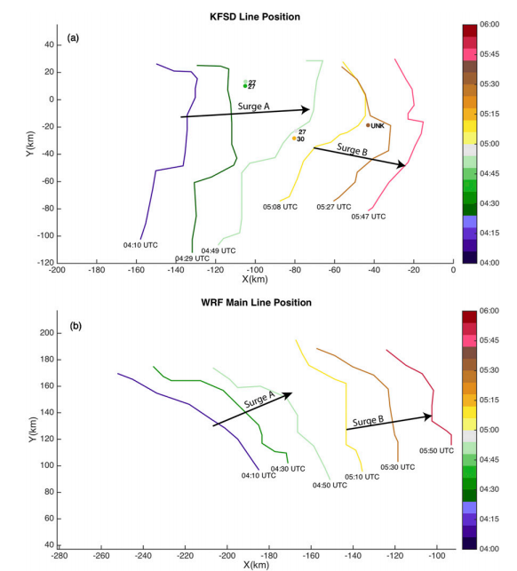

Slide 10
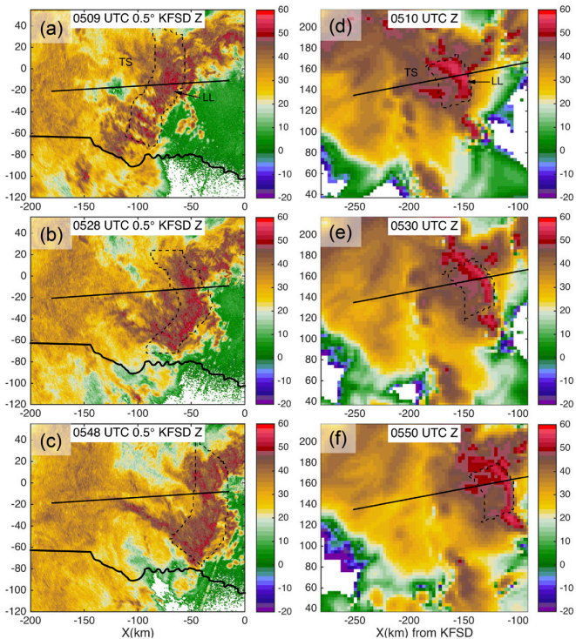

Slide 11
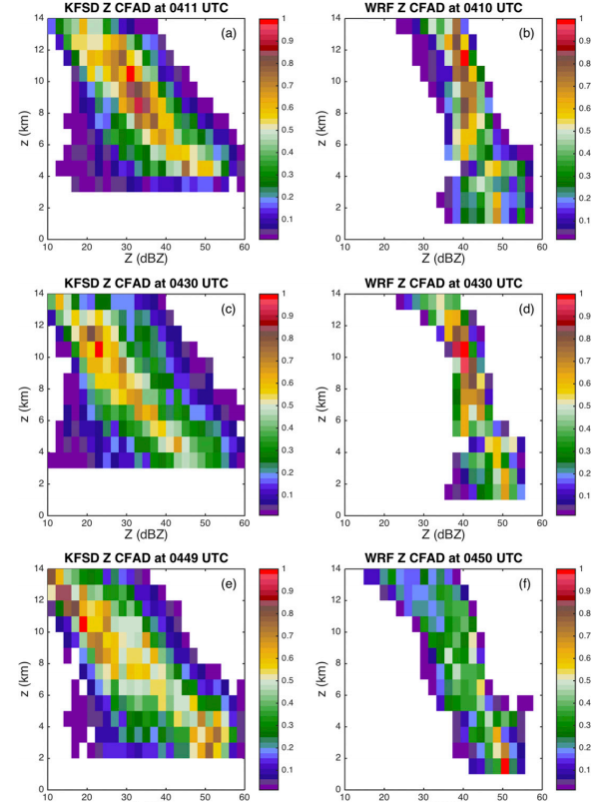

Slide 12
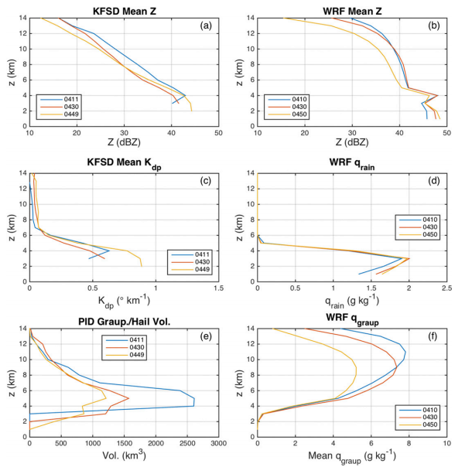

Slide 13
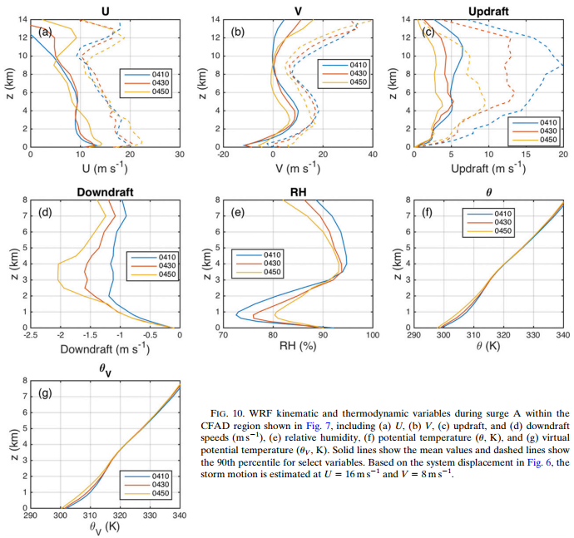

Slide 14
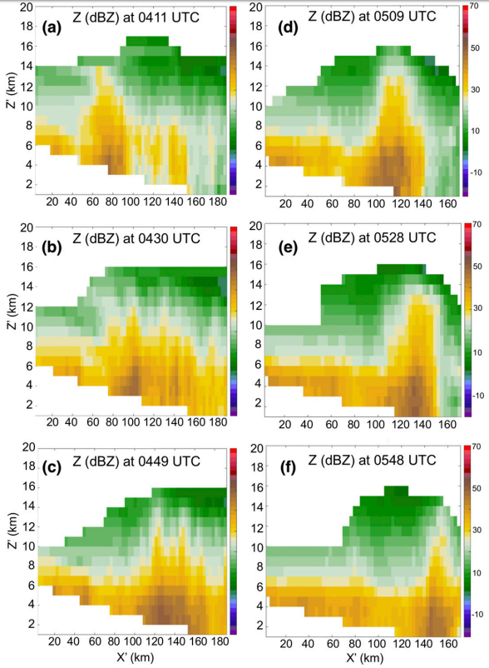

Slide 15
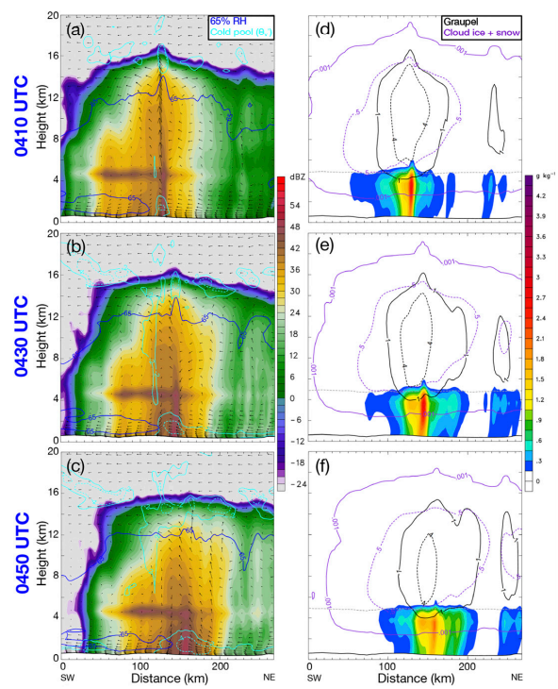

Slide 16
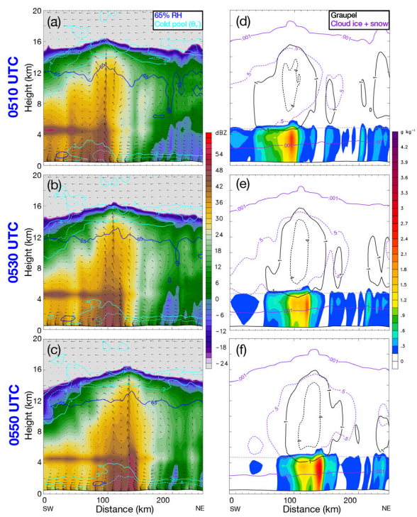

Slide 17
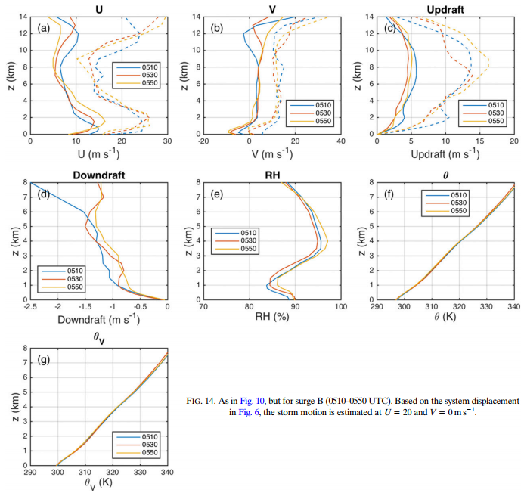

Slide 18
Conclusions
This study documents the transitional stages of a mature MCS convective line which evolves from a well-defined leading line to a multicellular structure (surge A), and then reorganizes back to a well-defined leading line (surge B).
During surge A, several microphysical changes are observed in both the radar data and WRF simulations. Reflectivity decreases and graupel concentrations are reduced above the freezing level, while KFSD near-surface reflectivity and Kdp increase corresponding to an increase in WRF Z and rainwater mixing ratio.
Mean and 90th percentile updraft velocities decrease by approximately a factor of 2, and may be a contributing factor to fallout and reduced production of larger ice particles as evidenced by lower Z aloft. Near-surface zonal winds increase substantially, and mean downdraft behind the convective line intensifies. The strongest downdraft develops behind the primary convective line, causing increased hydrometeor loading and evaporative cooling. These processes likely contribute to the development of a more intense and deeper cold pool.

Slide 19
The MCS regains a mature appearance with a convex-shaped, leading-line and extensive trailing-stratiform region during surge B. The WRF simulation shows an intense updraft region with a collocated column of high Z and qgraupel aloft, consistent with radar observations of an upright column of high Z.
Moreover, mesoscale flow patterns continue to develop with a stronger rear-inflow jet and zonal wind speeds approaching severe wind criteria. The highest 90th percentile zonal wind speeds are observed between 0450 and 0550 UTC, which coincides with several severe wind reports.

