Slide 1
The Role of Vortical Hot Towers in the Formation of Tropical Cyclone Diana (1984)
Hendricks, E. A., M. T. Montgomery and C. A. Davis, 2004: The Role of Vortical Hot Towers in the Formation of Tropical Cyclone Diana (1984). J. Atmos. Sci., 61, 1209-1232.

Slide 2
Introduction
Model description
Simulated VHTs
  A. Scale, intensity and vertical structure
  B. Lower-tropospheric cyclonic PV towers
Local tangential momentum and heat budgets
  A. Example of ‘preconditioning’
  B. Example of ‘diabatic vortex merger’
Quasi-balanced evolution?
A simple comparison of moist and dry vortex merger
Conclusions

Slide 3
Introduction
Mesoscale convective vortices (MCVs), which form in the stratiform precipitation region at mid-levels of the troposphere in disturbed weather regions, are a precursor to tropical cyclogenesis.
(Bister and Emanuel, 1997; Ritchie and Holland, 1997)
Low-level vortex merger and axisymmetrization of small-scale diabatically generated cyclonic potential vorticity (PV) anomalies could intensify a larger-scale vortex.
(Montgomery and Enagonio, 1998; Moller and Montgomery, 2000)

Slide 4
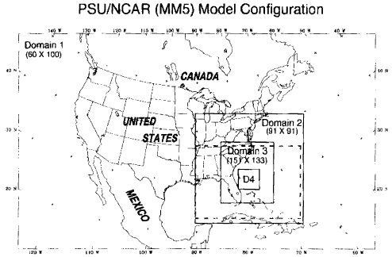
Model description
MM5
81 km / 27 km / 9 km / 3 km
NCEP reanalysis
MRF PBL
KF cumulus on d01/d02/d03
NEM microphysics
Dudhia radiation
disturbance
TD
TS
t=24
t=36

Slide 5
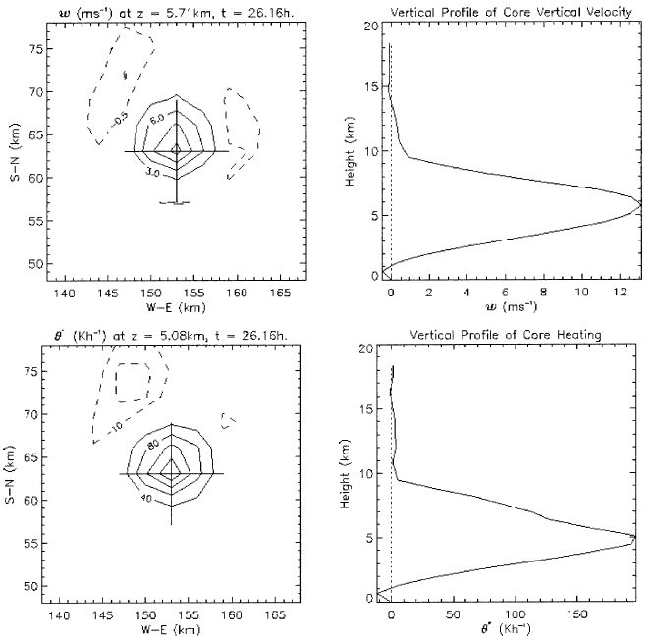
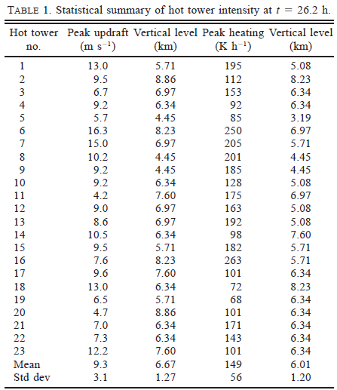

Scale, intensity and vertical structure
w
$$\dot{θ}$$

Slide 6
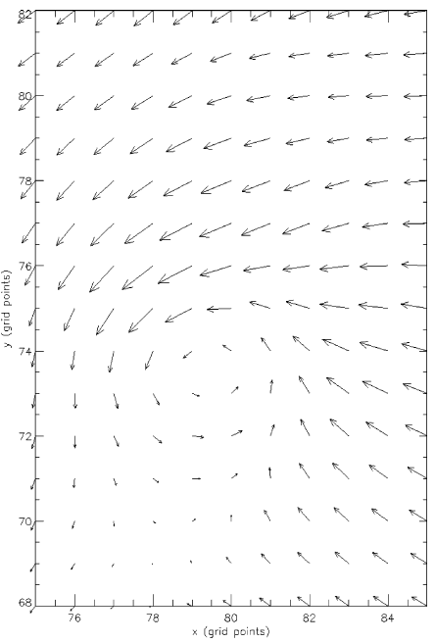

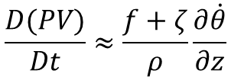

Lower-tropospheric cyclonic PV towers
t = 23.5 h z = 0.67 km
t = 26.16 h
$$\frac{D(PV)}{Dt}=\frac{ζ_{a}}{ρ}∙∇\dot{θ}+\frac{1}{ρ}(∇×F)∙∇θ$$
$$\frac{D(PV)}{Dt}≈\frac{f+ζ}{ρ}\frac{∂\dot{θ}}{∂z}$$
$$\frac{D(PV)}{Dt}≈\frac{{10}^{−3}}{0.7}\left(1.25×{10}^{−5}\right)≈64 PVU/h$$

Slide 7
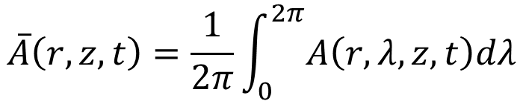

Local tangential momentum and heat budgets
$$A(r,λ,z,t)=\overline{A}(r,z,t)+A^{′}(r,λ,z,t)$$
$$\overline{A}\left(r,z,t\right)=\frac{1}{2π}\int_{0}^{2π}{A\left(r,λ,z,t\right)dλ}$$
$$\overline{v}\left(t_{b}\right)−\overline{v}\left(t_{a}\right)=−\int_{t_{a}}^{t_{b}}{\left(\overline{u}\overline{η}\right)dt}−\int_{t_{a}}^{t_{b}}{\left(\overline{w}\frac{∂\overline{v}}{∂z}\right)dt}−\int_{t_{a}}^{t_{b}}{\left(\overline{u^{′}ζ^{′}}\right)dt}−\int_{t_{a}}^{t_{b}}{\left(\overline{w^{′}\frac{∂v^{′}}{∂z}}\right)dt}−\int_{t_{a}}^{t_{b}}{\left(\overline{PBL}+\overline{DIFF}\right)dt}$$
$$\overline{θ}\left(t_{b}\right)−\overline{θ}\left(t_{a}\right)=−\int_{t_{a}}^{t_{b}}{\left(\overline{u}\frac{∂\overline{θ}}{∂r}\right)dt}−\int_{t_{a}}^{t_{b}}{\left(\overline{w}\frac{∂\overline{θ}}{∂z}\right)dt}−\int_{t_{a}}^{t_{b}}{\left(\overline{u^{′}\frac{∂θ^{′}}{∂r}}\right)dt}−\int_{t_{a}}^{t_{b}}{\left(\overline{w^{′}\frac{∂θ^{′}}{∂z}}\right)dt}−\int_{t_{a}}^{t_{b}}{\left(\overline{\dot{θ}}\right)dt}$$

Slide 8
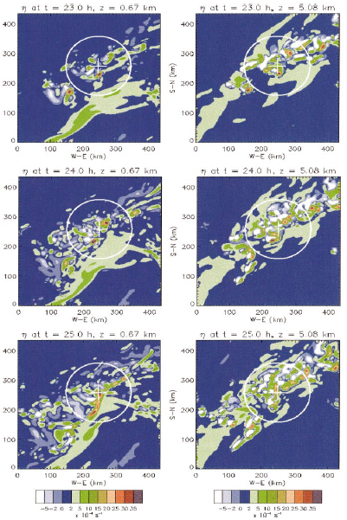
Example of ‘preconditioning’

Slide 9
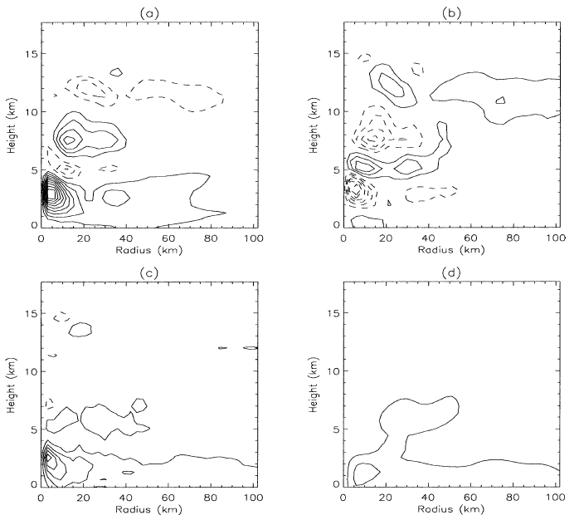
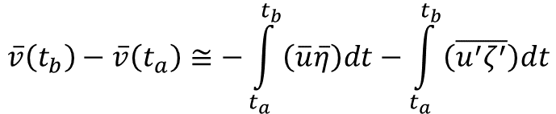
  Example of ‘preconditioning’
(a)
(b)
$$\overline{v}\left(t_{b}\right)−\overline{v}\left(t_{a}\right)≅−\int_{t_{a}}^{t_{b}}{\left(\overline{u}\overline{η}\right)dt}−\int_{t_{a}}^{t_{b}}{\left(\overline{u^{′}ζ^{′}}\right)dt}$$
(d)
(c)
-
+
+

Slide 10
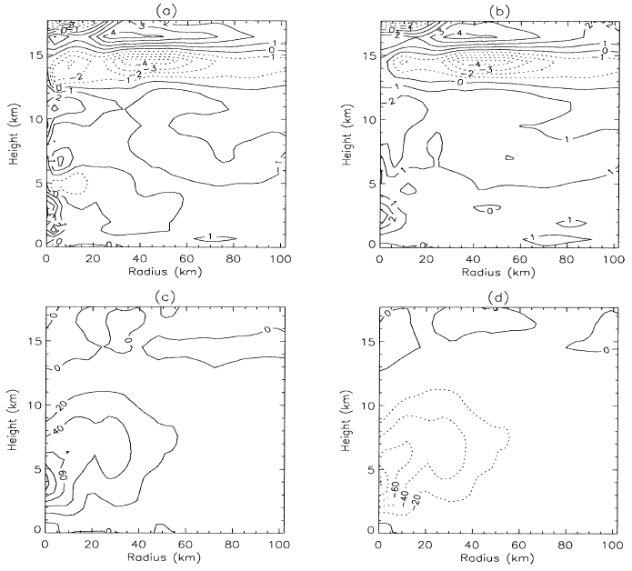
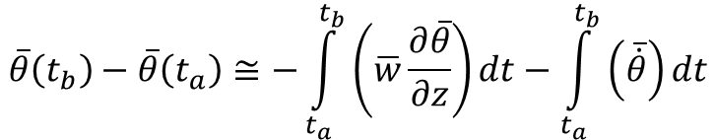
Example of ‘preconditioning’
(d)
(c)
$$\overline{θ}\left(t_{b}\right)−\overline{θ}\left(t_{a}\right)≅−\int_{t_{a}}^{t_{b}}{\left(\overline{w}\frac{∂\overline{θ}}{∂z}\right)dt}−\int_{t_{a}}^{t_{b}}{\left(\overline{\dot{θ}}\right)dt}$$
(a)
(b)

Slide 11
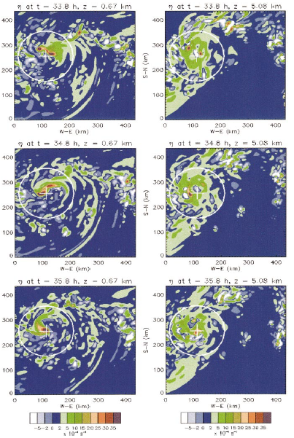
Example of ‘diabatic vortex merger’

Slide 12
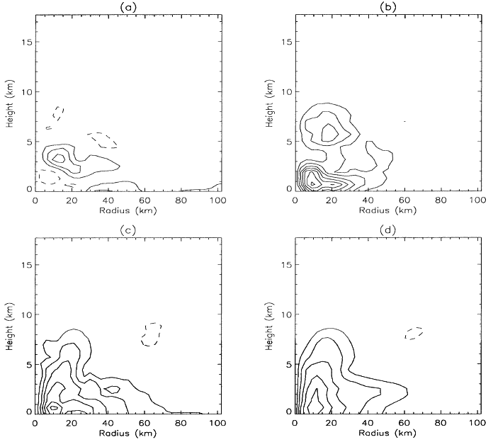
Example of ‘diabatic vortex merger’
(a)
(b)
$$\overline{v}\left(t_{b}\right)−\overline{v}\left(t_{a}\right)≅−\int_{t_{a}}^{t_{b}}{\left(\overline{u}\overline{η}\right)dt}−\int_{t_{a}}^{t_{b}}{\left(\overline{u^{′}ζ^{′}}\right)dt}$$
+
(d)
(c)
+
+

Slide 13
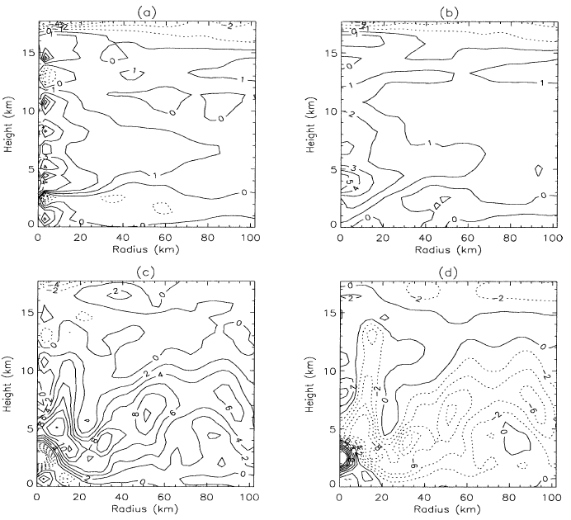
Example of ‘diabatic vortex merger’
(d)
(c)
$$\overline{θ}\left(t_{b}\right)−\overline{θ}\left(t_{a}\right)≅−\int_{t_{a}}^{t_{b}}{\left(\overline{w}\frac{∂\overline{θ}}{∂z}\right)dt}−\int_{t_{a}}^{t_{b}}{\left(\overline{\dot{θ}}\right)dt}$$
(a)
(b)

Slide 14
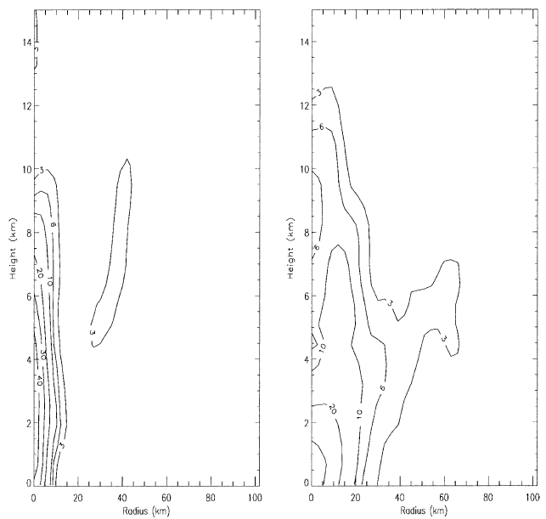
preconditioning
diabatic vortex merger

Slide 15
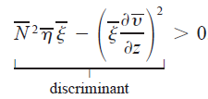
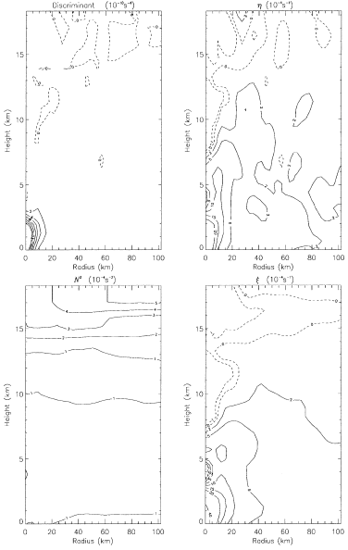
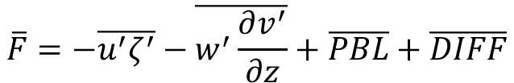
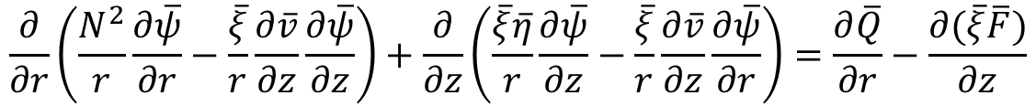
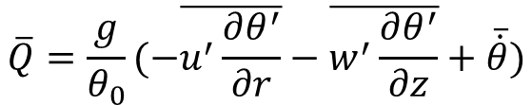
Quasi-balanced evolution?
$$\frac{∂}{∂r}\left(\frac{N^{2}}{r}\frac{∂\overline{ψ}}{∂r}−\frac{\overline{ξ}}{r}\frac{∂\overline{v}}{∂z}\frac{∂\overline{ψ}}{∂z}\right)+\frac{∂}{∂z}\left(\frac{\overline{ξ}\overline{η}}{r}\frac{∂\overline{ψ}}{∂z}−\frac{\overline{ξ}}{r}\frac{∂\overline{v}}{∂z}\frac{∂\overline{ψ}}{∂r}\right)=\frac{∂\overline{Q}}{∂r}−\frac{∂(\overline{ξ}\overline{F})}{∂z}$$
$$\overline{F}=−\overline{u^{′}ζ^{′}}−\overline{w^{′}\frac{∂v^{′}}{∂z}}+\overline{PBL}+\overline{DIFF}$$
$$\overline{Q}=\frac{g}{θ_{0}}(−\overline{u^{′}\frac{∂θ^{′}}{∂r}}−\overline{w^{′}\frac{∂θ^{′}}{∂z}}+\overline{\dot{θ}})$$

Slide 16
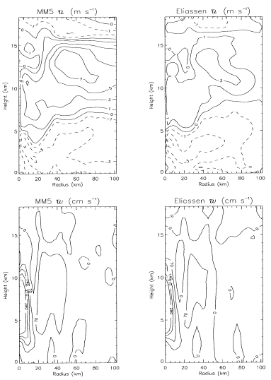
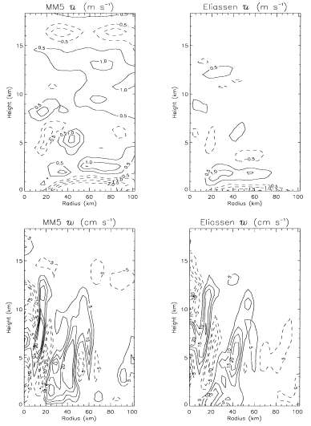
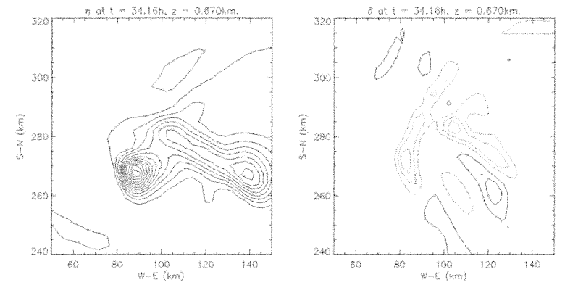
preconditioning t=24h
diabatic vortex merger t=35.5

Slide 17
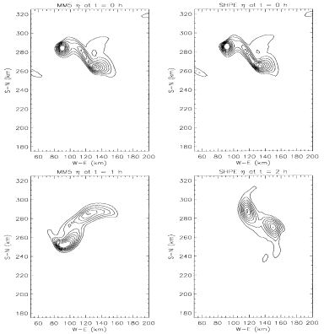
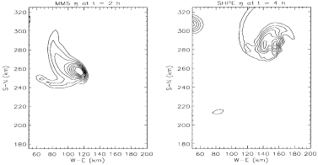


A simple comparison of moist and dry vortex merger

Slide 18
Conclusions
A two-phase evolution driven by the VHTs suggested in the numerical simulation:
  (i) “vorticity” preconditioning of the lower troposphere via the generation of multiple small-scale intense cyclonic vortex tubes.
  (ii) multiple mergers/axisymmetrization of these tubes in the lower troposphere
The low-level influx of mean angular momentum (driven by the diabatic heating of the ensemble of hot towers) is equally important for increasing the macroscale low-level vertical vorticity and tangential winds throughout the genesis.

Slide 19
Conclusions
Using the Sawyer–Eliassen balanced vortex model, the cyclogenesis of Diana is demonstrated to proceed in approximate gradient and hydrostatic balance in the vicinity of vortex structures, or a quasi-balanced evolution where radial and vertical accelerations are small.
Moist convective effects and attending secondary circulations accelerate the low-level merger process in the real atmosphere and tend to produce a merged vortex that is significantly stronger than its dry-merged counterpart.

