Slide 1
Precipitation Budget of the Madden-Julian Oscillation
Adames, A. F., 2017: Precipitation budget of the Madden-Julian Oscillation. J. Atmos. Sci., 74, 1799–1817.

Slide 2
introduction
The maintenance of precipitation anomalies:
three-way interaction between moisture, convection, and radiation (Raymond 2001; Kim et al. 2015; Del Genio et al. 2015)
eastward propagation of the anomalous precipitation in the MJO:
horizontal advection of moisture driven by the MJO’s anomalous lower tropospheric wind field (Maloney 2009; Zhao et al. 2013; Pritchard and Bretherton 2014; Kim et al. 2014a; Zhu and Hendon 2015; among others).
free-tropospheric moistening arising from vertical motion, either by cloud-related moisture fluxes (Benedict and Randall 2007; Hannah et al. 2016; Powell and Houze 2015; Powell 2016) or forced by equatorial wave motion (Wang 1988; Hsu and Li 2012; Liu and Wang 2016).
Notes:
the mechanisms in which large-scale convection is maintained and propagates eastward
are not entirely understood.

Slide 3
evolution of the MJO’s precipitation:
anomalous column water vapor
climatological-mean distribution of precipitation,$\overline{p}$
convective adjustment time scale
intraseasonal precipitation anomalies, $p′$
prognostic equation for precipitation, $\frac{∂p^{′}}{∂t}$
Notes:
the evolution of the MJO’s precipitation features is not only dependent on anomalous column water vapor but also on the climatological-mean distribution of precipitation, which determines the aforementioned convective adjustment time scale.
By incorporating this convective adjustment time scale onto the moisture field, an estimate of the intraseasonal precipitation anomalies is obtained that compares favorably with observations.
Moreover, a prognostic equation for precipitation is obtained that offers a more concise description of the physical processes responsible for the propagation of anomalous precipitation.

Slide 4
Moisture equation (20-100-day time scale):
empirical equation of precipitation (Bretherton et al., 2004):
$$R_{h}={\left\langle q\right\rangle }/{\left\langle q_{s}\right\rangle }, column relative humidity$$

Slide 5
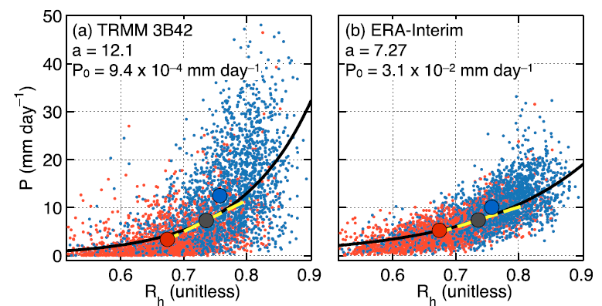
Over Indian Ocean
Taylor series expansion
active MJO convection
black line: nonlinear least squares fit
suppressed MJO convection
Notes:
large scatter between precipitation and column relative humidity.
the relationship is approximately exponetial, with a sharp pickup in precipitation at Rh =0.74.
the most humid and rainy days correspond to days when the MJO is active over the Indian Ocean. Conversely, the
driest days correspond to days when MJO convection is suppressed.

Slide 6
Horizontal distribution of precipitation
Notes:
All three fields exhibit qualitatively similar patterns, implying that, to first order, precipitation variability is proportional
to the low-frequency background state.

Slide 7
empirical equation of precipitation (Bretherton et al., 2004):
Taylor series expansion:
$$\frac{∂p}{∂R_{h}}=a∙[P_{0}\exp\left(aR_{h}\right)]=a∙P(R_{h})$$
$$R_{h}^{′}=\frac{\left\langle q^{′}\right\rangle }{\left\langle \overline{q_{s}}\right\rangle }$$
$$P=\overline{P}+P^{′}$$
: 100-day low-pass filter
Notes:
Intraseasonal precipitation anomalies are, to first order, directly related to the amplitude of the low-frequency background precipitation.
a becomes clearer, as it determines the magnitude of precipitation variability

Slide 8
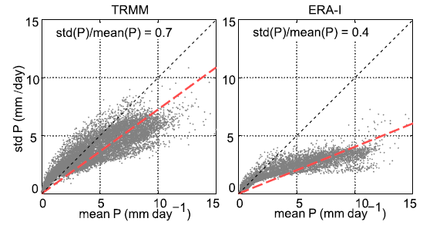
Notes:
intraseasonal variations in precipitation increase as climatological-mean precipitation increases

Slide 9
low-frequency background convective adjustment time scale:
$τ_{c}$ is smallest over the climatologically rainy regions and tends toward infinity over the dry regions of the tropics.
convective relaxation frequency:
Notes:
Some of the terms on the right-hand side of Eq. (6) can be used to define a low-frequency background convective adjustment time scale.

Slide 10
$\left\langle \overline{q_{s}}\right\rangle$ exhibiting relatively little variation in the
tropics
Notes:
nc shows a nearly identical distribution to the climatological-mean precipitation.
This is due to hqsi exhibiting relatively little variation in the tropics
Intraseasonal precipitation tendency ›P0/›t is directly related to nc.
Thus, intraseasonal precipitation variability (Fig. 2b) will be largest in regions where nc is large.

Slide 11
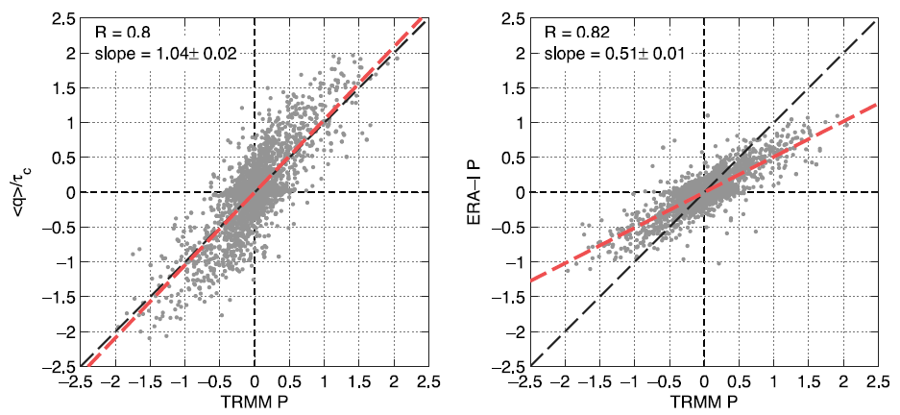
$$P^{′}=\frac{\left\langle q^{′}\right\rangle }{\overline{τ_{c}}}$$
Notes:
A robust relationship is observed between the two fields, with a correlation coefficient of ;0.8 and a slope of 1.04.

Slide 12
~ Maritime Continent
~ central Indian ocean
contours: $\left\langle q^{′}\right\rangle$
arrows: 500-1000-hPa average wind field
Notes:
The fields P’ and <q’> exhibit similar horizontal structures, with the characteristic ‘‘swallowtail’’ shape.
However, P’ is meridionally narrower than <q’>. Also, P’ is strongest in the regions that correspond to the equatorial warm pool, and along the narrow bands of the ITCZ

Slide 13
Moisture equation (20-100-day time scale):
$$P^{′}=\frac{\left\langle q^{′}\right\rangle }{\overline{τ_{c}}}$$
column-process term:
precipitation
surface latent heat fluxes
vertical moisture advection

Slide 14
diabatic heating and cooling:
radiatively driven component:
convective processes and largescale vertical motion:
“convectively driven’’ column process:
Notes:
diabatic heating and cooling from adiabatic expansion induced by anomalous ascent:
Since the main contributors to diabatic heating Q1 arise from convective and radiative heating

Slide 15
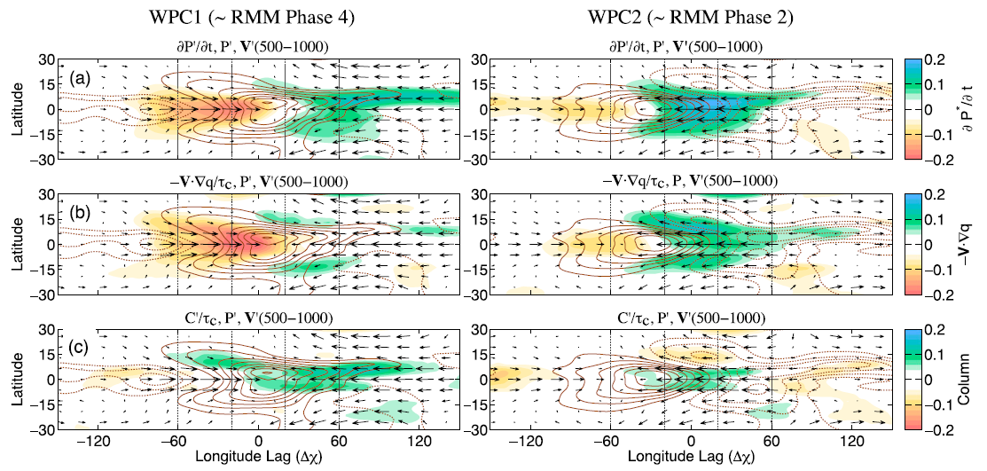
~ Maritime Continent
~ central Indian ocean
contours: $p^{′}$
arrows: 500-1000-hPa wind field
Notes:
In WPC1, column processes dominate the moistening to the east of the rain area while horizontal moisture advection is the dominant sink to the west.
The pattern in WPC2, which shows a large positive precipitation tendency in the node of the dipole in enhanced and suppressed convection has substantial contributions from both horizontal moisture advection andC0.
C’ are a larger contributor near the equator while horizontal moisture advection is a larger contributor away from the equator (poleward of 108N/S).

Slide 16
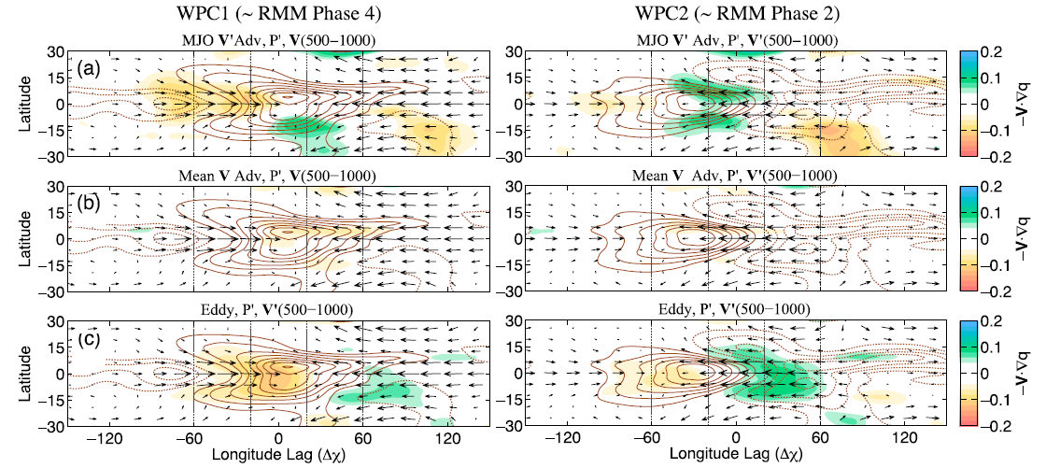
contours: $p^{′}$
arrows: 500-1000-hPa wind field
Notes:
horizontal advection of low-frequency moisture by the MJO winds, a term describing the advection of MJO moisture by the background winds, and a third term
representing the nonlinear advection of moisture by eddies of time scales shorter than 20 days.
drying by high-frequency eddy activity which exhibits the largest magnitude.
-<V ‘ q> exhibits a horizontal structure that is in quadrature with the rain area in WPC1, while it acts to broaden the rain area in WPC2.
Advection of moisture by the mean flow contributes little to the propagation of the intraseasonal precipitation anomalies.

Slide 17
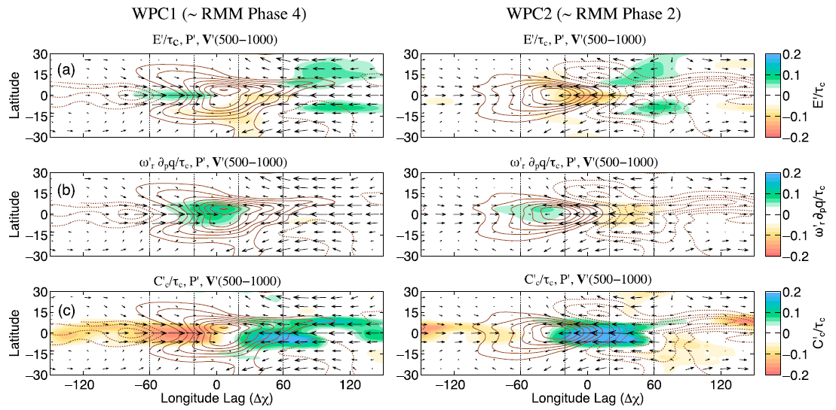
contours: $p^{′}$
arrows: 500-1000-hPa wind field
Notes:
surface latent heat fluxes E1, (b) radiatively driven vertical moisture advection v0 r›q/›p, (c)and the convectively driven column processes C’
latent heat fluxes is anticorrelated with the precipitation tendency, indicating that it acts to slow down the propagation of the precipitation anomalies,
The contribution of OLR to the precipitation tendency is comparable to that of surface latent heat fluxes but is collocated with the precipitation anomalies, albeit shifted westward
In C’ are in phase with the zonalwind anomalies, with moistening occurring in regions of anomalous easterlies and drying in westerlies.

Slide 18
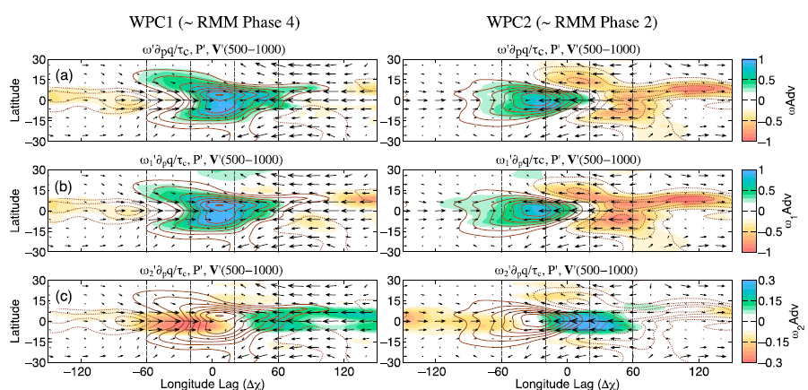
Notes:
Vertical moisture advection by w1 (middle panel) exhibits nearly the same structure as the total vertical moisture advection.
Advection by w2, exhibits a nearly identical spatial pattern as C’,
This result suggests that vertical moisture advection by v2 is an important contributor to the precipitation tendency near the equator
in regions where the profile of ascent is shallow, moist boundary layer air is advected to the lower free troposphere, leading to tropospheric moistening and increasing precipitation.
In regions of elevated stratiform ascent, the precipitation tendency is dominated by anomalous descent occurring beneath the 600-hPa level, which dries out the lower free troposphere

Slide 19
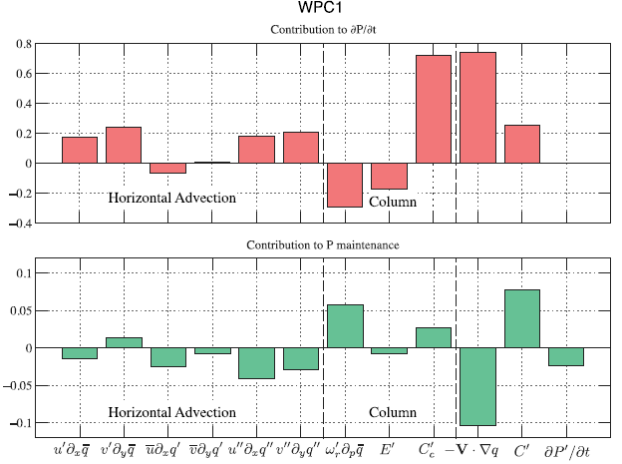
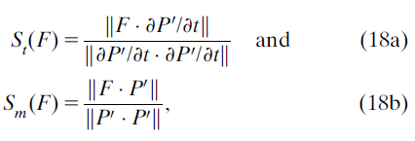
Horizontal advection
column
Notes:
it is clear that horizontal moisture advection is the largest contributor to the propagation of the precipitation anomalies.
it is clear that vertical moisture advection from longwave radiation and convective column processes C’c act to maintain the rain area against the dissipative action of horizontal moisture advection and reduced surface latent heat fluxes.

Slide 20
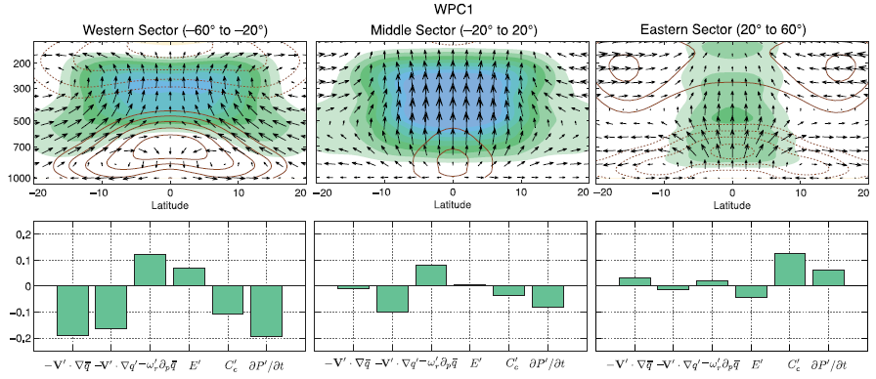
$p^{′}$maintenance
contours: zonal wind
shading: RH anomaly
Notes:
C’c is the single dominant term that maintains the rain area, and ›P0/›t.0.
(right) the vertical velocity profile is shallower and is moistening the atmosphere.
(left) Ascent driven by radiative heating and surface evaporation acts to maintain the rain area but is smaller in magnitude than the drying by horizontal moisture advection and C’c, and ›P0/›t is negative as a result.
(middle) longwave radiative feedbacks and drying by horizontal advection from high-frequency eddy activity

Slide 21
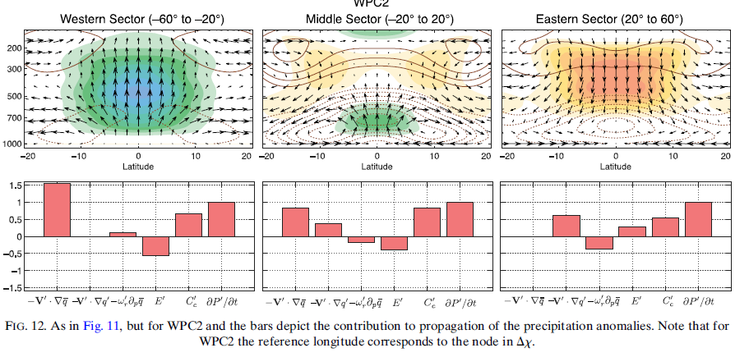
Propagation of precipitation
Notes:
all three sectors are characterized by boundary layer convergence.
In contrast, the left panel of Fig. 10 shows strong boundary layer divergence associated with negative C’c.
In the eastern sector, horizontal moisture advection is dominated by high-frequency eddy activity, transitioning to advection of low-frequency moisture by the MJO flow.

Slide 22
conclusions
The amplitude of the MJO-related precipitation estimate is obtained:
$$P^{′}=\frac{\left\langle q^{′}\right\rangle }{\overline{τ_{c}}}$$
convert the moisture budget into precipitation budget:
$$P^{′}=\frac{\left\langle q^{′}\right\rangle }{\overline{τ_{c}}}$$

Slide 23
the maintenance of $p^{′}$ is dominated by the ‘‘convective column’’ process:
moistening → shallow ascent
drying → stratiform convection
Propagation of precipitation:
horizontal moisture advection plays a key role in the damping and propagation of the precipitation anomalies.

Slide 25
In this study, we will show that the evolution of the MJO’s precipitation features is not only dependent on anomalous column water vapor but also on the climatological-mean distribution of precipitation, which determines the aforementioned convective adjustment time scale.
By incorporating this convective adjustment time scale onto the moisture field, an estimate of the intraseasonal precipitation anomalies is obtained that compares favorably with observations.
Moreover, a prognostic equation for precipitation is obtained that offers a more concise description of the physical processes responsible for the propagation of anomalous precipitation. The precipitation budget differs from traditional moisture or moist static energy budgets in that it emphasizes the regions where precipitation is most sensitive to changes in moisture.

Slide 26
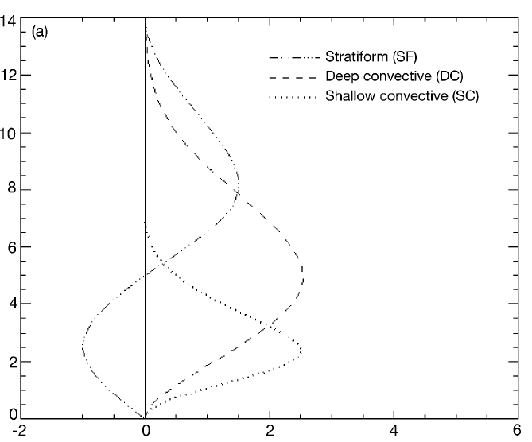
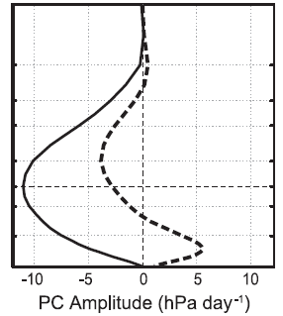
Idealized latent heating profiles
$$ω1$$
$$ω2$$

