Slide 1
Near-Surface Thermodynamic Sensitivities in Simulated Extreme-Rain-Producing Mesoscale Convective Systems
Professor : Ming-Jen Yang
Student : Jyong-En Miao
Date : 2017/10/03
Schumacher, R., S., and J. M. Peters, 2017
Mon. Wea. Rev., 145, 2177–2200.

Slide 2
Introduction
warm-season MCSs often occur in environments in which mesoscale and storm-scale processes play important roles, and those processes in turn are very sensitive to the details of their environments. => limited predictability (e.g., Wandishin et al. 2008, 2010; Melhauser and Zhang 2012).
Schumacher (2015) showed that the location and magnitude of the rainfall in a simulated elevated MCS was highly sensitive to very small changes in low-level moisture.
Bretherton et al. (2004) showed a strong, nonlinear relationship between integrated column water vapor (IWV) and precipitation over tropical oceans
In midlatitude convective systems, the relationship between moisture and precipitation may be complicated, in part because of the tendency for MCSs to be organized by vertical wind shear and horizontal temperature gradients.
Observations from the 2015 Plains Elevated Convection At Night (PECAN) showed that the operational Rapid Refresh analysis had low-level moisture errors of 2–4 g/kg near a heavily raining MCS (Peters et al. 2017).

Slide 3
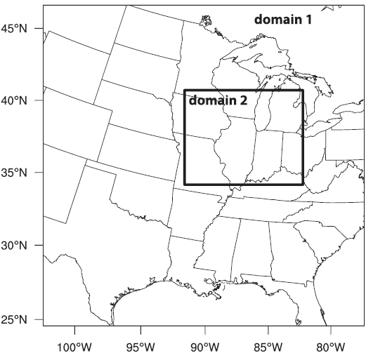
Model Setup
version 3.7.1 of the ARW
Horizontal grid spacing: 4km, 1.33km
A stretched vertical grid with 40 levels
YSU PBL
Thompson microphysics
Dudhia shortwave radiation
RRTM longwave radiation
The lower boundary was set to a flat, constant ‘‘grassland’’ surface, with surface–atmosphere fluxes turned off and no land surface model used.

Slide 4
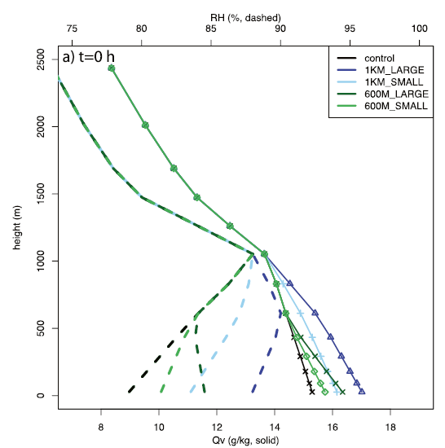
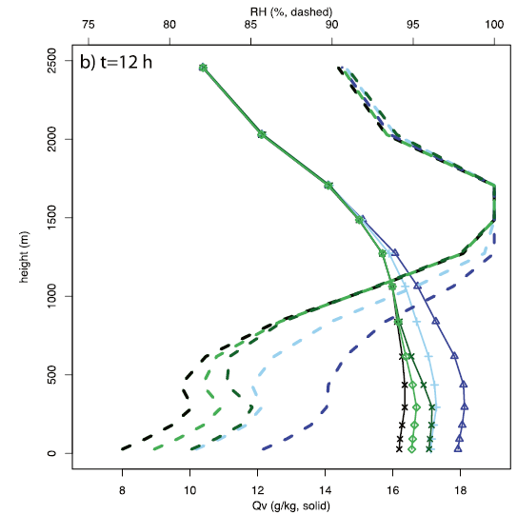
Four experiments : two with increased moisture in the lowest 1 km, and two with increased moisture in the lowest 0.6 km.

Slide 5
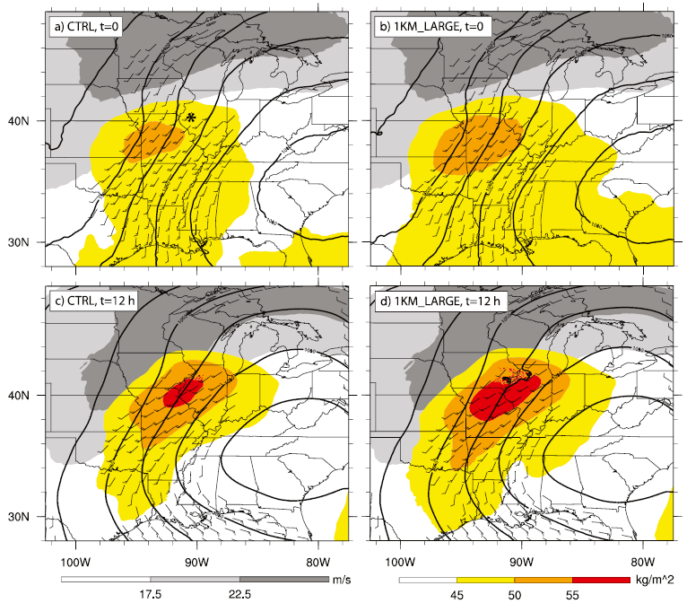

Slide 6
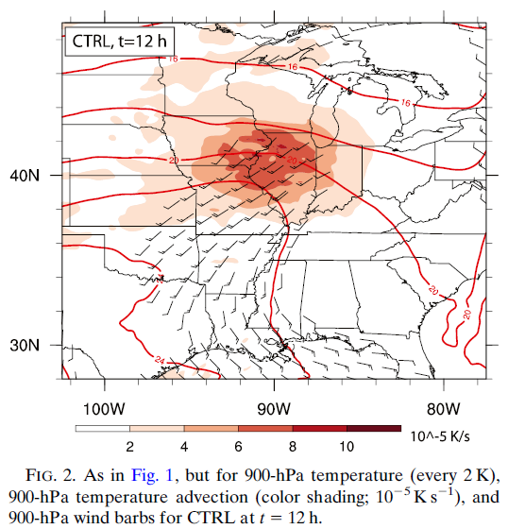

Slide 7
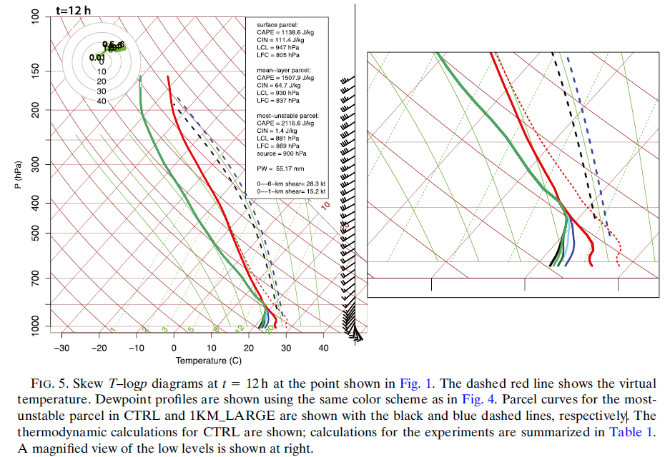

Slide 8
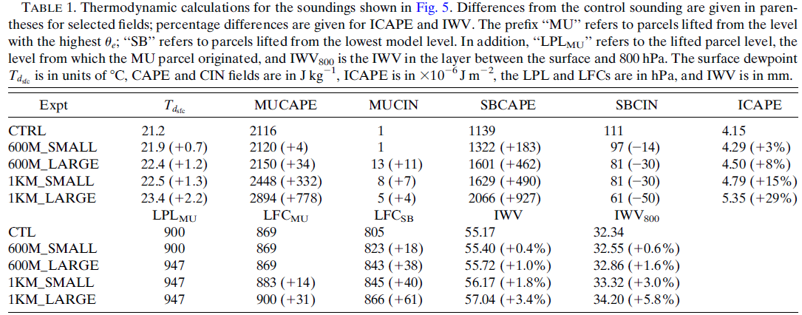

Slide 9
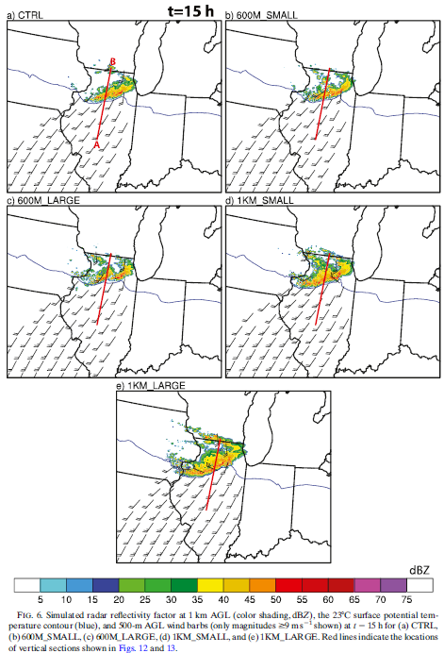
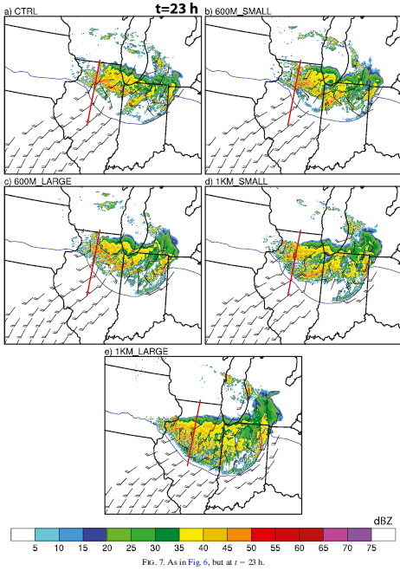

Slide 10
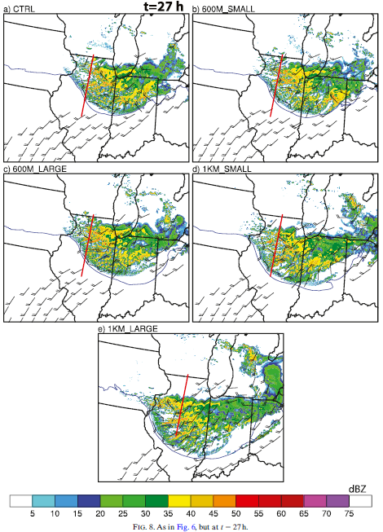

Slide 11
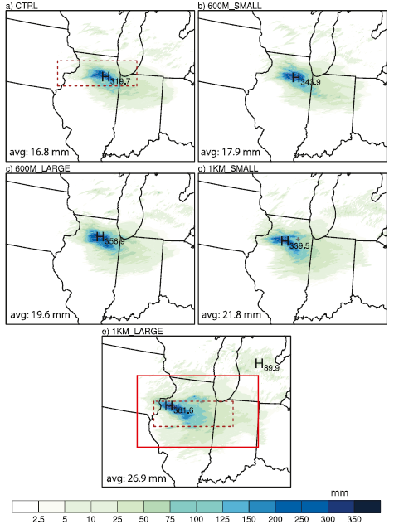

Slide 12
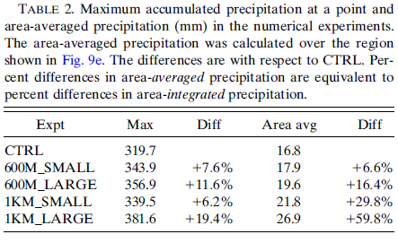
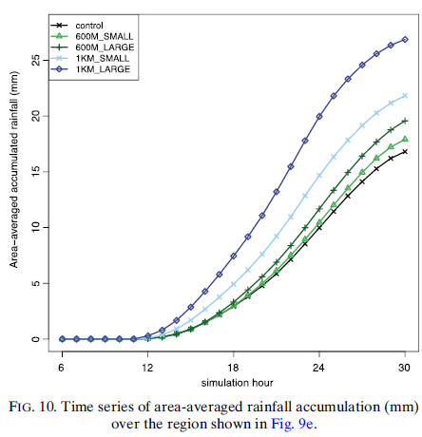

Slide 13
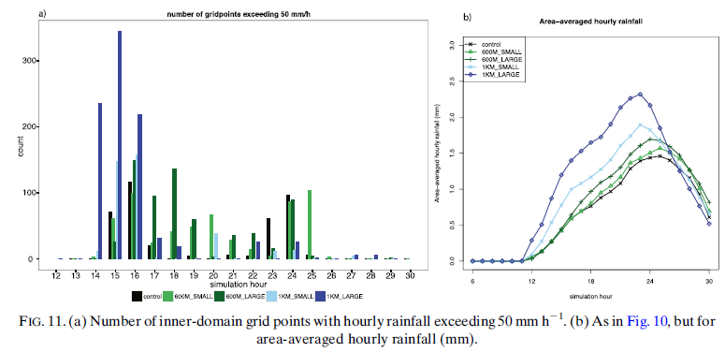

Slide 14
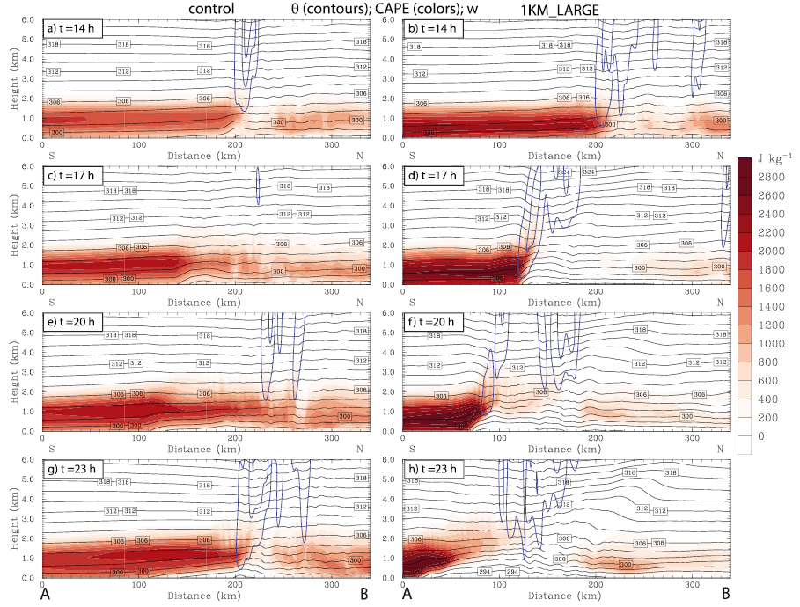

Slide 15
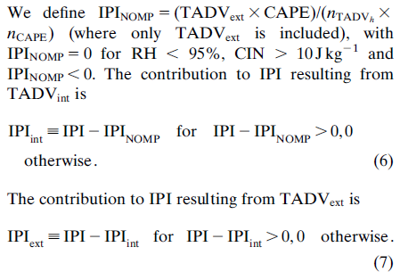

Slide 16
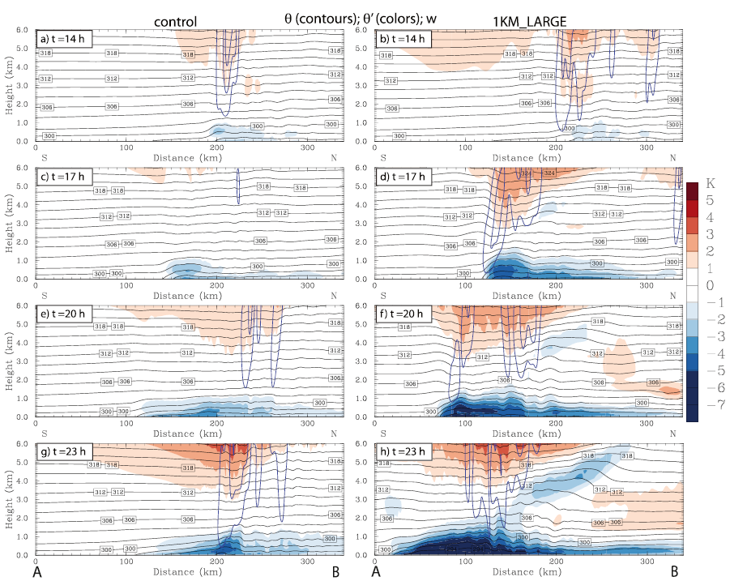

Slide 17
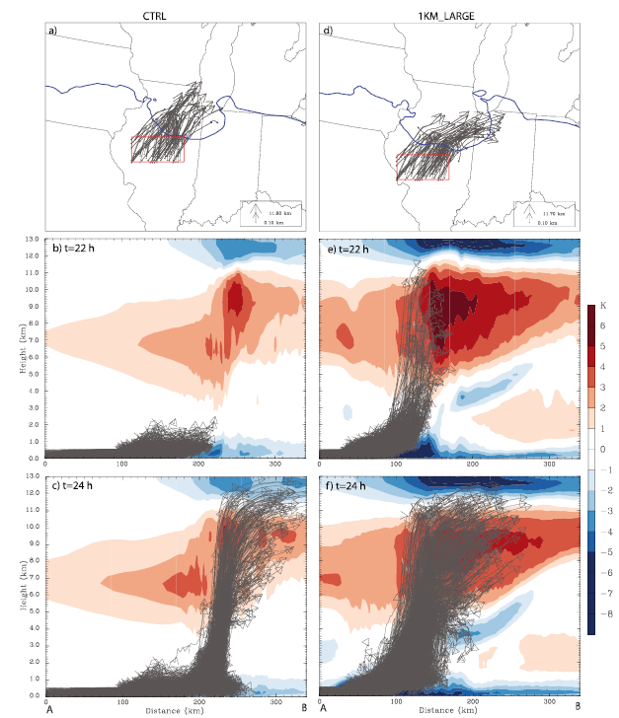

Slide 18
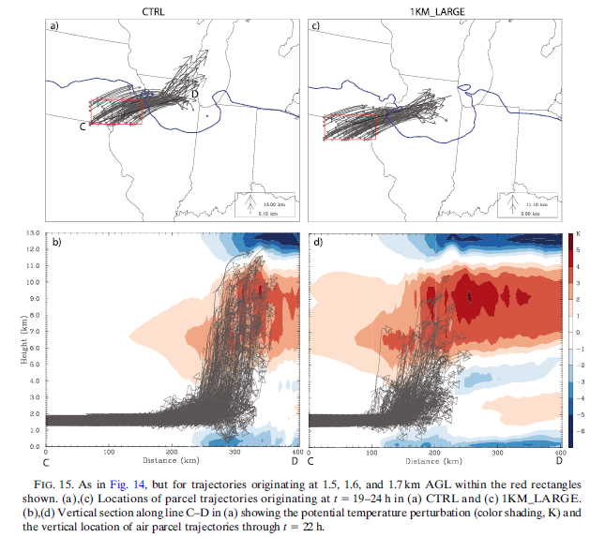

Slide 19
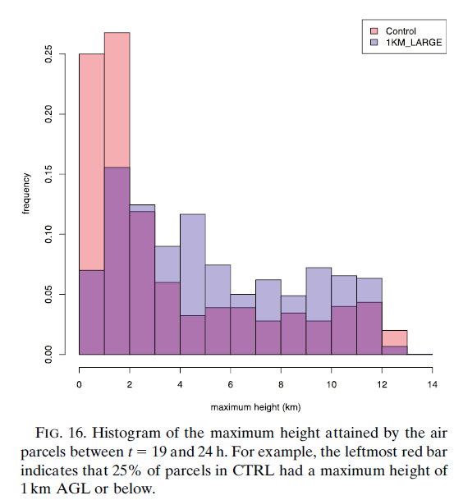

Slide 20
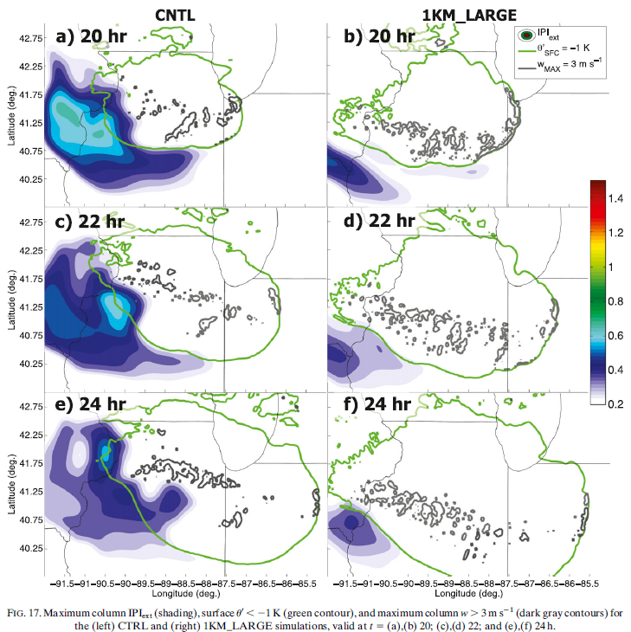

Slide 21
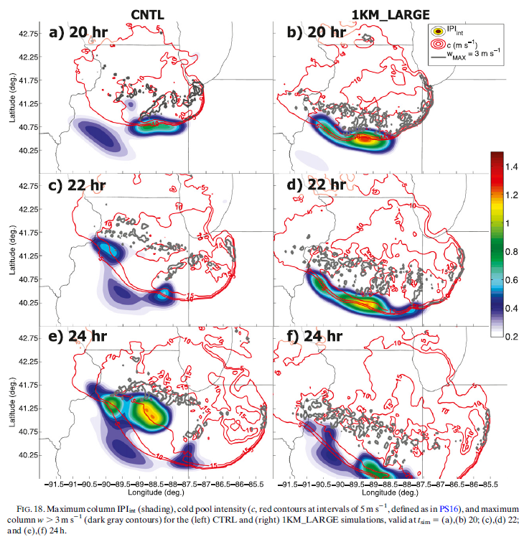

Slide 22
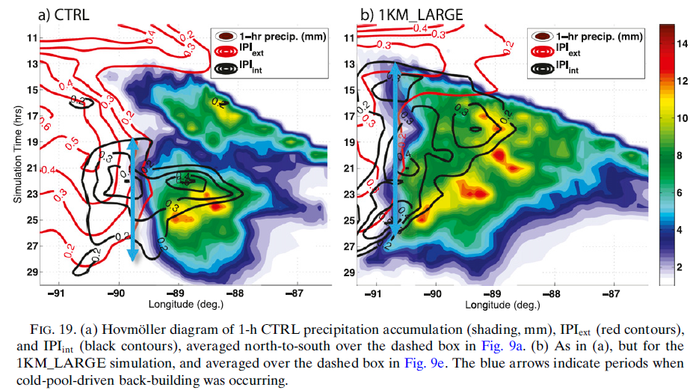

Slide 23
