Slide 1
Convective-Scale Variations in the Inner-Core Rainbands of a Tropical Cyclone
2017.09.26
Didlake, A. C., Jr., and R. A. Houze Jr., 2013: Convective-Scale Variations in the Inner-Core Rainbands of a Tropical Cyclone. J. Atmos. Sci., 70, 504-523.

Slide 2
Outline
Data and methodology
Variation of the reflectivity field
Convective cells in the inner and outer upwind regions
Composite characteristics
Radial momentum budget analysis
Assumption of gradient balance
Local imbalance of radial forces
Tangential momentum budget analysis
Azimuthal evolution of convection
Implications for secondary eyewall formation
Conclusions

Slide 3
Data and methodology
RAINEX – Hurricane Rita (2005)
NRL P3 – NCAR ELDORA
X-band dual-Doppler radar
1845 – 2032 UTC 21 Sep 2005
NOAA P3 – dropsondes
1748 – 1908 UTC 21 Sep 2005

Slide 4
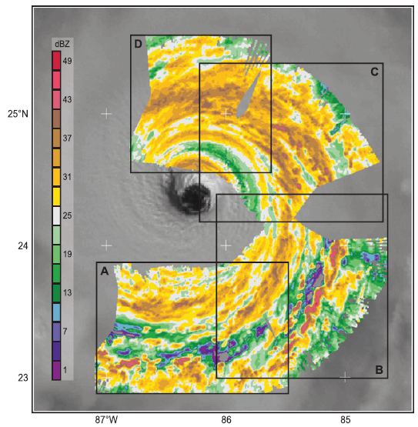
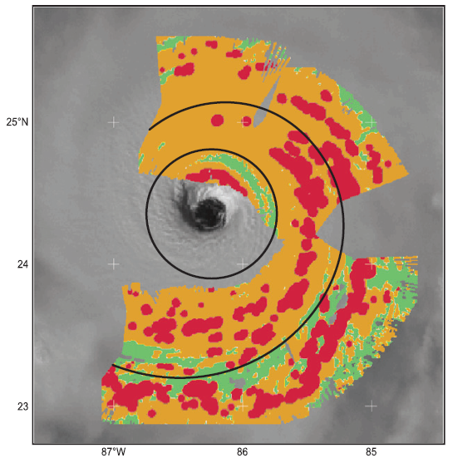
Variation of the reflectivity field
Shear vector
10m/s, 89.5º

Slide 5
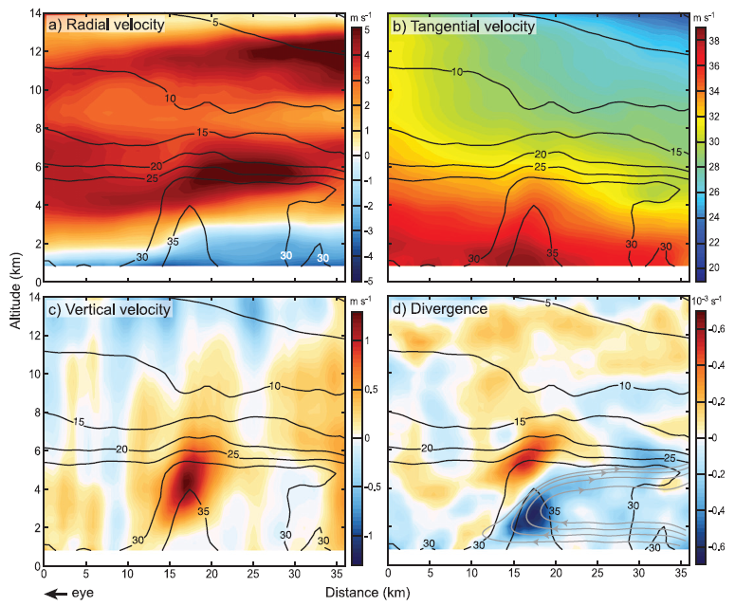
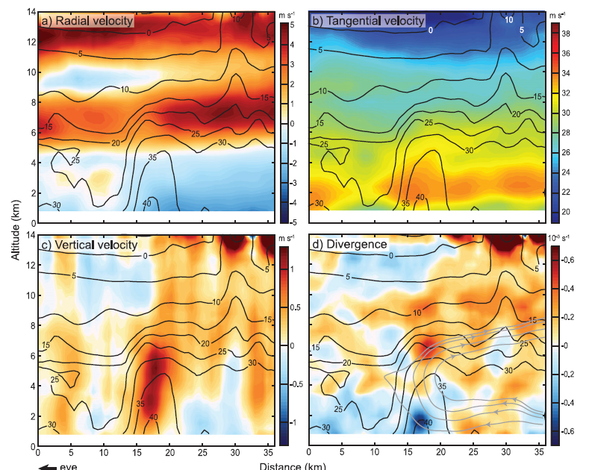
Convective cells in the inner and outer upwind regions Composite characteristics
12, 24 km
0.375º
in sections A & B
Inner cell 284
outer cell 263

Slide 6
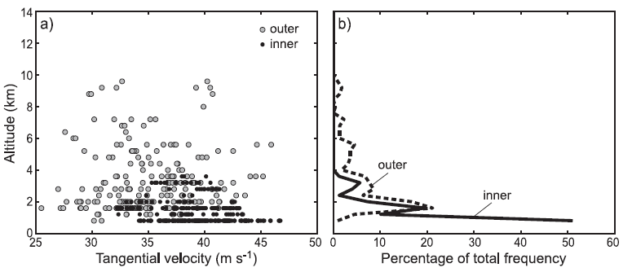
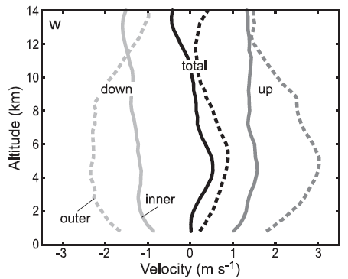
Convective cells in the inner and outer upwind regions Composite characteristics

Slide 7
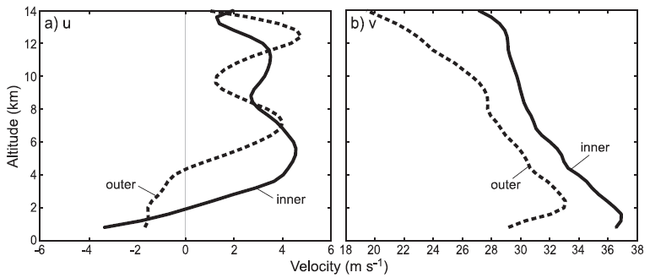
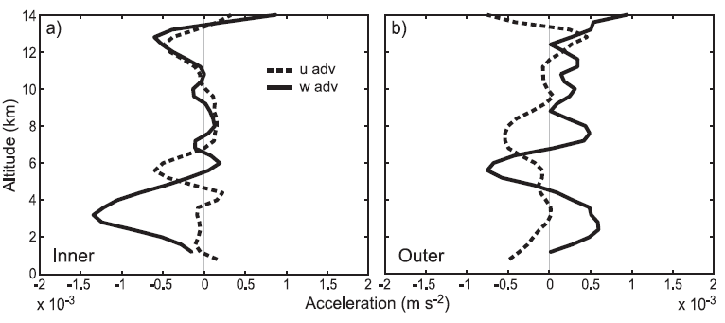
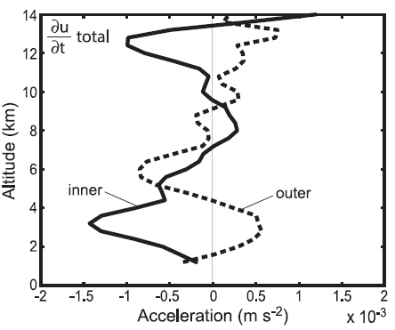
Convective cells in the inner and outer upwind regions Radial momentum budget analysis
$$\frac{∂u}{∂t}=−u\frac{∂u}{∂r}−\frac{v}{r}\frac{∂u}{∂θ}−w\frac{∂u}{∂z}+\frac{v^{2}}{r}+fv−\frac{1}{ρ}\frac{∂p}{∂r}+F_{r}$$
inflow
outflow
Under the assumption of gradient balance

Slide 8
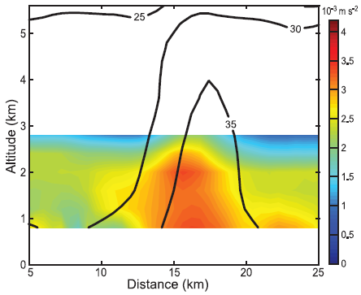
Convective cells in the inner and outer upwind regions Radial momentum budget analysis
GBR
$$\frac{∂u}{∂t}=−u\frac{∂u}{∂r}−\frac{v}{r}\frac{∂u}{∂θ}−w\frac{∂u}{∂z}+\frac{v^{2}}{r}+fv−\frac{1}{ρ}\frac{∂p}{∂r}+F_{r}$$
GBR > 0 → supergradient wind → outward acceleration
GBR < 0 → subgradient wind→inward acceleration
w adv →$δv$,
$∂p=0$
$$\frac{2vδv}{r}+\frac{{(δv)}^{2}}{r}+fδv$$
$$p^{′}∝\frac{d\overset{⃑}{V}}{dz}∙∇_{H}w^{′}$$
$w,\frac{∂u}{∂z}>0$ → $−\frac{1}{ρ}\frac{∂p}{∂r}$ decrease → $GBR>0$

Slide 9
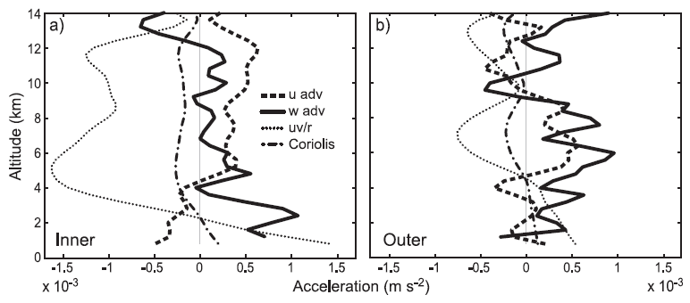
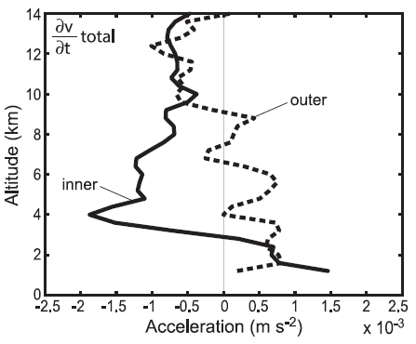
Convective cells in the inner and outer upwind regions Tangential momentum budget analysis
$$\frac{∂v}{∂t}=−u\frac{∂v}{∂r}−\frac{v}{r}\frac{∂v}{∂θ}−w\frac{∂v}{∂z}−\frac{uv}{r}−fu−\frac{1}{ρ}\frac{∂p}{∂θ}+F_{θ}$$
outflow
outflow
inflow
inflow

Slide 10
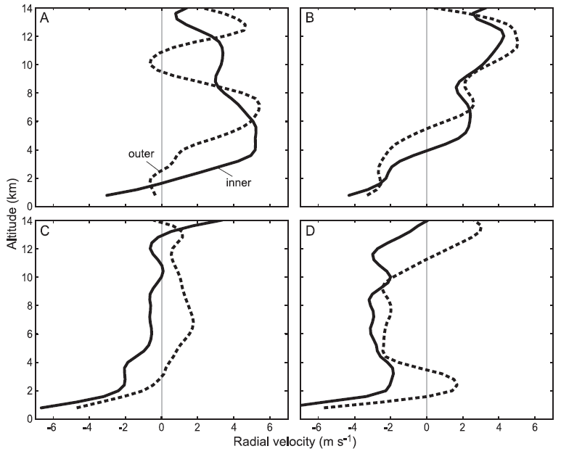
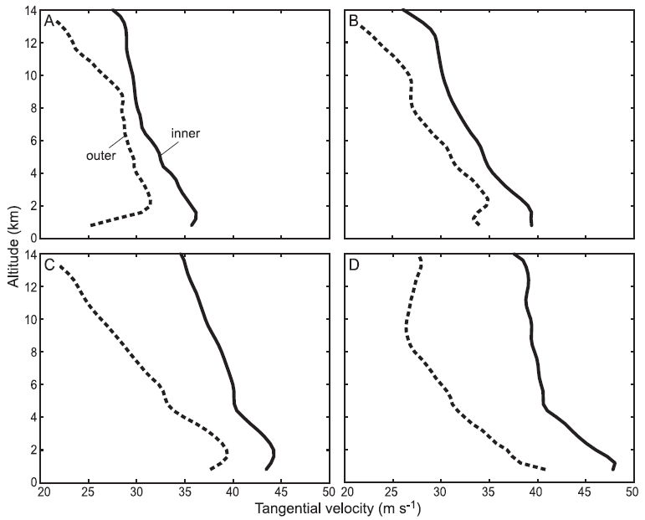
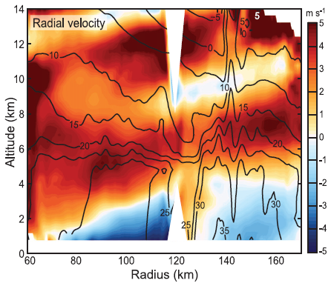
Azimuthal evolution of convection

Slide 11
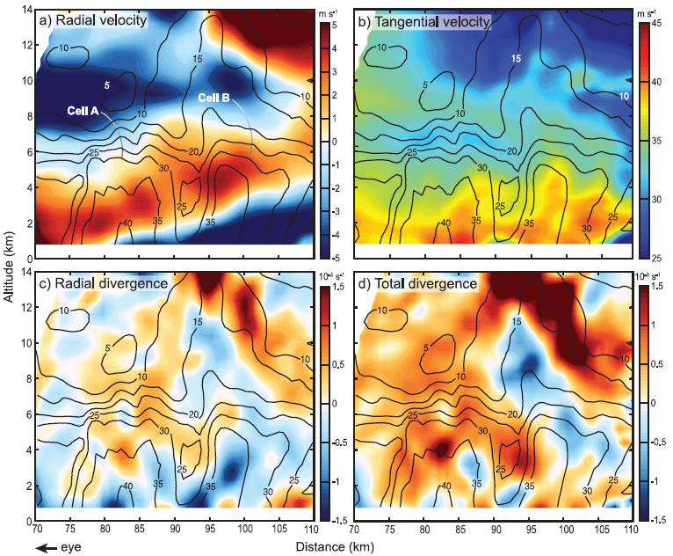
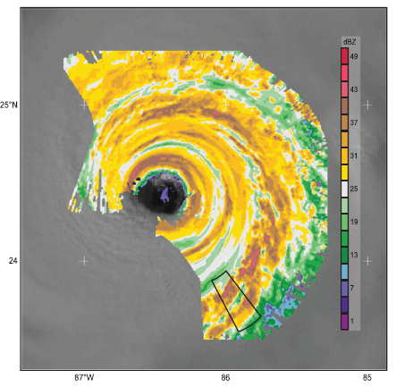
Implications for secondary eyewall formation

Slide 12
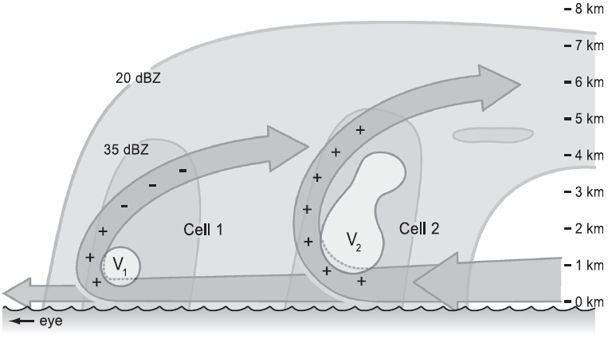
Conclusions

Slide 13
Conclusions
Convective cells at smaller radii contained a low-level tangential jet determined largely by tangential acceleration due to angular momentum conservation while cells at larger radii contained a low-level and/or midlevel jet determined jointly by the angular momentum conservation and vertical advection terms.
The low-level tangential jet and convectively generated pressure gradients produce outward-pointing supergradient acceleration that decelerates the boundary layer inflow.
It is hypothesized that a critical zone for secondary eyewall formation exists where sufficiently high u_{z} consistently constrains the altitudes of convectively generated supergradient flow so that convection in this radial zone leads to a newly developed eyewall.

