Slide 1
Contribution of tropical waves to the formation of Supertyphoon Megi (2010)
Fang, J., and F. Zhang, 2016: Contribution of tropical waves to the formation of Supertyphoon Megi (2010). J. Atmos. Sci., 73, 4387–4405.
Notes:
Through observational analysis and numerical simulations, this study examines the roles of the Madden– Julian oscillation (MJO) and tropical waves in the three-stage formation of Supertyphoon Megi (2010)

Slide 2
introduction
MJO:
enhancing large-scale low-level convergence and meridional cyclonic shear and causing easterly vertical wind shear anomalies (Maloney and Hartmann 1998, 2000b; Bessafi and Wheeler 2006; Frank and Roundy 2006; Molinari et al. 1997).

Slide 3
equatorial Rossby (ER) and Kelvin waves
ER wave:
twin TC formation across the equator [Schreck and Molinari (2009) and Schreck et al. (2012)]
providing convergence and easterly vertical wind shear to promote wave energy trapping and accumulation. [Molinari et al. (2007)]
Kelvin wave:
It can reduce (enhance) westerly (easterly) vertical wind shear and increase atmospheric moisture and low-level potential vorticity [(Schreck and Molinari 2011; Ventrice et al. 2012a,b)].

Slide 4
mixed Rossby–gravity (MRG) and TD-type waves (i.e. easterly wave)
providing seedlings of TCs. [Dunkerton et al. (2009); Schreck et al. (2012); Xu et al. (2013)]
The primary initial disturbance of TCs over the Northern Hemisphere.[Schreck et al. (2012)]

Slide 5
Data
NCEP: 0.58 resolution, 6-hourly data
best-track data: JMA
blackbody temperature (TBB): Japanese Geostationary Meteorological Satellite (GMS)/Multifunctional Transport Satellite (MTSAT)
precipitation: Tropical Rainfall Measuring Mission (TRMM)
tropical wave | periods (day) | wavenumber
MJO | 30~96 | 0~9
Kelvin wave | 2.5~17 | 1~14
ER wave | 9~72 | -10~-1
MRG wave | 3~10 | -10~-1
TD-type wave | 2.5~5 | -20~-6
Schreck et al. (2012)

Slide 6
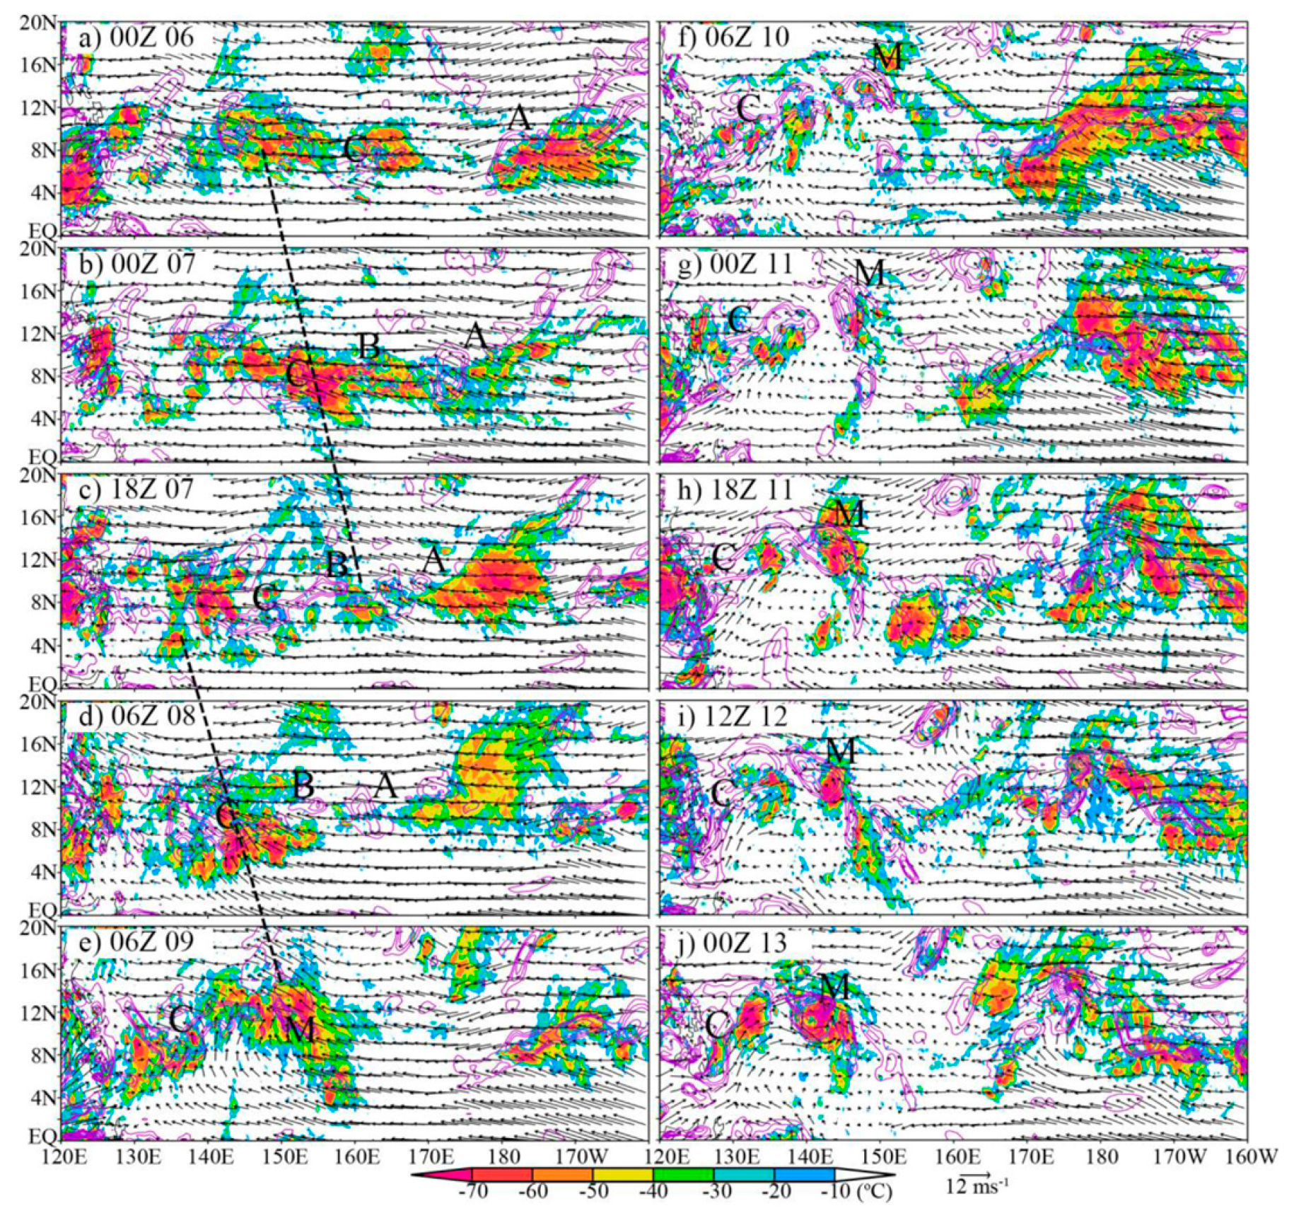
massive
convective burst
decaying
convection
stage 2
vortex
rearrangement
stage 1
stage 3
deep convection
reinvigoration,
vortex
intensification
vorticity aggregation
vectors: 850-hPa wind
contours: vorticity
shaded: blackbody temperature
Notes:
於西北太平洋存在A和C的PVA.
隨著PVA向西移動，受到兩個深對流影響，PVA C逐漸增強，並生成新的PVA B
於此同時，位於PVA C東南側的850hPa的風場逐漸由東南東風轉成南南西風，而導致位於PVA C的東北側的低層輻合以及正渦度增加，並且減緩向西移動的PVA B的移速
最後PVA B 被後方的PVA A追上並合併成PVA M
PVA M的對流系統迅速減弱，於此同時，低層的西南風增強而使得PVA C的東北側的渦度增強，並往東北方移動與PVA M結合 使PVA M變得更有組織，隨時間增強成TD

Slide 7
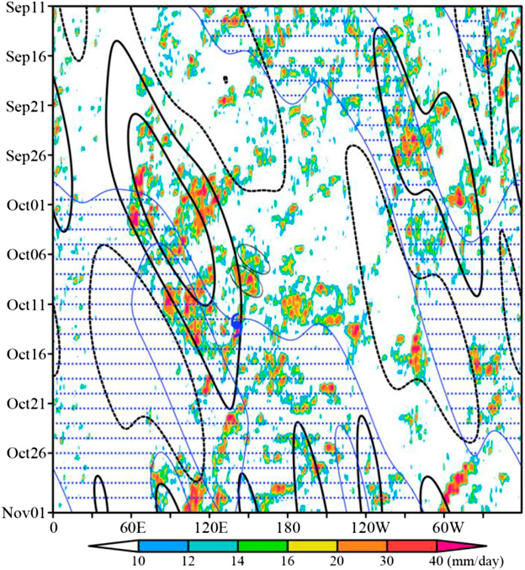
5°N~15 ° N average
time
inner-core average
(2° radius of Megi precursors)
MJO did precondition the large-scale environment by enhancing low-level convergence and cyclonic vorticity as well as low-to midlevel relative humidity.
shaded: TRMM rainfall
contours: MJO-filtered rainfall
blue contours: 850-hPa zonal wind speed (0, 2 m/s)
stipple: westerly flow
Notes:
梅姬颱風主要由兩個向西移動的對流雲系，並位於MJO主要對流位置的前緣，雖然MJO的位置相較於梅姬西側遠處，但MJO提供低層輻合、氣旋式渦度以及高的相對濕度，使梅姬能夠在適合的環境增強為颱風。

Slide 8
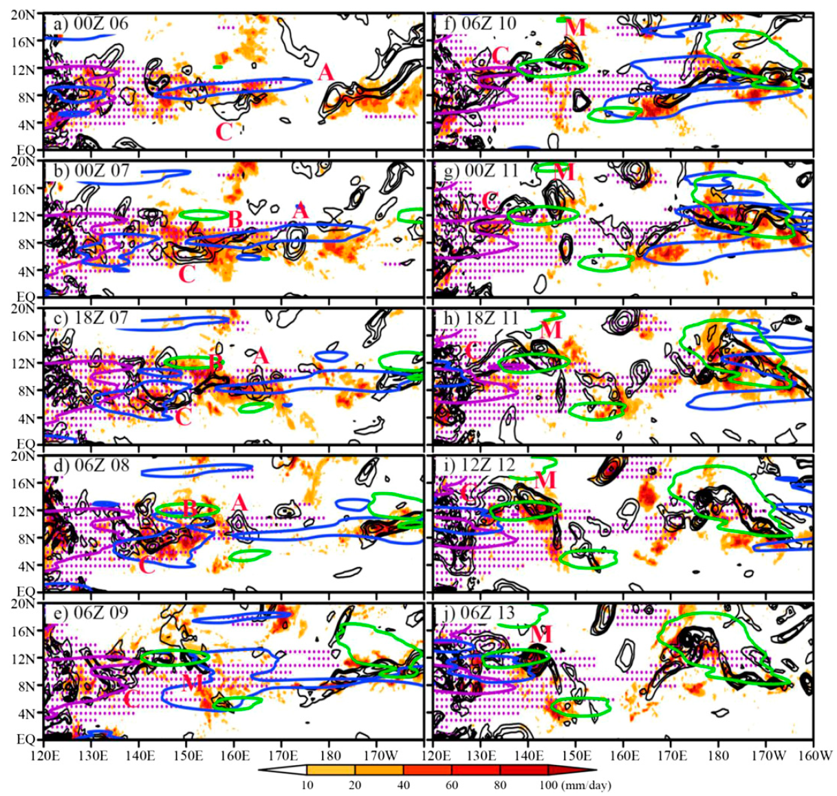
contours:
Black - 850hPa vorticity
Purple - MJO rainfall
Blue - Kelvin rainfall
Green – ER rainfall
Shading:
unfiltered rainfall
Stipple:
Positive MJO-filtered rainfall
Notes:
正渦度A 和C位於MJO和Kelvin waves之內，並且持續至10月8日，
於此之後，正渦度B和東北側的正渦度C，開始受ER wave的影響
接著，kelvin wave持續東移，而離開正渦度M的位置，但ER wave持續影響渦度M，直到PVA M 增強至TD

Slide 9
Kelvin, U
ER, U
10/08
M
M
shading:
850-hPa zonal velocity
contours:
TRMM rainfall (5N~15N average)
Notes:
(a) 當kelvin wave的雨帶隨時間東移，低層西風於10/8 00Z抵達渦度位置的西側，使輻合增強
(b) 10/8之後，正渦度B受到ER wave雨帶中的西風影響，而造成西移速度減慢，並與東側的正渦度A合併。
此時 ER wave造成渦度和低層輻合增強。

Slide 10
ER, U
ER, V
shading:
850-hPa meridional velocity
contours:
TRMM rainfall (5N~15N average)
Notes:
ER wave持續影響PVA M，於PVAM的西南方ER wave提供西南風的風場，造成PVAM輻合增加，並且促使PVAC東側的PVA合併至PVAM內

Slide 11
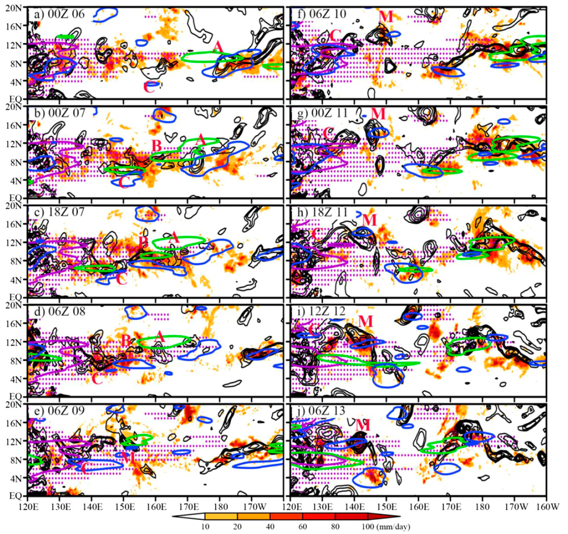
contours:
Black - 850hPa vorticity
Purple - MJO rainfall
Blue - TD rainfall
Green – MRG rainfall
Shading:
unfiltered rainfall
Stipple:
Positive MJO-filtered rainfall
Notes:
PVA A 在一開始就受MRG 和 TD wave的影響，並且TD wave 亦於PVA M 西南側增強西南風

Slide 12
MRG-TD, U
MRG-TD, V
shading:
850-hPa zonal/meridional velocity
contours:
TRMM rainfall (5N~15N average)

Slide 13
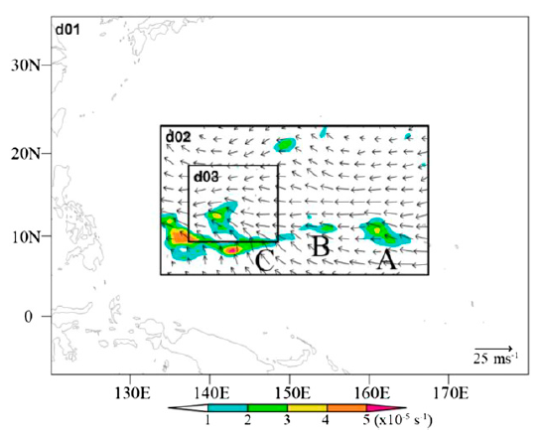
WRF Model (version 3.5.1; Skamarock and Klemp 2008)
horizontal grid spacings: 13.5, 4.5, and 1.5km (two-way nesting)
mesh sizes: 481 x 361, 811 x 601, and 811 x 691
vertical levels: 35 levels
model top: 10 hPa
microphysics scheme: WSM6
boundary layer scheme: YSU
longwave radiation: RRTM
shortwave radiation scheme: Dudhia
initial time: 0600 UTC 8 October

Slide 14
Time: 00 UTC 13 October
vectors: 850hPa wind
shading: vorticity (x10⁵s⁻¹)
blue contours: SLP (hPa)
black line: track of observed Megi’s precursor
pink line: CNTRL-derived
Notes:
模式模擬結果與觀測相近

Slide 15
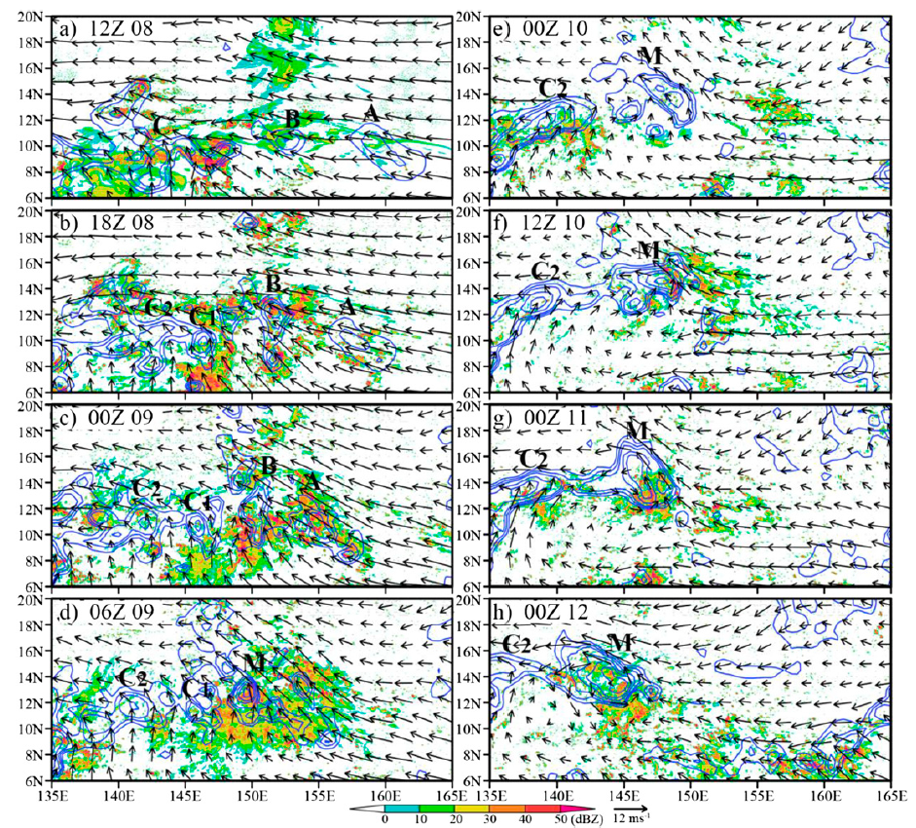
control simulation
vectors: 850hPa wind
contours: vorticity
shading: column-maximum reflectivity
Notes:
CTL的表現與觀測類似，在模擬6小時候，於西太平洋發展出多個深對流，而PVA A和B逐漸增強並合併，之後降水蒸發或是融化產生冷池，造成環境不是和對流發展，導致PVA M對流逐漸消散。
在10/10 00Z PVA M西南側的西南風增強使得西南風前緣C1渦度與對流增強並合併至PVA M內。
PVA M 渦度增強之後，對流重新增強，之後增強為TD

Slide 16
(Time: 00 UTC 13 October)
Performing Five sensitivity experiments
vectors: 850hPa wind
shading: vorticity (x10⁵s⁻¹)
blue contours: SLP (hPa)
black line: track of observed Megi’s precursor
pink line: CNTRL-derived
Notes:
除了MRG-TD wave 其他敏感度實驗都沒有模擬出與觀測或CTL位置和時間點興進的TC
雖然在NOMJO實驗裡有模擬出TC，但距離觀測的位置差500km 以上。

Slide 17
noWaves - CTL (0600UTC 8 Oct 2010)
shading:
850hPa vorticity (diff.)
vectors:
850hPa winds (diff.)
purple contours:
850hPa vorticity (case)
shading:
850hPa divergence
contours:
1000-700hPa
averaged specific humidity
stippled:
surface-based CAPE
shading:
850hPa vorticity (8°N~16 ° N average)
contours:
850hPa wind speed (9°N~13 ° N average)
shading:
column-maximum reflectivity (6 ° N~16 ° N average)
vectors:
850hPa winds (9° N~13 ° N average)
Notes:
移除掉所有的熱帶波動後，低層福散度增加，而造成對流明顯減弱，並且隨著時間發展，低層東風沒有減弱而變得較CTL東風風速強，因此使得渦度A, b, c西移的速度太過，而無法發展。

Slide 18
noMJO - CTL (0600UTC 8 Oct 2010)
shading:
850hPa vorticity (diff.)
vectors:
850hPa winds (diff.)
purple contours:
850hPa vorticity (case)
shading:
850hPa divergence
contours:
1000-700hPa
averaged specific humidity
stippled:
surface-based CAPE
shading:
850hPa vorticity (8°N~16 ° N average)
contours:
850hPa wind speed (9°N~13 ° N average)
shading:
column-maximum reflectivity (6 ° N~16 ° N average)
vectors:
850hPa winds (9° N~13 ° N average)
Notes:
移除掉MJO wave後，低層輻合、水氣以及渦度減少、對流強度稍微減弱
PVA B 與 C1結合，但因為沒有跟PVA A合併而沒有發展
低層西風較CTL實驗強，造成140E輻合增加，與C2位置相同而隨時間C2渦度增強，使得最後發展成TC但位置較CTL偏西500km處。

Slide 19
noKelvin - CTL (0600UTC 8 Oct 2010)
shading:
850hPa vorticity (diff.)
vectors:
850hPa winds (diff.)
purple contours:
850hPa vorticity (case)
shading:
850hPa divergence
contours:
1000-700hPa
averaged specific humidity
stippled:
surface-based CAPE
shading:
850hPa vorticity (8°N~16 ° N average)
contours:
850hPa wind speed (9°N~13 ° N average)
shading:
column-maximum reflectivity (6 ° N~16 ° N average)
vectors:
850hPa winds (9° N~13 ° N average)
Notes:
移除kelvin wave之後，其PVAs其發展趨勢與CTL結果類似，強度稍弱。
水氣、低層輻合以及CAPE減少
由於東風稍微較強，輻合減少，PVA B 、 A和C在10/10之前都還沒有合併，雖然到最後有合併，但沒有發展成TD

Slide 20
noER - CTL (0600UTC 8 Oct 2010)
shading:
850hPa vorticity (diff.)
vectors:
850hPa winds (diff.)
purple contours:
850hPa vorticity (case)
shading:
850hPa divergence
black contours:
1000-700hPa
averaged specific humidity
stippled:
surface-based CAPE
shading:
850hPa vorticity (8°N~16 ° N average)
contours:
850hPa wind speed (9°N~13 ° N average)
shading:
column-maximum reflectivity (6 ° N~16 ° N average)
vectors:
850hPa winds (9° N~13 ° N average)
Notes:
移除ER wave之後，在西太平洋的赤道地區，產生氣旋式環流的風場，使得PVA A, B 和C1西移的速度較CTL快。
由於C2在140E西側增強，使得PVA M西側的西風較弱，造成PVA M區域輻合減弱，導致PVA M增強的效率較，雖然有渦度合併，但最後沒有發展成TD

Slide 21
noMRG-TD - CTL (0600UTC 8 Oct 2010)
shading:
850hPa vorticity (diff.)
vectors:
850hPa winds (diff.)
purple contours:
850hPa vorticity (case)
shading:
850hPa divergence
contours:
1000-700hPa
averaged specific humidity
stippled:
surface-based CAPE
shading:
850hPa vorticity (8°N~16 ° N average)
contours:
850hPa wind speed (9°N~13 ° N average)
shading:
column-maximum reflectivity (6 ° N~16 ° N average)
vectors:
850hPa winds (9° N~13 ° N average)
Notes:
由於渦度A和B的南側，低層輻合和渦度增加，導致對流於緯度平均圖中，呈現與CTL的結果發展的要強，但由於渦度A和B的位置不利渦度發展，使得A、B隨時間變化較CTRL弱。
一直到合併成PVA M之後，由於西風增強，低層輻合增加，之後由於C2的對流發展較弱且隨時間發展逐漸與PVA M合併，因此PVA M逐漸發展成TC。

Slide 22
inner-core average (2° radius of Megi precursors)
shading:
mean frequency of
convection top height
contours:
vertical velocity
shading:
vorticity
contours:
horizontal divergence
(a)
thick black: $\frac{∂δ}{∂t}$(1000m)
red:
horizontal advection
blue:
stretching effect
thin black:
summation=(red)+(blue)
(b)
red:
vertical advection
blue:
tilting effect
vorticity budget equation:
Notes:
Stage 1: 0600Z 10/08 ~ 0600Z 10/09
存在深對流雲系
Stage 2: 0600Z 10/09~10/10
深對流雲系消耗完不穩定度後，逐漸消散，低層級高層呈現下沉氣流，僅中層存在上升運動且渦度增加，為層狀雲系
Stage 3: after 10/10 0600Z
對流重新發展，渦度合併，呈現低層轉變為政渦度增加，透過渦度收支分析，stage 3 主要受輻合項的正貢獻，使低層渦度增加。
雖然垂直平流象對渦度趨勢有正貢獻，但被傾斜項幾乎平衡。
隨著時間發展，低層的渦度向上延伸至將近200hPa高度，因此判定Megi為

Slide 23
inner-core average (2° radius of Megi precursors)
shading:
mean frequency of
convection top height
contours:
vertical velocity
shading:
vorticity
contours:
horizontal divergence
thick black: $\frac{∂δ}{∂t}$(1000m)
red:
horizontal advection
blue:
stretching effect
thin black:
summation=(red)+(blue)
red:
vertical advection
blue:
tilting effect

Slide 24
inner-core average (2° radius of Megi precursors)
shading:
mean frequency of
convection top height
contours:
vertical velocity
shading:
vorticity
contours:
horizontal divergence
thick black: $\frac{∂δ}{∂t}$(1000m)
red:
horizontal advection
blue:
stretching effect
thin black:
summation=(red)+(blue)
red:
vertical advection
blue:
tilting effect
Notes:
在noMJO實驗中，低層的渦度發展較弱且厚度較薄，在stage 3時期，只有零星的深對流發展。
Inner-core的輻合，以及引發的渦度趨勢較弱，因此無法發展為TD

Slide 25
inner-core average (2° radius of Megi precursors)
shading:
mean frequency of
convection top height
contours:
vertical velocity
shading:
vorticity
contours:
horizontal divergence
thick black: $\frac{∂δ}{∂t}$(1000m)
red:
horizontal advection
blue:
stretching effect
thin black:
summation=(red)+(blue)
green:
vertical advection + tilting effect
Notes:
雖然有深對流重新發展，但是強度不足以使拉伸項有效的增強渦度

Slide 26
inner-core average (2° radius of Megi precursors)
shading:
mean frequency of
convection top height
contours:
vertical velocity
shading:
vorticity
contours:
horizontal divergence
thick black: $\frac{∂δ}{∂t}$(1000m)
red:
horizontal advection
blue:
stretching effect
thin black:
summation=(red)+(blue)
green:
vertical advection + tilting effect
Notes:
10/12之後對流爆發，拉伸項開始提高。

Slide 27
conclusions
MJO preconditioned the large-scale circulation and low-level moisture favorable for convection
Kelvin and ER waves brought low-level convergence and cyclonic vorticity anomalies to enhance massive convection.
MRG-TD and ER waves increased low-level southwesterlies to the southwest of the precursor (PVA B, M).
Deep convection reinvigorated in stage 3 played a critical role in the spinup of a TC.

