Slide 1
The Warm-Core Structure of Hurricane Earl (2010)
Stern D. P., and F. Zhang, 2016: The Warm-Core Structure of Hurricane Earl (2010), J. Atmos. Sci., 73, 3305-3328.

Slide 2
Scientific Questions
Is there a relationship between the height of the maximum perturbation temperature and either the intensity or intensity tendency?
Is the height of maximum perturbation temperature sensitive to the choice of reference profile?
Is it possible to relate structural changes in the wind field to changes in the height of the warm core?

Slide 3
02-00Z
30-12Z
29-00Z

Slide 4
Observations
P-3 (radar reflectivity, wind field)
DC-8 (dropsondes; 8/29,8/30,9/1,9/2)
  24,23,29,33
  00,06,06,07 (radius < 15km)
G-IV (dropsondes)
  27,31,31,33 (150km > radius > 1000km)

Slide 5
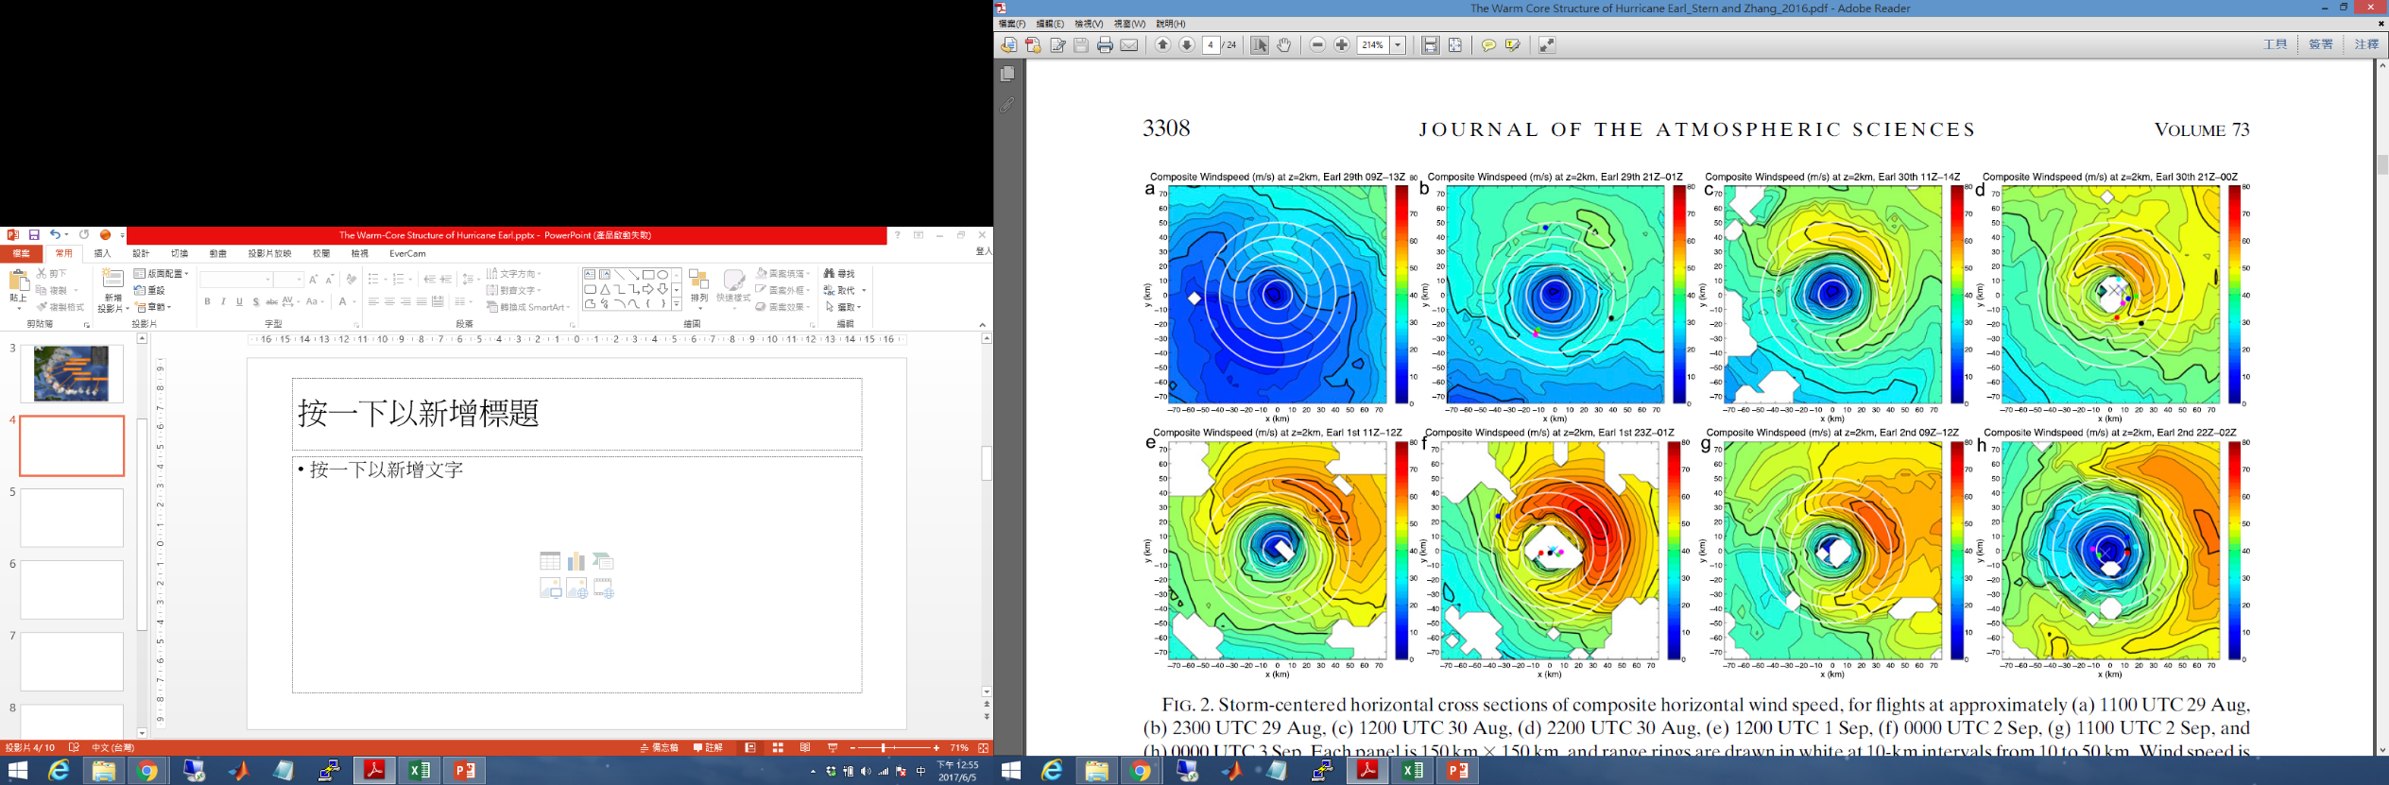
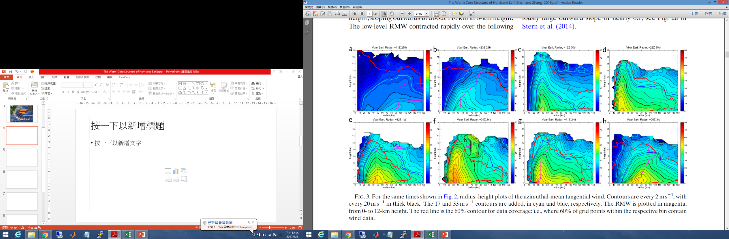
RI
ERC began
8/29 09-13Z
8/29 21-01Z
8/30 11-14Z
8/30 21-00Z
RI
ERC

Slide 6
ERC completed
Peak intensity
2nd ERC
9/1 11-12Z
9/1 23-01Z
9/2 09-12Z
9/2 22-02Z
Peak intensity

Slide 7
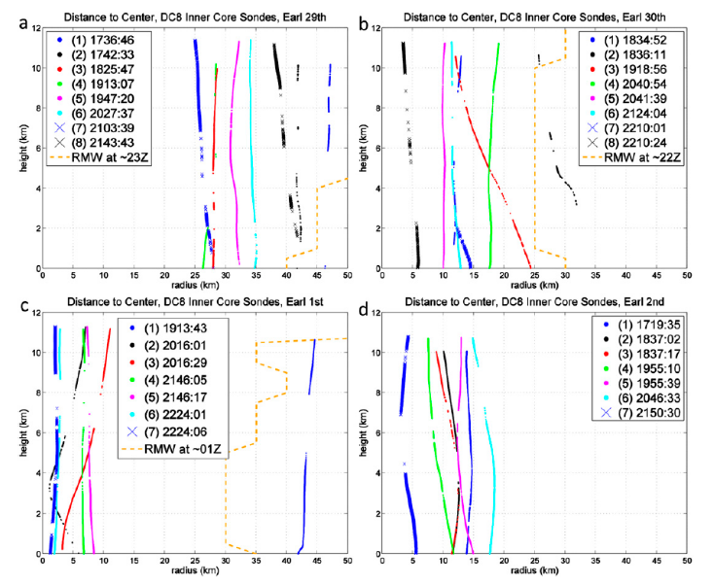
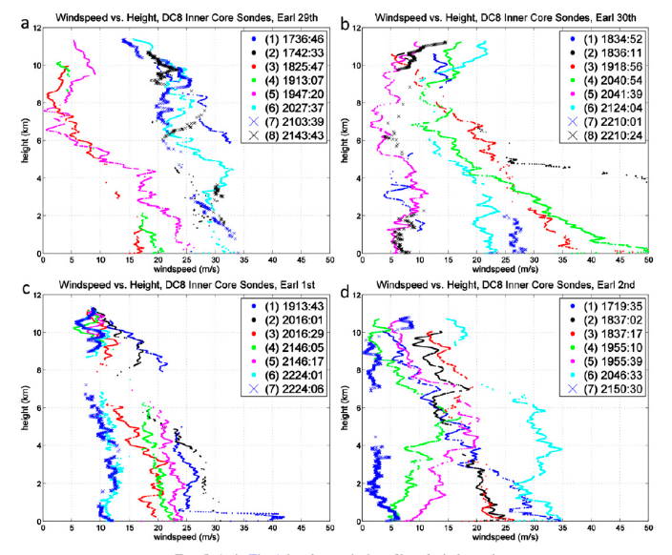
RI
PI

Slide 8
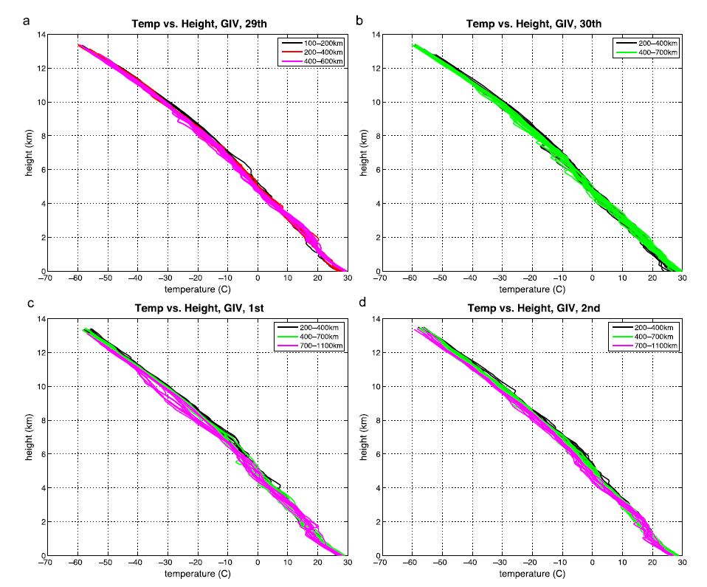



$$T_{GIV}$$
$$\overline{T_{GIV}}−T_{Dunion}$$

Slide 9
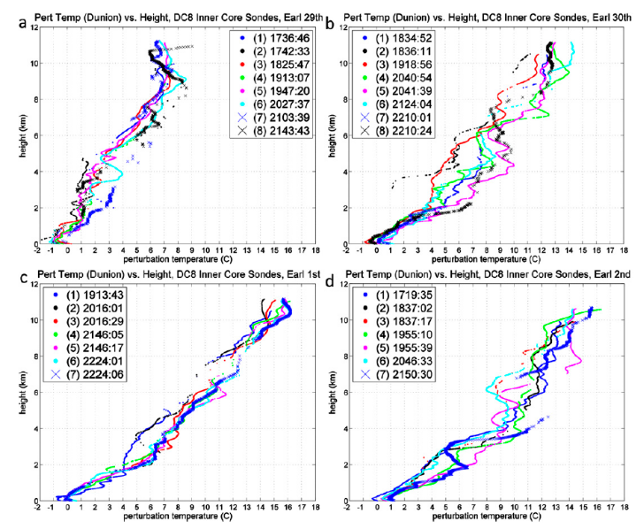
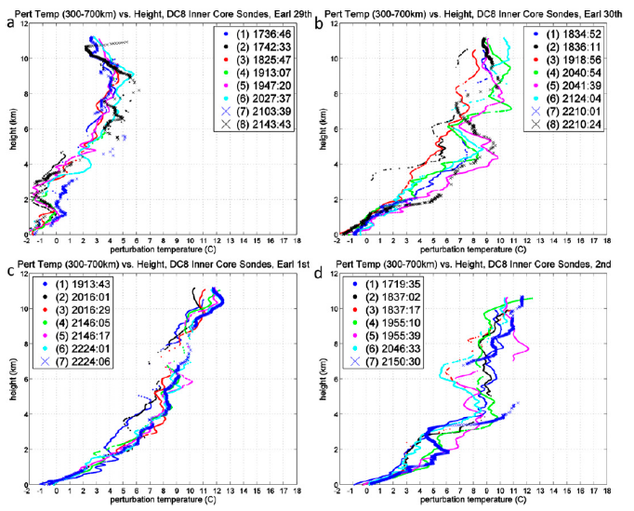


$$T_{DC−8}−T_{Dunion}$$
$$T_{DC−8}−\overline{T_{{GIV}_{300−700}}}$$
Notes:
A→b 整層大氣加熱,對應此時風速增強,壓力降低
C→d 6公里以上加熱但強度減弱

Slide 10
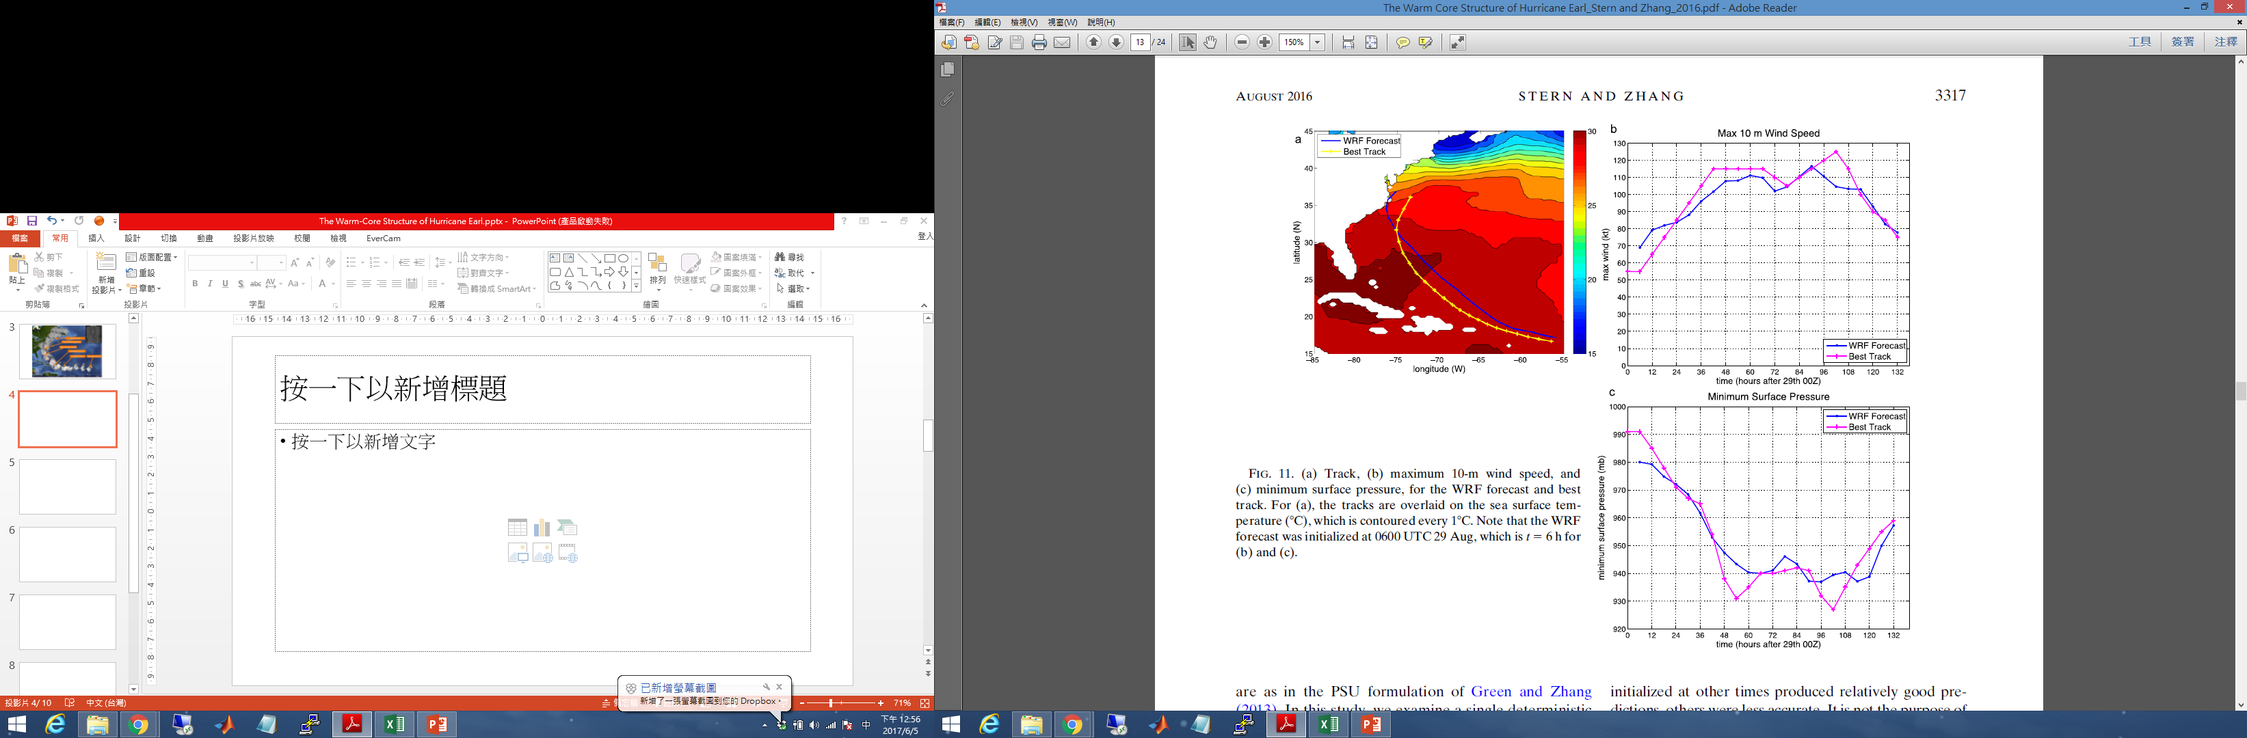
PSU Real-Time WRF-EnKF system
WRF-ARW v3.4.1
Three nested domain (dx: 27/9/3 km) with 43 vertical levels
YSU/WSM6/RRTM/Dudhia
DA: P-3/G-IV/Pmin

Slide 11
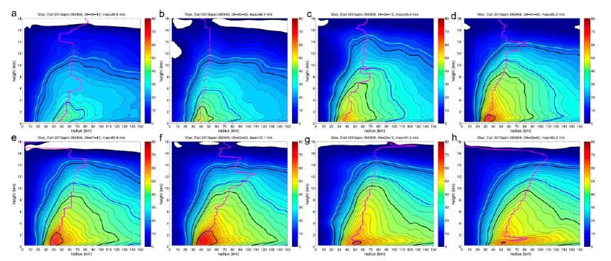
8/29 12Z
8/30 00Z
8/30 12Z
8/31 00Z
9/01 12Z
9/02 00Z
9/02 12Z
9/03 00Z

Slide 12
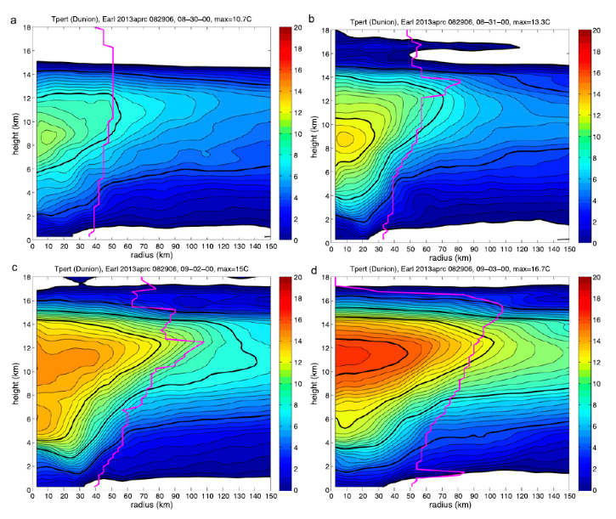
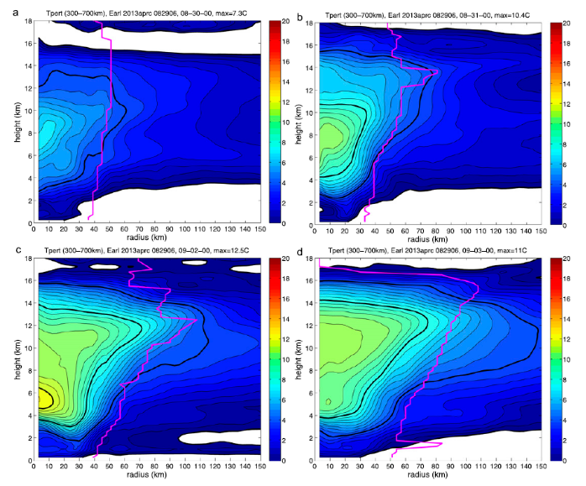



$$T_{Dunion}<\overline{T_{{GIV}_{300−700}}}$$
$$T_{WRF}−T_{Dunion}$$
$$T_{WRF}−\overline{T_{{GIV}_{300−700}}}$$

Slide 13

$$T_{WRF}−T_{Dunion}$$
$$T_{WRF}−\overline{T_{{GIV}_{300−700}}}$$

Slide 14
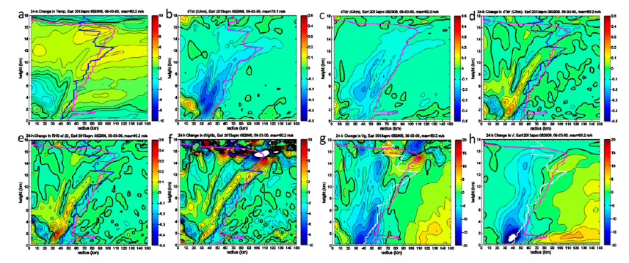
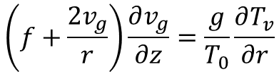


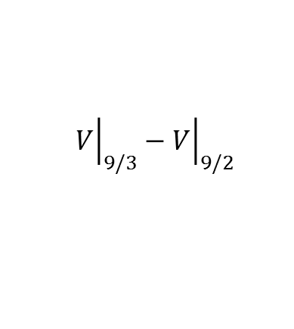
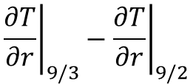
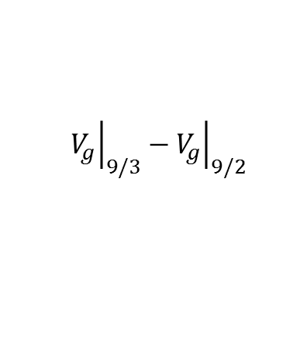
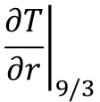

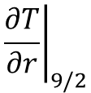

$${\left.\frac{∂T}{∂r}\right|}_{9/2}$$
$${\left.\frac{∂T}{∂r}\right|}_{9/3}$$
$${\left.\frac{∂T}{∂r}\right|}_{9/3}−{\left.\frac{∂T}{∂r}\right|}_{9/2}$$
$$∆T$$
$${\left.\frac{∂v_{g}}{∂z}\right|}_{9/3}−{\left.\frac{∂v_{g}}{∂z}\right|}_{9/2}$$
$${\left.V_{g}\right|}_{9/3}−{\left.V_{g}\right|}_{9/2}$$
$${\left.V\right|}_{9/3}−{\left.V\right|}_{9/2}$$
$${rhs}_{9/3}−{rhs}_{9/2}$$
$$\left(f+\frac{2v_{g}}{r}\right)\frac{∂v_{g}}{∂z}=\frac{g}{T_{0}}\frac{∂T_{v}}{∂r}$$
$$\frac{∂T}{∂r}=\frac{2T_{0}}{g}\frac{v_{g}}{r}\frac{∂v_{g}}{∂z}$$
(Schubert et al., 2007)

Slide 15
Conclusions
Both the height of the absolute maximum perturbation temperature and the overall shape of the profile can be quite sensitive to the chosen reference profile.
We found no obvious systematic relationship between the height of the warm core in Earl and either intensity or intensity change.
Above the boundary layer, thermal wind balance is a good approximation, and the warm core is closely related to the wind structure.

Slide 17
