Slide 1
Impact of the cold pool on mesoscale convective system-produced extreme rainfall over southeastern South Korea: 7 July 2009.
Professor : Ming-Jen Yang
Student : Jyong-En Miao
Date : 2017/05/16
Jeong, J.-H., D.-I. Lee, and C.-C. Wang, 2016
Mon. Wea. Rev., 144, 3985–4006.

Slide 2
Introduction
back-building/quasi-stationary mesoscale convective systems (MCSs), which consist of a line or cluster of deep convection and occur when convective cells repeatedly form upstream of their predecessors (Schumacher and Johnson 2005).
New convective cells develop along the leading edge of the cold pool, and cold pools are known to be the primary mechanism for the maintenance of convective lines in two- and three-dimensional numerical simulations (Rotunno et al. 1988; Fovell and Tan 1998; Lin et al. 1998). Hane et al. (1987) reported that cooling owing to evaporation and melting within an MCS leads to a near-surface cold pool.
In East Asia, it is generally recognized that cold pools are rarely observed in the Changma (mei-yu or baiu) frontal region in which the lowest layer of the atmosphere is very moist.
Davis and Lee (2012) and Xu et al. (2012) found that the cold pool in the lowest layer (below 500 m) interacted with oncoming warm and moist air, which repeatedly produced heavy rainfall over southwestern Taiwan.

Slide 3
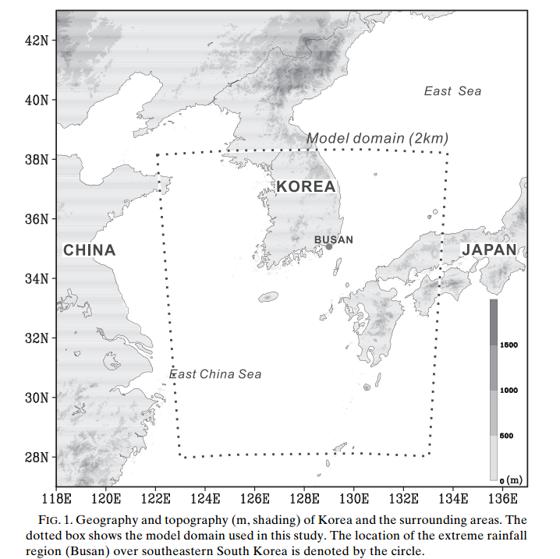
Introduction
On 7 July 2009, an extreme rainfall-producing quasi-stationary MCS developed along the Changma front, producing 310 mm of rain in less than 12 h over Busan metropolitan area.
This study focuses on the stationary stage of the convective system, with the goal of identifying the mechanisms that result in such heavy precipitating systems becoming stationary over a given location. In particular, we use a high-resolution (2 km) nonhydrostatic atmospheric model.(CRESS)

Slide 4
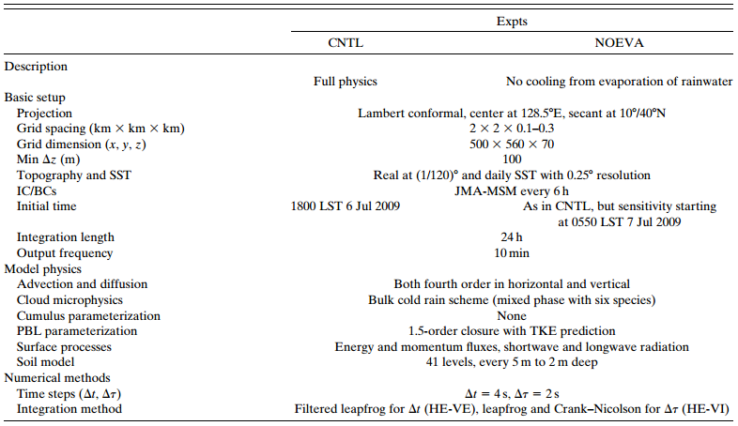

Slide 5
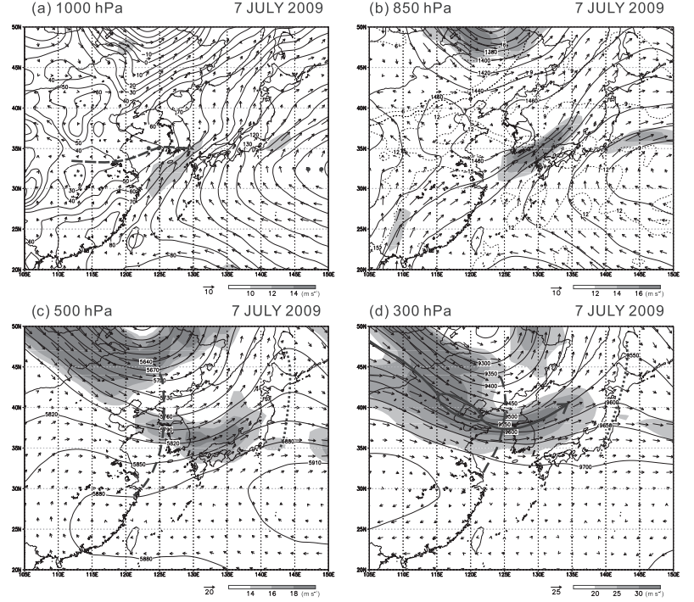

Slide 6
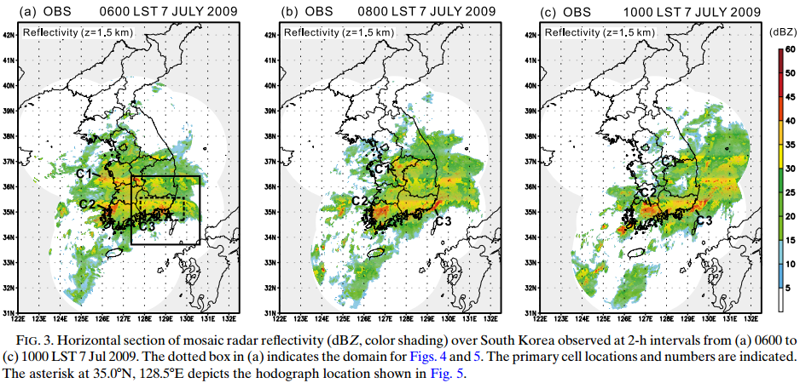

Slide 7
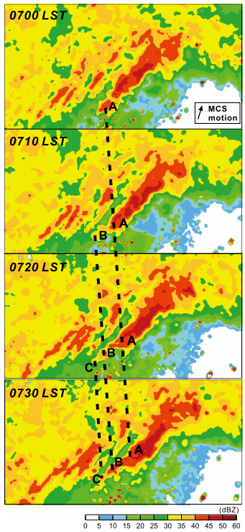

Slide 8
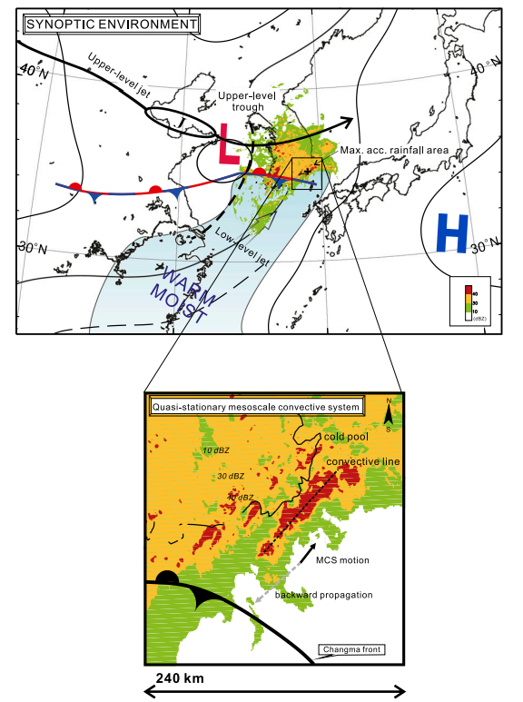

Slide 9
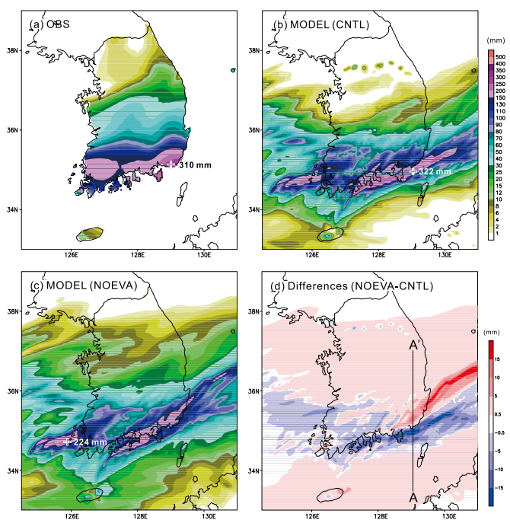

Slide 10
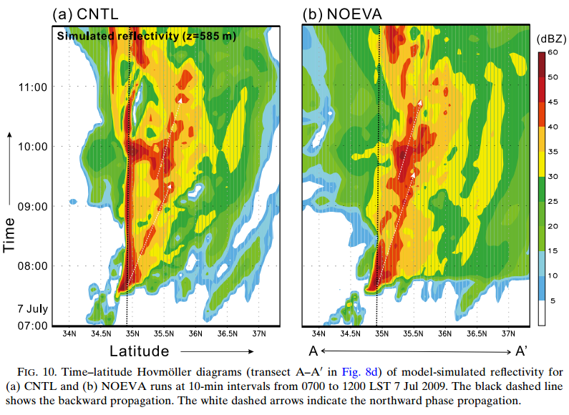

Slide 11
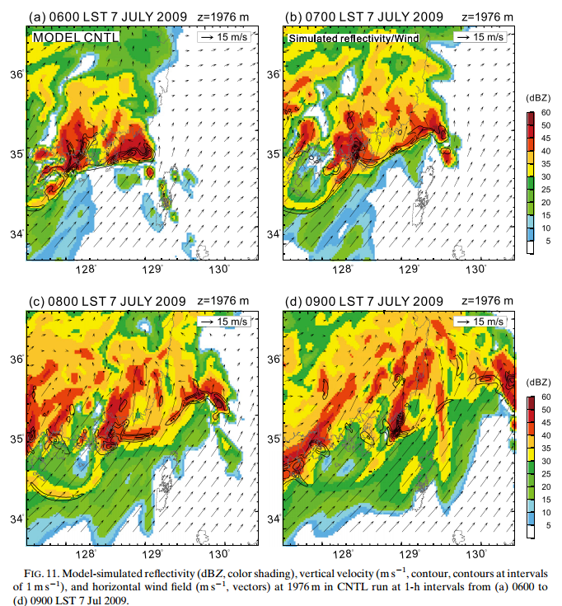

Slide 12
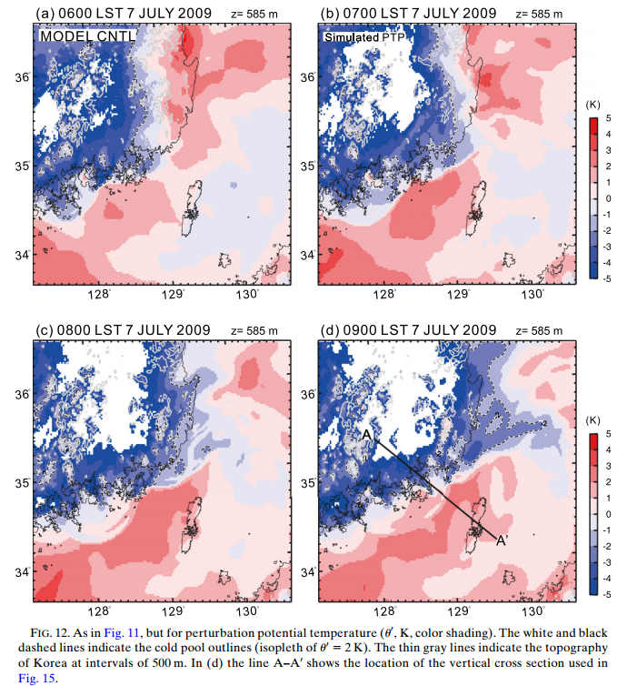

Slide 13
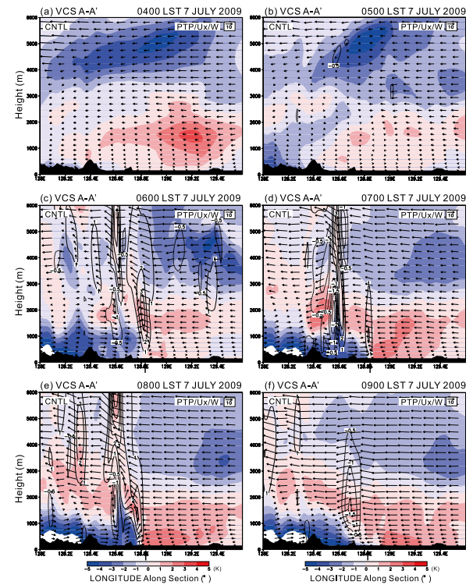

Slide 14
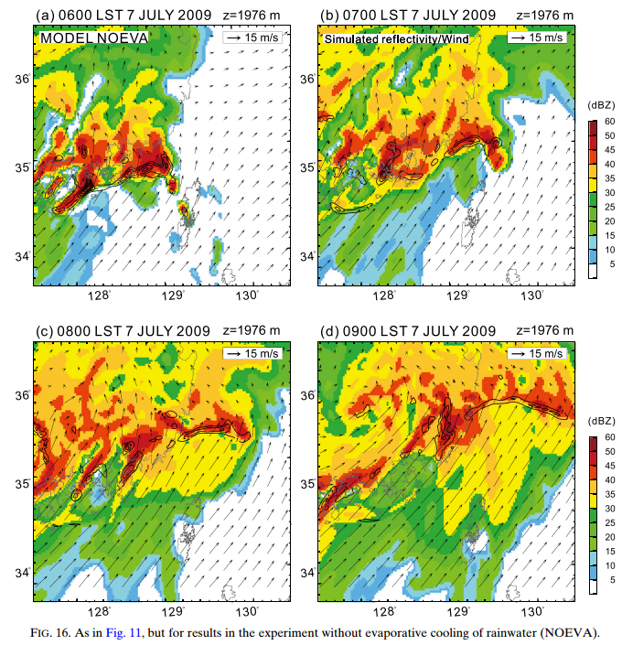

Slide 15
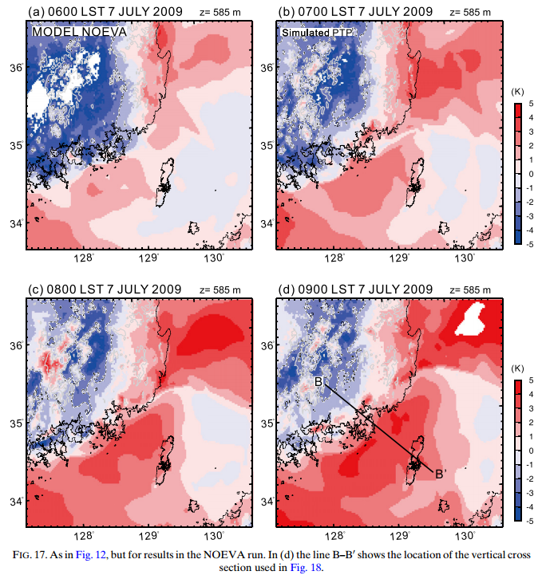

Slide 16
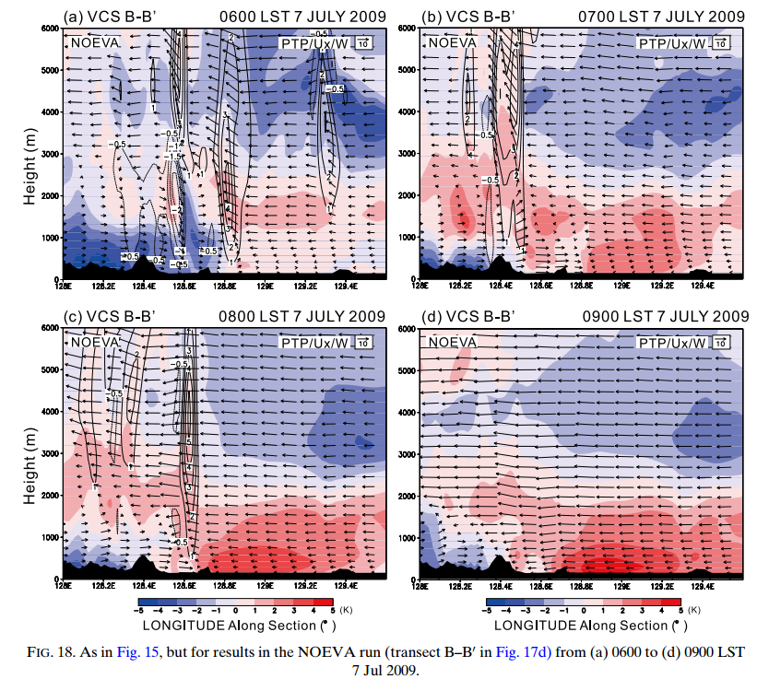

Slide 17
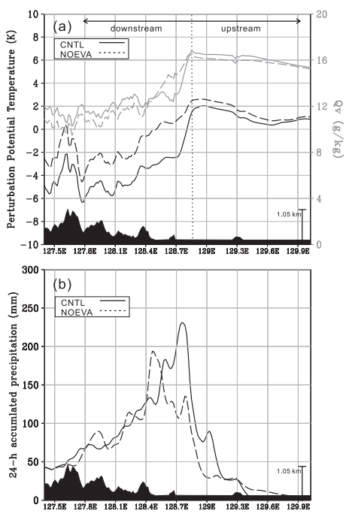

Slide 18
