Slide 1
Extreme Precipitation in Models: An Evaluation
Herman G. R., and R. S. Schumacher (WAF, 2016)
Abstract
1. precip. return period (RP) exceedances [雨量超過某個門檻的重現率]
2. NOAA’s Global Ensemble Forecast System Reforecast (GEFS/R) and
National Severe Storms Laboratory WRF (NSSL-WRF) model
are evaluated for 24-h precipitation accumulations
3. the climatology of extreme precip. events for 6-h accumulations is also
explored in three convection-allowing models:
1) NSSL-WRF; 2) the North American Mesoscale 4-km nest (NAM-NEST);
3) the experimental High Resolution Rapid Refresh (HRRR)
4. GEFS/R and NSSL-WRF show similar 24-h accumulation RP exceedance
climatologies over the U.S. West Coast as obs.,and approximately equally
skillful at predicting these exceedance events in this region
GEFS/R struggles to predict the predominantly convectively driven extreme
QPFs, predicting far fewer events than obs. and exhibiting inferior[較差]
forecast skill to the NSSL-WRF over the eastern two-thirds of the CONUS
5. The NSSL-WRF and HRRR 6-h extreme precipitation climatologies are
approximately in accord with obs.
NAM-NEST produces many more RP exceedances than obs. across the CONUS.

Slide 2
1. Introduction
1. Extreme precip., particularly in the warm season, is widely considered to be one of the most poorly forecast variables in NWP.
2. flash flood potential based on QPFs can be assessed in different ways:
assess the local climatology and antecedent[先前的] conditions to produce
flash flood guidance thresholds; exceedance of these thresholds at
their respective points is believed to produce flash flooding
weakness: large discontinuities in threshold estimates
simply considers whether some fixed, large precip. threshold will be
exceeded over a specified accumulation interval (AI), such as 50mm in 3h
weakness: same rainfall amount may result in different consequences
return period threshold (RPT) exceedances have a much better
correspondence with precip. impacts and flash flood potential than the
use of any fixed threshold across the meteorologically and hydrologically
diverse regions of the CONUS
3. event: RP N = return period of N-year,
N: the rarity[稀有性] of the event
AI T = accumulation interval of T-hour
T: the span of time for precipitation to accumulate

Slide 3
2. Data and methods (a. forming return period threshold grids)
[obs.]
1. Based on gauge data, NOAA and Hydrometeorological Design Studies Center has generated comprehensive and up-to-date RPT estimates via the Atlas 14 project to develop updated CONUS-wide RPT estimates for RPs from 1 to 1000 yr and AIs from minutes to months.
2. Each of these estimates have considerable uncertainty, especially at higher RPs; however, the quantitative uncertainty associated with the RPT estimates is beyond the scope of this study and will not be considered in determining RP exceedance events.
3. NCEP stage IV precip analysis, a high-resolution (~4.75 km grid spacing), multisensory product using both rain gauge observations and radar-derived rainfall estimates to generate CONUS wide analyses for 1-, 6- and 24-h AIs.
4. deficiencies of radar-derived rainfall estimates:
radar beam blocked by complex terrain
beam refraction from low-level surface inversions
QC of NCEP stage IV data:
e.g., Hitchens et al. 2013; Stevenson and Schumacher 2014;
Nelson et al. 2016
APPENDIX (most manually)

Slide 4
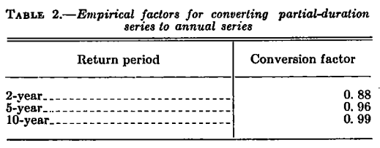
2. Data and methods (a. forming return period threshold grids)
5. Stevenson. S. N., and R. S. Schumacher (MWR, 2014):
“A “50-yr rain event” is defined as the 2% chance that precipitation
accumulation in a given time span will exceed the threshold in any given
year at any given point. Similarly, the term “100-yr rain event” refers
to the 1% chance the aforementioned will occur.”
6. Hershfield, D. M. (1961, U.S. Weather Bureau Tech. Paper 40, 61 pp):
“The 200-year 1-hour value is required for the point at 35°N, 90°W. The 2-, 5-, 10-, 25-, 50-, and 100-year values are estimated from the maps to be 1.7, 2.2, 2.5, 2.9, 3.1, and 3.5 inches. After multiplying the 2-year value by 0.88, the 5-year value by 0.96, and the 10-year value by 0.99, the six values are plotted on extreme-value probability paper, a line is fitted to the data and extrapolated linearly.”

Slide 5
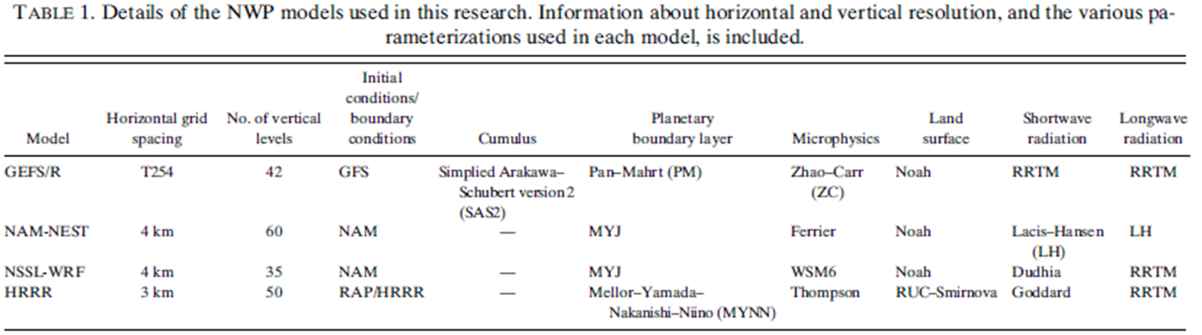
2. Data and methods (b. Model analysis and verification[fcst.])
(~40km)
1. Depending on model data availability, either the
9 Jun. 2009–30 Aug. 2014 period or the shorter
12 Aug. 2014–11 Aug. 2015 period was used for evaluation and comparison.
2. GEFS/R and NSSL-WRF model were evaluated for the 24-h AI over the longer 2009~14 period for 12~36h forecasts off of each model’s 00Z initialization.
The GEFS/R dataset contains reforecasts of the Feb. 2012 version (with data assimilation input in association with operational upgrades made in May 2012) of the GEFS from Dec. 1984 to the present, and only CTRL is used.[!!]
The NSSL-WRF (regional) has only one change: an update of the WRF version from 3.1.1 to 3.4.1 in Apr. 2013.[!!]

Slide 6
2. Data and methods (b. Model analysis and verification[fcst.])
3. Convection allowing models (CAMs) was conducted for 6-h AIs over the shorter 2014–15 period comparing the NSSL-WRF, NAM-NEST, and HRRR.
4. The beginning of this period coincides with a major update to the NAM-NEST, which significantly altered the model’s QPF bias characteristics.[!!]
The HRRR WRF did experience model changes during this analysis period:[!!]
a hybrid 3DVAR–EnKF implementation on 10 Apr. 2015
the Thompson microphysics parameterization was upgraded to an aerosol-
aware formulation, with an added coupled parameterization to represent
small-scale boundary layer clouds, to alleviate warm season warm and
dry biases over the Great Plains and also to alleviate observed biases
in QPFs.

Slide 7
2. Data and methods (b. Model analysis and verification[fcst.])
5. All model data were regridded onto the stage IV Hydrologic Rainfall
Analysis Projection (HRAP) grid (~4.75 km grid spacing) using a first-order conservative scheme, preserving the total amount of precipitation on each grid. [??]

Slide 8
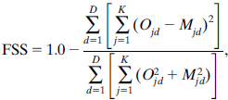
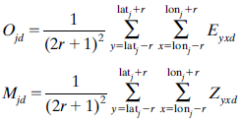


2. Data and methods (b. Model analysis and verification)
6. Quantitative assessments of model skill were conducted by means of an aggregated fractions skill score (FSS). For an evaluation radius r, over K evaluation points and D evaluation times:
Pyxd (obs.) and Qyxd (fst.): precip. at lat(y) and lon(x) accumulated over
the period corresponding to obs. record d
θyx: the critical precip. threshold (= N-year T-hour RPT)
7. The FSS allows for spatial error in the placement of observed features or exceedances—up to a specified tolerance as prescribed by the evaluation radius—without penalty.
8. FSS = 1.0 = perfect forecasts
FSS = 0.0 = no skill forecasts (Roberts and Lean 2008:Scale-selective verification of rainfall accumulations from high-resolution forecasts of convective events.)

Slide 9
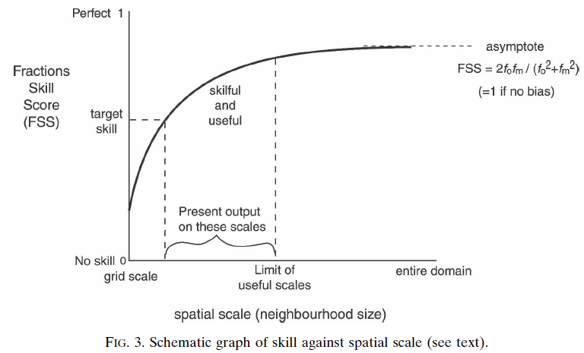
2. Data and methods (b. Model analysis and verification)
9. Roberts and Lean (2008, MWR):
“it may be considered a waste of resources to run a 1-km model for
forecasting on scales as large as 100 km, but it may be perhaps useful for
flood prediction on a scale of 50 km”

Slide 10
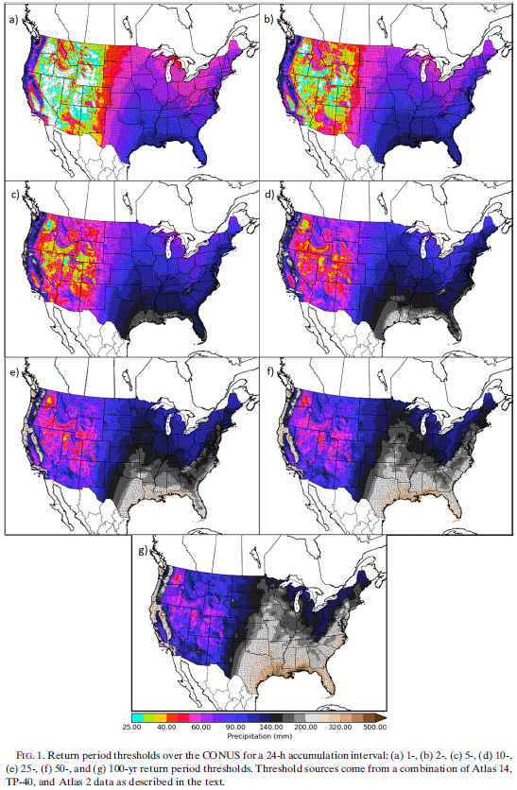
3. Results (a. Threshold analysis)
1. RPT for 24-h accumulated precip.
interval of 1-, 2-,
5-, 10-,
25-, 50-,
100-year RP
2. Threshold estimates increase
monotonically with increasing RP.
3. For the 1-yr RP, areas of arid[乾旱]
and Intermountain West, have 24-h RPTs
of less than 25 mm.
Much wetter regions as the Pacific
coastal mountains and southeast Gulf
Coast region experience 1-yr RPT of
around 150 and 100 mm.
-> this highlights the stark contrast
the RP framework brings relative to
the traditional fixed threshold
analysis approach

Slide 11
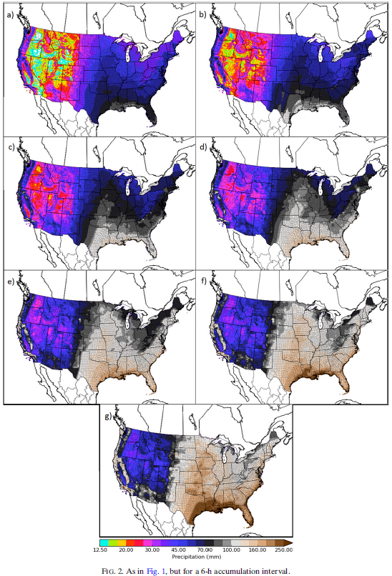
3. Results (a. Threshold analysis)
4. RPT for 6-h accumulated precip.
interval of 1-, 2-,
5-, 10-,
25-, 50-,
100-year RP
5. In the West, extreme precip. events are
predominantly stratiform cases of long-
duration, low-to-moderate intensity.
-> a large difference between the 6-
and 24-h AI thresholds
6. In contrast, many extreme precip.
events in the East are driven by
convective cells or convective systems,
and tend to be shorter-duration,
higher-intensity, the difference
between the 6- and 24-h thresholds is
not large.
7. 1-yr RP for the Olympic Mountains of Washington:
200mm for 24-h AI, but 80mm for 6-h AI
central Iowa:
65mm for 24-h AI, but 55mm for 6-h AI

Slide 12
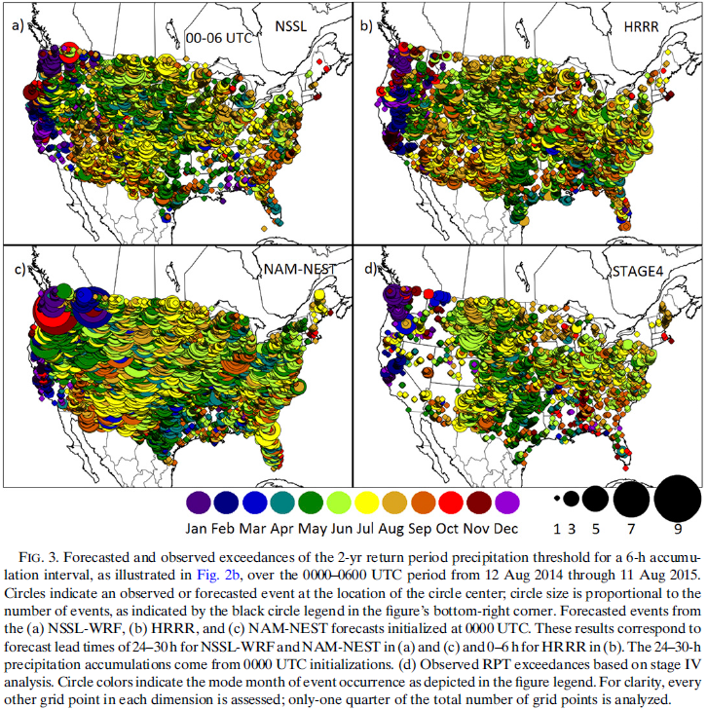
3. Results (b. Climatological and bias analysis, 6H 2-yr RP)
Most events, both forecast and observed, occur during the cool months (Oct.–Mar.) in the Pacific coast states.
2. To the east of the Rockies, the vast majority of events occur in the warm months from Apr.–Sep.
3. The central U.S. from Texas up
through North Dakota
experience most events
during the early part of the
warm season—primarily from
Apr.–Jul.
4. Almost all events over the
eastern states are between
Jun. and Sep.
5. The southeast U.S. has diverse
events seasonally in both the
warm and cool seasons. The
mid-to-late season (Aug.–Oct.
) are associated with TC.
f24-30
f00-06
f24-30

Slide 13
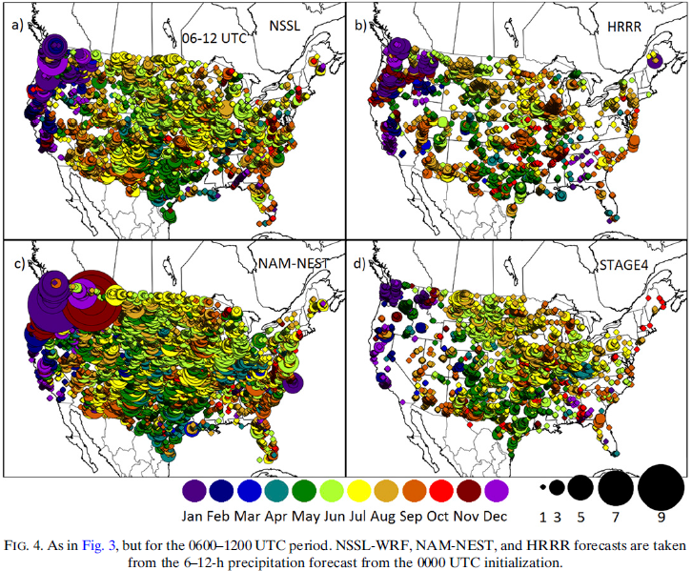
3. Results (b. Climatological and bias analysis, 6H 2-yr RP)
6. A min. in extreme precip. events is over the far eastern states.

Slide 14
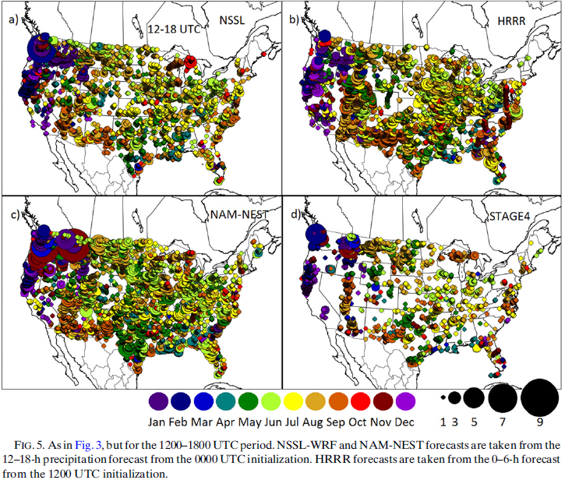
3. Results (b. Climatological and bias analysis, 6H 2-yr RP)
7. During 1200–1800 UTC (sunrise), likely because the limited time for solar heating effects to operate, local minimum in extreme precip. events across the CONUS as indicated by a minimum in the number of plotted circles. (Fig. 3d, 4d, 5d, 6d)
8. A phase and intensity bias in the CAMS at areas of complex terrain in which convection is initiated too
early and is too strong on the
windward side of topography.

Slide 15
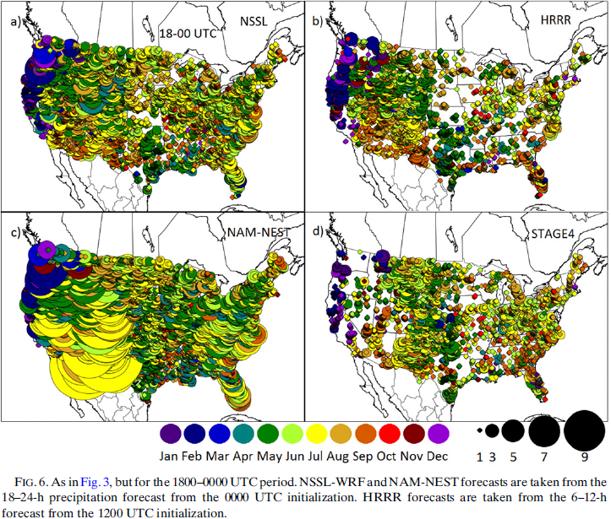
3. Results (b. Climatological and bias analysis, 6H 2-yr RP)
9. A concentration of obs. events is along the Rocky Mountains which serve as
a forcing for convective initiation, and the time coincides with the onset of substantial solar radiation over the region. [12-18 LST]
10. A secondary obs. max. events is near the Atlantic coast with a local obs.
min. events over the Mississippi valley between the two max.

Slide 16
3. Results (b. Climatological and bias analysis, 6H 2-yr RP)
11. eastward progression from 18–00Z to 00–06Z and to 06–12Z of the
extreme-precip.-producing storms (Rocky Mountains–sourced storms)
12. States to the west of the Rocky Mountains, with predominantly cold season
events observed to be approximately uniformly distributed across these
four periods.
18-00Z
00-06Z
06-12Z
12-18Z

Slide 17
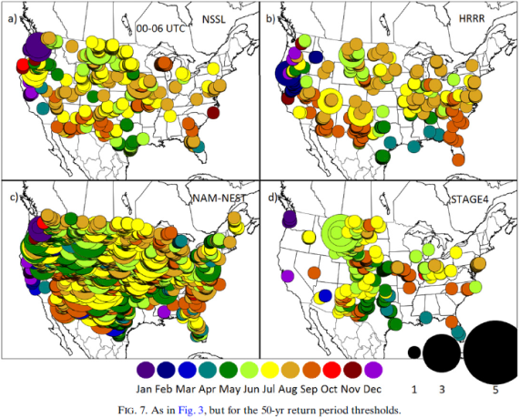
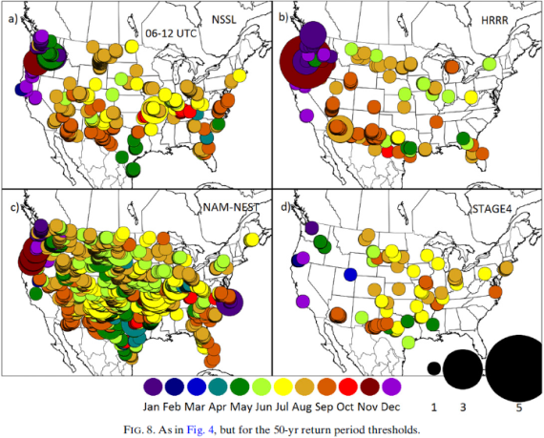
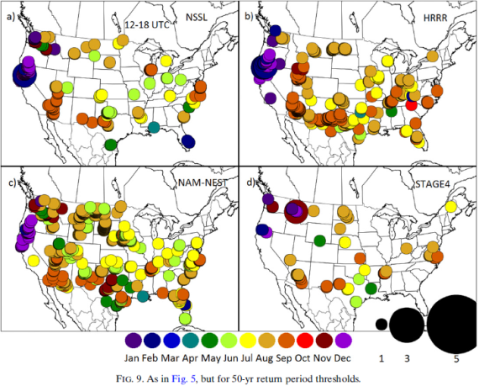
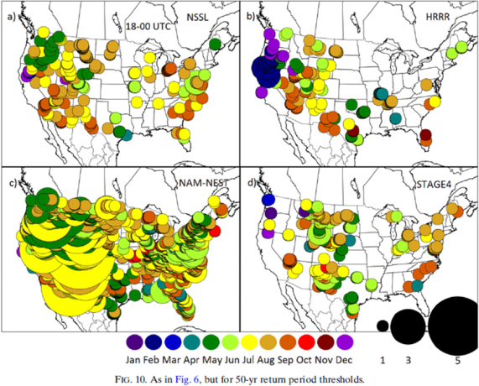
3. Results (b. Climatological and bias analysis, 6H 50-yr RP)
13. seasonality: the CAMs approximately agrees with the obs.
Springtime events is overforecast in many of the CAMs in the Intermountain
West, Southeast, and the mid-Atlantic regions. (Figs. 3-10)
14. The event concentration to the immediate east of the Rocky Mountains seen
in the obs. in Fig. 7d is not apparent or much less in the CAMs.
15. The NAM-NEST overforecast occurrences of locally extreme rainfall events
at both the 2-yr and especially the 50-yr RP all across the CONUS.
The NSSL-WRF and HRRR forecast only a few more events than are obs.

Slide 18
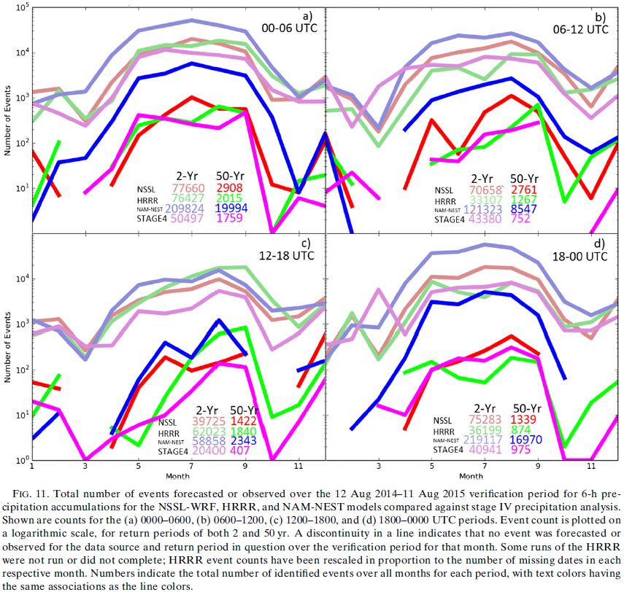
3. Results (b. Climatological and bias analysis, 6H 2- 50-yr RP)
16. most (fewer) events are during warm (cold) season months
17. 12–18Z (00–06Z) have the smallest (largest) number of obs. events
18. NAM-NEST forecast many more events than obs. These biases was not seen in
previous versions of the NAM-NEST (not shown), and is likely attributable
to the Aug. 2014 model updates,
including the switch to the
Ferrier–Aligo microphysics
parameterization.
19. NSSL-WRF exhibits smaller
positive bias in warm seasons,
and HRRR bias characteristics
appear to be quite good, except
12–18Z that may due to HRRR
model changes, leading to
improved bias characteristics
during Apr.–Jul.

Slide 19
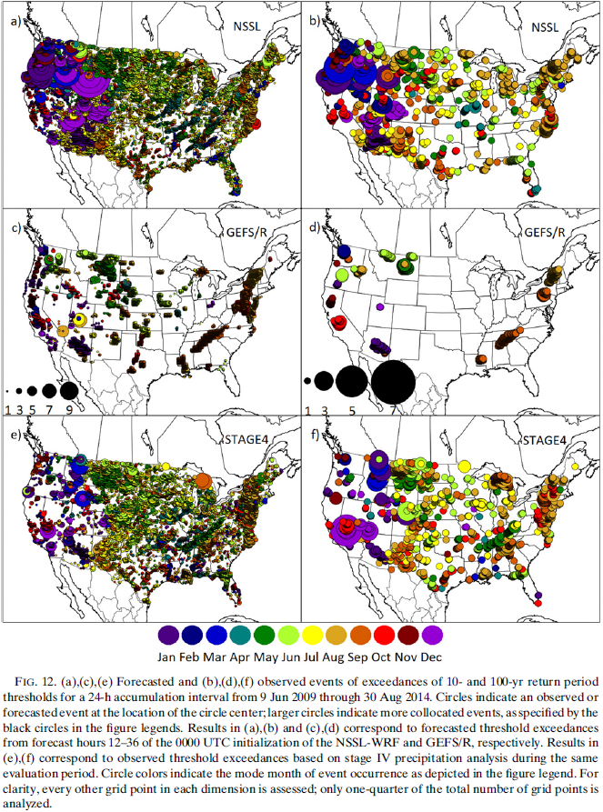
3. Results (b. Climatological and bias analysis, 24H 10- 100-yr RP)
20. The coarse GEFS/R forecasts far
fewer events than obs. due to
the GEFS/R[~40km] being unable to
resolve many small-scale
processes that contribute to the
development of locally extreme
precip. events.
21. From Fig. 12d, events over the
West Coast during cool season,
which associate with synoptic-
scale systems with stratiform
precip. or TCs.
22. The NSSL-WRF performed better
with Hurricane Sandy and TS
Debby in northern Florida, and
correctly forecast many Aug./Sep.
events in warm season across the
plains.
[??]

Slide 20
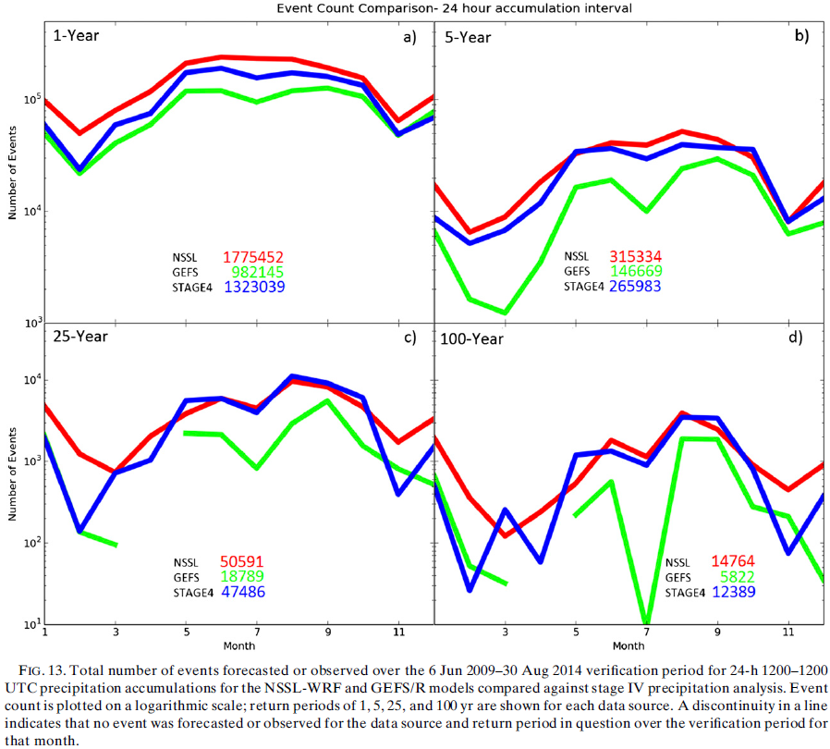
3. Results (b. Climatological and bias analysis, 24H)
23. The signal does amplify with increasing RP; that is, the difference
between events of cool and warm season months increases with increasing RP.
24. At low RPs, the bias
of GEFS/R and NSSL-WRF
are both fairly good,
at higher RPs, some
discernable biases
begin to emerge.
25. GEFS/R greatly under-
predicts high-RP
events. In Jul., GEFS/R
underforecasts the
number of events by an
exceptional two orders
of magnitude relative
to the relatively
large number of events
obs. during that month
over the +5-yr
analysis period.[??]

Slide 21
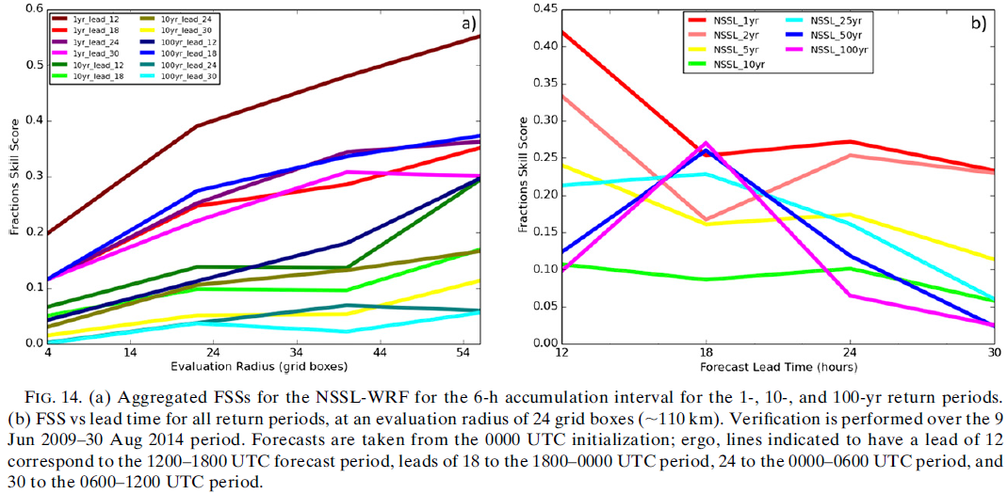
3. Results (c. Skill analysis, 6H NSSL-WRF)
1. FSSs generally increase with increasing evaluation radius, and the highest scores are seen at lower RPs, which are typically more predictable.
2. At all evaluation radii and RPs, the highest scores by a considerable amount are observed with the 12–18-h forecast period.[not in 100yr RPs!!!]
1) a lower proportion of events in this 6-h period is convectively driven than the other periods, and the events caused by smaller convective cells with weaker large-scale forcing tend to be inherently less predictable.
2) this is the earliest forecast period analyzed with respect to forecast initializa-
tion time
and thus has
had the least
time for
nonlinear
error growth.

Slide 22
3. Results (c. Skill analysis, 6H NSSL-WRF)
3. The FSSs at all evaluation radii are very low for the 50- and 100-yr RPs at the 24- and 30-h lead times, probably because of these periods being the farthest from the model initialization and these both being convectively active times of day. (Fig. 14b)
4. The low values at high-evaluation radii also highlight that errors were not merely in spatial displacement but were primarily to completely missing events that occurred and forecasting widespread extreme events that did not verify.

Slide 23
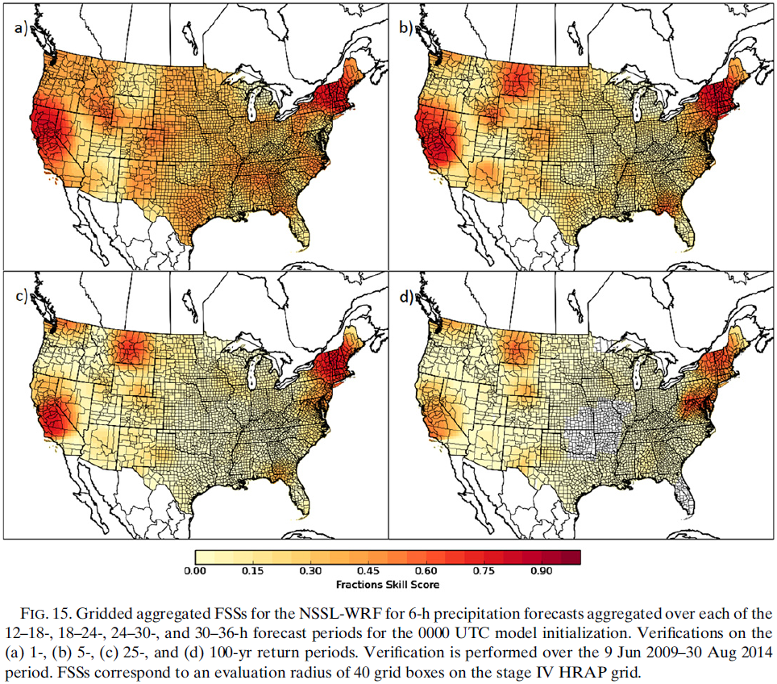
3. Results (c. Skill analysis, 6H NSSL-WRF)
5. the general trend of decreasing forecast skill with increasing RP
6. At low RPs, several events often impact a given region over the analysis period, resulting in a smoother FSS field.
7. At high RPs, none or just one event occurred during the 5-yr analysis period, resulting in the highlighting of areas where the model handled one event well.
8. The broad areas of extreme precip.,
as determined by low RP exceedances,
in the California and New England
systems were very well handled by
NSSL-WRF.
9. In the high-RP, Montana and the mid-
Atlantic (the May Montana floods and
TS Lee): the NSSL-WRF may have
forecast the events well, but did
not perform quite as well when
forecasting the spatial extent of
the locally extreme rainfall.
~190km

Slide 24
3. Results (c. Skill analysis, 6H NSSL-WRF)
10. On the less extreme spectrum of extreme rainfall events, areas of the
mountain and desert West and Southwest were not well handled.
11. For the most extreme event threshold, the Florida peninsula and the
central plains were the areas with the worst verifying forecasts.
[miss or false-alarm??]
~190km

Slide 25
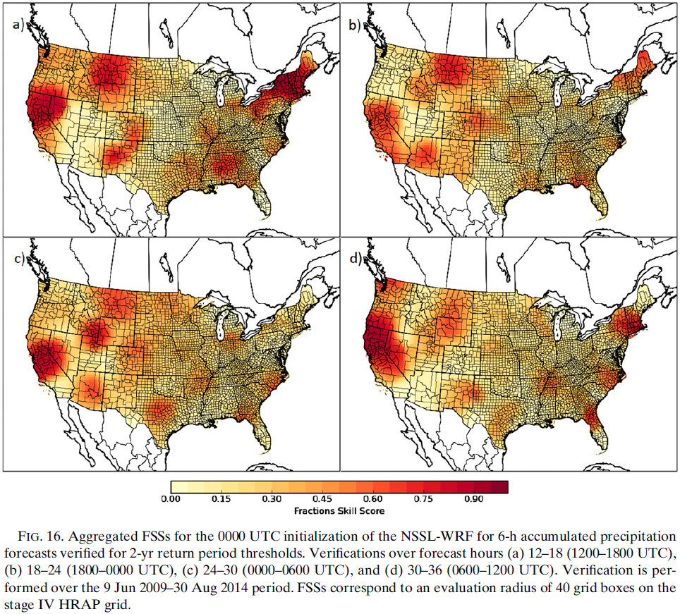
3. Results (c. Skill analysis, 6H NSSL-WRF)
12. Much of the variance in the Northeast comes from the largely coincidental
timing of tropical cyclone landfall.
13. Substantially elevated skill during the less convective 1200–1800 UTC
period in comparison with the other three.
14. In eastern Colorado and western Kansas and Nebraska, the lowest skill is
seen during the 06–12 UTC period,
likely attributable to the locally
anomalous time of occurrence of
these types of events; typically,
ongoing convection is well to the
east of this region at this time.

Slide 26
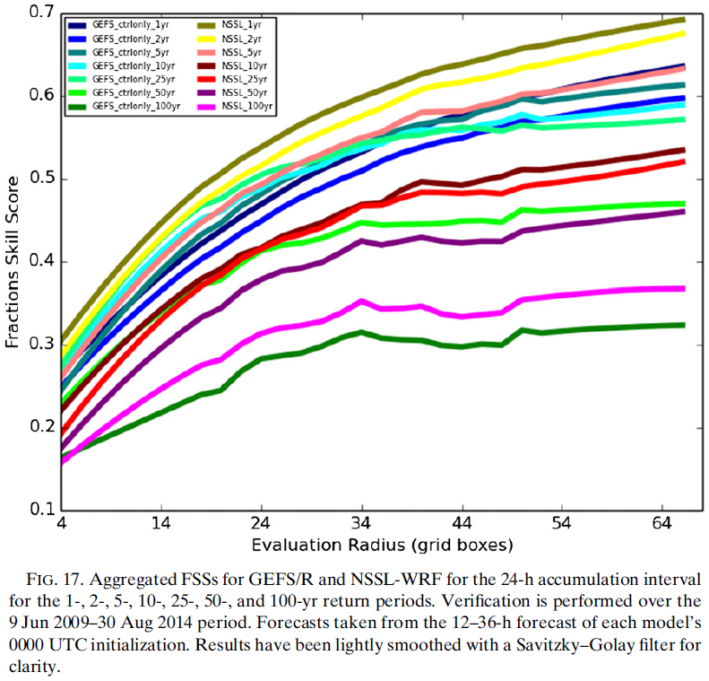
3. Results (c. Skill analysis, 24H GEFS_ctrl NSSL-WRF)
15. FSSs again generally increase with increasing evaluation radius and
decrease with increasing RP.[not in GEFS_ctrl 2-25yr RP!!!]
16. The higher skill at 24-h accumulation intervals is likely attributable to
the decreased sensitivity to temporal and to a lesser extent spatial
displacement error, in addition
to a larger proportion of 24-h
events occurring in association
with longer-lived, larger-scale
processes as opposed to 6-h
events.

Slide 27
3. Results (c. Skill analysis, 24H GEFS_ctrl NSSL-WRF)
17. At 1-, 2-, 5-, and 100-yr RP, the NSSL-WRF outperforms the GEFS/R at all
evaluation radii.
18. From 10 to 50 yr RP, the GEFS/R is competitive with and even outperforms
the NSSL-WRF. This may have to do with the types of systems that are found
to exceed thresholds in this
frequency range, but not higher
or lower: to generate precip.
of this rarity, strong large-
scale forcing is required.

Slide 28
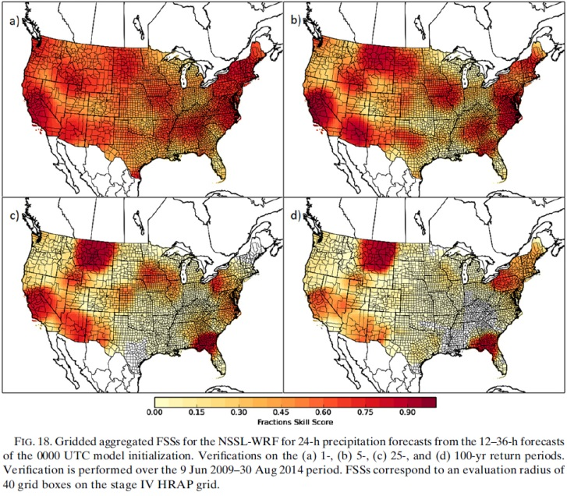
3. Results (c. Skill analysis, 24H GEFS_ctrl NSSL-WRF)
19. the 25-yr RP (Fig. 18c): Montana and the Florida panhandle in association
largely with Tropical Storm Debby [Montana??]
20. Previous research has found that the enhanced skill in the Midwest
coincides with a local maximum in Lagrangian persistence (e.g., Germann et
al. 2006), that is, the
tendency for storm motion,
both speed and direction,
to remain the same.

Slide 29
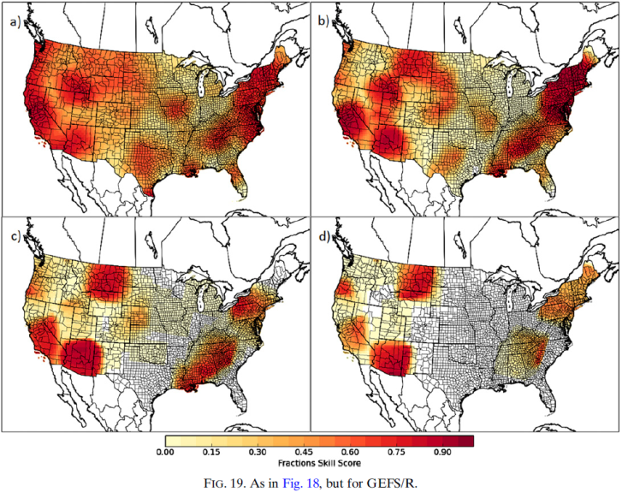
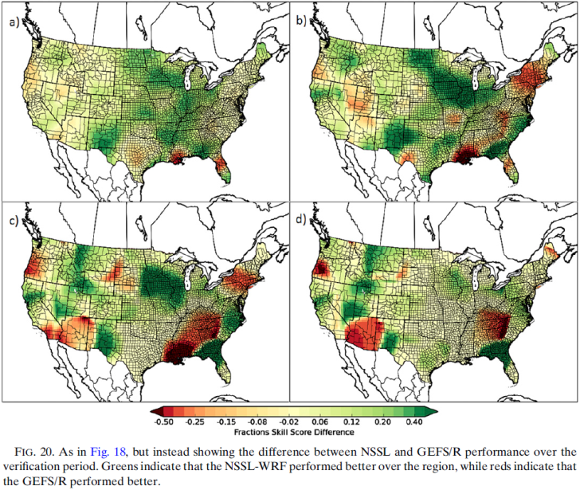
3. Results (c. Skill analysis, 24H GEFS_ctrl NSSL-WRF)
21. In the eastern two-thirds of the CONUS, with the exception of areas near
the Gulf Coast, the NSSL-WRF exhibits higher skill than the GEFS/R,
particularly over the convection dominated regions of the plains, the
Midwest, and the Mississippi valley. (Fig. 20a)
22. In Figs. 20b and 20c, particular events can be identified:
NSSL-WRF better handled TS Debby, the New Mexico flooding of Sep. 2013,
and to a lesser extent the Montana floods
GEFS/R had better forecasts for the Jan. 2010 and Sep. 2009 events in
Arizona and the southeast US, in addition to better TC forecasts in the
mid-Atlantic and New England.
23. The northeast CONUS, where the model performances become more similar,
these differences are exacerbated[惡化、加重] at the 100-yr RP (Fig. 20d).

Slide 30
4. Discussion and conclusions
1. The most recent (as of Aug. 2014) NAM-NEST was found to have a strong
positive frequency bias nationwide, forecasting many more events at all RPs
than obs.
2. The NSSL-WRF and HRRR also overforecast extreme events from 1- to 100-yr RPs, but both greatly reduced overall frequency biases when compared with the NAM-NEST, with the HRRR actually being negatively biased at 18-00 UTC.
3. At the 24-h AI, the NSSL-WRF exhibits rather similar extreme precipitation characteristics to those seen in the 6-h AI. The coarser GEFS/R, however, had much different characteristics than the CAMs, producing almost no events at the higher RPs outside of the cool season Pacific coast synoptic systems and tropical cyclones from the Atlantic basin, resulting in almost no very extreme events forecast by the GEFS/R over the Great Plains and Midwest.
4. Models are unsurprisingly found to make the most skillful predictions of the less extreme (lower RP) events, with the worst skill typically observed in forecasting for the rarest of event thresholds.

Slide 31
4. Discussion and conclusions
5. For 6-h periods, the 12–18 UTC time is the most skillful period for the NSSL-WRF, which is likely attributable to this period having the lowest proportion of low-predictability, small-scale convective events, and this period coinciding with the shortest forecast lead time of the four verification periods.
6. For the 24-h AI, at higher RPs, typically one event dominated the regional skill score, allowing comparison of model performance for individual recent extreme precipitation events but leaving insufficient data to robustly compare regionally compare model skill for highly extreme cases.
Overall, the NSSL-WRF is found to demonstrate superior forecast skill at low and very high RPs, while the GEFS/R is competitive and occasionally outperforms the NSSL-WRF at moderate RPs.
7. The models evaluated were as consistent as possible during the analysis periods selected, and the precip. and RPT estimates were also as consistent as possible within the context of the data sources.

Slide 32
4. Discussion and conclusions
8. Increased model resolution is useful for improving verification of extreme precip. caused by convection, it is not an all-around panacea[萬能藥]; the coarse GEFS/R model performed as well or better than the high-resolution guidance at extreme QPFs for most other types of extreme-precipitation-producing systems.
9. Hamill and Juras (2006): verification across time and especially space within a fixed-threshold verification framework may often produce results that reflect the varying climatology, with bulk performance characteristics biased toward performance in climatologically favored times or regions.
Using a fixed-frequency framework such as that afforded through RPs or recurrence intervals is critical for a successful diagnosis. Development of consistent sets of climatology-aware thresholds will assist in the verification of models for future studies.
10. Future work will examine the important question of how the raw NWP output
used in this research can be optimally postprocessed by means of
downscaling, quantile mapping, machine learning, probability calibration,
and other methods to produce skillful deterministic and probabilistic
predictions of RPT exceedances.

Slide 34


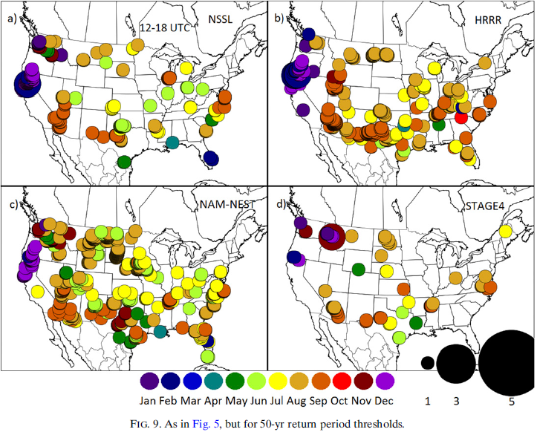

3. Results (b. Climatological and bias analysis, 6H 50-yr)

Slide 35

00-06Z
06-12Z
12-18Z
18-00Z

Slide 36
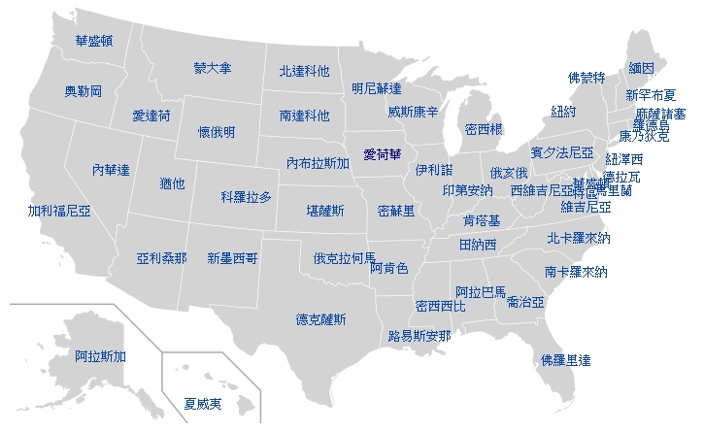
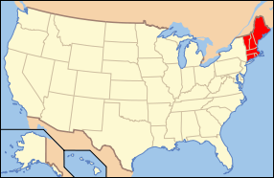
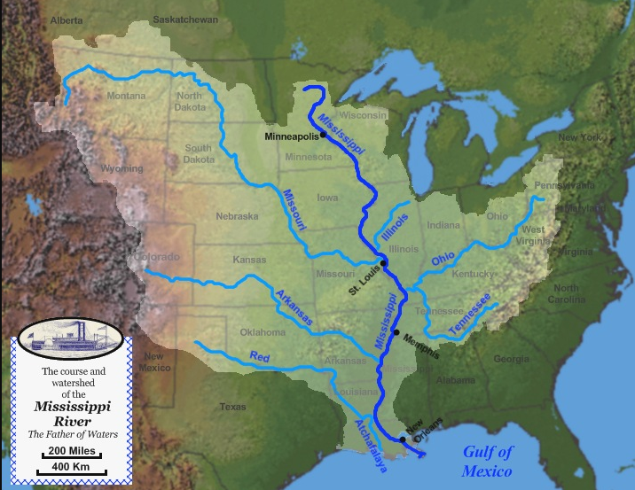
New England
東部標準時（Eastern Standard Time；EST；UTC-5；R區）
中部標準時（Central Standard Time；CST；UTC-6；S區）
山區標準時（Mountain Standard Time；MST；UTC-7；T區）
太平洋標準時（Pacific Standard Time；PST；UTC-8；U區）

