Slide 1
Seasonality of the structure and propagation characteristics of the MJO
Adames, A. F., J. M. Wallace, and J. M. Monteiro, 2016: Seasonality of the structure and propagation characteristics of the MJO. J. Atmos. Sci., 73, 3511–3526.

Slide 2
Introduction
the convective centers in the MJO shift seasonally toward the summer hemisphere, following the belt of highest sea surface temperature (SST). [Zangvil (1975)]
Winter:
The MJO is more active and more symmetric with respect to the equator (Wang and Rui 1990; Zhang and Dong 2004).
The eastward propagation of the regions of enhanced rainfall is accompanied by southward propagation toward the South Pacific convergence zone (SPCZ). [Wheeler and Hendon (2004)]

Slide 3
Summer:
the regions of enhanced convection exhibit pronounced northward propagation. [(Annamalai et al. 1999; Kemball-Cook and Wang 2001; Lawrence and Webster 2002; Shukla 2014)]

Slide 4
Data and methods
ERA-Interim dataset (Dee et al. 2011).
Grid spacing: 1.5° $×$ 1.5°
dataset from 1979 to 2011

Slide 5
Warm pool composite
A regression maps based on linear combinations of PC1 and PC2 of $∆χ$ (850-150 hPa) for the MJO phases in which the $∆χ$ maximum is centered over the Indo-Pacific warm pool (60。E–180。E).
Each of these maps is then zonally shifted such that the longitude at which $∆χ$ is a maximum corresponds to the reference longitude (0 。).
Notes:
Warm pool composite:
使用MJO的速度位差，在EOF分析後，將EOF1和EOF2經過linear combination，找到速度位差的maximum的位置。
之後再將速度位差的maximum做為參考座標，水平移動X的座標軸，而成為warm pool composite的圖。

Slide 6
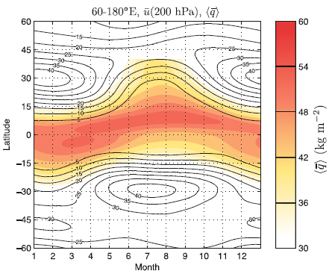
Seasonality (I)
warm pool–averaged (60°E–180°E)
shaded: <q>
contoured :
u200-hPa
Notes:
the belt of high vertically integrated moisture migrates from ~5S in the boreal winter to ~7N in the boreal summer collocated with the seasonal march in SSTs and following the insolation by about a month.
The boreal spring transition occurs in April; the autumn transition is more gradual and occurs a month or two later relative to the equinox.
The jets near 308N/S are most prominent during the respective winter seasons.
熱力風平衡

Slide 7
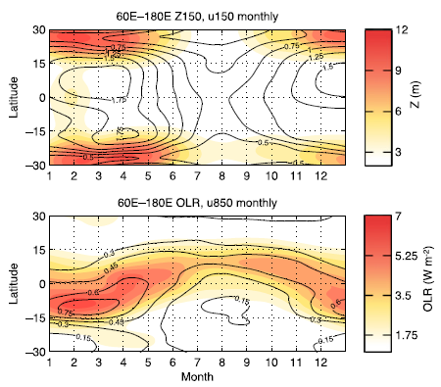
Seasonality (II)
$$RMS=(1/2)\sqrt{{PC}_{1}^{2}+{PC}_{2}^{2}}$$
warm pool–averaged (60°E–180°E), RMS amplitude
(a)
shaded: Z (m)
Contoured :
u150-hPa
(b)
Shaded: OLR
Contoured :
u850-hPa
Notes:
The flanking Rossby waves, with pronounced maxima in the RMS Z field along 28N/S are strong in both hemispheres from December through April and
weaken abruptly in May.
Amplitudes are stronger during the boreal winter, but the MJO signature is clearly detectable year-round.

Slide 8
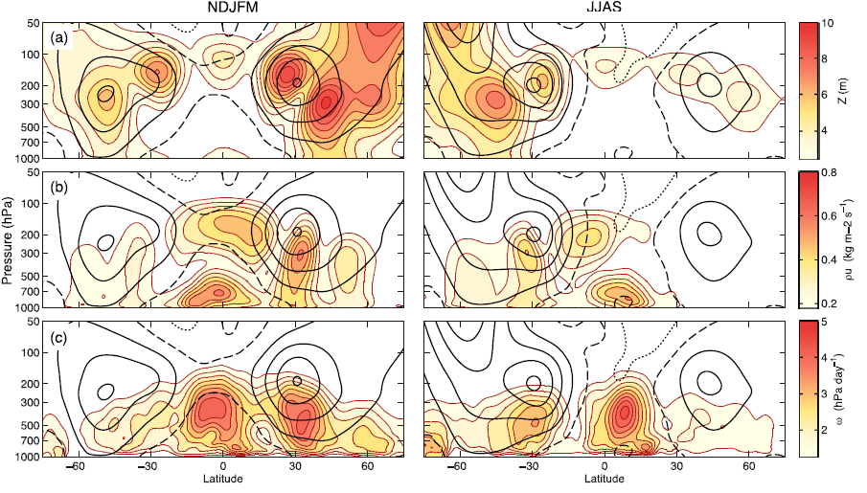
Zonal-mean RMS amplitudes
Shaded:
geopotential height Z
(b) zonal mass flux ρu
(c) vertical velocity ω
Contoured:
zonal wind field
Notes:
flanking Rossby waves are evident in both hemispheres along 288N/S equatorward of the cores of the climatological-mean westerly jets, and
they are stronger in the Northern Hemisphere.
The signature of the flanking Rossby waves in the upper-tropospheric zonal mass flux and vertical velocity fields (Figs. 4b,c) are largely restricted
to the winter hemisphere.
In contrast, the lower tropospheric zonal mass flux and equatorial vertical velocity are shifted toward the summer hemisphere.

Slide 9
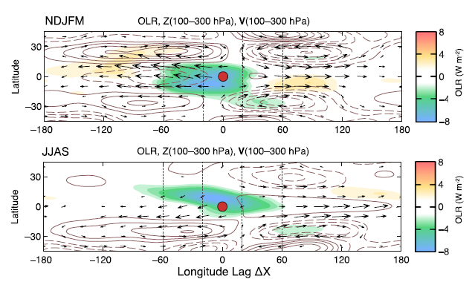
Warm pool composite (Maritime Continent)
shaded: OLR (Wm⁻²)
contoured : Z (100-300 hPa)
arrows: horizontal winds
Notes:
centers of action in the height field tend to be stronger in the winter hemisphere and stronger in the Northern Hemisphere during NDJFM than in the Southern Hemisphere in JJAS.

Slide 10
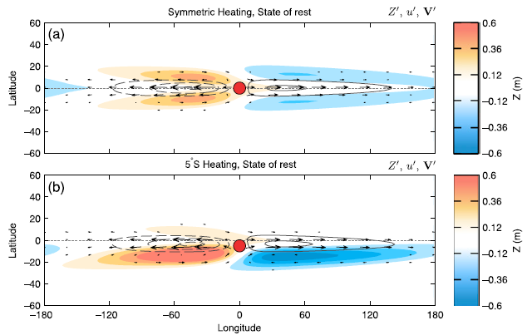
nonlinear shallow-water model (Geophysical Fluid Dynamics Laboratory)
Zero-basic-state-flow simulations
barotropic vorticity equation:
Sverdrup balance:
$$f∇∙V^{′}=−v^{′}∂_{y}f$$
$$\overline{u}=0$$
Notes:
heat source Q₀ centered on the equator (θ_{p} = 0) for a stationary basic state (H₀ = 0 m) and a resting fluid depth of h = 600 m.
The response is composed of equatorially symmetric Rossby waves and a Kelvin wave response.

Slide 11
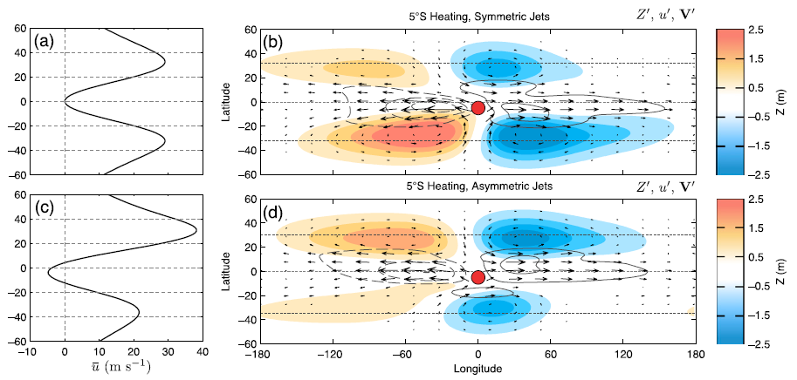
Vorticity balance equation:
Notes:
Incorporation of the climatological-mean jets substantially widens the meridional extent of the wave response
For a symmetric pair of jets, the flanking Rossby wave response is stronger in the hemisphere with the stronger diabatic heating.
the vorticity balance of the Rossby wave response is modulated by the advection of eddy relative vorticity by the climatological-mean flow u.

Slide 12
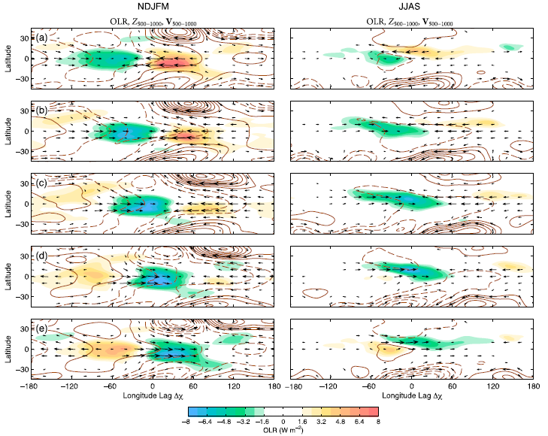
Indian
Ocean
Maritime
continent
Western
Pacific
West.
Hem.
Notes:
NDJFM:
a patch of convection initially develops over the western part of the domain and propagates eastward with a slight southward displacement, weakening as it approaches the eastern side of the warm pool domain.
As the OLR anomalies propagate eastward, the associated zonal wind anomalies become progressively stronger.
The structure is, to first order, equatorially symmetric.
JJAS:
dominated by a west-northwest–eastsoutheast- tilted rainband in the tropics of the Northern Hemisphere that propagates eastward and northward.
In the early panels in the sequence, the rainband is preceded by a band of easterly wind anomalies, while in the later panels it is followed by a band of westerly wind anomalies.

Slide 13
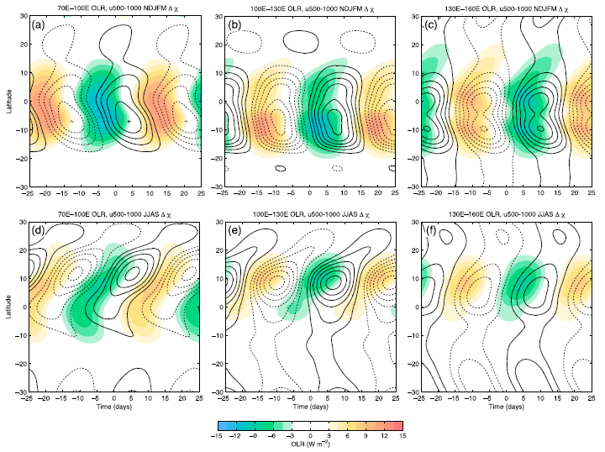
70E~100E
100E~130E
130E~160E
swallowtail shape
NDJFM
JJAS
shaded: OLR (Wm⁻²)
contours: averaged u (500~1000hPa)
Notes:
NDJFM:
poleward propagation of the OLR and zonal wind anomalies in both hemispheres.
Southward propagation in the Southern Hemisphere is dominant over the western part of the domain, where the zonal wind perturbations reach 10S about a week after they first appear over the equator
JJAS:
narrower and more slowly northward-propagating rainbands.
That the zonal wind perturbations and OLR perturbations are in quadrature with negative OLR anomalies poleward of westerly wind anomalies

Slide 14
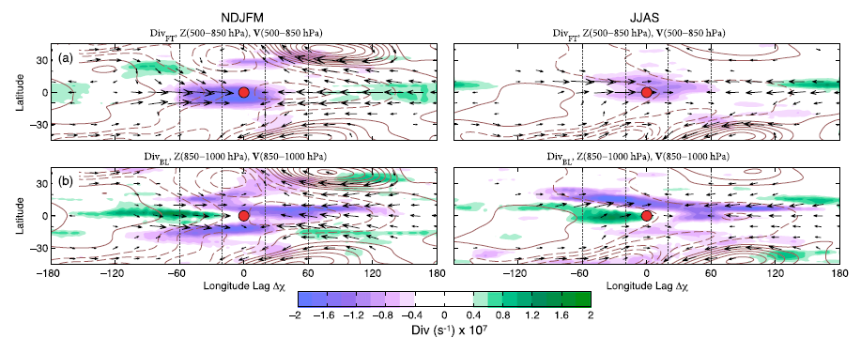
Maritime Continent
Free tropospheric
(500-850 hPa)
boundary layer
(850-1000 hPa)
Notes:
NDJFM:
Lower-free tropospheric convergence during NDJFM is slightly shifted toward the Southern Hemisphere.
boundary layer divergence field is stronger in the Southern Hemisphere.
JJAS:
It is displaced only slightly toward the Northern Hemisphere, and it evidently does not contribute substantially to maintaining the rain bands observed in the OLR field. It is only about half as strong as the anomalous lower free-tropospheric convergence observed in NDJFM.
boundary layer divergence field is dominated by a west-northwest–east-southeast-tilting convergence line.
boundary layer (BL) convergence dominates in JJAS implies that the profile of vertical velocity is more bottom heavy

Slide 15
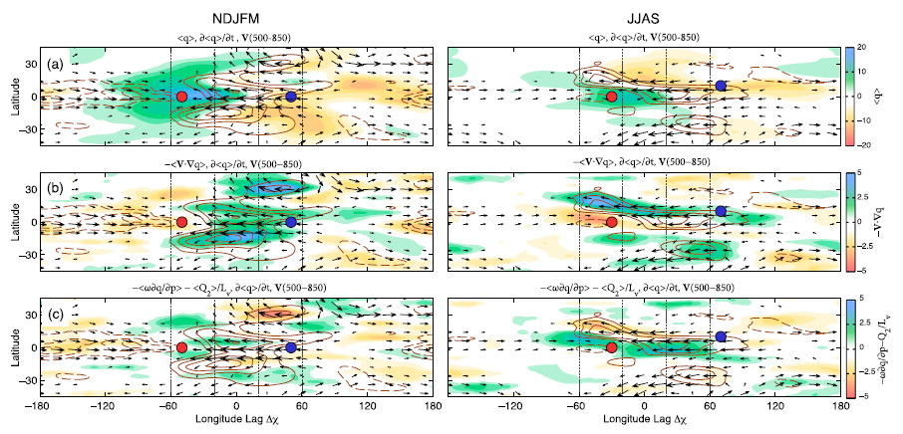
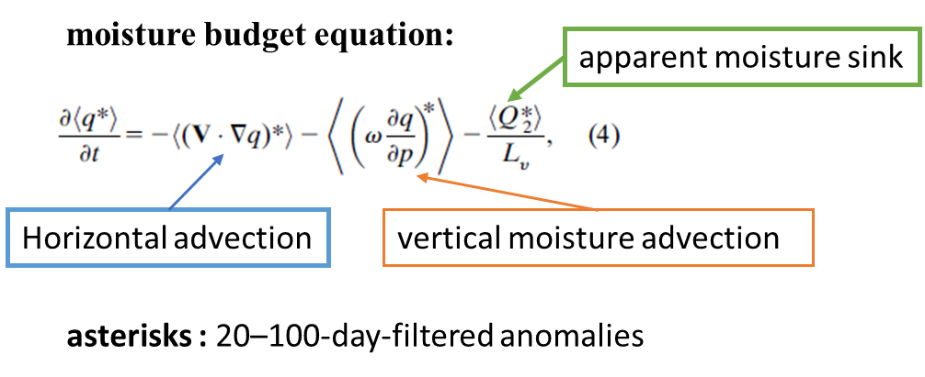
Indian Ocean
Notes:
NDJFM:
the region of maximum moistening is slightly shifted toward the Southern Hemisphere.
moistening within the equatorial belt (158N–158S) is dominated by horizontal moisture advection.
JJAS:
strongest moistening occurs along the node in the moisture field to the north of the advancing rain band, collocated in a region of strong easterly wind anomalies.
horizontal moisture advection is dominant in the Northern Hemisphere tropics
while column processes are mainly responsible for the eastward propagation of the rain bands along the equator.

Slide 16
$$−v^{′}{∂\overline{q}}/{∂y}$$
$$−u^{′}{∂\overline{q}}/{∂x}$$
$$−\overline{u}∂q^{′}/∂x$$
Notes:
the nonlinear term is dominated by moisture advection from eddies of frequencies higher than 1 cycle per 20 days (not shown).
The other two terms are dominated by interactions of the intraseasonal (20–100 days) anomalies with the low frequency background state
NDJFM:
In NDJFM, advection of mean moisture by the anomalous meridional flow is the dominant term in the budget, contributing to ;60% of the total moisture
Tendency.
JJAS:
both the advection of mean moisture by the anomalous flow, and advection of anomalous moisture by the mean zonal flow contribute significantly to the propagation.

Slide 17
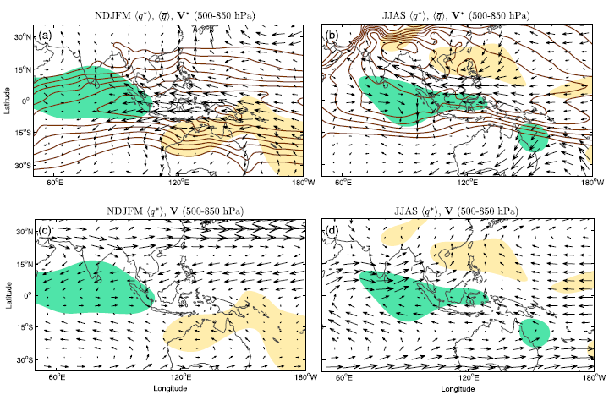
arrows: $V^{∗}$
arrows: $\overline{V}$
contours: $\left\langle \overline{q}\right\rangle$
shaded: $\left\langle q^{∗}\right\rangle$ (from 0.5 kgm⁻²)
Notes:
NDJFM:
Poleward flow is clearly evident in both hemispheres from ;80E to 130E, but the meridional advection is stronger in the Southern Hemisphere.
the meridional gradient in mean moisture is strongest, consistent with the stronger moisture tendency
the climatological-mean NDJFM flow, shown in Fig. 13c is weak and contributes little to the eastward propagation of the rain area.
JJAS:
The MJO-related easterly wind anomalies along the northern flanks of the rainbands advect humid air westward across India and the Arabian Sea, while the westerly anomalies along the southern flanks advect dry air eastward, thus moving the line of low-level moisture northward.
The eastward propagation of the rain bands is enhanced by advection of the rain bands by the climatological mean westerly monsoon jet.

Slide 18
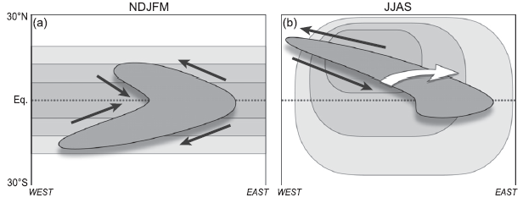
conclusions
the amplitude of the flanking Rossby waves is strongly influenced by the seasonally varying strength of the climatological-mean tropospheric jet streams.
Notes:
the amplitude of the flanking Rossby waves is strongly influenced by the seasonally varying strength of the climatological-mean tropospheric jet streams.

Slide 20
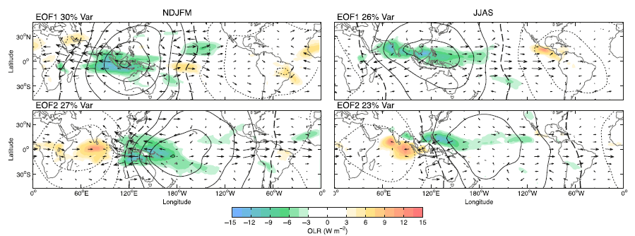
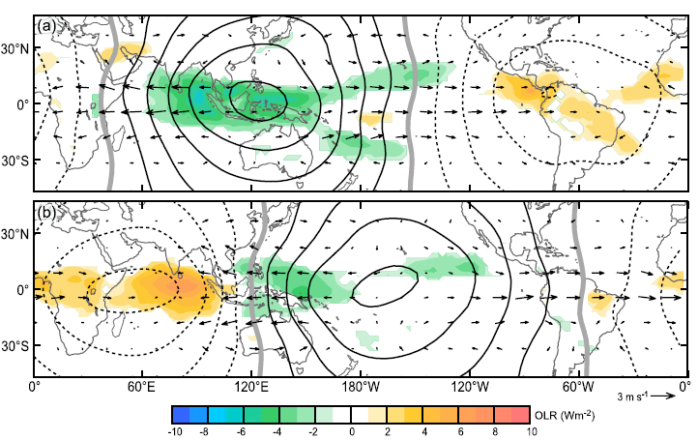
annual-mean
EOF1
contour: $∆χ$
(850- minus 150-hPa)
arrows :
150-hPa wind vectors
EOF2
shading : OLR (wm⁻²)
Adames and Wallace (2014a)

Slide 21
Geophysical Fluid Dynamics Laboratory’s flexible modeling system’s spherical nonlinear shallow-water model
meridionally varying topography:
H₀ = 2000m
N = 2
At day 25, a heat source of the following form is turned on:
θ : latitude,
θp : the latitude of the center of the heat source
L : the longitude
Lp is the longitude of the center of the heat source
Lx and Ly respectively determine the zonal and meridional extent of the heating.
Notes:
which yields a mean state with climatological-mean jet streams located at around 30N/S.

Slide 22
abstract
At upper-tropospheric levels, the flanking Rossby waves remain centered around 28°N/S year-round, but they tend to be stronger in the winter hemisphere, where the climatological-mean jet stream is stronger, rendering the subtropical circulation more sensitive to forcing by a near-equatorial heat source.
Amplitudes of the MJO-related deep convection and lower-tropospheric zonal wind are stronger in the summer hemisphere, where the column-integrated water vapor is larger.

Slide 23
NDJFM
During NDJFM, the equatorial asymmetry is subtle: as in the annual mean, moisture convergence into swallowtail-shaped regions of enhanced deep convection is an integral part of the equatorial Rossby wave signature, and the eastward propagation is due to moistening of the air to the east of the enhanced convection by poleward moisture advection.

Slide 24
JJAS
During the Asian summer monsoon in JJAS, the convection assumes the form of northward propagating, west-northwest–east-southeast-oriented rainbands embedded within cyclonic shear lines.
These features are maintained by frictional convergence of moisture, and their northward propagation is mainly due to the presence of features in the climatological-mean fields: that is, the west–east moisture gradient over India and the Arabian Sea and the southwesterly low-level monsoon flow over the northwest Pacific.

Slide 25
Monteiro et al. (2014)

