Slide 1
A Lightning Parameterization for the ECMWF Integrated Forecasting System
Speaker: Yao-Chu Wu
A100, Meteorology Building A, NTU
28 March 2017
Lopez P., 2016: A lightning parameterization for the ECMWF Integrated Forecasting System. Mon. Wea. Rev., 144, 3057-3075.
Errico R. M., 1997: What is an adjoint model? Bull. Amer. Meteor. Soc., 78, 2577-2591.

Slide 2
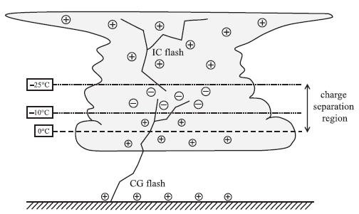
Outline
Lightning Observation
Model and Lightning Parameterization
Validation of the Lightning Parameterization
Multiyear simulations ($T255 ≈80 km$)
Month-long simulations ($∆x=80, 25, 9 km$)
Adjoint sensitivity experiment
Conclusions

Slide 3
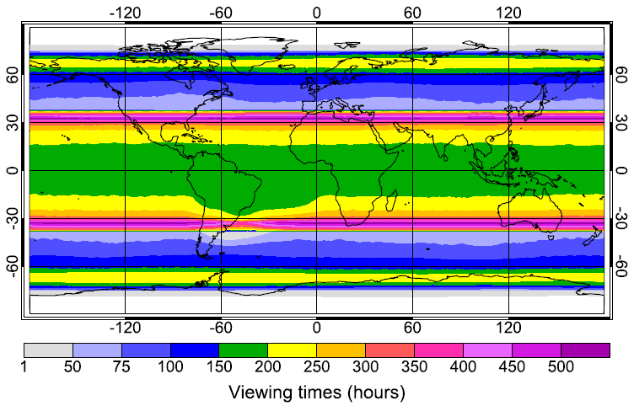
Lightning Observation
1995-2010
Cecil et al. (2014a,b)
OTD (OV-1)
Apr. 1995 – Mar. 2000
75ºN – 75ºS
710 km altitude
Detection efficiency: 37% - 52%
LIS (TRMM)
1997 – 2015
38ºN – 38ºS
400 km altitude
Detection efficiency: 69% - 88%
SAA → geomagnectic radiation → SNR higher

Slide 4
Model and Lightning Parameterization
ECMWF IFS version 42r1 and 42r2
(ECMWF global Integrated Forecasting System)
ECMWF 4D-Var data assimilation system (adjoint sensitivity)
Convective massflux scheme
Condensation and precipitation (diagnosis)
Graupel/hail (no information)

Slide 5
Model and Lightning Parameterization
The convective available potential energy
$CAPE (J {kg}^{−1})$
The vertical profile of the frozen precipitation convective flux
$P_{f} (kg m^{−2} s^{−1})$
The profile of cloud condensate amount within the convective updraft
$q_{cond} (kg {kg}^{−1})$
The convective cloud-base height
$z_{base} (km)$

Slide 6
Model and Lightning Parameterization
Lightning flash density (flashes km⁻² day⁻¹)
$f_{T}=α Q_{R} \sqrt{CAPE}{ min⁡(z_{base},1.8)}^{2}$
$Q_{R}=\int_{z_{0}}^{z_{−25}}{q_{gr}(q_{cond}+q_{sn})}\overline{ρ}dz$
$q_{gr}=β\frac{P_{f}}{\overline{ρ}V_{gr}}$
$q_{sn}=(1−β)\frac{P_{f}}{\overline{ρ}V_{sn}}$
$$CAPE=\int_{z_{LFC}}^{z_{w=0}}{\max\left(g\frac{T_{v}^{u}−\overline{T_{v}}}{\overline{T_{v}}},0\right)dz}$$
α → 32.40 (tuned number).
β → 0.7 over land; 0.45 over ocean.

Slide 7
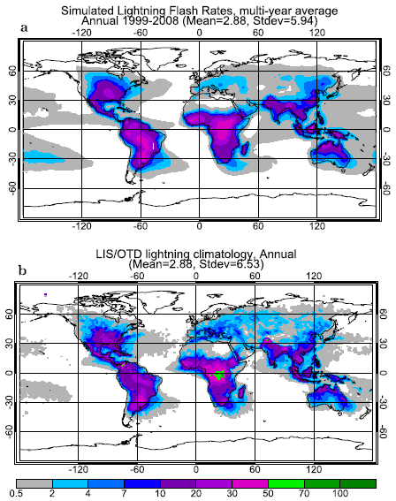
Validation of the Lightning Parameterization
Multiyear simulations ($T255 ≈80 km$)
0000 UTC 1 Jan 1999-2008
IC: ECMWF ERA-Interim reanalyses
STT updated every day (no ocean coupling)
Land surface condition updated every time steps

Slide 8
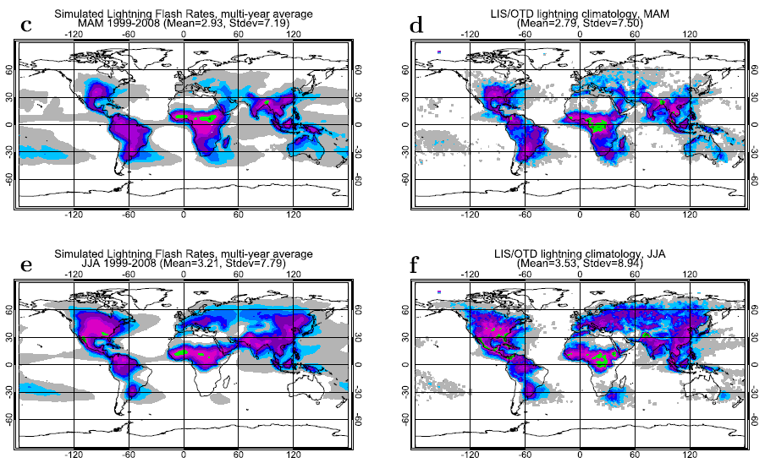
spring
summer

Slide 10
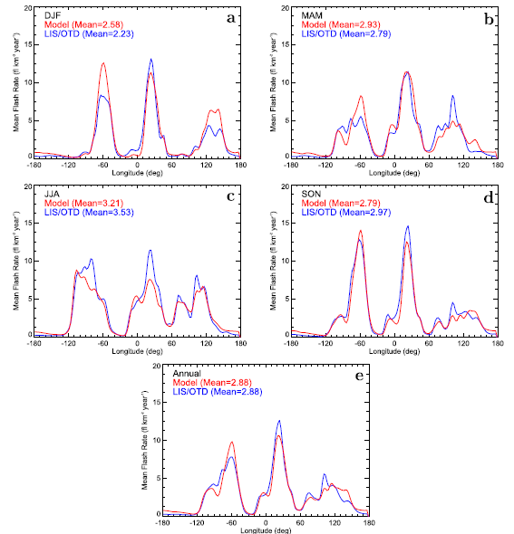

Slide 11
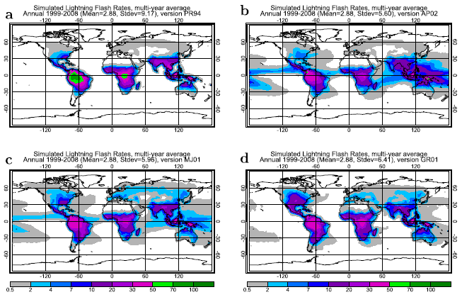
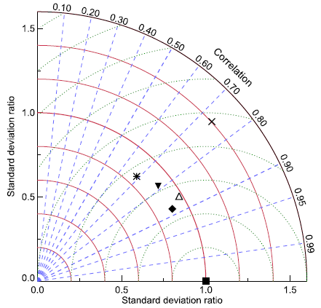
NEW
PR94
AP02
PR94
MJ01
GR01
AP02
MJ01
GR01
NEW

Slide 12
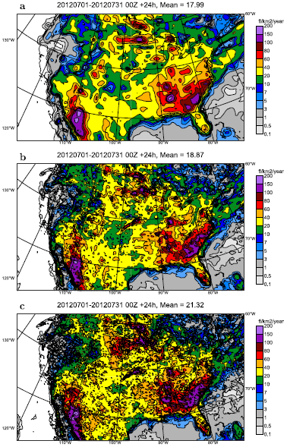
Month-long simulations ($∆x=80, 25, 9 km$)
Mean: 18→18.9→21.3 (flashes km⁻² yr⁻¹)

Slide 13
Adjoint sensitivity experiment
$$\overset{⃑}{b_{p}}=M\left(\overset{⃑}{a_{p}}\right)$$
$$J_{np}=J\left(\overset{⃑}{b_{p}}\right)$$
$$∆J_{n}$$
Old method, ensemble is needed
$$\overset{⃑}{b_{c}}=M\left(\overset{⃑}{a_{c}}\right)$$
$$J_{nc}=J\left(\overset{⃑}{b_{c}}\right)$$
$$J^{′}=\sum_{k}{\frac{∂J}{∂b_{k}}∆b_{k}, J′=}\sum_{k}{\frac{∂J}{∂a_{k}}∆a_{k}}$$
$\overset{⃑}{a_{p}}=\begin{matrix}[a_{p,1} & ⋯ & a_{p,3}]\end{matrix}$, $∆\overset{⃑}{a}=\overset{⃑}{a_{p}}−\overset{⃑}{a_{c}}$
$$\overset{⃑}{a_{c}}=\begin{matrix}[a_{c,1} & ⋯ & a_{c,k}]\end{matrix}$$
$$\frac{∂J}{∂\overset{⃑}{b}}$$
$$\frac{∂J}{∂\overset{⃑}{a}}$$

Slide 14
Adjoint sensitivity experiment
$$\overset{⃑}{b_{c}}=M\left(\overset{⃑}{a_{c}}\right)=M_{N}(⋯\left(M_{1}\left(M_{0}\left(\overset{⃑}{a_{c}}\right)\right)\right))$$
$$b_{j}^{′(n)}=\sum_{k}{\frac{∂b_{j}^{(n)}}{∂b_{k}^{(n−1)}}b_{k}^{′(n−1)} , b_{j}^{′(0)}=\sum_{k}{\frac{∂b_{j}^{(0)}}{∂a_{k}}a_{k}^{′}, }}$$
$$J=J\left(\overset{⃑}{b}\right)=J\left(M\left(\overset{⃑}{a}\right)\right)$$
$$\frac{∂J}{∂a_{j}}=\sum_{k}{\frac{∂J}{∂b_{k}}\frac{∂b_{k}}{∂a_{j}}}$$

Slide 15
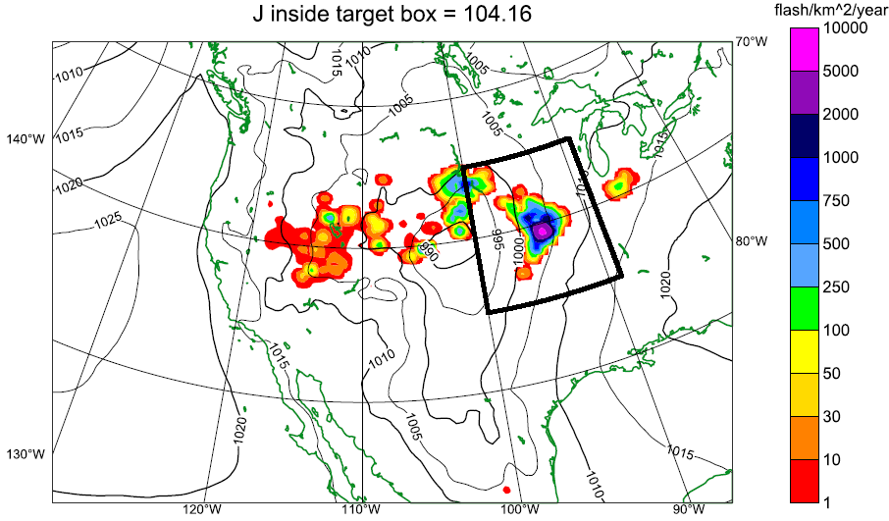
Adjoint sensitivity experiment
$$\overset{⃑}{x}\underset{→}{M[t_{0},t_{f}]}J_{ltg}=\frac{1}{N_{t}A_{box}}\sum_{t=1}^{N_{t}}{\sum_{i=1}^{N_{i}}{f_{T}(i,t)a_{i}Φ_{i}}}$$
$${\left[∇_{f_{T}}J_{ltg}\right]}_{t_{f}}=\frac{a_{i}Φ_{i}}{N_{t}A_{box}}\underset{→}{M^{∗}[t_{f},t_{0}]}{[∇_{\overset{⃑}{x}}J_{ltg}]}_{t_{0}}$$
$$M[t_{0},t_{f}]$$
$$J_{ltg}$$
$$t_{0}$$
$$t_{f}$$
$${\left[∇_{\overset{⃑}{x}}J_{ltg}\right]}_{t_{0}}$$
$$M^{∗}[t_{f},t_{0}]$$
$${\left[∇_{f_{T}}J_{ltg}\right]}_{t_{f}}$$

Slide 16
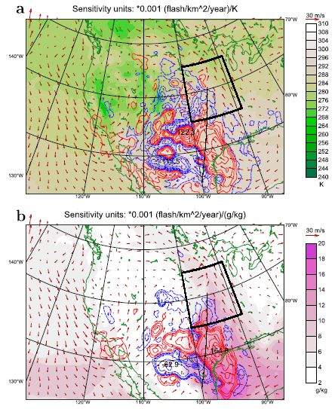
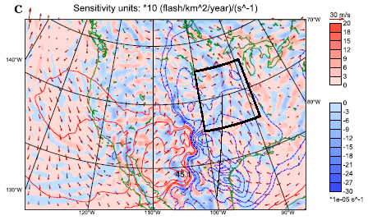

Slide 17
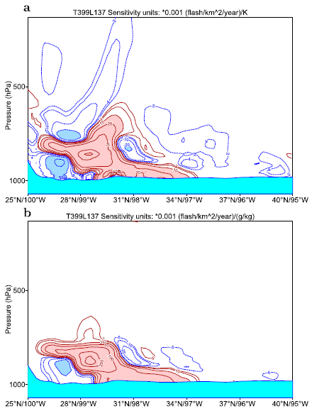
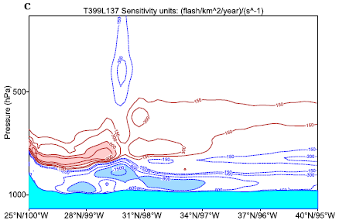

Slide 18
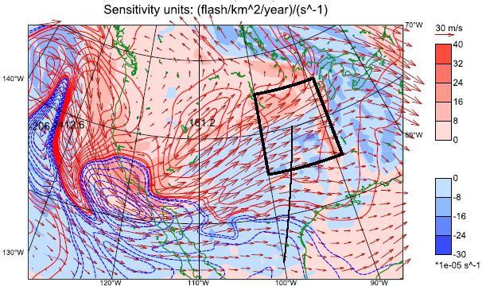

Slide 19
Conclusions
Future potential purposes of lightning parameterization includes:
NOx emissions from lightning → O₃ in troposphere and stratosphere → climate
Severe weather forecasting
Data assimilation
Main deficiency is underestimation of strong lightning activity in Congo.
The 4D-Var data assimilation of lightning observations become reality.

