Slide 1
Predictability and Dynamics of Tropical Cyclone Rapid Intensification Deduced from High-Resolution Stochastic Ensembles
Falko Judt and Shuyi S. Chen
Wei-Ting Fang
2017.03.21

Slide 2
Outline
Introduction
Stochastic ensembles
Ensemble predictions of Earl’s rapid intensification
Predictability of RI and uncertainty in RI timing
Environmental and internal control of RI timing
TC–environment interactions
Distinct dynamical processes in early and late RI cases
Summary and conclusions

Slide 3
Intensity & intensification
Maximum intensity
mostly controlled by environmental thermodynamic conditions (Emanuel 1986; Emanuel 1988; DeMaria and Kaplan 1994)
Intensify
TC intensification is governed by complex physical and dynamical processes. RI is affected by multiscale interactions between the TC environment, the mean TC vortex, and internal convective processes (Rogers 2010; Guimond et al. 2010; Rogers et al. 2015)
Predictability
The mean TC vortex and the wavenumber 1 asymmetry controlled by the TC environment, are predictable for much longer (>7 days)
small-scale structures controlled by internal convective processes with predictability limits of ,12 h (Judt et al. 2016)

Slide 4
Rapid intensification (RI)
Definition
≥ 15ms⁻¹ increase in the maximum surface wind speed over a 24-h period
Challenge
RI has low predictability (for reasons that are not fully understood), but this predictability has not been precisely quantified.

Slide 5
Previous study on RI
Diabatic heating and inward advection of angular momentum (Ooyama 1969, 1982; Shapiro and Willoughby 1982, Bui et al. 2009; Smith et al. 2009, Lee and Chen 2012; Chen et al. 2013)
The abrupt onset of RI can be explained by means of a drastic increase in thermodynamic efficiency when the heating is concentrated in a region of high inertial stability (Schubert and Hack 1982; Vigh and Schubert 2009; Nolan et al. 2007; Pendergrass and Willoughby 2009)
RI is often preceded by the development of a symmetric ring of precipitation. (Kieper and Jiang 2012, Stevenson et al. 2014; Rogers et al.2015; Chen and Gopalakrishnan 2015)
Satellite observations and model studies have not confirmed that CBs* are either a necessary or a sufficient condition for RI. (Rogers 2010; Jiang 2012)
*Convective burst

Slide 6
Model setup
Use five high-resolution stochastic ensembles of Hurricane Earl (2010) with a combined total of 100 members.
Domain
D1: Covering most of the North Atlantic (Δx = 12 km)
D2-3: Two vortex-following domains (Δx = 4 and 1.33 km)
All ensembles had 20 members, which were initialized at 0000 UTC 27 August 2010 and integrated for 7 days (168 h).

Slide 7
SKEBS
The stochastic kinetic-energy backscatter (SKEBS: Shutts, 2005; Berner et al., 2009, 2011) algorithm was used to perturb the model ensembles with spatially and temporally correlated patterns of noise. (Judt et al. 2016)
SKEBS perturbs the model fields by adding random, small-amplitude perturbations to the horizontal wind and potential temperature tendency equations at each time step.

Slide 8
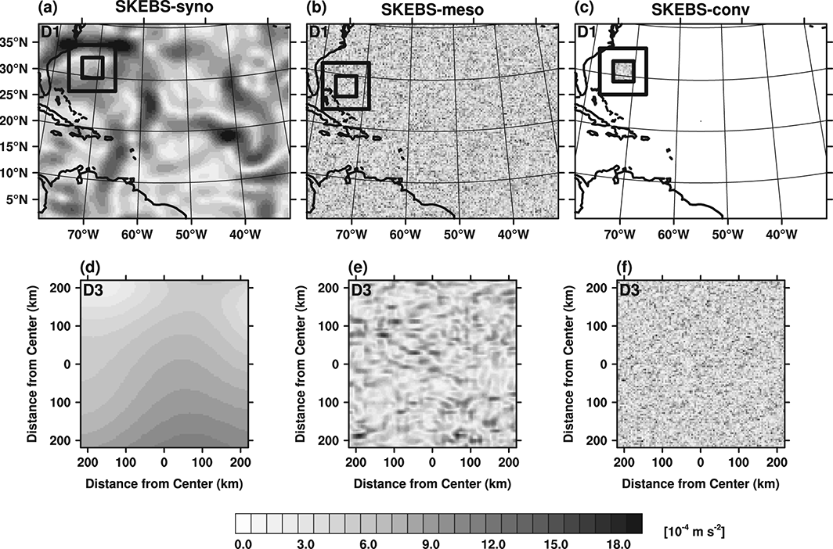
SKEBS perturbation characteristics
Judt et al. 2016
x 20 = 100

Slide 9
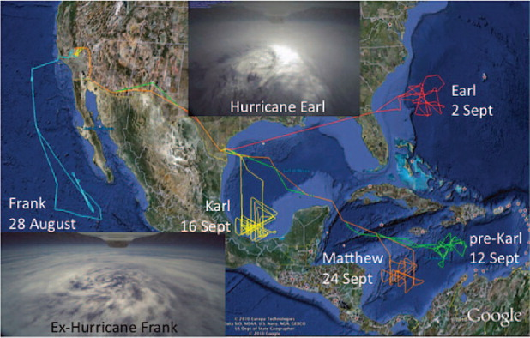
Rapid Intensification Processes (GRIP) Field Experiment
Braun et al. 2013
In August–September 2010, NASA, NOAA, and the National Science Foundation (NSF) conducted separate but closely coordinated hurricane field campaigns, bringing to bear a combined seven aircraft with both new and mature observing technologies.

Slide 10
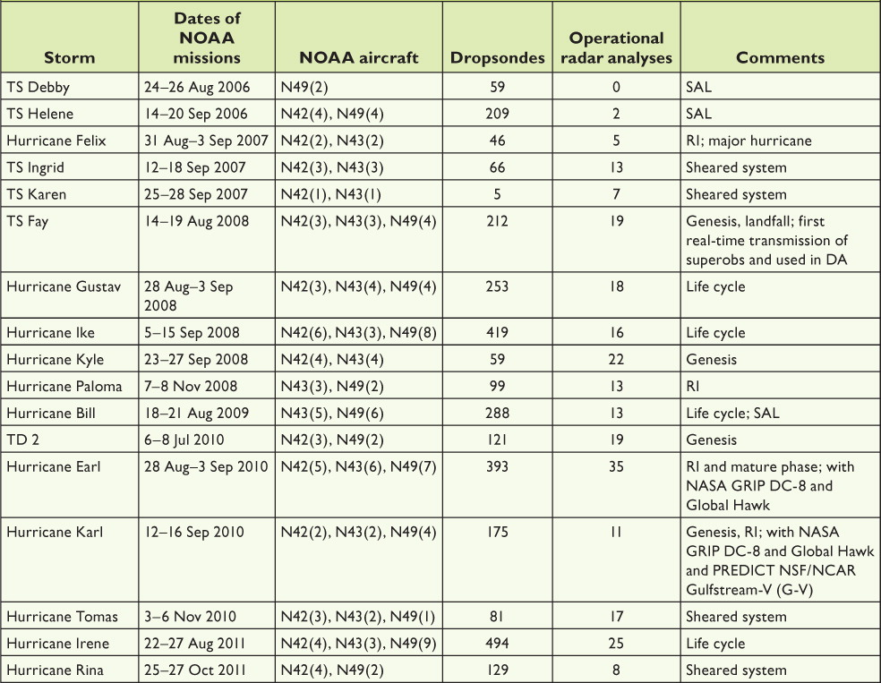
NOAA Intensity Forecasting Experiment (IFEX)
Rogers et al. 2013

Slide 11
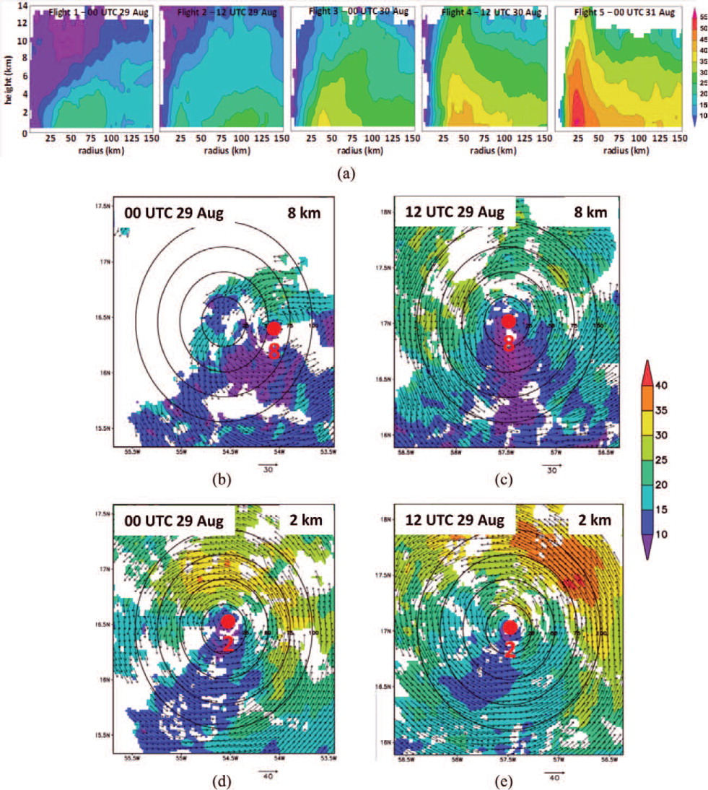
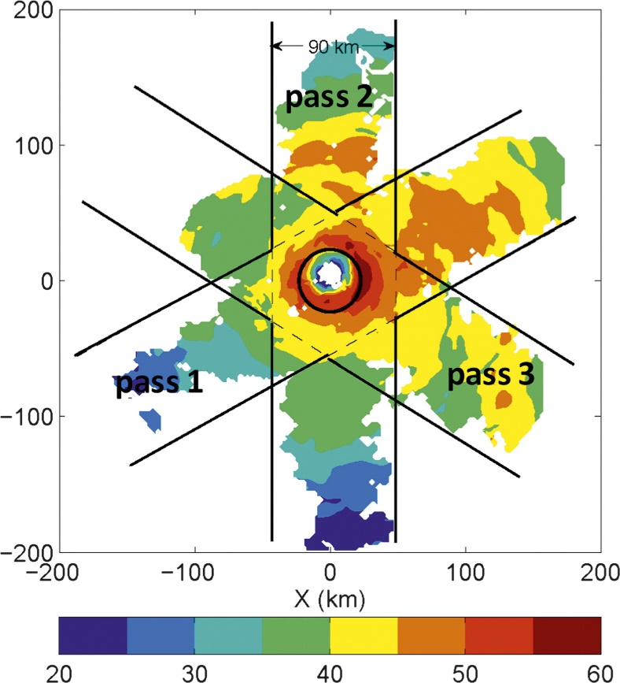
Hurricane Earl (2010)
Rogers et al. 2013
Rogers et al. 2013b

Slide 12
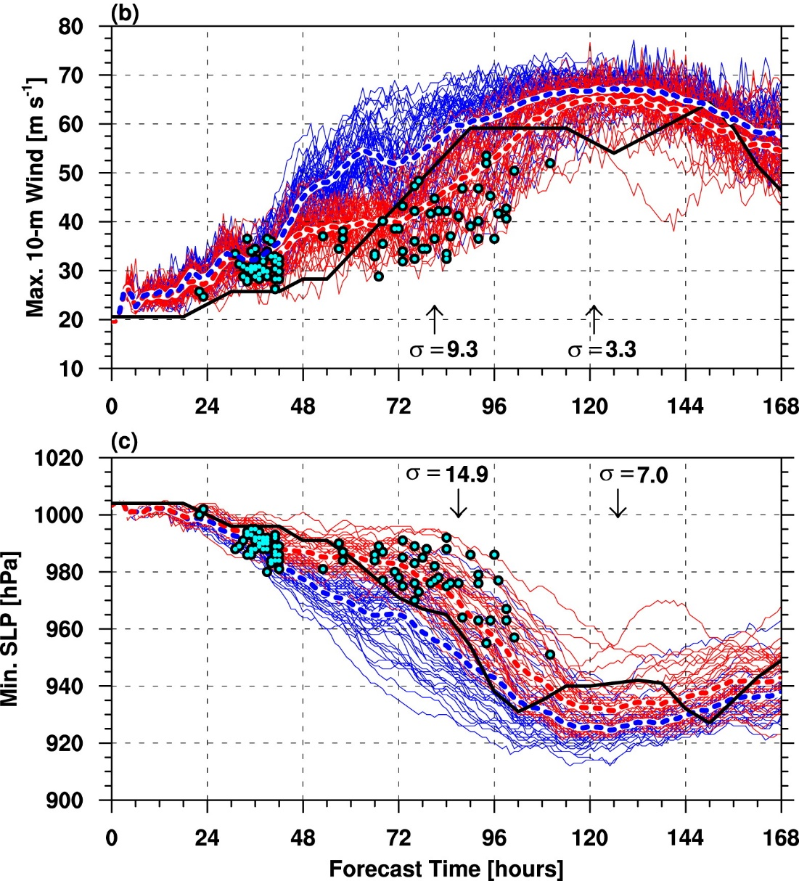
Ensemble predictions
Early case: before t = 48 h
late case: after t = 48 h
?
High bias
Temporary weakening
> 0.625 m s⁻¹ h⁻¹ [15m s⁻¹ (24 h)⁻¹]
91/100 RI cases
Clustered into two groups
RI and the maximum intensity period are governed by regimes with distinct uncertainty characteristics.

Slide 13
Predictability of RI and uncertainty in RI timing
The predictability of RI can therefore be examined in terms of 1) the likelihood of RI during the TC lifetime and 2) the timing of RI
Environmental factors
Internal factors

Slide 14
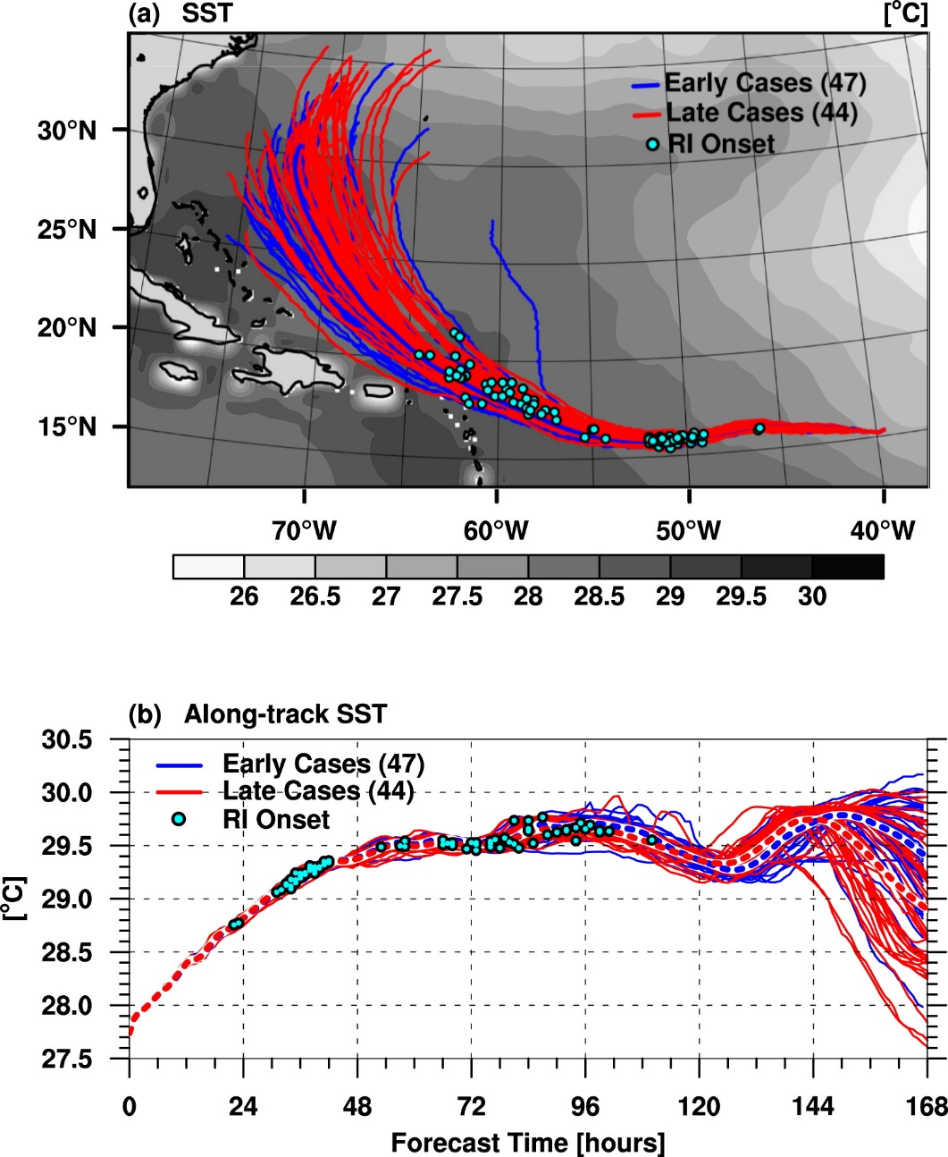
SST (Environmental factors)
Evidently, differences in RI timing cannot be explained by differences in SST in these ensemble experiments.

Slide 15
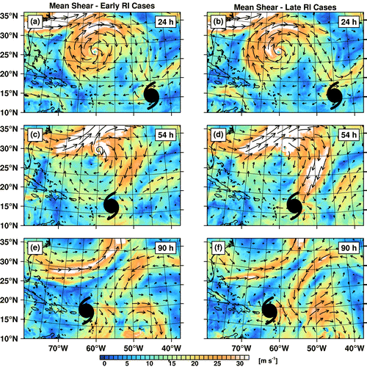
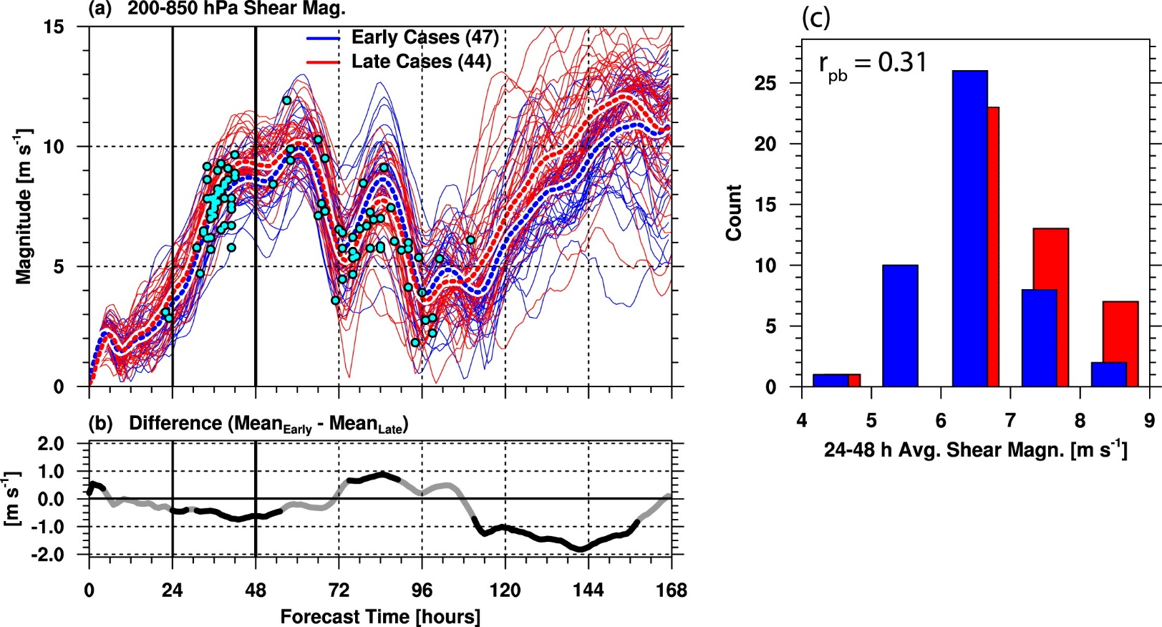
Vertical wind shear (Environmental factors)
Mean wind vectors of the 200- and 850-hPa levels averaged within a 200–800-km annulus around the storm.
More hostile environment for the late RI cases, which featured significantly(??) higher shear between t = 22 and 57 h.
The decreasing shear created a more conducive environment for intensification
Shear is not the only factor explaining the RI timing differences

Slide 16
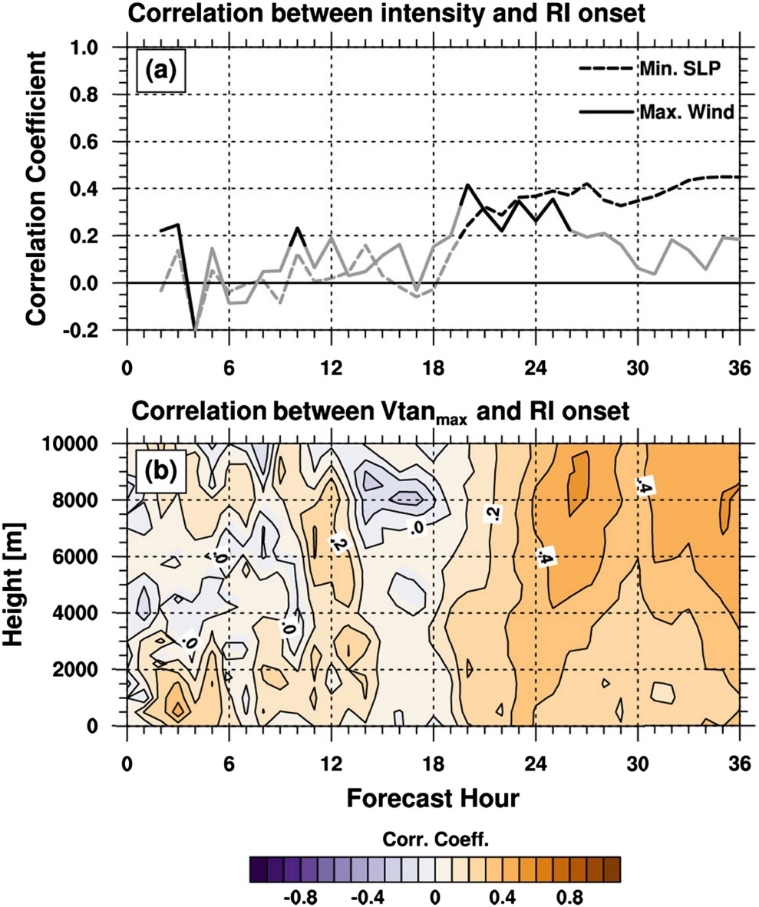
Intensity (Internal factors)
Vertical extent and structure of the vortex may be more important for RI than intensity itself.

Slide 17
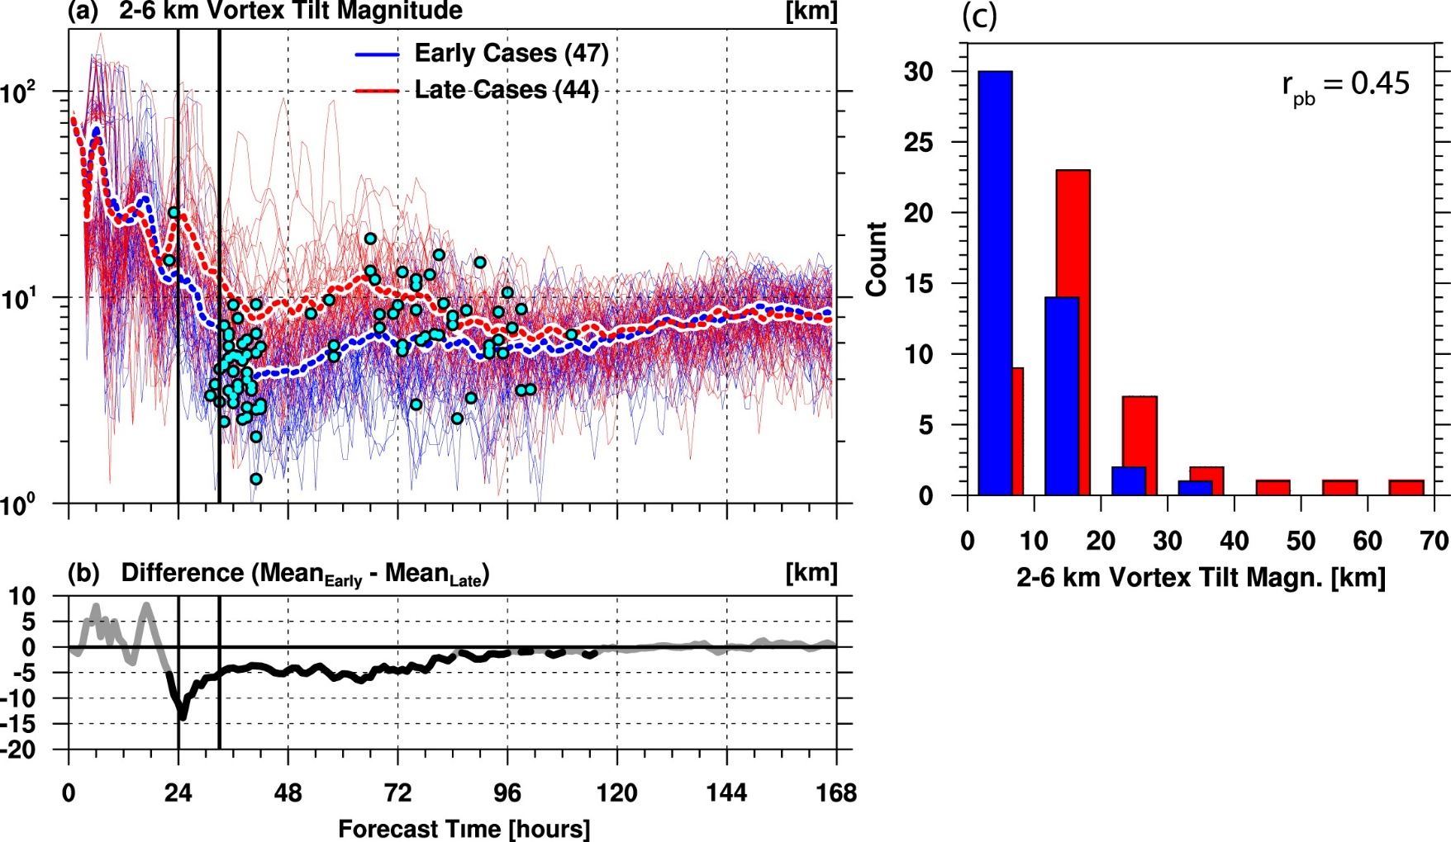
Tilt of the vortex (Internal factors)
Between 18 and 24 h, the tilt in the late cases increases abruptly, likely in response to the increasing shear

Slide 18
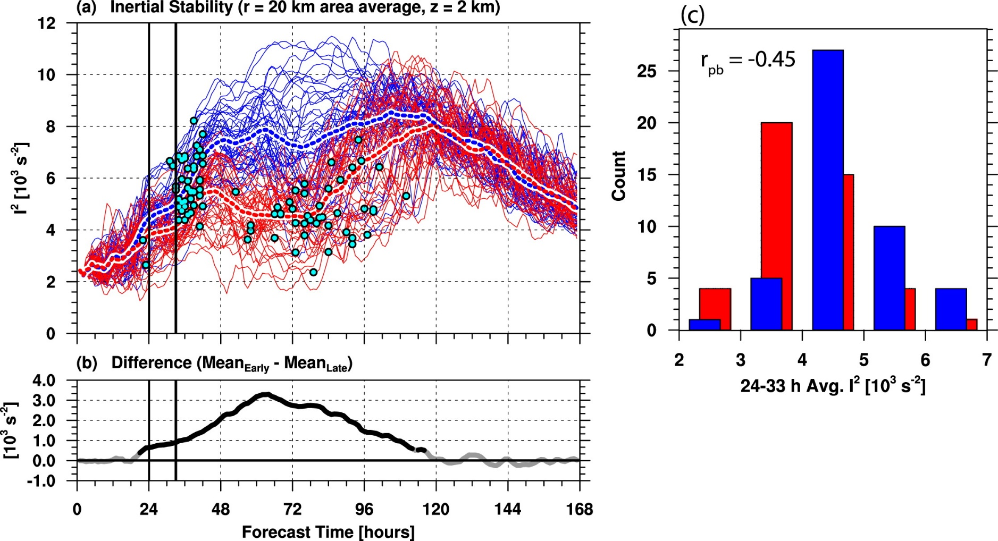
Inertial stability (Internal factors)
$$I^{2}=(f+\frac{v}{r}+\frac{∂v}{∂r})(f+\frac{2v}{r})$$
The dynamical structure of the inner core in these (late) members suffers from the worsening environmental conditions.

Slide 19
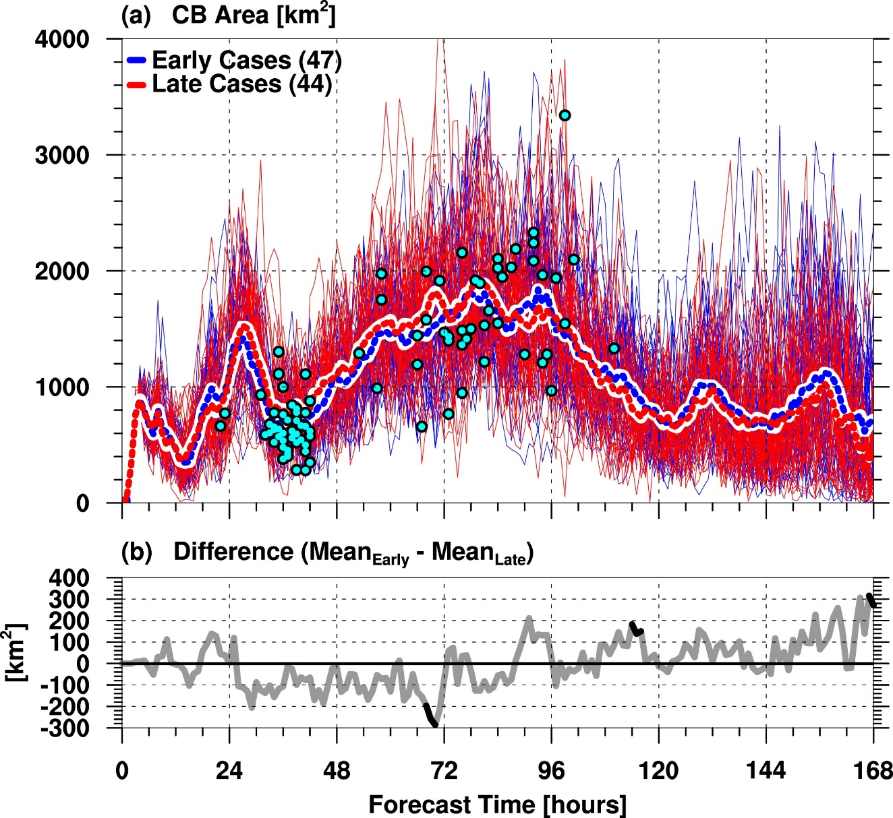
Convective burst (Internal factors)
The maximum vertical velocity in the 8–16-km layer is > 5ms-¹ and the reflectivity averaged in the 8–14-km layer is > 20dBZ
There are virtually no statistically significant differences between the early and late cases in terms of CB activity

Slide 20
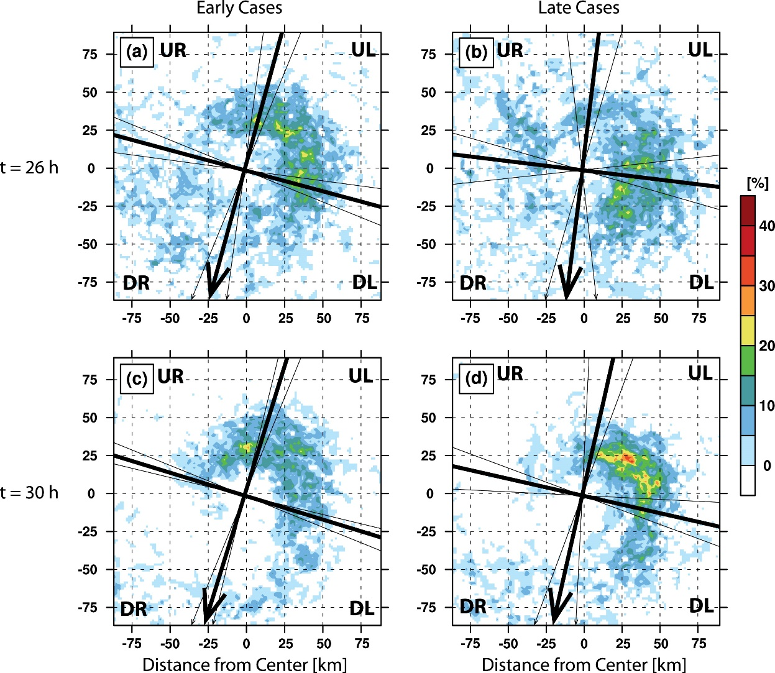
Convective burst (Internal factors)
Similar to the observations(??)
Several observational studies noted a counterclockwise azimuthal translation of CBs during Earl’s evolution. Just prior to RI, CB activity propagated from the downshearleft quadrant through the upshear-left quadrant into the upshear storm sector (Stevenson et al. 2014; Rogers et al. 2015).

Slide 21
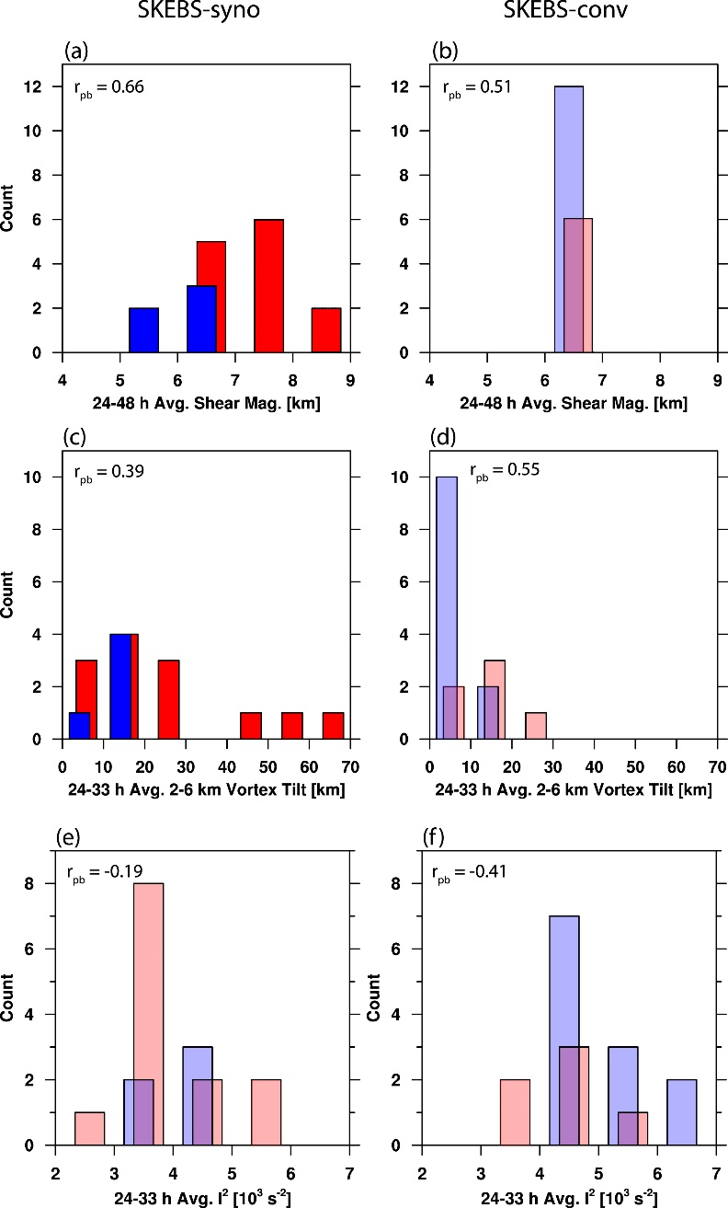
Environmental and internal control of RI timing
Ensembles with synoptic- and convective-scale perturbations
Environmental wind shear variability and RI uncertainty
Vortex tilt, inner-core inertial stability, and RI

Slide 22
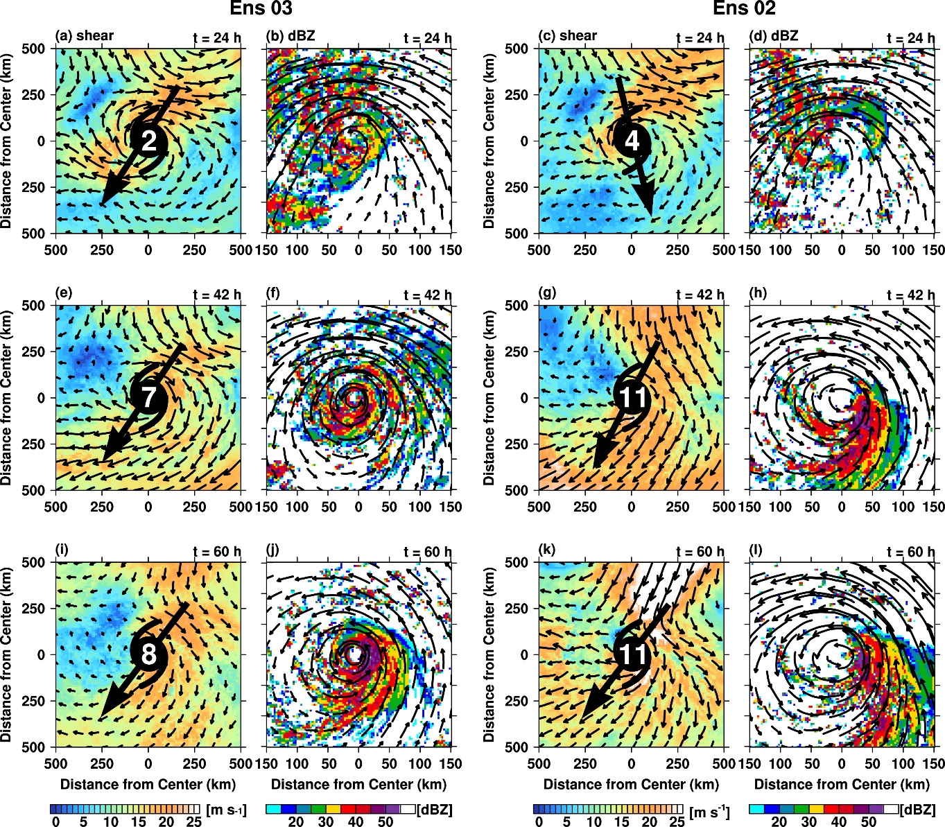
TC–environment interactions
Members with stronger shear feature more asymmetric vortices, which then struggle to intensify.

Slide 23
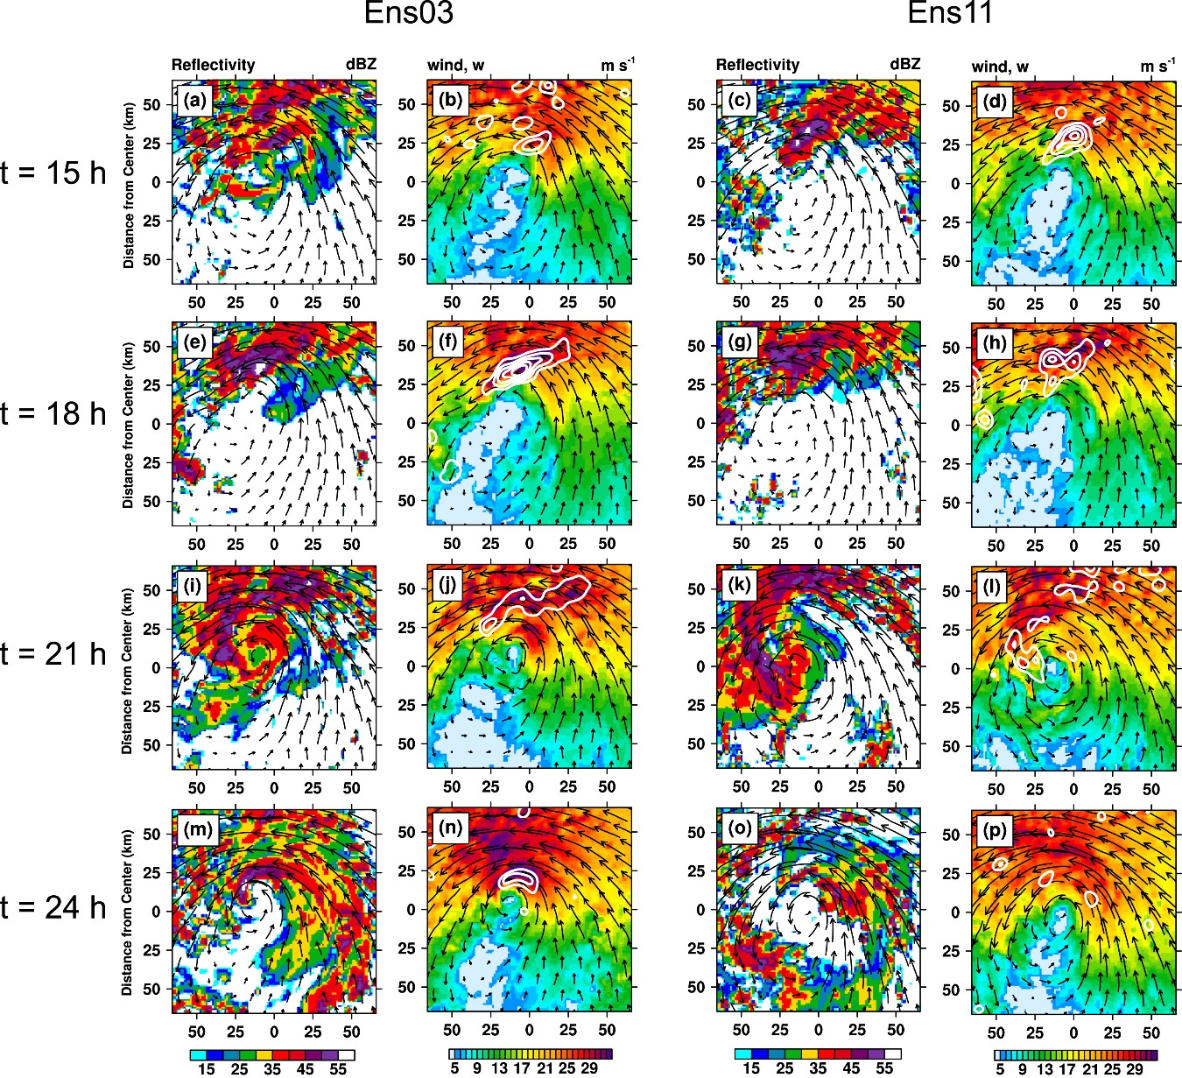
TC–environment interactions
This finding has important implications for the intrinsic predictability of RI timing and suggests that the stochastic nature of convective processes may make it very difficult to achieve accurate deterministic predictions of RI timing.

Slide 24
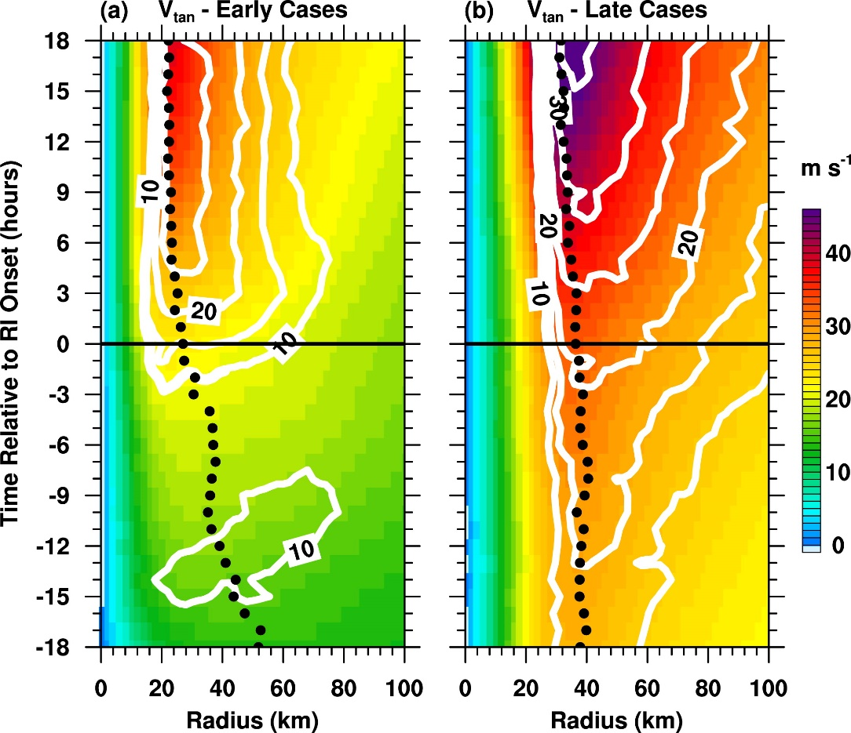
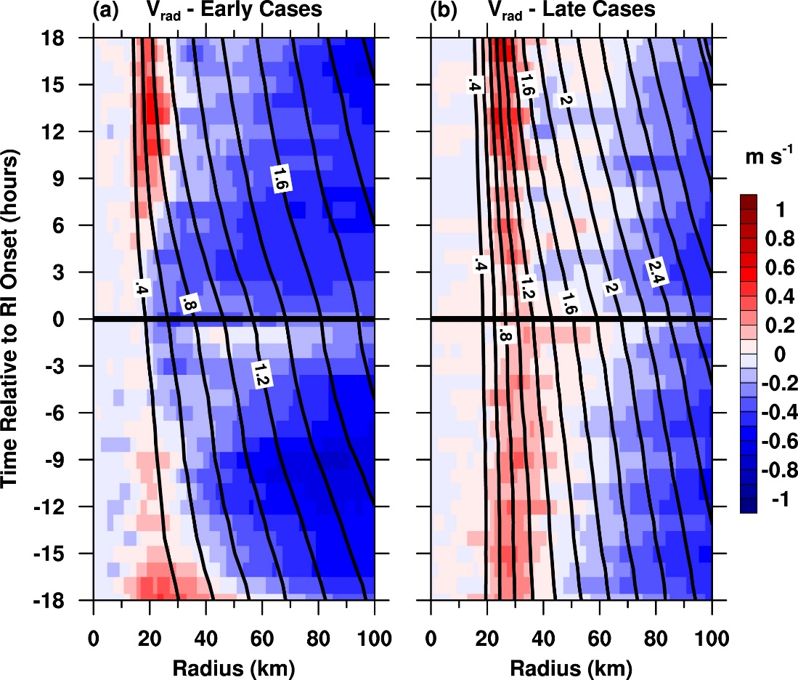
Evolution of the TC structure
2–5-km height-averaged radial velocity
This behavior is somewhat inconsistent with the convective ring model of TC intensification (Shapiro and Willoughby 1982; Willoughby et al. 1982), but Stern et al. (2015) showed that intensification does not necessarily coincide with a contraction of the RMW, especially in stronger TCs.

Slide 25
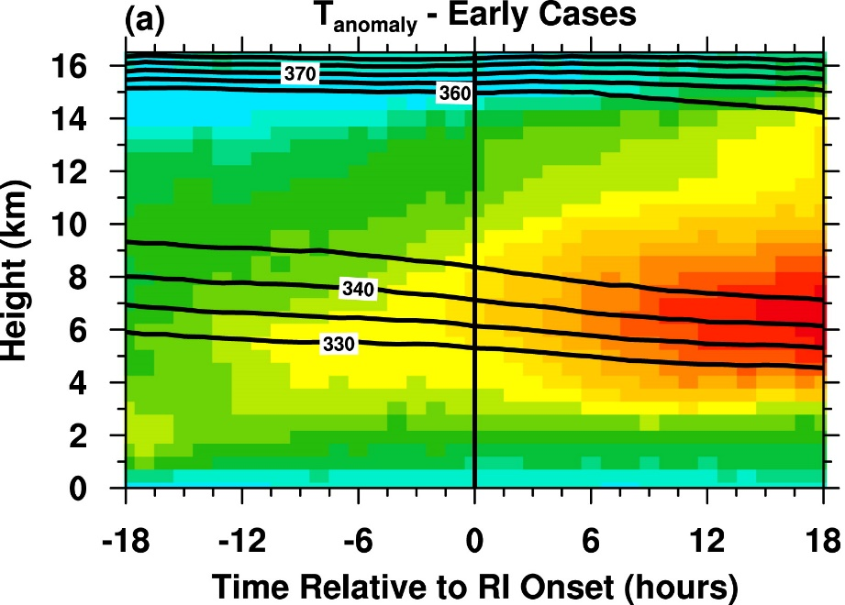
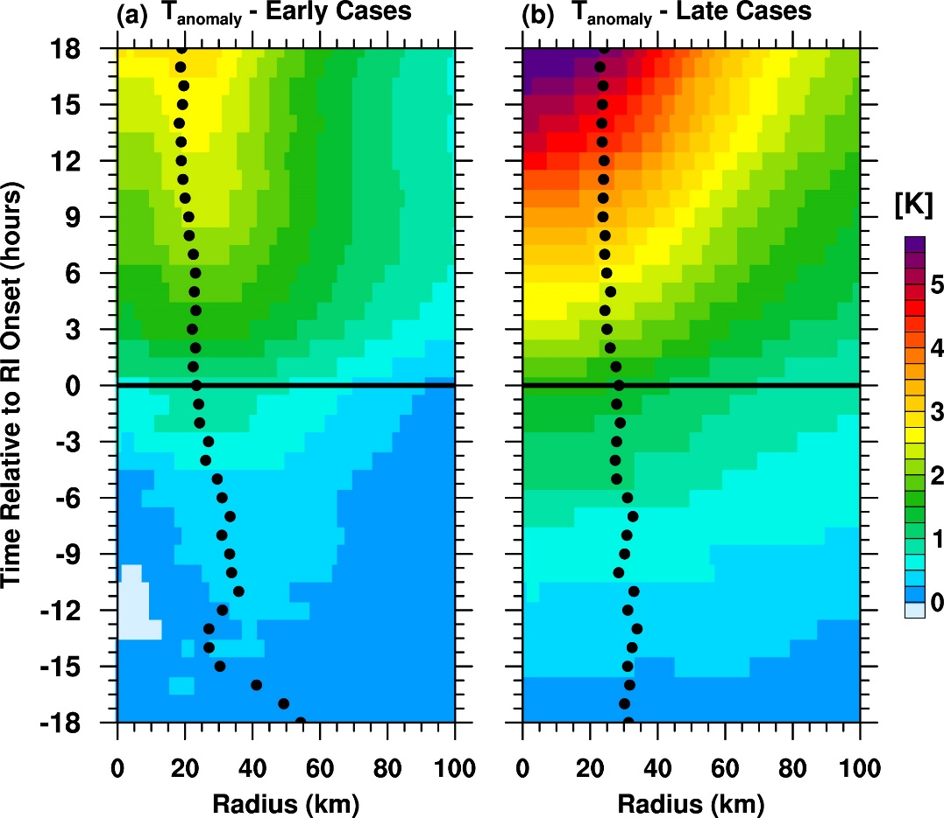
Development of the warm core
12–14-km height-averaged temperature anomaly

Slide 26
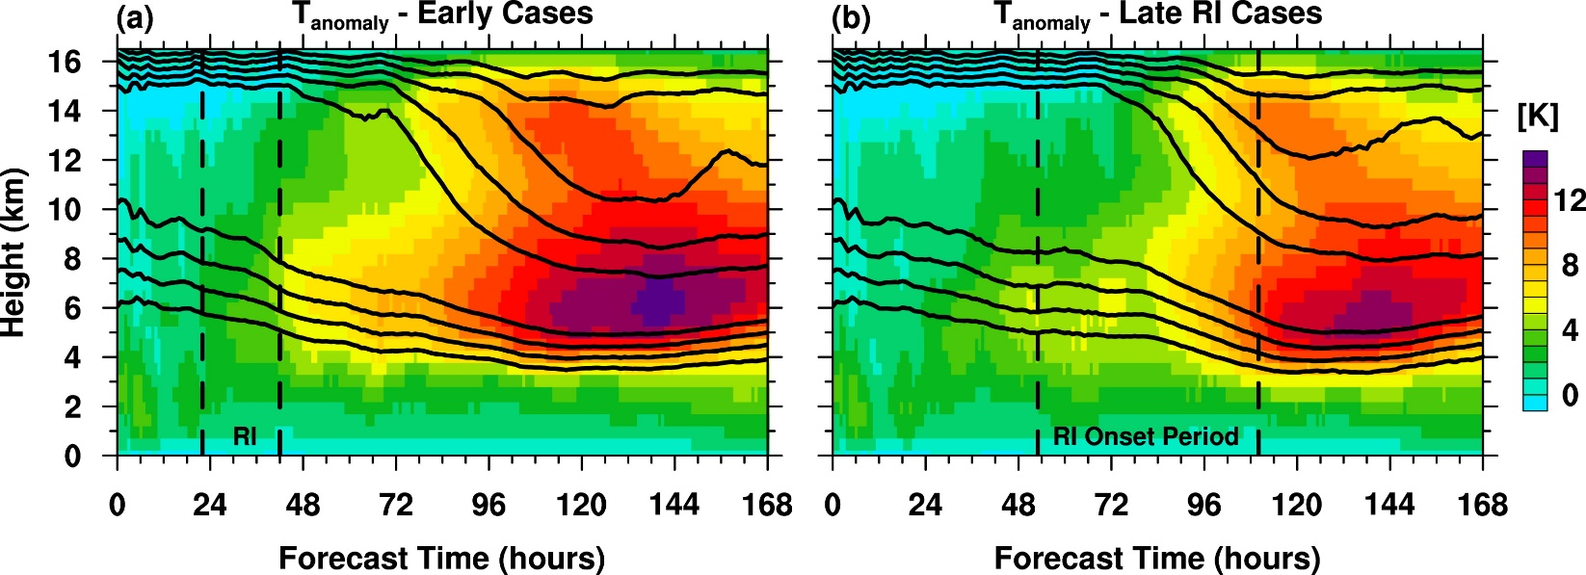
Is the upper-level warm core necessary for RI?
The warm core development does not appear to be a necessary condition for RI.

Slide 27
Most important findings
The environment controls the overall tendency for RI and sets the bounds for the maximum TC intensity. The likelihood of RI may be predictable with numerical models as long as the synoptic-scale environment is predictable.
The initiation of the RI itself has a stochastic component, and the exact timing of RI is controlled by complex interactions between the TC environment (e.g., vertical wind shear), the mean vortex, and convective processes. While the predictability limit of the mean vortex can be >7 days in long-lasting TCs, small-scale convective processes have predictability limits of <12 h.
Two distinct dynamic modes of RI were identified:
When RI occurs during the early stages of the TC life cycle, it is generally characterized by a rapidly contracting RMW and the formation of an eyewall.
In mature, well-developed TCs, RI is accompanied by the development of an upper-level warmcore, whereas eyewall contraction is less pronounced.

Slide 28
Suggestions
Advances in data assimilation should be directed toward improving the model representation of the mean vortex structure.
Improving the parameterization of physical processes (e.g., microphysics, boundary layer turbulence, air–sea momentum/heat exchange).
Model biases tend to nullify advances in improving the initial conditions through data assimilation (Vukicevic et al. 2013).

Slide 29
Thanks

Slide 30
Summary
The ensemble generally captured Earl’s RI, evidenced by the fact that 91 out of the total of 100 ensemble members qualify as RI cases.
It indicates that the TC environment determines the overall predictability of RI in the sense of whether RI will occur.
It follows that the predictability of RI is higher if a TC is embedded in an environment that will remain favorable (or unfavorable) for an extended period of time. In contrast, the timing of RI seems to have limited predictability, similar to the predictability of TC genesis discussed in Zhang and Sippel (2009).
Wind shear plays a critical role in the uncertainty of RI timing in two ways.
Shear variability is directly related to differences in RI timing in the sense that stronger shear leads to a reduction in the likelihood of RI.
Interactions between the environmental shear, the TC vortex, and convection are responsible for RI timing uncertainty, even when the shear magnitude is uniform within an ensemble.

Slide 31
Inertial stability can make the vortex resilient to moderate-to-strong shear and allow for RI in an otherwise not ideal environment.
These complex feedbacks between convection and the mean vortex imply that the predictability of RI is ultimately limited as a result of the short predictability of convective processes.
The contrast between environmental and internal controls implies that maximum intensity predictions for long-lived hurricanes are inherently easier than intensity forecasts for a TC growing toward maturity.
The different processes associated with RI are dependent on the TC’s stage in its life cycle.
upper-level warming and a more pronounced drop in SLP are exclusively associated with the late RI regime, indicating that the warm core is likely not the immediate cause of RI.

