Slide 1
Spectral Characteristics of Convective-Scale Precipitation Observations and Forecasts
Wong M. and W. C. Skamarock (MWR, 2016)
Abstract
1. verification of NCEP/Stage IV and Multi-Radar Multi-Sensor (MRMS) precipitation products and convective-scale model forecasts
2. a similar weak power-law behavior in 1D spectral decompositions, although the MRMS analysis does not drop off in power at wavelengths less than approximately 20 km as found in the stage IV analysis
3. the forecasts produce similar behavior to the MRMS when the model’s effective resolution is sufficient
4, a break in the spectral slope at the scales for which the analyses and forecasts are valid
5. the 2D spectra show power varying significantly as a function of azimuthal angle for a given wavenumber, this azimuthal anisotropy(各向異性) is significant, and is dominated by the second mode (wavenumber 2)
6. The phase of the mode is the result of the convective system orientations and propagation.
7. Observations show a shift in orientation (phase) over May–June–July. The convective forecasts reproduce this shift in phase, although with a consistent but small phase error.

Slide 2
1. Introduction (general)
1. convection-permitting forecast models:
horizontal spacing of a few km or less
deep convective updrafts are explicitly simulated
produce convective-system structure and evolution very similar to obs.
allow for better representation of terrain and topographic flow effects
2. Traditional approaches for comparing precipitation forecasts to obs. such as ETS and bias do not provide any direct measure of the scale or structure of precipitation features.
3. Scale is an important consideration in forecast model performance; specifically, what scales are resolved in a model forecast, and are they resolved properly.

Slide 3
1. Introduction (1D & 2D spectra)
4. Observational analyses using 1D spectra exhibit a power-law relationship
for precipitation as a function of horizontal scale, and this relationship is consistent with the power-law relationship observed for the horizontal wind fields, specifically the kinetic energy.
5. The 1D spectral analyses: 1) do observations show any break in the power-law scaling and 2) do convection permitting model forecasts reproduce the power-law scaling, and over what scales are the forecast spectra accurate?
6. The smallest scale where observed power-law scaling holds is one definition of the effective resolution of a model configuration, usually evaluated using horizontal or vertical velocity spectra.
7. The 2D precipitation spectra are cast in polar coordinates (horizontal wavenumber, azimuth) and the characteristics of the spectra as a function of azimuth for a given wavelength are examined.
8. Examined how the variance and structure of the precipitation fields evolve from late spring (May) through summer (July). The observed 2D precipitation spectra change noticeably over the 2.5-month period, and this change is also evident in the forecast spectra.

Slide 4
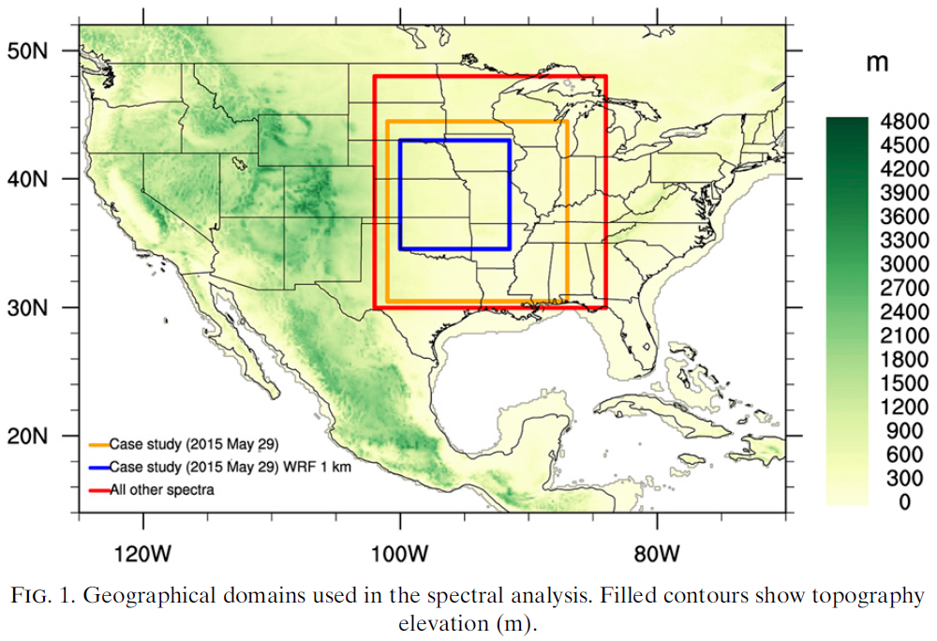
2. Description of models and observations
1. Temporally averaged vertical velocity, horizontal kinetic energy, and precipitation spectra are computed from hourly forecasts and precipitation analyses over a domain with 720×720 grid points (1800×1800 points for the MRMS analyses). The MPAS and NCEP/stageIV are interpolated to a 0.025°× 0.025° grid, the MRMS are on a 0.01°× 0.01° grid.
2. case study:
WRF 3-km
(0.025°)
WRF 1-km
(0.01°)

Slide 5
2. Description of models and observations
3. Two sets of MPAS: [lacking 1~7 June??]
a. NOAA Hazardous Weather Testbed (HWT)
between 1 and 31 May, daily 5-day (120 h) forecasts, initialized by the
0000 UTC Global Forecast System (GFS) analysis
b. Plains Elevated Convection At Night (PECAN)
between 8 June and 14 July, 3-day (72 h) forecasts, initialized by the
0000 UTC GFS analysis
nominally 3-km horizontal grid spacing
MYNN surface layer scheme and planetary boundary layer (PBL) scheme
the Grell-Freitas scale-aware cumulus scheme
the WSM6 single-moment microphysics scheme
the Rapid Radiative Transfer Model for GCM (RRTMG) short- and longwave
radiation schemes

Slide 6
Model for Prediction Across Scales
(https://mpas-dev.github.io)
1. Global model
2. Voronoi (hexagonal) meshes (沃羅諾伊空間分割) and C-grid staggering

Slide 7
2. Description of models and observations
4. NCEP/stage IV 4-km gridded precip. estimates: (Lin & Mitchell 2005)
regional hourly and 6-hourly
based on WSR-88D observations bias corrected using rain gauge measurements
and satellite information
some manual quality control by forecasters
5. MRMS 1-km gridded precipitation estimates: (Zhang et al. 2014, 2016)
(regional) hourly
combining information from multiple radars in the United States and Canada,
lightning and rain gauges, climatology data, satellite data, atmospheric
environmental data, and NWP model output.
fully automated and do not benefit from manual quality control

Slide 8
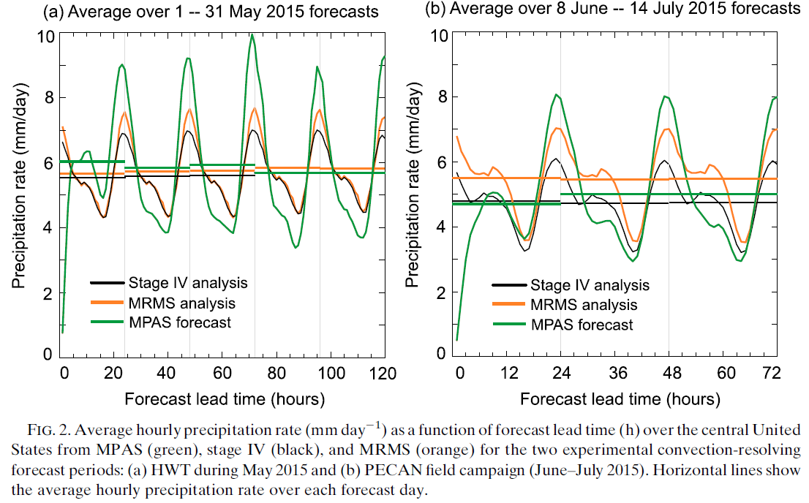
2. Description of models and observations
6. To avoid model spinup errors, such as that discussed in Skamarock (2004), we do not use the first 24 forecast hours in our spectral calculations.
7. MPAS typically overestimates the diurnal precipitation maximum and underestimates the minimum, but the model bias does not vary significantly with forecast lead time.
[10% differences
between MRMS and
Stage IV??]
[spinup 10 h??]
[what fcst data
selected??]

Slide 9
2. Description of models and observations
8. case study: WRF-ARW
48-h forecast
2-way nested within 15-km, 3-km, and 1-way to 1-km
initialized from analyses generated by the WRF Data Assimilation Research
Testbed: a continuously cycled system uses an ensemble adjustment Kalman
filter and observations from aircraft, marine, surface, and
upper-air observations
Mellor-Yamada-Janjic´ (MYJ) PBL scheme with the Eta surface layer scheme
Tiedtke cumulus scheme (no cumulus parameterization the 3- and 1-km domains)
Thompson microphysics scheme (with prognostic variables for cloud liquid-
water, pristine ice, rainwater, snow, and graupel)
the RRTMG short- and longwave radiation schemes

Slide 10
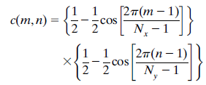
3. Spectral power analysis [so complicated……]
1. 2D Fourier transforms
2. The 2D Hanning window (Harris 1978) is
applied by scaling each grid point (m, n)
with the following coefficient:
Nx and Ny are the number of grid points in
the x and y directions
3. 1D rainfall spectra: azimuthal averaging of the 2D spectrum
4. Elongated precipitation features are reflected as anisotropy in the 2D power spectrum. (Hinkelman et al. 2005, 2007)
5. a similar anisotropy parameter but using the ratio of power variance to the squared mean at each total wavenumber k:
σ_{θ}(k) standard deviation
μ_{θ}(k) the azimuthal average
of the power coefficients S(k,θ) at wavenumber k
for an isotropic spectrum, S(k,θ)=S(k) and σ_{θ}(k)=0

Slide 11
3. Spectral power analysis [so complicated……]
6. anisotropy phase ψ(k): to quantify the dominant orientation of anisotropy
The Fourier transform of a real-valued two-dimensional field is symmetric about kx=-ky. If the 2D spectrum shows a peak in power along a particular angle θ, the power at an arbitrary total wavenumber will be in the form of two sinusoidal waves with a phase shift depending on θ at which the peak occurs. To quantify this phase shift, we perform a 1D Fourier transform on S(k0,θ) for all wavenumbers k0 and find the phase angle ψ(k0) of the second harmonic, where -π≦ψ(k0)≦π. We then map the phase angle ψ to the anisotropy phase ψ’using
such that ψ’(k)=0 corresponds to (kx, 0) in the 2D spectrum and the angle increases counterclockwise. The heaviest rainfall feature will align perpendicular to this phase; for example, an elongated rainfall feature aligned in the northeast-southwest direction will show anisotropy at ψ’=3π/4 in the 2D spectrum.

Slide 12
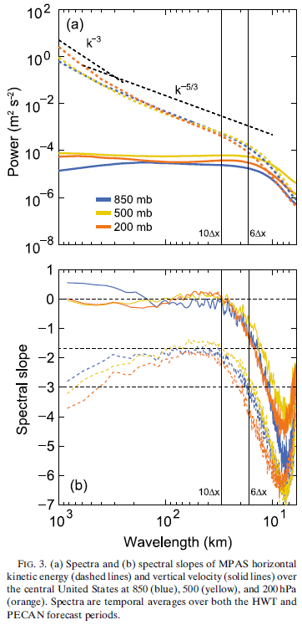
4. Vertical velocity and horizontal kinetic energy
1. the k^{-5/3} and the k⁻³ spectra are reproduced by the
MPAS at 850, 500, and 200 hPa (dashed lines),
a departure from the -5/3 slope may be
interpreted as reaching the model-effective
resolution (Skamarock 2004), this effective
resolution is smaller than the global average of
6Δx may be a result of the dominant local
weather regime (continental convection)
2. Flat vertical velocity spectra (solid line) were
also observed in the stratospheric aircraft
measurements and model simulations, a flat shape
up to a wavelength of approximately 10Δx.
3. a weak spectral peak near wavelength 30km
(positive slopes in Fig. 3b), the stratospheric
measurements also showed a deviation from a flat
spectrum at about 25 km
4. The model resolution is still too low to
accurately resolve the spectral characteristics
of convective vertical velocities.

Slide 13
5. Precipitation scaling near the grid scale
1. Crane (1990) computed rainfall spectra using 1-km horizontal grid spacing radar volume scans just below the freezing level:
k^{-5/3} regime at scales between 13.5 and 50 km
(energy input)
k⁻³ regime at scales between 4 and 13.5 km
k⁻¹ regime below 4 km
(2D turbulence theory)
2. Menabde et al. (1999) examined the scaling between 500m and 30km using radar scans with 250-m resolution pixels:
spectral slopes in the range of k^{-2.11} to k^{-2.42}.
3. Harris et al. (2001) examined rainfall spectra from a 2-km horizontal grid spacing radar and found scaling from k^{-2.7} to k^{-3.1} at the 4-33-km scales, transitioning to a much gentler slope at scales greater than 33 km (at approximately k⁻¹ but there was little mentioning of this scaling).

Slide 14
5. Precipitation scaling near the grid scale
4. Harris et al. (2001) also conducted a 3-km numerical simulation. In addition to a break at 33 km, they also found a spectral break at 15 km (5Δx) and attributed the spectral drop to numerical filter effects.
5. Willeit et al. (2015): for convective events
the observed spectra showed a scaling break at about 15-20 km
the modeled spectra showed a break at 20-30 km
modeled slope (k^{-2.21}) gentler than observed (k^{-3.16} for 1-h rainfall accumulations and k^{-2.72} for rainfall rate) at the smaller scales (5.6-25 km)
6. radar locations, duration, and reflectivity-to-rainfall rate conversion
reflectivity from different radars
radar-rainfall estimates are subject to uncertainties such as range effects due to beam elevation and attenuation, and choice of a single Z-R relationship
single radar measurements also means that the domain is limited by the maximum range and azimuthally averaged spectral estimates at scales greater than 15 km may be affected by a smaller sample size

Slide 15
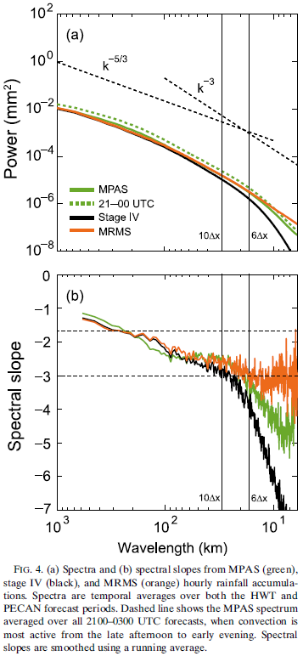
5. Precipitation scaling near the grid scale
7. Near the grid scale, the power from stage IV
analyses drops off much faster with wavenumber
than those from MPAS and MRMS.
-> stage IV small-scale precipitation features
are smoother and more organized
8. The rainfall spectrum from MPAS compares well
with MRMS and shows similar small-scale
variability down to approximately 12 km, the
slopes begin to differ noticeably at about 6Δx
[similar to Harris et al. (2001) for their model].

Slide 16
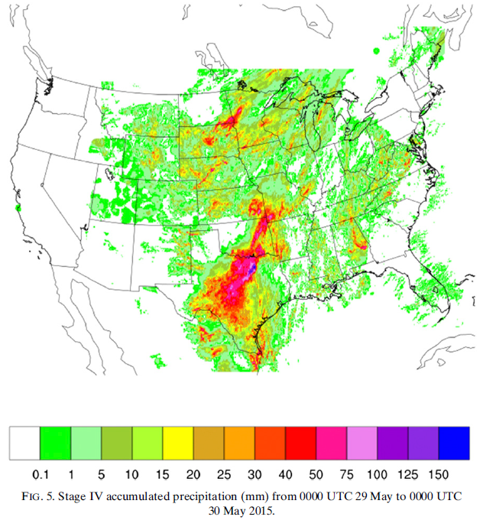
5. Precipitation scaling near the grid scale
9. 2100 UTC 29 May~1200 UTC 30 May 2015 24-h accumulated precipitation from stage IV of a squall line was simulated by WRF 3- and 1-km 48-h (began at 0000 UTC 28 May 2015).
10. scattered thunderstorms

Slide 17
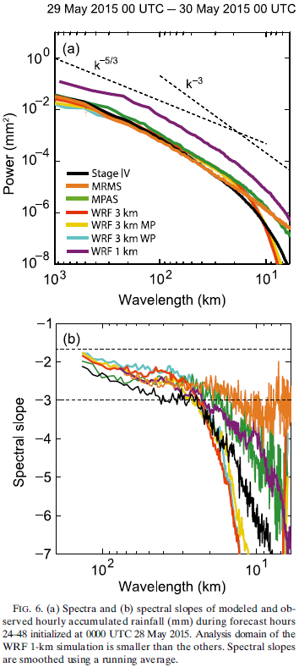
5. Precipitation scaling near the grid scale
11. similar to the 4-km stage IV spectrum, the WRF
3-km simulation shows a sharp spectral drop at
the 6-25-km wavelengths
12. both the 1-km WRF forecast and MRMS analysis
show relatively consistent scaling down to 6 km
=> the drop in the 3-km WRF forecast and the 4-km
stage IV spectra may be due to the coarser
resolution in WRF and smoothing procedures in
the objective analyses
13. two additional 3-km WRF simulations with the WRF
physics (WP) suite and the MPAS physics (MP)
suite showed slightly less precipitation.
14. Differences are found between the two sets of
physics parameterizations at the synoptic scale,
but near the grid scale their spectral behavior
is very similar.
=> the spectral drop at the grid scale is
independent of physics options

Slide 18
average rain rate obtained from a single volume scan of weather radar in Bintulu, Malaysia on Dec. 19, 1978 at 0400 LT during winter monsoon measurement program (WMONEX)

Slide 19
5. Precipitation scaling near the grid scale
15. there are differences between the numerical filters for scalars in MPAS and WRF that may affect the near-grid-scale behavior
16. MPAS: no explicit diffusion is applied on the scalar variables
the third order advection scheme has a fourth-order damping term and
a monotonicity constraint in the scalar advection scheme behaves
like a filter
WRF : a fifth-order horizontal advection scheme is used
inherently diffusive with a sixth-order damping term
monotonic moisture advection, a sixth order hyperdiffusion is
employed for scalars

Slide 20
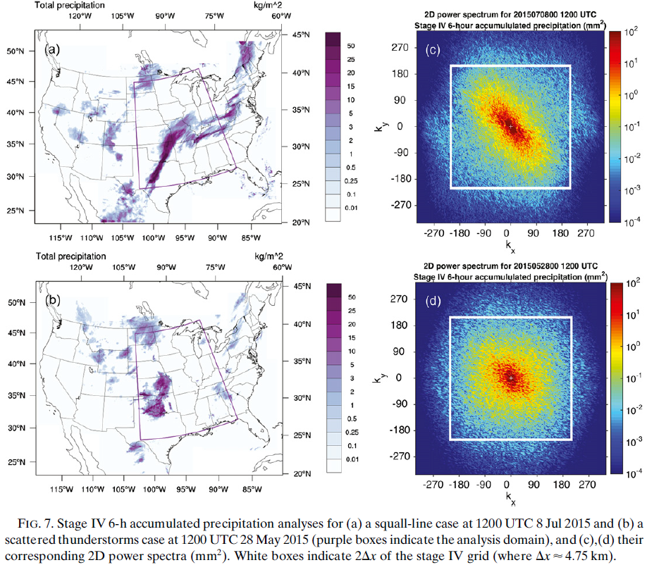
6. Orientation of dominant precipitation features
1. the orientation
of squall line
is reflected
peaks in the
power spectrum
along an angle
perpendicular
to the physical
feature
2. scattered and
less-organized
convective
cells
-> much more
isotropic

Slide 21
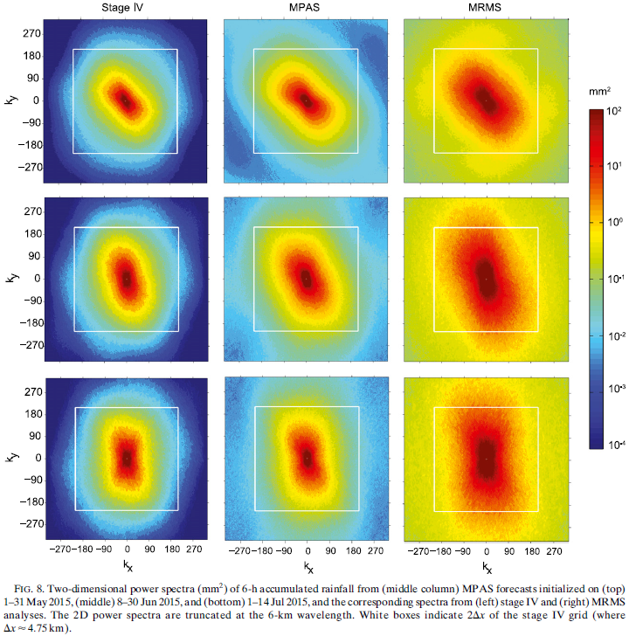
6. Orientation of dominant precipitation features
3. The orientations of
the physical features
are predominantly in
the northeast-south-
west direction (ψ’=
3π/4) during May and
transitioning to an
east-west direction (
ψ’=π/2) during
June and July.

Slide 22
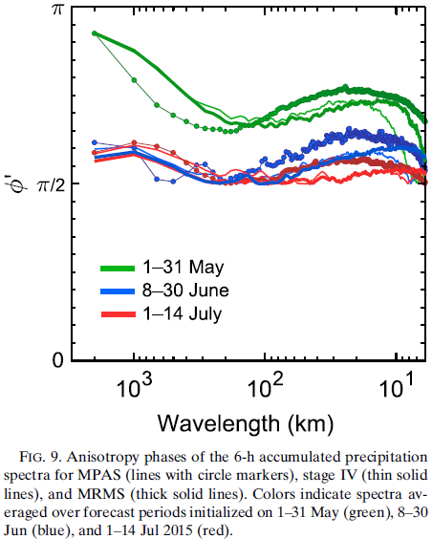
6. Orientation of dominant precipitation features
4. Since the spectrum is symmetric, only even harmonics of the power along the azimuth are nontrivial. We examined the variance contributions of the second and fourth harmonics in the spectra shown in Fig. 8, and found that the second harmonic contributes 46.6%-62.2% of the variance, while the fourth harmonic only contributes 9.3%–14.5%.
5. The phase shifts of the second harmonic are, therefore, used to compute the anisotropy phases in Fig. 9.
6. at scales smaller than approximately 100 km,
the model consistently overestimates the phase
7. Near the grid scale, the anisotropy phases
decrease sharply in stage IV, which is
associated with reaching the Nyquist
wavenumber (at a wavelength of 9.5 km).

Slide 23
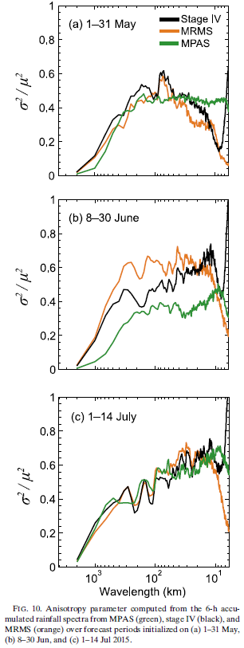
6. Orientation of dominant precipitation features
8. MPAS is able to reproduce the spectral anisotropy well
in May and July, but with an underestimation in June.
9. The underestimation indicates that the MPAS spectrum is
slightly more isotropic than those from stage IV and
MRMS, and that the predicted precipitation features
were less organized than observed.

Slide 24
7. Summary
1. 1D precipitation spectrum of stage IV (4-km) analyses: a distinct break in the spectral slope at approximately 25 km
The steeper slope at the smaller scales implies smoother and more organized precipitation structures.
MRMS (1-km) spectrum: near uniform scaling at k⁻³ between 6 and 100 km
=> the scale break appears to be a result of the horizontal resolution
2. MPAS at a 3-km nominal grid spacing shows better agreement with the MRMS results.
the regional WRF at the 3-km grid spacing shows a similar scale break as that from stage IV
the WRF spectrum at 1-km grid spacing shows scaling similar to MRMS
=> the differences are not sensitive to physics options

Slide 25
7. Summary
3. MRMS, stage IV, and MPAS all show dominant features aligned in the northeast direction during the month of May, gradually shifting to an east-west direction in June and July
MPAS tends to underestimate the phase angles
4. well-organized systems (squall lines) have a larger anisotropy parameter
more spatially sporadic thunderstorms have a smaller anisotropy parameter
MPAS agrees fairly well with stage IV except in June, where the forecast precipitating systems appear to be somewhat more disorganized.

