Slide 1
Representation of Clouds in Large-Scale Models
Tiedtke, M., 1993: Representation of clouds in large-scale models. Mon. Wea. Rev., 121, 3040–3061.

Slide 2
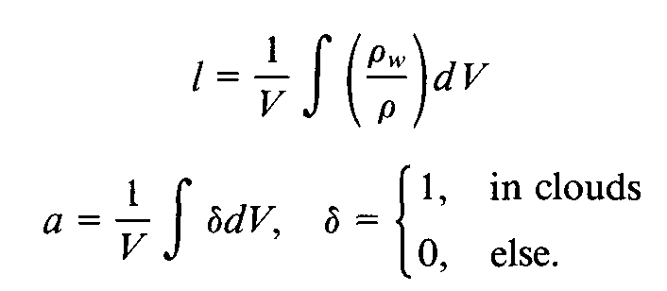
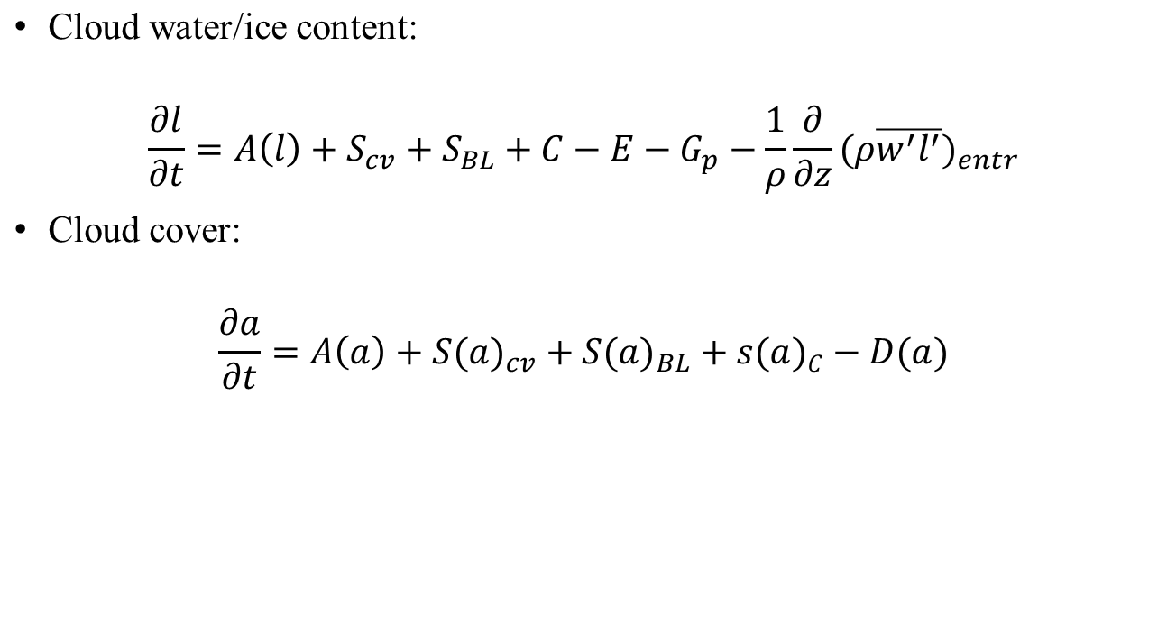
The time evolution of clouds is defined through large-scale budget equation for cloud water content and cloud cover.
precipitation rate
convection
boundary-layer
evaporation
condensation

Slide 3
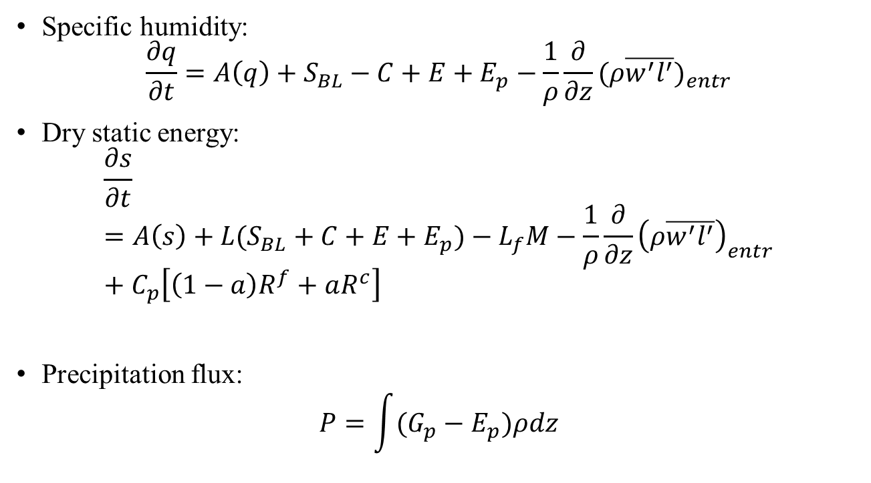
Condensation, evaporation
turbulent
radiation

Slide 4
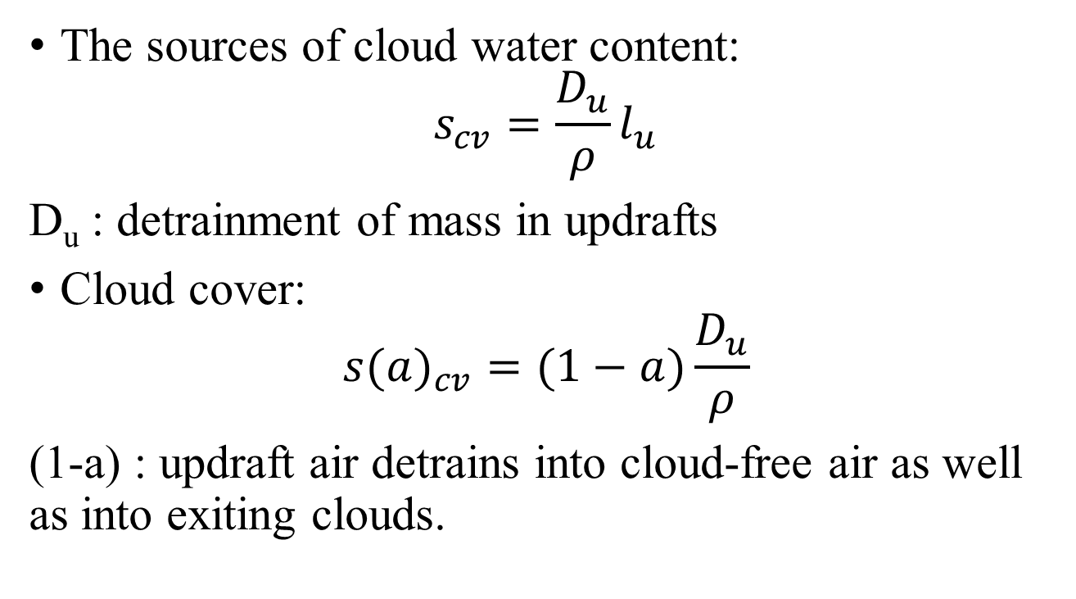
The sources from convection
Notes:
水氣透過積雲對流抬升，凝結後再逸出至環境中，經過蒸發後增加環境的水氣量。

Slide 5
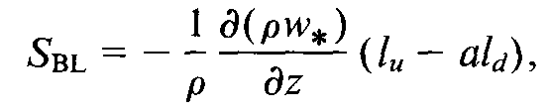
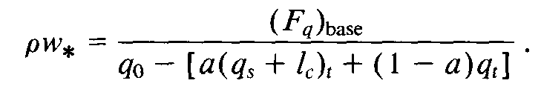
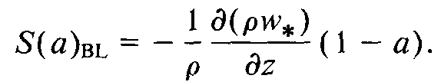
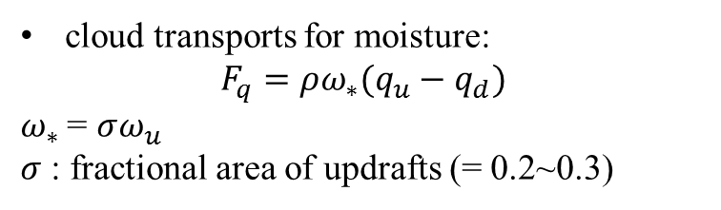
Sources from boundary layers
The turbulent fluxes in the interior of the boundary layer are entirely due to convective circulations.
Subscripts 0 and t :
model levels near the surface and cloud top
Notes:
在邊界層內的cloud water的來源，是以在上沖流產生的凝結和下沖流的蒸發作用呈上質量通量的垂直分布。

Slide 6
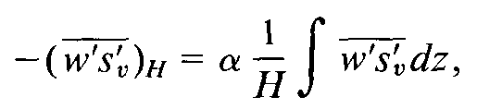
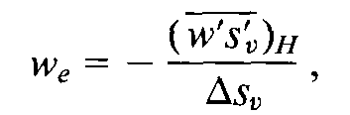
entrainment
the turbulent entrainment of warm and dry air form above the inversion layer.
Negative buoyancy flux at cloud top is proportional to the average buoyancy flux within the mixed layer:
H : height of the mixed layer
α : 0.5
Linear decrease toward zero at cloud base and the next level above the inversion
Warming and drying in cloud layer, cooling and moistening above
Entrainment velocity:

Slide 7
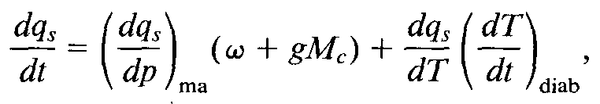
Large-scale lifting, diabatic cooling
The formation of cloud water is determined by the rate at which the saturation specific humidity decrease.
ω: area-mean vertical velocity
M_{c} : cumulus-induced subsidence
(dT/dt)_{diab} : the net temperature tendency due to radiative and turbulent processes including entrainment processes.
Notes:
Ma : the change of qs along the moist adiabat through point.
(dT/dt)diab : the net temperature tendency due to radiative and turbulent processes including entrainment processes.

Slide 8
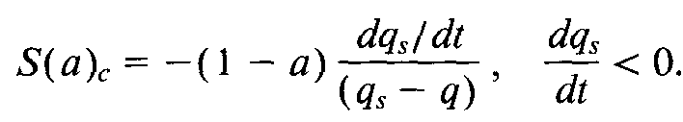

condensation
in exiting clouds
formation of new clouds
The increase in cloud cover is determined by how much of the cloud-free area exceeds saturation within a time step.
: the fractional cloud cover produced per time step
Notes:
New clouds are assumed to form when the grid averaged relative humidity exceeds a threshold value, which is prescribed to be 80% at 650 mb and increasing toward 100% as boundary layer and stratosphere are approached.

Slide 9

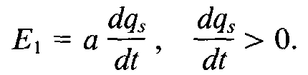


Evaporation of clouds
1. in connection with large-scale descent
2. by turbulent mixing of cloud air and unsaturated environmental air
: cloud water content per cloud area
Diffusion coefficient :

Slide 10

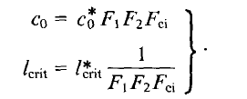

Precipitation processes
The conversion of cloud water into rain:
$C_{0}^{}$: characteristic time scale for conversion of cloud droplets into drops
l_{crit} : typical cloud water content at which the release of precipitation begins to be efficient
F₁ : the effect of collection of cloud droplets
F₂: Bergeron-Findeisen process
F₃: the case of cirrus clouds
Sundqvist (1988)

Slide 11
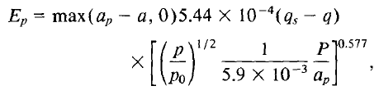
Rain evaporation: [Kessler’s scheme (Kessler 1969)]
a : fractional precipitation area
a_{p}-a : cloud-free area where precipitation occurs

Slide 12
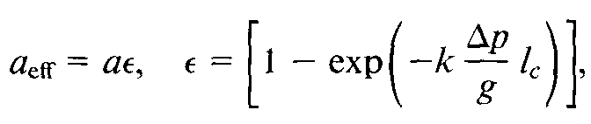
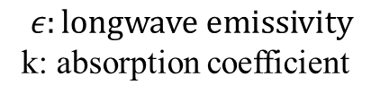
Cloud cover
(c) Satellite-observed mean cloud cover
(ISCCP)
Initial time: 1200 UTC 1 July 1987
30-day mean, T63L31
(b) real cloud cover
(a) Effective cloud cover:
$$ε:longwave emissivity$$
k: absorption coefficient
Notes:
Optical thickness: 光學厚度
Effective cloud cover: 考慮到輻射或光線受到雲粒子的散射或吸收的影響的雲量。

Slide 13
Cloud cover of high-level clouds
(c) Satellite-observed mean cloud cover
(ISCCP)
(b) real cloud cover
(a) Effective cloud cover

Slide 14
Cloud cover of middle- and low-level clouds
(c) Satellite-observed mean cloud cover
(ISCCP, middle + low level cloud)
(b) Low-level cloud cover
(a) Middle-level cloud cover

Slide 15
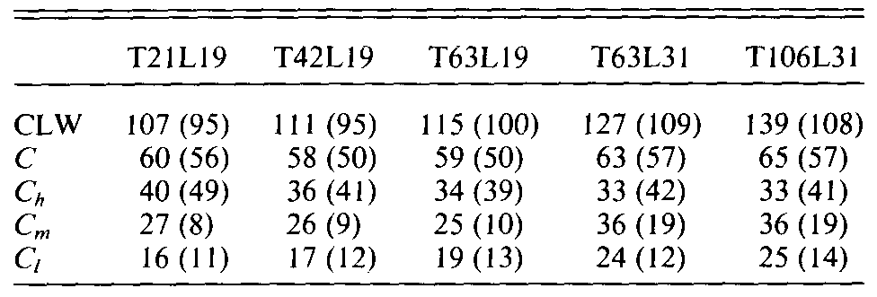
Cloud amounts (%) C : total
C_{h} : high clouds, p/p_{s} < 0.45
C_{m} : medium clouds, 0.45 < p/p_{s} < 0.85
C_{l} : low clouds, p/p_{s} > 0.85

Slide 16
Cloud liquid water content
SSM/I
Prognostic cloud scheme
Contour interval: 80 (g m⁻²)
Shaded : 80 < LWC 560 (g m⁻²)
Blanked out: 560 (g m-2)

Slide 17
Full line: prognostic scheme
Dotted line: SSM/I

Slide 18
Cross sections of zonally averaged cloud water content
ECMWF diagnostic scheme
Prognostic cloud scheme

Slide 19
Scatter diagram of cloud water content
Frequency occurrence (%)
Solid lines: prognostic cloud scheme
Aircraft measurements : crosses = 0~2.5 cm/s (vertical velocity)
triangles = 2.5~10 cm/s
circles = 10~33 cm/s
squares = > 33 cm/s

Slide 20
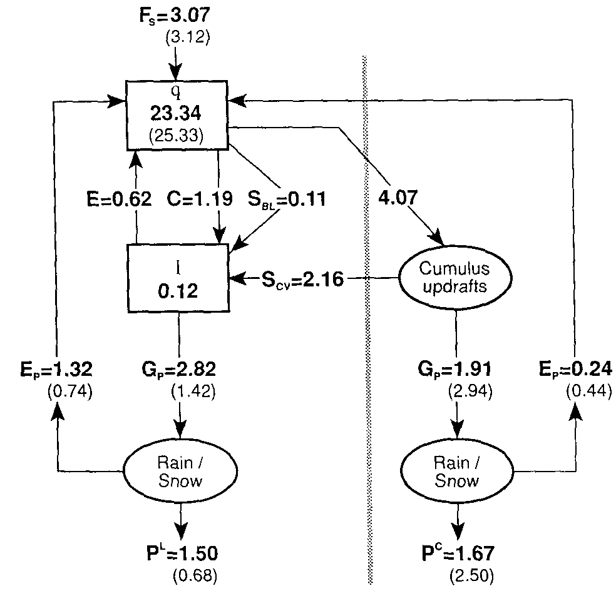
Hydrological cycle (Globally averaged values)
Turbulent surface fluxes
Brackets :
ECMWF operational cloud scheme
Stratiform clouds
cumulus updrafts
q, l: 30-day means (mm)
Conversion terms : mm/day

Slide 21
30-day means
P^{L}: stratiform precipitation
P^{L}+P^{C} : total precipitation
(d) Ensemble of ECMWF
operational forecasts
(c) Climatological estimate for July
[Jager (1976)]
(b) ECMWF diagnostic scheme
(a) Prognostic cloud scheme

Slide 22
Zonally averaged relative humidity
(c) ECMWF analysis
(b) New prognostic scheme
(a) ECMWF operational scheme
Shaded: RH > 60%

Slide 23
conclusions
Improvements in tropical cloudiness:
New cloud scheme -
the time evolution of clouds from optically thick anvil clouds to transmissive cirrus clouds is considered.
Operational scheme -
Cloud water detrained from updraft is assumed to evaporate instantly.
Notes:
1.

Slide 24
conclusions
Stratiform clouds:
New cloud scheme -
The formation of clouds are linked closely to the large-scale ascent and diabatic processes.
Operational scheme -
Empirical relationships

Slide 25
Future refinements
Distinction of cloud water and cloud ice:
Temperature > prognostic equations
Insufficient shallow cumulus in the tropics:
Bimodal distributions of the detrainment of cloud air
Turbulent transports related to cloud processes, which have been ignored.

