Slide 1
An Information-Theoretical Score (ITS) of
Dichotomous(分岔) Precipitation Forecast
Fekri and Yau (2016, MWR)
1. a hypothetical forecast setup is employed to investigate the responses of the scores to bias, phase (location) error, and event frequency
the desirable mutual information portion of ITS (C⁺) is closer to TSS(true skill statistics)
the undesirable mutual information portion of ITS (C⁻) reveals the presence of biases and random errors in the forecast
There is also a similarity between ITS and ETS.
2. The sensitivities of ITS and ETS to forecast bias tendency are examined analytically using the critical performance ratio (CPR).
ITS has a more dynamical response to incremental bias
By increasing the bias, the CPR value of ITS increases more rapidly than that of ETS indicating a higher resistance to hedging(限制、衝突).
3. the skill scores on two sets of operational forecasts are applied with respect to a mosaic of observed radar reflectivity
ITS remains more consistent in its evaluation of skills at different thresholds compared to other scores

Slide 2
1. Introduction
1. A number of recurrent questions exist about the true skill of precipitation forecasts, including the sensitivity of the scores to bias, location error, and event frequency.
2. bias can skew scores: a wet-biased forecast with a larger bias to score better than a slightly more skillful but unbiased forecast
This higher score is believed to be a consequence of the inflated(擴大) coverage of the precipitation and not an indication of actual forecast skill.
3. The information-theoretical analysis of the forecasts provides a measure of the entropy of forecast compared to the entropy of the observation.
4. conventional scores: identify objective similarities between forecast and observation
information-based scores: the mutual information includes every organized similarity that can be desirable or undesirable
5. The C⁺ index indicates desirable similarity and C⁻ represents the undesirable similarity (or dissimilarity) between forecast and observation.

Slide 3
2. Formulation of scores
1. p_{r}: the probability of rain on grid point
1-p_{r}: the probability of no-rain on grid point
2. [the total information of a closed set of events] = [the entropy function]
3. the entropy function S(F) for any set of binary forecast data F:
the logarithm with base 2 and the information is given in units of bytes
G(total entropy) ≦ O(entropy) + F(entropy)
G = O + F => O and F are totally random and statistically independent
the difference between the entropy of G and the sum of the entropies of O and F can be regarded as the interdependence(互相依賴) of O and F (Watanabe 1969)
This interdependence is also called the mutual information or joint information J, which is always greater than or equal to zero:

Slide 4
2. Formulation of scores
4. a: correct hits
b: false alarms
c: misses
d: correct negatives
5.
6. direct similarity C⁺ and dissimilarity C⁻ of binary sets
perfect similarity between forecast and observation:
a + d = 1, b = 0, c = 0 ==> C⁺ maximum, C⁻ = 0
forecast and observation are exact opposites:
b + c = 1, a = 0, d = 0 ==> C⁺ = 0, C⁻ maximum

Slide 5
2. Formulation of scores
7.
8. the maximum possible value of joint information is always less than or equal to the entropy of observation:
9. normalize the joint information score using the entropy of observation:
10. ITS is a dimensionless, nonnegative value equal to or smaller than 1
ITS is the ratio of the mutual information to the observation information
11. +C⁺: systematic similarity between prediction and observation that contributes positively to the total score
-C⁺: the similarities are random, and dissimilarities are prominent
C⁺ = 0 is the threshold below which the forecast has no desired skill
+C⁻: systematic dissimilarity between forecast and observation that contributes positively to the score but must come from a serious error in the forecast
-C⁻: negates some of the total joint information and indicates the magnitude of the random errors

Slide 6
2. Formulation of scores
Prefigurance(前估), probability of detection：a/(a+c) = hit/(hit+miss)
Post agreement(後符)： a/(a+b) = hit/(hit+false alarm)

Slide 7
Rainfall validation （Schaefer, Wea. Forecasting, 1990）
Threat Score (value: 0 = no ability ~ 1 = best)
= (n11)/(n11+n10+n01)
Equitable Threat Score (value: -1/3 ~ 0 = no ability ~ 1 = best)
= (n11-R)/(n11+n10+n01-R)
R (random hit) = [(n11+n10)/N] × [(n11+n01)/N] × N
Bias Score (value: 0~ ∞, best = 1)
= (n11+n10)/(n11+n01)
Base Rate = (n11+n01)/N
Forecast Rate = (n11+n10)/N
Observed
yes
≧threshold
no
＜threshold
O
Forecast
F
n01
yes
≧threshold
hit
(n11, a)
false alarm
(n10, b)
n10
n11
n00
no
＜threshold
miss
(n01, c)
correct negative hit
(n00, d)

Slide 8
Statistics issues:
1. Classified method (分類統計法) vs. point-to-point
Classified method: sort and count the numbers above the threshold of F and O, the minimum is n11
point-to-point: same as traditional method
2. Evaluation by TS, ETS, and the definition of R (random hit)
(Wang 2014, Wea. Forecasting, Schaefer 1990, Wea. Forecasting)
R = F×(O/N) = O×(F/N) = expected value of random hit
point × (chance of random hit)
If (O/N): N = total stations
If (F/N): N = total model domain grid points
Should O define by single simulation or climatologic value?

Slide 9
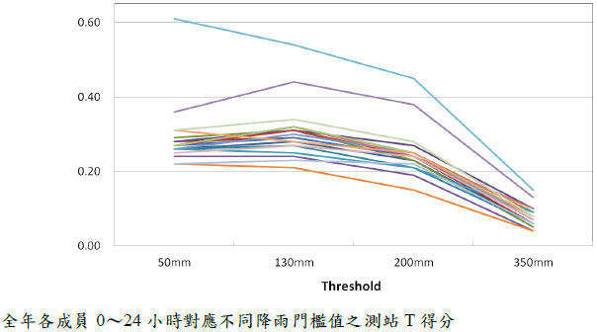
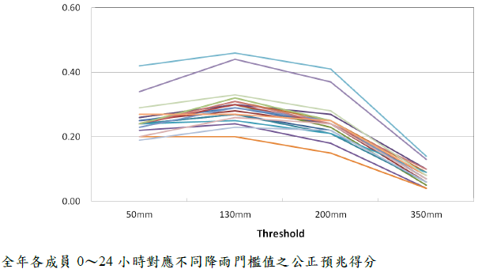
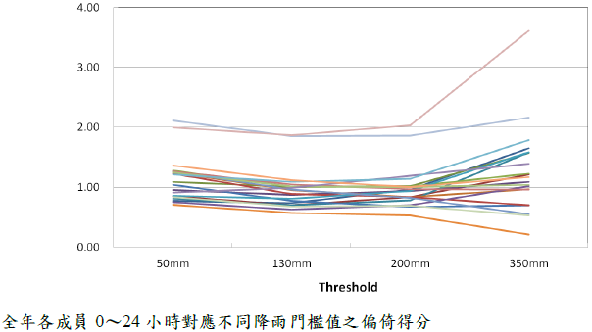
Rainfall validation: Classified statistics (分類統計法)
stdcase | TS | ETS | BS | BR | FR
50 | 0.771 | 0.592 | 0.901 | 0.524 | 0.472
100 | 0.699 | 0.611 | 0.812 | 0.297 | 0.241
130 | 0.658 | 0.598 | 0.738 | 0.211 | 0.156
150 | 0.619 | 0.571 | 0.722 | 0.165 | 0.119
200 | 0.530 | 0.503 | 0.673 | 0.088 | 0.059
250 | 0.460 | 0.445 | 0.592 | 0.050 | 0.030
300 | 0.439 | 0.431 | 0.489 | 0.029 | 0.014
350 | 0.397 | 0.393 | 0.475 | 0.016 | 0.008
pcase | TS | ETS | BS | BR | FR
50 | 0.854 | 0.621 | 0.949 | 0.680 | 0.645
100 | 0.801 | 0.635 | 0.929 | 0.524 | 0.487
130 | 0.777 | 0.640 | 0.901 | 0.452 | 0.407
150 | 0.763 | 0.642 | 0.899 | 0.407 | 0.366
200 | 0.739 | 0.651 | 0.863 | 0.313 | 0.270
250 | 0.677 | 0.604 | 0.827 | 0.241 | 0.199
300 | 0.634 | 0.575 | 0.759 | 0.194 | 0.148
350 | 0.602 | 0.556 | 0.715 | 0.156 | 0.112
TS
ETS
BS
NOTE: scores of TTFRI is for river-regions

Slide 10
Rainfall validation: CWB station vs. CReSS CTRL interpolated
stdcase | TS | ETS | BS | BR | FR
50 | 0.641 | 0.394 | 0.900 | 0.524 | 0.472
100 | 0.477 | 0.350 | 0.811 | 0.297 | 0.241
130 | 0.420 | 0.336 | 0.738 | 0.211 | 0.155
150 | 0.375 | 0.310 | 0.722 | 0.165 | 0.119
200 | 0.307 | 0.273 | 0.673 | 0.088 | 0.059
250 | 0.255 | 0.237 | 0.592 | 0.050 | 0.030
300 | 0.267 | 0.258 | 0.489 | 0.028 | 0.014
350 | 0.237 | 0.232 | 0.475 | 0.016 | 0.008
pcase | TS | ETS | BS | BR | FR
50 | 0.746 | 0.400 | 0.948 | 0.679 | 0.644
100 | 0.666 | 0.425 | 0.930 | 0.523 | 0.486
130 | 0.617 | 0.415 | 0.900 | 0.451 | 0.406
150 | 0.588 | 0.407 | 0.899 | 0.406 | 0.365
200 | 0.530 | 0.396 | 0.863 | 0.312 | 0.269
250 | 0.479 | 0.379 | 0.827 | 0.240 | 0.199
300 | 0.442 | 0.365 | 0.759 | 0.194 | 0.147
350 | 0.408 | 0.348 | 0.715 | 0.156 | 0.112
TS
ETS
BS
NOTE: scores of TTFRI is for river-regions

Slide 11
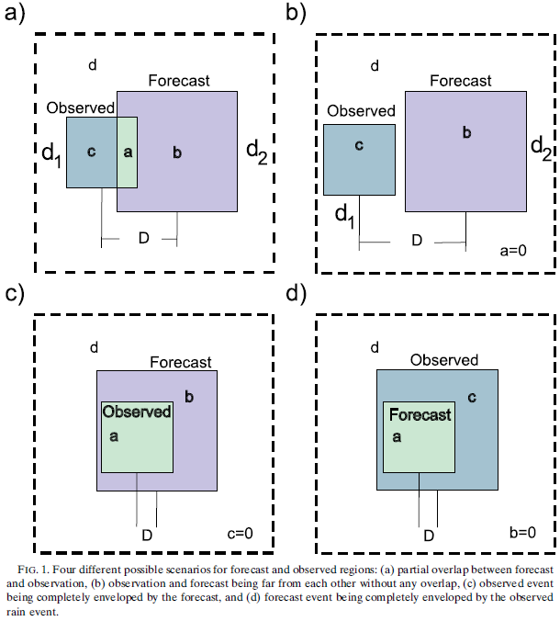
3. Hypothetical test
1. event frequency α = d₁²
forecast coverage d₂²
forecast bias B = (d₂/d₁)²
rare event α = 0.04
common event α = 0.16
very common event α = 0.36
2. The 2×2 contingency table is
calculated as a function of
displacement D and bias B
and then scores of forecast
skills are computed.

Slide 12
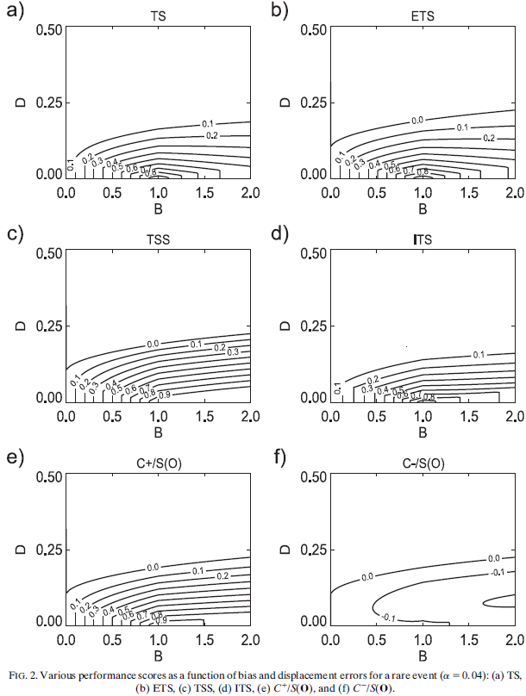
3. Hypothetical test: a. Rare event
3. The best score: B=1 and D=0
4. B<1 and D<0.1: the forecast square
is completely contained within the
observed square, the contours
become parallel to the D axis
5. TSS is the only score that does
not penalize false alarms [??]
6. The normalized C⁻ reveals how the
ITS score is affected by random
errors

Slide 13
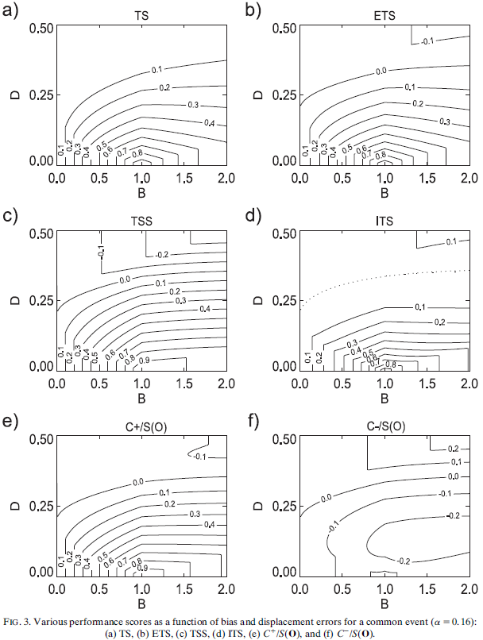
3. Hypothetical test: b. Common event
7. The dotted line in Fig. 3d shows
the region of the minimum score
where the ITS becomes very close
to zero.
8. upper-right quadrant of the figures:
At very large bias, the forecast
square becomes large enough that
it overlaps the observation square
to generate some hits
ETS and TSS both become negative
TS remains insensitive
ITS becomes larger than zero
C⁻ becomes positive
C⁺ takes on negative values
ITS is associated with systematic
dissimilarity and not the usual
systematic similarity

Slide 14
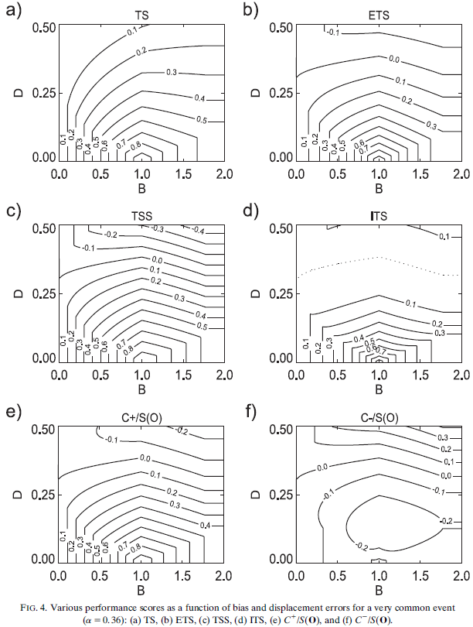
3. Hypothetical test: c. Very common event
9. high bias values (B>1.7): the sum
of the areas of observation and
forecast becomes more than the
reference area
the score values are insensitive
to B>1.7 and the contours become
parallel to the B axis

Slide 15
3. Hypothetical test: c. Very common event
10. Some researchers argue that the small phase error in the high-resolution NWP models contributes to the total amount of random forecast error.
11. Spatial forecast verification methods such as fractions skill score (FSS) serve that purpose (Mittermaier and Roberts 2010).
12. Another method is to consider joint histograms and contingency methods together (Hogan et al. 2009).
13. In traditional contingency methods there is no difference between errors caused by phase error or any other sources of error.
14. The C⁻ portion of ITS seems to provide a measure for errors caused by small perturbations such as small phase errors.

Slide 16
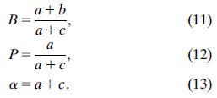
4. Analytical assessment of sensitivities
1. bias: B
probability of detection: P
event frequency: α = constant
==>
2. CPR(critical performance ratio, ρ):

Slide 17
4. Analytical assessment of sensitivities
3. comparing CPR to the small changes of P relative to the small change in B specifies the condition for improvement of scores
4. The quantity ΔP/ΔB can be explained as the fraction of hit that is added or removed by changing a fraction of bias.
: when bias is increasing ΔB>0, improvement in score happens if
the ratio of added hits beats CPR
: when bias is decreasing ΔB<0, the ratio of removed hits has to
be smaller than CPR to allow for improvement of the score

Slide 18
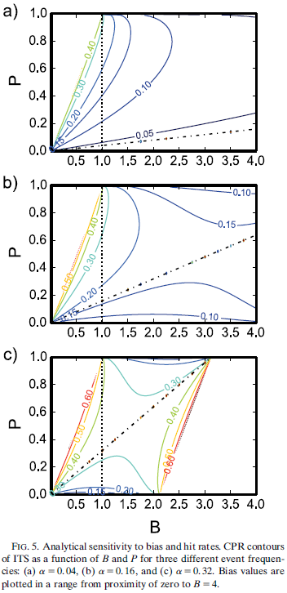
4. Analytical assessment of sensitivities
5. The comparison between event frequencies shows
that more common events are associated with
higher ITS CPR values and sharper CPR gradients
along the B and P axes.
6. The dotted vertical line indicates an unbiased
situation where B=1.
7. The slanting dash–dotted lines indicate P=αB,
it specifies the expected score of random
forecasts.
The area above (below) this line designates
forecasts that are performing more (less)
skillfully than a random forecast.

Slide 19
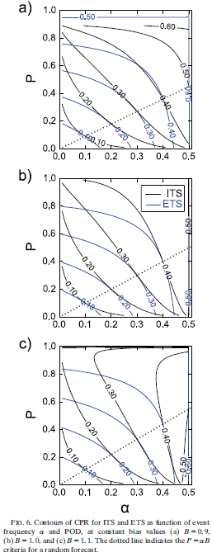
4. Analytical assessment of sensitivities
8. The dotted line again indicates the P=αB criterion.
9. CPR values of ETS and ITS both increase as P and α
increase, meaning that it becomes more difficult to
improve forecasts by increasing bias at higher scores
and event frequencies
10. B<1: dry-biased forecast: both ETS and the ITS CPRs
have larger values and greater gradients.
However, the relative increase in the magnitude
and gradient of the ITS CPR is more noticeable,
especially at higher POD values
B>1: wet-biased forecast
11. in both ETS and ITS scores, CPR contours respond to
changes in bias by resisting against the direction
of bias improvements. The ETS CPR contours change
slightly in the space of P and α, but the ITS CPR
changes markedly and shows a dynamic resistance to
hedging by bias

Slide 20
5. Application in real forecast and observations
1. NOAA CAPS 10 WRF members, 30-h(00～06Z), 4km resolution, no assimilation
2. CMC GEM model, 15km resolution, 58 levels topped at 10 hPa, assimilated satellite radiance
3. NSSL radar reflectivity mosaic, 1km resolution, CAPPI at 2.5km
4. 6-h rain rate: accumulating the instantaneous rain rates at every 15 min during the periods between 0000, 0600, 1200, and 1800 UTC, remapped to 16-km resolution
5. domain: the central and eastern US from 103°~78°W and 32°~45°N
duration: 4/16~6/6 2008, 540h, 90 cases of 6-h accumulations

Slide 21
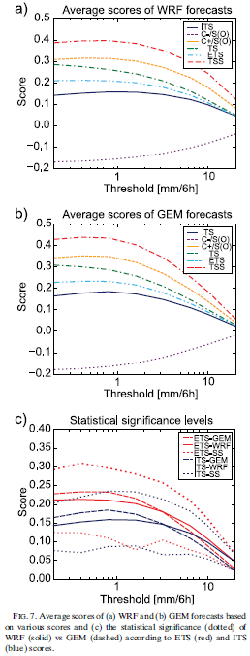
5. Application in real forecast and observations
6. Figures 7a and 7b show various performance
scores of two independent precipitation
forecasts (WRF based and GEM based)
compared to the radar observations averaged
over 90 cases of 6-h accumulations.
7. different scores as a function of event
thresholds or precipitation intensities
8. C⁻ shows more negative scores at lower
thresholds:
there are more random errors associated
with small-scale features

Slide 22
5. Application in real forecast and observations
9. Dotted lines above (below) the averaged WRF score indicate the level that GEM has to reach in order to prove (disprove) the null hypothesis with a
statistical significance.
10. The ITS has the smallest value on average. However, the reduced magnitude
of ITS scores reduces the temporal variance in the score differences and,
therefore, increases the statistical confidence.
11. GEM ITS score needs a relatively smaller
increase (from 0.17 to 0.20) to reach the
statistical significance level than that of
the GEM ETS (from 0.23 to 0.30).
12. The former roughly corresponds to an 18%
increase in the relative average score
magnitude while the latter requires a 30%
increase.

Slide 23
6. Discussion and conclusions
1. the C⁺ index of ITS has a comparable behavior with respect to other
traditional scores, especially TSS
2. the C⁻ index provides additional information about the inaccuracies
of the forecast
3. The accumulative contribution of C⁺ and C⁻ results in an ITS score that
in most cases of the hypothetical test showed resemblance with ETS. Although
total ITS decreases as the error increases, the decrease of C⁺ has a
different interpretation than the negative contribution of C⁻.
4. The ITS formulation originates directly from information theory, and its
meaning is understandable in terms of entropy.
5. A comparison between the sensitivity of ETS and ITS to small changes in
bias and hit rate indicated that both scores have a natural resistance to
further change because of their increasing CPR. The existence of a higher
resisting sensitivity for ITS against hedging by bias.

Slide 24
6. Discussion and conclusions
6. When we consider forecast scores at multiple thresholds, the observed event
frequency becomes a function of the threshold to affect the consistency of
the forecast evaluation. The ITS is not as much affected by the observed
event frequency compared to other scores.
7. The ITS is an attractive alternative measure for the evaluation of
precipitation forecasts.

