Slide 1
Water Budget of Typhoon Nari(2001)
Yang, M.-J.*, S. A. Braun, and D.-S. Chen, 2011: Water budget of Typhoon Nari (2001). Mon. Wea. Rev., 139, 3809-3828, doi: 10.1175/MWR-D-10-05090.1. (SCI)

Slide 2
Outline
Introduction
Model description
Budget formulation
Result
a. water vapor budget
b. condensed water budget
c. Vertically integrated sources and sinks
d. Volume-integrated budget
e. precipitation efficiencies
conclusion

Slide 3
Introduction
Although there have been many observational and modeling studies of tropical cyclones (TCs), the understanding of TCs’ budgets of vapor and condensate and the changes of budgets after TCs’ landfall is still quite limited.
high-resolution (2-km horizontal grid size and 2-min data interval) model output from a cloud-resolving simulation of Typhoon Nari (2001) is used to examine the vapor and condensate budgets and the respective changes of the budgets after Nari’s landfall on Taiwan.

Slide 4
Introduction
1st objective: investigating the evolution of the water vapor, cloud, and precipitation budgets during Nari’s landfall on Taiwan, especially for the transition from the more axisymmetric structure over the ocean to the highly asymmetric structure over the mountains.
2nd objective: understanding what portions of the heavy rainfall from Nari were produced in situ, and what portions of rainfall were produced by moisture transported from the surrounding oceanic environment.
3rd objective: examining whether the precipitation efficiency is indeed increased after Nari’s landfall on the mountainous island of Taiwan.

Slide 5
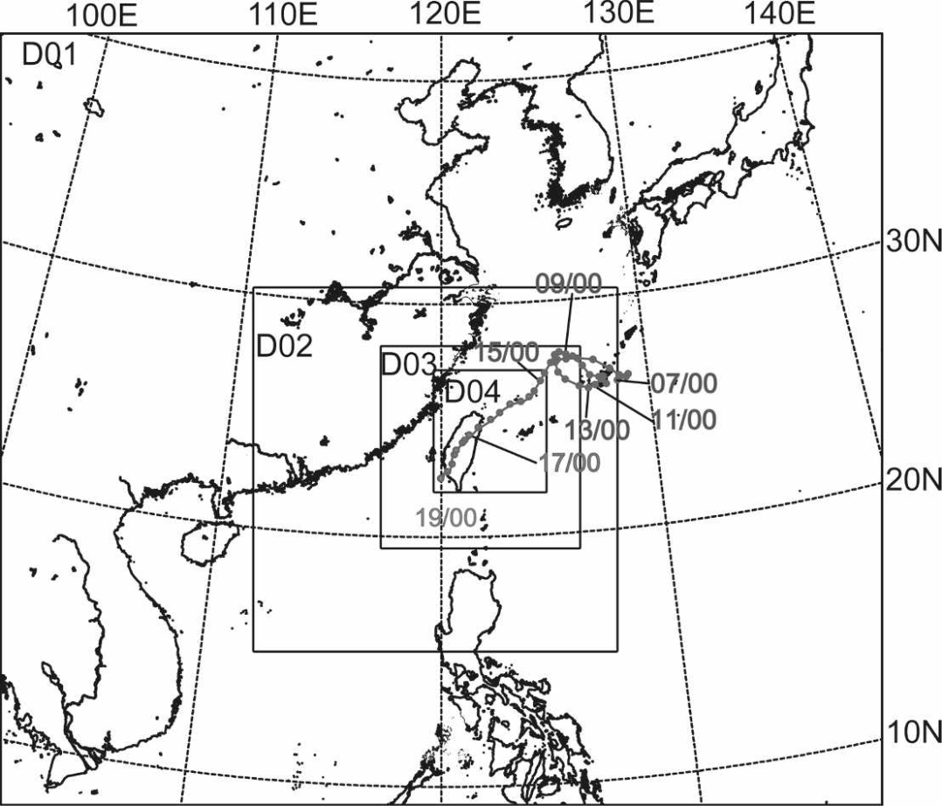
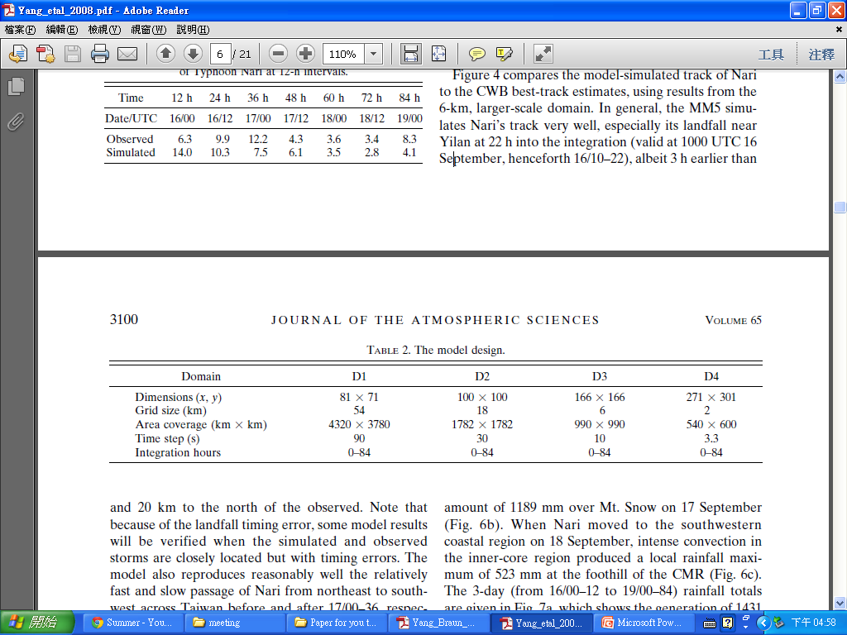
Model description
A nonhydrostatic version of the PSU–NCAR MM5 model
nested grid (54, 18, 6, and 2 km)domains.
high-resolution model output from a cloud-resolving simulation
1200UTC 15 September 2001 ~ 0000UTC 19 September 2001
2-km horizontal grid size
(x, y, σ) : 271 ×301 × 32 grid points
Covering area : 540 km × 600 km
3-ice microphysics scheme

Slide 6
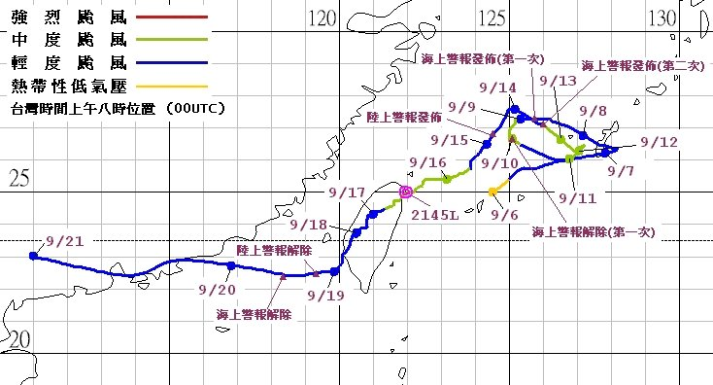
Model description
Ocean stage: 13–14 h
(0100–0200 UTC 16 September 2001)
landfall stage: 23.5–24.5 h
(1130–1230 UTC 16 September 2001)

Slide 7
Simulated structures
(Ocean stage)
Ocean stage: 13–14 h
Quasi-axisymmetric structure
Color shading
simulated radar reflectivity
Contour in (a) and (d)
storm-relative radial velocities
Contours in (b) and (c)
vertical velocities
Strong radial inflow(-26m/s) near the surface
Radial outflow 14m/s at the upper level.

Slide 8
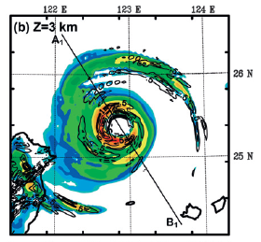
Simulated structures (Ocean stage)
Color shading in(a)(c)
simulated radar reflectivity.
Blue shading in(b)
cloud water mixing ratio
Thick contour in (a)(b)
vertical velocity
q_{l}>2g/kg
Thin contours in (b)
red line is 0ºC isotherm.
Contours in (c)
storm-relative radial velocity.

Slide 9
Simulated structures (Ocean stage)
(a) tangential velocity
(b) radial velocity
(c) vertical velocity
(d) water vapor mixing ratio
(e) cloud water and ice mixing ratios
(f) rain ,snow , and graupel mixing ratios

Slide 10
Simulated structures (Land stage)

Slide 11
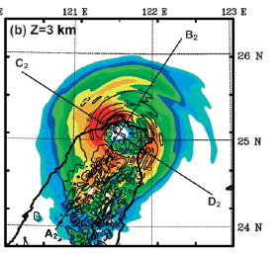
60m/s
(a) tangential velocity
(b) radial velocity
(c) vertical velocity
(d) water vapor mixing ratio
(e) cloud water and ice mixing ratios
(f) rain ,snow , and graupel mixing ratios

Slide 12
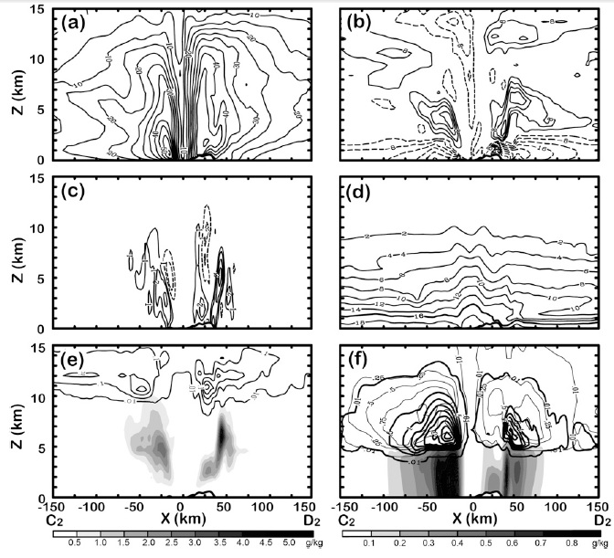
(a) tangential velocity
(b) radial velocity
(c) vertical velocity
(d) water vapor mixing ratio
(e) cloud water and ice mixing ratios
(f) rain ,snow , and graupel mixing ratios

Slide 13
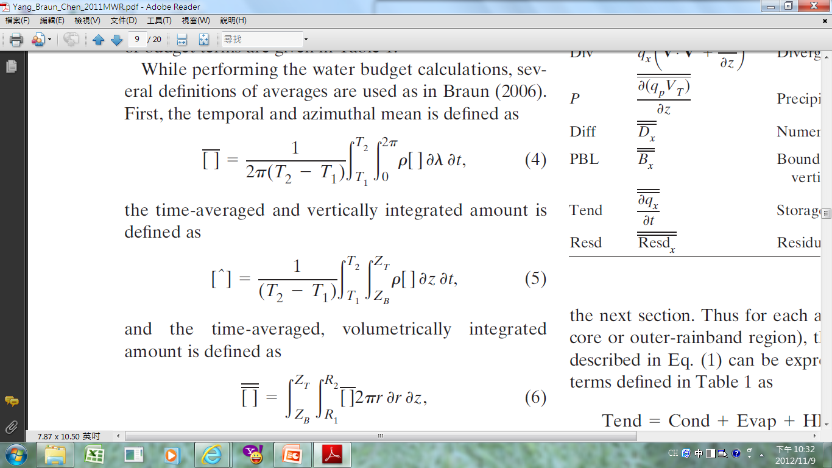
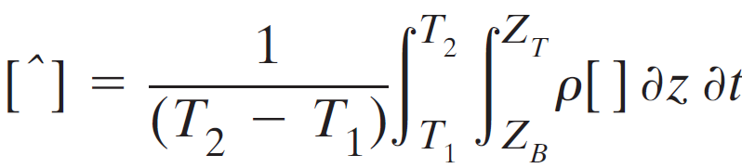
Budget formulation
Cylindrical coordinates (r, λ, z)
TC center :
over ocean: the center of minimum sea level pressure
over land: the primary vortex circulation center at 4-km altitude
Definitions of averages:
temporal and azimuthal mean:
time-averaged and vertically integrated amount:
time-averaged, volumetrically integrated amount:

Slide 14
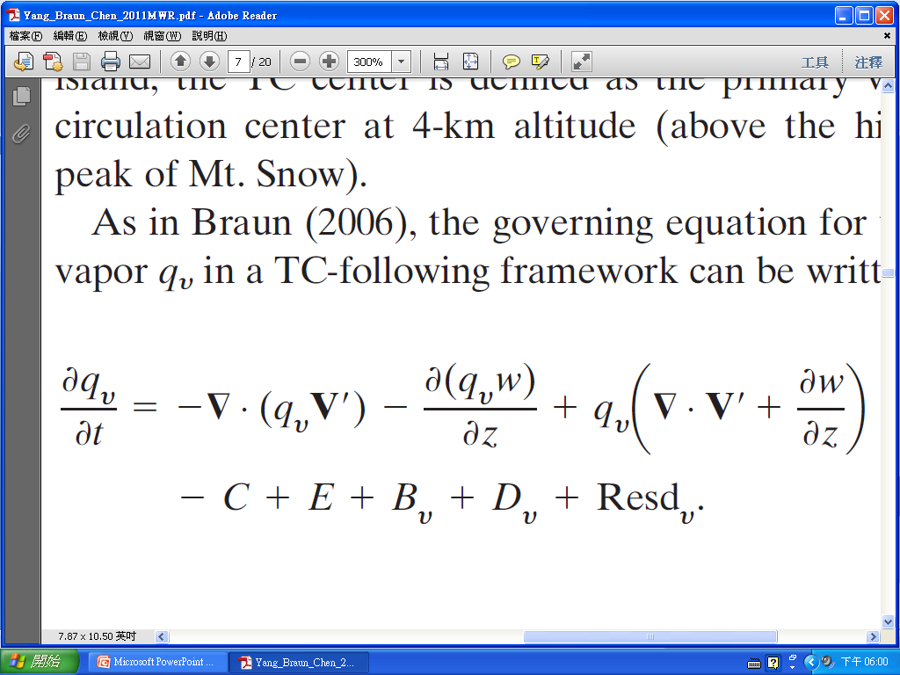
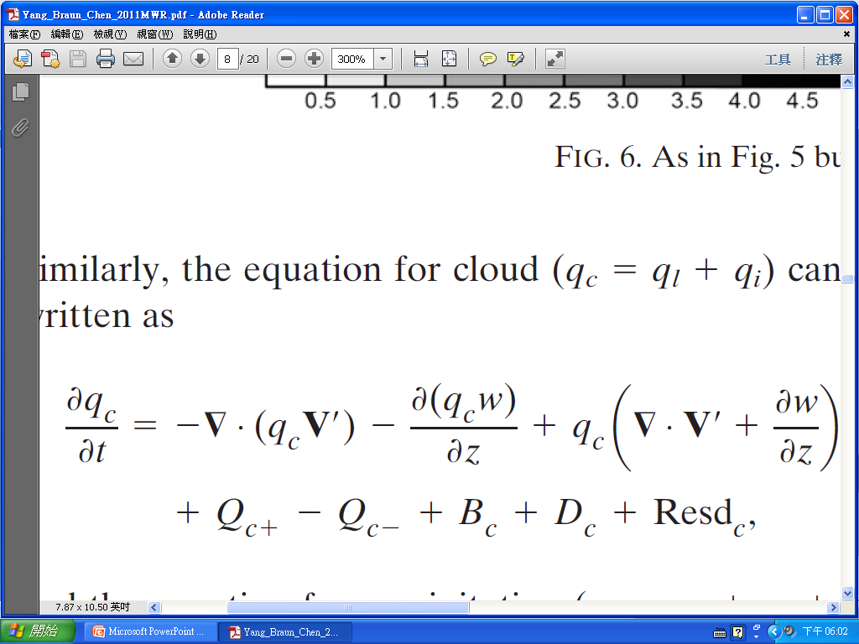
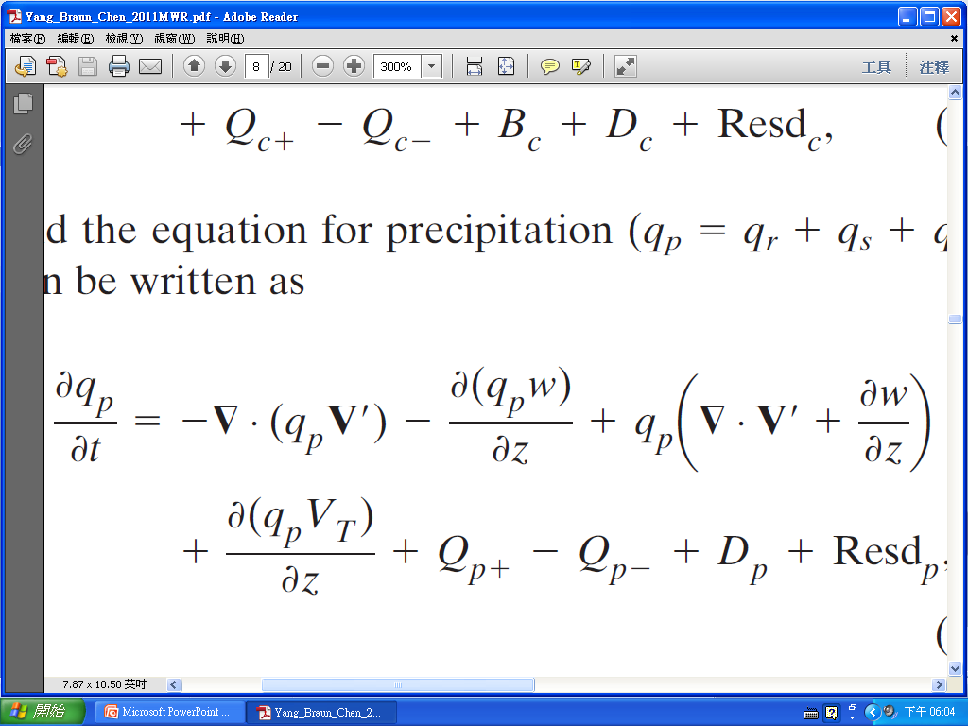
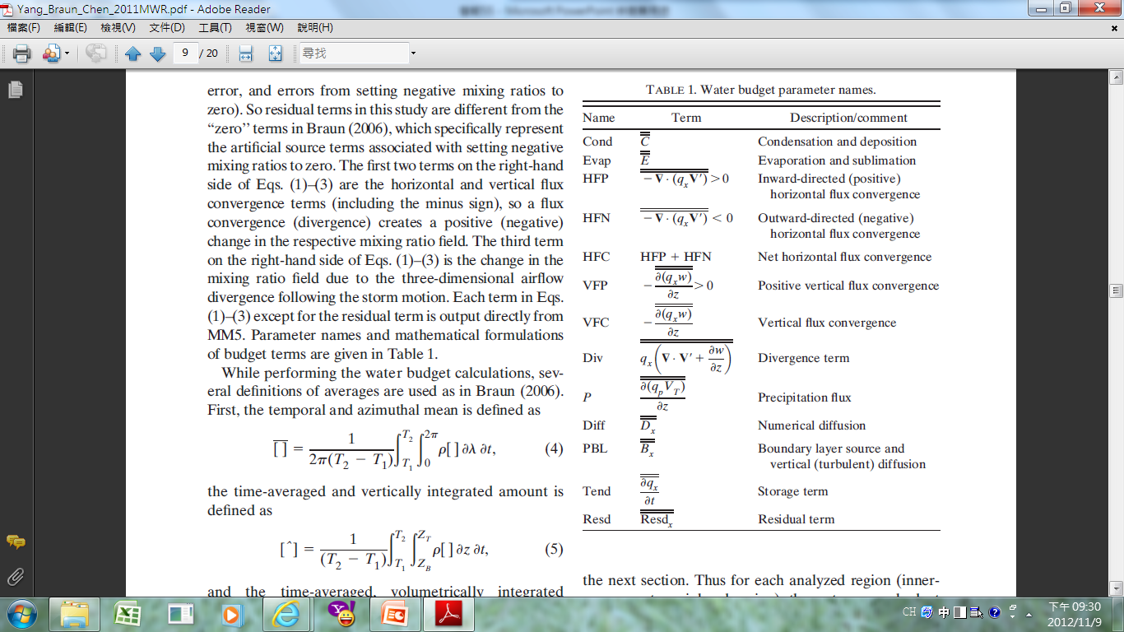
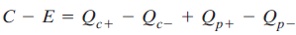
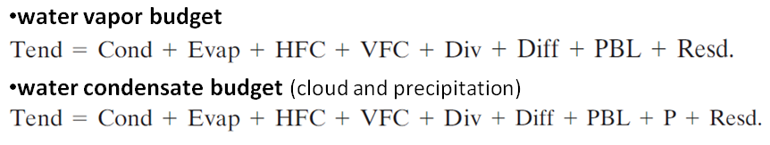
Budget formulation
V’: horizontal air motion
W: vertical air motion
VT: hydrometeor terminal velocities
Water vapor (qv):
Cloud (qc):
Precipitation (qp):

Slide 15
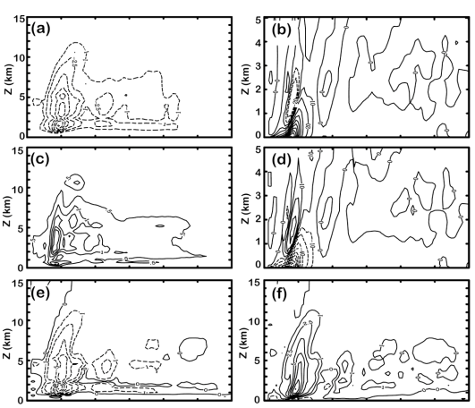
Result(water vapor budget)
Condensation+deposition
HFC
Over ocean
Evaporation
VFC
Sum of (a) and (c)
Sum of (b) and (d)

Slide 16
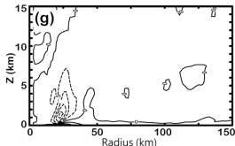
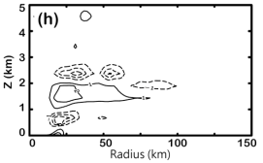
Result(water vapor budget)
Over ocean
Divergence term
Boundary layer source & vertical diffusion term

Slide 17
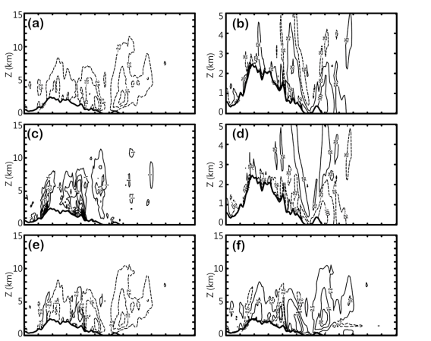
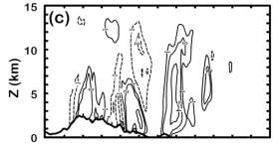
water vapor budget after landfall
Condensation+deposition
HFC
Evaporation
VFC
Sum of (a) and (c)
Sum of (b) and (d)

Slide 18
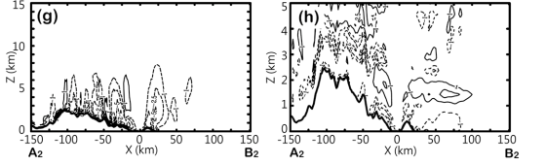
water vapor budget after landfall
Divergence term
Boundary layer source & vertical diffusion term

Slide 19
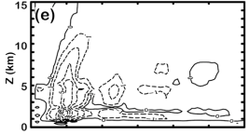
Condensed water budget(ocean stage)
net condensation
HFC
Precipitation
fallout term
VFC
Boundary layer source
Precipitation fallout+
total flux convergence

Slide 20
Condensed water budget(ocean stage)
Source
sink
rain
graupel
snow

Slide 21
Condensed water budget(after landfall)
HFC
Net condensation
VFC
Precipitation fallout
Precipitation + HFC+VFC

Slide 22
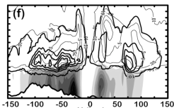
vertically integrated sources and sinks
Over ocean
Landfall stage
Total rain source
Warm rain source
Cold rain source

Slide 23
vertically integrated sources and sinks
Ocean stage
Landfall stage
condensation
evaporation
Precipitation fallout

Slide 24
Volume-integrated budgets
87.8%=(46.9/53.4)
10.9%[(1.3+4.7)/(23.5+31.3)]
5.5%(1.3/23.5)
15%(4.7/31.3)
122.3%(80.6/65.9)

Slide 25
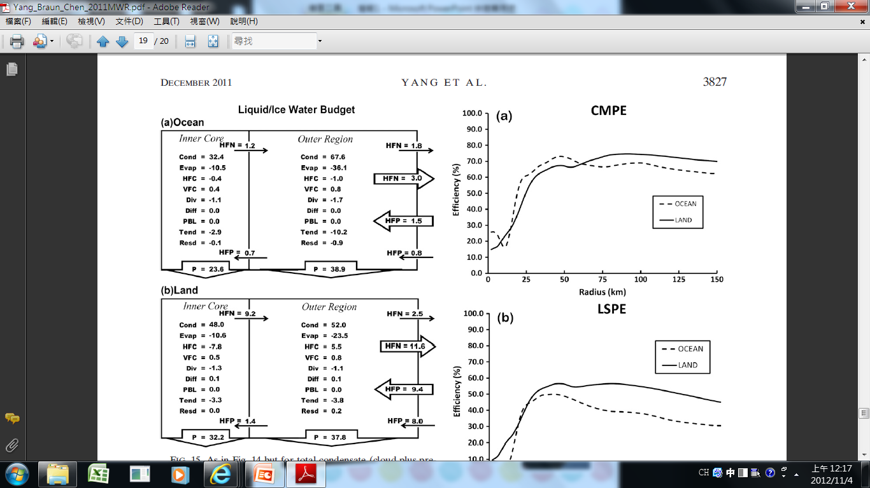
Volume-integrated budgets
21.9%
37.4%

Slide 26
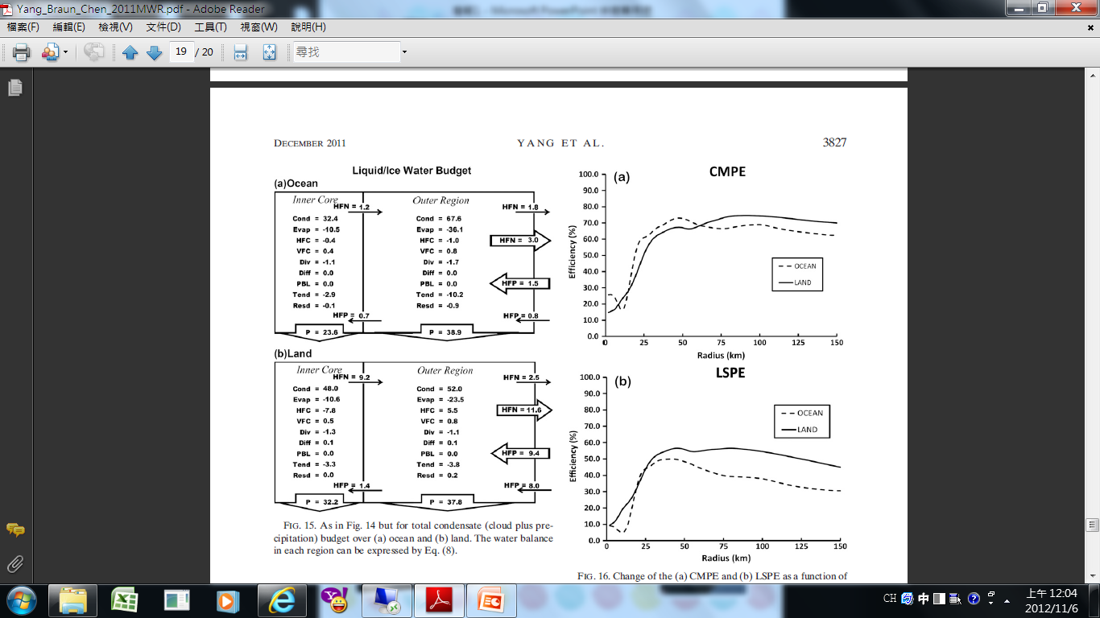
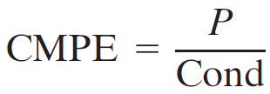
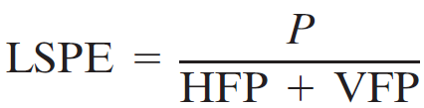
Precipitation efficiency
the cloud microphysics precipitation efficiency (CMPE)
(Total precipitation)
(Total condensation)
the large-scale precipitation efficiency(LPSE)
(Total precipitation)
(Total vapor transport into a large-scale area)

Slide 27
Conclusion
For the vapor budget
1.evaporation from the ocean surface is 11% of the inward horizontal vapor transport within a 150-km radius from the storm center, and the net horizontal vapor convergence into the storm is 88%of the net condensation. The ocean source of water vapor in the inner core is a small portion (5.5%) of horizontal vapor import.
2.After landfall, Taiwan’s steep terrain enhances Nari’s secondary circulation significantly and results in stronger horizontal vapor import at lower levels and more cloud ice and snow export to outer regions at upper levels across the inner core.
3.the net horizontal vapor convergence into the storm within 150 km is increased to 122% of the net condensation after landfall.

Slide 28
Conclusion
For the condensed water budget
1.precipitation particles are falling out as quickly as they are produced.
2.warmrain processes dominate in the eyewall region, while the cold rain processes are comparable to warm rain processes outside of the eyewall.
3.After landfall, cold rain processes are further enhanced above the Taiwan terrain and the storm-total condensation within 150 km of the center is increased by 22%.

Slide 29
Conclusion
Precipitation efficiency
1.Precipitation efficiency, defined from either the large-scale or microphysics perspective, is increased 10%–20% over the outer-rainband region after landfall, in agreement with the enhanced surface rainfall over the complex terrain.

