Slide 1
Powerpoint Presentation Template

Slide 2
Introduction
Motivation for this study
For a reasonable QPF, a realistic hydrometeor size distribution is needed. Different microphysics schemes have different assumption in them, there’s no “panacea” scheme for every purpose
A strategy is needed to evaluate these schemes. How about dual-pol variables?
How to use dual pol radar- derived variables to evaluate microphysical schemes’ performance? In past studies, it is shown that 2M schemes (Morrison, Thompson etc.) produced better storm structure and cold pool compared with 1M schemes (Milbrandt and Yau 2006; Dawson et al. 2010)
Further studies (Jung et al. 2010a, Milbrandt and McTaggart-Cowan 2010) has shown that the reason for 1M schemes’ underperformance is due to the lack of size-sorting effect, which worsens the sedimentation process simulation. Said effect is especially important in supercell thunderstorms.
For a reasonable QPF, a realistic hydrometeor size distribution is needed. Different microphysics schemes have different assumption in them, there’s no “panacea” scheme for every purpose
A strategy is needed to evaluate these schemes. How about dual-pol variables?
How to use dual pol radar- derived variables to evaluate microphysical schemes’ performance? In past studies, it is shown that 2M schemes (Morrison, Thompson etc.) produced better storm structure and cold pool compared with 1M schemes (Milbrandt and Yau 2006; Dawson et al. 2010)
Further studies (Jung et al. 2010a, Milbrandt and McTaggart-Cowan 2010) has shown that the reason for 1M schemes’ underperformance is due to the lack of size-sorting effect, which worsens the sedimentation process simulation. Said effect is especially important in supercell thunderstorms.
01

Slide 3
Introduction
The authors chose an idealized supercell thunderstorm to compare the dual-polarization variable simulation between different microphysical schemes
(Reason: Dual-pol signatures for supercells are very well documented and researched)
Schematic diagram for dual-pol signatures
in supercells (Kumjian 2013b)
02

Slide 4
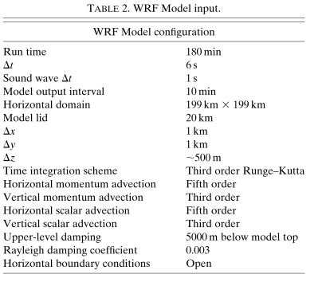
Introduction
Numerical simulation and Polarimetric radar simulator
Sounding used in WRF model (Weisman and Klemp 1982)
03
Notes:
This is the basic WRF model figuration for this study. Some important points regarding the setting include 1. horizontal grid spacing ~1km, with vertical grid spacing ~500m otoh
In terms of thermodynamical setting, Weisman and Klemp (1982)’s sounding is used here, with large CAPE value and slightly drier low tsphere (consistent with Midwest continental environment). It also contains strong VWS and horizontal shear for producing enough h. vorticity to strengthen mesocyclone. This experiment is initialized with ellipsoidal thermal bubble with a theta’=3K

Slide 5
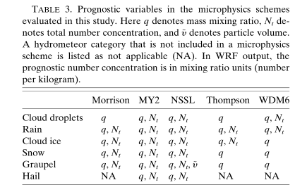
Introduction
Numerical simulation and Polarimetric radar simulator
04
Notes:
The microphysics schemes used in this study is shown in Table3, it’s important to note that some of these schemes are NOT full 2M scheme, as in, it only provides the number concentration for specific hydrometeor categories (eg. WDM6), also some schemes are so called 3ice scheme (do not forecast hail). This has important consequences to the simulated polarimetric result, which will be discussed in the next few slides.
The pic on the left shows the radar simulator used in this study, developed by CAPS at OU, it’s a python-based system that simulates the p. variables associated with a specific wrf run. There are lots of technical settings involved to make as close a simulation to reality as possible. They will be explained briefly in the next slide.

Slide 6
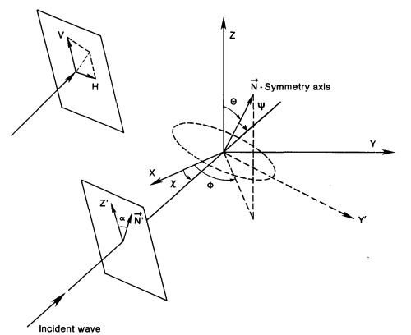
Introduction
Radar Simulator: Some technical issues
“Wet particles”, scattering simulation
In models, as soon as hail/graupel starts melting, its mass is defined as qr, but this is not how it works in real life! There is a need to define a new category: wet graupel/hail
In this model, authors used an iterative method (Dawson et al. 2014) to diagnose the melting process:
Define q_crit over each diameter bin,
q_total>q_crit at a particular time step -> q_r
q_total<q_crit at a particular time step -> q_gr with water fraction
Another issue for radar variable simulation is how to simulate scattering effect by water particles. T-matrix method (Waterman 1969; Vivekanandan et al. 1991) is used in this simulator.
To improve efficiency, a lookup table for different graupel density is used to quickly find out the coefficient for T-matrix
Scattering geometry
05
Notes:
In real life, water is first “soaked” into the graupel itself, then gradually forms a “water shell” on the graupel/hail particle. Therefore, qr in the model can not be simply seen as rain water, some of the qr could be on the graupel particles, this could present difficulty in deducing relationship between reflectivity and real rainrate.
Simply put, the basic idea of T-matrix method is that the radiative field can be expanded in terms of diff geometrical properties (canting angle etc.) Expansion is based on some coefficient which would change after beam is scattered by particles, and we would like to know how these coefficients change.
And from real life, we know that backscatter cross section changes with diameter & particle properties (eg. Water shell), therefore, a consideration for scattering is the graupel density.

Slide 7
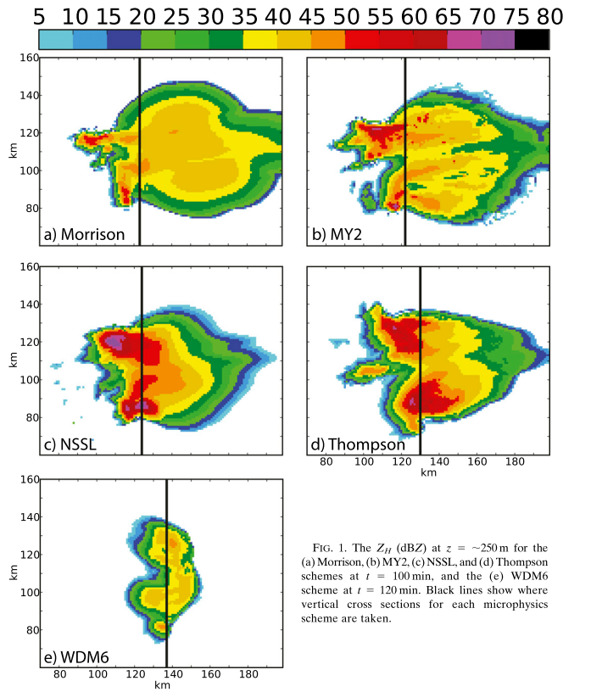
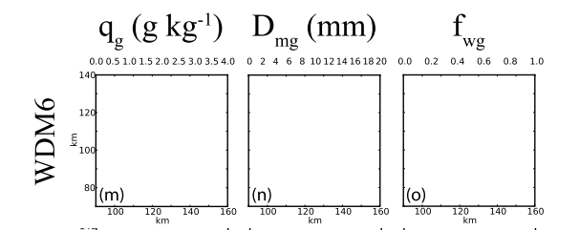
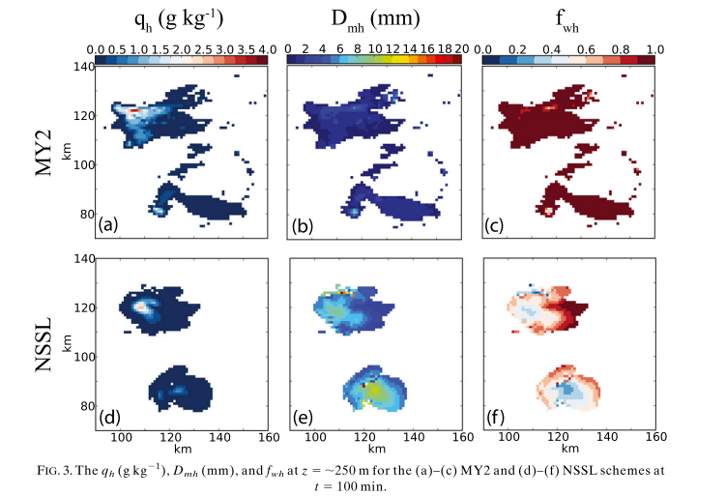
Simulation Results
(1) Basic Reflectivity (Z_H) at ~250m
Low reflectivity value and small FF region: (No graupel reached ground, which inhibits the formation of stratiform rain)
06
Notes:
For an overview of simulation result we can look at the Zh value by diff microphysical schemes. First we notice that WDM6 is noticeably weaker & has a smaller forward-flank, this is due to the fact that no graupel particle reached ground and that weakens stratiform rain immensely (maybe due to 1M ice scheme). Secondly, notice that NSSL, MY2 both simulate storms with intense reflectivity value, this strong Zh is caused by large,wet hail in the area (Fig3)

Slide 8
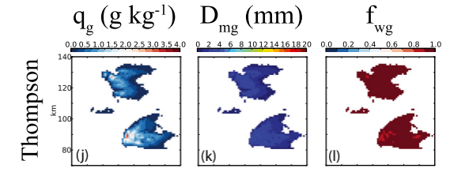
Simulation Results
(1) Basic Reflectivity (Z_H) at ~250m
Large Z_H value: (Medium-sized wet graupel reaches lowest model level, with largest Z_H value coincide with where the largest graupels are)
Relatively low Z_H value: (Only small amount of wet graupel reached lowest level)
07
Notes:
As for others, large overall Zh values are found with and Thompson schemes. Examination of their respective graupel & hail size and amount, it is obvious that large Zh value in Thompson scheme is related to mid-sized wet graupel in the lowest level. As for Morrison, small amount of wet graupel ensures that relatively weak Zh value is simulated.

Slide 9
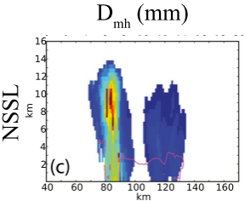
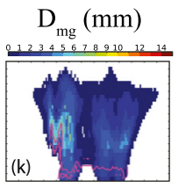
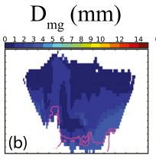
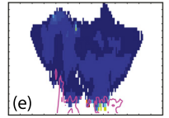
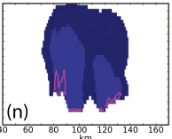
Simulation Results
(1b) Reflectivity cross section
Large vertical reflectivity: relatively large graupel in Thompson scheme; large hail in NSSL scheme
Reflectivity core seems correlated to the location of slightly larger graupel
08
Notes:
Now we show how this reflectivity changes vertically. In these simulations, the schemes that have the strongest Zh value above 0C line are Thompson and NSSL, from the diameter plot it is obvious that (T) larger wet graupel and (NSSL) large,relatively dry hail contribute to this large Zh value. Whereas in other schemes, reflectivity maxima position and strength seemed to be highly correlated to rimed ice, as in, maxima position tends to happen where slightly larger graupel is located. In MY2 scheme, there’s a separate hail variable, but careful comparison shows the amount of hail in MY2 simulation is NOT enough to severely influence the reflectivity value above 0C level.

Slide 10
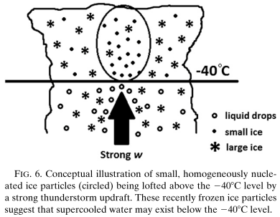
Simulation Results
Polarimetric signatures – I. ZDR, KDP columns
Zdr column: A column of extended Zdr value well above 0C level. The easiest way to identify this feature is the usage of RHI scans.The feature is most likely to located in/on the periphery of strong updraft (Hubbert et al. 1998; Ryzhkov et al. 2008; Rowe et al. 2011)
Easy to imagine the cause of this signature to due to large amount of super-cooled drops and wet ice particle upward transport by strong updraft
(Reinhart et al. 2014)
Example of Zdr column in supercells (Kumjian and Ryzhkov 2008b)
09

Slide 11
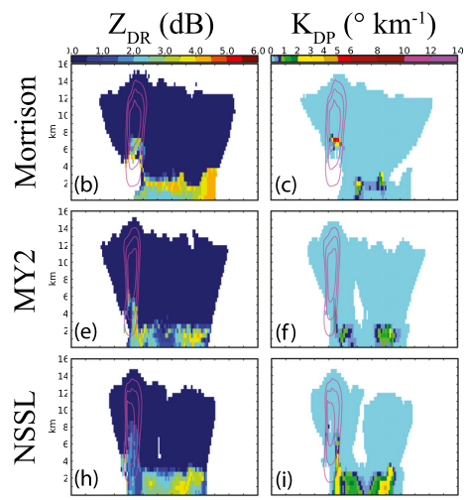
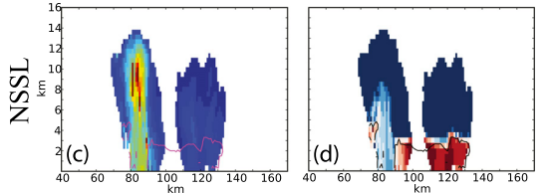
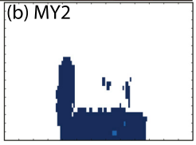
Simulation Results
(2a) Zdr, Kdp column
Weak Zdr, Kdp column in MY2 appears related to low qr value
10
Notes:
Most of these schemes produce vigorous Zdr,Kdp column, but obviously some are stronger, while some weaker. In this figure, purple contour shows the reflectivity value simulated before. Overall, Zdr column seems to be weakest in NSSL scheme. We recall that NSSL simulate large amount of dry, big hail above 0C line, this is the reason NSSL has a low ZDR value as big, dry hail tend to gyrate and tumble, which tend to cause particles appear spherical to radar. We can also see Zdr increase downward, which is caused by the decrease influence of hail and increase influence to larger, oblate rain drop. OTOH, weak Zdr and Kdp column in MY2 is a result of low qr produced by said scheme

Slide 12
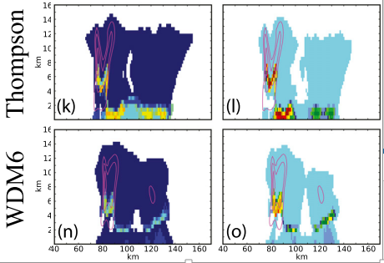
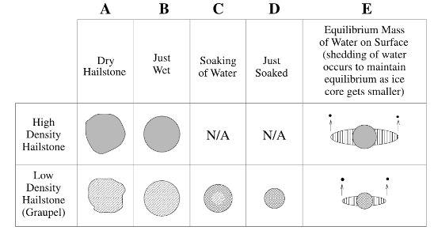
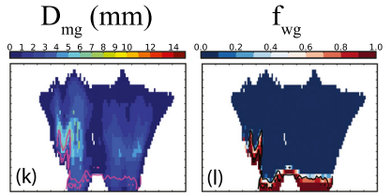
Simulation Results
(2a) Zdr, Kdp column
(Rasmussen and Heymsfield 1987)
11
Notes:
In Thompson scheme, OTOH. Strongest Zdr value can be found at a region that wet but mid-sized graupel are found. At this size (~1cm), wet graupel would produce large Zdr before the water on the graupel surface tend to stick at the equator of the particle in order to stabilize it aerodynamically. This would cause the particle to appear oblated. As for Kdp column, its visibility mainly depends on 2 things: drop size & liquid water mass. In WDM6, the region that has the most drastic decrease of Kdp value so it is region with dramatic decrease of wet graupel value, also notice the increase of small raindrop in this area, all of which encourage this result.
Other interesting discoveries in WDM6 includes enhanced Kdp in left-moving cell (due to slightly oblated raindrops/graupel at this level (notice enhanced Zdr), also the Zdr and Kdp of this scheme is very low near the surface (could be due to lack of graupel near ground and relatively small rain drop size.

Slide 13
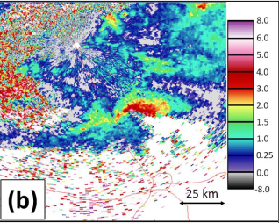
Simulation Results
Polarimetric signatures – II. ZDR arc
Zdr arc: Size sorting of hydrometeors by storm-relative horizontal wind is the culprit of this signature (Ryzhkov et al. 2005; Kumjian and Ryzhkov 2012; Dawson et al. 2015a)
Size sorting of hydrometeors forms Zdr gradient due to differing terminal velocities of different drop size.
Example of Zdr arc in supercells (Kumjian 2013b)
12

Slide 14
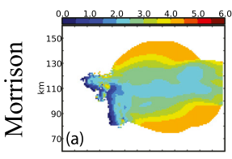
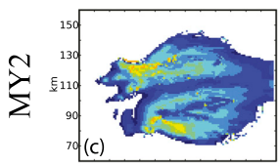
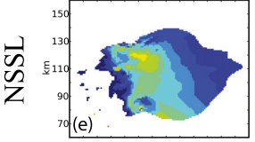
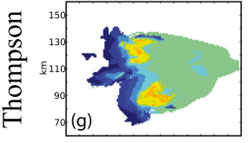
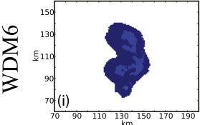
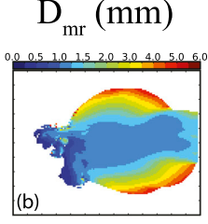
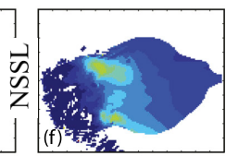
Simulation Results
(2b) Zdr arc
Relatively realistic Zdr arc (NSSL especially so, MY2 slightly farther to the forward flank)
No Zdr arc (1M for graupel species)
13
Notes:
To see if diff schemes could simulate Zdr arc, we look at 250m Zh in horizontal direction. First we notice that Thompson and WDM6 schemes can’t simulate Zdr arc at all, considering both schemes are 1M for graupel species, unrealistic size-sorting simulation of graupel and hail particles seems to be a major hurdle to Zdr arc simulation. OTOH, MY2, NSSL are the 2 models that has the most realistic Zdr arc simulation. Thirdly, Morrison scheme has the strongest, symmetric Zdr arc. This is due to the much larger rain drop diameter in Morrison scheme compare with NSSL/MY2 schemes.

Slide 15
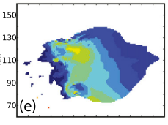
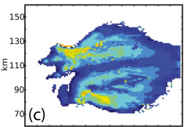
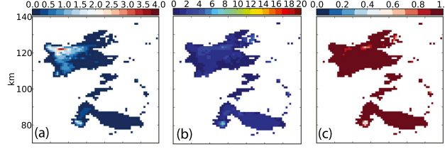
Simulation Results
Polarimetric signatures – III. Hail signature in FFD, Kdp foot
Hail Signature: An area of low Zdr near the surface that is caused by large, dry hailstones
Example of Hail Signature (twitter.com/psu_radarmeteo/)
14
Notes:
The only scheme that produced a hail signature is NSSL scheme (e). This reduced Zdr region is associated with large, dry hail at the lowest level (fig3). MY2 scheme (c) does not have a visible hail signature as the hail that reached ground are mostly quite small and wet, this melting, mid-sized hail would increase Zdr instead.

Slide 16
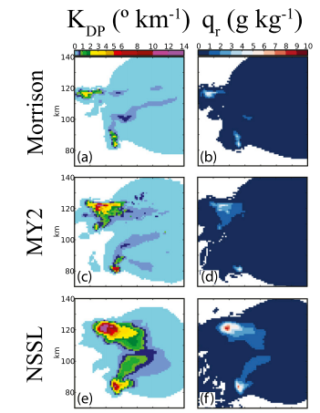
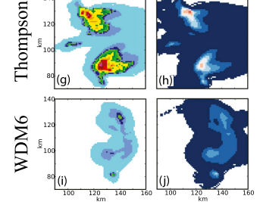
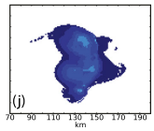
Simulation Results
Polarimetric signatures – III. Hail signature in FFD, Kdp foot
Kdp foot: Region of large Kdp near surface that spans from florward flank into hook region. Magnitude of this signature is sensitive to qr present. As Kdp is less sensitive to large hail, Kdp foot could be a better indicator of heavy rain/melting mid-size hail.
Kdp foot, therefore, can be seen as a good signal for downdraft region (especially for thermodynamically-driven downdraft).
15
Notes:
However, Kdp estimation is difficult in supercells because of frequent non-Rayleigh scatters (large hail) and large Phi-dp gradient, which introduced bias due to non-uniform beam filling
From these diagrams, schemes that has the most visible Kdp foot is Thompson and NSSL scheme (Thompson, large qr value near ground; NSSL, Kdp increase significantly even if qr is only increase modestly from Morrison, large diameter plays a huge role in that)
As for the other schemes, WDM6 scheme’s small Kdp value is due to the small diameter size of its rain drops, MY2-> small qr value near ground)

Slide 17
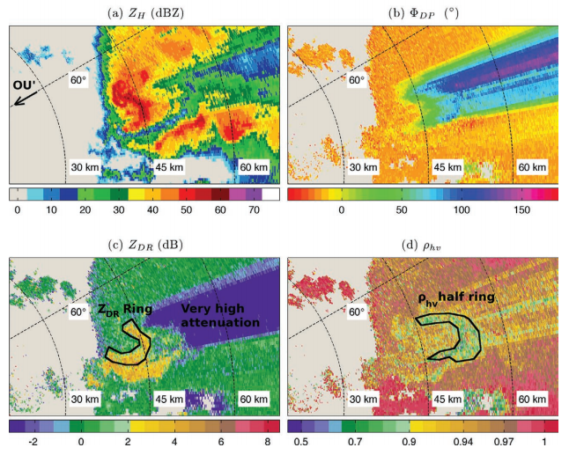
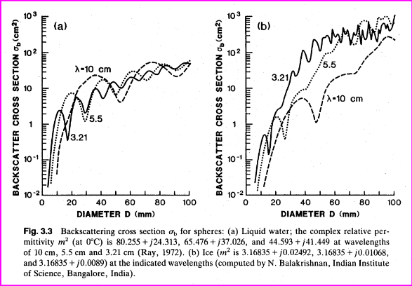
Simulation Results
Polarimetric signatures – IV. Mid-level Rhohv, Zdr rings
Rhohv rings because of the melting of frozen hydrometeors as they fall around the updraft; Large raindrop and oblate, melting rimed ice -> a ring of high Zdr value.
In Mie scattering region, scattering cross section oscillates with particle size -> RhoHV increases
Comparing a large, wet hail particle and a dry one, wet hail would have a lower RhoHV due to larger resonance effect (decrease with larger water fraction)
Example of of RhoHV, Zdr ring during 10-05-2010 OK tornado outbreak
(Palmer et al. 2011)
16
Notes:
However, Kdp estimation is difficult in supercells because of frequent non-Rayleigh scatters (large hail) and large Phi-dp gradient, which introduced bias due to non-uniform beam filling
From these diagrams, schemes that has the most visible Kdp foot is Thompson and NSSL scheme (Thompson, large qr value near ground; NSSL, Kdp increase significantly even if qr is only increase modestly from Morrison, large diameter plays a huge role in that)
As for the other schemes, WDM6 scheme’s small Kdp value is due to the small diameter size of its rain drops, MY2-> small qr value near ground)

Slide 18
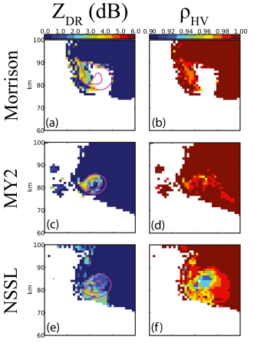
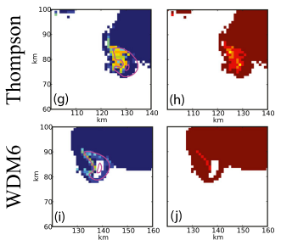
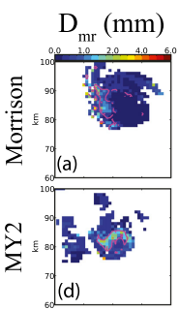
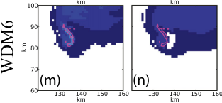
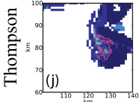
Simulation Results
Polarimetric signatures – IV. Mid-level Rhohv, Zdr rings
17
Notes:
Morrison, MY2,Thompson->Largest Zdr ring, WDM6 -> weakest Zdr ring. Schemes with the most apparent Zdr rings have relatively large rain drops in the vicinity of the ring. Whereas in WDM6 scheme, the combining effect of small graupel & mid-size rain drops = slight increase of Zdr in the ring area, small graupel also limited the rhohv decrease in the area (weakest rhohv ring)

Slide 19
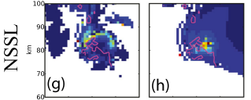
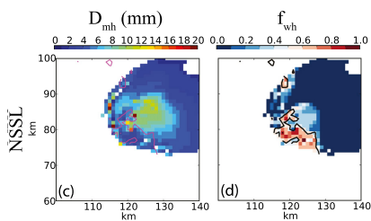
Simulation Results
Polarimetric signatures – IV. Mid-level Rhohv, Zdr rings
18
Notes:
OTOH, NSSL’s rain and graupel size is comparable in Morrison, MY2, Thompson schemes. The reason why Zdr is relatively small in the ring area is due to the occurance of big hail particle (spherical in shape) in the area. These hail are relatively wet, which creates the strongest mid-lv rhohv ring signal in these 5 schemes. This and MY2 scheme produce most realistic rhohv ring signature in this experiment.

Slide 20
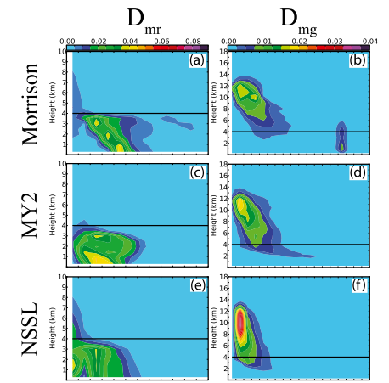
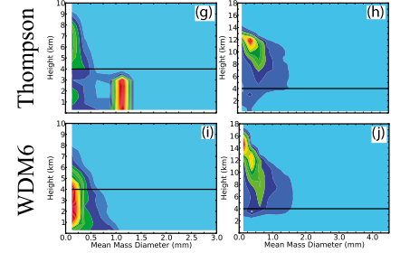
Simulation Results
DSD properties – I. Liquid hydrometeors
19
Notes:
Using CFAD, we can have a more general idea of the size distribution of raindrop/graupel in diff. schemes.
Morrison, MY2 have excessive size sorting in terms of raindrop diameter, it is due to the fact that shape parameter=0 for rain PSD. Morrison is the scheme that maximum rain drop size is most likely to be found (albeit low possibility), the authors argue that the reason for this is because raindrop breakup is accomplished by lowering self-collection rate, but self-collection have to pass a certain mixing ratio thereshold to initiate-> so it’s possible that this thereshold is not reached in Morrison scheme, causing large raindrops to form.
(2) These abnormally large raindrops in CFAD caused the strong, symmetric Zdr arc mentioned earlier.
The distinct secondary Dmr peak above melting level (most noticeable in Thompson,Morrison,NSSL) is thought to be related to the supercool water near updraft.

Slide 21
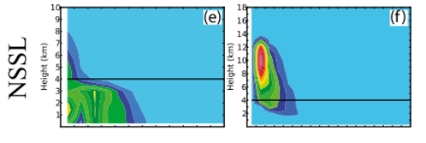
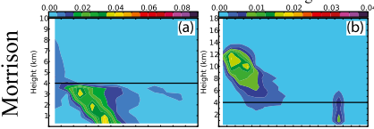
Simulation Results
DSD properties – I. Liquid hydrometeors
20
Notes:
In fact, another schemes did have some hint of a size-sorting but numerous physical reason hinders its strength.
WDM6: A continuous small bias can be noticed in this scheme from above melting layer to near ground. The reason for the small drop bias in this scheme is unknown. Small water droplets above melting layer could be the result of autoconversion process
In Thompson scheme, lack of size-sorting is the result of an artificial increase of number-weighted fall speed (M15). In CFAD we can see that drop size below melting layer is pretty constant in this scheme.
The method to decrease size-sorting in NSSL scheme is by modifying number concentration of rain, graupel, rain during sedimentation process.

Slide 22
Simulation Results
DSD properties – II. Ice hydrometeors
21
Notes:
In graupel CFADs, a distinct frequency at 3.5-3.75 mm bin is simulated. With finer contour levels (not shown) it can be seen that this peak is in fact connected to the peak graupel frequency above melting layer, which is yet another evidence for excessive size sorting in this scheme. Less extreme size sorting can also be seen in MY2 scheme.
Thompson and Morrison are the only 2 schemes in has an appreciable amount of graupel at the lowest model level, these graupel are quite wet as can be seen from previous slides -> Why no hail signature (Zdr increase instead).
OTOH, as Thompson, WDM6 are 1M ice scheme, no size-sorting is allowed. The slight increase in diameter in CFAD is thought to be caused by other mechanism (collision caused graupel mass increase) instead. This is also the reason why no Zdr arc can be identified with these scheme as Zdr arc is highly correlated to the size-sorting process of ice particle (discussed previously)

Slide 23
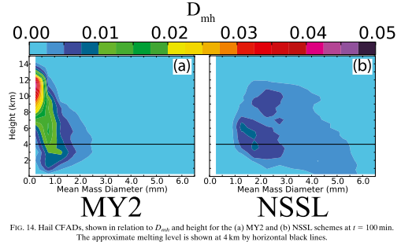
Simulation Results
DSD properties – II. Ice hydrometeors
22
Notes:
Finally, in hail CFAD, there’s a stark difference between MY2 and NSSL schemes. In NSSL scheme, there’s a possibility to large hail at low model level, which is consistent with the fact that we can only see hail signature (low Zdr area) in this scheme.
Mainly we can say that MY2 tends to produce very small hail particle, whereas NSSL is generally larger. Authors argue that this difference is because of the categorization of frozen rain in these two schemes: MY2: classified as hail; NSSL: graupel. So main producer of hail in MY2 is frozen rain whereas NSSL is graupel undergoing wet growth.

Slide 24
Conclusion
What we learn from this
Determine
Relate
How well each microphysics scheme produces unique polarimetric signatures in supercells
How is the magnitude of these signature tells us about the hydrometeor properties of each scheme
Our goal
Improve
A better realized hydrometeor size/frequency distribution to improve QPF
23

Slide 25
Conclusion
What we learn from this
Data assimilation
Ice parameterization
An incorrectly simulated polarimetric signature can lead to bias in precipitation forecasting (eg. Hail signature near ground)
Why dual-pol variable simulation
A correct ice parameterization is needed for realistic signature simulation (1M significantly worse than 2M ice scheme)
Improve
Comparison with real data to improve microphysics parameterization
(applicability in other weather condition?)
24

