Slide 1
Sensitivity of real-data simulations of the 3 May 1999 Oklahoma City tornadic supercell and associated tornadoes to multimoment microphysics. Part I: Storm- and tornado-scale numerical forecasts
Professor : Ming-Jen Yang
Student : Jyong-En Miao
Date : 2016/10/04
Dawson, D. T. II, M. Xue, J. A. Milbrandt, and A. Shapiro, 2015
Mon. Wea. Rev., 143, 1152–1171

Slide 2
Introduction
Bulk microphysics scheme is a substantial source of model uncertainty on the convective scales for metrics such as surface precipitation type and amount, storm morphology and propagation, convective downdrafts and cold pools, and even tornadogenesis potential.
Snook and Xue (2008) found that Smaller values of N0 that favored relatively large raindrops and hailstones resulted in 1) weaker cold pools, 2) a more vertically stacked low-to-midlevel updraft and mesocyclone and 3) stronger and longer-lived TLVs
Lerach et al. (2008) found that more polluted environments (i.e., higher CCN concentrations) favored more intense and longerlived TLVs.
this current study examines and explains the impact of multimoment versus 1M-BMPs for the numerical prediction of the 3 May 1999 Oklahoma City, Oklahoma, tornadic supercell thunderstorm and TLVs.

Slide 3
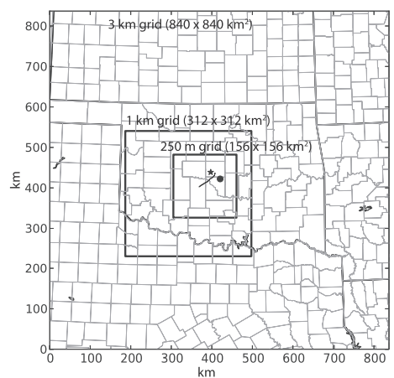
Experiment methodology
ARPS model (Xue et al. 2000, 2001, 2003) for forward prediction during the data assimilation cycles and for the ensuing forecasts, and use the ARPS 3DVAR (Gao et al. 2004; Hu et al. 2006b) and its complex cloud analysis system (Zhang et al. 1998; Xue et al. 2003; Hu et al. 2006a) for data assimilation
three levels of one-way nested grids : 3 km, 1 km(Radar DA), 250 m
Vortices that form in the hook echo and RFD region of the simulated storms that achieve tornado-like magnitudes (when computed on the scale of a typical tornado) of vertical vorticity [O(0.1–1.0) s^-1 ] and horizontal wind speeds (>32m/s ) are referred to as TLVs
53 vertical levels
Microphysics: Milbrandt and Yau

