Slide 1
Three-Dimensional Structure and Evolution of the Moisture Field in the MJO
Adames, A., and J. M. Wallace, 2015: Three-dimensional structure and evolution of the moisture field in the MJO. J. Atmos. Sci., 72, 3733–3754.

Slide 2
introduction
The interaction between largescale motions and diabatic heating associated with deep convection plays a central role in its dynamics. (Matsuno 1966; Gill 1980)
Cloud-related moisture fluxes gradually moisten the lower troposphere to the east of the rain area, causing the rain area to propagate eastward. Benedict and Randall (2007)
The forced, planetary wave response to an equatorial heat source consisting of equatorial Kelvin and Rossby waves gives rise to an equatorially trapped region of shallow ascent to the east of the region of enhanced rainfall.

Slide 3
Warm pool composite
A series of regression maps based on linear combinations of PC1 and PC2 of Δx for the MJO phases in which the Δx maximum is centered over the Indo-Pacific warm pool (60。E–180。E).
Each of these maps is then zonally shifted such that the longitude at which Δx is a maximum corresponds to the reference longitude (0 。).
Compositing these shifted regression maps yields a single map that describes the mean structure of MJO related features as they propagate across the Indo-Pacific warm pool from 60。E to the date line.

Slide 4
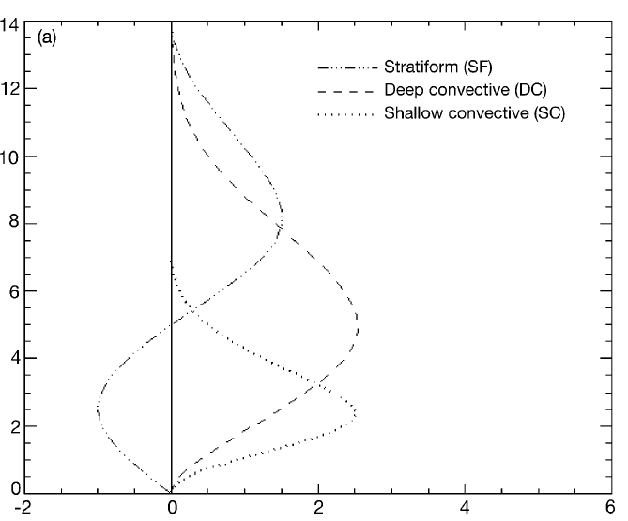
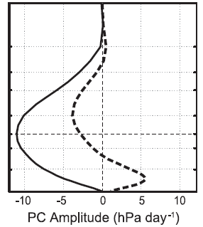
ω1
ω2

Slide 5
data
ERA Interim dataset
Grid spacing : 1.5。X1.5 。
Dataset from 1979 to 2011
29 pressure levels from 1000 to 50 hPa
OLR: NOAA’s polar-orbiting satellites (Liebmann and Smith 1996)
Precipitation: Rainfall Measurement Mission (TRMM-3B42; Huffman et al. 2007)

Slide 6
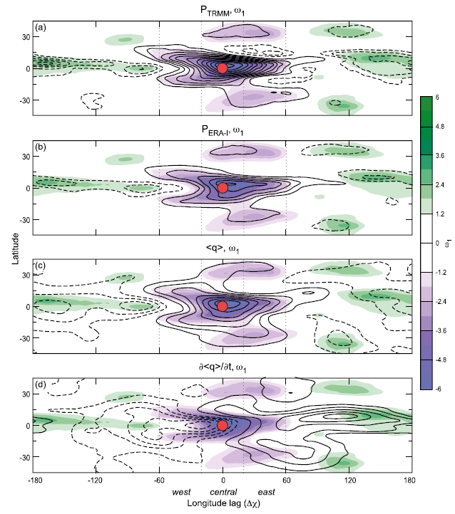
Warm pool composite
Contour:
TRMM-3B42 precipitation
ERA-Interim precipitation
Water vapor
Water vapor tendency
Shaded:
ω1

Slide 7
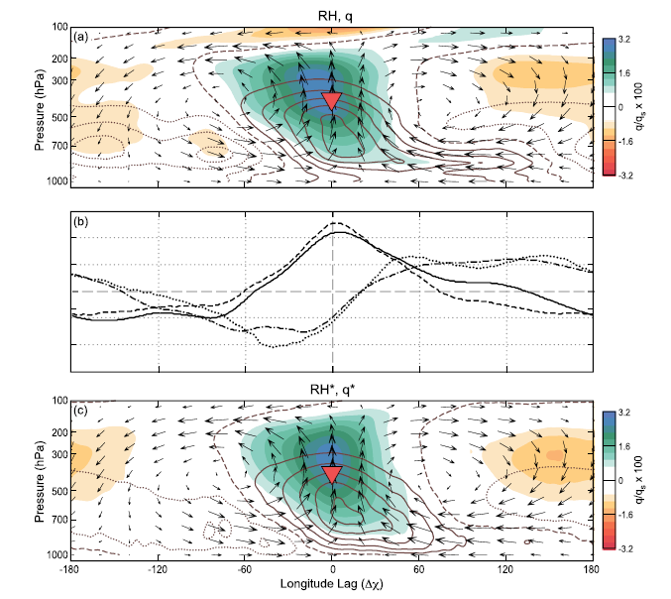
Vertical cross section (10。S~10 。 N)
Shaded:
RH anomalies
Contoured:
q(0.025 gkg-1)
arrows:
Mass circulation
-ω1
q
(∂q/∂t)
ω2

Slide 8
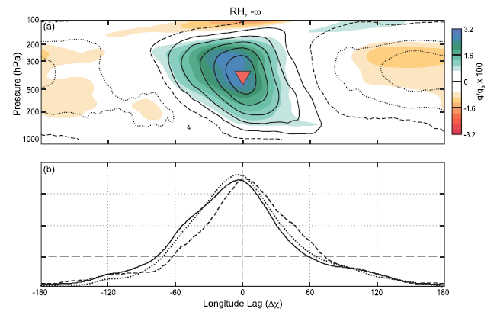
Shaded:
RH
Contoured:
-ω(1hPa day-1)
RH
OLR
-ω1

Slide 9
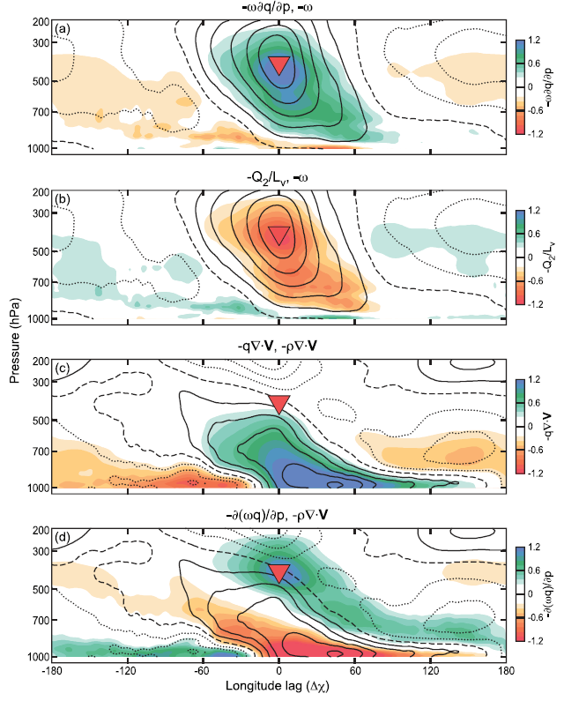

Slide 10
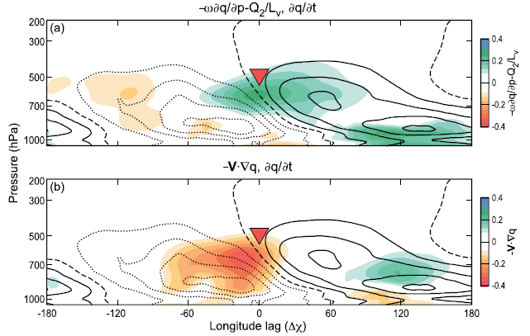

Slide 11
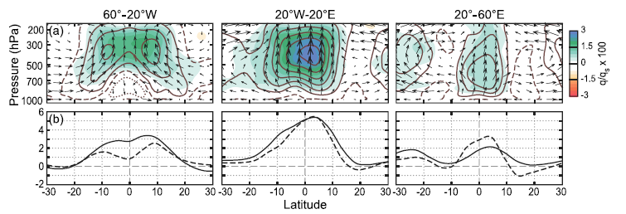
composite meridional cross sections
solid: negative OLR(Wm-2)
dashed: TRMM precipitation rate X5 (mm day-1)

Slide 12
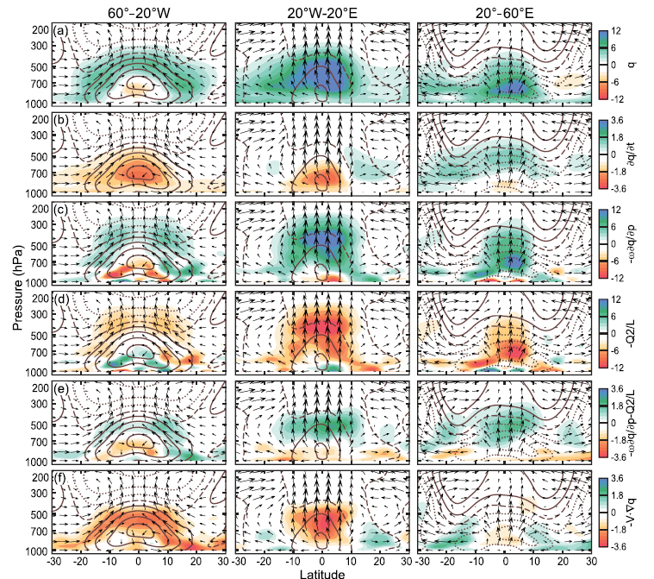

Slide 13
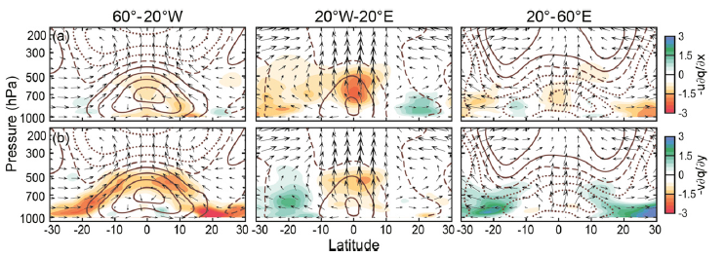

Slide 14
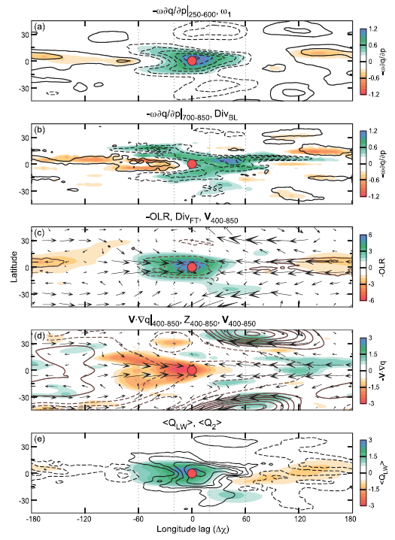

Slide 15
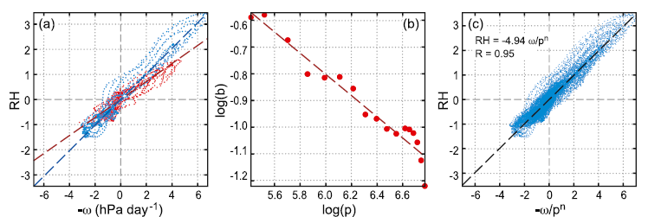
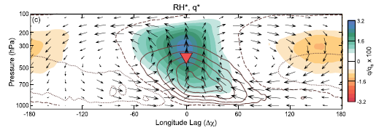

Slide 16
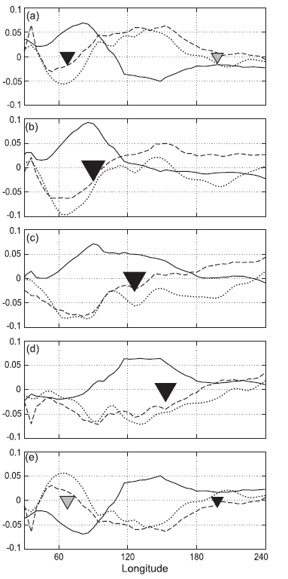

Slide 17
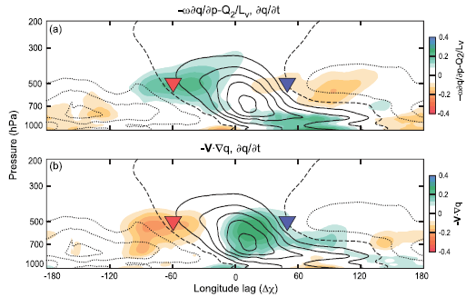

Slide 18
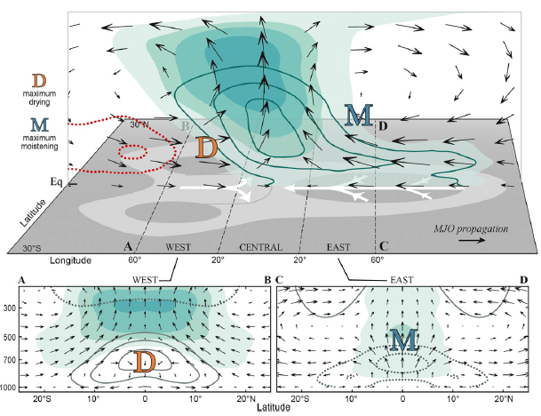
conclusions
warm pool composite

Slide 19
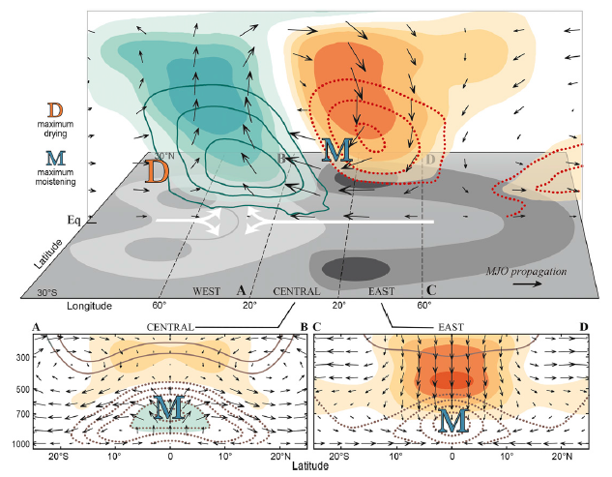
Indian Ocean

