Slide 1
Incorporating diagnosed intercept parameters and the graupel category within the ARPS cloud analysis system for the initialization of double-moment microphysics: Testing with a squall line over south China
Professor : Ming-Jen Yang
Student : Jyong-En Miao
Date : 2016/06/07
Pan, Y., M. Xue, and G. Ge, 2016
Mon. Wea. Rev., 144, 371–392.

Slide 2
Introduction
cloud and precipitation PSDs are often represented by a gamma size distribution:
The zeroth moment of PSD is the total number concentration, the third moment is proportional to the mass mixing ratio, and the sixth moment is related to the reflectivity factor

Slide 3
retrieves precipitation mixing ratios according to the reflectivity formula defined in Smith et al. (1975). (SMO)
the diagnoses of the total number concentrations given the reflectivity contribution of a given species

Slide 4
Wainwright et al. (2014) formulated and tested diagnostic relationships between the intercept parameter and water/ice content for rain, snow, graupel, and hail

Slide 5
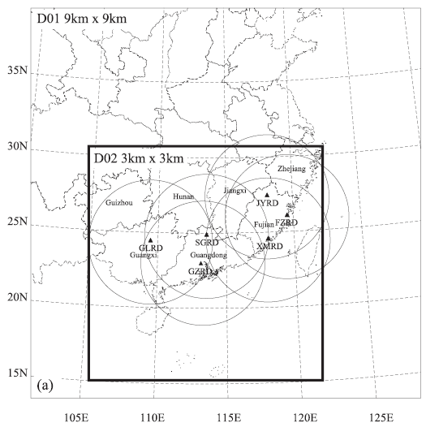
The ARPS model is a three-dimensional nonhydrostatic, compressible atmospheric model

Slide 7
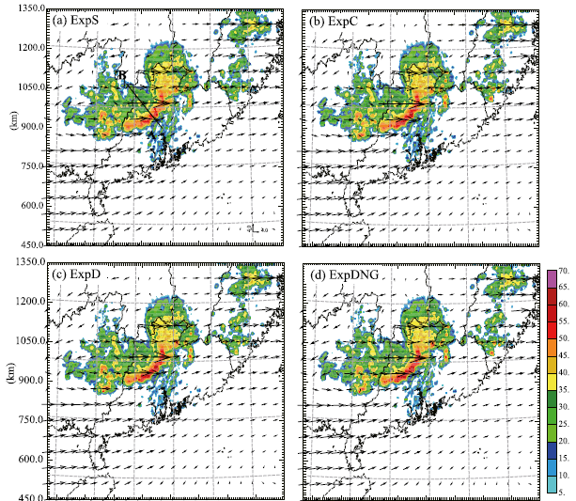
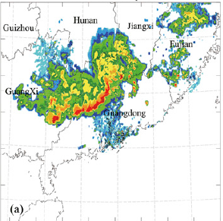

Slide 8
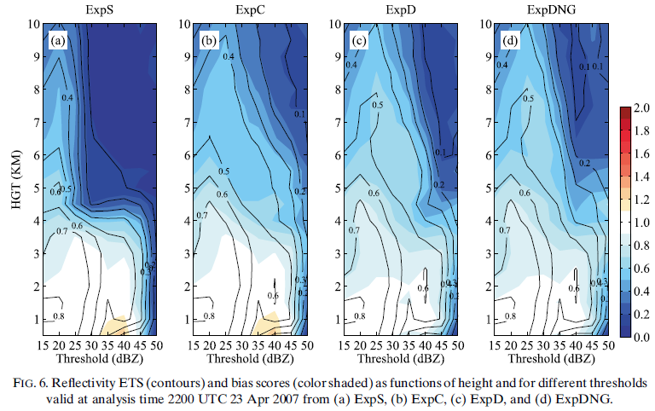

Slide 9
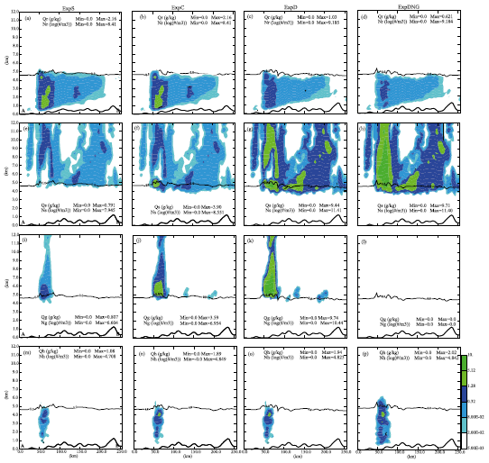

Slide 10
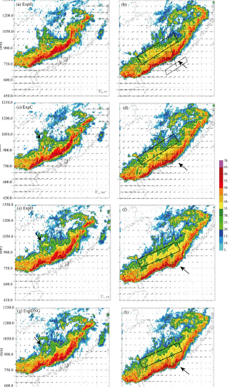

Slide 11
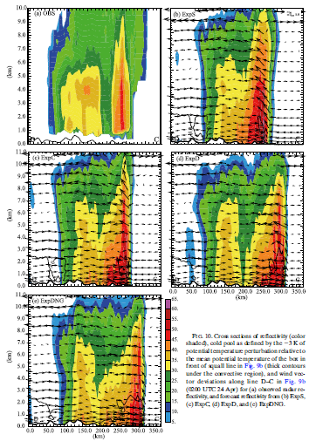

Slide 12
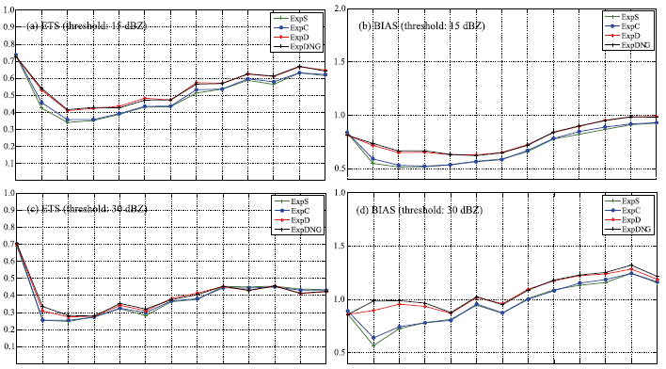

Slide 13
