Slide 1
Mesoscale Vortex Development during Extreme Precipitation: Colorado,September 2013
Professor : Ming-Jen Yang
Student : Jyong-En Miao
Date : 2016/05/10
Morales, A., R. S. Schumacher, and S. M. Kreidenwes, 2015
Mon. Wea. Rev., 143, 4943–4962.

Slide 2
Introduction
During 9–16 September 2013, a slow-moving upper-level cutoff low in the southwestern United States funneled unseasonal amounts of moisture to the Colorado Front Range resulting in extreme precipitation and flooding
colder cloud tops and lightning were observed over Boulder as the city and adjacent foothills experienced flash flooding caused by high rain rates ( > 40 mm/hr ) accumulating over 180 mm of rain from 0000 to 0600 UTC 12 September

Slide 3
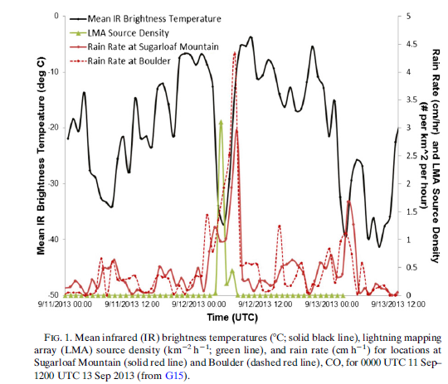

Slide 4
Introduction
Amid the region of heaviest rainfall on 12 September, a mesovortex was observed northwest of Denver
observations of radial velocity from the Denver (KFTG) radar show an enhanced rotational signature associated with intensification of the mesovortex from 0400 to 0700 UTC 12 September, approximately 30km in diameter.
Radial velocities show enhanced upslope flow associated with an easterly low-level jet (maximum speeds of 15m/s in the 1–2km AGL layer) on the north side of the mesovortex .

Slide 5
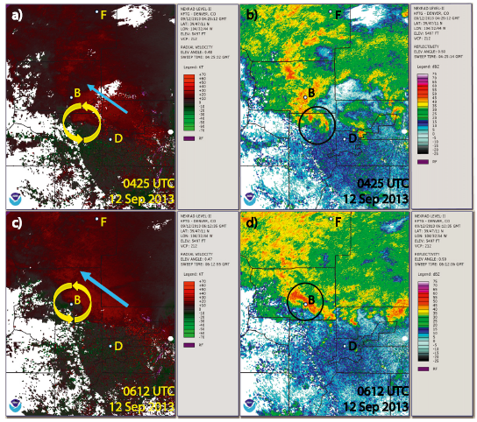

Slide 6
Introduction
Friedrich et al. (2015) used radar and disdrometer observations to show that convective rainfall was enhanced when the mesovortex interacted with the local terrain.
The Denver Cyclone is a cyclonic circulation that forms in the lee of the Palmer Divide. These mesoscale features are sometimes associated with severe weather near Denver and the eastern Colorado plains, including hail and flooding and tornadoes

Slide 7
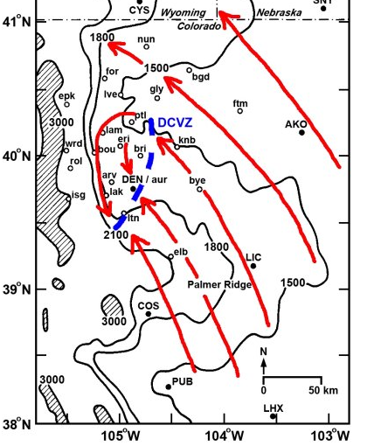

Slide 8
Introduction
very moist air (precipitable water >30mm)
low CAPE
little to no convective inhibition (CIN)
nearly saturated from the surface to 500 hPa
The combination of a deep layer of warm cloudy air to promote warm rain processes, and a highly saturated environment inhibiting both high rain evaporation and entrainment of dry air, results in high precipitation efficiencies

Slide 9
Introduction
Raymond and Jiang (1990) MCS maintain themselves through potential vorticity anomalies generated by latent heating .
Such a profile places the maximum LH, and thus an increase in LH with height in the lower troposphere, allowing for a cyclonic circulation to form closer to the surface.

Slide 10
Introduction
We hypothesize that the vertical profile of LH played a more critical role in the intensification of mesovortex, than did lee vortex formation.

Slide 11
Experiment design
version 3.3.1 of ARW
two-way nested grid with three domains: 36, 12, and 4 km
36 stretched vertical levels (higher resolution near the surface)
Thompson microphysics scheme
Dudhia shortwave radiation
the Rapid Radiative Transfer Model longwave radiation
the four-layer Noah land surface model
Yonsei University planetary boundary layer

Slide 12
Experiment design
1) LATENT HEATING EXPERIMENTS

Slide 13
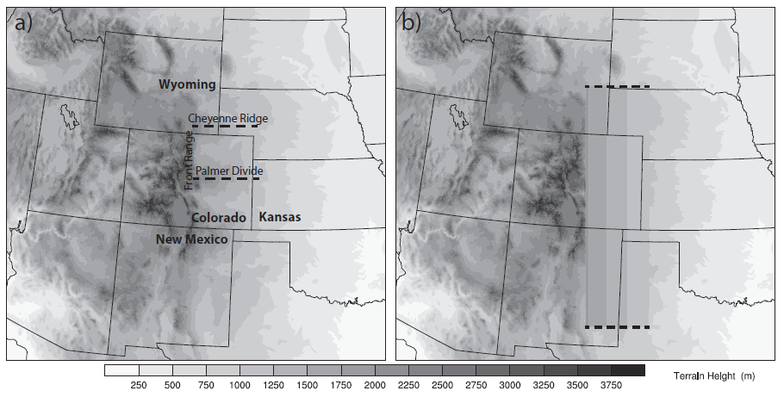
Experiment design
2) SENSITIVITY TO NORTH–SOUTH VARIATIONS IN TOPOGRAPHY

Slide 14
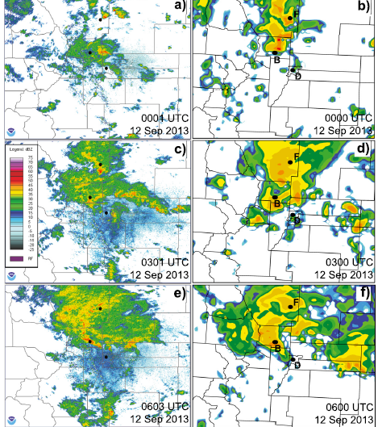

Slide 15
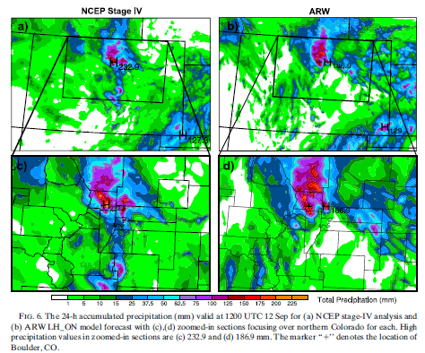

Slide 16
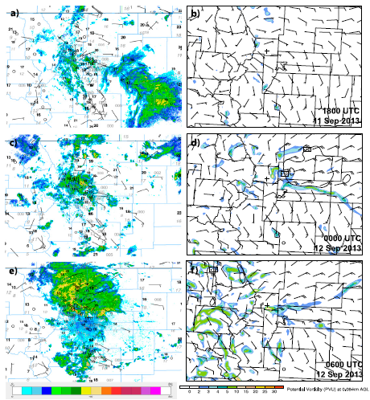

Slide 17
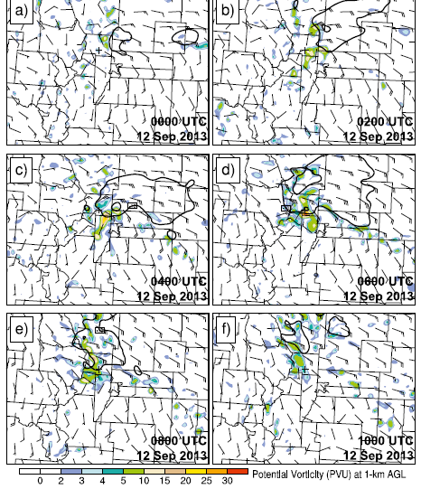

Slide 18
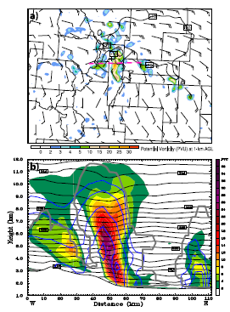

Slide 19
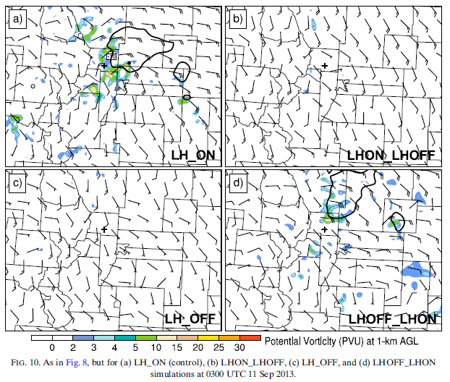

Slide 20
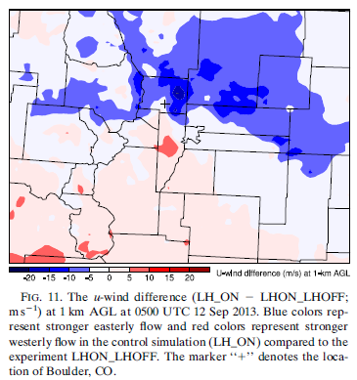

Slide 21
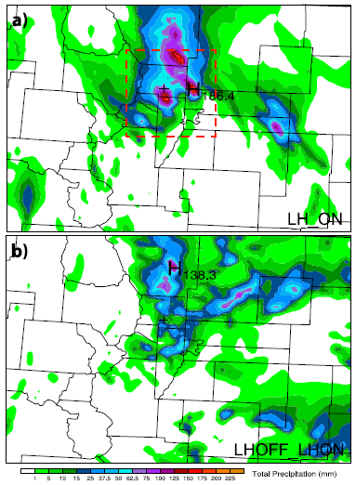

Slide 22
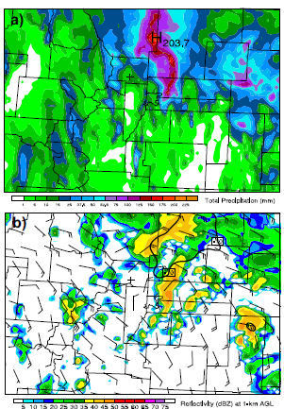
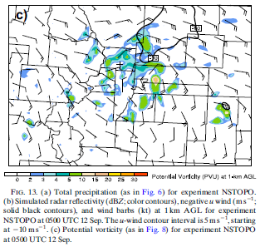

Slide 23
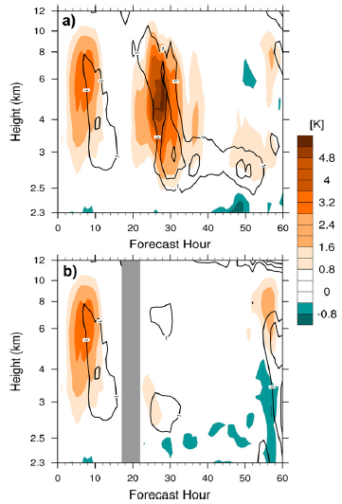

Slide 24
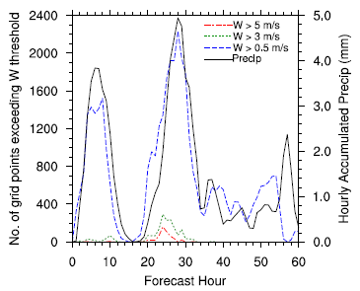

Slide 25
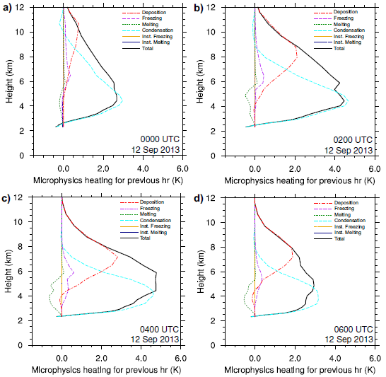

Slide 26
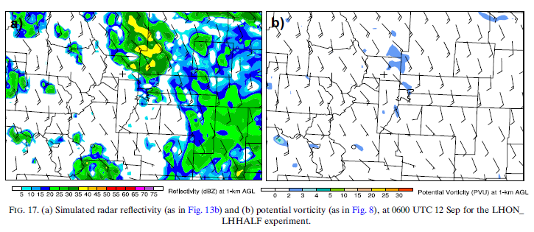

Slide 27
Summary
Turning off LH for the entire simulation resulted in no mesovortex intensification, whereas a run similar to the control but with modified terrain still produced a mesovortex.
LH just before and during the mesovortex event played a larger role in enhancing potential vorticity
LH and not lee vortex formation was responsible for the observed evolution and intensity of the mesovortex

Slide 28
Summary
an LLJ was induced in response to upward motions caused by LH, leading to enhanced upslope flow, which subsequently enhanced convection and surface precipitation.
High values of PV near the surface were associated with a positive vertical gradient in LH located in the lower troposphere
condensation of cloud water was the dominant process responsible for the positive vertical gradient in LH in the lower troposphere
In LHON_LHHALF, there was no mesovortex or LLJ and there was a significant reduction in precipitation
microphysical processes play not only in the production of precipitation, but also in the evolution of mesoscale features, such as the mesovortex

