Slide 1
Paper Review
May 3, 2016
Evaluation of WRF cloud microphysics schemes using radar observations.
Min, K.-H., S. Choo, D. Lee, and G. Lee, 2015: Evaluation of WRF cloud microphysics schemes using radar observations. Wea. Forecasting, 30, 1571–1589.

Slide 2
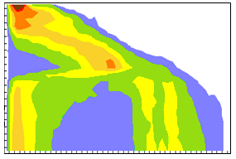
Outline
ˇ
Introduction
Method and Data
Results
Summary and Conclusions
Reference
ˇ
ˇ
ˇ
ˇ

Slide 3
Introduction
ˇ
WSM6 and WDM6(cloud water, rain water and CCN) :
WDM6 reduce light precipitation and increase moderate precipitation, reducing the systematic bias of WSM6.[Hong et al.2010]
ˇ
South Korean Meteorological Administration(KMA) implement a 10-yr project to develop its own global model(KGM) by 2020.[Kwon et al. 2014]
KIAPS Integrated Model with the Spectral Element Hydrostatic dynamical core(KIMSH)
(10-km resolution or higher)
(LETKF is included)
ˇ
Cases: Summer monsoon and convective precipitation cases during 2011 across Korean Peninsula. (KMA S-band Doppler radar)
Notes:
S- band = wave length 10cm

Slide 4
Method and Data
a. Calculation of radar-equivalent
reflectivity factor
b. WRF model setup
(rain, snow and graupel)
[Thompson et al.(2008)]
($\frac{{mm}^{6}}{m^{3}}$)
[Stoelinga(2005)]
($dBZ$)
(As Re[t]>0,
X=D)
ˇ
Radar data were quality controlled through fuzzy logic algorithm.[developed at the Kyungpook National University(KNU)]

Slide 5
Method and Data
c. Selected cases
d. KMA radar data
GDK
ˇ
Radar data were quality controlled through fuzzy logic algorithm.
[developed at the Kyungpook National
University(KNU), Cho et al. 2006;
Ye 2012]
KWK
KSN
ˇ
Radar resolution(Hor., Ver.)=(4km, 250m)
ˇ
Dual-polarized Doppler radars.
r=100km

Slide 6
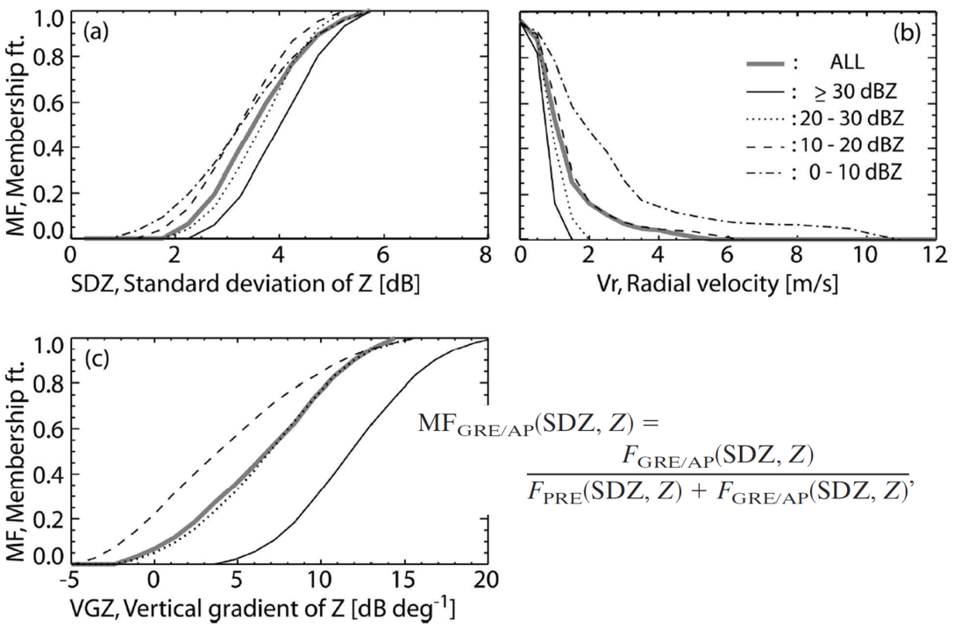
Fuzzy Logic Algorithm in radar QC:
0.55
After QC
Original data
[Cho et al. 2006]

Slide 7
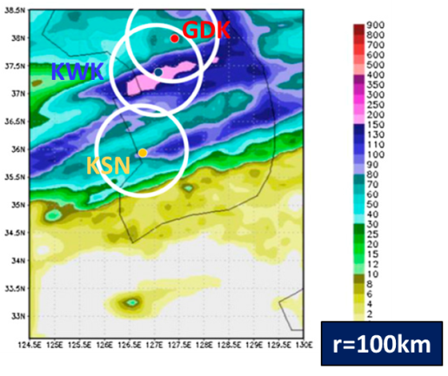
Results
Case 1: 24-25 Jun. 2011 (Summer Monsoon)
a. CFAD
BB
0’C
BB
0’C
Avg ($dBZ$)
BB
BB
weaker
Avg ($\frac{{mm}^{6}}{m^{3}}$)
25%
50%
75%
Larger dBZ
BB
0’C
BB

Slide 8
Results
GDK
KWK
Case 2: 14 Aug. 2011 (Convective)
a. CFAD
KSN
0’C
0’C
Avg ($dBZ$)
Avg ($\frac{{mm}^{6}}{m^{3}}$)
25%
50%
75%
Failed simulations
0’C

Slide 9
Results
b. Time-height cross sections
Case 1: 24-25 Jun. 2011
(Summer Monsoon)

Slide 10
Results
b. Time-height cross sections
Case 2: 14 Aug. 2011
(Convective)
GDK
KWK
KSN

Slide 11
Results
c. Vertical profiles
Case 1: 24-25 Jun. 2011
(Summer Monsoon)
WDM6:
More humid below the melting layer.
More qrain → stronger CFAD.

Slide 12
KSN
KSN
Results
c. Vertical profiles
Case 2: 14 Aug. 2011
(Convective)
GDK
KWK
More cloud than the rain.
KWK
KWK
KSN

Slide 13
Summary and Conclusions
a. For monsoon cases:
WSM6 shows a lower bias of radar reflectivity beneath the melting level, while WDM6 shows a higher bias.
b. For convective cases:
Both schemes needs improvement for modeling.
It is important to note that it is not possible to make a strict comparison between SR and that measured by ground-based radar.

Slide 14
Reference
ˇ
Cho, Y.H.,G. Lee, K.-E. Kim, and I. Zawadzki, 2006: Identification and removal of ground
echoes and anomalous propagation using the characteristics of radar echoes. J. Atmos.
Oceanic Technol., 23, 1206–1222, doi:10.1175/JTECH1913.1.
Cornman, L. B., R. K. Goodrich, C. S. Morse, and W. L. Ecklund, 1998: A fuzzy logic method for
improved moment estimation from Doppler spectra. J. Atmos. Oceanic Technol., 15,
1287–1305, doi:10.1175/1520-0426(1998)015,1287: AFLMFI.2.0.CO;2.
Hong, S.-Y., and J.-O. J. Lim, 2006: The WRF single-moment 6-class microphysics scheme
(WSM6). J. Korean Meteor. Soc.,42, 129–151.
Hong, S.-Y., K.-S. Lim, Y.-H. Lee, J.-C. Ha, H.-W. Kim, S.-J. Ham, and J. Dudhia, 2010:
Evaluation of the WRF double-moment 6-class microphysics scheme for precipitating
convection. Adv.Meteor., 2010, 707253, doi:10.1155/2010/707253.
Kwon, H., J. S. Kang, Y. Jo, and J. H. Kang, 2014: Implementation of a GPS-RO data
processing system for the KIAPS-LETKF data assimilation system. Atmos. Meas. Tech.
Discuss., 7, 11 927–11 956, doi:10.5194/amtd-7-11927-2014.
Min, K.-H., S. Choo, D. Lee, and G. Lee, 2015: Evaluation of WRF cloud microphysics schemes
using radar observations. Wea. Forecasting, 30, 1571–1589.
Ye, B.-Y., 2012: Quality control of radar moment data by combining moment-based fuzzy
logic algorithm and radar signal processing. M.S. thesis, Dept. of Astronomy and
Atmospheric Sciences, Kyungpook National University, 72 pp.

Slide 15
Progress Report
November 26, 2015
Thanks for
your
attention!

