Slide 1
The Sensitivity of Simulated Shallow Cumulus Convection and Cold Pools to Microphysics
Professor : Ming-Jen Yang
Student : Jyong-En Miao
Date : 2016/03/22
Li, Z., P. Zuidema, P. Zhu, and H. Morrison, 2015
J. Atmos. Sci., 72, 22–40.

Slide 2
Introduction
Significant precipitation with surface rain rates exceeding 1mm/h is frequently observed from shallow cumuli in the Caribbean trade wind region
Rain evaporation cools the surrounding air and generates convective downdrafts that form cold pools at the surface
The suppression of convection within the stable surface cold pool region and the invigoration of convection at the cold pool downwind boundary are responsible for the arc-shaped mesoscale cloud organizations observed during the Rain in Cumulus over the Ocean (RICO)
radiative budget and hydrological cycle of the expansive trade wind region

Slide 3
Introduction
The goal of this study is to understand the shallow cumulus precipitation and cold pool properties in response to cloud and rain microphysics by comparing model simulations that are configured in the exact same setup, except for the microphysical scheme.
Shipway and Hill (2012a) compare the Thompson (as Thompson09) and Morrison schemes within a one dimensional kinematic framework that we also employ and report more accumulated water due to more autoconversion, less accretion, and more evaporation for the Thompson scheme

Slide 4
Simulation Setup
version 3.2 of the Weather Research and Forecasting Model
The parent domain and four two-way nested inner domains are centered at 188N, 61.78W within the operational domain of the Research Vessel (R/V) Seward Johnson during the RICO experiment (Zuidema et al. 2012).
innermost domain: domain size of 24 km X 24km
horizontal grid spacing of 100m
vertical grid spacing varying from 6 to 200m between the
surface and the 4-km level

Slide 5
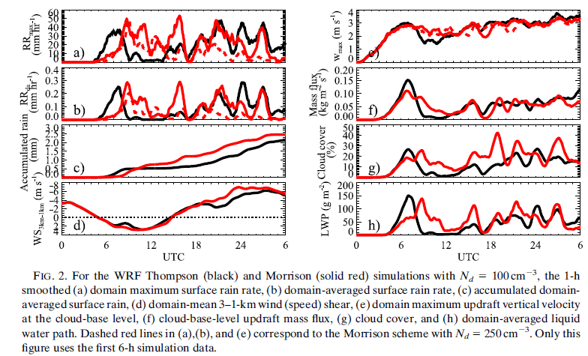

Slide 6
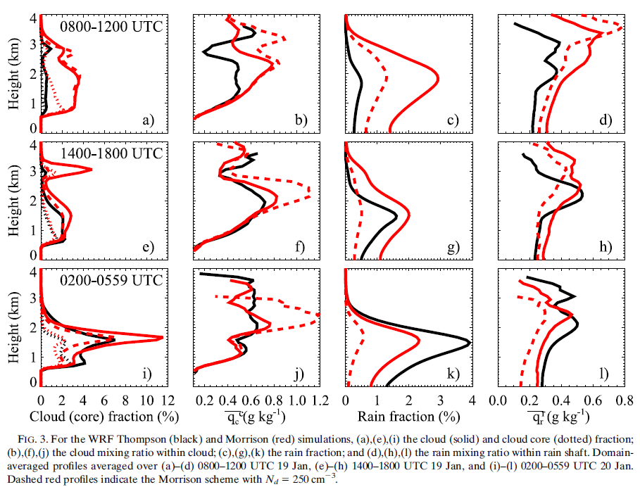

Slide 7
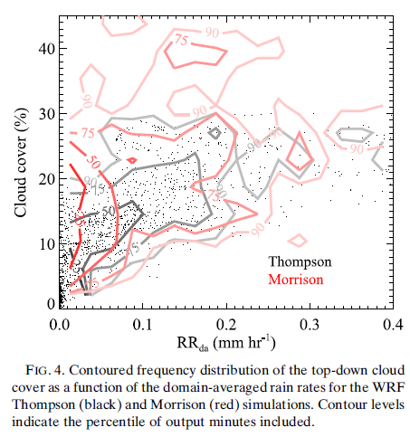

Slide 8
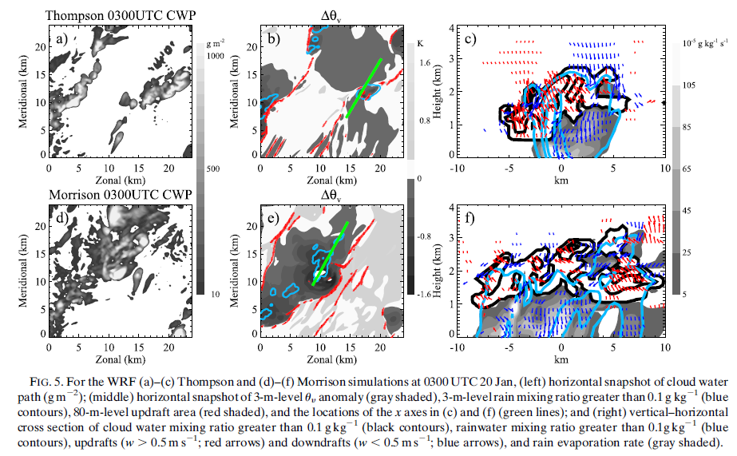

Slide 9
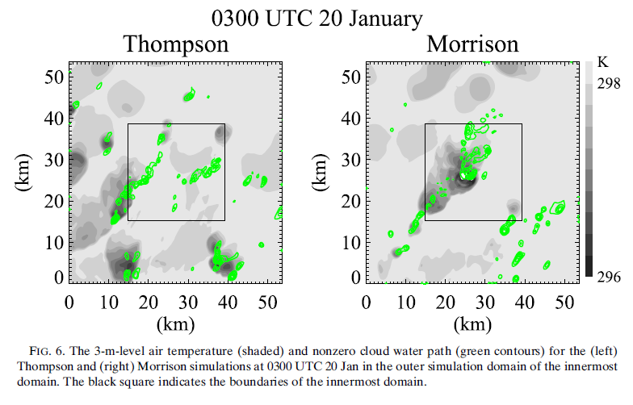

Slide 10
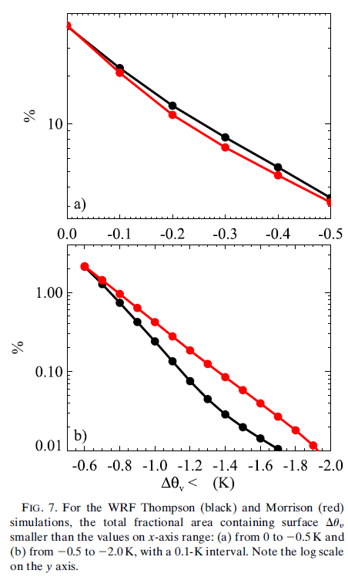

Slide 11
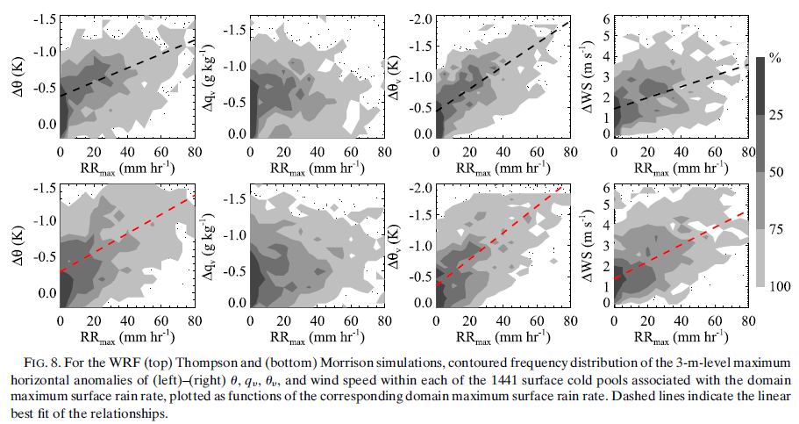

Slide 12
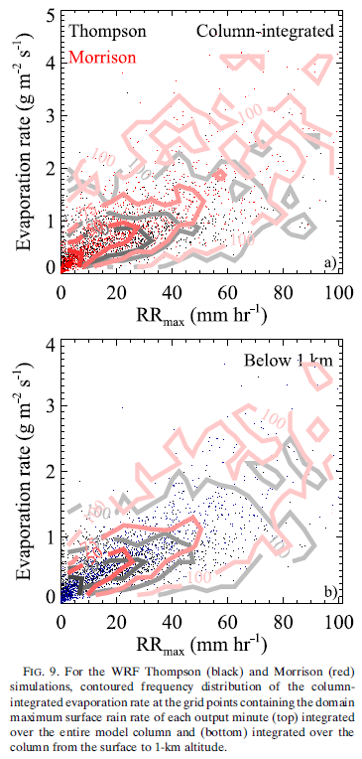

Slide 13
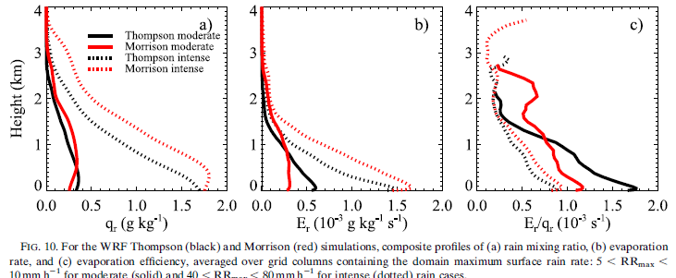

Slide 14
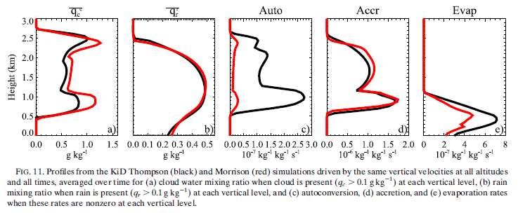

Slide 15
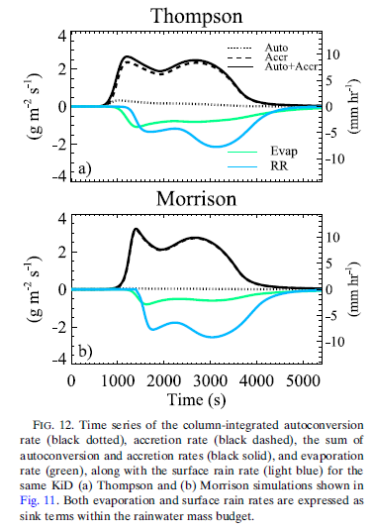

Slide 16
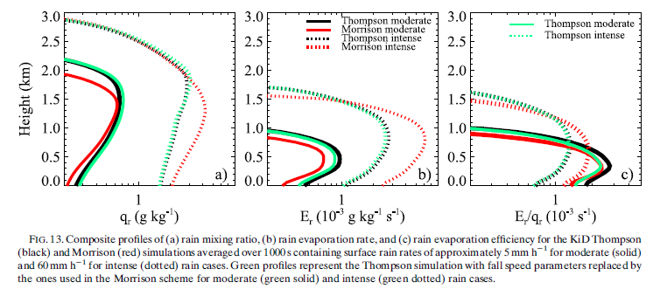

Slide 17
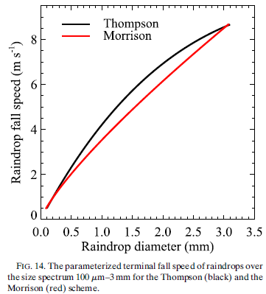

Slide 18
