Slide 1
Simulation of the Downshear Reformation of a Tropical Cyclone
Leon T. Nguyen and John Molinari, 2015: Simulation of the Downshear Reformation of a Tropical Cyclone. J. Atmos. Sci., 72, 4529–4551.

Slide 2
Introduction
Shear weakens the TC by ventilating the upper-level warm core, resulting in rising surface pressure. (Frank and Ritchie 2001)
Shear could affect TC intensity via thermodynamic modification of the inflow layer. (Riemer et al. 2010)
Vertical wind shear acts to tilt the tropical cyclone vortex preferentially toward the downshear-left direction. (e.g., Jones 1995; Reasor et al. 2004; Braun et al. 2006; Riemer et al. 2010)
TC vortex tilt is often accompanied by an azimuthal wavenumber-1 vertical motion and convective asymmetry. (e.g., Braun et al. 2006; Riemer et al. 2010; Corbosiero and Molinari 2002; Chen et al. 2006; Reasor et al. 2013)
Diabatic processes may also help the vortex resist shear through the process of downshear reformation. (Molinari et al. 2004)

Slide 3
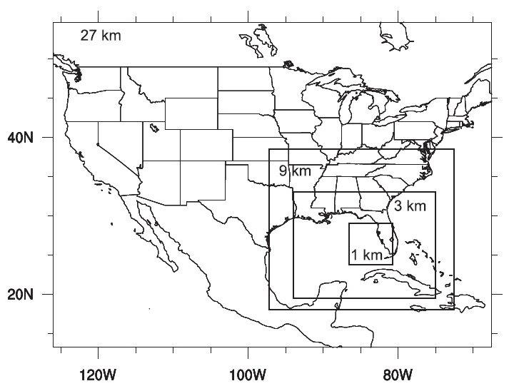
WRF v3.2
Hurricane Gabrielle
Paramerterizations
KF cumulus parameterization on D1 & D2
WSM6 micrphysics parameterization
Dudia short wave parameterization
RRTM long wave radiation parameterization
YSU PBL parameterization
IC/BC
NCEP GFS FNL analysis
9/13 1200 UTC
9/13 1800 UTC
9/14 0000 UTC
D1 & D2
D3
D4

Slide 4
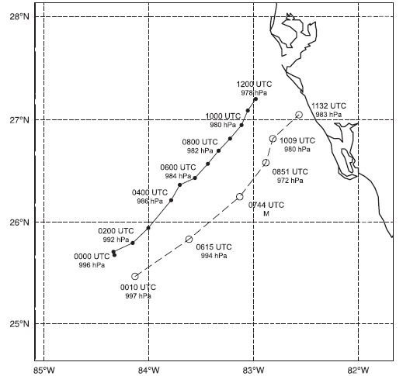
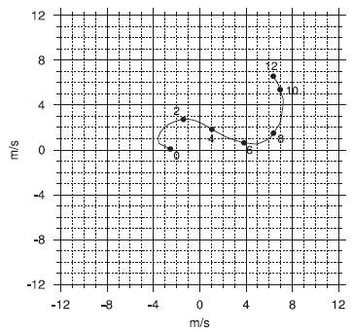
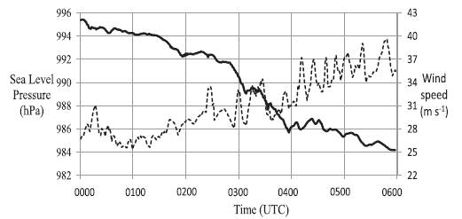

Slide 5
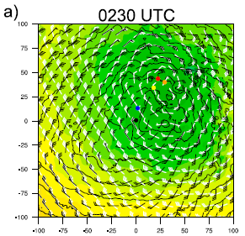
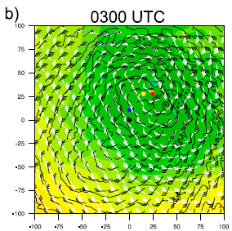
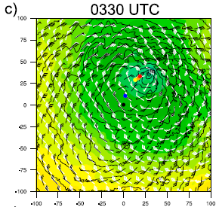
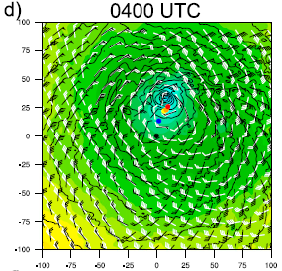
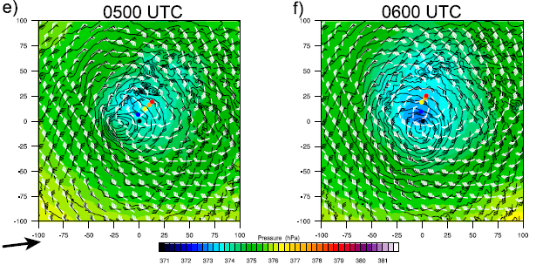
Shear-induced asymmetries

Slide 6
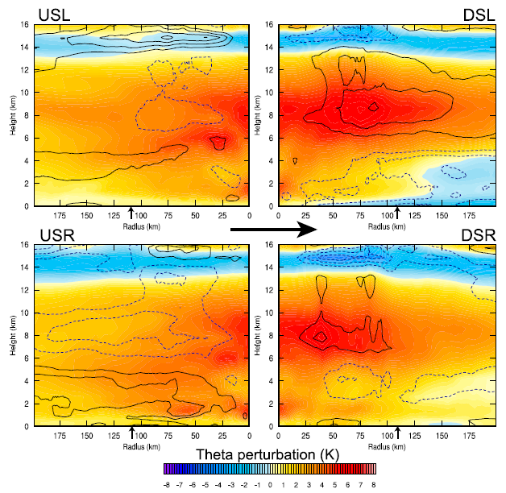
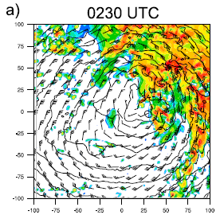
0200-0230 UTC
DSL
USL
~7K
DSR
USR
Adiabatic cooling in updraft slightly exceeding diabatic heating. (Zhang et al., 2002)
Evaporation cooling associate with downdrafts.
-1~-3K
DSL
USL
DSR
USR

Slide 7
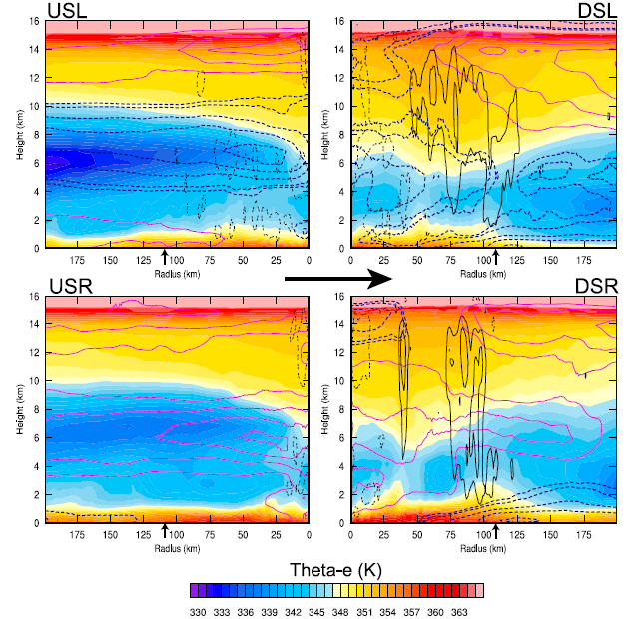

Slide 8
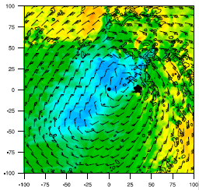
DSL
USL
higher theta-e
DSR
lower theta-e
USR
Latent heat flux
higher theta-e

Slide 9
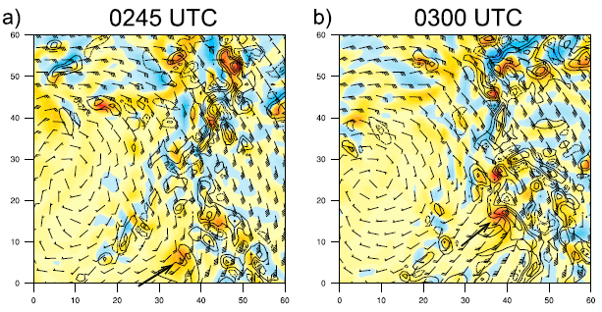
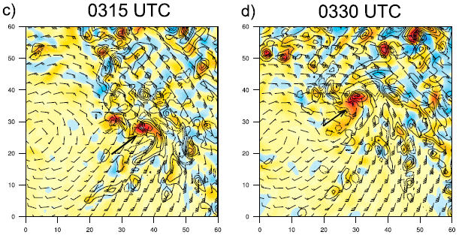

Slide 10
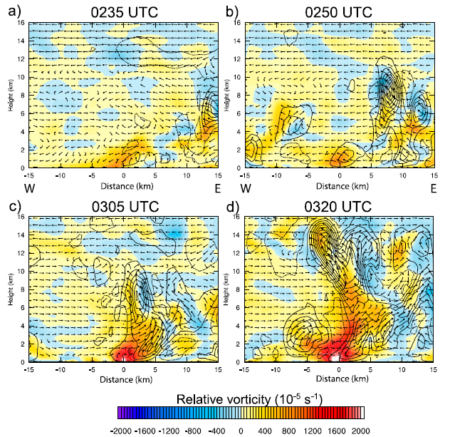

Slide 11
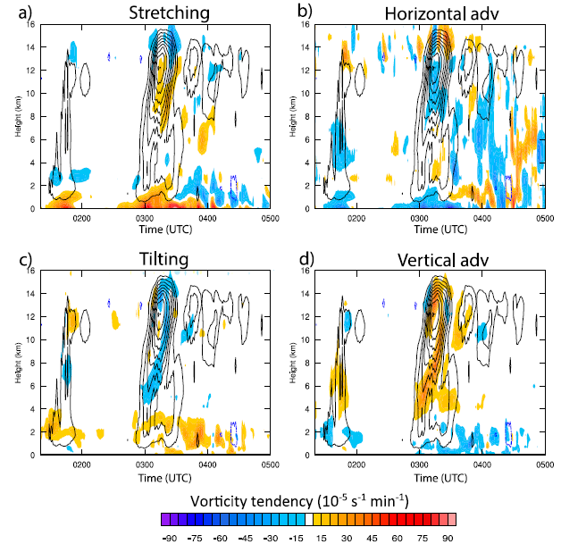
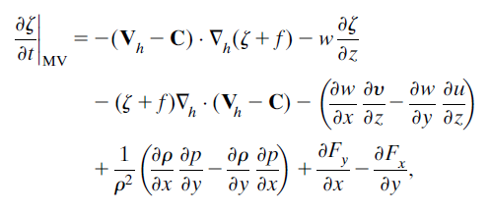
Absolute vorticity tendency equation
Fang & Zhang (2010)

Slide 12
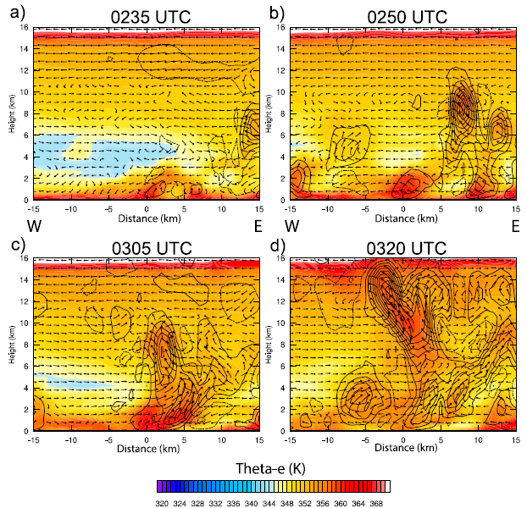
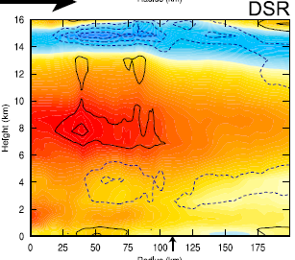
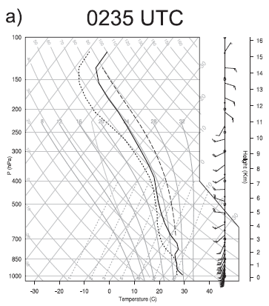
advected & sinking (warm dry adiabatic process)
downstream
upstream

Slide 13
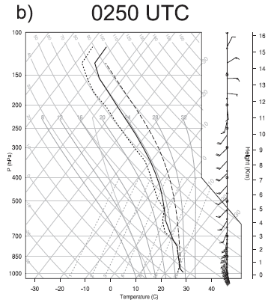

Slide 14
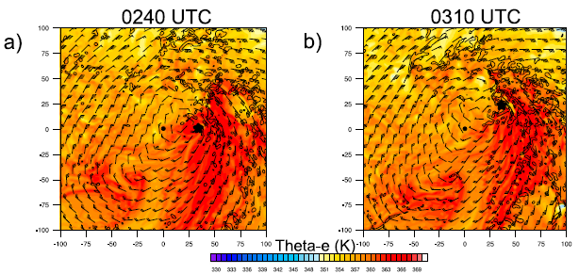
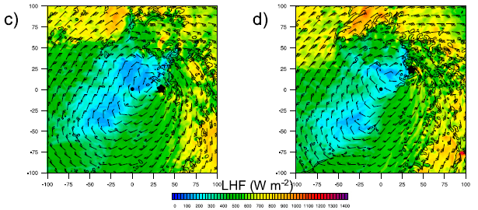
$$z≅31m$$

Slide 15
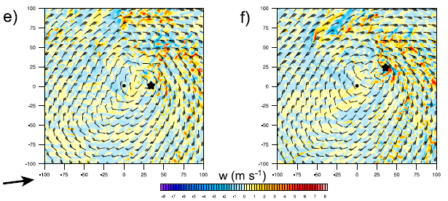
$$z≅31m$$
$$z≅1km$$
The lack of downdrafts

Slide 16
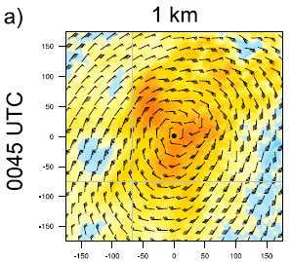
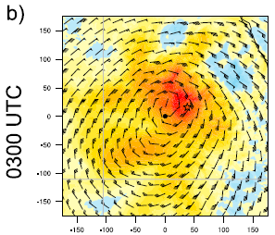
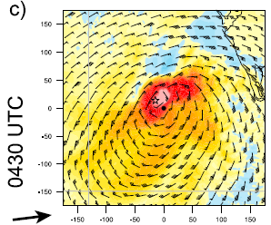
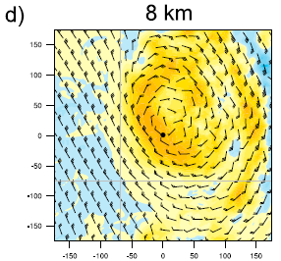
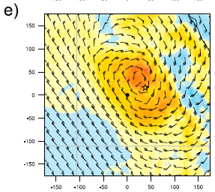
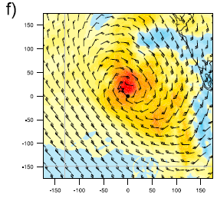

Slide 17
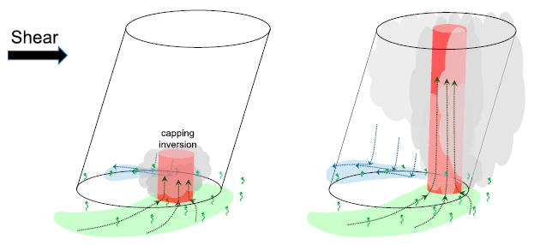
Conclusions

Slide 18
Reference
Leon T. Nguyen and John Molinari, 2015: Simulation of the Downshear Reformation of a Tropical Cyclone. J. Atmos. Sci., 72, 4529–4551.

