Slide 1
Sensitivity of a Simulated Squall Line to Horizontal Resolution and Parameterization of Microphysics
GEORGE H. BRYAN AND HUGH MORRISON
National Center for Atmospheric Research,* Boulder, Colorado
(Manuscript received 25 February 2011, in final form 15 June 2011)
MONTHLY WEATHER REVIEW

Slide 2
Introduction
The Second Verification of the Origins of Rotation in Tornadoes Experiment (VORTEX2). [Squall line in Oklahoma on 15 May 2009]
The primary focus is on the sensitivity of the structure and intensity of the squall line.
Horizontal Resolution
4 km, 1 km and 0.25 km
The primary focus is on the sensitivity of the structure and intensity of the squall line to horizontal grid spacing between 4 and 0.25 km, as well as two key aspects of a three-class bulk microphysics parameterization: 1) one moment versus two moment and 2) inclusion of either graupel or hail as the dense precipitating ice species.
One moment
vs.
Two moment
Microphysics Parameterization
Graupel
vs.
Hail

Slide 3
Outline
Methodology
Sensitivity to horizontal resolution
Sensitivity to microphysics
Raindrop size distribution ( 2M vs. 1M )
Hail versus graupel ( HAIL vs. GRAL )
Comparison to VORTEX2 analyses
Summary

Slide 4
Methodology
Model setup
Cloud Model version 1 (CM1)
[3D non-hydrostatic numerical model]
Along-line (y) direction : Periodic lateral boundary conditions Across-line (x) direction : Open boundary conditions
The domain size is 576 km $×$ 144 km $×$25 km.
Horizontal grid spacings ($∆$x) : 4, 1, and 0.25 km.
Vertical grid spacing: 100 levels
[increasing from 100 m to 400 m]
A time step of 3 s
The squall line is initialized with a cold pool.
Random temperature perturbations :$±$0.2 K
CAPE=4200 ${Jkg}^{−1}$
Random temperature perturbations :$±$0.2 K are inserted near the edge of the cold pool to initiate three-dimensional motions.

Slide 5
Methodology
TWO-MOMENT SCHEME .vs. ONE-MOMENT SCHEME
The hydrometeor size distributions $N(D)$ are treated using gamma functions:
$N(D)$ = $N_{0}D^{μ}e^{−λD}$
TWO-MOMENT SCHEME (2M)
[This scheme is based on the parameterization of M05]
Mixing ratios(q) and Number concentrations(N)
$N_{0}$ and $λ$ are free parameters that are determined from the predicted mixing ratio($q$) and number concentration($N$) for each species
$λ$=${[\frac{cNΓ(μ+4)}{qΓ(μ+1)}]}^{1/d}$ $N_{0}$=[$\frac{Nλ^{μ+1}}{Γ(μ+1)}$]
ONE-MOMENT SCHEME (1M)
Mixing ratios(q)
$N_{0}$ is specified for rain, snow, and graupel,
N and$λ$ are derived from the predicted q
and specified $N_{0}$ and$μ$.
D : Particle diameter
$N_{0}$ : Intercept parameter
$μ$ : Shape parameter
$λ$ : Slope parameter
$Γ$ : Euler gamma function
c, d : From power-law mass– diameter ($m$–$D$) relationship [$m$= $cD^{d}$ ]
All particles are assumed to be spheres for simplicity.
Notes:
水相粒子的粒徑分佈大致上是參照下列的嘎嗎function所設定

Slide 6
Methodology
HAIL AND GRAUPEL MICROPHYSICS
The only differences between the hail and graupel versions of the scheme are the
1) particle density– and 2) fall speed–size relationships.
GRAUPEL (GRAL)
Medium-density graupel (400 kg $m^{−3}$) Following Reisner et al. (1998)
V = ${aD}^{b}$ a =19.3 $m^{1−b}$ $s^{−1}$ and b =0.37 Following Locatelli and Hobbs (1974)
HAIL (HAIL)
High-density hail (900 kg $m^{−3}$) Similar to Lin et al. (1983).
V = ${aD}^{b}$ a =114.5 $m^{1−b}$ $s^{−1}$and b=0.5 Following Matson and Huggins

Slide 7
Outline
Methodology
Sensitivity to horizontal resolution
Sensitivity to microphysics
Raindrop size distribution ( 2M vs. 1M )
Hail versus graupel ( HAIL vs. GRAL )
Comparison to VORTEX2 analyses
Summary

Slide 8
Sensitivity to horizontal resolution
a. Individual convective cells
Horizontal cross at z=5 km and t=6 h for 2M-HAIL
$∆x$=4 km
$∆x$=1 km
$∆x$=0.25 km
Shading : Vertical velocity $w$ ( $ms^{−1}$)
Contours : Cloud water evaporation rate $E_{c} ({{1×10}^{5}kgkg}^{−1}s^{−1}$)

Slide 9
Sensitivity to horizontal resolution
a. Individual convective cells
Vertical cross sections at t=6 h for 2M-HAIL
Along-line
Across-line
Shading : Equivalent potential temperature $θ_{e}$ (K)
Contours : Cloud water evaporation rate $E_{c} ({1×10}^{5}{kgkg}^{−1}s^{−1}$)

Slide 10
Sensitivity to horizontal resolution
b. Microphysical processes
Time series of domain-total rainfall rate ($×{10}^{6}$ kg $s^{−1}$ )
$∆x$=4 km
$∆x$=1 km
$∆x$=0.25 km
Domain-total surface precipitation ($×{10}^{11}$ kg)
: t = 6–9 h.

Slide 11
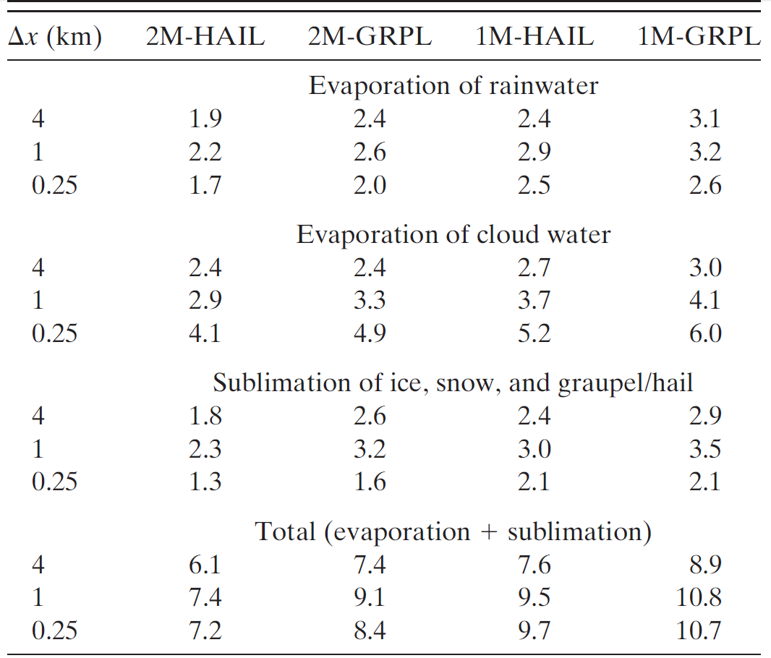
Sensitivity to horizontal resolution
b. Microphysical processes
Domain-total evaporation/sublimation ($×{10}^{11}$ kg)
: t = 6–9 h.
Domain-total condensation/deposition ($×{10}^{11}$ kg)
: t = 6–9 h.
Domain-total surface precipitation ($×{10}^{11}$ kg)
: t = 6–9 h.
Precipitation efficiency (%)
: t = 6–9 h.

Slide 12
Sensitivity to horizontal resolution
c. System intensity
Total upward flux of dry air
All variables are averaged from t = 6–9 h.
The bold numbers highlight the largest value for a given microphysical setup
The numbers in italics indicate that the value is statistically different from the 2M-HAIL/Dx = 0.25-km value at the 99% confidence level.
Maximum vertical velocity
Cold pool intensity
System propagation speed
Maximum line averaged
perturbation wind speed
(at the lowest model level)
Maximum cloud top
Notes:
All variables are averaged from t = 6–9 h.
The bold numbers highlight the largest value for a given microphysical setup
The numbers in italics indicate that the value is statistically different from the
2M-HAIL/Dx 5 0.25-km value at the 99% confidence level

Slide 13
Sensitivity to horizontal resolution
Horizontal cross at z=5 km and t=6 h for 2M-HAIL
$∆x$=4 km
$∆x$=1 km
$∆x$=0.25 km
Shading : Vertical velocity $w$ ( $ms^{−1}$)
Contours : Cloud water evaporation rate $E_{c} ({{1×10}^{5}kgkg}^{−1}s^{−1}$)

Slide 14
Sensitivity to horizontal resolution
Line-averaged vertical cross sections at t =9 h for 2M-HAIL
$∆x$=4 km
$∆x$=1 km
$∆x$=0.25 km
The tracer is initialized with a constant value of mixing ratio (1 ${gg}^{−1}$) in the pre-squall line environment and only for z $<$1.5 km (i.e., in the boundary layer), but is zero everywhere else.
Shading: The mixing ratio (${gg}^{−1}$) of a passive fluid tracer
(originally released in the pre-squall-line boundary layer)

Slide 15
Outline
Methodology
Sensitivity to horizontal resolution
Sensitivity to microphysics
Raindrop size distribution ( 2M vs. 1M )
Hail versus graupel ( HAIL vs. GRAL )
Comparison to VORTEX2 analyses
Summary

Slide 16
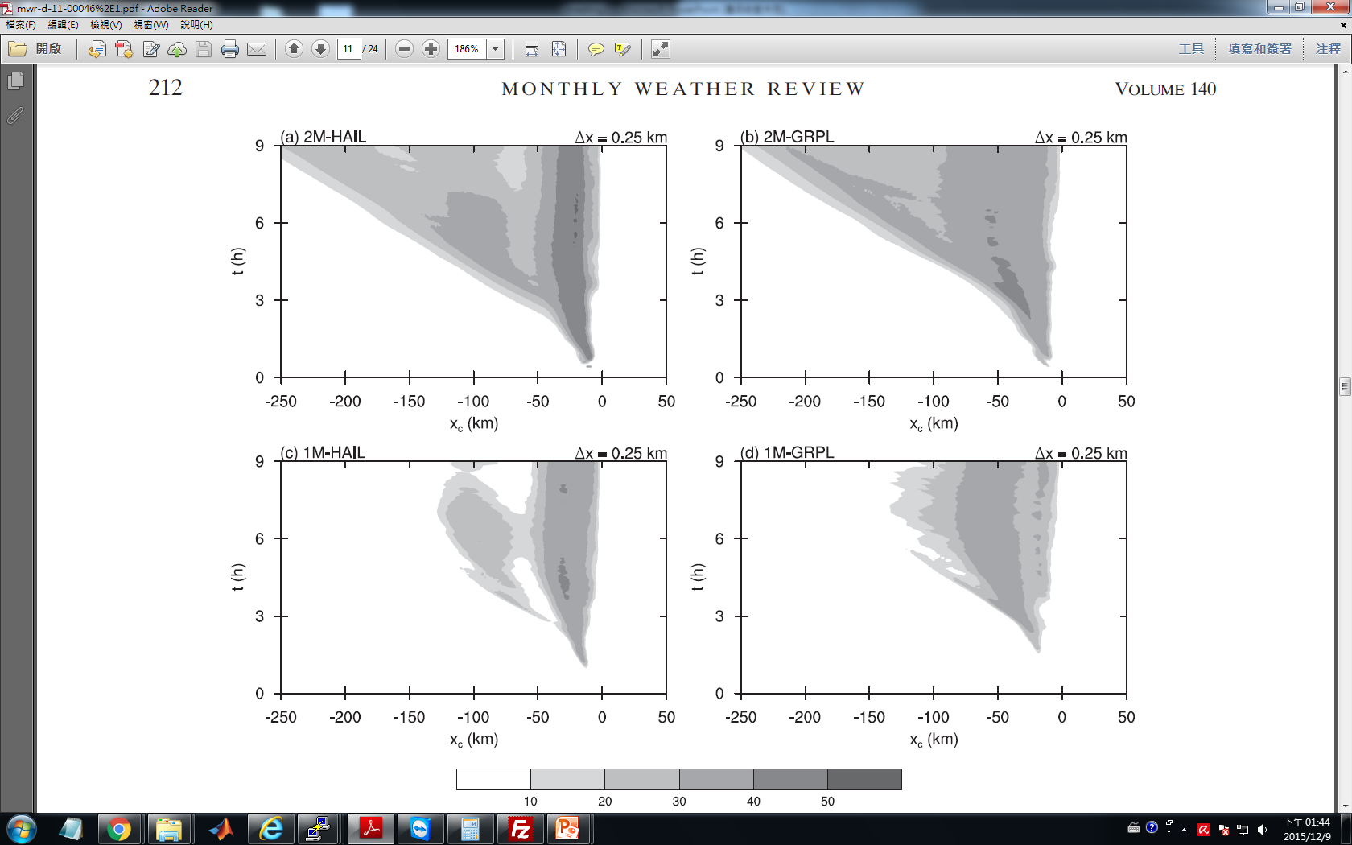
Sensitivity to microphysics
For simplicity, we define the convective region as reflectivity $<$30 dBZ in the area just behind the surface gust front.(p212)
All microphysical sensitivity simulations
$∆x$=0.25 km
All simulations use 2M ice crystals and 1M cloud water
(with fixed number concentration of 300 ${cm}^{−3}$).
a) Raindrop size distribution (2M vs 1M)
b) Hail or graupel (HAIL vs GRAL)
$Hovm\ddot{o}ller$ diagrams of line-averaged reflectivity (dBZ) (at the lowest model level using $∆x$=0.25 km)
Convective region :
reflectivity $>$30 dBZ
2M
1M
Notes:
All simulations use 2M ice crystals and 1M cloud water (with fixed number concentration of 300 ${cm}^{−3}$).

Slide 17
Sensitivity to microphysics
a. Raindrop size distribution (2M vs. 1M)
Line-averaged vertical cross sections at t=9 h using $∆x$=0.25 km
2M
1M
Shading: Reflectivity (dBZ)
Contours: Rainwater evaporation rate $E_{r}({{10}^{−7}kgkg}^{−1}s^{−1}$)
Notes:
Contours: Rainwater evaporation rate $({{1,3,5,7,9×10}^{−7}kgkg}^{−1}s^{−1}$)

Slide 18
Sensitivity to microphysics
a. Raindrop size distribution (2M vs. 1M)
Line-averaged vertical cross sections of the predicted${ N}_{0r}$ from 2M at t=9 h using $∆x$=0.25 km
2M-HAIL
2M-GRPL
Contours: Predicted $N_{0r}$ [$\log_{10}\left(N_{0r}\right)]$ from 2M
Thick contours : $N_{0r}$ = ${10}^{7}m^{−4}$ [$\log_{10}\left(N_{0r}\right)]$ from 1M

Slide 19
Sensitivity to microphysics
a. Raindrop size distribution (2M vs. 1M)
2M-HAIL-1MR
2M-GRAL-1MR
2M
1M

Slide 20
Sensitivity to microphysics
b. Hail versus graupel
Convective region :
reflectivity $>$30 dBZ
$Hovm\ddot{o}ller$ diagrams of line-averaged reflectivity (dBZ) (at the lowest model level using $∆x$=0.25 km)
HAIL
GRAL
Shading: Reflectivity (dBZ)
Bryan and Parker (2010)

Slide 21
Sensitivity to microphysics
b. Hail versus graupel
Line-averaged vertical cross sections at t=9 h using $∆x$=0.25 km
HAIL
GRAL
Bryan and Parker (2010)
Shading: Reflectivity (dBZ)
Contours: Rainwater evaporation rate $E_{r}({{10}^{−7}kgkg}^{−1}s^{−1}$)

Slide 22
Sensitivity to microphysics
b. Hail versus graupel
2M-HAIL
2M-GRAL
Line-averaged vertical cross sections at t=9 h using $∆x$=0.25 km
2M-HAIL-D400
2M-HAIL-FG
Shading: Reflectivity (dBZ)
Contours: Fall velocity of hail / graupel $(1ms^{−1}$)

Slide 23
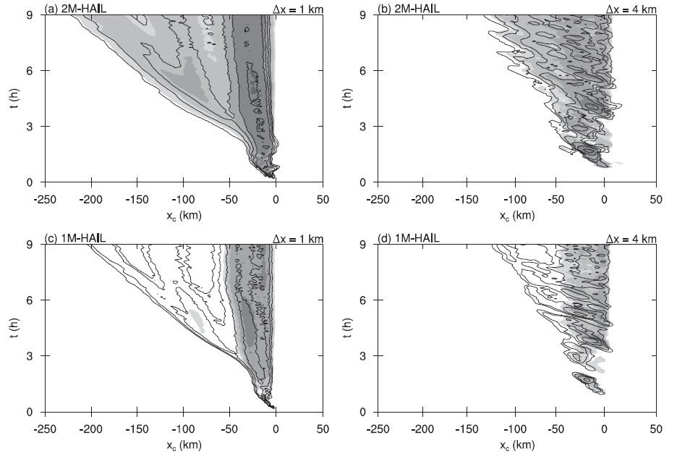
Sensitivity to microphysics
c. Impact of resolution on microphysical sensitivities
$Hovm\ddot{o}ller$ diagrams of line-averaged reflectivity (dBZ)
2M-HAIL
$∆x$=0.25 km
2M-HAIL
$∆x$=1 km
2M-HAIL
$∆x$=4 km
1M-HAIL
$∆x$=0.25 km
1M-HAIL
$∆x$=1 km
1M-HAIL
$∆x$=4 km
Shading: Reflectivity (dBZ) at the lowest model level
Contours: Reflectivity (dBZ) at z=3km (interval 10 dBZ)

Slide 24
Outline
Methodology
Sensitivity to horizontal resolution
Sensitivity to microphysics
Raindrop size distribution ( 2M vs. 1M )
Hail versus graupel ( HAIL vs. GRAL )
Comparison to VORTEX2 analyses
Summary

Slide 25
Comparison to VORTEX2 analyses
Relative humidity (H)
Cold pool: $x_{c}<$ 0 km & z$<$3km
Line-averaged vertical cross sections [averaged over 4–5 h]
2M-HAIL
$∆x$=0.25 km
1M-HAIL
$∆x$=0.25 km
2M-GRAL
$∆x$=0.25 km
2M-HAIL
$∆x$=1 km
2M-HAIL
$∆x$=4 km
analysis
Contours: Relative humidity H (%)
Shading: Relative humidity H $>$ 80%
Notes:
Contour interval : 10%
cold pool (for $x_{c}<$0 and z$<$3 km)
The model output shown here is averaged along the line, whereas the observations are from one location.

Slide 26
Comparison to VORTEX2 analyses
Bouncy (B)
Cold pool: $x_{c}<$ 0 km & z$<$3km
Line-averaged vertical cross sections [averaged over 4–5 h]
2M-HAIL
$∆x$=0.25 km
1M-HAIL
$∆x$=0.25 km
2M-GRAL
$∆x$=0.25 km
2M-HAIL
$∆x$=1 km
2M-HAIL
$∆x$=4 km
analysis
Cold pool depth (h)
Contours: Buoyancy B (${ms}^{−2}$)
Light shading: B $<$ -0.02 ${ms}^{−2}$
Dark shading: B $<$ -0.3 ${ms}^{−2}$
Notes:
Contour interval : 0.1 ${ms}^{−2}$ intermediate contours:0 .02 ${ms}^{−2}$

Slide 27
Comparison to VORTEX2 analyses
System-relative across-line flow (u)
Line-averaged vertical cross sections [averaged over 4–5 h]
2M-HAIL
$∆x$=0.25 km
1M-HAIL
$∆x$=0.25 km
2M-GRAL
$∆x$=0.25 km
2M-HAIL
$∆x$=1 km
2M-HAIL
$∆x$=4 km
analysis
Contours: Wind speed u (${ms}^{−1}$)
Shading: u$>0$ ${ms}^{−1}$

Slide 28
Outline
Methodology
Sensitivity to horizontal resolution
Sensitivity to microphysics
Raindrop size distribution ( 2M vs. 1M )
Hail versus graupel ( HAIL vs. GRAL )
Comparison to VORTEX2 analyses
Summary

Slide 29
Summary
Surface precipitation decreases as horizontal grid spacing decreases. (specifically, surface precipitation is 10%–30% lower with $∆x$ = 0.25 km than with $∆x$ = 1 km. This result can be explained by changes in condensation and evaporation)
Decreasing $∆x$ typically leads to larger cloud water evaporation ($E_{c}$).
Precipitation (R) (1km, 0.25km), precipitation efficiency (PE) decreases as $∆x$ decreases.
1) Total surface area of clouds
2) Enhanced entrainment/detrainment
Horizontal Resolution
4 km, 1km and 0.25 km
One moment
vs.
Two moment
Microphysics Parameterization
Microphysical sensitivities are found to be qualitatively similar for the different grid spacings.
This result suggests that model users can test microphysical sensitivity at lower resolution and get qualitatively consistent results. However, quantitative differences are apparent for higher resolution.
Graupel
vs.
Hail
1M produces less realistic results.
Graupel produce convective regions that are too wide and have lower reflectivity.
Changes to $∆x$ have a greater impact overall than the changes in microphysical setup.
Rainwater evaporates too quickly.
low buoyancy bias and higher relative humidity in the cold pool
Slower fall velocity of graupel compared to hail

Slide 31
Bryan and Parker (2010)

Slide 32
Formulating an equation for w and assuming usual normal mode solutions.
One can derive the following relationship between the amplitude of the normal modes, $W_{0}$ and $B_{0}$
 | Nonhydrostatic | Hydrostatic
Amplitude of Vertical motion ($W_{0}$)
Vertical mass flux (m)
Frequency ($ω$)
$B_{0}$ : Buoyancy
N : Brunt–V$\ddot{a}$is$\ddot{a}$l$\ddot{a}$ frequency
k (=$2π$/$λ_{x})$ , l ($=2π$/$λ_{z})$ : Horizontal and vertical wavenumbers
Vertical mass flux (m)$∝$ $W_{0}$/k.
Weiaman et al. (1996)

Slide 33
Comparison to VORTEX2 analyses
Cold pool depth (h) and Cold pool intensity (C) at t =5 h using $∆x$ = 0.25 km
2M-HAIL
1M-HAIL
Cold pool depth (h)
2M-HAIL
1M-HAIL
Cold pool intensity (C)
Shading : Encloses minimum and maximum values in the domain
plus symbols : Observed values

Slide 34
Comparison to VORTEX2 analyses
Soundings
Line-averaged soundings at $x_{c}$=50 km (trailing stratiform region) at t=5 h using $∆x$=0.25 km
2M-HAIL
1M-HAIL
Thin lines: Observed sounding
Thick lines : Model sounding
Notes:
An observed sounding (S7 from BP10) is shown by thin lines that
was launched at xc=-46 km approximately 5 h after the squall line formed.

Slide 35
Summary
Surface precipitation decreases as horizontal grid spacing decreases. (specifically, surface precipitation is 10%–30% lower with $∆x$ = 0.25 km than with $∆x$ = 1 km. This result can be explained by changes in condensation and evaporation)
Changes to $∆x$ have a greater impact overall than the changes in microphysical setup.
Surface precipitation decreases as horizontal grid spacing decreases. (specifically, surface precipitation is 10%–30% lower with $∆x$ = 0.25 km than with $∆x$ = 1 km. This result can be explained by changes in condensation and evaporation)
Decreasing $∆x$ typically leads to larger evaporation, and most of the change is attributable to the evaporation of cloud water (not rainwater).
Changes in the total surface area of clouds, and enhanced entrainment/detrainment because of resolved turbulence, seem to be primarily responsible for the increase in cloud water evaporation with decreasing $∆x$ .
Single moment (1M) specification of microphysics produces less realistic results.
Because rainwater evaporates too quickly
Also accounts for a low buoyancy bias in the cold pool, and higher relative humidity, compared to both observations and the 2M runs).
Simulations with graupel (instead of hail) produce convective regions that are too wide and have lower reflectivity.
Which is primarily attributable to the slower fall velocity of graupel compared to hail.
By comparing against rawinsonde data collected during VORTEX2, the simulation with $∆x$ = 0.25 km, double moment microphysics, and hail as the dense ice species is the most realistic. This run (2M-HAIL) stands out .
Microphysical sensitivities are found to be qualitatively similar for the different grid spacings.
This result suggests that model users can test microphysical sensitivity at lower resolution and get qualitatively consistent results. However, quantitative differences are apparent for higher resolution.

Slide 36
Summary
By comparing against rawinsonde data collected during VORTEX2, the simulation with $∆x$ = 0.25 km, double moment microphysics, and hail as the dense ice species is the most realistic. This run (2M-HAIL) stands out .
(i) it has realistic convective, transition, and trailing stratiform regions,
(ii) the depth, intensity, and distribution of the surface-based cold pool compare favorably with observations, and
(iii) it has reasonably low values of relative humidity at low levels (z, 4 km) in the trailing stratiform region.

Slide 37
Methodology
TWO-MOMENT SCHEME
The two-moment bulk cloud microphysics scheme predicts mixing ratios and number concentrations of five hydrometeor species: cloud droplets, cloud ice, snow, rain, and either graupel or hail.
The hydrometeor size distributions $N(D)$ are treated using gamma functions:
$N(D)$ = $N_{0}D^{μ}e^{−λD}$
D is the particle diameter, and $N_{0}$, $μ$, and $λ$ are the intercept, shape, and slope
parameters, respectively.
$N_{0}$and $λ$ are free parameters that are determined from the predicted mixing ratio($q$) and number concentration($N$) for each species
$λ$=${[\frac{cNΓ(μ+4)}{qΓ(μ+1)}]}^{1/d}$ $N_{0}$=[$\frac{Nλ^{μ+1}}{Γ(μ+1)}$]
$Γ$ is the Euler gamma function ,and c, d are from power-law mass– diameter ($m$–$D$) relationship of the
hydrometeors for each species, where $m$= $cD^{d}$. All particles are assumed to be spheres for simplicity.
ONE-MOMENT SCHEME
$N_{0}$ is specified for rain, snow, and graupel, and N and$λ$ are derived from the predicted q and specified $N_{0}$ and$μ$.

Slide 38
Methodology
HAIL AND GRAUPEL MICROPHYSICS
The only differences between the hail and graupel versions of the scheme are the particle density– and fall speed–size relationships
We test the impact of assuming either graupel or hail for the dense (rimed) ice species by setting the bulk particle density to either a lower value appropriate for
Medium-density graupel (400 kg $m^{−1}$) following Reisner et al. (1998)
High-density hail (900 kg $m^{−1}$) similar to Lin et al. (1983).
The fall speed–size relationship is given by a power law, V = ${aD}^{b}$.
For graupel, a =19.3 $m^{1−b}$ $s^{−1}$ and b =0.37 following the relationship in Locatelli
and Hobbs (1974) for lump graupel.
For hail, a =114.5 $m^{1−b}$ $s^{−1}$and b=0.5 following Matson and Huggins

Slide 39
Methodology
HAIL AND GRAUPEL MICROPHYSICS
The only differences between the hail and graupel versions of the scheme are the particle density– and fall speed–size relationships
BULK DENSITY
Medium-density graupel (400 kg $m^{−1}$) following Reisner et al. (1998)
High-density hail (900 kg $m^{−1}$) similar to Lin et al. (1983).
FALL SPEED–SIZE RELATIONSHIP
V = ${aD}^{b}$
Graupel : a =19.3 $m^{1−b}$ $s^{−1}$ and b =0.37 following Locatelli and Hobbs (1974)
Hail : a =114.5 $m^{1−b}$ $s^{−1}$and b=0.5 following Matson and Huggins

Slide 40
Sensitivity to microphysics
For simplicity, we define the convective region as reflectivity $<$30 dBZ in the area just behind the surface gust front.(p212)
All microphysical sensitivity simulations
All simulations use 2M ice crystals and 1M cloud water
(with fixed number concentration of 300 ${cm}^{−3}$).
$Hovm\ddot{o}ller$ diagrams of line-averaged reflectivity (dBZ) (at the lowest model level using $∆x$=0.25 km)
Convective region :
reflectivity $>$30 dBZ
2M-HAIL
2M
1M
Notes:
All simulations use 2M ice crystals and 1M cloud water (with fixed number concentration of 300 ${cm}^{−3}$).

Slide 41
Comparison to VORTEX2 analyses
Relative humidity (H)
Line-averaged vertical cross sections [averaged over 4–5 h]
2M-HAIL
$∆x$=0.25 km
1M-HAIL
$∆x$=0.25 km
2M-GRAL
$∆x$=0.25 km
2M-HAIL
$∆x$=1 km
2M-HAIL
$∆x$=4 km
analysis
Contours: Relative humidity H (%)
Shading: Relative humidity H $>$ 80%
Notes:
Contour interval : 10%
cold pool (for $x_{c}<$0 and z$<$3 km)
The model output shown here is averaged along the line, whereas the observations are from one location.

Slide 42
Comparison to VORTEX2 analyses
Relative humidity (H)
Cold pool: $x_{c}<$ 0 km & z$<$3km
Line-averaged vertical cross sections [averaged over 4–5 h]
2M-HAIL
$∆x$=0.25 km
1M-HAIL
$∆x$=0.25 km
2M-GRAL
$∆x$=0.25 km
2M-HAIL
$∆x$=1 km
2M-HAIL
$∆x$=4 km
analysis
Contours: Relative humidity H (%)
Shading: Relative humidity H $>$ 80%
Notes:
Contour interval : 10%
cold pool (for $x_{c}<$0 and z$<$3 km)
The model output shown here is averaged along the line, whereas the observations are from one location.

Slide 43
Comparison to VORTEX2 analyses
Relative humidity (H)
Cold pool: $x_{c}<$ 0 km & z$<$3km
Line-averaged vertical cross sections [averaged over 4–5 h]
2M-HAIL
$∆x$=0.25 km
1M-HAIL
$∆x$=0.25 km
2M-GRAL
$∆x$=0.25 km
2M-HAIL
$∆x$=1 km
2M-HAIL
$∆x$=4 km
analysis
Contours: Relative humidity H (%)
Shading: Relative humidity H $>$ 80%
Notes:
Contour interval : 10%
cold pool (for $x_{c}<$0 and z$<$3 km)
The model output shown here is averaged along the line, whereas the observations are from one location.

Slide 44
Comparison to VORTEX2 analyses
Bouncy (B)
Cold pool: $x_{c}<$ 0 km & z$<$3km
Line-averaged vertical cross sections [averaged over 4–5 h]
2M-HAIL
$∆x$=0.25 km
1M-HAIL
$∆x$=0.25 km
2M-GRAL
$∆x$=0.25 km
2M-HAIL
$∆x$=1 km
2M-HAIL
$∆x$=4 km
analysis
Cold pool depth (h)
Contours: Buoyancy B (${ms}^{−2}$)
Light shading: B $<$ -0.02 ${ms}^{−2}$
Dark shading: B $<$ -0.3 ${ms}^{−2}$
Notes:
Contour interval : 0.1 ${ms}^{−2}$ intermediate contours:0 .02 ${ms}^{−2}$

