Slide 1
Genesis of Typhoon Nari (2001) from a mesoscale convective system
Zhang, D.-L., L. Tian, and M.-J. Yang, 2011: Genesis of Typhoon Nari (2001) from a mesoscale convective system. J. Geophys. Res., 116, D23104

Slide 2
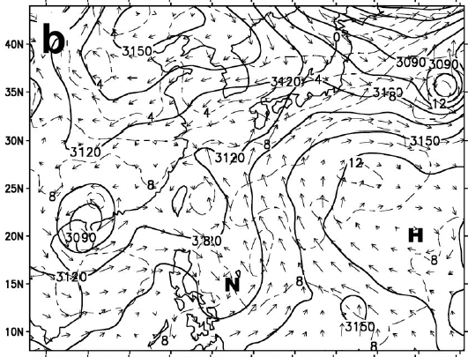
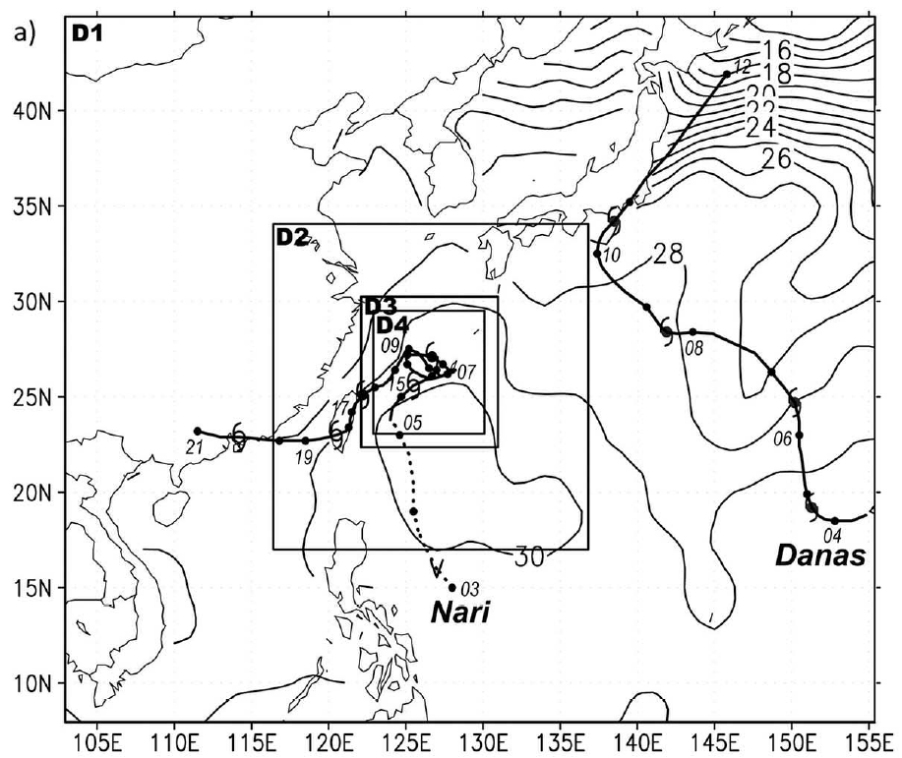
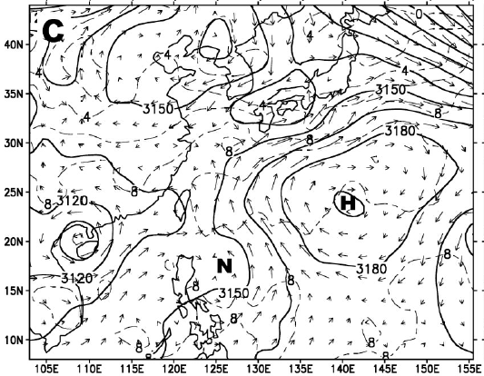
Overview
9/2 00UTC
9/3 00UTC

Slide 3
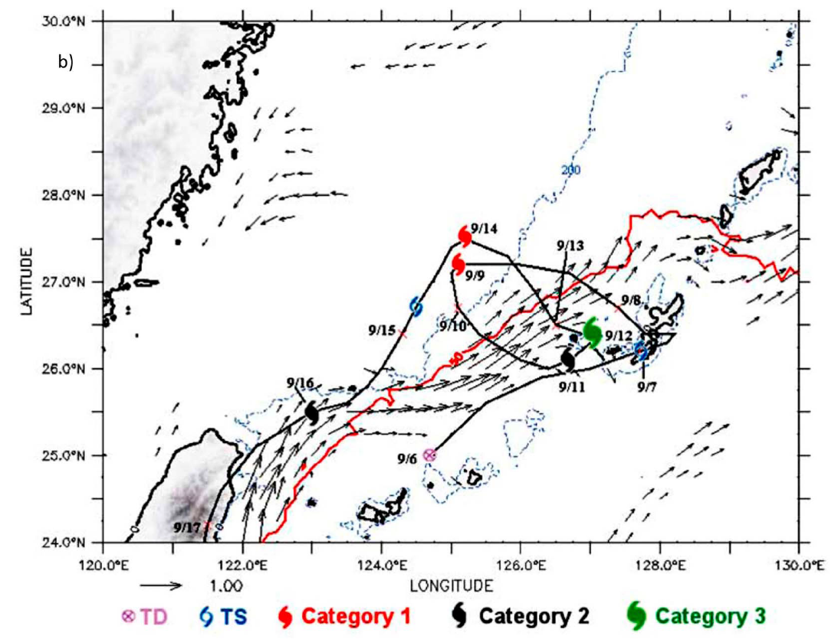

Slide 4
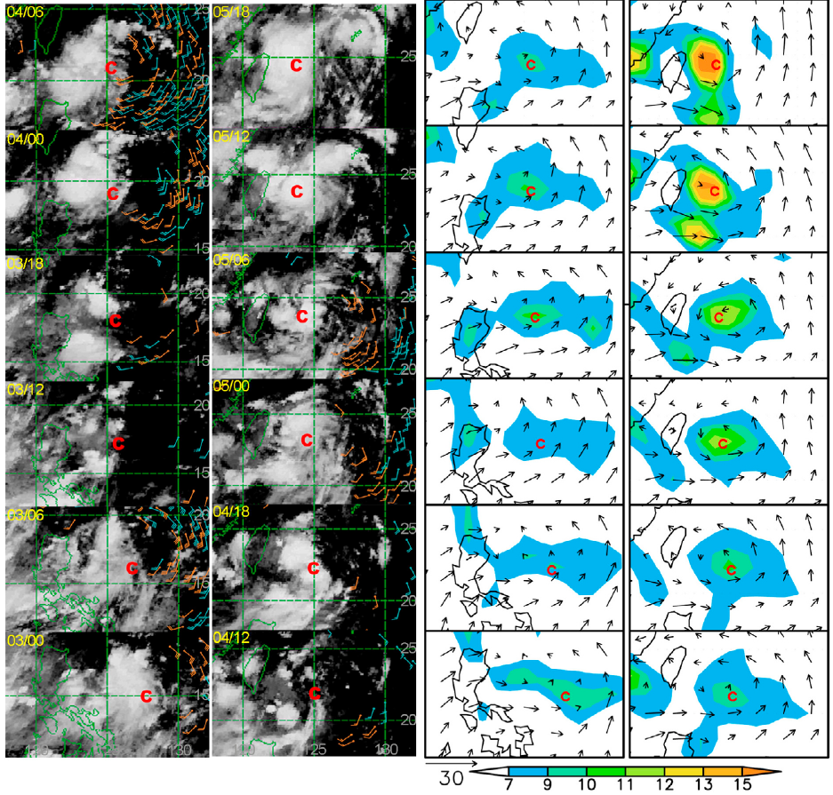

Slide 5
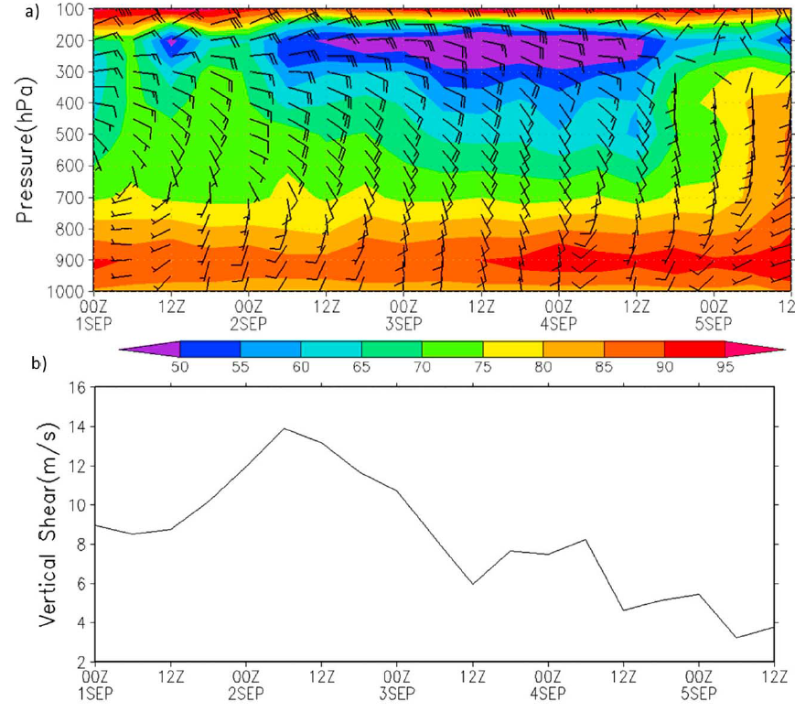

Slide 6
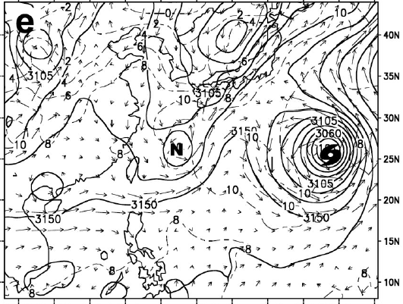
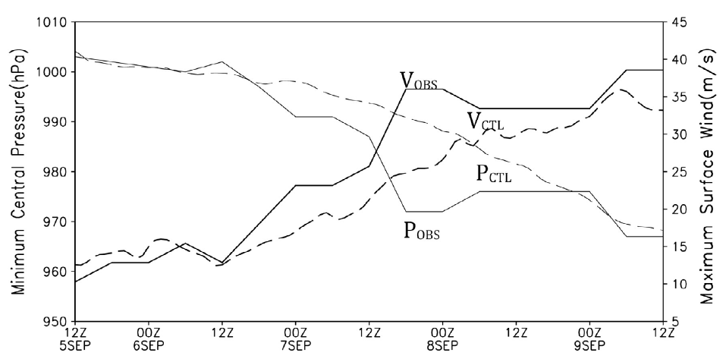
9/7 00UTC

Slide 7
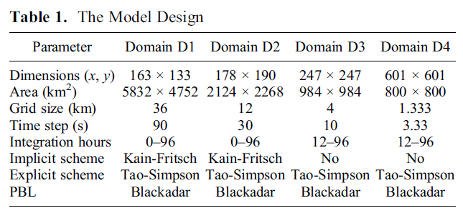
Model Configuration
MM5 V3.6 (nonhydrostatic, two-way interactive nested domain)
43 uneven sigma level
IC & BC: ECMWF 1.25x1.25
Initial time: Sep 5, 2001 1200 UTC
CU
MP

Slide 8
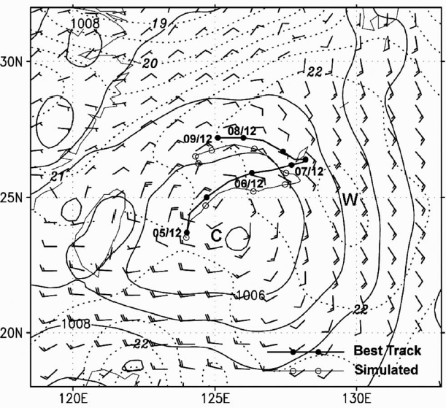
Verification
9/5 12UTC

Slide 9
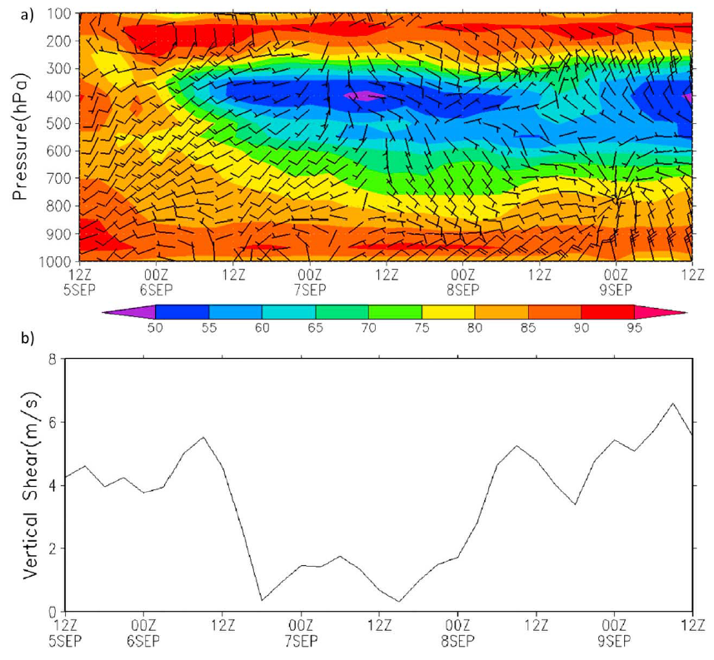

Slide 10
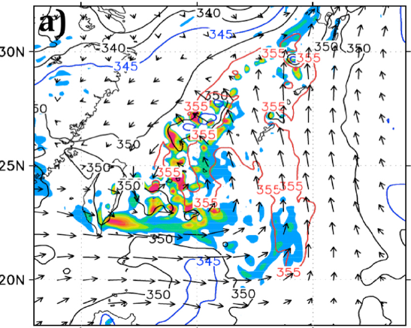
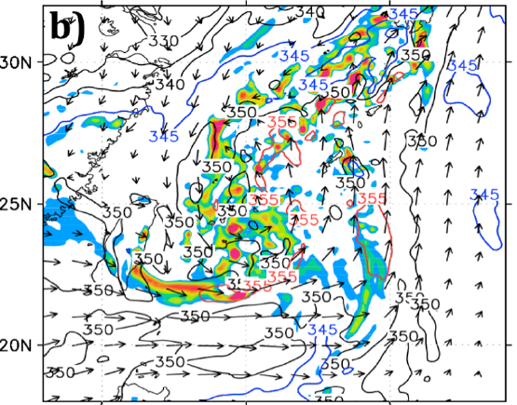
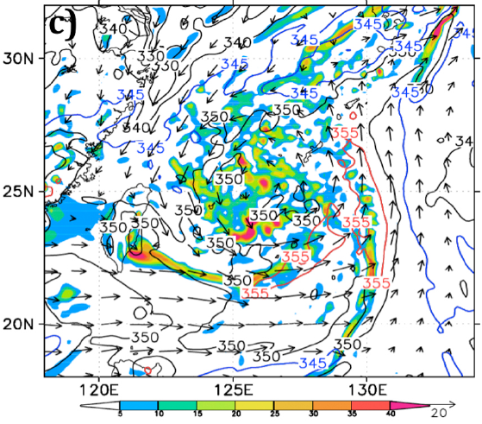
MCS → Typhoon
9/5 18UTC
9/6 00UTC
9/6 06UTC

Slide 11
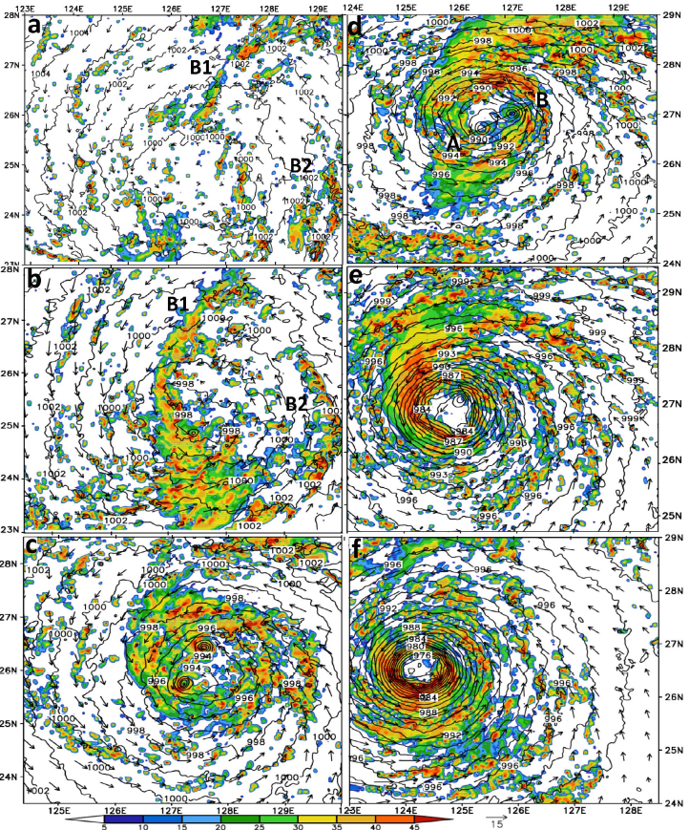
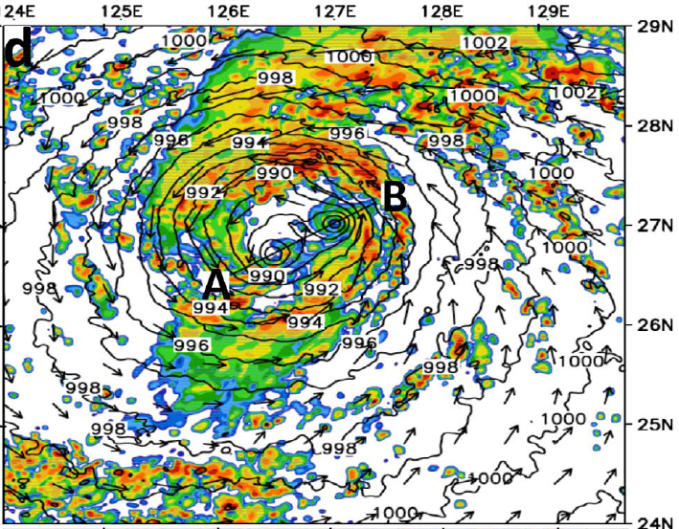
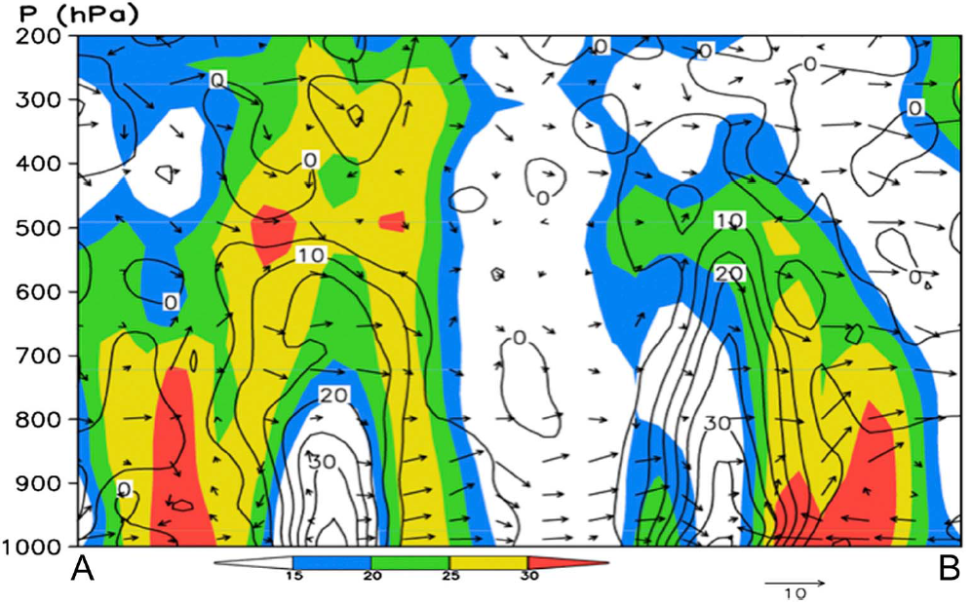
9/6 12UTC
9/8 00UTC
9/7 00UTC
9/8 12UTC
9/7 12UTC
9/9 00UTC

Slide 12
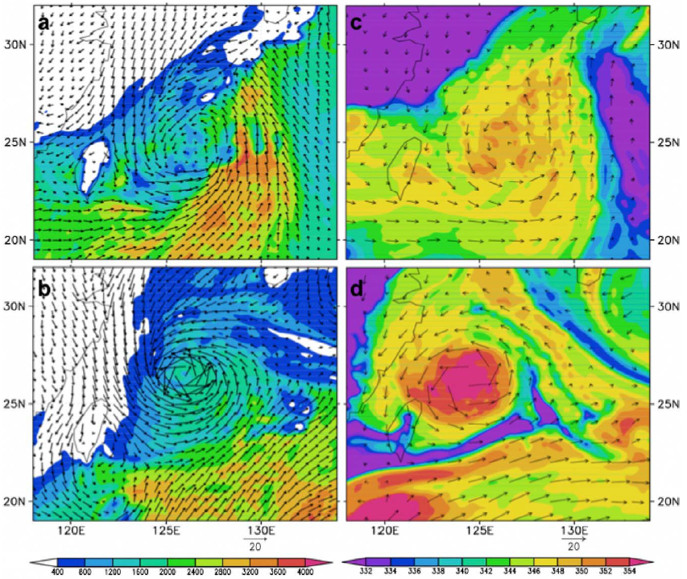
9/6 12UTC
9/9 12UTC

Slide 13
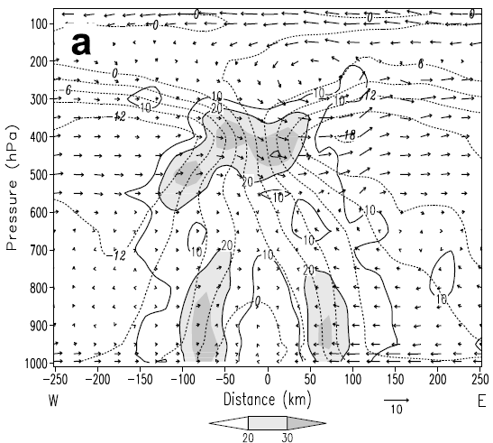
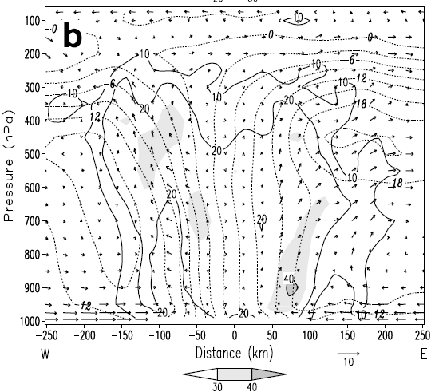
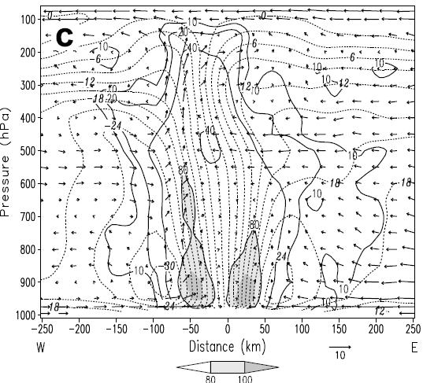
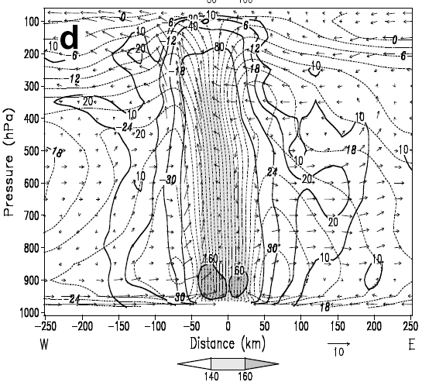
Spin-up
9/6 12UTC
9/7 12UTC
9/8 12UTC
9/9 12UTC

Slide 14
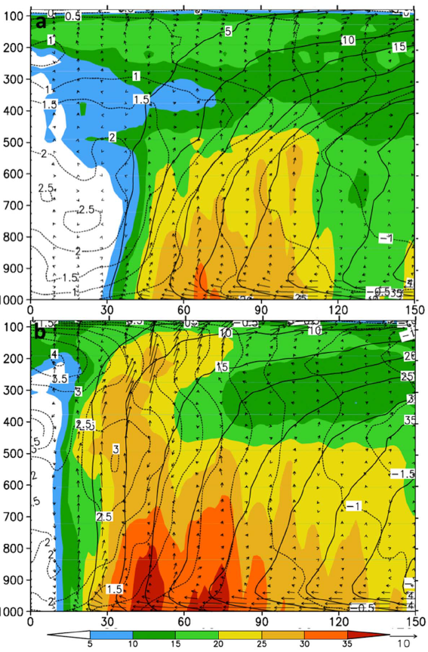
9/8 12UTC
9/9 12UTC

Slide 15
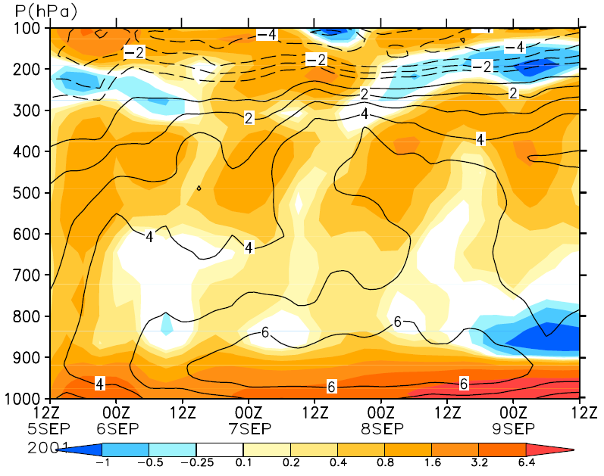

Slide 16
Conclusions

Slide 17
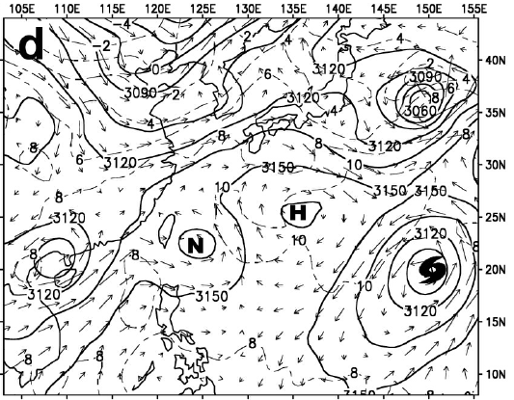
9/5 00UTC

