Slide 1
Thermally Forced Convection over a Mountainous Tropical Island
Wang, C.-C., and D. J. Kirshbaum, 2015: Thermally forced convection over a mountainous tropical island. J. Atmos. Sci., 72, 2484–2506.

Slide 2
Outline
Observations
Control simulations
Sensitivity tests
Heat-engine theory
Conclusions
Reference

Slide 3
Observations
Dominica Experiment(DOMEX) : April-May 2011
Radiosonde( , TFFR)
Meteorological stations( )
Operational radars( )
Satellite(NOAA GOES-13)
Wyoming King Air(WKA) aircraft
(P, T, U, V, W, reflectivity, radial wind,
$m_{v}$, cloud and rain DSD)
(Smith et al. 2012, S12)
Four week-wind events on 18 April 2011.
Primarily focus on the island thermal
circulations, rather than the cloud
microphysics.

Slide 4
Observations
Z=300m
Satellite data:
effective albedo
Z=1800m
L3, L4

Slide 5
Control simulations
WRF V3.5
f-plane at $15°N$
$L_{z}=12km$, 81 stretched layers
$$∆x=1000m, 500m, 250m, 125m$$
Periodic lateral boundaries
$$N_{c}=200{cm}^{−3}$$
Initial condition: aircraft sounding
Parameterization:
Shortwave: Dudhia scheme
Longwave: RRTM scheme
Boundary layer: Explicit ($∆x≦500m$)
or MYJ prognostic TKE scheme
Cumulus: Explicit
Microphysics: Thompson scheme
$$L_{x}=180km$$
Broad leaf forest
land skin temperature=292K
$$L_{y}=180km$$
Sea surface temperature=300K

Slide 6
Calculating $M_{h}$ and $M_{v}$
$M_{h}$=$\int_{z_{0}}^{z_{δ0}}{\oint_{c}{ρv_{n}dsdz}}$
The vertically integrated surface-based horizontal
mass flux across the island perimeter.
dz
ds
C
$$v_{n}$$
$M_{v}$=$\iint_{S}{ρw|_{w>0,q_{c}>{(q_{c})}_{t} }ds}$
The horizontally integrated vertical cloud mass flux at fight level($z_{KWA}=1.8km$).
$$ds=∆x∆y$$
$${(q_{c})}_{t}=0.1 {gkg}^{−1}$$
ds

Slide 7
Sensitivity tests
a. Topographic forcing
$$LWP and 1st level wind.$$
0-500m
AGL mean
Island convergence
fraction
$$The terrain height$$
is capped at 2m.
$$The surface heat$$
$$fluxes are shut off.$$
$$CTL\text{−}250$$
(but epssm=0.1)
Island cloud
fraction

Slide 8
Sensitivity tests
b. Boundary layer winds
$$LWP and 1st level wind.$$
0-500m
AGL mean
Half the $0−2km$
$$wind profile$$
Double the $0−2km$
$$wind profile$$
$$0−1km wind profile with$$
$$60∘clockwise rotation$$
Convective cores
at z=1.8km
Island cloud
fraction

Slide 9
Sensitivity tests
c. Cloud feedbacks
$$LWP and 1st level wind.$$
0-500m
AGL mean
NORNCOD-REF
Shut off the autoconversion
from clouds to rain.
Shut off the clouds effect on
optical depth.
Shut off the both RN and COD.
Convective cores
at z=1.8km
Island cloud
fraction
Shut off the microphysics scheme.

Slide 10
Heat-engine theory
Diabatic temperature
difference
With terrain
Without terrain
$$W_{T}={[\frac{η}{μ}(C_{p}∆T_{na}+L_{v}∆m_{v})]}^{\frac{1}{2}}$$
$$η=\frac{gH}{C_{p}\overline{T}}$$
$$μ=8(1+L/H)$$
$$(Tian and Parker 2003)$$
Island mixed
layer depth
Circulation
strength

Slide 11
Conclusions
The cumulus convection was driven by island thermal forcing.
Flattening the terrain led to stronger island-scale mass convergence $M_{h}$ (or the bulk surface based inflow crossing the island perimeter) but weaker cloud vertical mass flux $M_{v}$.
Experiments varying the ambient winds indicated that the island thermal anomaly was controlled by the residence time of air parcels over the heated island.
The heat-engine theory : the elevated terrain in the mountain case reduced the mixed-layer depth and thus lowered the circulation’s thermodynamic efficiency. (Contrary to Tian and Parker 2003; Kirshbaum and Wang 2014).

Slide 12
Reference
Kirshbaum, D. J., and C.-C. Wang, 2014: Boundary layer updrafts driven by airflow over
heated terrain. J. Atmos. Sci., 71, 1425–1442, doi:10.1175/JAS-D-13-0287.1.
Smith, R. B., P. Schafer, D. J. Kirshbaum, and E. Regina, 2009:Orographic precipitation in the
tropics: Experiments in Dominica. J. Atmos. Sci., 66, 1698–1716,
doi:10.1175/2008JAS2920.1.
Smith, R. B., and Coauthors, 2012: Orographic precipitation in the tropics: The
Dominica Experiment. Bull. Amer. Meteor. Soc., 93,1567–1579,
doi:10.1175/BAMS-D-11-00194.1.
Tian, W. S., and D. J. Parker, 2003: A modeling study and scaling analysis of orographic
effects on boundary layer shallow convection. J. Atmos. Sci., 60, 1981–1991,
doi:10.1175/1520-0469(2003)060,1981:AMSASA.2.0.CO;2.
Wang, C.-C., and D. J. Kirshbaum, 2015: Thermally forced convection over a mountainous
tropical island. J. Atmos. Sci., 72, 2484–2506.

Slide 13
Thanks for your attention!

Slide 14
Control simulations
4 control simulations:
$$∆x=1000m\left(CTL\text{-}1000\right)$$
$500m$ $\left(CTL\text{−}500\right)$
$250m\left(CTL\text{−}250\right)$
$125m\left(CTL\text{−}125\right)$
Z=300m
Z=1800m

Slide 15
leg3, leg4

Slide 16
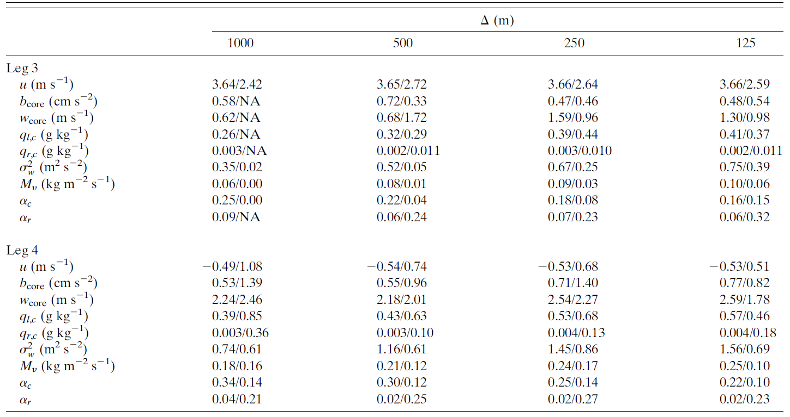
Observed/Simulated
zonal wind
w variance
cloud mass flux
cloud fraction
rain fraction
zonal wind
w variance
cloud mass flux
cloud fraction
rain fraction

Slide 17
1000-1700 LST accumulated rainfall
Leg 4 average values

