Slide 1
Thermodynamic Constraints on the Morphology of Simulated Midlatitude Squall Lines
DIEGO A. ALFARO AND MARAT KHAIROUTDINOV
School of Marine and Atmospheric Sciences, Stony Brook University, Stony Brook, New York
(Manuscript received 10 October 2014, in final form 9 April 2015)

Slide 2
Introduction
Observational studies have revealed that severe midlatitude squall-line (SL) environments are characterized by having relatively large latent instability, as measured by the convective available potential energy (CAPE), as well as considerable low-to-midtropospheric vertical wind shear, perpendicular to which the convective line generally organizes.
The importance of environmental wind shear for the organization and longevity of SLs has been elucidated through numerical simulations, but the specific role of CAPE in determining storm characteristics remains unclear.
This work will investigate the mechanisms through which the thermodynamic environment constrains SL characteristics, focusing on the development of cold pools and upper-tropospheric heating.
This study proposes a sounding-generating technique, focusing on the vertical distributions of CAPE and of the level of free convection (LFC).
This framework is considered to be convenient for investigating layer-lifting convective phenomena.
Develop deep cold pools that displace layers of low- and midtropospheric air vertically to the upper troposphere. ( a process commonly referred to as layer lifting convection)
We hypothesize that latent heating of midtropospheric parcels ascending under layer-lifting convection may be relevant for determining the degree of uppertropospheric warming, which, in turn, feeds back on the mesoscale circulations.
We analyze numerically simulated SLs in thermodynamic environments constrained by vertical distributions of CAPE and LFC.

Slide 3
Methodology
This technique allows the specification of soundings via vertical distributions of CAPE (J ${kg}^{−1}$) and LFC (hPa).
CAPE = CAPE (p)
p : the pressure level of origin of a parcel on the sounding
LFC = LFC (p)
CAPE : Measures the potential updraft intensity,
LFC : Determines the distance a parcel must be lifted to trigger the latent instability.

Slide 4
Methodology
a. Environmental thermodynamics
baseline
base_sens
stable

Slide 5
Methodology
a. Environmental thermodynamics
high
high
low
low
deep
shallow

Slide 6
Methodology
a. Environmental thermodynamics
MUCAPE : Most Unstable CAPE (maximum CAPE) ; $J {kg}^{−1}$
MLCAPE : Mean-layer CAPE (CAPE of a parcel with the average characteristics of the lowermost 100 hPa) ; $J{ kg}^{−1}$
ICAPE : Integrated CAPE(the bulk latent instability throughout the atmospheric column) ; $J m^{−2}$ ${10}^{−6}$
ICAPE(p) = $g^{−1}\int_{p}{CAPE(p)}$ dp
DCAPE : Downdraft CAPE (kinetic energy gained during descent) ; $J {kg}^{−1}$
CIN : Convective inhibition ; $J{kg}^{−1}$
PW : Precipitable water $kg m^{−2}$

Slide 7
Methodology
b. Environmental kinematics
3.5km

Slide 8
Model
System for atmospheric modeling (SAM), which is a nonhydrostatic CRM based on the anelastic fluid equations.
The numerical simulations were carried out for 7.5 h with a 2.5-s time step.
Horizontal boundaries are doubly periodic; thus, a relatively long domain is required in the across-line direction to prevent storm-induced perturbations from traversing the domain and affecting the SL.
The horizontal domain extends 128 $×$ 1536 ${km}^{2}$(along-line $×$ across-line directions, respectively), with 500-m grid spacing in both directions.
The domain extends to 28.5 km in the vertical through 64 levels with variable spacing.
Microphysic scheme: Morrison
The lower boundary condition is free slip, with all surface fluxes, Coriolis effects, and radiative heat fluxes being neglected.

Slide 9
Result
a. Simulations with $∆$U $=$ 16
Domain-wide surface PR (${mm day}^{−1}$) for $∆$U $=$ 16 simulations.
Mature state
PE(%) =$\frac{PR}{WVIR}$ $×100\%$
water vapor inflow rate (kg $s^{−1}$)
c = ${[−2\int_{0}^{z^{′}}{\overline{b}(z)} dz ]}^{1/2}$
$\overline{b}$: along-line-averaged buoyancy
$z^{′}$: the height where neutral
buoyancy is first attained
PR: precipitation rate (${mm day}^{−1}$)
PS : surface-relative storm propagation speed (m$s^{−1}$)
PE : Precipitation efficiencies (%)
c : cold pool intensities (m$s^{−1}$)

Slide 10
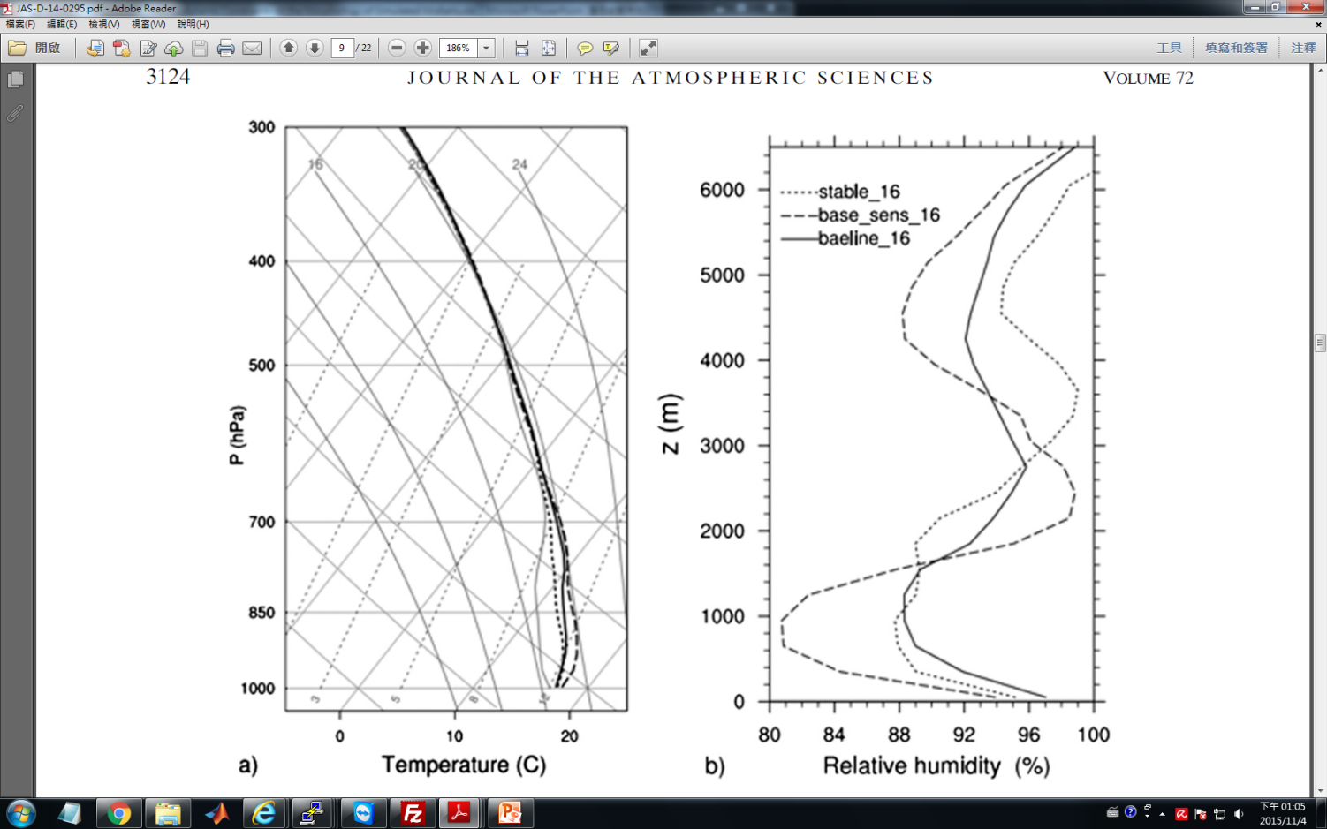
Result
a. Simulations with $∆$U $=$ 16
FTRF
Color : buoyancy field
Red contours : surface-relative horizontal velocity
Black contours : pressure perturbation
RIJ
Cold pool
Cold pool
outflow

Slide 11
Result
a. Simulations with $∆$U $=$ 16
Color : buoyancy field
Red contours : surface-relative horizontal velocity
Black contours : pressure perturbation

Slide 12
Result
a. Simulations with $∆$U $=$ 16
deep
shallow

Slide 13
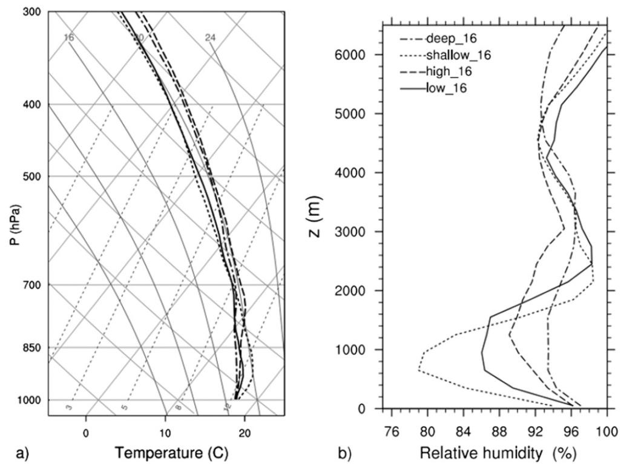
Result
a. Simulations with $∆$U $=$ 16

Slide 14
Result
b. Particle trajectories
Lagrangian particles were placed at 4 h of simulation time with initial positions at various heights, about 6 and 15km ahead of the cold pool edge, and with 1-km spacing in the along-line direction.
baseline_16

Slide 15
Result
b. Particle trajectories
1800m
300m

Slide 16
Result
b. Particle trajectories
baseline_16

Slide 17
Result
c. Simulations with $∆U=$ 8 and $∆U=$24
$∆U=$ 8
$∆U=$ 24
$∆U=$ 8
$∆U=$ 24

Slide 18
Result
c. Simulations with $∆U=$ 8 and $∆U=$24
$∆U=$ 8
$∆U=$ 16
$∆U=$ 24
$∆U=$ 8
$∆U=$ 16
$∆U=$ 24

Slide 19
Result
c. Simulations with $∆U=$ 8 and $∆U=$24
B measures the upper-tropospheric warming caused by the storm, defined as
$\overline{b}$ being the along-line-averaged buoyancy at an across-line location near the center of the mesolow.

Slide 20
Result
c. Simulations with $∆U=$ 8 and $∆U=$24
The shear-layer inflow fractions (SLIFs) being the storm-relative mass flux of air from the environmental shear layer as a fraction of the total stormrelative mass flux.
Most of the latent unstable layer (the layer through which CAPE is defined) is found within the sheared layer.
The latent unstable parcels are precisely those that may cause upper-tropospheric warming when lifted.
shear-layer inflow fractions
(SLIFs)
(PS)

Slide 21
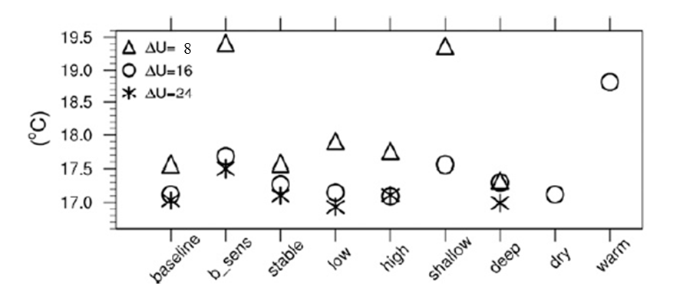
Result
c. Simulations with $∆U=$ 8 and $∆U=$24
baseline_16
The trajectories initiated at 75-m height and within 20 km of the across-line
37%
55%

Slide 22
Discussion
Conceptual model of convection in SLs

Slide 23
Conclusions
Results show that frequently used CAPE indices are unsuitable for diagnosing SL characteristics, while integrated CAPE (ICAPE) discriminates the amplitude of the storm-induced heating for a given value of environmental shear.
The skill of ICAPE follows from its relation to the buoyancy attained by low- and midtropospheric parcels as they ascend over the cold pool under layer-lifting convection.
Environmental kinematics also affect the storm-induced heating, with stronger low-level shear leading to a greater proportion of inflowing latent unstable air among total storm-relative inflow, thus producing higher temperatures aloft.
The precipitable water accounts for much of the precipitation-rate variation for a given value of shear. The precipitation efficiency is lower in environments with weaker shear and dryer midtropospheric conditions.
SLs with a small vertical gradient of cold pool buoyancy propagate less rapidly and produce small surface wind speeds.
Surface cold pool temperatures are insensitive to the strength of the lowtropospheric shear, as well as to changes in mid- and low-tropospheric environmental thermodynamics. Cold pool temperatures are slightly affected by environmental variations beneath the layer of minimum moist static energy, with drier midtropospheric conditions and weaker shear leading to warmer cold pools.
Cold pool properties could be affected by a descending branch of the front-to-rear flow, which crosses over with the rear inflow jet.

Slide 24
THE END

