Slide 1
Concurrent Sensitivities of an Idealized Deep Convective Storm to Parameterization of Microphysics, Horizontal Grid Resolution, and Environmental Static Stability
Hugh Morrison, Annareli Morales, and Cecille Villanueva-Birriel, 2015: Concurrent Sensitivities of an Idealized Deep Convective Storm to Parameterization of Microphysics, Horizontal Grid Resolution, and Environmental Static Stability. Mon. Wea. Rev., 143, 2082–2104.

Slide 2
Experiment Design
Advanced Research WRF version 3.3.1
Horizontal domain size: 80 km x 80 km
75 vertical levels
Parameterization of Microphysics | Horizontal Grid Resolution | Environmental Static Stability
WSM6 | 2 km | High CAPE
Thompson (THO) | 1 km | Moderate CAPE
Morrison (MORR) | 0.5 km | Low CAPE
 | 0.25 km
 | 0.125 km

Slide 3
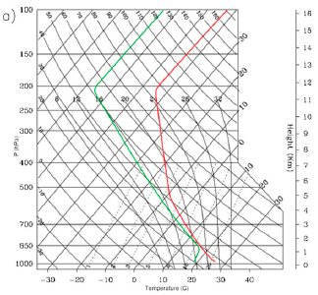
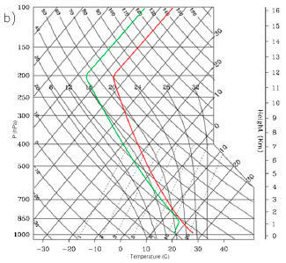
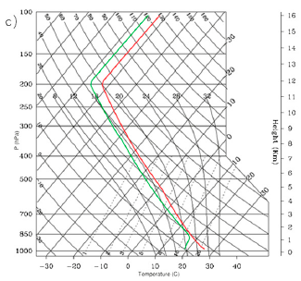
Experiment Design
Low CAPE (1543 JKg-1) Moderate CAPE (2715 JKg-1) High CAPE (4229 JKg-1)

Slide 4
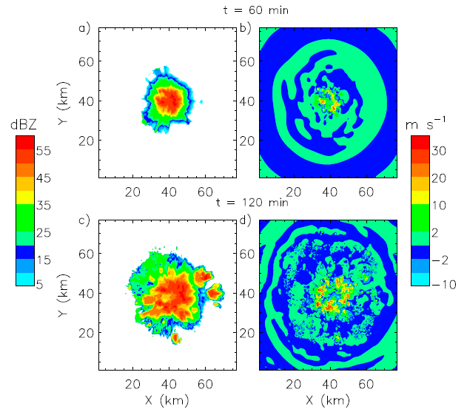
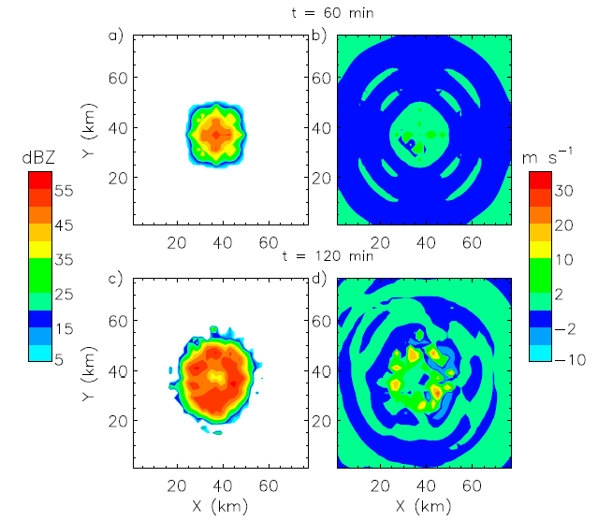
Results – Overview
Δx=0.125 km
Δx=2 km

Slide 5
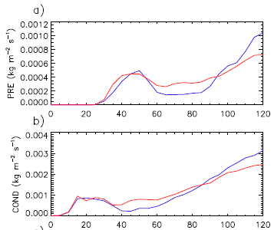
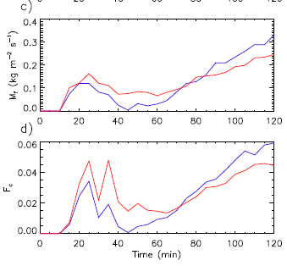
Results – Overview

Slide 6
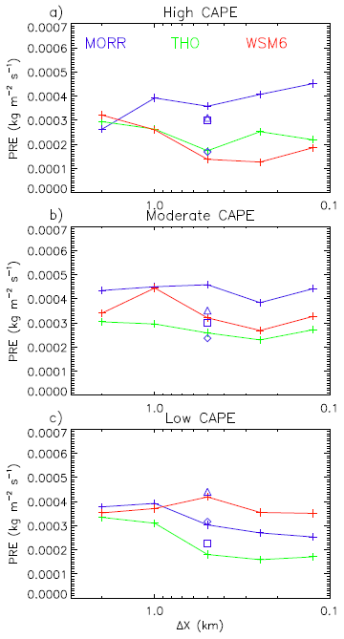
Bulk Water Budget & Precipitation Efficiency
$$PRE=\left[COND\right]−\left[EVAP\right]−RES$$
$$PE=\frac{PRE}{COND}=1−\frac{EVAP}{COND}−\frac{RES}{COND}$$

Slide 7
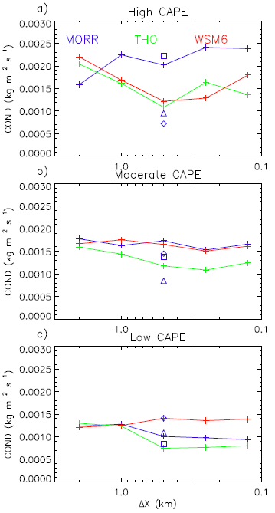
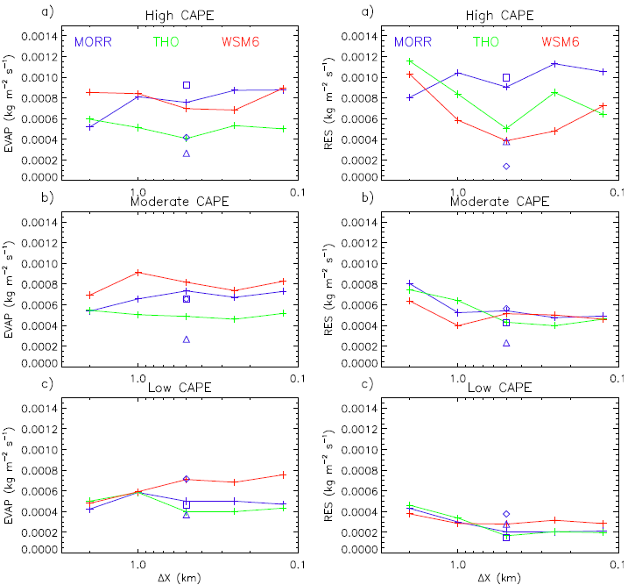
$$PRE=\left[COND\right]−\left[EVAP\right]−RES$$

Slide 8
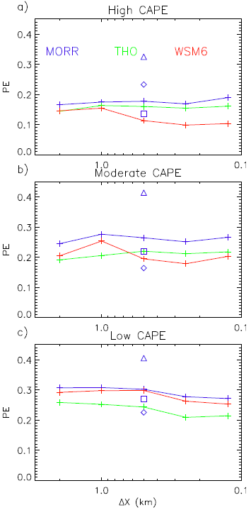
$$PE=\frac{PRE}{COND}=1−\frac{EVAP}{COND}−\frac{RES}{COND}$$
$$PRE=\left[COND\right]−\left[EVAP\right]−RES$$

Slide 9
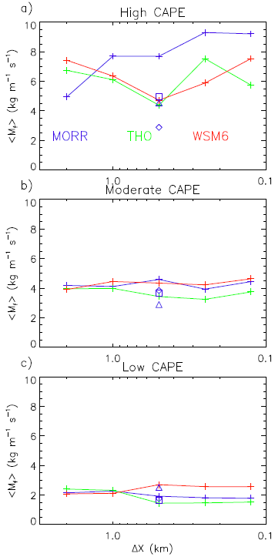
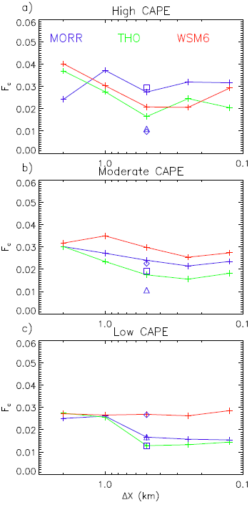
Condensation rate & updraft mass flux
[M_{f}]
Vertically integrated convective
updraft mass flux
PRE
COND
[M_{f}]
F_{c}

Slide 10
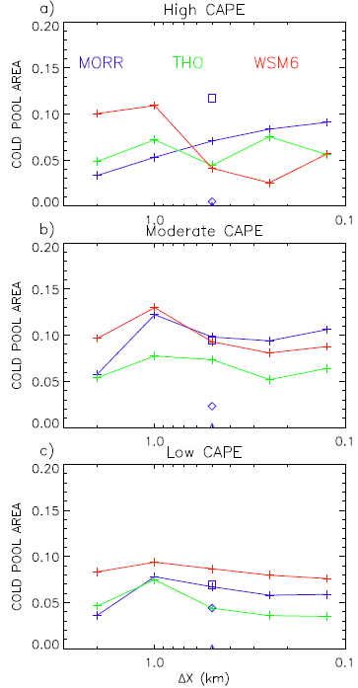
Cold pools & convection organization
F_{c}
Cold pool area

Slide 11
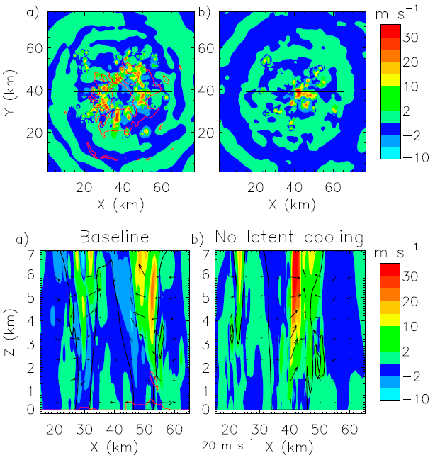
$$N_{r}\left(D\right)=N_{0,r}exp⁡(−Λ_{r}D)$$
$$Λ_{r}={(\frac{πρ_{w}N_{0,r}}{ρ_{a}Q_{r}})}^{0.25}={(\frac{πρ_{w}{ρ_{a}N}_{T,r}}{Q_{r}})}^{0.33}$$
$$N_{T,r}=\int_{0}^{∞}{N_{r}\left(D\right)}dD=\frac{N_{0,r}}{Λ_{r}}$$

Slide 12
Microphysics
EVAP / Qg
Cold pool
Fc
[Mf]
COND
PRE
Conclusion

