Slide 1
The Simulated Structure and Evolution of a Quasi-Idealized Warm-Season Convective System with a Training Convective Line
Professor : Ming-Jen Yang
Student : Jyong-En Miao
Date : 2015/12/24
Peters, J. M., and R. S. Schumacher, 2015
J. Atmos. Sci., 72, 1987-2010.

Slide 2
Introduction
primary mechanism for heavy rainfall generation in MCS involves the continuous motion of individual convective elements within the larger convective system over a fixed geographic region
Two processes—training and backbuilding
Training involves a convective line comprised of smaller convective-scale updrafts that move in a line-parallel direction, resulting in their repeated motion over a fixed geographic region
Backbuilding involves the repeated upstream redevelopment of convective updrafts, resulting in a near-zero net motion of the larger convective system

Slide 3
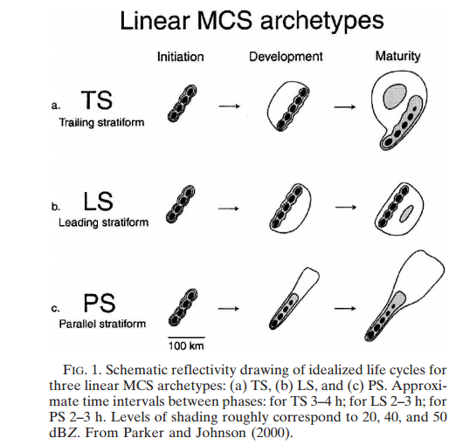

Slide 4
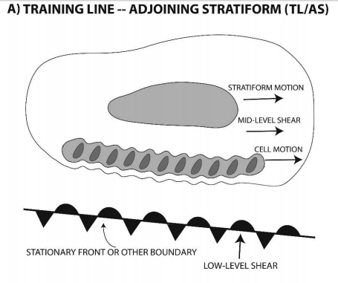

Slide 5
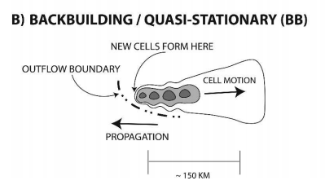

Slide 6
Introduction
small spatial scales (of order 10–100 km)
meso-a-to-synoptic scale(>200km)phenomena
low-level warm-air advection
convergence along the nose of a low-level jet
a supply of low-level CAPE
low-level frontal circulations
upper-level jet streaks

Slide 7
Introduction
isolated convective systems within an horizontally homogeneous thermodynamic and kinematic environment
Mahoney et al. (2009) artificially constructed a zonal jet and associated baroclinic zone by varying the meridional tropospheric temperature (and thus the meridional pressure and wind fields ), while retaining zonal homogeneity.

Slide 8
Introduction
Coniglio and Stensrud (2001) constructing a large-scale environment from composite atmospheric fields => both zonal and meridional inhomogeneity!

Slide 9
Experiment degign
rotated principal component analysis (RPCA)
synoptic type events (24 cases)
warm season type events (26 cases)
Time, forcing, traing&backbuilding, ROD
Rearward Off-boundary Development

Slide 10
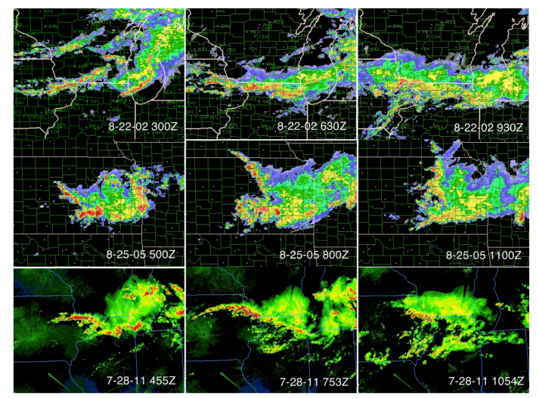

Slide 11
composite atmospheric progressions spatially centered at the location of the maximum 1-h precipitation accumulation and temporally centered at the time of the maximum 1-h accumulation.

Slide 12
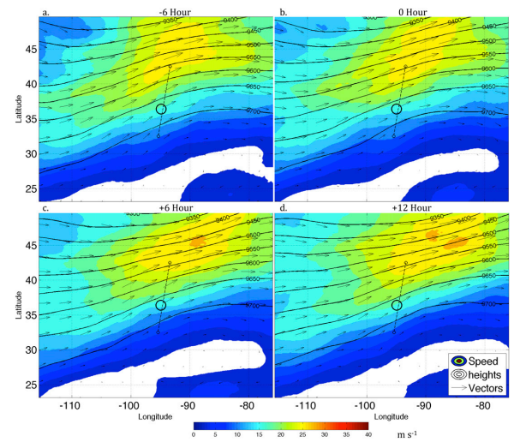

Slide 13
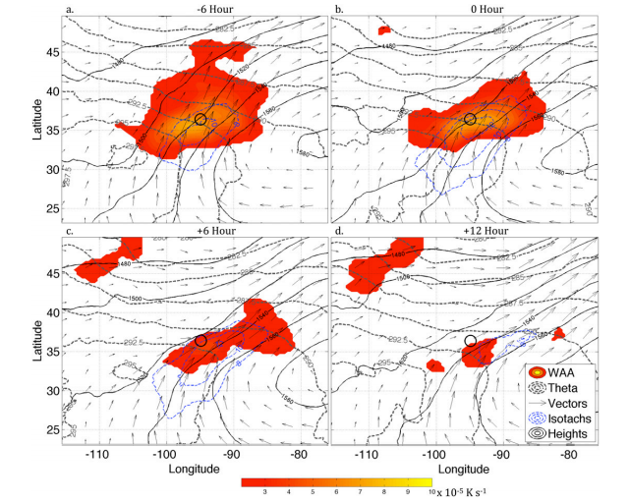

Slide 14
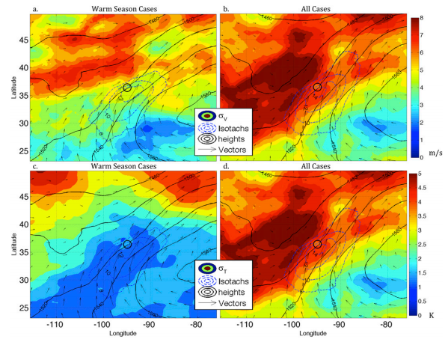

Slide 15
Control simulation
No microphysics simulation

Slide 16
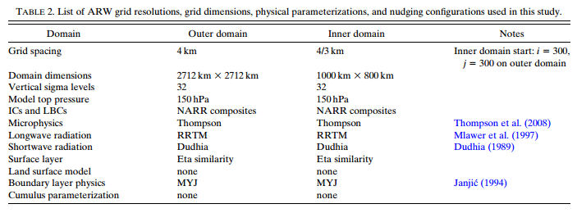

Slide 18
Control simulation (CNTL)
No microphysics simulation (NOMP)
to assess the similarity between the simulated environment and that of the composites and later to define convective perturbation fields.

Slide 19
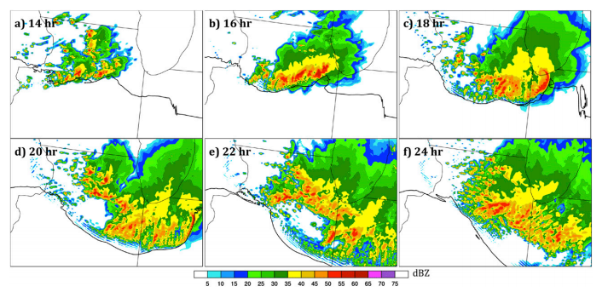

Slide 20
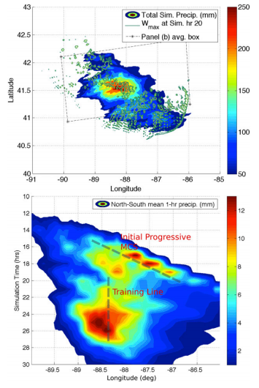

Slide 21
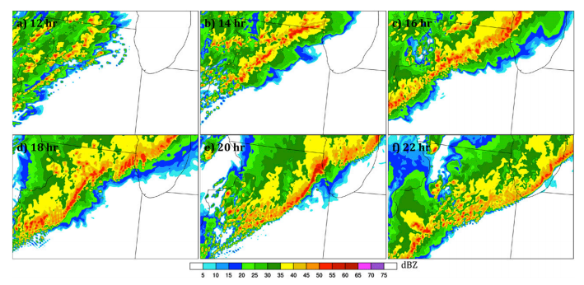

Slide 22
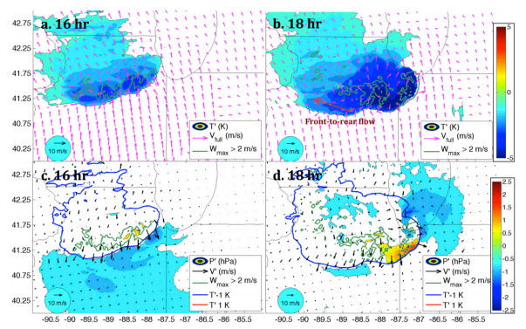

Slide 23
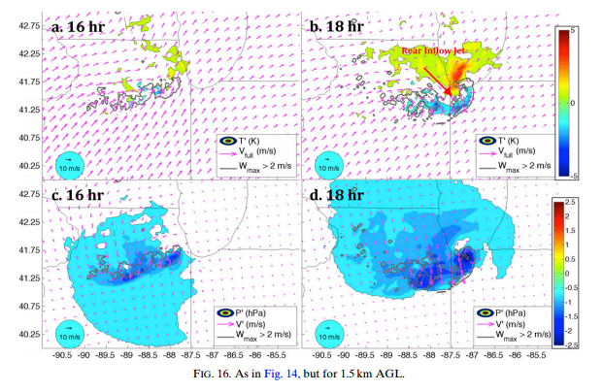

Slide 24
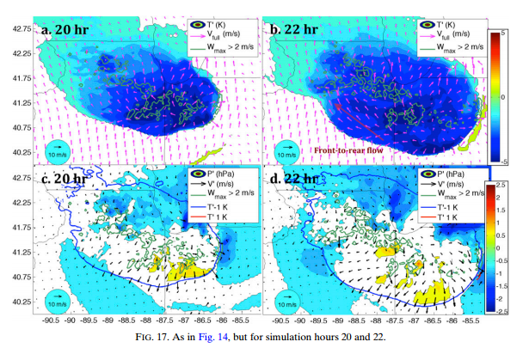

Slide 25
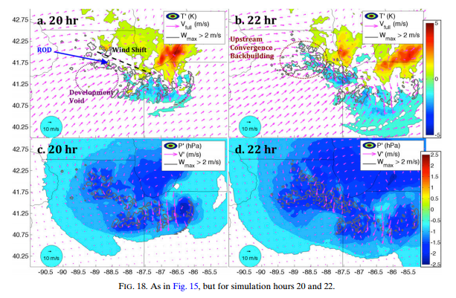

Slide 26
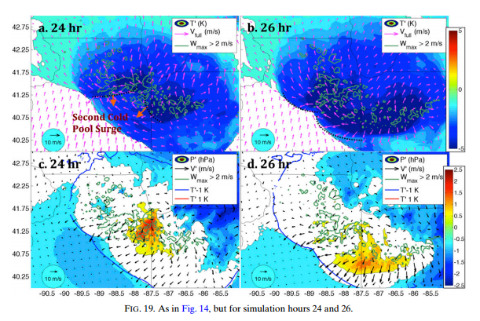

Slide 27
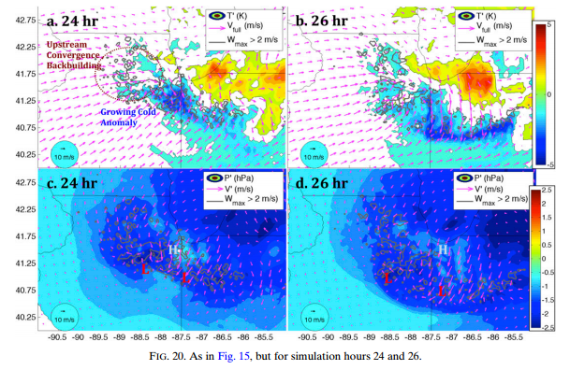

Slide 28
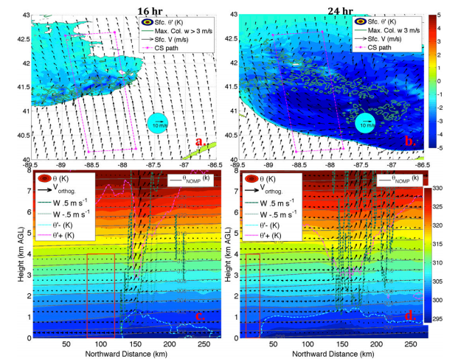

Slide 29
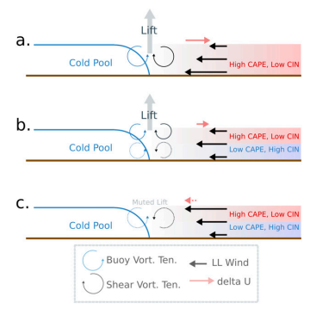

Slide 30
merry christmas and happy new year 2016

