Slide 1
The More Rain, the Better the Model Performs-The Dependency of Quantitative Precipitation Forecast Skill on Rainfall Amount for Typhoons in Taiwan
CHUNG-CHIEH WANG
Department of Earth Sciences, National Taiwan Normal University, Taipei, Taiwan

Slide 2
Outline
Before you study: Skill measures of model QPFs
Introduction and motivation of study
The CReSS model, and methodology
Examples of CReSS model forecasts
The dependency of model QPF skills on rainfall
The origin of the dependency
The implications of the dependency
Summary and conclusions
Reference

Slide 3
OBS
Skill measures of model QPFs(1/2)
YES
NO
2 x 2 contingency table
(Schaefer 1990; Wilks 1995; Ebert et al. 2003)
O = a+c
F = a+b
N = a+b+c+d
a
(hit)
b
(false alarm)
YES
Forecast
d
(correct negative)
c
(miss)
NO
(0 < TS <1)
Threat Score(TS) = a/(a+b+c)
Bias(BS) = (a+b)/(a+c) (Schaefer 1990; Wilks 1995; Ebert et al. 2003)
3. Probability of detection(POD) = a/(a+c)
4. False alarm rate(FAR) = b/(a+b)
5. Accuracy(ACC) = (a+d)/N (Mesinger and Black 1992; Hong 2003)
6. Equitable threat score(ETS) = (a-R)/(a+b+c-R) (Schaefer 1990)
R = expected number of random hits = O x F/N
7. Peirce skill score(PSS) = a/(a+c)-b/(b+d) = POD – b/(b+d) (Mason 2003)
Odds ratio(OR) = (axd)/(bxc) (Doswell et al. 1990; Wilks 1995)
(0 < BS < $∞$, BS = 1)
(0 < POD <1)
(0 < FAR <1)
(0 < ACC <1)
(-⅓ < ETS <1)
(-1 < PSS <1)
(0 < OR < $∞)$

Slide 4
OBS
Skill measures of model QPFs(2/2)
YES
NO
a
(hit)
b
(false alarm)
YES
Forecast
d
(correct negative)
c
(miss)
NO
(0 < TS <1)
Threat Score(TS) = a/(a+b+c)
Bias(BS) = (a+b)/(a+c) (Schaefer 1990; Wilks 1995; Ebert et al. 2003)
(0 < BS < $∞$, BS = 1 is the best.)
Pay careful attention to “double penalty”
on models. (Ebert and McBride 2000;
Davis et al. 2006; Clark et al. 2007)
The measures are chosen in Taiwan because…..
1. Terrain-induced rainfall.
2. Dense network of rain gauges.
3. Easy calculation.
The linkage between QPF and rain-area size.

Slide 5
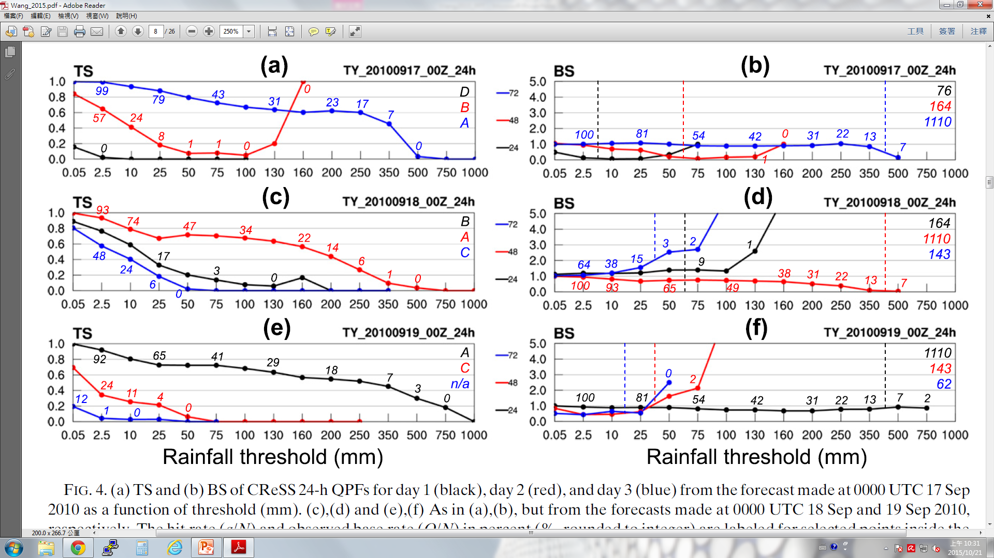
Introduction and motivation of study
How common is this dependency in forecasts,
and how strong is it on average? Does it come simply from the variation in rain-area size, or is the model in fact more skillful in predicting larger events and why? What are its importance and implications? What is the true skill of model QPFs, especially for extreme rainfalls that have high potential for hazards? How can we evaluate model QPFs more accurately and effectively? Does this phenomenon also occur in other models, other
rainfall regimes, and other regions besides Taiwan?
Higher QPF scores when there is more rain…..
All the questions motivated the author to carry out the present study, with real-time CReSS forecasts in three seasons of 2010–12 for a total of 15 typhoons.
(0 < TS <1; a/N%)
(0 < BS < $∞$, BS = 1 is the best; O/N%)
Typhoon Fanapi(2010)

Slide 6
The CReSS model, and methodology
Cloud Resolving Storm Simulator (CReSS) [Tsuboki and Sakakibara (2002, 2007)]
Summary of 2.5km CReSS configurations used for operational 3-day forecasts during
the typhoon seasons of 2010-2012.

Slide 7
List of the 15 typhoons in this study
Observational Data: hourly rainfall data from more than 400 automated rain gauges
over Taiwan(Hsu 1998) from CWB.
Criteria for selecting TC case periods:
1. 24-h QPFs(0000-2400 or 1200-1200 UTC) (Ebert and McBride 2000).
2. Sea-warning periods issued by CWB.
3. At least one part of the rainfall in Taiwan during each 24-h period must be linked to
the TC or under its influence(outer circulation, rainbands and monsoon).
4. At least one 24-h segment must be included from each of the 15 typhoons.
→ 99 segments are selected.
Classify 99 segments: at least 50 rain gauges reaching 100, 50, 25mm and otherwise.
(A) (B) (C) (D)

Slide 8
OBS
Skill measures of model QPF
YES
NO
2 x 2 contingency table
(Schaefer 1990; Wilks 1995; Ebert et al. 2003)
O = a+c
F = a+b
N = a+b+c+d
a
(hit)
b
(false alarm)
YES
Forecast
d
(correct negative)
c
(miss)
NO
(0 < TS <1)
Threat Score(TS) = a/(a+b+c)
Bias(BS) = (a+b)/(a+c) (Schaefer 1990; Wilks 1995; Ebert et al. 2003)
3. Probability of detection(POD) = a/(a+c)
4. False alarm rate(FAR) = b/(a+b)
5. Accuracy(ACC) = (a+d)/N (Mesinger and Black 1992; Hong 2003)
6. Equitable threat score(ETS) = (a-R)/(a+b+c-R) (Schaefer 1990)
R = expected number of random hits = O x F/N
7. Peirce skill score(PSS) = a/(a+c)-b/(b+d) = POD – b/(b+d) (Mason 2003)
Odds ratio(OR) = (axd)/(bxc) (Doswell et al. 1990; Wilks 1995)
(0 < BS < $∞$, BS = 1 is the best.)
(0 < POD <1)
(0 < FAR <1)
(0 < ACC <1)
(-⅓ < ETS <1)
(-1 < PSS <1)
(0 < OR < $∞)$

Slide 9
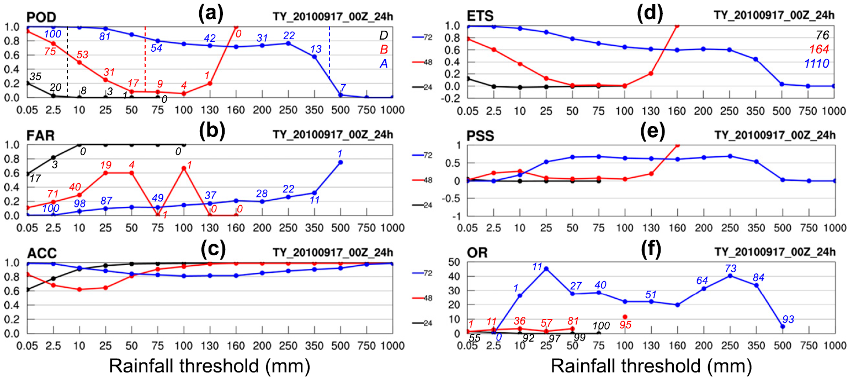
Examples of CReSS model forecasts
(0 < TS <1; a/N%)
(0 < BS < $∞$, BS = 1 is the best; O/N)
(0 < TS <1; a/N%)
(0 < BS < $∞$, BS = 1 is the best; O/N%)
(0 < POD <1; O/N)
(-⅓ < ETS <1)
(0 < FAR <1; F/N)
(-1 < PSS <1)
(0 < ACC <1)
(0 < OR < $∞$ ; d/N)
Typhoon Fanapi(2010)
Typhoon Megi(2010)

Slide 10
Typhoon Saola(2012)
Typhoon Nanmadol(2011)
Typhoon Tembin(2012)
(0 < TS <1; a/N%)
(0 < BS < $∞$, BS = 1 is the best; O/N%)
Typhoon Saola(2012)
Typhoon Nnmadol(2011)
Typhoon Tembin(2012)

Slide 11
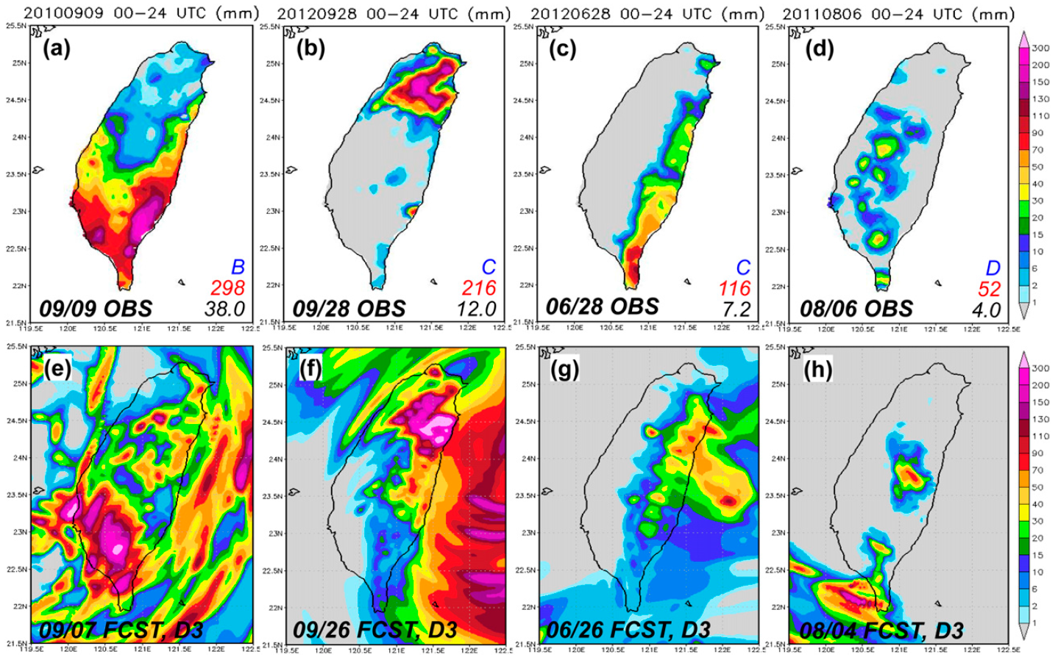
(0 < TS <1; a/N%)
Typhoon Meranti(2010)
Typhoon Jelawat(2012)
Typhoon Doksuri(2012)
Typhoon Muifa (2011)
Typhoon Meranti(2010)
Typhoon Jelawat(2012)
Typhoon Doksuri(2012)
Typhoon Muifa (2011)
From the ample examples above, a clear tendency for the model to yield higher TS and perform better (out to 3 days) when there is more overall rainfall brought by the TC in Taiwan (and vice versa) is well demonstrated (Section 5 and 6).
We further explore the dependency of QPF skill on rainfall amount below.
With O/N and H/N given, one also sees in these examples that although many scores for groups B–D, which are essentially nonhazardous but account for three-fourths of all segments (cf. Table 2), can be computed over the range of 75–500mm, they are often obtained with small samples especially toward higher thresholds and thus are of low statistical representativeness.

Slide 12
The dependency of model QPF skills on rainfall
(0 < TS <1, group size)
Classify 99 segments: at least 50 rain gauges
reaching 100, 50, 25mm and otherwise.
Top 5 from group A: Fanapi(2010), Megi(2010),
Nanmadol(2011), Saola(2012) and Tembin(2012).
The model indeed performs significantly better in forecasting group A when there is more rain.
The results here should also clarify some of the confusion in interpretation noted previously (e.g., Walser and Schär 2004; Yuan et al. 2005), as the scores tend to be lower toward higher thresholds in forecasts for an individual period but higher for more-rainy periods(larger rain-area sizes) that can also reach higher thresholds.

Slide 13
The origin of the dependency
Is the rain-area size the only factor, or is the model indeed more skillful in predicting larger events?
Classify 99 segments: coverage of 99%, 95%,
90%-10% every 10%, 5% and 1%.
→ the impact of rain-area size is removed.
Typhoon Fanapi
(2010)
Thus, for the same areal coverage, every segment uses its own threshold that yields the specified O/N (say, 30%), and the impact of rain-area size is removed by standardizing according to the observed rainfall.

Slide 14
(0 < TS <1; group size)
TOP5 > A > B > C > D
The differences appear smaller among
TOP 5, A and B
The CReSS model is indeed more skillful in predicting larger TC rainfall events.

Slide 15
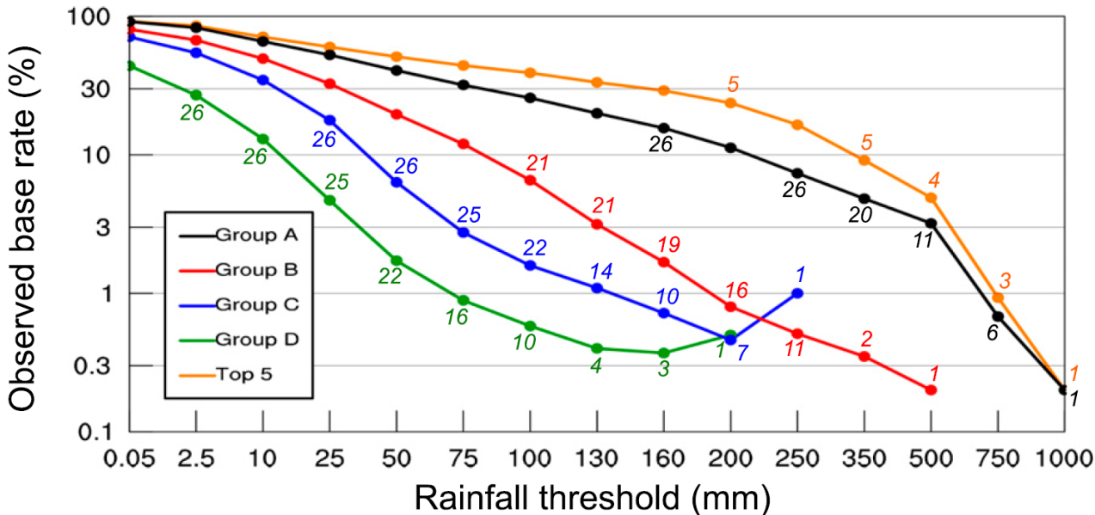
The implications of the dependency
Time-averaged scores sometimes misleading the information.
Improper assumptions for arithmetic mean when evaluating the performance of
model QPFs:
1. The scores for different forecast periods are of the same importance.
2. The same statistical significance in all values.
3. The rainfall near the two ends of segment may not be linked to the TC.
(All)
(group size)
(O/N)

Slide 16
A
B
C
D
Other rainfall regimes(Mei-yu).
Other models.

Slide 17
Summary and conclusions
The averaging of scores should only be performed among target periods with comparable overall rainfall, since the inclusion of data from less-rainy periods would lower the score, easily to a level not indicative to the true skill.
(0 < TS <1; group size)
If the forecasters/users are aware of this dependency property, they should raise their
confidence in model QPFs when a more extreme event is predicted in advance, not the other way around.

Slide 18
Reference
Wilks, D. S., 1995: Statistical Methods in the Atmospheric Sciences. Academic Press, 467 pp.
Jolliffe, I. T., and D. B. Stephenson, 2003: Forecast Verification: A Practitioner’s Guide in Atmospheric
Science. Wiley and Sons, 240 pp.
Tsuboki, K., and A. Sakakibara, 2002: Large-scale parallel computing of cloud resolving storm simulator. High
Performance Computing, H. P. Zima et al., Eds., Springer, 243–259.
Olson, D. A.,N.W. Junker, andB.Korty, 1995: Evaluation of 33 years of quantitative precipitation forecasting
at the NMC. Wea. Forecasting, 10, 498–511, doi:10.1175/1520-0434(1995)010,0498:
EOYOQP.2.0.CO;2.
Charba, J. P., and F. G. Samplatsky, 2011: High-resolution GFSbased MOS quantitative precipitation forecasts
on a 4-km grid. Mon. Wea. Rev., 139, 39–68, doi:10.1175/2010MWR3224.1.
Marchok, T., R. Rogers, and R. Tuleya, 2007: Validation schemes for tropical cyclone quantitative
precipitation forecasts: Evaluation of operational models for U.S. landfalling cases. Wea.
Forecasting, 22, 726–746, doi:10.1175/WAF1024.1.

Slide 19
Thanks for your listening

